Slide 1
与以撒一同承受产业
经文：创世纪21：1-10
讲员： 伍雷弟兄
惟耶和华在他的圣殿中。全地的人，都当在他面前肃敬静默。
The Lord is in his holy temple; let all the earth be silent before him.
哈巴谷书 Habakkuk 2:20

Slide 2
宣召 Calling to Worship
哥林多前书 1 Corinthians 1:30
但你们得在基督耶稣里，是本乎神，神又使他成为我们的智慧，公义，圣洁，救赎。
It is because of him that you are in Christ Jesus, who has become for us wisdom from God—that is, our righteousness,holiness and redemption.

Slide 3
愿你崇高
我要在万民中称谢你，
我要在列邦中歌颂你，
你的慈爱高及诸天，
你的信实上达穹苍，
你的慈爱高及诸天，
你的信实上达穹苍。
哈利路亚，哈利路亚 ，
你的慈爱高及诸天，
哈利路亚，哈利路亚 ， 你的信实上达穹苍。

Slide 4
As We Gather
As we gather may Your Spirit work within us
As we gather may we glorify Your Name
Knowing well that as our hearts begin to worship
We’ll be blessed because we came
We’ll be blessed because we came

Slide 5
当我们聚集
当我们聚集时侯祢圣灵运行，
当我们聚集愿荣耀祢圣名，
当我们来到祢面前同心敬拜，
深知将蒙祢祝福。
深知将蒙祢祝福。

Slide 6
希伯来书 Hebrews 13:15
我们应当靠着耶稣，常常以颂赞为祭献给神，这就是那承认主名之人嘴唇的果子。
By him therefore let us offer the sacrifice of praise to God continually, that is, the fruit of our lips giving thanks to his name.

Slide 7
We Bring The Sacrifice Of Praise
We bring the sacrifice of praise into the house of the Lord.
We bring the sacrifice of praise into the house of the Lord.
And we offer up to You, the sacrifices of thanksgiving;
And we offer up to You, the sacrifices of joy !

Slide 8
獻上讚美祭
我們獻上讚美的祭，來進入 神的殿中,
我們獻上讚美的祭，來進入 神的殿中,
我們以感恩的心，來向祢獻上感謝的祭,
我們以喜樂的心，來獻上讚美的祭。

Slide 9
Hymn #452 你信實何廣大

Slide 10
452 祢信實何廣大
GREAT IS THY FAITHFULNESS
父阿，在祢並無轉動的影兒，
Great is Thy faithfulness, O God my Father,
祢的信實極其廣大無邊；
There is no shadow of turning with Thee;
千萬億載祢的恩惠永存在，
Thou changest not,
Thy compassions they fail not;
祢的憐憫像祢永遠不變。
As Thou hast been Thou forever wilt be.
Stanza 1 of 3
聖徒詩歌

Slide 11
（副）
祢信實何廣大！祢信實何廣大！
Great is Thy faithfulness!
Great is Thy faithfulness!
祢的憐憫每晨都是新鮮！
Morning by morning new mercies I see;
凡所需祢聖手都預備完全，
All I have needed Thy hand hath provided,
祢的信實極其廣大無邊！
Great is Thy faithfulness, Lord unto me!
聖徒詩歌
Stanza 1 of 3

Slide 12
（二）
冬夏時令，莊稼及時的供應，
Summer and winter,
and springtime and harvest,
日月星辰，晝夜不斷運轉；
Sun, moon and stars in their courses above
祢的創造，多方都在作見證，
Join with all nature in manifold witness
祢的信實極其廣大無邊。
To Thy great faithfulness, mercy and love.
聖徒詩歌
Stanza 2 of 3

Slide 13
（副）
祢信實何廣大！祢信實何廣大！
Great is Thy faithfulness!
Great is Thy faithfulness!
祢的憐憫每晨都是新鮮！
Morning by morning new mercies I see;
凡所需祢聖手都預備完全，
All I have needed Thy hand hath provided,
祢的信實極其廣大無邊！
Great is Thy faithfulness, Lord unto me!
聖徒詩歌
Stanza 2 of 3

Slide 14
（三）
祢的赦免，所給平安與喜樂，
Pardon for sin and a peace that endureth,
祢的同在，所賜安撫、引導；
Thy own dear presence to cheer and to guide;
今日力量，明日光明的盼望，
Strength for today
and bright hope for tomorrow,
全都屬我，福份一無缺少。
Blessings all mine, with ten thousand beside!
Stanza 3 of 3
聖徒詩歌

Slide 15
（副）
祢信實何廣大！祢信實何廣大！
Great is Thy faithfulness!
Great is Thy faithfulness!
祢的憐憫每晨都是新鮮！
Morning by morning new mercies I see;
凡所需祢聖手都預備完全，
All I have needed Thy hand hath provided,
祢的信實極其廣大無邊！
Great is Thy faithfulness, Lord unto me!
聖徒詩歌
Stanza 3 of 3

Slide 16
祷告 Prayer
第一时段：现场的弟兄姐妹 (On site)
第二时段：线上的弟兄姐妹 (Online)
回到现场 (On site)

Slide 17
祷告 Prayer
第一时段：现场的弟兄姐妹 (On site)
第二时段：线上的弟兄姐妹 (Online)
回到现场 (On site)

Slide 18
祷告 Prayer
第一时段：现场的弟兄姐妹 (On site)
第二时段：线上的弟兄姐妹 (Online)
回到现场 (On site)

Slide 19
读经 Scripture reading
创世纪21：1-10
1耶和华按着先前的话眷顾撒拉，便照他所说的给撒拉成就。 2 当亚伯拉罕年老的时候，撒拉怀了孕，到神所说的日期就给亚伯拉罕生了一个儿子。 3 亚伯拉罕给撒拉所生的儿子起名叫以撒。 4 以撒生下来第八日，亚伯拉罕照着神所吩咐的给以撒行了割礼。 5 他儿子以撒生的时候，亚伯拉罕年一百岁。 6 撒拉说：“神使我喜笑，凡听见的必与我一同喜笑。” 7 又说：“谁能预先对亚伯拉罕说撒拉要乳养婴孩呢？因为在他年老的时候，我给他生了一个儿子。”
8 孩子渐长，就断了奶。以撒断奶的日子，亚伯拉罕设摆丰盛的筵席。 9 当时，撒拉看见埃及人夏甲给亚伯拉罕所生的儿子戏笑， 10 就对亚伯拉罕说：“你把这使女和她儿子赶出去，因为这使女的儿子不可与我的儿子以撒一同承受产业。”

Slide 20
Genesis 21: 1-10
1 Now the Lord was gracious to Sarah as he had said, and the Lord did for Sarah what he had promised. 2 Sarah became pregnant and bore a son to Abraham in his old age, at the very time God had promised him. 3 Abraham gave the name Isaac[a] to the son Sarah bore him. 4 When his son Isaac was eight days old, Abraham circumcised him, as God commanded him.5 Abraham was a hundred years old when his son Isaac was born to him.
6 Sarah said, “God has brought me laughter, and everyone who hears about this will laugh with me.” 7 And she added, “Who would have said to Abraham that Sarah would nurse children? Yet I have borne him a son in his old age.”
8 The child grew and was weaned, and on the day Isaac was weaned Abraham held a great feast. 9 But Sarah saw that the son whom Hagar the Egyptian had borne to Abraham was mocking, 10 and she said to Abraham, “Get rid of that slave woman and her son, for that woman’s son will never share in the inheritance with my son Isaac.”

Slide 21
信息 Message
A good place for speaker’s slide coversheet
The coworkers in the library will switch to Speaker’s slides from here on.

Slide 22
回应诗歌 Responsive song
#537 向前直往錫安

Slide 23
537 向前直往錫安 We’re Marching To Zion
愛主的人都來，將你喜樂敞開；
Come, we that love the Lord,
And let out joys be known;
甘甜唱著主的奇愛，
甘甜唱著主的奇愛，
Join in a song with sweet accord,
Join in a song with sweet accord,
同到寶座前來，同到寶座前來！
And thus surround the throne,
And thus surround the throne.

Slide 24
（副）
向前直往錫安，
We’re marching to Zion,
美麗又美麗的錫安；
Beautiful, beautiful Zion;
眾聖昂首齊奔錫安，
We’re marching upward to Zion,
直奔神美麗的聖城。
The beautiful city of God.

Slide 25
（二）
未識主名的人，讓他緘默無聲；
Let those refuse to sing
Who never knew our God;
我們屬天君王兒女，
我們屬天君王兒女，
But children of the heav’nly King,
But children of the heav’nly King,
應當喜樂歡騰，應當喜樂歡騰。
May speak their joys aboard,
May speak their joys aboard.

Slide 26
（副）
向前直往錫安，
We’re marching to Zion,
美麗又美麗的錫安；
Beautiful, beautiful Zion;
眾聖昂首齊奔錫安，
We’re marching upward to Zion,
直奔神美麗的聖城。
The beautiful city of God.

Slide 27
（三）
未入榮耀之城，未履精金之街，
The hill of Zion yields
A thousand sacred sweets,
郇山佳果甜美豐盈，
郇山佳果甜美豐盈，
Before we reach the heav’nly fields,
Before we reach the heav’nly fields,
豫嘗何等喜悅，豫嘗何等喜悅。
Or walk the golden streets,
Or walk the golden streets.

Slide 28
（副）
向前直往錫安，
We’re marching to Zion,
美麗又美麗的錫安；
Beautiful, beautiful Zion;
眾聖昂首齊奔錫安，
We’re marching upward to Zion,
直奔神美麗的聖城。
The beautiful city of God.

Slide 29
（四）
故當高聲歌唱，忘記所有憂傷；
Then let our songs abound
and every tear be dry;
經過以馬內利境界，
經過以馬內利境界，
We’re marching through Emmanuel’s ground,
We’re marching through Emmanuel’s ground,
直達更高天鄉，直達更高天鄉！
To fairer worlds on high,
To fairer worlds on high.

Slide 30
（副）
向前直往錫安，
We’re marching to Zion,
美麗又美麗的錫安；
Beautiful, beautiful Zion;
眾聖昂首齊奔錫安，
We’re marching upward to Zion,
直奔神美麗的聖城。
The beautiful city of God.

Slide 31
回应祷告 Responsive prayer
第一时段：现场的弟兄姐妹 (On site)
第二时段：线上的弟兄姐妹 (Online)
回到现场 (On site)

Slide 32
回应祷告 Responsive prayer
第一时段：现场的弟兄姐妹 (On site)
第二时段：线上的弟兄姐妹 (Online)
回到现场 (On site)

Slide 33
回应祷告 Responsive prayer
第一时段：现场的弟兄姐妹 (On site)
第二时段：线上的弟兄姐妹 (Online)
回到现场 (On site)

Slide 34
报告Announcement
欢迎新朋友 Welcome new friend(s)
主日学 Sunday School (9:30-10:30)
周一晚盼望小组聚会（HOPE Group, 7:30PM）
周三圣达菲公寓查经 （上午十点）
Santa Fe Tower Bible Study (Wednesday 10:00AM)
周三祷告会（晚 7:30 -9:00 ）
Prayer Meeting (Wednesday 7:30 -9:00 PM)
周五/周六 团契/查经 Friday/Saturday Fellowship/Bible Study
  北区 (North)、寻求组 (Seekers)、父母组 (Youth Parents)、青少年(Youth)
  网上聚会详见图书馆Zoom 链接 (Online zoom meetings: QR Codes in library)

Slide 35
报告Announcement
特别事项 Special Items
Thanksgiving, Special meeting (Brother Wu)
清洁服事 (Cleaning Service)
  本主日 (This Sunday):
姓名 Robert Kao
  下主日 (Next Sunday):
姓名 Xiang Youbin

Slide 36
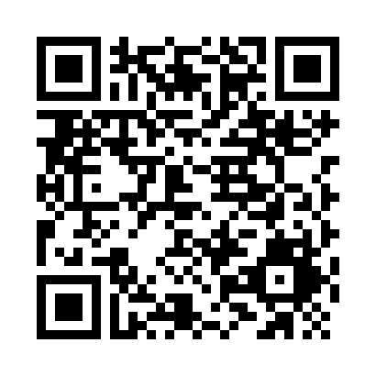
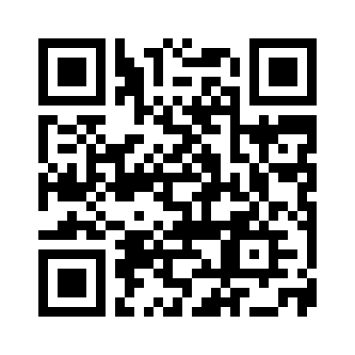
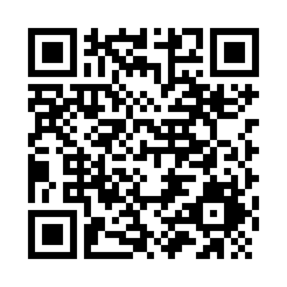
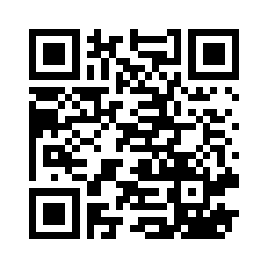
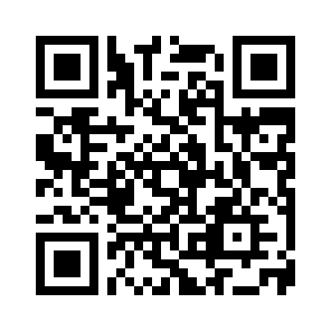
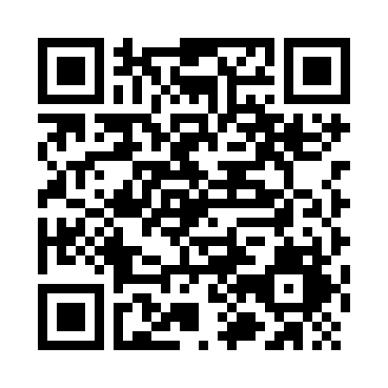
线上聚会链接 QR Codes for Online Meetings
Sunday Service (主日敬拜)
Sunday School (主日学)
Wednesday Prayer (周三祷告会)
North Group (北区团契)
Youth Parents (父母组团契)
Hope Group (盼望小组)

