Slide 1
凭信心在患难中得胜
Overcome in tribulation through faith
高正修弟兄 Brother Robert Kao
05/19/2024
惟耶和华在他的圣殿中。全地的人，都当在他面前肃敬静默。
The Lord is in his holy temple; let all the earth be silent before him.
哈巴谷书 Habakkuk 2:20

Slide 2
宣召 Calling to Worship
诗篇Ps 145:18-21
18 凡求告耶和华的，就是诚心求告他的，耶和华便与他们相近。
19 敬畏他的，他必成就他们的心愿，也必听他们的呼求，拯救他们。
20 耶和华保护一切爱他的人，却要灭绝一切的恶人。
21 我的口要说出赞美耶和华的话；惟愿凡有血气的都永永远远称颂他的圣名。
18 The LORD is near to all who call on him, to all who call on him in truth.
19 He fulfills the desire of those who fear him; he also hears their cry and saves them.
20 The LORD preserves all who love him, but all the wicked he will destroy.
21 My mouth will speak the praise of the LORD, and let all flesh bless his holy name forever and ever.

Slide 3
16 頌讚與尊貴 BLESSING AND HONOR
頌讚與尊貴並榮耀歸主，
Blessing and honor and glory be Thine,
願榮耀歸主，願榮耀歸主；
And glory be Thine, and glory be Thine.
頌讚與尊貴並榮耀歸主，
Blessing and honor and glory be Thine,
直到永永遠遠。
Both now and evermore.

Slide 4
讚祂！讚祂！
Praise Him! Praise Him!
聖徒們，來敬拜祂。
All ye saints adore Him.
讚祂！讚祂！
Praise Him! Praise Him!
直到永永遠遠。哈利路亞！
Both now and evermore. Hallelujah!

Slide 5
主是我力量 The Lord is my strength
主是我力量 我力量，主是患難中力量
主是我幫助 我幫助，主是隨時幫助
主是避難所 我避難所，主是堅固避難所
主是我力量 我幫助，惟主是避難所
大地雖會改變，高山雖會搖動
大海翻騰，大浪戰抖，但我們卻不害怕
哈利路亚 ，哈利路亚，哈利路亚！
哈利路亚， 哈利路亚，哈利路亚！

Slide 6
一家人 one family
讓我們 彼此相愛，雖然我們 有著許多不同
耶穌愛你 耶穌愛我，在耶穌裡 我們是 一家人
人生的路 有山有谷，感恩有你 一路上 陪著我
我願成為 你生命中最美的祝福，與你同奔天路
讓我們 手牽著手，當你跌倒 我會在你左右
我扶著你 你陪著我，在耶穌裡 我們是 一家人
人生的路 有山有谷，感恩有你 一路上陪著我
我願成為 你生命中最美的祝福，與你同奔天路

Slide 7
一家人 one family
人生的路 有山有谷，感恩有你 一路上 陪著我
我願成為 你生命中最美的祝福，與你同奔天路
讓我們 手牽著手，當你跌倒 我會在你左右
我扶著你 你陪著我，在耶穌裡 我們是 一家人
在耶穌裡 我們是 一家人
在耶穌裡 我們是 一家人

Slide 8
回应祷告 Responsive prayer
第一时段：现场的弟兄姐妹 (On site)
第二时段：线上的弟兄姐妹 (Online)
回到现场 (On site)

Slide 9
回应祷告 Responsive prayer
第一时段：现场的弟兄姐妹 (On site)
第二时段：线上的弟兄姐妹 (Online)
回到现场 (On site)

Slide 10
回应祷告 Responsive prayer
第一时段：现场的弟兄姐妹 (On site)
第二时段：线上的弟兄姐妹 (Online)
回到现场 (On site)

Slide 11
431 惟知道我所信的是誰 I Know Whom I Have Believed
我真不知神的奇恩，
I know not why God’s wondrous grace,
為何臨到我身；
To me hath been made known;
我也不知不堪如我，
Nor why unworthy as I am,
救來有何足多。
He claimed me for His own.

Slide 12
（副）
惟知道我所信的是誰，
But I know whom I have believed,
並且也深信祂實在是能
And am persuaded that He is able
保守我所信託祂的，
To keep that which I’ve committed,
都全備直到那日！
Unto Him against that day.

Slide 13
（二）
我真不知救我的信
I know not how this saving faith
如何進入我心；
To me He did impart;
我也不知何以一信，
Or how believing in His word
便得一個新心。
Wrought peace within my heart.

Slide 14
（副）
惟知道我所信的是誰，
But I know whom I have believed,
並且也深信祂實在是能
And am persuaded that He is able
保守我所信託祂的，
To keep that which I’ve committed,
都全備直到那日！
Unto Him against that day.

Slide 15
（三）
我真不知聖靈如何
I know not how the Spirit moves,
引人知道己過，
Convincing men of sin;
並由聖經顯明耶穌，
Revealing Jesus through the Word,
使人接祂為主。
Creating faith in Him.

Slide 16
（副）
惟知道我所信的是誰，
But I know whom I have believed,
並且也深信祂實在是能
And am persuaded that He is able
保守我所信託祂的，
To keep that which I’ve committed,
都全備直到那日！
Unto Him against that day.

Slide 17
（四）
我真不知我的前途，
I know not what of good or ill
到底是甘是苦；
May be reserved for me -
我也不知未見主前，
Of weary ways or golden days
還有什麼試煉。
Before His face I see.

Slide 18
（副）
惟知道我所信的是誰，
But I know whom I have believed,
並且也深信祂實在是能
And am persuaded that He is able
保守我所信託祂的，
To keep that which I’ve committed,
都全備直到那日！
Unto Him against that day.

Slide 19
（五）
我真不知何時主來，
I know not when my Lord may come,
那時我是何在 -
I know not how, nor where;
到底我當經過死谷？
If I shall pass the vale of death,
或將空中遇主？
Or meet Him in the air.

Slide 20
（副）
惟知道我所信的是誰，
But I know whom I have believed,
並且也深信祂實在是能
And am persuaded that He is able
保守我所信託祂的，
To keep that which I’ve committed,
都全備直到那日！
Unto Him against that day.

Slide 21
罗马书Romans 5:1-5
1 我们既因信称义，就藉著我们的主耶稣基督得与神相和。
2 我们又藉著他，因信得进入现在所站的这恩典中，并且欢欢喜喜盼望神的荣耀。
3 不但如此，就是在患难中也是欢欢喜喜的；因为知道患难生忍耐，
4 忍耐生老练，老练生盼望；
5 盼望不至於羞耻，因为所赐给我们的圣灵将神的爱浇灌在我们心里。

Slide 22
罗马书Romans 5:1-5
1 Therefore, since we have been justified by faith, we have peace with God through our Lord Jesus Christ.
2 Through him we have also obtained access by faith into this grace in which we stand, and we rejoice in hope of the glory of God.
3 Not only that, but we rejoice in our sufferings, knowing that suffering produces endurance,
4 and endurance produces character, and character produces hope,
5 and hope does not put us to shame, because God's love has been poured into our hearts through the Holy Spirit who has been given to us.

Slide 23
凭信心在患难中得胜
Overcome in tribulation through faith
高正修弟兄 Brother Robert Kao
05/19/2024
惟耶和华在他的圣殿中。全地的人，都当在他面前肃敬静默。
The Lord is in his holy temple; let all the earth be silent before him.
哈巴谷书 Habakkuk 2:20

Slide 24
458 惟靠耶穌 TRUSTING JESUS
日日專心靠救主，
Simply trusting everyday,
每逢患難主幫助;
Trusting thro’ a stormy way;
雖我信心或不足，
Even when my faith is small,
一切惟靠主耶穌。
Trusting Jesus that is all.
Stanza 1 of 4
聖徒詩歌

Slide 25
（副）
時時刻刻靠耶穌，
Trusting as the moments fly,
朝朝暮暮靠耶穌;
Trusting as the days go by;
無論遭遇何事故，
Trusting Him whate’er befall,
一切惟靠主耶穌。
Trusting Jesus that is all.
Stanza 1 of 4
聖徒詩歌

Slide 26
（二）
靠主聖靈來光照，
Brightly doth His Spirit shine
使我心中滿榮耀;
Into this poor heart of mine;
賴主扶持免跌倒，
While He leads I cannot fall,
一切惟靠主引導。
Trusting Jesus - that is all.
Stanza 2 of 4
聖徒詩歌

Slide 27
（副）
時時刻刻靠耶穌，
Trusting as the moments fly,
朝朝暮暮靠耶穌;
Trusting as the days go by;
無論遭遇何事故，
Trusting Him whate’er befall,
一切惟靠主耶穌。
Trusting Jesus that is all.
Stanza 2 of 4
聖徒詩歌

Slide 28
（三）
前途光明歌不休，
Singing if my way is clear,
路徑陰暗殷勤求;
Praying if the path be drear;
危時憑主我無憂，
If in danger, for Him call,
一切惟靠主拯救。
Trusting Jesus - that is all.
Stanza 3 of 4
聖徒詩歌

Slide 29
（副）
時時刻刻靠耶穌，
Trusting as the moments fly,
朝朝暮暮靠耶穌;
Trusting as the days go by;
無論遭遇何事故，
Trusting Him whate’er befall,
一切惟靠主耶穌。
Trusting Jesus that is all.
Stanza 3 of 4
聖徒詩歌

Slide 30
（四）
依靠耶穌度今生，
Trusting Him while life shall last,
仰賴救主不變更;
Trusting Him till earth be past;
直到離世進天城，
Till within the jasper wall,
靠託救主到永恆。
Trusting Jesus - that is all.
Stanza 4 of 4
聖徒詩歌

Slide 31
（副）
時時刻刻靠耶穌，
Trusting as the moments fly,
朝朝暮暮靠耶穌;
Trusting as the days go by;
無論遭遇何事故，
Trusting Him whate’er befall,
一切惟靠主耶穌。
Trusting Jesus that is all.
Stanza 4 of 4
聖徒詩歌

Slide 32
回应祷告 Responsive prayer
第一时段：现场的弟兄姐妹 (On site)
第二时段：线上的弟兄姐妹 (Online)
回到现场 (On site)

Slide 33
回应祷告 Responsive prayer
第一时段：现场的弟兄姐妹 (On site)
第二时段：线上的弟兄姐妹 (Online)
回到现场 (On site)

Slide 34
回应祷告 Responsive prayer
第一时段：现场的弟兄姐妹 (On site)
第二时段：线上的弟兄姐妹 (Online)
回到现场 (On site)

Slide 35
报告Announcement
欢迎新朋友 Welcome
主日晨祷 Sunday Morning Prayer
周一晚盼望小组聚会（HOPE Group, 7:30PM）
周三圣达菲公寓查经 （上午十点）
Santa Fe Tower Bible Study (10:00AM)
周三祷告会（晚 7:30 -9:00 教会）
Prayer Meeting (Wednesday 7:30 -9:00 PM, church)
周五团契/查经 Friday Fellowship/Bible Study
  北区 (North)、寻求组 (Seekers)、父母组 (Youth Parents)、青少年(Youth)
  网上聚会详见图书馆Zoom 链接 (Online zoom meetings: QR Codes in library)

Slide 36
报告Announcement
清洁服事 (Cleaning Service)
  本主日 (This Sunday):
高正修弟兄家
  下主日 (Next Sunday):
  项友斌弟兄家

Slide 37
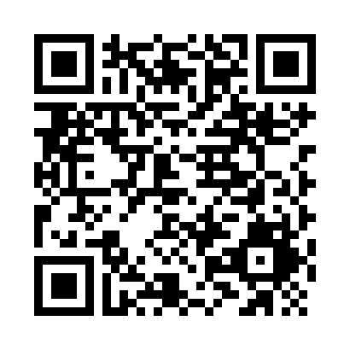
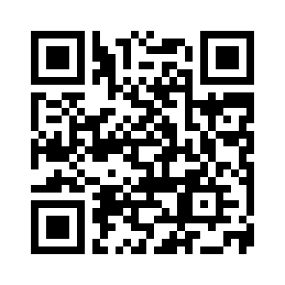
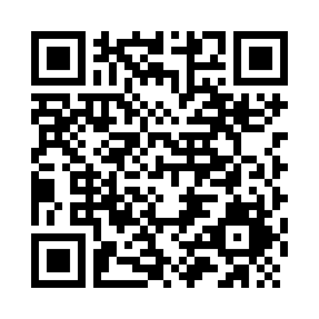

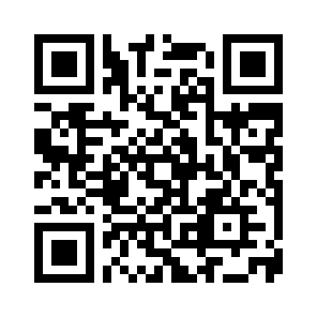
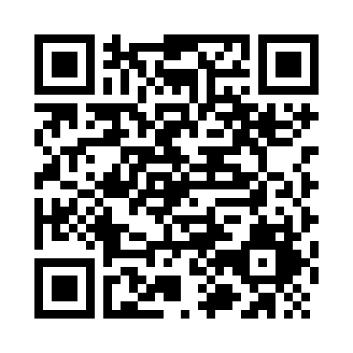
线上聚会链接 QR Codes for Online Meetings
Sunday Service (主日敬拜)
Sunday School (主日学)
Wednesday Prayer (周三祷告会)
North Group (北区团契)
Youth Parents (父母组团契)
Hope Group (盼望小组)

