Slide 1


Slide 2

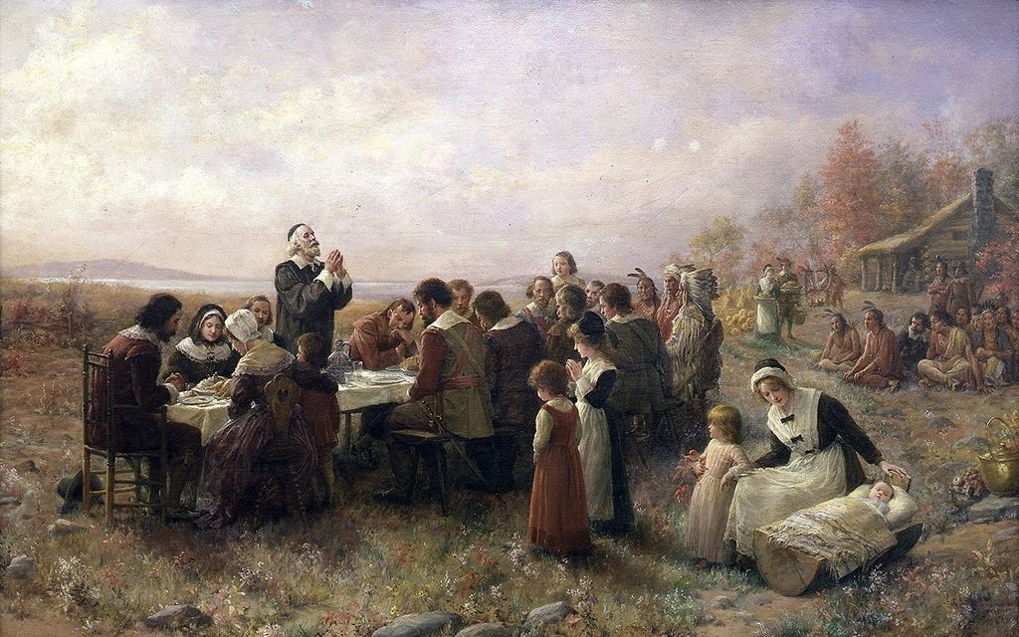
Live Worshipful Life:L#7 Psalm 100-Giving Thanks.
Introduction:In 1621,the first Thanksgiving in America was a celebration of giving thanks to God for a good harvest and for his goodness. We are commanded in Eph.5:18 to be filled with the Spirit of God, and the evidence of this fullness is that we are joyful(5:19),thankful(5:20)and submissive (5:21). We are instructed in Col.3 to be filled with the Word of God,and when we are, we are joyful(3:16),thankful(3:17),and submissive (3:20-25). The 3 characteristics of the believer controlled by God’s Spirit and God’s Word are also found in Psalm 100.
Psalm 100:
Who wrote it?
-___________________
What Psalm type is it?
-___________________
Unknown
Grateful Praise

Slide 3
Psalm 100: A psalm. For giving grateful praise. (1) Shout for joy to the Lord, all the earth. (2) Worship the Lord with gladness; come before him with joyful songs. (3) Know that the Lord is God. It is he who made us, and we are his; we are his people, the sheep of his pasture. (4) Enter his gates with thanksgiving and his courts with praise; give thanks to him and praise his name. (5) For the Lord is good and his love endures forever; his faithfulness continues through all generations.
诗篇100（称谢诗）(1)普天下当向耶和华欢呼。 (2)你们当乐意事奉耶和华。当来向他歌唱。(3)你们当晓得耶和华是神。我们是他造的，也是属他的。我们是他的民，也是他草场的羊。(4)当称谢进入他的门，当赞美进入他的院。当感谢他，称颂他的名。(5)因为耶和华本为善，他的慈爱，存到永远，他的信实，直到万代。

Slide 4
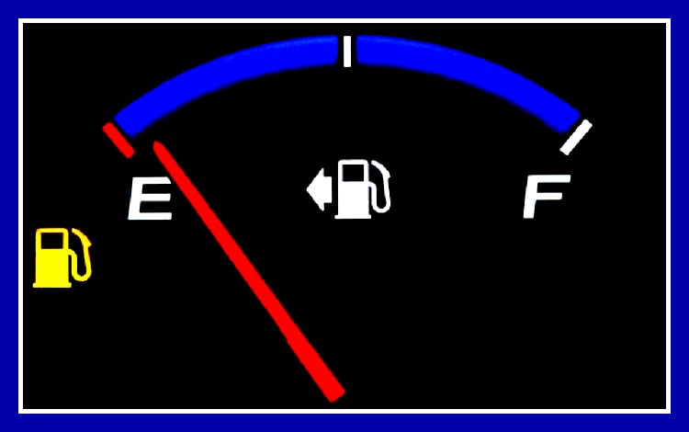

J o y f u l
1. J _ _ _ _ _ (v.1-2). When gas/power light comes on, then it is time to refill the gas/charge the battery.
C a u s e s
A.C _ _ _ _ _ for rejoicing.Happiness is external (Happy…). Joy is internal (Joy of the Lord is…”Neh.8:10).
(1) Joy of s _ _ _ _ _ _ _ _ (Ps.32:1-2,11; 51:8,12; Lk.15:6-7, 9-10,32).
(2) Joy of G _ _ (Ps.16:11;21:6). “The LORD reigns”(Ps.9:7; 93:1; 96:10; 97:1;99:1;146:10). God is in control.
(3) Joy in t _ _ _ _ _ (Ja.1:2). The Pilgrims faced a lot of trials in their first year in America.
s a l v a t i o n
G o d
t r i a l s

Slide 5

E x p r e s s i o n s
B.E _ _ _ _ _ _ _ _ _ _ of rejoicing. “Shout for joy to the LORD, all the earth. Worship the LORD with gladness; come before him with joyful songs”(Ps.100:1-2).
(1) S _ _ _ _ for joy.We shout and cheer for our favorite team
/person(Ps.20:5:33:3;35:27;47:1;65:13;66:1; 71:23;81:1; 95:1; 98:4;6;100:1).
(2) W _ _ _ _ _ _ the LORD. We are told to worship the LORD with gladness(100:2).
(3) Joyful s _ _ _ _ . “Sing to the Lord a new song” (33:3; 96:1; 98:1;144:9;149:1).Sing joyful songs.
S h o u t
W o r s h i p
s o n g
Application:“Rejoice in the Lord always. I will say it again: Rejoice!”(Phil4:4). “Rejoice always”(1Th5:16)

Slide 6
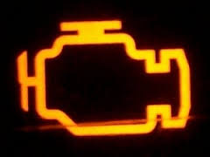
S u b m i s s i o n
2. S _ _ _ _ _ _ _ _ _ (v.3). When the engine light comes on, then the engine needs to be checked.
A.Submit to Jehovah as G _ _. “Know that the LORD is God”(100:3a). It is knowledge by experience.
B. Submit to Jehovah as C _ _ _ _ _ _ . “It is He who made us”(100:3b). He made us.
C. Submit to Jehovah as M _ _ _ _ _ . “We are His”(100:3c).
D. Submit to Jehovah as L _ _ _ . “We are His people”
(100:3d).
E. Submit to Jehovah as S _ _ _ _ _ _ _ . We are “the sheep of His pasture”(100:3e).
Application: “In all your ways submit to him, and he will make your paths straight”(Prov.3:6). “Submit yourselves, then, to God. Resist the devil, and he will flee from you”(Ja.4:6).
G o d
C r e a t o r
M a s t e r
L o r d
S h e p h e r d

Slide 7

T h a n k f u l
3. T _ _ _ _ _ _ _ (v.4-5). When the oil light comes on, then the oil needs to be checked or changed.
A. A _ _ _ _ _ _ _ God.“Enter His gates with thanksgiving and his courts with praise; give thanks to him and praise his name”(100:4).
B. B _ _ _ _ _ _ God. “For the LORD is good and his love en-dures forever;his faithfulness continues through all genera-tions” (100:5;106:1;107:1;118:1;136:1-3;1Chr.16:34;2Chr.5:13)
(1) God is g _ _ _ all the time.“Taste and see that the LORD is good”(34:8), and He gives that which is good(85:12;Ro.8:28).
(2) His l _ _ _ endures forever. (118:1,2,3,4,29).
“Give thanks to the LORD, for he is good. His love endures forever. Give thanks to the God of gods…His love endures forever. Give thanks to the Lord of lords… His love endures forever.” (136:1-26)
(3) His f _ _ _ _ _ _ _ _ _ _ _ _ continues through all generations (90:1; Ex.34:5-7).
A p p r o a c h
B e l i e v e
g o o d
l o v e
f a i t h f u l n e s s

Slide 8


C h a n g e
C. C _ _ _ _ _ the filter. Instead of complaining, think about these things. “Finally, brothers and sisters, whatever is true, whatever is noble, whatever is right, whatever is pure, what-ever is lovely, whatever is admirable—if anything is excellent or praiseworthy—think about such things” (Phil.4:8).
Application: “In every situation, by prayer and petition, with thanksgiving, present your requests to God”(Phil.4:6). “Give thanks in all circumstances; for this is God’s will for you in Christ Jesus”(1 Thes.5:18).

Slide 9

Conclusion: If we are controlled by the Holy Spirit and the Word of God, then we will reveal it in the way we worship God. Instead of being “unthankful”(Ro.1:21), we will be led by the Word and the Spirit to be joyful in the Lord, submissive to the Lord, and thankful to the Lord. It is not happy people who are thankful, it is thankful people who are happy. The Pilgrims thanked God, their neighbors, and their friends for their help. What are you thankful for this Thanksgiving?
“When drinking from the fountain think about its source.”

Slide 10
