Slide 1
What: "Mystery in the Library” Party!
Why: We need your help to solve the mystery!
How: You will be assigned a literary character to portray to solve the mystery.
Who: Christian teens who have completed 6th grade (at end of this school year) through high school.
What more: More information about Jr. CYIA and CYIA (Christian Youth in Action) summer missionary training for summer 2017. Any parents interested in also hearing this information, may join with us at that time.
When: Friday, February 17, 6:30–9:00pm
Where: Blue Ridge Bible Church,8524 Blue Ridge Blvd. Kansas City,MO 64138 (Party in fellowship hall come to south parking lot
Cost: Free! Light snacks will be served be served and special prizes given!
RSVP: Call Mrs. Heath at the local office of CEF of the Greater Kansas City Area (816) 358-1138 or email: staff@cef-gkca.org. Please RSVP no later than February 6.
Talk with your parents and let Pastor Gary or Julie Wang know if you want to go.

Slide 2
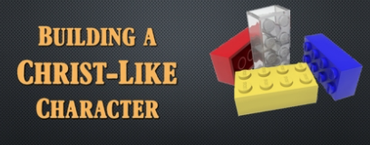
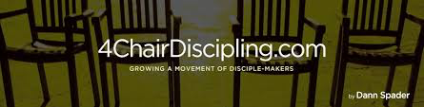
Do NOT look on page 2. Finish+Review your notes.
Building Christ-like Character: L#4-Commitment to God. Introduction: Jesus gave four challenges represented by four chairs(“4 chair discipling”=growth process).
A. Challenge 1:Come and see(Jn.1:39). Chair #1 are
_ _ _ _ _ _ _ = not children(IJn.2:19).
B. Challenge 2:Follow me(Jn.1:43). Chair #2 are
_ _ _ _ _ _ _ _ _ = children(IJn.2:12a,14a).
C. Challenge 3:Become a fisher of people(Mt.4:19). Chair #3 are _ _ _ _ _ _ _ = young men(IJn.2:13b;14c).
D. Challenge 4:Go and bear fruit(Jn.15:16). Chair #4 are disciple-_ _ _ _ _ _ = fathers(IJn.2:13a;14b).
s e e k e r s
b e l i e v e r s
w o r k e r s
m a k e r s

Slide 3
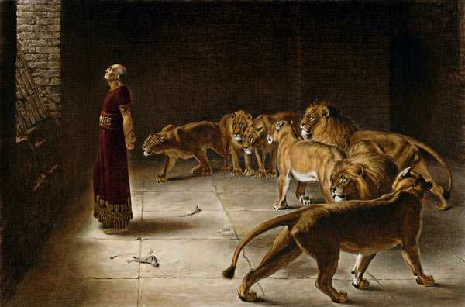
1. What is commitment? What does it mean to be committed? Who is a Biblical example of commitment?
A. It means to _ _ _ _ _ _ oneself to follow up on one’s word (promises, pledges, or vows) with action.
B. _ _ _ _ _ _ is an outstanding Biblical example of someone who was truly committed to God.
(1) He made godly choices in every area of life(Daniel 1:8).
(2) He stayed committed to
God for better or for worse-
no matter what the conse-
quence or the cost(3:18).
(3)He had great faith in God’s
promises despite the peer
pressure he faced(6:24-27).
d e v o t e
D a n i e l

Slide 4

2. What are the marks of a committed Christian? What are the distinguishing marks of a disciple?
A. _ _ _ _ _ _ Christ’s teaching. “If you hold to my teaching, you are really my disciples.”(Jn.8:31)
B. _ _ _ _ others.“By this everyone will know that you are my disciples,if you love one another.”(13:35)
C. _ _ _ _ fruit. “That you bear much fruit, showing yourselves to be my disciples.”(15:8)
F o l l o w
L o v e
B e a r

Slide 5
3. How to improve your commitment to God? What are some ways to improve your commitment?
A. _ _ _ _ God. “Love the Lord your God with all your heart and with all your soul and with all your strength.”(Deut.6:5)
B. _ _ _ _ and _ _ _ _ _ God. “To love the Lord your God, to walk in obedience to him, to keep his commands, to hold fast to him and to serve him with all your heart and with all your soul.”(Josh.22:5)
C. Make God your _ _ _ _ .“When Christ,who is your life...”
(Col.3:4)
L o v e
O b e y s e r v e
l i f e

Slide 6
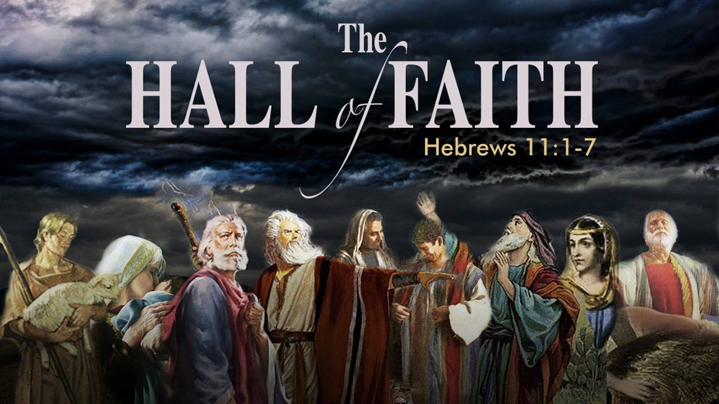
4. What is faith? Who are Biblical examples of faith?
A. It means to develop an unshakable _ _ _ _ _ _ _ _ _ in God and acting upon it.
B. It means to _ _ _ _ _ _ _ in something you cannot see, and placing confidence in its reality as if you could see, hear, taste, touch, and smell, is genuine faith.
C. Heb.11 is called the “Hall of Faith.” Who are examples of faith?-______________________________
c o n f i d e n c e
b e l i e v e
Abel, Enoch, Noah, Abraham, Sarah, Isaac, Jacob, Joseph, Moses’ parents,
Moses, Rahab, David,
Samuel, etc.

Slide 7
5. Why do you need to spend time daily in God’s Word? What are some reasons for reading the Bible?
A. To know _ _ _ (Phil.3:7-10).
B. To keep from _ _ _ _ _ _ _ (Ps.119:9-11).
C. To grow up _ _ _ _ _ _ _ _ _ _ _ (1Pet.2:2).
D. To meditate on His _ _ _ _ (Ps.1:2-3;119:97;99).
E. His Word is _ _ _ _ _ (Jn.17:17).
F. His Words are our _ _ _ _ (Dt.32:47;17:19;Mt.4:4).
G o d
s i n n i n g
s p i r i t u a l l y
W o r d
T r u t h
l i f e

Slide 8
6. What is prayer? What is the ACTS Model of how to pray?
A. It is the way that we _ _ _ _ with God. It is also the way that God uses to _ _ _ _ _ _ _ _ us.
B. ACTS Model of praying.
(1) A _ _ _ _ _ _ _ _ - You need to praise God for who He is and what He has done. Worship Him.
(2) C _ _ _ _ _ _ _ _ _ - You need to confess any sin. Come before Him and ask for forgiveness.
(3) T _ _ _ _ _ _ _ _ _ _ _ - Give thanks for all God has done and is going to do.
(4) S _ _ _ _ _ _ _ _ _ _ _ - Make request for others and yourself. Pray for guidance, discernment, peace, love, wisdom, and patience in your life.
t a l k
t r a n s f o r m
A d o r a t i o n
C o n f e s s i o n
T h a n k s g i v i n g
S u p p l i c a t i o n

Slide 9
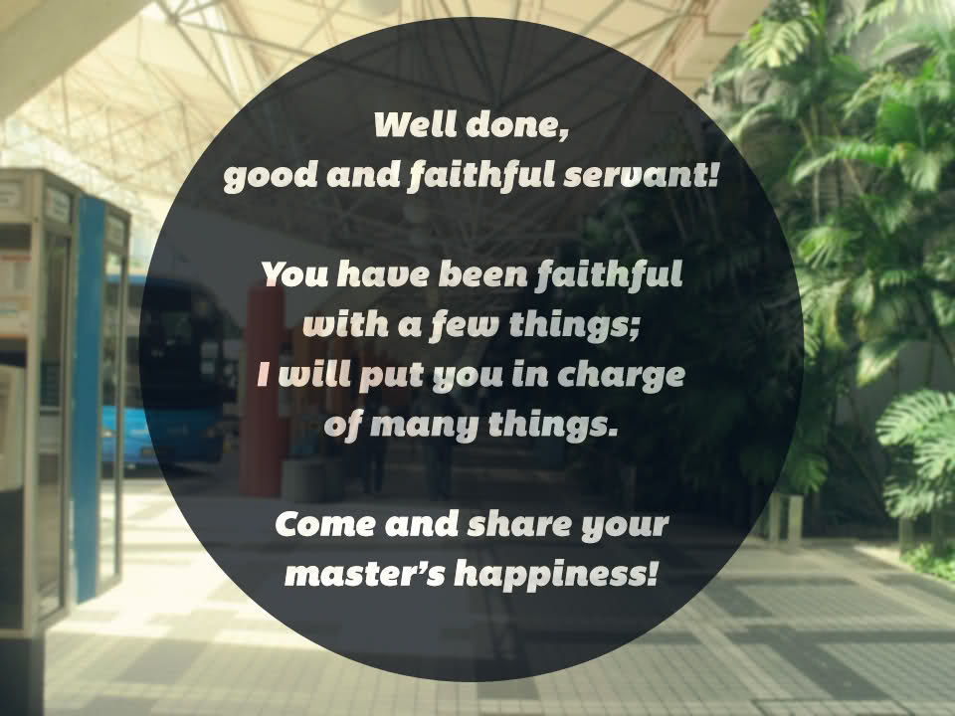
7. What is faithfulness? What does it mean you will do?
A. It means to be thorough in the performance of my duties; being _ _ _ _ to my words,promises and vows.
B. Grow in you relationship to _ _ _ (1Cor.4:2).
C. Be a loving and _ _ _ _ _ _ _ friend(Pr.13:17).
D. Enjoy the _ _ _ _ _ _ _ of faithfulness(Mt.25:23).
t r u e
G o d
t r u s t e d
r e w a r d s

Slide 10
Conclusion: Commitment,faith,prayer and faithfulness go together.Our faith is to be lived out every day of the week and in every action we take, every word we speak,and every relationship we make. It’s meant to be an overflow of everything we say and do.
Memory Verse: “You will seek me and find me when you seek me with all your heart.”(Jer.29:13)“Keep my commands and you will live; guard my teachings as the apple of your eye.”(Prov.7:2)
Small Group Ice Breaker Questions:
1. What is something you are thankful for this week?-
2. What is a challenge you are facing this week?-
3. What is a prayer request you have this week?-
Do NOT look on page2.Finish+Review your notes.

Slide 11
Build Christ-like Character L#4 Quiz: Name:___________ Do NOT look on page1.Finish+Score.
1.Define “commitment”(1pt).
2. What do the 4 chairs represent (4pts.)?
Chair #1 are ____________. Chair #3 are ______________.
Chair #2 are ____________. Chair #4 are ______________.
3. Give three marks of a committed Christian (3pts.)?
(1)
(2)
(3)
It means to devote oneself to fol-low up on one’s word(promises,pledges or vows) with action.
Seekers Workers
Believers Disciple-makers
Follow Christ’s Words.
Love others.
Bear fruit.

Slide 12
4. Give three reasons that we need to spend time daily in God’s Word (3 pts.).
(1)
(2)
(3)
5. What is prayer (1 pt.)?
To know God.
To keep from sinning.
To grow up spiritually.
To meditate on His Word.
His Word is Truth.
His Words are our life.
It is the way that we talk with God.
It is also the way that God uses to transform us.

Slide 13
6. What does ACTS stand for (4 pts).
A –______________________________
C –______________________________
S –______________________________
T –______________________________
7. What is faith (1 pt.)?
8. What is faithfulness (1 pt.)?
Adoration
Confession
Thanksgiving
Supplication
It means to develop an unshakable confidence in God and acting upon it. It means to believe in something you cannot see, and placing confidence in its reality.
It is the performance of my duties; being true to my words,promises and vows. Grow in you relationship to God. Be a loving and trusted friend. Enjoy the rewards of faithfulness.

Slide 14
9. Write out this lesson’s memory verse (2 pts.):
On time(___/1pt.)
Notes completed(___/2pts.)
Say Memory Verse(___/2pts.)
Quiz(___/20pts.)=Total:_____
“You will seek me and find me when you seek me with all your heart.”(Jer.29:13)
“Keep my commands and you will live; guard my teachings as the apple of your eye.”(Prov.7:2)
Small group leader marks points for being on time, com-pleting notes, saying memory verse, add up the total points.

