Slide 1
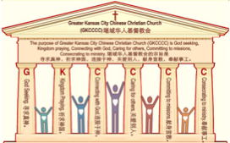

主日:二零一七年九月二十四日
Sunday: September 24, 2017
何礼义牧师 Pastor Gary Hart
题目：“社区教会。”
Topic: “Community Church.”
经文:徒17:16-34 Text: Acts 17:16-34
“保罗在雅典等候他们的时候，看见满城都是偶像，就心里着急”(徒17:16)。“While Paul was waiting for them in Athens,he was greatly distress to see that the city was full of idols”(Ac.17:16).
(1)

Slide 2
引言:A。使徒行传的信息。 Intro: A.Message of Acts of the Apostles.
(2)
(一)基督建造祂的教会（基督的灵借着使徒在作工）。
(二)使徒行传是圣灵的指挥,控制和赋权的事工,创立和加强了教会，并使它成长。
(三)使徒行传是一个过渡时期:从耶稣的事工到使徒的;从旧约到新约;从以色列作神的见证到教会作神的见证;从犹太教出来, 教会诞生了。
(四)使徒行传显示大使命得以遵行(1:8)从证人到耶路撒冷(1-8),到犹太和撒玛利亚(8-12)并到地极(13-28)。
(五)保罗继续了他的第二次传教旅程。
(1)Christ builds His Church(the Acts of the Spirit of Christ through the Apostles). (2)The Acts were the Spirit’s directing, controlling, and empowering ministry that founded and strengthened the church and caused it to grow.
(3)The Acts is a time of transitions: from ministry of Jesus to that of the apostles; from the Old Covenant to the New Covenant; from Israel as God’s witness to the Church as God’s witness; from Judaism is going out and Church is coming in.
(4)The Acts show the fulfillment of the Great Commission(1:8) from the witness to Jerusalem(1-8), to Judea and Samaria(8-12), and to the ends of earth(13-28).
(5) Paul continues his second missionary journey.

Slide 3
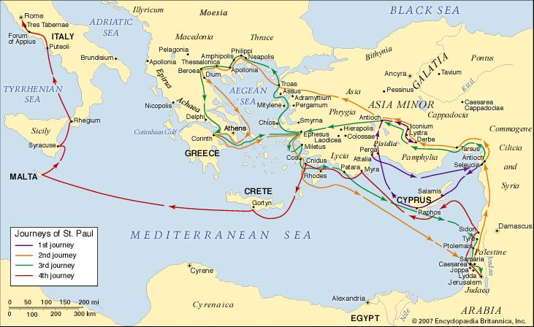
B。雅典的地理位置。B. Athens location.
(3)

Slide 4
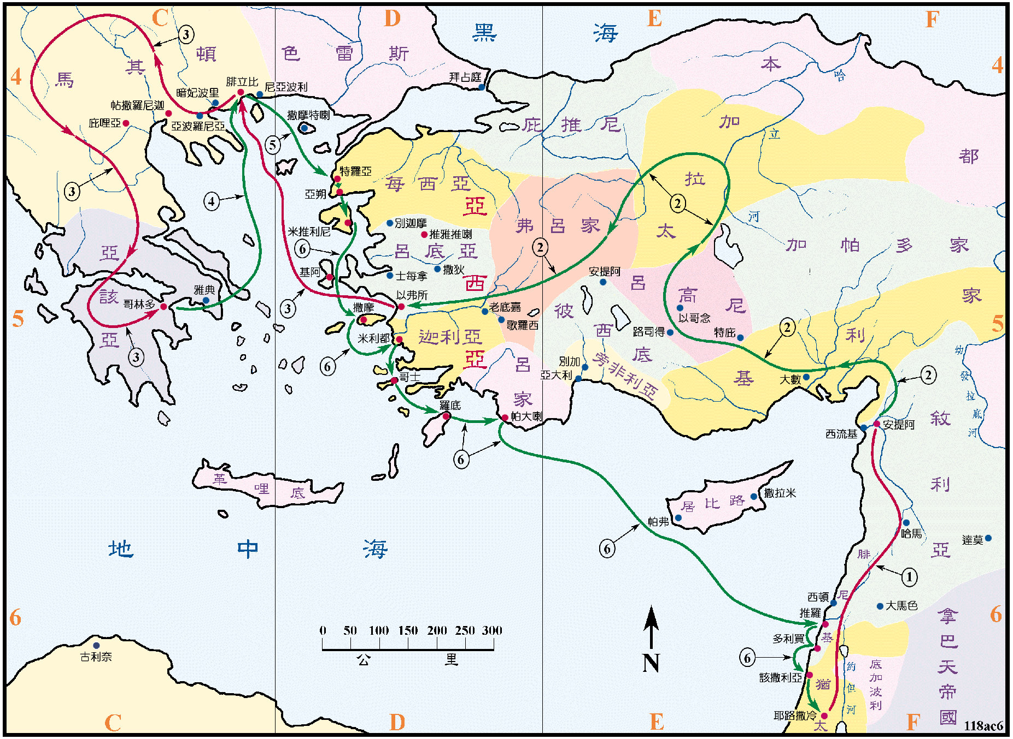
B。雅典的地理位置。B. Athens location.
(4)

Slide 5
C。雅典的历史背景。C. Athens historical background.
(5)
(1)雅典是希腊的首都，是文化和教育的中心。这个城市沉溺于偶像崇拜(17:16)，新奇(17:21)和哲学(17:18)。希腊宗教神化了人的属性和自然的力量。 偶像崇拜是恶魔(林前书10:14-23)。 新奇寻求听到和告诉“一些新事物”(传1:8-11)。享乐主义说“享受生命！”
(路12:19)。斯多噶派的说“忍受生命！”(来12:7)。保罗通过信靠基督来解释如何“进入生命！”(徒24:24)。(2)雅典教会是由保罗创立的。(3)雅典教会代表“社区教会”。(4)雅典是以智慧和知识的女神雅典娜的名字命名的。
(1)Athens was the capital of Greece and the center of culture and education.The city was given over to idolatry (17:16), novelty(17:21),and philosophy(17:18).The Greek religion was a deification of human attributes and the powers of nature. Idolatry is demonic(1Cor.10:14-23). Novelty seeks to hear and tell “some new thing”(Ecc.1:8-11).Epicureans said “Enjoy life!”(Lk.12:19).The Stoics said “Endure life!”(Heb.12:7). Paul explained how to “Enter into life!” through faith in Christ (Ac.24:24). (2)Athens church was founded by Paul. (3) Athens church represents “Community Church”. (4)Athens was named for the goddess Athene, the goddess of wisdom and knowledge.

Slide 6

(6)
一。保罗是一个使者。1.Paul was a messenger.
“保罗在雅典等候他们的时候”(17:16a)。
保罗“预备行各样的善事”(多3:1)。
A。保罗是个服务员。
不是在桌子上等着被服侍的人。(1)保罗等候“西拉和提摩太速速到他这里来，就回去了。保罗在雅典等候他们的时候”(17:15-16a)。(2)保罗在等候神。“从古以来人未曾听见，未曾耳闻，未曾眼见，在你以外有什么神为等候他的人行事。”(赛64:4)。“要等候耶和华。当壮胆，坚固你的心。我再说，要等候耶和华”(诗27:14)。 停下来祈求智慧，勇气，力量。
“While Paul was waiting for them in Athens…”(17:16a). Paul was “ready to do whatever is good”(Titus 3:1).
A. Paul was a waiter. Not one who waited on tables. (1) Paul was waiting “for Timothy and Silas to join him as soon as possible”(17:15-16a). (2) Paul was waiting on God. “Since ancient times no one has heard, no ear has perceived, no eye has seen any God besides you,who acts on behalf of those who wait for him”(Isa.64:4).“Wait for the Lord;be strong and take heart and wait for the Lord.” (Ps.27:14). Stop and pray for wisdom,courage,strength.

Slide 7
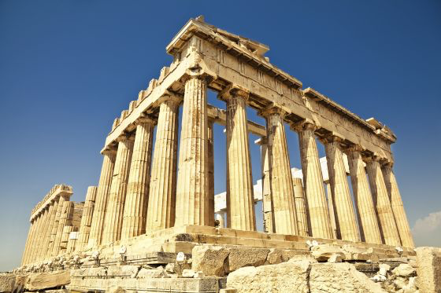
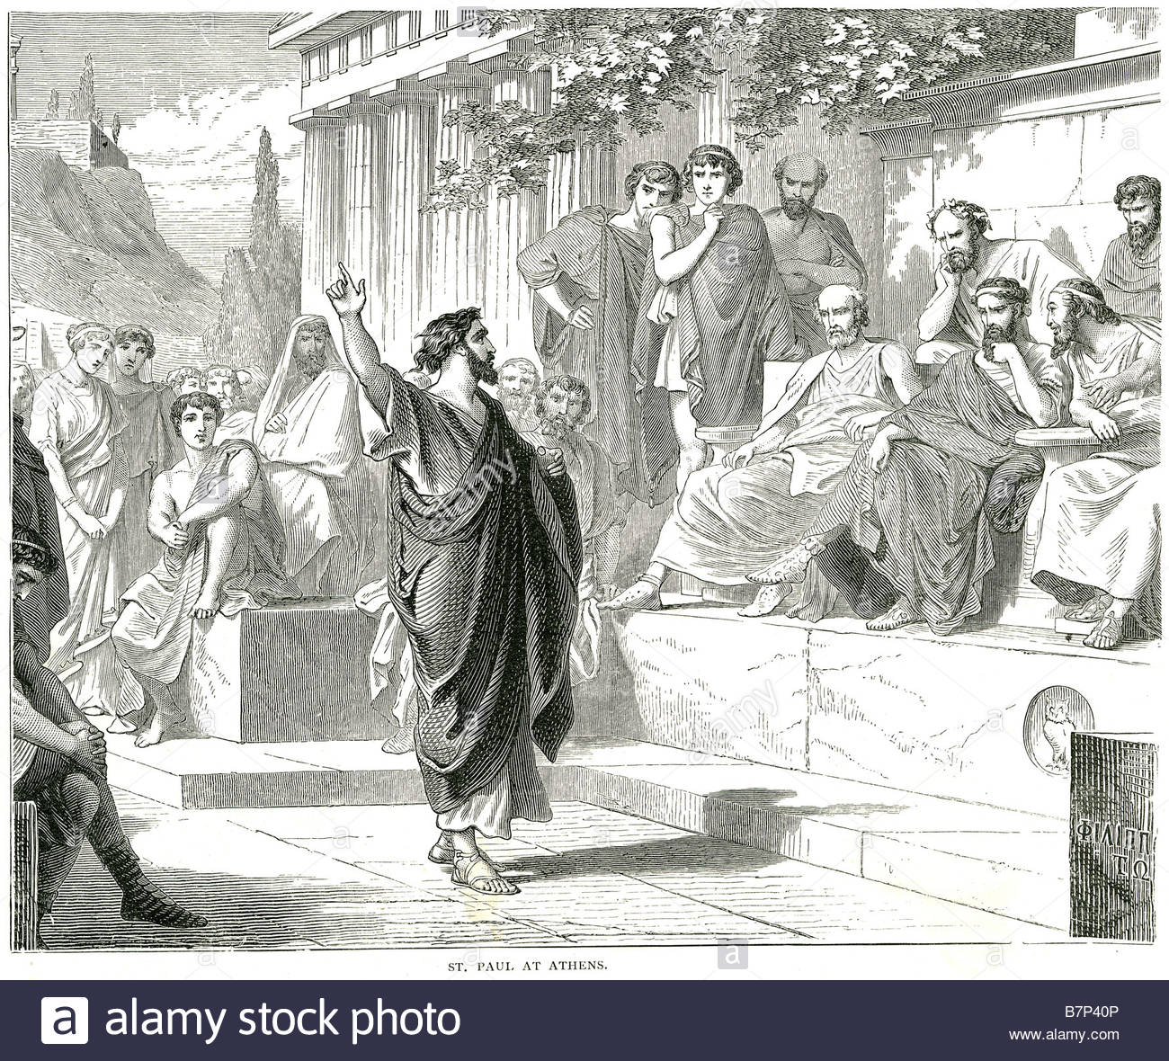
一。保罗是一个使者。1. Paul was a messenger.
(7)
B。保罗是一个受感动的人。 他的心被神的灵所感动，“看见满城都是偶像，就心里着急”(17:16)。他不是以雅典建筑的观光客的身份来看待这座城市的，而是以对神的作为的敬畏者的身份来看待这座城市的。他看到的不仅是人的建造，他看到的是建造人的那一位。
B. Paul was a mover. His heart was moved by the Spirit of God.“He was greatly distressed to see that the city was full of idols”(17:16b).He viewed the city not as a sight-seer of Athens buildings,but as a God-fearer of God’s workings.He saw more than architecture of men,he saw the Architect of mankind.

Slide 8
一。保罗是一个使者。1. Paul was a messenger.
(8)
C。保罗是一位辩士。“于是在会堂里，与犹太人，和虔敬的人，并每日在市上所遇见的人辩论”(17:17)。(1)他在犹太教堂里辩论。(2)他在市场上辩论。“还有以彼古罗和斯多亚两门的学士，与他争论。有的说，这胡言乱语的要说什么。有的说，他似乎是传说外邦鬼神的。这话是因保罗传讲耶稣，与复活的道。他们就把他带到亚略巴古说，你所讲的这新道，我们也可以知道吗？因为你有些奇怪的事，传到我们耳中。我们愿意知道这些事是什么意思。雅典人，和住在那里的客人，都不顾别的事，只将新闻说说听听”(17:18-21)。
C. Paul was a dialoguer. “So he reasoned in the synagogue with both Jews and God-fearing Greeks, as well as in the marketplace day by day with those who happened to be there”(17:17). (1)He reasoned in the synagogue. (2)He reasoned in the marketplace. “A group of Epicurean and Stoic philosophers began to debate with him. Some of them asked, “What is this babbler trying to say?” Others remarked, “He seems to be advocating foreign gods.”They said this because Paul was preaching the good news about Jesus and the resurrection.Then they took him and brought him to a meeting of the Areopagus,where they said to him,“May we know what this new teaching is that you are presenting?You are bringing some strange ideas to our ears,and we would like to know what they mean.”(All the Athenians and the foreigners who lived there spent their time doing nothing but talking about and listening to the latest ideas.)(17:18-21).

Slide 9
二。保罗给了一个信息。2. Paul gives a message.
(9)
“保罗站在亚略巴古当中，说…”(17:22)。在亚略巴古当中，保罗从人们献祭给未识之神的话题开始，引起了他们的兴趣，然后他解释了那位神是谁，他是怎么样子的。保罗以向每个人发起挑战的方式结束了这个信息，让每个议会议员面临一个道德决定，其中一些人决定相信耶稣基督。保罗称赞道:“众位雅典人哪，我看你们凡事很敬畏鬼神。我游行的时候，观看你们所敬拜的，遇见一座坛，上面写着未识之神。你们所不认识而敬拜的，我现在告诉你们”(17: 22-23)。保罗分享了关于神的四个基本真理。
“Paul then stood up in the meeting of the Areopagus and said…”(17:22). At a meeting of the council on Mars’ Hill,Paul started where the people were by referring to their altar dedicated to an unknown god.Having aroused their interest, he then explained who that God is what He is like. He concluded the message with a personal application that left each council member facing a moral decision,and some of them decided for Jesus Christ.Paul gave a compliment: “I see that in every way you are very religious.For as I walked around and looked carefully at your objects of worship, I even found an altar with this inscription: to an unknown god. So you are ignorant of the very thing you worship—and this is what I am going to proclaim to you” (17:22-23).Paul shared four basic truths about God.

Slide 10
(10)
二。保罗给了一个信息。2. Paul gives a message.
A。神的伟大：他是造物主。 “创造宇宙和其中万物的神，既是天地的主，就不住人手所造的殿”(17:24)。(1)人类的问题。 “我从哪里来？ 为什么我在这里？ 我要去哪里？”(2)人类的答案。 科学试图回答第一个问题，哲学试图回答第二个问题，但只有基督教信仰才能对这三个人有一个答案。(3)保罗肯定：“起初神！”神创造天地，他是万物的主宰。 他不是一个遥远的神，与他的创造分离，也不是他被监禁的神，锁在创造中。 他太大了，不能安置在人造圣殿(王上8:27;赛66:1-2; 徒7:48-50），但他关心人的需要。
A. The greatness of God: He is Creator. “The God who made the world and everything in it is the Lord of heaven and earth and does not live in temples built by human hands”(17:24).(1) The questions of mankind. “Where did I come from? Why am I here? Where am I going?” (2) The answers for mankind. Science attempts to answer the first question, and philosophy tries to answer the second,but only the Christian faith has an answer to all three. (3) Paul affirmed, “In the beginning, God!” God made the world and everything in it,and He is the Lord of all that He has made. He is not a distant God,separated from His creation, nor is He an imprisoned God, locked in creation. He is too great to be housed in man-made temples (1K.8:27;Isa.66:1-2;Ac. 7:48-50), but He is not too great to be concerned about man’s needs.

Slide 11
(11)
二。保罗给了一个信息。2. Paul gives a message.
B。神的恩典：他是供应者。 “也不用人手服事，好像缺少什么，自己倒将生命气息，万物，赐给万人”(17:25)。(1)错误的理解。人可以为服事神而自豪。(2)正确的理解。是神服事人。 如果神是神，那么他是自给自足的，没有什么需要人供应的。(3)殿堂不但不包含神，并且在殿中的服事也不会给神增添任何东西！是神给我们所需要的:“生命，呼吸，万事万物”。神是每一个善良和完美的礼物的来源(雅1:17)。 他给了我们生命，他凭着良善维持生命(太5:45)。 神的恩典理应引导人们悔改(罗2:4)。
B. The goodness of God: He is Provider. “And he is not served by human hands, as if he needed anything. Rather, he himself gives everyone life and breath and everything else”(17:25).(1)Wrong understanding.Men may pride themselves in serving God. (2) Correct understanding. It is God who serves man. If God is God, then He is self-sufficient and needs nothing that man can supply. (3)Not only do the temples not contain God,but the services in the temples add nothing to God! It is God who gives to us what we need: “life, and breath, and all things.” God is the source of every good and perfect gift (Ja.1:17). He gave us life and He sustains that life by His goodness(Mt.5:45). It is the goodness of God that should lead men to repentance(Ro.2:4).

Slide 12
二。保罗给了一个信息。2. Paul gives a message.
(12)
C。神的政权：他是统治者。 “他从一本，造出万族的人，住在全地上，并且预先定准他们的年限，和所住的疆界。要叫他们寻求神，或者可以揣摩而得，其实他离我们各人不远。我们生活，动作，存留，都在乎他，就如你们作诗的，有人说，我们也是他所生的。我们既是神所生的，就不当以为神的神性像人用手艺，心思，所雕刻的金，银，石”(17:26-29)。
C. The government of God: He is Ruler. “From one man he made all the nations,that they should inhabit the whole earth; and he marked out their appointed times in history and the boundaries of their lands. God did this so that they would seek him and perhaps reach out for him and find him, though he is not far from any one of us.‘For in him we live and move and have our being.’As some of your own poets have said, ‘We are his offspring.’ “Therefore since we are God’s offspring, we should not think that the divine being is like gold or silver or stone—an image made by human design and skill”(17:26-29).

Slide 13
(13)
二。保罗给了一个信息。2. Paul gives a message.
(1)希腊诸神是遥不可及的，并不关心人的问题和需要。(2)创造之神也是历史与地理之神！他“从一个人”(17:36)创造了整个人类，使所有的国家都是同源，同宗，同血脉。(3)神的政权决定了国家的兴衰(但4:35)。神不是遥远的神，“他离我们每个人都不远(17:27)。因此，人应该寻求神，真实地认识他。在这里，保罗引用了诗人伊壁孟德的诗句“我们生活，动作，存留，都在乎他”。然后他又加了两位诗人阿拉斯特和克莱门特的话：“因为我们也是他的后代。”罪人成为神的儿女只有信靠基督(约1:12)，但人是以神的形象创造的(创1:26)。神以他的形象造了我们，所以我们以自己的形象造偶像是愚蠢的！保罗指出了寺庙，寺庙仪式和偶像崇拜的愚昧。
(1) The Greek gods were distant beings who had no concern for the problems and needs of men. (2) The God of creation is also the God of history and geography! He created mankind “from one man”(17:36) so that all nations are made of the same stuff and have the same blood. (3) The government of God determines the rise and fall of nations(Dan.4:35). God is not a distant deity; “He is not far from every one of us(17:27). Therefore,men ought to seek God and come to know Him in truth. Here Paul quoted from the poet Epimenides: “For in him we live, and move, and have our being.” Then he added a quotation from two poets, Aratus and Cleanthes: “For we are also his offspring.” Sinners become God’s children only by faith in Christ(Jn.1:12),but man was created in the image of God(Gen.1:26). God made us in His image, so it is foolish for us to make gods in our own image! Paul shows the folly of temples, temple rituals, and the folly of idolatry.

Slide 14
(14)
二。保罗给了一个信息。2. Paul gives a message.
D。神的恩典：他是救主。“世人蒙昧无知的时候，神并不监察，如今却吩咐各处的人都要悔改。因为他已经定了日子，要借着他所设立的人，按公义审判天下。并且叫他从死里复活，给万人作可信的凭据”(17:30-31)。(1)神对人的罪和无知有耐心(14:16;罗3:25)。 这并不意味着人是无罪的(罗1:19-20)，只是神忍住了他的烈怒。(2)日期满足，神差遣救主，现在他命令所有的人为自己的愚行悔改。(3)这位救主死了，然后从死里复活，有一天，他将施行审判的证据是他已经从死里复活了。
D. The grace of God: He is Savior. “In the past God overlooked such ignorance, but now he commands all people everywhere to repent.For he has set a day when he will judge the world with justice by the man he has appointed.He has given proof of this to everyone by raising him from the dead”(Ac. 17:30-31). (1) God was patient with man’s sin and ignorance(14:16;Ro.3:25). This does not mean that men were not guilty(Rom.1:19-20), but only that God held back divine wrath. (2) In due time, God sent a Savior, and now He commands all men to repent of their foolish ways. (3) This Savior was killed and then raised from the dead and one day, He will return to judge the world. The proof that He will judge is that He have raised from the dead.

Slide 15
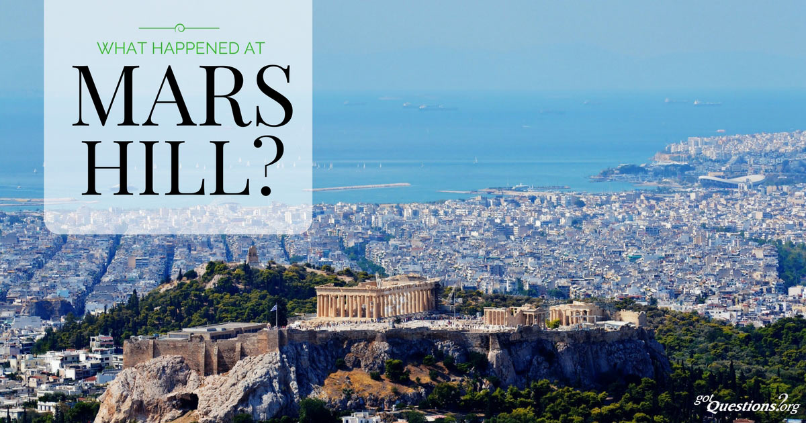
(15)
结论：Conclusion:
“众人听见从死里复活的话，就有讥诮他的，又有人说，我们再听你讲这个吧。于是保罗从他们当中出去了。但有几个人贴近他，信了主，其中有亚略巴古的官丢尼修，并一个妇人，名叫大马哩，还有别人一同信从”(徒17:30-34)。 三个不同的反应是什么？(1)有些人嘲笑，没有认真对待保罗的消息。(2)其他人有兴趣但想听到更多的。(3)一个小团体接受了保罗的传讲，相信了耶稣基督，并且得救了。
“When they heard about the resurrection of the dead, some of them sneered, but others said, “We want to hear you again on this subject.” At that,Paul left the Council. Some of the people became followers of Paul and believed. Among them was Dionysius, a member of the Areopagus, also a woman named Damaris, and a number of others”(Ac.17:32-34). What were the three different responses? (1) Some laughed and mocked and
did not take Paul’s message seriously.(2)Others
were interested but wanted to hear more.(3)A
small group accepted what Paul preached,
believed on Jesus Christ,and were saved.

Slide 16
(16)
结论：Conclusion:
智慧的雅典人是不会轻易接受保罗卑微的福音信息的，尤其当他把这个希腊历史归结为一个“无知的时代”时。我们需要能走向学院大门的见证人，将基督传扬给在他们的世界里有智慧但不知道世上真智慧的人。“可见你们蒙召的，按着肉体有智慧的不多，有能力的不多，有尊贵的也不多”(林前1:26)，但有些智慧人蒙神拣选，神可以用你去呼召他们。 把福音带到你的“雅典”到大堪萨斯城社区。对我们的社区有什么看法？ 美丽的喷泉，美味的烧烤，友好的人。 美国本地人Shawnee意思是“黑蹄”。Shawnee座右铭是“好的起点在这里”。社区来自“共同”。
Wise Athens would not take easily to Paul’s humbling message of the gospel,especially when he summarized all of Greek history in the phrase “the times of this ignorance.” We need witnesses who will go to the “halls of academe” and present Christ to people who are wise in their world but ignorant of the true wisdom of the world to come. “Not many wise men after the flesh, not many mighty, not many noble are called”(1Cor.1:26), but some are called, and God may use you to call them.Take the gospel to your “Athens”, to the GKC community. What are some observations about our community?GKC has beautiful fountains,good BBQ, friendly people.Native American name Shawnee means “black hoof.”Shawnee’s motto is,“Good starts here”.Community comes from common.

Slide 17
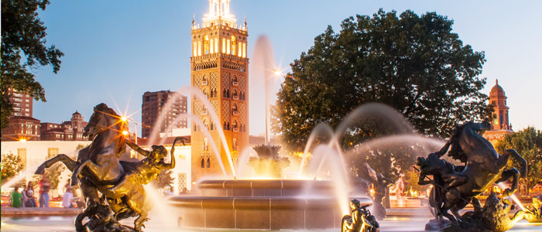

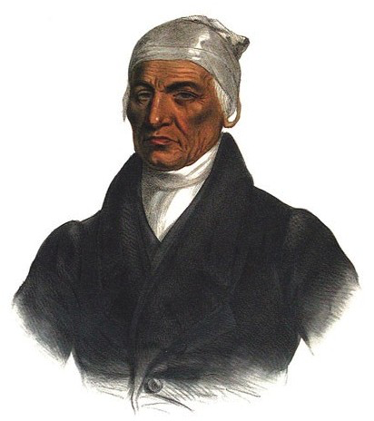


Slide 18
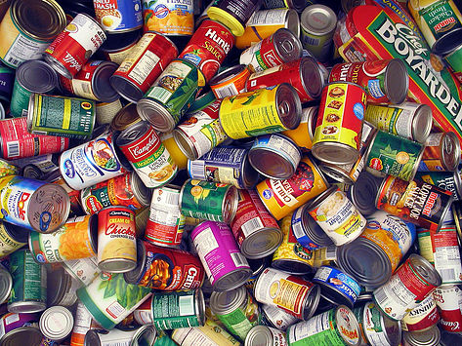

(1)2017年11月18日 ：225名家庭感恩节需要罐头蔬菜。
Nov.18,2017: 450 Cans of vegetables are needed for 225 families Thanksgiving.
(2)2017年12月21日 ：圣诞节“收养一个家庭”。
Dec.21,2017: “Adopt a Family” for Christmas.
(3)2017年12月21日 ：需要儿童书圣诞节。
Dec.21,2017: They need Children’s books for Christmas.

