Slide 1
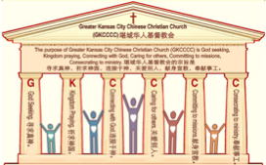

主日:二零一七年九月十七日
Sunday: September 17, 2017
何礼义牧师 Pastor Gary Hart
题目：“圣经教会。”
Topic: “Bible Church.”
经文:徒17:10-15 Text: Acts 17:10-15
“甘心领受这道，天天考查圣经…”(徒17:11)。
“For they received the message with great eagerness and examined the Scriptures every day…”(Ac.17:11).
(1)

Slide 2
引言:A。使徒行传的信息。 Intro: A.Message of Acts of the Apostles.
(2)
(一)基督建造祂的教会（基督的灵借着使徒在作工）。
(二)使徒行传是圣灵的指挥,控制和赋权的事工,创立和加强了教会，并使它成长。
(三)使徒行传是一个过渡时期:从耶稣的事工到使徒的;从旧约到新约;从以色列作神的见证到教会作神的见证;从犹太教出来, 教会诞生了。
(四)使徒行传显示大使命得以遵行(1:8)从证人到耶路撒冷(1-8),到犹太和撒玛利亚(8-12)并到地极(13-28)。
(五)保罗继续了他的第二次传教旅程。
(1)Christ builds His Church(the Acts of the Spirit of Christ through the Apostles). (2)The Acts were the Spirit’s directing, controlling, and empowering ministry that founded and strengthened the church and caused it to grow.
(3)The Acts is a time of transitions: from ministry of Jesus to that of the apostles; from the Old Covenant to the New Covenant; from Israel as God’s witness to the Church as God’s witness; from Judaism is going out and Church is coming in.
(4)The Acts show the fulfillment of the Great Commission(1:8) from the witness to Jerusalem(1-8), to Judea and Samaria(8-12), and to the ends of earth(13-28).
(5) Paul continues his second missionary journey.

Slide 3
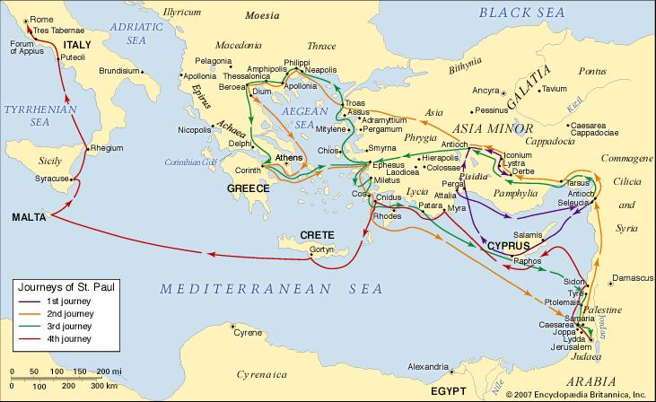
B。庇哩亚的地理位置。B. Berea location.
(3)

Slide 4
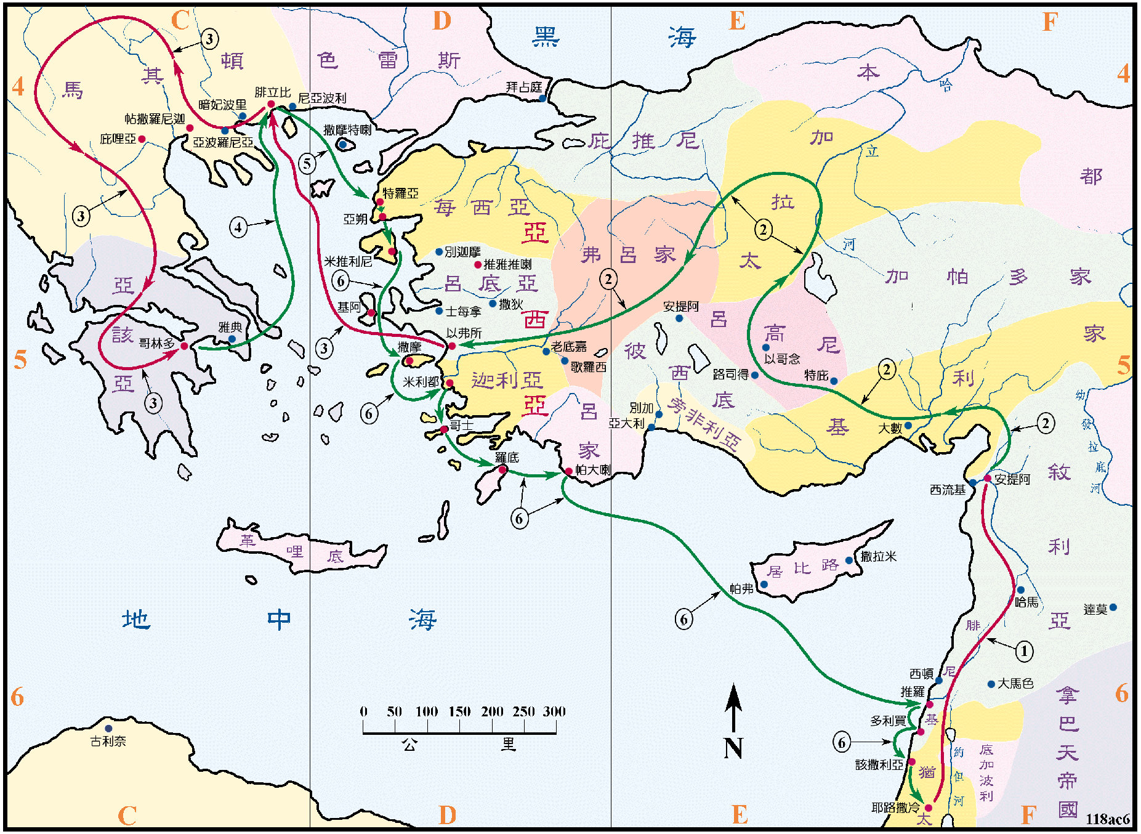
B。庇哩亚的地理位置。B. Berea location.
(4)

Slide 5
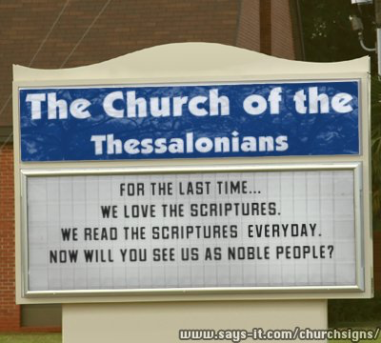
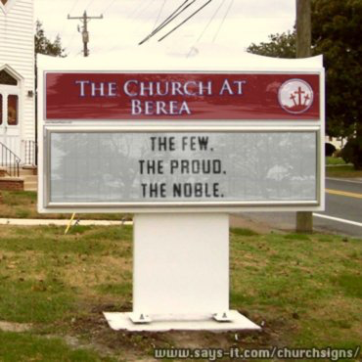
C。庇哩亚的历史背景。C. Berea historical background.
(5)
(1)庇哩亚在马其顿境内，离帖撒罗尼迦约45英里。 “这地方的人，贤于帖撒罗尼迦的人”（17:11a）。
(2)庇哩亚教会是由保罗创立的。 “弟兄们，随即在夜间打发保罗和西拉往庇哩亚去。二人到了，就进入犹太人的会堂”（17:10）。
(3)庇哩亚教会代表“圣经教会”。
(4)庇哩亚意思是“许多水域”。
(1) Berea was in Macedonia about 45 miles from Thessalonica. “Now the Berean Jews were of more noble character than those in Thessalonica”(17:11a).
(2) Berea church was founded by Paul. “As soon as it was night, the believers sent Paul and Silas away to Berea. On arriving there, they went to the Jewish synagogue”(17:10).
(3) Berea church represents “Bible Church”.
(4) Berea means“place of many waters.” “To make
her holy, cleansing her by the washing with water
through the word”(Eph.5:26).

Slide 6
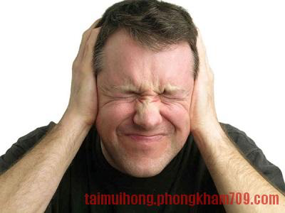

(6)
一。领受圣经。1. Receive the Bible.
“甘心领受这道…”(徒17:11b)。“谁有耳朵，让他们听到圣灵对教会说什么”“圣灵向众教会所说的话，凡有耳的就应当听”（启2:17）。 有五种听众。 你是哪种人？
A。听时闭着耳朵。 他们是不想听的听众。 他们不急于听到。 警告＃1:“因为这百姓油蒙了心，耳朵发沉，眼睛闭着。恐怕眼睛看见，耳朵听见，心里明白，回转过来，我就医治他们”(太13:15；徒28:27；提后4:3)。
“For they received the message with great eagerness…” (Ac.17:11b). “Whoever has ears, let them hear what the Spirit says to the churches”(Rev.2:17). There are five kinds of listeners. What kind(s) are you?
A. Listen with closed ears. They are listeners who don’t
want to hear. They are not eager to hear. Warning #1: “For
this people’s heart has become calloused; they hardly hear
with their ears, and they have closed their eyes. Otherwise
they might see with their eyes, hear with their ears,
understand with their hearts and turn, and I would heal
them”(Mt.13:15;Ac.28:27;2Tim.4:3).

Slide 7


一。领受圣经。1. Receive the Bible.
(7)
B。为知识而听。他们是只为了获得知识的听众。他们为了错误的目的而听道。 警告＃2:“但知识是叫人自高自大，惟有爱心能造就人。若有人以为自己知道什么，按他所当知道的，他仍是不知道。若有人爱神，这人乃是神所知道的”(林前8:1-3)。
C。为学习而听。他们记笔记，提问题。他们渴望听到。 警告＃3:“常常学习，终久不能明白真道”(提后3:7)。
B. Listen to gain knowledge. They are listeners who want only knowledge. They are eager to hear for the wrong reason. Warning #2: “But knowledge puffs up while love builds up. Those who think they know something do not yet know as they ought to know. But whoever loves God is known by God”(1Cor.8:1-3).
C. Listen to learn. They are learners who take notes and ask questions. They are eager to hear. Warning #3: “Always learning but never able to come to a knowledge of the truth”(2Tim.3:7).

Slide 8
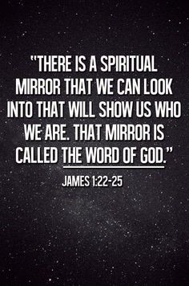
一。领受圣经。1. Receive the Bible.
(8)
D。为服从而听。他们不仅是听道者，也是行道者。他们更渴望听到。 警告＃4:“只是你们要行道，不要单单听道，自己欺哄自己。因为听道而不行道的，就像人对着镜子看自己本来的面目。看见，走后，随即忘了他的相貌如何。惟有详细察看那全备使人自由之律法的，并且时常如此，这人既不是听了就忘，乃是实在行出来，就在他所行的事上必然得福”(雅1:22-25)。
D. Listen to obey. They are not only listeners but also doers. They are more eager to hear. Warning #4: “Do not merely listen to the word, and so deceive yourselves. Do what it says. Anyone who listens to the word but does not do what it says is like someone who looks at his face in a mirror and, after looking at himself, goes away and immediately forgets what he looks like. But whoever looks intently into the perfect law that gives freedom, and continues in it—not forgetting what they have heard, but doing it—they
will be blessed in what they do”(Jam.1:22-25).
“我们可以看一个属灵的镜子，会告诉我们是谁，那个镜子被称为神的话。”

Slide 9
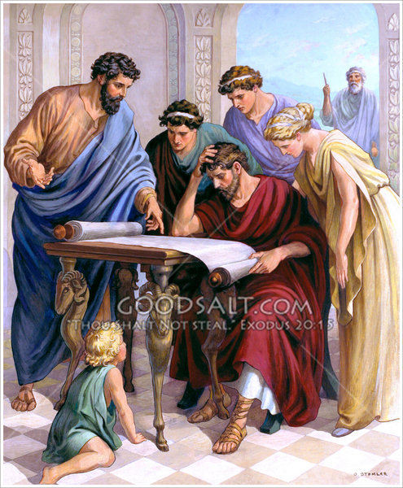
一。领受圣经。1. Receive the Bible.
(8)
E。为教导别人而听道。他们想与他人分享上帝教导他们的真理。 他们非常渴望听到。 警告＃5:“我的弟兄们，不要多人作师傅，因为晓得我们要受更重的判断”(雅3:1)。“你们在我身上所学习的，所领受的，所听见的，所看见的，这些事你们都要去行。赐平安的神，就必与你们同在”(腓4:9)。
E. Listen to teach. They want to share with others the truths that God has taught them. They have great eagerness to hear. Warning #5: “Not many of you should become teachers, my fellow believers, because you know that we who teach will be judged more strictly” (Jam.3:1). “Whatever you have learned or received or heard from me, or
seen in me—put it into practice. And the God of peace will be with you”(Phil.4:9).

Slide 10
(9)
二。研读圣经。2. Study the Bible.
“天天考查圣经，要晓得这道，是与不是”(17:11c)。
A。每天阅读。 你有阅读圣经的计划吗？ 你还允许圣经读你吗？ 责备＃1:“耶稣说，经上写着，匠人所弃的石头，已作了房角的头块石头。这是主所作的，在我们眼中看为希奇。这经你们没有念过吗？”(太21:42)。
B。完全搜索。 你在寻找宝藏吗？ 你还允许神鉴察你的心吗？责备＃2:“寻找他如寻找银子，搜求他如搜求隐藏的珍宝，你就明白敬畏耶和华，得以认识神”(箴2:4-5)。
“Examined the Scriptures every day to see if what Paul said was true”(17:11c).
A. Read it daily. Do you have a plan for reading your Bible? Do you also allow the Bible to read you? Rebuke #1: “Jesus said to them, “Have you never read in the Scriptures: “‘The stone the builders rejected has become the cornerstone; the Lord has done this, and it is marvelous in our eyes’?”(Mt.21:42).
B. Search it completely. Do you search for the treasures? Do you also allow God to search your heart? Rebuke #2: “If you look for it as for silver and search for it as for hidden treasure,then you will understand the fear of the Lord and find the knowledge of God”(Pr.2:4-5).

Slide 11
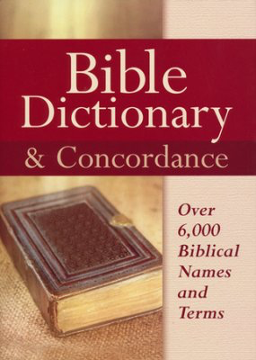
(10)
二。研读圣经。2. Study the Bible.
C。勤勉学习。你刻苦学习你的圣经吗？ 你也允许上帝的话来学习你吗？ 责备＃3:“你们查考圣经。 因你们以为内中有永生。给我作见证的就是这经”(约5:39)。
D。小心处理。 你能正确辨识真理之道吗？ 你还允许神的真理来辨别你吗？责备＃4:“你当竭力，在神面前得蒙喜悦，作无愧的工人，按着正意分解真理的道”(提后2:15)。
圣经字典和字汇
C. Study it diligently. Do you study diligently your Bible? Do you also allow God’s word to study you? Rebuke #3:“You study the Scriptures
diligently because you think that in them you have eternal life.These are the very Scriptures
that testify about me”(Jn.5:39).
D. Handle it carefully. Do you rightly divide the Word of Truth? Do you also allow God’s truth to discern you? Rebuke: #4: “Do your best to pre-sent yourself to God as one approved, a worker who does not need to be ashamed and who correctly handles the word of truth”(2Tim.2:15).

Slide 12
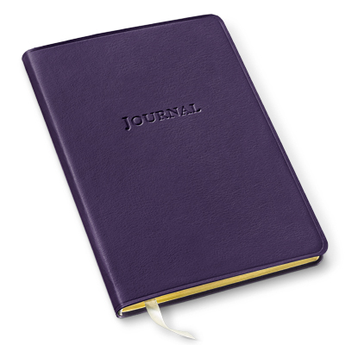
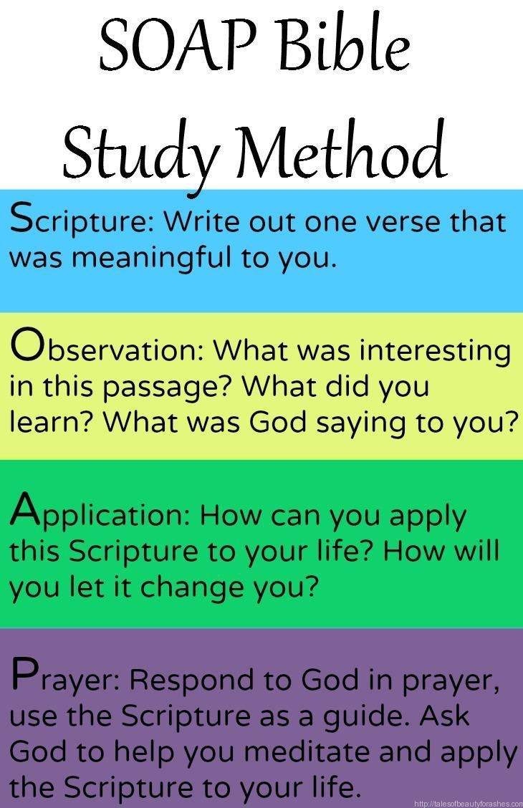
(10)
二。研读圣经。2. Study the Bible.
E。正确应用。 你正确地应用神的话吗？ 你也允许神的灵来正确应用吗？责备＃5:“神的道是活泼的，是有功效的，比一切两刃的剑更快，甚至魂与灵，骨节与骨髓，都能刺入剖开，连心中的思念和主意，都能辨明”(来4:12)。
S经文:写出一个对你有意义的经文。
E. Apply it correctly. Do you apply God’s word correctly? Do you also allow God’s Spirit to apply correctly? Rebuke #5: “For the word of God is alive and active.
Sharper than any double-edged sword, it penetrates even to dividing soul and spirit, joints and marrow; it judges the thoughts and attitudes of the heart”(Heb.4:12).
O注目:在这段经文你感兴趣的是什么?
A应用:怎么能将这个经文应用于你的生活？
S祷告:回应神祷告。

Slide 13
(11)
三。相信圣经。3. Believe the Bible.
“所以他们中间多有相信的。又有希利尼尊贵的妇女，男子也不少”(17:12)。
A。相信圣经的默示。 你对圣经的默示有什么看法？ 教义＃1:“圣经都是神所默示的…”(提后3:16a)。“因为预言从来没有出于人意的，乃是人被圣灵感动说出神的话来”(彼后1:21)。
B。相信圣经是无错误的。 你对圣经无错误的信仰是什么？ 教义＃2:“神的言语…他的言语，你不可加添。恐怕他责备你，你就显为说谎言的”(箴30:5-6)。
“As a result,many of them believed,as did also a number of prominent Greek women and many Greek men”(17:12)
A. Believe the Bible is inspired. What is your belief about Bible inspiration? Doctrine #1: “All Scripture is God-breathed…”(2Ti3:16a). “For prophecy never had its origin in the human will, but prophets, though human, spoke from God as they were carried along by the Holy Spirit”(2Pet.1:21).
B. Believe the Bible is inerrant. What is your belief about Bible inerrancy? Doctrine #2: “Every word of God is flawless…Do not add to his words, or he will rebuke you and prove you a liar”(Pr.30:5-6).

Slide 14
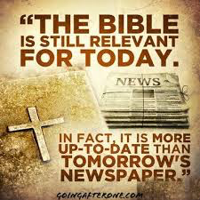
(12)
三。相信圣经。3. Believe the Bible.
C。相信圣经是与我们相关的。 你对圣经与我们相关有什么看法？ 教义＃3:“于教训，督责，使人归正，教导人学义，都是有益的。叫属神的人得以完全，预备行各样的善事”(提后3:16b-17)。
D。相信圣经是真实的。 你对圣经真理的信仰是什么？ 教义＃4: “求你用真理使他们成圣。你的道就是真理”(约17:17)。
E。相信圣经是永恒的。 你对圣经的永恒有什么看法？ 教义＃5: “耶和华阿，你的话安定在天，直到永远”(诗119:89)。
C. Believe the Bible is relevant. What is your belief about Bible relevancy? Doctrine #3: “And is useful for teaching, rebuking, correcting and training in righteousness, so that the servant of God may be thoroughly equipped for every good work”(2Tim.3:16b-17).
D. Believe the Bible is true. What is your belief about
Bible truth? Doctrine #4:“Sanctify them by the truth;your
word is truth”(Jn17:17)
E. Believe the Bible is eternal. What is your belief about
eternality of Bible? Doctrine #5:“Your word,Lord,is eternal;
it stands firm in the heavens”(Ps119:89).

Slide 15

(14)
二。讲圣经。4. Preach the Bible.
“但帖撒罗尼迦的犹太人，知道保罗又在庇哩亚传神的道，也就往那里去，耸动搅扰众人”(17:13)。“那些分散的人，往各处去传道”(8:4)。
“But when the Jews in Thessalonica learned that Paul was preaching the word of God at Berea,some of them went there too,agitating the crowds and stirring them up”(Ac17:13).“Those who had been scattered
preached the word
wherever they went” (8:4).

Slide 16
(15)
五。教导圣经。5. Teach the Bible.
“当时弟兄们便打发保罗往海边去。西拉和提摩太仍住在庇哩亚。送保罗的人带他到了雅典。既领了保罗的命，叫西拉和提摩太速速到他这里来，就回去了”(17:14-15)。
A。老师教导。“然而主的仆人不可争竞，只要温温和和的待众人，善于教导…”(提后2:24)。
B。长老/牧师教导。“作监督的，必须无可指责… 善于教导”(提前3:2)。“有牧师和教师”(弗4:11)。
“The believers immediately sent Paul to the coast, but Silas and Timothy stayed at Berea. Those who escorted Paul brought him to Athens and then left with instructions for Silas and Timothy to join him as soon as possible”(Ac.17:14-15). A.Teachers teach. “And the Lord’s servant must not be quarrelsome but must be kind to everyone, able to teach…”(2Tim.2:24).
B.Elders/Pastors teach. “Overseer is to be above reproach… able to teach…”
(1Tim.3:2). “The pastors and teachers”(Eph.4:11).

Slide 17

(16)
结论：Conclusion:
为什么贝雷亚人更高贵？ 因为他们接受，研究，相信，传讲和教导圣经。 你是圣经基督徒吗？ 我们是圣经教会吗？ 圣经在你的日常生活中占什么地位？ 圣经在教会中有什么部分？
Why were those in Berea more noble? Because they received, studied, believed, preached, and taught the Bible. Are you a Bible Christian? Are we a Bible Church? What part does the Bible have in your daily life? What part does the Bible have in the church?

Slide 18
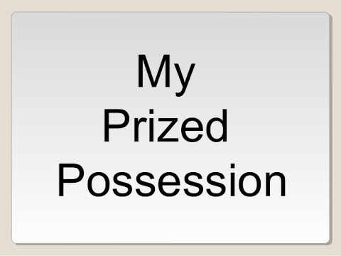
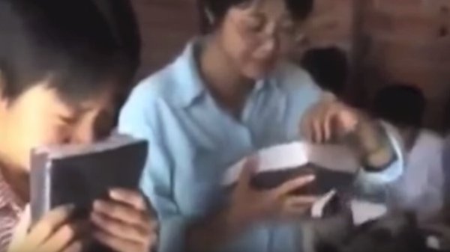
(17)
结论：Conclusion:
讲述圣经在中国的真实故事。
我最珍贵的财产是...
Tell the true story of the Bible in China.
My most prized possession is…
圣经，因为它告诉我如何被拯救和如何生活。
Bible, because it tells me how to be saved and live.
https://www.youtube.com/watch?v=CkXDcdMNE-I

