Slide 1
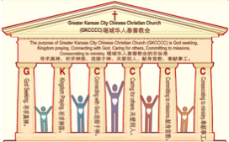
主日:二零一七年五月二十八日
Sunday: May 28, 2017
何礼义牧师 Pastor Gary Hart
题目：“多元文化的教会 。”
Topic: “Multicultural Church.”
经文:使徒行传10:1-48
“在该撒利亚有一个人，名叫哥尼流…”(徒10:1)。
Text: Acts 10:1-48
“At Caesarea there was a man named Cornelius …”(Acts 10:1).
(1)

Slide 2
引言:A。使徒行传的信息。 Intro: A.Message of Acts of the Apostles.
(2)
(一)基督建造祂的教会（基督的灵借着使徒在作工）。
(二)使徒行传是圣灵的指挥,控制和赋权的事工,创立和加强了教会，并使它成长。
(三)使徒行传是一个过渡时期:从耶稣的事工到使徒的;从旧约到新约;从以色列作神的见证到教会作神的见证;从犹太教出来, 教会诞生了。
(四)使徒行传显示大使命得以遵行(1:8)从证人到耶路撒冷(1-8),到犹太和撒玛利亚(8-12)并到地极(13-28)。
(五)圣灵将继续在教会作工，书写使徒行传28章(加上）。
(1)Christ builds His Church(the Acts of the Spirit of Christ through the Apostles). (2)The Acts were the Spirit’s directing, controlling, and empowering ministry that founded and strengthened the church and caused it to grow.
(3)The Acts is a time of transitions: from ministry of Jesus to that of the apostles; from the Old Covenant to the New Covenant; from Israel as God’s witness to the Church as God’s witness; from Judaism is going out and Church is coming in.
(4)The Acts show the fulfillment of the Great Commission(1:8) from the witness to Jerusalem(1-8), to Judea and Samaria(8-12), and to the ends of earth(13-28).
(5)The Acts are the continuing Acts of the Spirit in Churches in 28 chapters(plus).

Slide 3
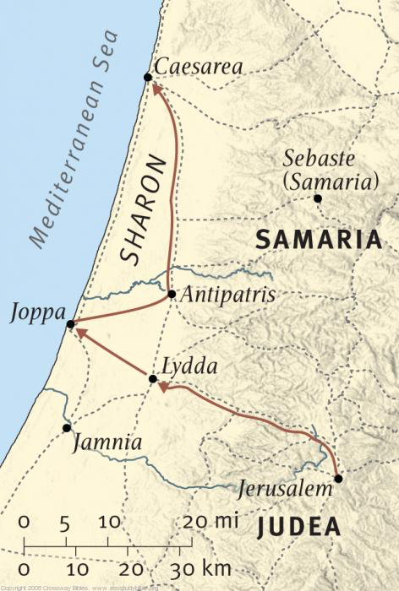
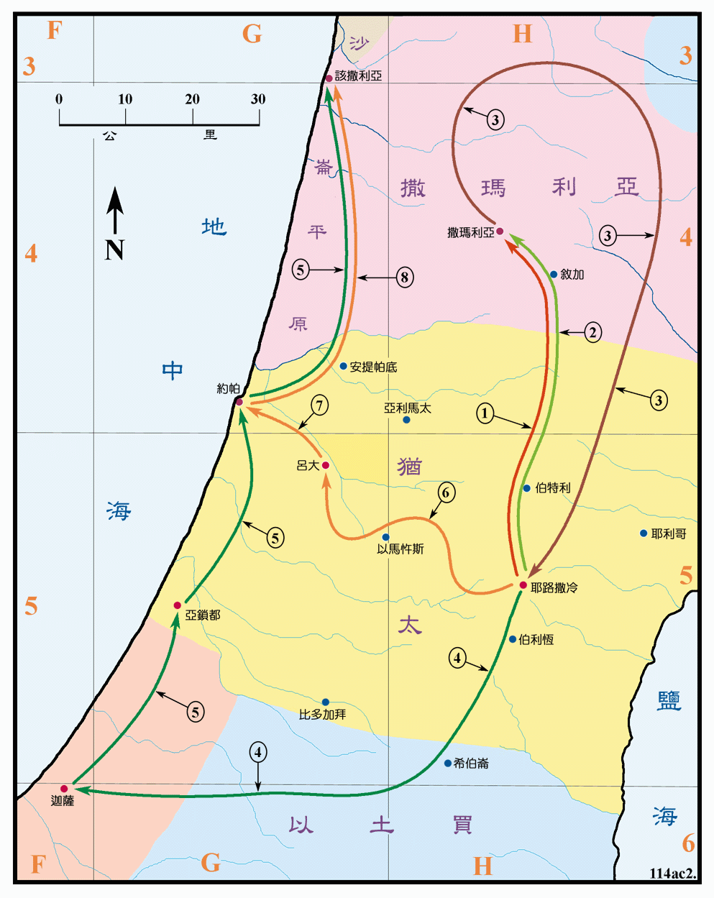
B。该撒利亚的地理位置。
B. Caesarea location.
(3)

Slide 4
C。该撒利亚的历史背景。C.Caesarea historical background.
(一)该撒利亚城也被称为海边的该撒利亚； 撒马利亚，巴勒斯坦和犹太的该撒利亚。 它是位于约帕以北30英里的港口城市。 它是由希律王大帝建造的（30BC），后来成为罗马犹太的首都。
(二)该撒利亚教会是由腓利创立的（8:40；21:8）。
(三)该撒利亚教会代表“多元文化”的教会。
(四)该撒利亚被起名为尤利乌斯该撒。 它有一座为该撒建造的庙。
最初，该撒是罗马帝国创始人的家族姓氏，他的继承人为了纪念该撒，用他的姓氏作头衔。该撒是权威的象征(太22：21)。
(1) Caesarea city is also known as Caesarea-on-the Sea(Maritima); Caesarea of Samaria,Palestine,and Judea. It was a port city 30 miles north of Joppa. It was founded(30BC)by Herod the Great and later became the capital of Roman Judea.
(2) Caesarea church was founded by Philip (8:40:21:8).
(3) Caesarea church represents the “multicultural” church.
(4) Caesarea was named for Julius Caesar. It had a temple which was built for Caesar. Originally, Caesar was the family name of the founder of the Roman Empire.His successors kept Caesar’s memory alive,and his name came to be used as a title.Caesar is a symbol for authority(Mt.22:21).
(4)

Slide 5
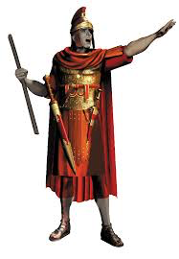
(5)
一。基督之灵的称许。1. Spirit of Christ’s commendation.
“在该撒利亚有一个人，名叫哥尼流…”（10:1a）。
A。公告。 他被起名为哥尼流（“喇叭”）。当哥尼流·苏拉解放了约10,000名奴隶时，一个拉丁名字受到欢迎。
B。权威。 他是一个百夫长，罗马军队的指挥官至少有100名男子。 罗马军团（约6 000人）分为十个团，每个团都有一个名称。这是意大利军团（10：1b）。 百夫长被精心挑选; 所有在新约提到的都似乎有高贵的品质(太8:5-13;路7:1-10;可15:39;徒27:3;10:1-48)。
“At Caesarea there was a man named Cornelius…”(10:1a).
A. Announcement. He was named Cornelius(“horn.”) A Latin name made popular when Cornelius Sulla liberated some 10,000 slaves.
B. Authority. He was a centurion, a commander in the Roman army in command of at least 100 men. The Roman legion (about 6,000 men) was divided into ten regiments,each of which had a designation.This was of the Italian Regiment (10: 1b). Centurions were carefully selected; all of them mentioned in the NT appear to have had noble qualities(Mt.8:5-13;Lk.7:1-10;Mk.15:39;Ac.27:3; 10:1-48).

Slide 6
一。基督之灵的称许。1. Spirit of Christ’s commendation.
(6)
C。克服障碍。 他是外邦人，不是犹太人(10:28).从犹太人的角度来看，外邦人经常被视为不认识真神的异教徒。 在耶稣的时候，许多犹太人对他们的文化和宗教遗产感到自豪，他们认为外邦人“不洁净”，称他们为“狗”，“未受割礼”。外邦人和半异教徒的撒马利亚人被认为是要避免的敌人(约 4:9; 18: 28).中国人叫外国人:“洋鬼子”,“鬼子”还是“老外”？
D。性格。 “他是个虔诚人，他和全家都敬畏神，多多周济百姓，常常祷告神”（10:2）。
C. Overcome obstacle. He was a Gentile, not a Jew(10:28). From the Jewish perspective, Gentiles were often seen as pagans who did not know the true God. During Jesus’ time,many Jews took such pride in their cultural and religious heritage that they considered Gentiles “unclean,” calling them “dogs” and “uncir-cumcision.” Gentiles and the half-Gentile Samaritans were viewed as enemies to be shunned (Jn.4:9;18:28).What do Chinese call foreigners: “foreign devils”(洋鬼子), “sons of demons”(鬼子) or “old outsiders”(老外)?
D. Character. “He and all his family were devout and God-fearing; he gave generously to those in need and prayed to God regularly” (10:2).

Slide 7
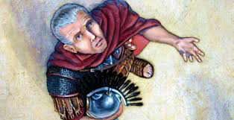
一。基督之灵的称许。1. Spirit of Christ’s commendation.
(7)
E。异象。“有一天，约在申初，他在异象中明明看见神的一个使者进去，到他那里，说：哥尼流。哥尼流定睛看他，惊怕说：主啊，什么事呢？天使说：你的祷告和你的周济达到神面前，已蒙记念了。现在你当打发人往约帕去，请那称呼彼得的西门来。他住在海边一个硝皮匠西门家里，房子在海边上”(10:3-6)。
F。行动。“向他说话的天使去后，哥尼流叫了两个家人和常伺候他的一个虔诚兵来。把这事都述说给他们听，就打发他们，往约帕去”(10:7-8)。
E. Vision. “One day at about three in the afternoon he had a vision. He distinctly saw an angel of God, who came to him and said, “Cornelius!” Cornelius stared at him in fear. “What is it, Lord?” he asked. The angel answered, “Your prayers and gifts to the poor have come up as a memorial offering before God. Now send men to Joppa to bring back a man named Simon who is called Peter. He is staying with Simon the tanner, whose house is by the sea”(10:3-6).
F. Action. “When the angel who spoke to him had gone,
Cornelius called two of his servants and a devout soldier
who was one of his attendants. He told them everything
that had happened and sent them to Joppa”(10:7-8).

Slide 8
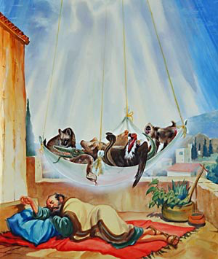
(8)
二。基督之灵的责备。2. Spirit of Christ’s condemnation.
“第二天，他们行路将近那城，彼得约在午正，上房顶去祷告。觉得饿了，想要吃。那家的人正预备饭的时候，彼得魂游象外。看见天开了，有一物降下，好像一块大布。系着四角，缒在地上。里面有地上各样四足的走兽，和昆虫，并天上的飞鸟。又有声音向他说，彼得起来，宰了吃”(10:9-13)。
A。异议。“彼得却说，主阿，这是不可的，凡俗物，和不洁净的物，我从来没有吃过”（10:14）。
B。更正。“第二次有声音向他说，神所洁净的，你不可当作俗物”
(10:15)。
“About noon the following day as they were on their journey and approaching the city, Peter went up on the roof to pray.He became hungry and wanted something to eat,and while the meal was being prepared, he fell into a trance. He saw heaven opened and some-thing like a large sheet being let down to earth by its four corners.It contained all kinds of four-footed animals, as well as reptiles and birds. Then a voice told him, “Get up, Peter. Kill and eat.”(10:9-13).
A. Objection. “Surely not, Lord!” Peter replied. “I have never eaten anything impure or unclean”(10:14).
B. Correction. “The voice spoke to him a second time, “Do not call anything impure that God has made clean”(10:15).

Slide 9
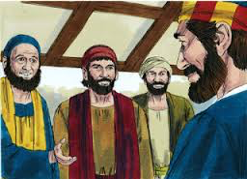
(9)
二。基督之灵的责备。2. Spirit of Christ’s condemnation.
C。重复。“这样一连三次，那物随即收回天上去了”(10:16)。
D。犹豫。“彼得心里正在猜疑之间，不知所看见的异象是什么意思，哥尼流所差来的人，已经访问到西门的家，站在门外，喊着问，有称呼彼得的西门住在这里没有。彼得还思想那异象的时候，圣灵向他说，有三个人来找你。起来，下去，和他们同往，不要疑惑。因为是我差他们来的” (10:17-20)。
C. Repetition. “This happened three times, and immediately the sheet was taken back to heaven”(10:16).
D. Hesitation. “While Peter was wondering about the meaning of the vision, the men sent by Cornelius found out where Simon’s house was and stopped at the gate. They called out, asking if Simon who was known as Peter was staying there.While Peter was still thinking about the vision,
the Spirit said to him,Simon, three men are looking
for you.So get up and go downstairs.Do not hesitate
to go with them, for I have sent them”(10:17-20).

Slide 10
(10)
二。基督之灵的责备。2. Spirit of Christ’s condemnation.
E。问题。“于是彼得下去见那些人，说，我就是你们所找的人。你们来是为什么缘故”（10:21）。
F。批评。 (一)不好的批评：使徒和在犹太的众弟兄，听说外邦人也领受了神的道。及至彼得上了耶路撒冷，那些奉割礼的门徒和他争辩说，你进入未受割礼之人的家，和他们一同吃饭了(11:1-3)。
(二)好的批评：彼得一进去，哥尼流就迎接他，俯伏在他脚前拜他。彼得却拉他说，你起来，我也是人(10:25-26)。后来保罗批评彼得的虚伪（加2：11-15）。
E. Question. Peter went down and said to the men, “I’m the one you’re looking for. Why have you come?”(10:21).
F.Criticism. (1)Bad criticism:“The apostles and the believers throughout Judea heard that the Gentiles also had received the word of God.So when Peter went up to Jerusalem,the circumcised believers criticized him and said,You went into the house of uncircumcised men and ate with them”(11:1-3).
(2)Good criticism: “As Peter entered the house, Cornelius met him and fell at his feet in reverence. But Peter made him get up. “Stand up,” he said, “I am only a man myself”(10:25-26). Later Paul criticized Peter for his hypocrisy(Gal.2:11-15).

Slide 11
三。基督之灵的忠告。3. Spirit of Christ’s counsel.
(11)
“彼得和他说着话进去，见有好些人在那里聚集，就对他们说，你们知道犹太人，和别国的人亲近来往，本是不合例的”(10:27-28a)。
A。悔悟。“但神已经指示我，无论什么人，都不可看作俗而不洁净的。所以我被请的时候，就不推辞而来。现在请问：你们叫我来有什么意思呢？”（10:28b-29）。
B。启示。“彼得就开口说，我真看出神是不偏待人。原来各国中，那敬畏主行义的人，都为主所悦纳”（10:34-35）。
“While talking with him, Peter went inside and found a large gathering of people. He said to them: “You are well aware that it is against our law for a Jew to associate with or visit a Gentile”(10:27-28a).
A. Conviction. “But God has shown me that I should not call anyone impure or unclean. So when I was sent for, I came without raising any objection. May I ask why you sent for me?”(10:28b-29).
B. Revelation. “Then Peter began to speak: I now realize how true it is that God does not show favoritism but accepts from every nation the one who fears him and does what is right”(10:34-35).

Slide 12
三。基督之灵的忠告。3. Spirit of Christ’s counsel.
(12)
C。福传。“神藉着耶稣基督，他是万有的主，传和平的福音…众先知也为他作见证，说：凡信他的人，必因他的名得蒙赦罪”
（10:36-43）。
D。确认。彼得还说这话的时候，圣灵降在一切听道的人身上。那些奉割礼和彼得同来的信徒，见圣灵的恩赐也浇在外邦人身上，就都希奇。因听见他们说方言，称赞神为大。于是彼得说，这些人既受了圣灵，与我们一样，谁能禁止用水给他们施洗呢？(10:44-47)。
C. Evangelization. “You know the message God sent to the people of Israel, announcing the good news of peace through Jesus Christ, who is Lord of all…All the prophets testify about him that everyone who believes in him receives forgiveness of sins through his name”(10:36-43).
D. Confirmation. “While Peter was still speaking these words, the Holy Spirit came on all who heard the message. The circumcised believers who had come with Peter were astonished that the gift of the Holy Spirit had been poured out even on Gentiles.For they heard them speaking in tongues and praising God. Then Peter said, “Surely no one can stand in the way of their being baptized with water. They have received the Holy Spirit just as we have”(10:44-47).

Slide 13
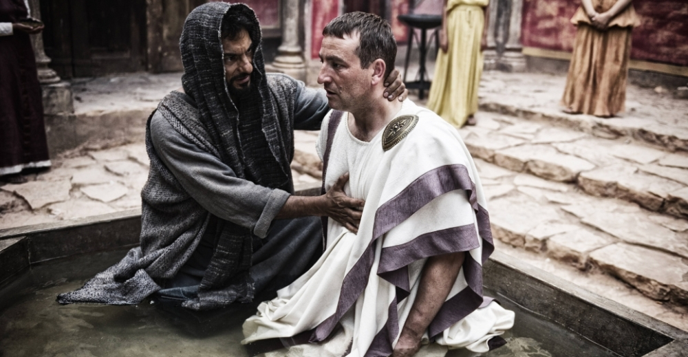
三。基督之灵的忠告。3. Spirit of Christ’s counsel.
(13)
E。鉴定。“就吩咐奉耶稣基督的名给他们施洗”（10:48a;11:15-18）。
F。指令。“他们又请彼得住了几天”（10:48b）。
E. Identification. So he ordered that they be baptized in the name of Jesus Christ”(10:48a;11:15-18).
F. Instruction.“Then they asked Peter to stay with them for a few days”(10:48b).

Slide 14
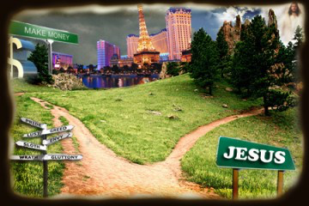
(14)
四。基督之灵的挑战。4. Spirit of Christ’s challenge.
“所以我立时打发人去请你…”(10:33a)。
A。使命。“你来了很好”(10:33b)。
B。指令。“现今我们都在神面前，要听主所吩咐你的一切话”
（10:33c）。
C。解释。“众人听见这话，就不言语了”（11:18a)。
“So I sent for you immediately...”(10:33a).
A. Commission. “It was good of you to come”(10:33b).
B. Instruction. “Now we are all here in the presence of God to listen to everything the Lord has commanded you to tell us”(10:33c).
C. Explanation. “When they heard this, they had no further objections”(11:18a).

Slide 15
(15)
四。基督之灵的挑战。4. Spirit of Christ’s challenge.
D。高举神。 “只归荣耀与神，说：这样看来，神也赐恩给外邦人，叫他们悔改得生命了”(11:18b)。
E。广泛的。 救恩甚至包括外邦人(赛49:6；路2:32)。
F。唯独的。 救恩只能藉着耶稣(约14:6；徒4:10)。
D. Exaltation. “And praised God, saying, So then, even to Gentiles God has granted repentance that leads to life”(11:18b).
E. Inclusive. Salvation is even to Gentiles(Isa.49:6;Lk.2:32).
F. Exclusive. Salvation is only through Jesus(Jn.14:6;Ac.4:10).

Slide 16
(16)
结论：Conclusion:
“该撒利亚犹太人的教会”成为了“该撒利亚犹太人和外邦人的教会”。 它成为一个“多元文化”的教会，因为他们认识到上帝不偏袒人，而是接纳每个敬畏他行正义的国家。 大使命是“你们要去使万民作我的门徒”(太28: 19)。 在天堂有人“从各族，各方，各民，各国中” (启5:9; 7:9)。
“Caesarea Jewish Church” became ”Caesarea Jewish and Gentile Church”. It became a “Multicultural” Church, because they realized how true it is that God does not show favoritism but accepts from every nation the one who fears him and does what is right. The Great Commission is “Go and make disciples of all nations”(Mt.28:19). In heaven there will be “persons from every tribe and language and people and nation”(Rev.5:9;7:9).

