Slide 1
堪城华人基督教会2017年教会祷告:GKCCCC2017 Congregation Prayer:
请站起来，跟我一起祷告：神啊，…
我们感谢您因您是我们的父也因着信心我们是您的家人。
我们感谢您因基督是我们的头也因着恩典我们是基督的身体。
我们感谢您因圣灵是我们的恩膏也因着祂的能力我们活着。
我们感谢您因圣经是您的书也因着灵感我们有神的话。
我们祈求您恩膏和打开我们的耳朵因着可以听神的话。
我们祈求您恩膏和打开我们的眼睛因着可以明白神的话。
我们祈求您恩膏和打开我们的心因着可以接受神的话。
我们祈求您恩膏和改变我们的思想因着可以跟从神的旨意。
我们祈求您恩膏和用我们的手因着可以照着神的旨意而做。
我们祈求您恩膏和用我们的脚因着可以在神的旨意上行走。
我们祈求您恩膏和使用您的仆人因着他能向我们表达您的信息。
我们祈求您恩膏和帮助您的教会寻求真神，祈求神国，连接于神，关爱别人，献身宣教，奉献事工。我们奉耶稣的名祷告，阿们。

Slide 2
堪城华人基督教会2017年教会祷告:GKCCCC2017 Congregation Prayer:
Please stand, and pray together with me: O God,…
We thank You that You are our Father and by faith we are God’s family.
We thank You that Christ is our Head and by grace we are Christ’s body.
We thank You that the Holy Spirit is our Anointing, by His power we live.
We thank You the Bible is Your Book, by inspiration we have God’s Word.
We ask You to anoint and open our ears to hear God’s Word.
We ask You to anoint and open our eyes to understand God’s Word.
We ask You to anoint and open our hearts to receive God’s Word.
We ask You to anoint and change our minds to follow God’s will.
We ask You to anoint and use our hands to do God’s will.
We ask You to anoint and use our feet to walk in God’s will.
We ask You to anoint and speak Your message through Your servant.
We ask You to anoint and help Your church to be God seeking, Kingdom praying, Connecting with God, Caring for others, Committing to missions, Consecrating to ministry. We pray in Jesus name, Amen.

Slide 3

主日：二零一七年一月八日
Sunday: January 8, 2017
何礼义牧师 Pastor Gary Hart
题目：“基督要建造他的教会 。”
Topic: “Christ will build His Church.”
经文:马太福音16:18“我还告诉你，你是彼得，我要把我的教会建造在这磐石上，阴间的权柄，不能胜过他。”
Text:Mt.16:18 “And I tell you that you are Peter, and on this rock I will build my church, and the gates of Hades will not overcome it.”
(1)

Slide 4
引言：历史背景。
Intro: Historical Background.
在马太福音16章，我们看到四种
信心程度和它们跟基督的关系。
(一)没有信心－试探基督（16:1-4）。
(二)小信心－不明白基督（16:5-12）。
(三)得救信心－承认基督（16:13-20）。
(四)服事信心－跟随基督（16:21-28）。
In Matthew 16, we see four levels
of faith and how they relate to Christ.
(1)No faith—Tempting Christ(16:1-4).
(2)Little faith—Misunderstanding Christ(16:5-12).
(3)Saving faith—Confessing Christ(16:13-20).(4)Serving faith—Following Christ(16:21-28).
(2)

Slide 5
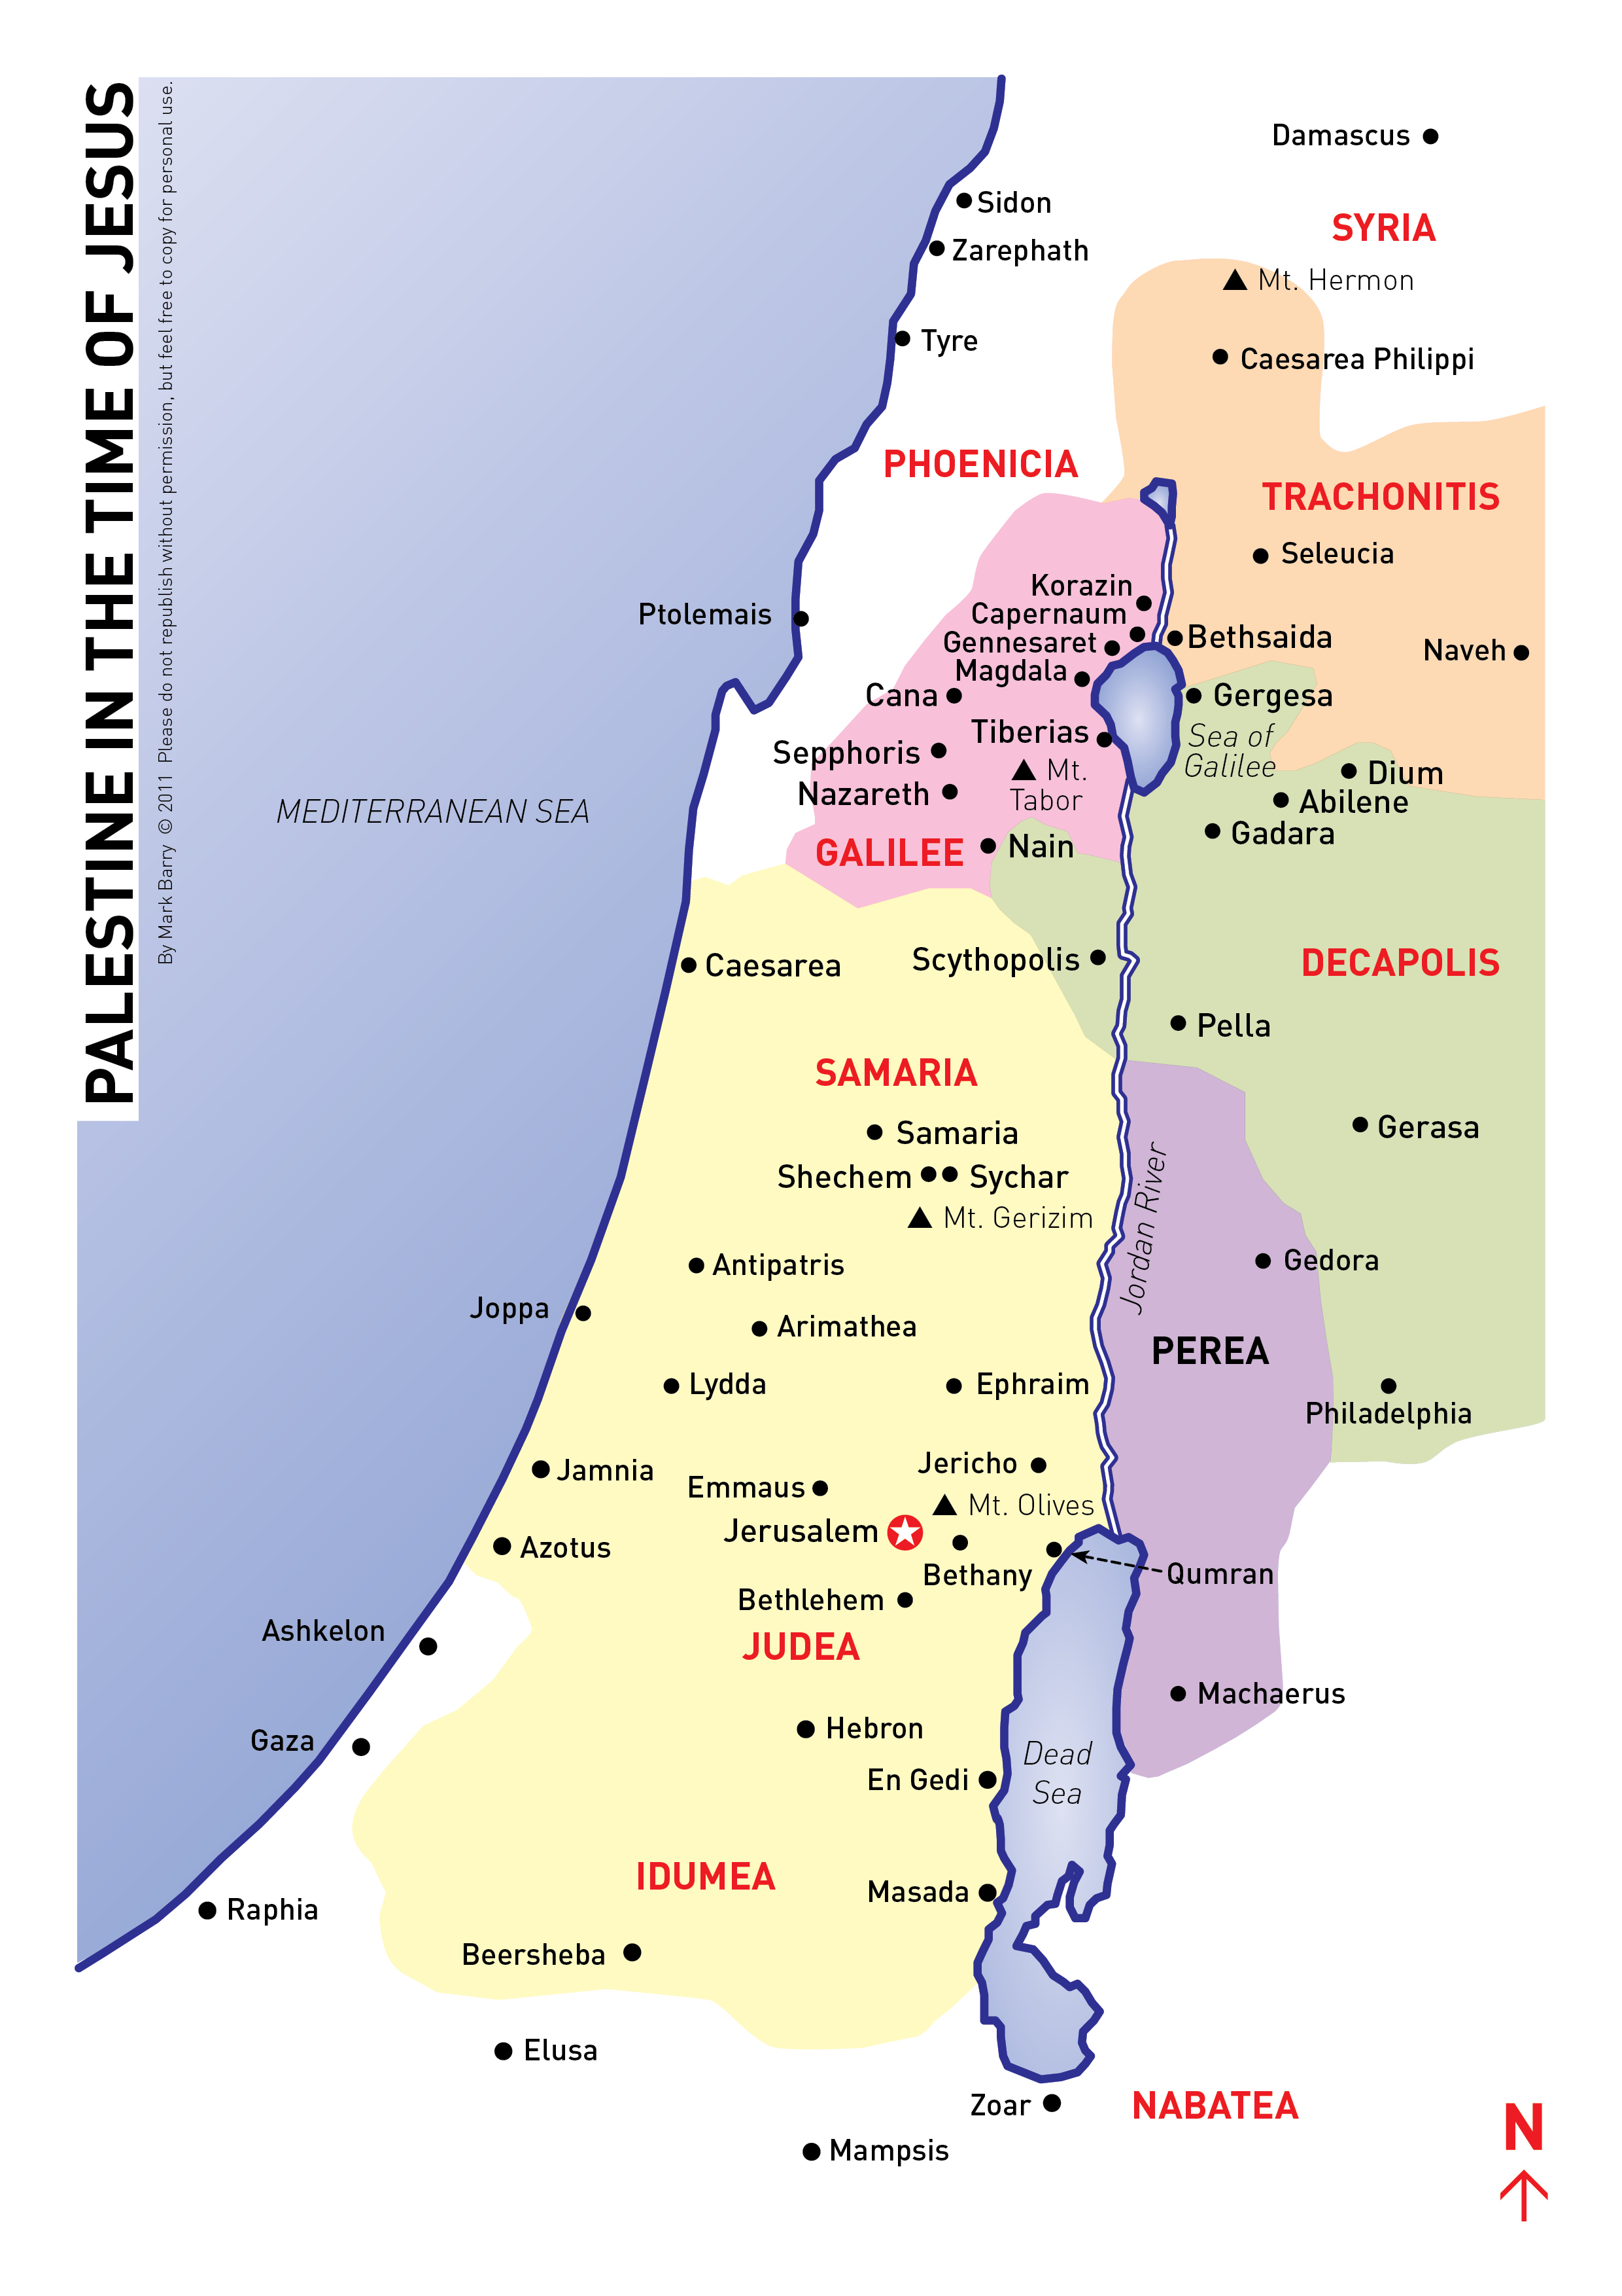
引言：历史背景。
Intro: Historical Background.
黑门山
该撒利亚腓立比
大海
（地中海）
该撒利亚
北

Slide 6
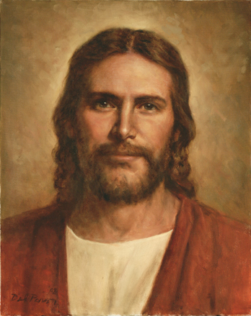
1. 我＝基督。耶稣问他的门徒两个问题。对的主耶稣基督的承认是得救的根基（罗10:9-10）。
1. I=Christ. Jesus asked his disciples two questions. A right con-fession of the Lord Jesus Christ is basic to salvation(Rom.10:9-10).
A. “人说我人子是谁?”
(一) “有人说是施洗的约翰。”(可6:14)
(二) “有人说是以利亚。”(可6:15；马拉基书4:5)
(三) “又有人说是耶利米。”耶利米是爱哭先知。
(四) “先知里的一位。”不能用人投票来决定耶稣是谁。
应用：今天人说耶稣是谁？（林后11:3-4）
A. “Who do people say the Son of Man is?”
(1) “Some say John the Baptist.” (Mk.6:14).
(2)“Others say Elijah.” (Mk.6:15;Mal.4:5).
(3) “Others, Jeremiah.” Jeremiah was weeping prophet.
(4) “One of the prophets.” Can’t decide who Jesus is by people poll.
Application: Today who do people say Jesus is? (2Co.11:3-4)
(3)

Slide 7
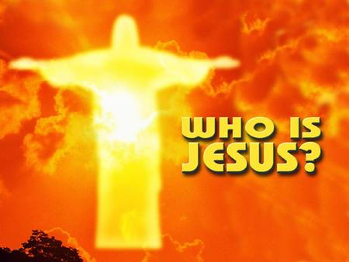
我＝基督。耶稣问他的门徒两个问题。
1. I=Christ. Jesus asked his disciples two questions.
B. “你们说我是谁?”（彼得有什么反应？）
(一) “你是基督(弥赛亚)。”
(二) “是永生神的儿子。”
(三) “因为这…是我在天上的父指示的。”
(四) “你是彼得(石头),我要把我的教会建造在这磐石上。”
应用：今天你说耶稣是谁？
B. “Who do you say I am?” (What was Peter’s response?)
“You are the Messiah(the Christ).”
(2) “The Son of the living God.”
(3) “For this was revealed to you…by my Father in heaven.”
(4) “You are Peter (petros=stone), and on this rock
(petra=large rock,bedrock) I will build my church.”
Application: Today who do you say that Jesus is?
(4)

Slide 8
2. 要＝应许。基督答应做…。
2. Will=Promise. Christ promised to be…
A。基督是教会建造的根基磐石。
（一）旧约先知（诗篇118:22；以赛亚28:16）。
（二）耶稣自己（马太福音21:42）。
（三）彼得（使徒行转4:10-12）。
（四）保罗（林前3:11）。
B。基督是教会之首（以弗所书1:22；歌罗西书1:18）。
应用：今天这个应许对你有什么意义？
A. Christ is the foundation rock on which the church is built.
(1) The OT prophets (Ps.118:22;Isa.28:16).
(2) Jesus Himself (Mt.21:42).
(3) Peter (Ac.4:10-12).
(4) Paul (1 Cor.3:11).
B. Christ is the head of the Church (Eph.1:22; Col.1:18).
Application: Today what does this promise mean to you?
(5)

Slide 9

3. 建造＝门徒训练。耶稣告诉两种生命态度。
3. Build=Discipleship. Jesus told about two approaches to life.
A. 舍己或者为自己活。
B. 背起你的十字架或者不管十字架。
C. 来跟从基督或者跟从世界。
D. 为他丧掉你的生命或者为自己救你的生命。
E. 放弃世界或者赚得世界。
F. 得着生命或者丧掉生命。
G. 享受奖赏和荣耀或者丧掉奖赏和荣耀。
应用：今天门徒训练对你有什么意义？
Deny yourself or live for yourself.
B. Take up your cross or ignore the cross.
C. Follow Christ or follow the world.
D. Lose your life for His sake or save your life for you own sake.
E. Forsake the world or gain the world. F. Keep your soul or lose your soul.
G. Share His reward and glory or lose His reward and glory.
Application: Today what does discipleship mean to you?
(6)

Slide 10

4. 我的＝关系。我们跟…有属灵的关系。
4. My=Relationship. We have a spiritual relationship with…
A. 圣父（约翰福音1:12）。
B. 圣子（启示录3:20）。
C. 圣灵（约翰福音14:16-17）。
D. 神的话（约翰福音8:31）。
E. 神的教会（希伯来书10:25）。
应用：今天属灵的关系对你有什么意义？
A. God the Father (Jn.1:12).
B. God the Son (Rev.3:20).
C. God the Holy Spirit (Jn.14:16-17).
D. God’s Word (Jn.8:31).
E. God’s Church (Heb.10:25).
Application: Today what does spiritual relationship mean to you?
(7)

Slide 11
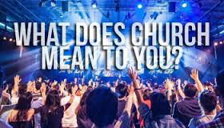
5. 教会＝团体。希腊文(ekklesia)英文(ecclesiastical)。
5. Church=Community. Greek (ekklesia) English (ecclesiastical).
A. 一个“被呼召聚会。”
B. 一个地方教会（聚会）。
C. 一个普世教会（基督的身体）。
D. 一个希腊民主聚会（使徒行传19:32，39，41）。
E. 一个犹太聚会为了宗教活动的结合（申命记31:30）。
应用：今天教会对你有什么意义？
A. “A called-out assembly.”
B. A local church (assembly).
C. A universal church (body of Christ).
D. A popular assembly of Greek citizens (Ac.19:32,39,41).
E. A Jewish assembly gathered for religious activity (Deut.31:30).
Application: Today what does church mean to you?
(8)

Slide 12

结论：“阴间的权柄，不能胜过他。”
Conclusion: “And the gates of Hades will not overcome it.”
这个象征是死亡和撒旦的能力。接着他的死亡和复活，基督胜过死亡，所以死亡不能抓住他的人。记得“我要建造我的教会”的意思就是基督应许门徒训练，关系和团体。我们也要跟从他对教会的目标。
应用：今天信心对你有什么意义？什么是“承认真理”？你相信什么？
This would symbolize the organized power of death and Satan.By His death and resurrection, Christ would conquer death, so that death would not be able to hold any of His people. Remember “I will build my church” means that Christ Promises Discipleship, Relationship, and Community. We are also to follow His purposes for His Church. Application: Today what does faith mean to you?
What is “Truth confessed”? What do you believe?
(9)

Slide 13
堪城华人基督教会的信仰宣告：
圣经都是神所默示，永远旨意完整启示。
圣父圣子圣灵是神，三一真神永恒独一。
我主耶稣祂是基督，祂是永生神的儿子。
道成肉身受死埋葬，复活升天主必再来。
教会是永生神的家，基督身体羔羊新妇。
Faith Statement of GKCCCC:
The Bible is the inspired word of God,
the complete revelation of His eternal will.
God the Father,the Son and the Holy Spirit,is the triune only true God.
Jesus is Christ and Lord, He is the Son of the Eternal God.
Word became flesh, died, was buried, and resurrected.
He ascended to Heaven and will return again.
The church is the house of the Living God,
the body of Christ, and the bride of the Lamb.
http://www.gkcccc.org/openchurch/gkcccc_home
(10)

Slide 14
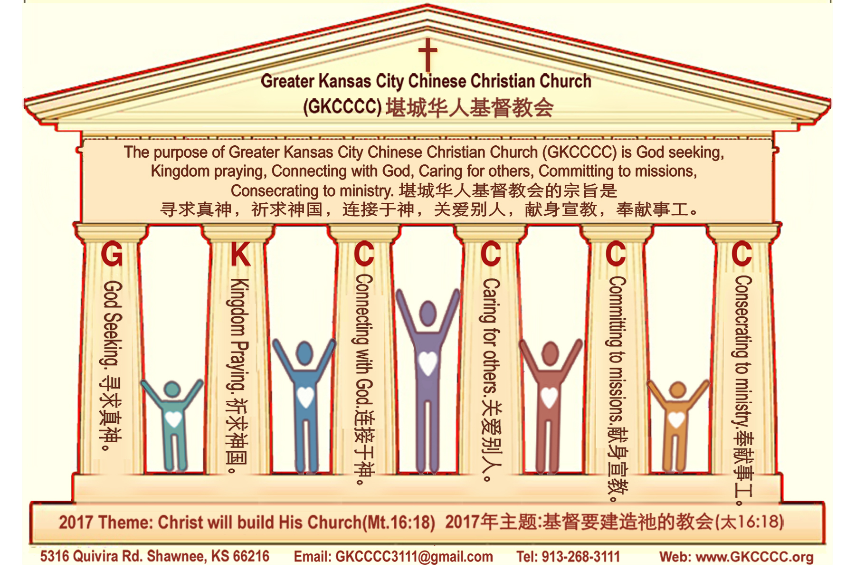
(11)
堪城华人基督教会的宗旨是
寻求真神，祈求神国，连接于神，
关爱别人，献身宣教，奉献事工。
Purpose Statement of
Greater Kansas City Chinese Christian Church (GKCCCC) is
God seeking, Kingdom praying, Connecting with God,
Caring for others, Committing to missions, Consecrating to ministry.

