Slide 1
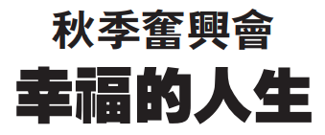




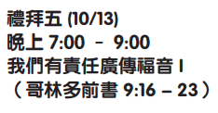
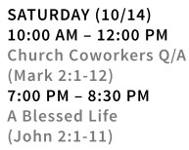
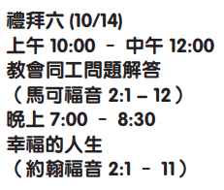
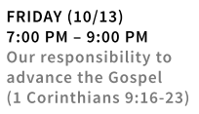

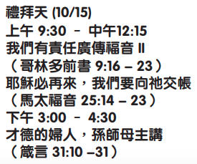

孙约翰牧师 Pastor John Sun

Slide 2
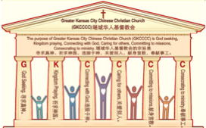

主日:二零一七年十月八日
Sunday: October 8, 2017
何礼义牧师 Pastor Gary Hart
题目：“世俗的教会。”
Topic: “Worldly Church.”
经文:徒18:1-17 Text: Acts 18:1-17
“这事以后，保罗离了雅典，来到哥林多”
(徒18:1)。“After this, Paul left Athens and went to Corinth”(18:1).
(1)

Slide 3
引言:A。使徒行传的信息。 Intro: A.Message of Acts of the Apostles.
(2)
(一)基督建造祂的教会（基督的灵借着使徒在作工）。
(二)使徒行传是圣灵的指挥,控制和赋权的事工,创立和加强了教会，并使它成长。
(三)使徒行传是一个过渡时期:从耶稣的事工到使徒的;从旧约到新约;从以色列作神的见证到教会作神的见证;从犹太教出来, 教会诞生了。
(四)使徒行传显示大使命得以遵行(1:8)从证人到耶路撒冷(1-8),到犹太和撒玛利亚(8-12)并到地极(13-28)。
(五)保罗继续了他的第二次传教旅程。
(1)Christ builds His Church(the Acts of the Spirit of Christ through the Apostles). (2)The Acts were the Spirit’s directing, controlling, and empowering ministry that founded and strengthened the church and caused it to grow.
(3)The Acts is a time of transitions: from ministry of Jesus to that of the apostles; from the Old Covenant to the New Covenant; from Israel as God’s witness to the Church as God’s witness; from Judaism is going out and Church is coming in.
(4)The Acts show the fulfillment of the Great Commission(1:8) from the witness to Jerusalem(1-8), to Judea and Samaria(8-12), and to the ends of earth(13-28).
(5) Paul continues his second missionary journey.

Slide 4
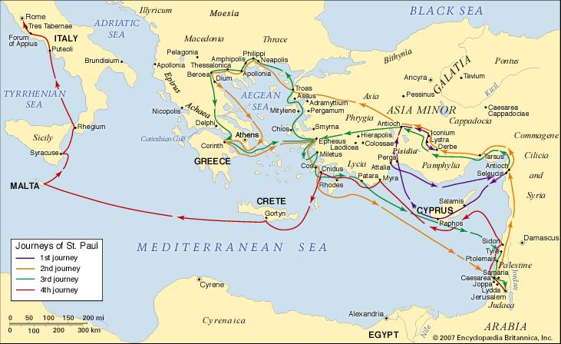
B。哥林多的地理位置。B. Corinth location.
(3)

Slide 5
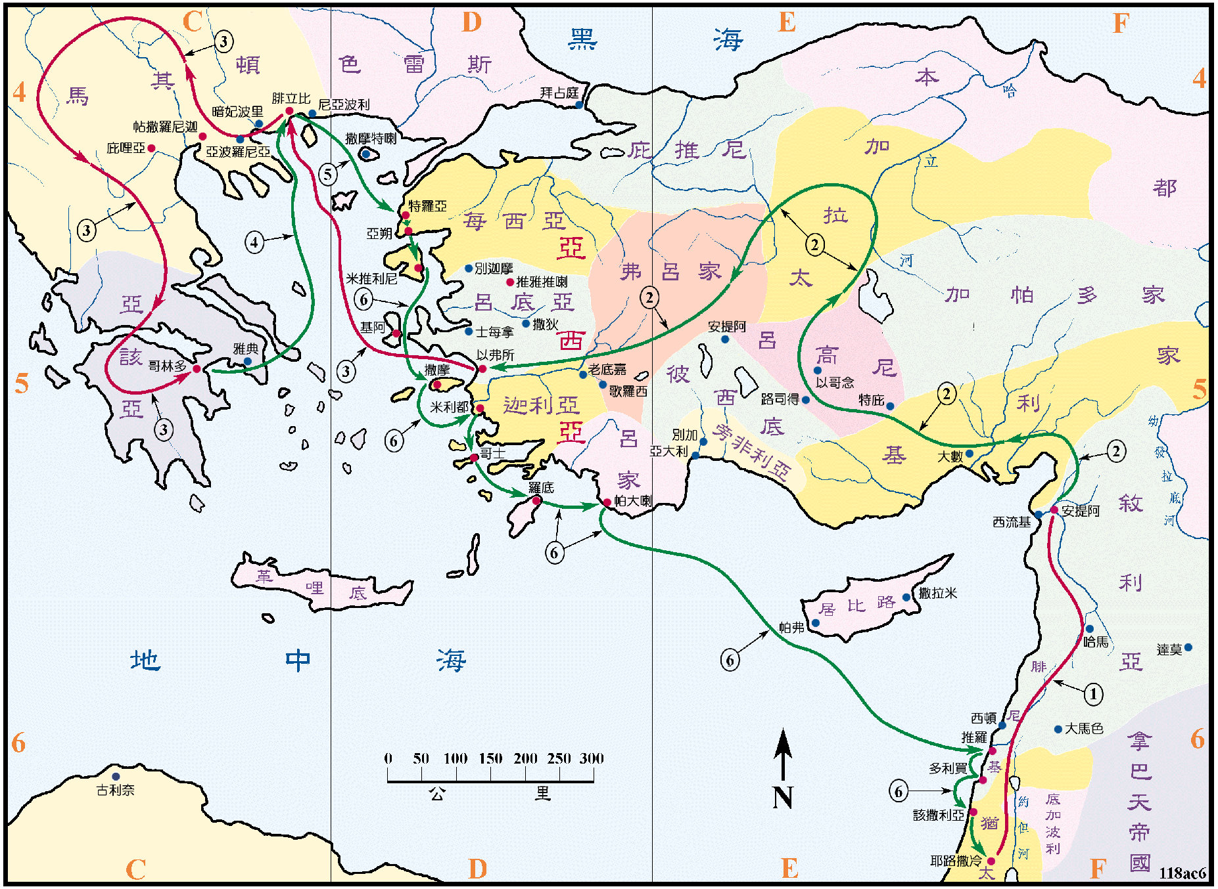
B。哥林多的地理位置。B. Corinth location.
(4)

Slide 6
C。哥林多的历史背景。C. Corinth historical background.
(5)
(1)哥林多是阿夏亚的首府，是贸易和旅游的中心。他们崇拜希腊的性女神，阿芙罗狄蒂。 这个城市道德沦丧。(2)哥林多教会是由保罗创立的。(3)哥林多教会代表“世俗的教会”。“弟兄们，我从前对你们说话，不能把你们当作属灵的，只得把你们当作属肉体，在基督里为婴孩的。我是用奶喂你们，没有用饭喂你们。那时你们不能吃，就是如今还是不能。你们仍是属肉体的。因为在你们中间有嫉妒分争，这岂不是属乎肉体，照着世人的样子行吗？”（林前3:1-3）。(4)哥林多意思是“装饰，美”。
(1)Corinth was capital of Achaia and the center of trade and travel.They worship the Greek goddess of sex, Aphrodite. The city was given over to immorality. (2) Corinth church was founded by Paul. (3) Corinth church represents “Worldly Church.” “Brothers and sisters, I could not address you as people who live by the Spirit but as people who are still worldly—mere infants in Christ. I gave you milk, not solid food, for you were not yet ready for it. Indeed, you are still not ready.You are still worldly. For since there is jealousy and quarreling among you, are you not worldly?Are you not acting like mere humans?”(1Cor.3:1-3). (4)Corinth means “ornament, beauty”

Slide 7
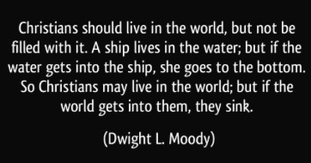
C。哥林多的历史背景。C. Corinth historical background.
(6)
教会与世界的关系应该是什么？ “我不求你叫他们离开世界，只求你保守他们脱离那恶者。他们不属世界，正如我不属世界一样。求你用真理使他们成圣。你的道就是真理。你怎样差我到世上，我也照样差他们到世上”(约17:15-18)。 所以基督徒不属于这个世界，但基督徒被差遣到这个世界上来是为了传讲真理的。
What should be the relationship between the church and the world? “My prayer is not that you take them out of the world but that you protect them from the evil one. They are not of the world, even as I am not of it.Sanctify them by the truth; your word is truth.As you sent me into the world,I have sent them into the world”
(Jn.17:15-18). So Christians do not belong to this world, but Christians are sent into this world with the Word of Truth.
“基督徒应该生活在世界上，但不能充满生机。 一艘船住在水中; 但是如果水进入船，她就到底了。 所以基督徒可以生活在世界上，但如果世界进入他们，他们就会沉没”(Dwight L. Moody)。

Slide 8

一。什么是错的?世俗的(属肉体的)。1. What is wrong?Worldliness.
(7)
“写信给在哥林多神的教会，就是在基督耶稣里成圣，蒙召作圣徒的”(林前1:2)。“你们若属世界，世界必爱属自己的。只因你们不属世界。乃是我从世界中拣选了你们，所以世界就恨你们”(约15:19)。
A。反对。 “他们既抗拒，毁谤…”(徒18:6)。 “因为有宽大又有功效的门，为我开了，并且反对的人也多”(林前16:9)。保罗决心留在哥林多完成他的工作。
“To the church of God in Corinth,to those sanctified in Christ Jesus and called to be his holy people”
(1Cor.1:2). “If you belonged to the world,it would love you as its own. As it is, you do not belong to the world,but I have chosen you out of the world. That is why the world hates you”(Jn.15:19).
A. Opposition. “But when they opposed Paul and became abusive…”(Ac.18:6). “A great door for effective work has opened to me, and there are many who oppose me”(1Cor.16:9).Paul was determined to stay to get the job done in Corinth.

Slide 9
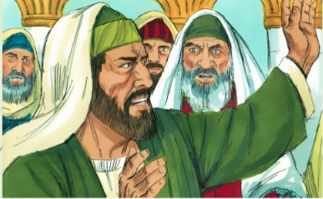
一。什么是错的?世俗的(属肉体的)。1. What is wrong?Worldliness.
(8)
(1)抖衣服，就像洗手一样，是一种判断行为(尼5:13;太10:14;徒13:5)。(2)你手上沾者鲜血意味着你对另一个人的死亡有负责，因为你没有尽忠警告他们。在城墙上的人们。(结3:17-21;33:1-9)。 保罗的手是干净的(徒20:25)，犹太人自己手上沾满了血，因为他们拒绝了神的真理。
(1) To shake one’s garments was an act of judgment like washing their hands of a situation(Neh.5:13;Mt.10:14;Ac.13:5). (2) To have blood on your hands means you bear the responsibility for another’s death because you were not faithful to warn them.Watchmen on the city walls. (Ezek.3:17-21;33:1-9). Paul’s hands were clean(Ac.20:25), but the Jews
had their own blood on their own
hands because they rejected God’s
truth.

Slide 10
一。什么是错的?世俗的(属肉体的)。1. What is wrong?Worldliness.
(9)
B。罪恶。“教训我们除去不敬虔的心，和世俗的情欲，在今世自守，公义，敬虔度日”(多2:12)。 (1)性不道德: “风闻在你们中间有淫乱的事。这样的淫乱，连外邦人中也没有...你们要逃避淫行。人所犯的，无论什么罪，都在身子以外。惟有行淫的，是得罪自己的身子。岂不知你们的身子就是圣灵的殿吗？这圣灵是从神而来，住在你们里头的。并且你们不是自己的人。因为你们是重价买来的”(林前5:1;6:18-20)。(2)诉讼:“你们中间有彼此相争的事，怎敢在不义的人面前求审，不在圣徒面前求审呢？”(林前6:1)。
B. Sin. “It teaches us to say “No” to ungodliness and worldly passions, and to live self-controlled, upright and godly lives in this present age” (Titus2:12). (1)Sexual immorality: “It is reported that there is sexual immorality among you,and of a kind that even pagans do not tolerate…Flee sexual immorality. All other sins a person commits are outside the body, but whoever sins sexually sins against their own body. Do you not know that your bodies are temples of the Holy Spirit,who is in you,whom you have received from God? You are not your own; you were bought at a price. Therefore honor God with your bodies”(1Cor.5:1;6:18-20). (2)Lawsuits: “If any of you has a dispute with another, do you dare to take it before the ungodly for judgment instead of before the Lord’s people?”(6:1).

Slide 11
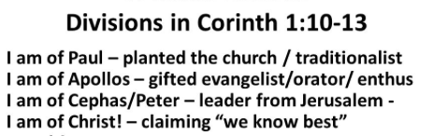

一。什么是错的?世俗的(属肉体的)。1.What is wrong?Worldliness.
(10)
C。困难。(1)分裂。“弟兄们，我借我们主耶稣基督的名，劝你们都说一样的话。你们中间也不可分党。只要一心一意彼此相合”
(1:10)。(2)祭偶像的食物。“论到祭偶像之物... 所以食物若叫我弟兄跌倒，我就永远不吃肉，免得叫我弟兄跌倒了”(8:1,13)。
C. Difficulties. (1)Divisions: “I appeal to you, brothers and sisters, in the name of our Lord Jesus Christ, that all of you agree with one another in what you say and that there be no divisions among you, but that you be perfectly united in mind and thought”(1:10). (2)Food offered to idols. “Now about food sacrificed to idols:…Therefore, if what I eat causes my brother or sister to fall into sin, I will never eat meat again, so that I will not cause them to fall”(8:1,13).

Slide 12

(11)
一。什么是错的?世俗的(属肉体的)。1. What is wrong?Worldliness.
D。问题。(1)关于婚姻:“论到你们信上所提的事…”(7:1)。(2)关于擘饼:“第一，我听说你们聚会的时候，彼此分门别类。我也稍微地信这话。在你们中间不免有分门结党的事，好叫那些有经验的人，显明出来。你们聚会的时候，算不得吃主的晚餐。因为吃的时候，各人先吃自己的饭，甚至这个饥饿，那个酒醉。你们要吃喝，难道没有家吗？还是藐视神的教会，叫那没有的羞愧呢？我向你们可怎么说呢？可因此称赞你们吗？我不称赞”(11:18-22)。
D. Questions. (1)About marriage:“Now for the matters you wrote about…”(7:1). (2)About Lord’s Supper: “I hear that when you come together as a church, there are divisions among you, and to some extent I believe it. No doubt there have to be differences among you to show which of you have God’s approval.So then, when you come together, it is not the Lord’s Supper you eat, for when you are eating, some of you go ahead with your own private suppers. As a result, one person remains hungry and another gets drunk. Don’t you have homes to eat and drink in? Or do you despise the church of God by humiliating those who have nothing? What shall I say to you? Shall I praise you? Certainly not in this matter!”(11:18-22).

Slide 13
(12)
二。什么是正确的?属灵的。2.What is correct?-Spiritualities.
保罗说，“我们行善，不可丧志。若不灰心，到了时候，就要收成”
(加6:9)。
A。助手。(1)亚居拉和百基拉。 “遇见一个犹太人，名叫亚居拉，他生在本都。因为革老丢命犹太人都离开罗马，新近带着妻百基拉，从义大利来。保罗就投奔了他们。他们本是制造帐棚为业。保罗因与他们同业，就和他们同住作工”(徒18:2-3)。(2)西拉和提摩太。“西拉和提摩太从马其顿来的时候，保罗为道迫切，向犹太人证明耶稣是基督”(18:5)。
Paul said, “Let us not become weary in doing good,for at the proper time we will reap a harvest if we do not give up” (Gal.6:9).
A. Helpers. (1) Aquila and Priscilla: They were tentmakers or workers in leather. “There he met a Jew named Aquila, a native of Pontus, who had recently come from Italy with his wife Priscilla, because Claudius had ordered all Jews to leave Rome. Paul went to see them, and because he was a tentmaker as they were, he stayed and worked with them”(Ac.18:2-3). (2)Silas and Timothy: “When Silas and Timothy came from Macedonia, Paul devoted himself exclusively to preaching, testifying to the Jews that Jesus was the Messiah”(18:5).

Slide 14
二。什么是正确的?属灵的。2.What is correct?-Spiritualities.
(13)
B。奉献：“因我所缺乏的，那从马其顿来的弟兄们都补足了。我向来凡事谨守，后来也必谨守，总不至于累着你们”(林后11: 9)。 “你们岂不知为圣事劳碌的，就吃殿中的物吗？伺候祭坛的，就分领坛上的物吗？主也是这样命定，叫传福音的靠着福音养生”(林前9:13-14)。“论到为圣徒捐钱…每逢七日的第一日，各人要照自己的进项抽出来留着。免得我来的时候现凑” (16:1-2)。 “我可以证明他们是按着力量，而且也过了力量，自己甘心乐意的捐助。再三地求我们，准他们在这供给圣徒的恩情上有分。并且他们所作的，不但照我们所想望的，更照神的旨意，先把自己献给主，又归附了我们。” (林后8: 3-5)。
B. Offerings. “For the brothers who came from Macedonia supplied what I needed.I have kept myself from being a burden to you in any way, and will continue to do so”(2Cor.11:9).“Don’t you know that those who serve in the temple get their food from the temple, and that those who serve at the altar share in what is offered on the altar? In the same way, the Lord has commanded that those who preach the gospel should receive their living from the gospel”(1Cor.9:13-14).“Now about the collection for the Lord’s people…On the first day of every week, each one of you should set aside a sum of money in keeping with your income,saving it up,so that when I come no collections will have to be made”(16:1-2). “For I testify that they gave as much as they were able,and even beyond their ability...They gave themselves first of all to the Lord,and then by the will of God also to us”(2Cor.8:3-5).

Slide 15
二。什么是正确的?属灵的。2.What is correct?-Spiritualities.
(14)
C。朋友。(1) “于是离开那里，到了一个人的家中，这人名叫提多犹士都，是敬拜神的，他的家靠近会堂”(徒18:7)。(2) “”(罗16:23)。(3) “管会堂的基利司布和全家都信了主”(徒18:8)。
D。果子。(1)信徒:“还有许多哥林多人听了，就相信受洗”(徒18:8)。(2)门徒:他们受洗和受门徒训练。(3)属灵的恩赐 “论到属灵的恩赐…”(林前12:1)。
E。鼓励。(1) 异象:“夜间主在异象中对保罗说”(徒18:9)。(2) 应许“不要怕，只管讲，不要闭口。有我与你同在，必没有人下手害你。因为在这城里我有许多的百姓”(18:9-10)。
C. Friends. (1) Titius Justus: “Then Paul left the synagogue and went next door to the house of Titius Justus, a worshiper of God”(Ac.18:7). (2) Gaius: “Gaius, whose hospita-lity I and the whole church here enjoy, sends you his greetings” (Ro.16:23). (3) Crispus: “Crispus, the synagogue leader, and his entire household believed in the Lord”(Ac.18:8).
D. Fruit. (1)Believers: “Many of the Corinthians who heard Paul believed and were baptized”(18:8b). (2)Disciples:They were baptized and discipled. (3)Spiritual gifts: “Now about the gifts of the Spirit…”(12:1).
E. Encouragement. (1) Vision: “One night the Lord spoke to Paul in a vision”(18:9a). (2) Promise: “Do not be afraid; keep on speaking, do not be silent. For I am with you, and no one is going to attack and harm you,because I have many people in this city”(18:9-10).

Slide 16
二。什么是正确的?属灵的。2.What is correct?-Spiritualities.
(15)
F。保护。(1)迦流捍卫保罗:“到迦流作亚该亚方伯的时候，犹太人同心起来攻击保罗，拉他到公堂，说，这个人劝人不按着律法敬拜神。保罗刚要开口，迦流就对犹太人说，你们这些犹太人，如果是为冤枉，或奸恶的事，我理当耐性听你们。但所争论的，若是关乎言语，名目，和你们的律法，你们自己去办吧。这样的事我不愿意审问。就把他们撵出公堂。众人便揪住管会堂的所提尼，在堂前打他。这些事迦流都不管”(徒18:12-17)。(2)所提尼:犹太会堂领袖也皈依了(林前1:1)。
F. Protection. (1)Gallio defended Paul: “While Gallio was proconsul of Achaia, the Jews of Corinth made a united attack on Paul and brought him to the place of judgment. “This man,” they charged, “is persuading the people to worship God in ways contrary to the law.”Just as Paul was about to speak, Gallio said to them, “If you Jews were making a complaint about some misde-meanor or serious crime, it would be reasonable for me to listen to you. But since it involves questions about words and names and your own law—settle the matter yourselves. I will not be a judge of such things.” So he drove them off. Then the crowd there turned on Sosthenes the synagogue leader and beat him in front of the proconsul; and Gallio showed no concern what-ever.”(18:12-17). (2)Sosthenes: The Jewish synagogue leader also was converted(1Cor.1:1).

Slide 17

(17)
结论：Conclusion:
哥林多教会允许这个城市的罪进入当地的教会。 哥林多是一个污秽的城市，充满了各种各样的邪恶和世俗的乐趣。 那时对一名男子的最恶劣的指责，就是称他为“哥林多人”。世界已经进入了哥林多教会。 “保罗在那里住了一年零六个月，将神的道教训他们”(雅18:11)。保罗面对反对，罪恶，困难和疑问坚持下来了。 永不放弃！ “坚持不懈的是你厌倦了你已经做的辛苦工作后所做的努力”（Newt Gringrich）。
The Corinthian Church permitted the sins of the city to get into the local church. Corinth was a polluted city, filled with every kind of vice and worldly pleasure. About the lowest accusation you could make against a man in that day would be to call him a “Corinthian.” Worldliness had entered into the Corinthian Church. “So Paul stayed in Corinth for a year and a half, teaching them the word of God”
(Ac.18:11). Paul persevered with opposition, sin, problems, and questions. Never give up!

Slide 18

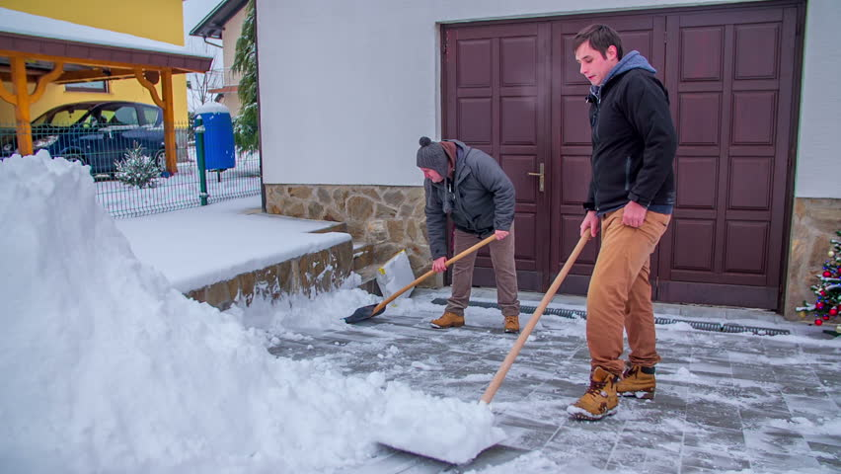
(18)
结论：Conclusion:
(两个男孩铲雪的故事)。“放弃总是嫌太早”(V.Raymond Edman)。
(Story of two boys shoveling snow). “It’s always too soon to quit”(V.Raymond Edman).

