Slide 1
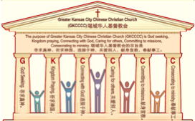

主日:二零一七年十一月十二日
Sunday: November 12, 2017
何礼义牧师 Pastor Gary Hart
题目：“革哩底教会。”
Topic: “Crete Church.”
经文:多1:1-16
Text: Titus 1:1-16
“我从前留你在革哩底，是要…”(多1:5)。
“The reason I left you in Crete was…”(Titus 1:5).
(1)

Slide 2
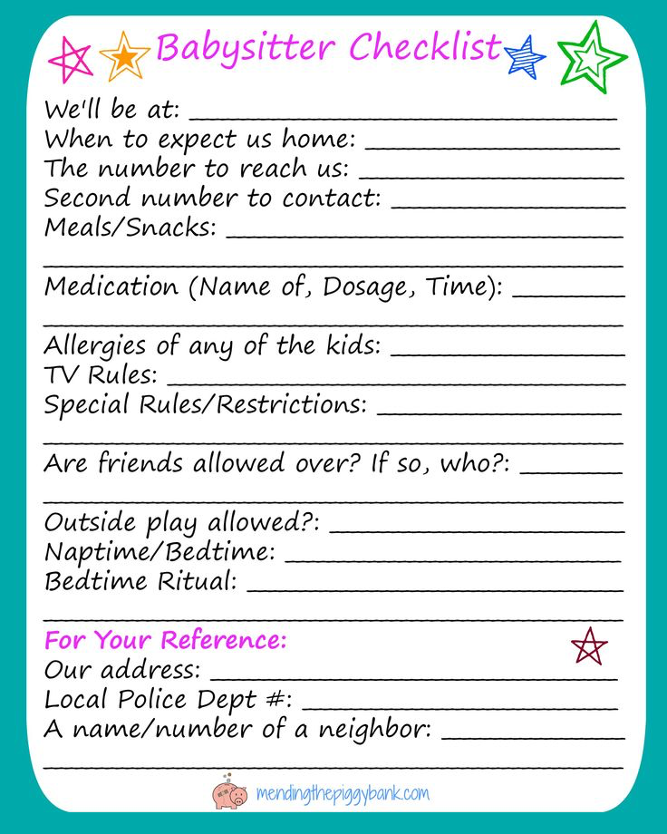

引言:A。给看护者指示。Intro:A.Instructions to caregiver.
(2)
(1)你会告诉你孩子保姆什么？
(2)你会告诉你年长父母的看护者什么？保罗写信指示提多关于对革哩底教会的管理。
(1) What would you tell a babysitter for your children?
(2)What would you tell a caregiver for your elderly parents? Paul writes to instruct Titus concerning the care of the church on the island of Crete.
Notes:
(1) Nǐ huì gàosù nǐ háizi bǎomǔ shénme?
(2) Nǐ huì gàosù nǐ nián zhǎng fùmǔ de kānhù zhě shénme? Bǎoluó xiě xìn zhǐshì tí duō guānyú duì gé lī dǐ jiàohuì de guǎnlǐ.

Slide 3
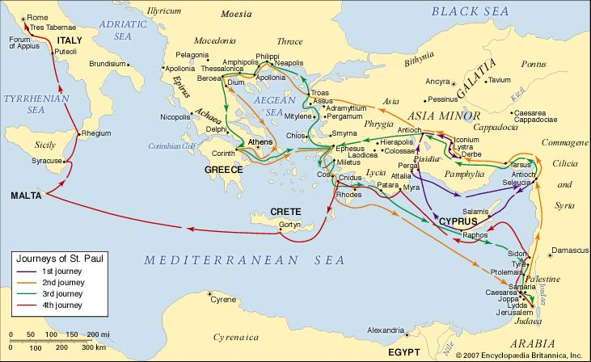
B。革哩底的地理位置。B. Crete location.
(4)

Slide 4
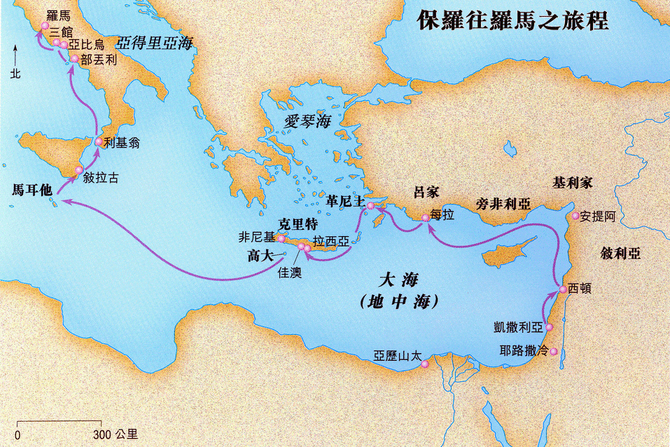
B。革哩底的地理位置。B. Crete location.
(4)

Slide 5
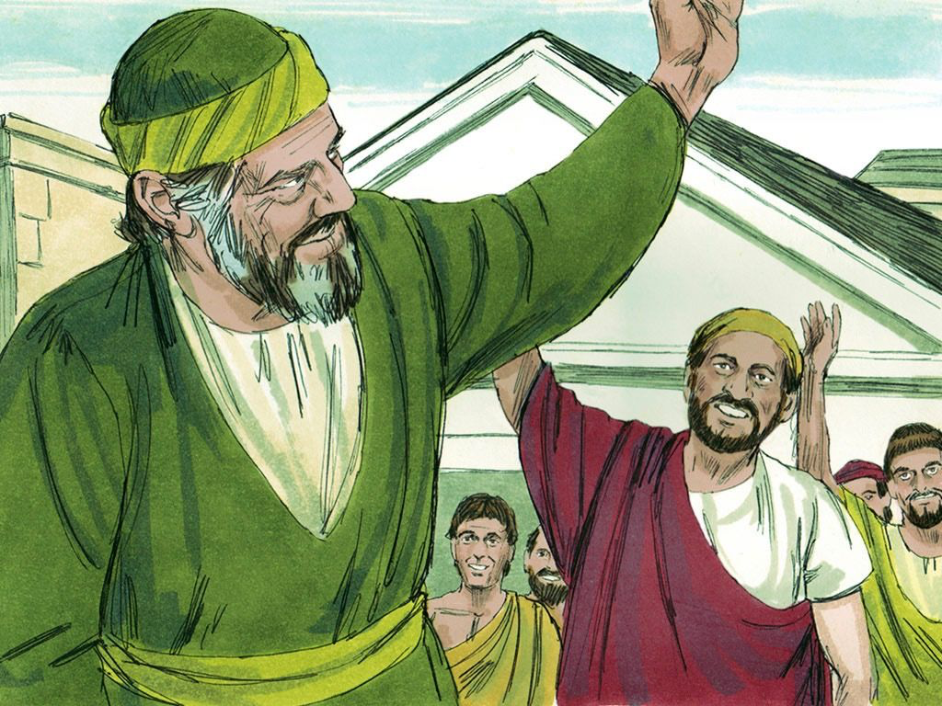
C。革哩底的历史背景。C. Crete historical background.
(5)
(1)克哩底岛是地中海第四大岛。克里底岛居民的不诚实，贪婪和懒惰是众所周知的(1:12)。
(2)克哩底教会可能是由保罗创立的，之后他把提多留在那里完成教会的组织(1:5)。 有克哩底岛来的犹太经历了人五旬节(徒2:11)，可能他们把福音带回了他们的家乡。
(1)Crete is the fourth largest island in the Mediterranean Sea. The dishonesty, gluttony and laziness of Crete’s inhabitants were well knownl(1:12).
(2)Crete church was probably founded
by Paul, after which he sent Titus to
remain there to complete the
organizing of the church(1:5). Since
Jews from Crete were present at
Pentecost(Ac. 2:11),it is possible that
they had carried the gospel to their
native land.
Notes:
(1) Kè lī dǐ dǎo shì dìzhōnghǎi dì sì dà dǎo. Kè lǐ dǐ dǎo jūmín de bù chéngshí, tānlán hé lǎnduò shì zhòngsuǒzhōuzhī de (1:12).
(2) Kè lī dǐ jiàohuì kěnéng shì yóu bǎoluó chuànglì de, zhīhòu tā bǎ tí duōliú zài nàlǐ wánchéng jiàohuì de zǔzhī (1:5). Yǒu kè lī dǐ dǎo lái de yóutài jīnglìle rén wǔ xún jié (tú 2:11), Kěnéng tāmen bǎ fúyīn dài huíle tāmen de jiāxiāng.

Slide 6
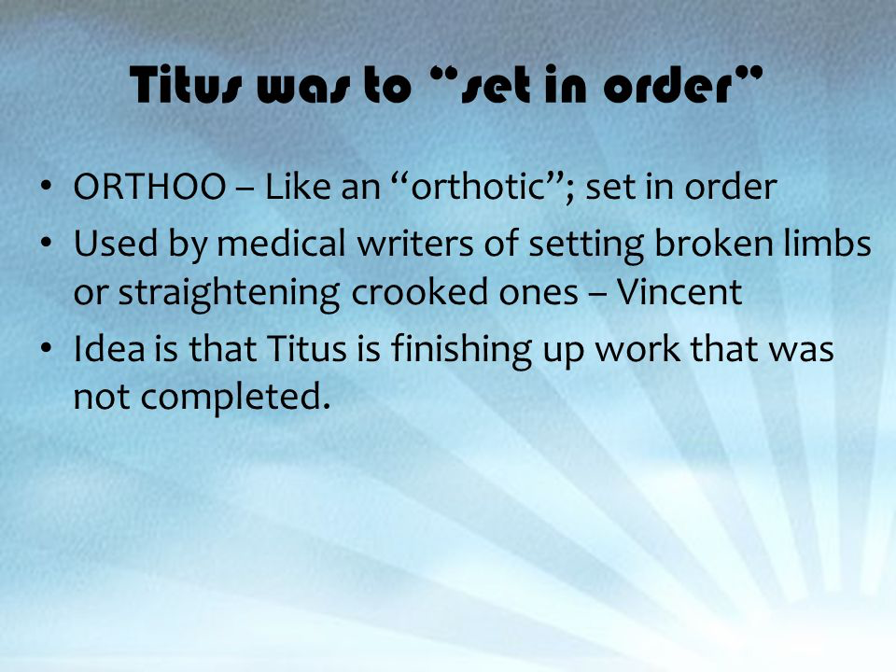
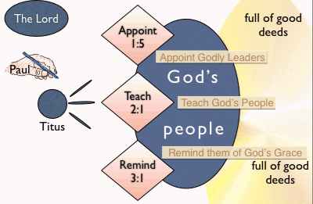
D. 对教会的信息是什么？D.What is a message to the Church?
(6)
爱，行，并教导“什么是善”(1:8; 2:3; 7;17; 3:1;14)。 保罗留提多在克哩底岛，“是要你将那没有办完的事都办整齐了，又照我所吩咐你的，在各城设立长老”(1:5)。
Love, do, and teach “what is good”(1:8; 2:3;7;17;3:1;14). Paul left Titus in Crete “that you might put in order what was left unfinished and appoint elders in every town,as I directed you”(1:5).
设立。
教导。
提醒。
像“矫形器”; 按顺序设置。
由医学作家设置断肢或矫直弯曲的。
想法是提多正在完成尚未完成的工作。
Notes:
Ài, xíng, bìng jiàodǎo “shénme shì shàn”(1:8; 2:3; 7;17; 3:1;14). Bǎoluó liú tí duō zài kè lī dǐ dǎo,“shì yào nǐ jiāng nà méiyǒu bàn wán de shì dōu bàn zhěngqíle, yòu zhào wǒ suǒ fēnfù nǐ de, zài gè chéng shèlì zhǎnglǎo”(1:5).
Xiàng “jiǎoxíng qì”; àn shùnxù shèzhì.
Yóu yīxué zuòjiā shèzhì duàn zhī huò jiǎo zhí wānqū de.
Xiǎngfǎ shì tí duō zhèngzài wánchéng shàngwèi wánchéng de gōngzuò
Shèlì (1:5). Jiàodǎo (2:1). Tíxǐng (3:1).

Slide 7

一。设立:如何设立领袖。1. Appoint: How to appoint godly leaders.
(7)
“神的仆人，耶稣基督的使徒保罗 ”(1:1a)。
A。传讲什么是好的。“把他的道显明了。这传扬的责任，是按着神我们救主的命令交托了我”(1:3b)。
(1)传道是建立“增强神选民的信心”(1:1b)。
(2)讲道促进“真理的知识”(1:1c)。
(3)讲道“导致敬虔”(1:1d)。
(4)讲道有“盼望那无谎言的神在万古之先所应许的永生”(1:2a)。
(5)传道“到了日期，借着传扬的工夫”(1:3a)。
(6)传道产生“共信之道”(1:4)。
“Paul, a servant of God and an apostle of Jesus Christ”(1:1a).
A. Preach what is good. “Entrusted to me by the command of God our Savior”(1:3b).
(1)Preaching builds “to further the faith of God’s elect”(1:1b).
(2)Preaching promotes “their knowledge of the truth”(1:1c).
(3)Preaching “leads to godliness”(1:1d).
(4)Preaching gives “the hope of eternal life,which God, who
does not lie, promised before the beginning of time”(1:2a).
(5)Preaching “brings to light at his appointed season”(1:3a).
(6)Preaching produces “common faith”(1:4).
Notes:
A. Chuán jiǎng shénme shì hǎo de.
(1) Chuándào shì jiànlì “zēngqiáng shén xuǎnmín de xìnxīn”(1:1B).
(2) Jiǎng dào cùjìn “zhēnlǐ de zhīshì”(1:1C).
(3) Jiǎng dào “dǎozhì jìngqián”(1:1D).
(4) Jiǎng dào yǒu “pànwàng nà wú huǎngyán de shén zài wàngǔ zhī xiān suǒ yīngxǔ de yǒngshēng”(1:2A).
(5) Chuándào “dàole rìqí, jièzhe chuányáng de gōngfū”(1:3A).
(6) Chuándào chǎnshēng “gòng xìnzhī dào”(1:4).

Slide 8
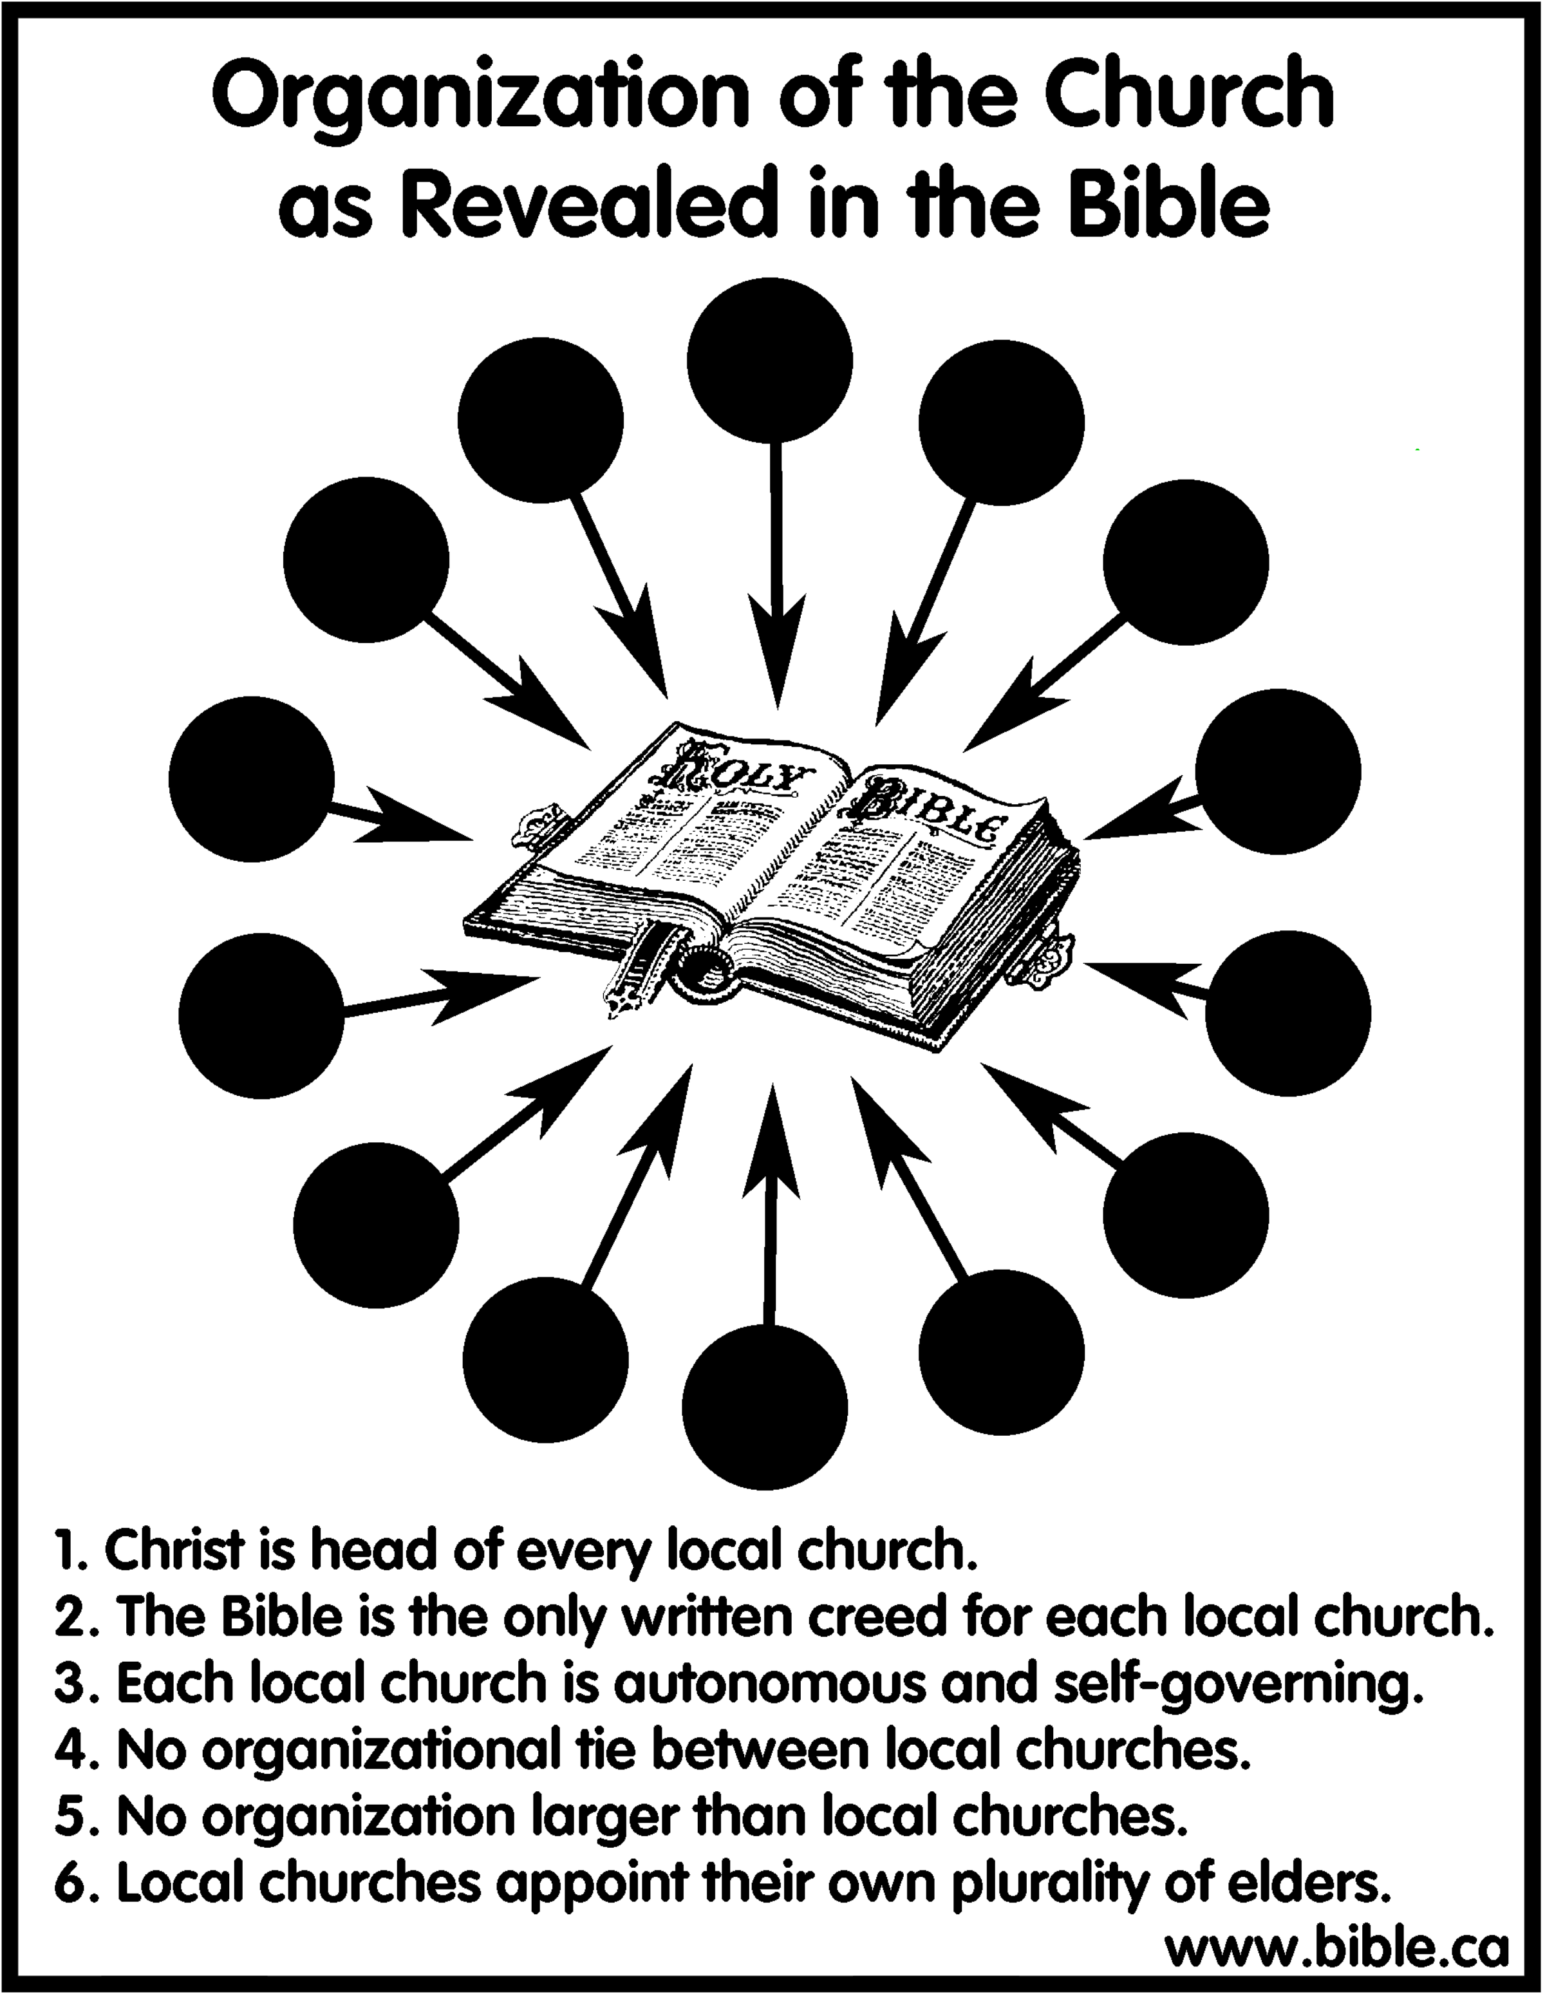
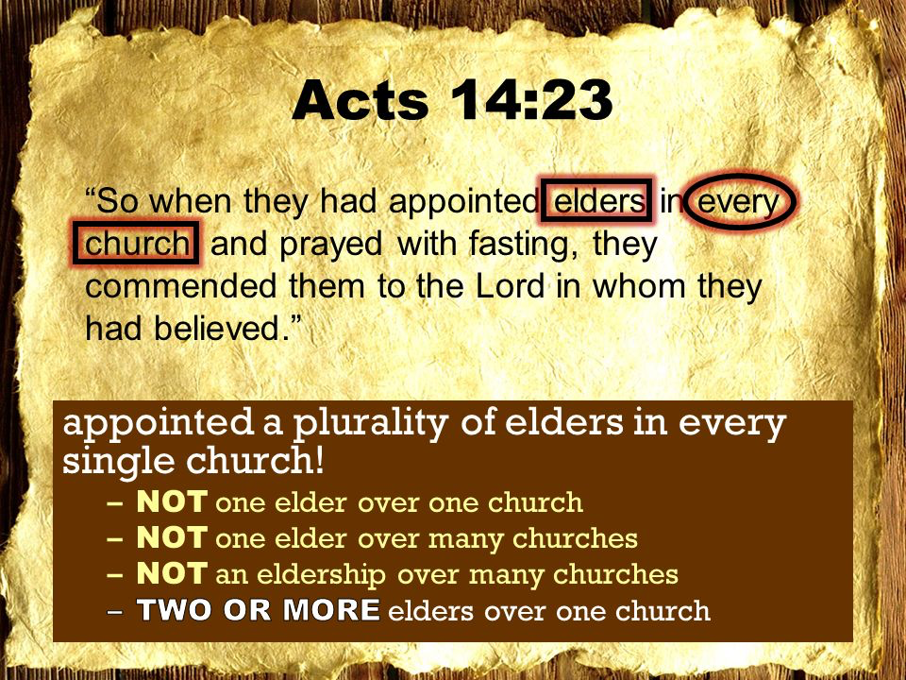
(8)
一。设立:如何设立领袖。1. Appoint: How to appoint godly leaders.
圣经中所显示的教会的组织。
1.基督是每一个地方教会的首领。
2.圣经是每个地方教会唯一的信条。
3.每个地方教会都是自治的。
4.地方教会之间没有组织联系。
5.没有比当地教会更大的组织。
6.地方教设立他们自己的多位长老。
二人在各教会中选立了长老…就把他们交托所信的主(徒14:23)。
Notes:
Shèngjīng zhōng suǒ xiǎnshì de jiàohuì de zǔzhī.
1. Jīdū shì měi yīgè dìfāng jiàohuì de shǒulǐng.
2. Shèngjīng shì měi gè dìfāng jiàohuì wéiyī de xìntiáo.
3. Měi gè dìfāng jiàohuì dōu shì zìzhì de.
4. Dìfāng jiàohuì zhī jiān méiyǒu zǔzhī liánxì.
5. Méiyǒu bǐ dāngdì jiàohuì gèng dà de zǔzhī.
6. Dìfāng jiào shèlì tāmen zìjǐ de duō wèi cháng lǎo.
Èr rén zài gè jiàohuì zhòngxuǎn lìle zhǎnglǎo…jiù bǎ tāmen jiāo tuō suǒxìn de zhǔ (tú 14:23).

Slide 9

(8)
一。设立:如何设立领袖。1. Appoint: How to appoint godly leaders.
B。设立好善的长老。 长老必须…
(1)他无可指责。“无可指责的人”(1:6a)。
“监督既是神的管家，必须无可指责”(1:7a)。
(2)他是一位忠实的丈夫。“作一个妇人的丈夫”(1:6b)。
(3)他是一位忠实的父亲。“儿女也是信主的，没有人告他们是放荡不服约束的，就可以设立”(1:6c)。
(4)他是不任性的。 “不任性”(1:7b)。
(5)他不会很快被激怒。“不暴躁”(1:7c)。
B.Appoint elders who love what is good.Elder must be…
(1)He is above accusation. “Blameless”(1:6a). “Overseer
manages God’s household, he must be blameless” (1:7a).
(2)He is a faithful husband. “Faithful to his wife”(1:6b).
(3)He is a faithful father. “A man whose children
believe and are not open to the charge of being
wild and disobedient” (1:6c).
(4)He is not self-willed. “Not overbearing”(1:7b).
(5)He is not soon angered.“Not quick-tempered”(1:7c).
教会领袖
Notes:
B. Shèlì hào shàn de cháng lǎo. Zhǎnglǎo bìxū…
(1) tā wú kě zhǐzé.“Wú kě zhǐzé de rén”(1:6A).“Jiāndū jìshì shén de guǎnjiā, bìxū wú kě zhǐzé”(1:7A).
(2) Tā shì yī wèi zhōngshí de zhàngfū.“Zuò yīgè fù rén de zhàngfū”(1:6B).
(3) Tā shì yī wèi zhōngshí de fùqīn.“Érnǚ yěshì xìn zhǔ de, méiyǒu rén gào tāmen shì fàngdàng bùfú yuēshù de, jiù kěyǐ shèlì”(1:6C).
(4) Tā shì bù rènxìng de. “Bù rènxìng”(1:7B).
(5) Tā bù huì hěn kuài bèi jīnù.“Bù bàozào”(1:7C).

Slide 10
(9)
一。设立:如何设立领袖。1. Appoint: How to appoint godly leaders.
(6)他清醒。 “不因酒滋事”(1:7d)。
(7)他不是一个恶霸。 “不打人”(1:7e)。
(8)他诚实且不贪婪的。 “不贪无义之财”(1:7f)。
(9)他邀请人。 “乐意接待远人”(1:8a)。
(10)他好善。 “好善”(1:8b)。
(6)He is sober. “Not given to drunkenness” (1:7d).
(7)He is not a bully. “Not violent”(1:7e).
(8)He is not dishonest nor greedy. “Not pursuing
dishonest gain”(1:7f).
(9)He invites people. “He must be hospitable”(1:8a).
(10)He loves good. “One who loves what is good”(1:8b).
教会领袖
Notes:
(6) Tā qīngxǐng. “Bù yīn jiǔ zīshì”(1:7D).
(7) Tā bùshì yīgè èbà. “Bù dǎ rén”(1:7E).
(8) Tā chéngshí qiě bù tānlán de. “Bù tān wú yì zhī cái”(1:7F).
(9) Tā yāoqǐng rén. “Lèyì jiēdài yuǎn rén”(1:8A).
(10) Tā hào shàn. “Hào shàn”(1:8B).

Slide 11
(10)
一。设立:如何设立领袖。1. Appoint: How to appoint godly leaders.
(11)他是温和的。“庄重”(1:8c)。
(12)他是一个忠于自己的人。 “公平”(1:8d)。
(13)他没被玷污。“圣洁(1:8e)。”
(14)他是有纪律的。 “自持”(1:8f)。
(15)他有很好的教学。 “坚守所教真实的道理，就能将纯正的教训劝化人。又能把争辩的人驳倒了”(1:9)。
(11)He is temperate. ”Self-controlled”(1:8c).
(12)He is a man of integrity who sticks by his word.
“Upright” (1:8d).
(13)He is unstained. “Holy(1:8e).”
(14) He is disciplined. “He has self-control” (1:8f).
(15) He has sound teaching. “He must hold firmly to the
trustworthy message as it has been taught,so that he can
encourage others by sound doctrine and refute those who
oppose it” (1:9).
教会领袖
Notes:
(11) Tā shì wēnhé de.“Zhuāngzhòng”(1:8C).
(12) Tā shì yīgè zhōngyú zìjǐ de rén. “Gōngpíng”(1:8D).
(13) Tā méi bèi diànwū.“Shèngjié (1:8E).”
(14) Tā shì yǒu jìlǜ de. “Zìchí”(1:8F).
(15) Tā yǒu hěn hǎo de jiàoxué. “Jiānshǒu suǒ jiào zhēnshí de dàolǐ, jiù néng jiāng chúnzhèng de jiàoxùn quànhuà rén. Yòu néng bǎ zhēngbiàn de rén bódǎole”(1:9).

Slide 12
(11)
一。设立:如何设立领袖。1. Appoint: How to appoint godly leaders.
C。谴责那些不行善的人。
(1)他们不服从神话语的权威。 “因为有许多人不服约束，说虚空话，欺哄人。那奉割礼的，更是这样”(1:10)。
(2)他们有破坏性。 “这些人的口总要堵住。他们因贪不义之财，将不该教导的教导人，败坏人的全家”(1:11)。
(3)他们说话和行事就像克里底岛人一样。“有革哩底人中的一个本地先知说，革哩底人常说谎话，乃是恶兽，又馋又懒。这个见证是真的”(1:12-13a)
C. Rebuke those who fail to do good.
(1)They do not submit to the authority of God’s Word. “For there are many rebellious people, full of meaningless talk and deception, especially those of the circumcision group” (1:10).
(2)They are disruptive. “They must be silenced, because they are disrupting whole house-holds by teaching things they ought not to teach—and that for the sake of dishonest gain”(1:11).
(3)They speak and behave like a Cretan. “One of Crete’s own prophets has said it:Cretans are always liars,evil brutes,lazy gluttons.This saying is true”(1:12-13a).
Notes:
There was an mixture of Jewish legalism, man-made traditions, and mysticism.
一个当地的革哩底岛哲学家埃皮梅尼德斯（Epimenides），展示撒满岛屿的撒旦式的欺骗。
Yīgè dāngdì de kè lǐ tè dǎo zhéxué jiā āi pí méi ní dé sī (Epimenides), zhǎnshì sā mǎn dǎoyǔ de sādàn shì de qīpiàn.
C. Qiǎnzé nàxiē bù xíngshàn de rén.
(1) Tāmen bùfúcóng shénhuà yǔ de quánwēi. “Yīnwèi yǒu xǔduō rén bù fú yuēshù, shuō xūkōng huà, qīhǒng rén. Nà fèng gēlǐ de, gèng shì zhèyàng”(1:10).
(2) Tāmen yǒu pòhuài xìng. “Zhèxiē rén de kǒu zǒng yào dǔ zhù. Tāmen yīn tān bù yì zhī cái, jiāng bù gāi jiàodǎo de jiàodǎo rén, bàihuài rén de quánjiā”(1:11).
(3) Tāmen shuōhuà hé xíngshì jiù xiàng kè lǐ dǐ dǎo rén yīyàng.“Yǒu gé lī dǐ rén zhōng de yīgè běndì xiānzhī shuō, gé lī dǐ rén cháng shuōhuǎng huà, nǎi shì è shòu, yòu chán yòu lǎn. Zhège jiànzhèng shì zhēn de”(1:12-13A)

Slide 13
(12)
一。设立:如何设立领袖。1. Appoint: How to appoint godly leaders.
(4)他们需要被责备。“所以你要严严地责备他们，使他们在真道上纯全无疵。不听犹太人荒渺的言语，和离弃真道之人的诫命”
(1:13b-14)。
(5)他们是腐败的。 “在洁净的人，凡物都洁净。在污秽不信的人，什么都不洁净。连心地和天良，也都污秽了”(1:15)。
(6)他们是伪装者。 “他们说是认识神行事却和他相背。本是可憎恶的，是悖逆的，在各样善事上是可废弃的”(1:16)。
(4)They need to be rebuked. “Therefore rebuke them sharply, so that they will be sound in the faith and will pay no attention to Jewish myths or to the merely human commands of those who reject the truth”(1:13b-14).
(5)They are corrupt. “To the pure, all things are pure, but to those who are corrupted and do not believe, nothing is pure. In fact, both their minds and consciences are corrupted” (1:15).
(6)They are pretenders. “They claim to know God, but by their actions they deny him.They are detestable, disobedient and unfit for doing anything good”(1:16).
Notes:
(4) Tāmen xūyào bèi zébèi.“Suǒyǐ nǐ yào yán yán dì zébèi tāmen, shǐ tāmen zài zhēndào shàng chún quán wú cī. Bù tīng yóutàirén huāng miǎo de yányǔ, hé líqì zhēndào zhī rén de jiè mìng”
(1:13B-14).
(5) Tāmen shì fǔbài de. “Zài jiéjìng de rén, fán wù dōu jiéjìng. Zài wūhuì bùxìn de rén, shénme dōu bù jiéjìng. Lián xīndì hé tiānliáng, yě dū wūhuìle”(1:15).
(6) Tāmen shì wèizhuāng zhě. “Tāmen shuō shì rènshì shén xíngshì què hé tā xiāng bèi. Běn shì kě zēngwù de, shì bèinì de, zài gè yàng shànshì shàng shì kě fèiqì de”(1:16).

Slide 14

(13)
二。教导:如何教导神的子民。2. Teach: How to teach God’s people.
“但你所讲的，总要合乎那纯正的(健康的)道理”(2:1)。
A。良好的健康生活的指示。 如何生活的权利。
(1)对年长的男人:“劝老年人，要有节制，端庄，自守，在信心爱心忍耐上，都要纯全无疵”(2:2)。
(2)对年长的女人:“又劝老年妇人，举止行动要恭敬，不说谗言，不给酒作奴仆，用善道教训人”(2:3)。
“You, however, must teach what is appropriate to sound (healthy) doctrine”(2:1).
A. Instructions for good healthy living. How to live right.
(1)For older men: “Teach the older men to be temperate,worthy of respect, self-controlled, and sound in faith, in love and in endurance”(2:2).
(2)For older women: “Likewise, teach the older women to be reverent in the way they live, not to be slanderers or addicted to much wine,
but to teach what is good”(2:3).
Notes:
(4) Tāmen xūyào bèi zébèi.“Suǒyǐ nǐ yào yán yán dì zébèi tāmen, shǐ tāmen zài zhēndào shàng chún quán wú cī. Bù tīng yóutàirén huāng miǎo de yányǔ, hé líqì zhēndào zhī rén de jiè mìng”
(1:13B-14).
(5) Tāmen shì fǔbài de. “Zài jiéjìng de rén, fán wù dōu jiéjìng. Zài wūhuì bùxìn de rén, shénme dōu bù jiéjìng. Lián xīndì hé tiānliáng, yě dū wūhuìle”(1:15).
(6) Tāmen shì wèizhuāng zhě. “Tāmen shuō shì rènshì shén xíngshì què hé tā xiāng bèi. Běn shì kě zēngwù de, shì bèinì de, zài gè yàng shànshì shàng shì kě fèiqì de”(1:16).

Slide 15
二。教导:如何教导神的子民。2. Teach: How to teach God’s people.
(14)
(3)对年轻女人:“好指教少年妇人，爱丈夫，爱儿女，谨守贞洁，料理家务，待人有恩，顺服自己的丈夫，免得神的道理被毁谤”(2:4-5)。
(4)对年轻男人:“又劝少年人要谨守”(2:6)。
(3)For younger women: “Then they can urge the younger women to love their husbands and children,to be self-controlled and pure, to be busy at home, to be kind, and to be subject to their husbands, so that no one will malign the word of God”(2:4-5).
(4) For younger men:“Similarly,encourage the young men to be self-controlled”
(2:6).
Notes:
(3) Duì niánqīng nǚrén:“Hǎo zhǐjiào shàonián fù rén, ài zhàngfū, ài érnǚ, jǐn shǒu zhēnjié, liàolǐ jiāwù, dàirén yǒu ēn, shùnfú zìjǐ de zhàngfū, miǎndé shén de dàolǐ bèi huǐbàng”(2:4-5).
(4) Duì niánqīng nánrén:“Yòu quàn shàonián rén yào jǐn shǒu”(2:6).

Slide 16
二。教导:如何教导神的子民。2. Teach: How to teach God’s people.
(15)
(5)对提多(领袖):“你自己凡事要显出善行的榜样，在教训上要正直，端庄，言语纯全，无可指责，叫那反对的人，既无处可说我们的不是，便自觉羞愧…这些事你要讲明，劝戒人，用各等权柄责备人。不可叫人轻看你”(2:7-8,15)。
(6)对仆人:“劝仆人要顺服自己的主人，凡事讨他的喜欢。不可顶撞他。不可私拿东西。要显为忠诚，以致凡事尊荣我们救主神的道”(2:9-10)。
(5)For Titus(leaders): “In everything set them an example by doing what is good. In your teaching show integrity,seriousness and soundness of speech that cannot be condemned,so that those who oppose you may be ashamed because they have nothing bad to say about us…These, then, are the things you should teach.Encourage and rebuke with all authority.Do not let anyone despise you”(2:7-8,15).
(6)For slaves: “Teach slaves to be subject to their masters in everything, to try to please them, not to talk back to them, and not to steal from them, but to show that they can be fully trusted, so that in every way they will make the teaching about God our Savior attractive”(2:9-10).
Notes:
(5) Duì tí duō (lǐngxiù):“Nǐ zìjǐ fánshì yào xiǎn chū shànxíng de bǎngyàng, zài jiàoxùn shàng yào zhèngzhí, duānzhuāng, yányǔ chún quán, wú kě zhǐzé, jiào nà fǎnduì de rén, jì wú chù kě shuō wǒmen de bùshì, biàn zìjué xiūkuì…zhèxiē shì nǐ yào jiǎng míng, quàn jiè rén, yòng gè děng quánbǐng zébèi rén. Bùkě jiào rén qīng kàn nǐ”(2:7-8,15).
(6) Duì púrén:“Quàn púrén yào shùnfú zìjǐ de zhǔrén, fánshì tǎo tā de xǐhuān. Bùkě dǐngzhuàng tā. Bùkě sī ná dōngxī. Yào xiǎn wèi zhōngchéng, yǐzhì fánshì zūn róng wǒmen jiù zhǔshén de dào”(2:9-10).

Slide 17

(16)
二。教导:如何教导神的子民。2. Teach: How to teach God’s people.
B。良好的健康生活的基础。 为什么要活得对。
(1)神得救的恩典:“因为上帝的恩典显现出来，为所有的人提供救恩”(2:11)。
(2)神成长的恩典:“教导我们要对不敬虔和世间的情欲说”不“，并且要在这个时代生活自制，正直和敬虔的生活”(2:12)。
B. Foundations of good healthy living. Why to live right.
(1) God’s saving grace: “For the grace of God has appeared that offers salvation to all people” (2:11).
(2) God’s growing grace: “It teaches us to say
“No” to ungodliness and worldly passions, and
to live self-controlled, upright and godly lives in
this present age” (2:12).
Notes:
B. Liánghǎo de jiànkāng shēnghuó de jīchǔ. Wèishéme yào huó dé duì.
(1) Shén déjiù de ēndiǎn:“Yīn wéi shàngdì de ēndiǎn xiǎnxiàn chūlái, wéi suǒyǒu de rén tígōng jiù ēn”(2:11).
(2) Shén chéngzhǎng de ēndiǎn:“Jiàodǎo wǒmen yào duì bù jìngqián hé shìjiān de qíngyù shuō” bù “, bìngqiě yào zài zhège shídài shēnghuó zìzhì, zhèngzhí hé jìngqián de shēnghuó”(2:12).

Slide 18
(17)
二。教导:如何教导神的子民。2. Teach: How to teach God’s people.
(3)基督荣耀的降临：“我们等候那有福的盼望，就是出现我们伟大的上帝和救主，耶稣基督的荣耀”(2:13)。
(4)基督完全的救赎：“谁为我们拯救我们脱离一切邪恶，为自己净化一个属于自己的人，渴望行善”(2:14)。
(3) Christ’s glorious coming: “While we wait for the blessed hope—the appearing of the glory of our great God and Savior, Jesus Christ”(2:13).
(4) Christ’s complete redemption:“Who gave himself for us to redeem us from all wickedness and to purify for himself a people
that are his very own,eager to do what is good”
(2:14).
Notes:
(3) Jīdū róngyào de jiànglín:“Wǒmen děnghòu nà yǒufú de pànwàng, jiùshì chūxiàn wǒmen wěidà de shàngdì hé jiù zhǔ, yēsū jīdū de róngyào”(2:13).
(4) Jīdū wánquán de jiùshú:“Shéi wèi wǒmen zhěngjiù wǒmen tuōlí yīqiè xié'è, wèi zìjǐ jìnghuà yīgè shǔyú zìjǐ de rén, kěwàng xíngshàn”(2:14).

Slide 19
三。提醒:如何提醒神的子民。3.Remind:How to remind God’s people.
(18)
A。做善的准备。 作为基督徒生活需要什么？
(1)基督徒应遵纪守法。 “你要提醒众人，叫他们顺服作官的，掌权的，遵他的命”(3:1a)。
(2)基督徒应积极。“预备行各样的善事”(3:1b)。
(3)基督徒在讲话时要小心。 “不要毁谤”(3:2a)。
(4)基督徒不是斗士，“不要争竞，总要和平”(3:2b)。
(5)基督徒要温顺。“向众人大显”(3:2c)。 控制脾气。
(6)基督徒要温柔。 “温柔”(3:2d)。
A. Preparation to do good. What is required to live as Christians?
(1)Christians should be law abiding. “Remind the people to be subject to rulers and authorities,to be obedient(3:1a).
(2)Christians should be active. “To be ready to do whatever is good”(3:1b). (3)Christians are to be careful in speech. “To slander no one” (3:2a).
(4)Christians are not to be fighters. “To be peaceable”(3:2b).
(5)Christians are to be meek. “Considerate”(3:2c). Have temper under control. (6)Christians are to be gentle. “Always to be gentle toward everyone” (3:2d).
Notes:
A. Zuò shàn de zhǔnbèi. Zuòwéi jīdū tú shēnghuó xūyào shénme?
(1) Jīdū tú yīng zūn jì shǒufǎ. “Nǐ yào tíxǐng zhòngrén, jiào tāmen shùnfú zuò guān de, zhǎngquán de, zūn tā de mìng”(3:1A).
(2) Jīdū tú yīng jījí.“Yùbèi háng gè yàng de shànshì”(3:1B).
(3) Jīdū tú zài jiǎnghuà shí yào xiǎoxīn. “Bùyào huǐbàng”(3:2A).
(4) Jīdū tú bùshì dòushì,“bùyào zhēngjìng, zǒng yào hépíng”(3:2B).
(5) Jīdū tú yào wēnshùn.“Xiàng zhòngrén dà xiǎn”(3:2C). Kòngzhì píqì.
(6) Jīdū tú yào wēnróu. “Wēnróu”(3:2D).

Slide 20

三。提醒:如何提醒神的子民。3.Remind:How to remind God’s people.
(19)
B。行善的动机。
(1)提醒我们过去的生活。“我们从前也是无知，悖逆，受迷惑，服事各样私欲和宴乐，常存恶毒嫉妒的心，是可恨的，又是彼此相恨”
(3:3)。
B. Motivation to do good.
(1)We are reminded of our past life. “At one time we too were foolish, disobedient, deceived and enslaved by all kinds of passions and pleasures.We lived in malice and envy, being hated and hating one another”(3:3).
Notes:
B. Xíngshàn de dòngjī.
(1) Tíxǐng wǒmen guòqù de shēnghuó.“Wǒmen cóngqián yěshì wúzhī, bèinì, shòu míhuò, fú shì gè yàng sīyù hé yàn lè, cháng cún èdú jídù de xīn, shì kěhèn de, yòu shì bǐcǐ xiāng hèn”(3:3).

Slide 21
三。提醒:如何提醒神的子民。3.Remind:How to remind God’s people.
(20)
(2)我们想起了基督曾为我们所做的。但到了神我们救主的恩慈，和他向人所施的慈爱显明的时候，他便救了我们，并不是因我们自己所行的义，乃是照他的怜悯，借着重生的洗，和圣灵的更新。圣灵就是神借着耶稣基督我们救主，厚厚浇灌在我们身上的。好叫我们因他的恩得称为义，可以凭着永生的盼望成为后嗣”(3:4-7)。
(2)We are reminded of Christ’s past work for us. “But when the kindness and love of God our Savior appeared,he saved us,not because of righteous things we had done,but because of his mercy.He saved us through the washing of rebirth and renewal by the Holy Spirit, whom he poured out on us generously through Jesus Christ our Savior, so that, having been justified by his grace, we might become heirs having the hope of eternal life”(3:4-7).
Notes:
(2) Wǒmen xiǎngqǐle jīdū céng wèi wǒmen suǒ zuò de. Dàn dàole shén wǒmen jiù zhǔ de ēncí, hé tā xiàng rén suǒ shī de cí'ài xiǎnmíng de shíhòu, tā biàn jiùle wǒmen, bìng bùshì yīn wǒmen zìjǐ suǒ xíng de yì, nǎi shì zhào tā de liánmǐn, jiè zhuó chóngshēng de xǐ, hé shènglíng de gēngxīn. Shènglíng jiùshì shén jièzhe yēsū jīdū wǒmen jiù zhǔ, hòu hòu jiāoguàn zài wǒmen shēnshang de. Hǎo jiào wǒmen yīn tā de ēn dé chēng wèi yì, kěyǐ píngzhe yǒngshēng de pànwàng chéngwéi hòusì”(3:4-7).

Slide 22
(21)
三。提醒:如何提醒神的子民。3.Remind:How to remind God’s people.
C。行善的决心。
(1)该说什么:“这话是可信的，我也愿你把这些事，切切实实的讲明，使那些已信神的人，留心作正经事业。这都是美事，并且与人有益”(3:8)。
(2)应该避免的是:“要远避无知的辩论，和家谱的空谈，以及分争，并因律法而起的争竞。因为这都是虚妄无益的。分门结党的人，警戒过一两次，就要弃绝他。因为知道这等人已经背道，犯了罪，自己明知不是，还是去作”(3:9-11)。
C. Determinations to do good.
(1)What to assert: “This is a trustworthy saying.And I want you to stress these things,so that those who have trusted in God may be careful to devote them-selves to doing what is good.These things are excellent and profitable for every-one”(3:8).
(2)What to avoid: “But avoid foolish controversies and genealogies and arguments and quarrels about the law, because these are unprofitable and useless.Warn a divisive person once, and then warn them a second time. After that, have nothing to do with them. You may be sure that such people are warped and sinful; they are self-condemned”(3:9-11).
Notes:
C. Xíngshàn de juéxīn.
(1) Gāi shuō shénme:“Zhè huà shì kě xìn de, wǒ yě yuàn nǐ bǎ zhèxiē shì, qiè qièshí shí de jiǎng míng, shǐ nàxiē yǐ xìn shén de rén, liúxīn zuò zhèngjīng shìyè. Zhè dōu shì měi shì, bìngqiě yǔ rén yǒuyì”(3:8).
(2) Yīnggāi bìmiǎn de shì:“Yào yuǎn bì wúzhī de biànlùn, hé jiāpǔ de kōngtán, yǐjí fēn zhēng, bìng yīn lǜ fǎ ér qǐ de zhēngjìng. Yīnwèi zhè dōu shì xūwàng wúyì de. Fēn mén jié dǎng de rén, jǐngjièguò yī liǎng cì, jiù yào qì jué tā. Yīn wéi zhīdào zhè děng rén yǐjīng bèi dào, fànle zuì, zìjǐ míngzhī bùshì, háishì qù zuò”(3:9-11).

Slide 23


结论：Conclusion:
(23)
今天教会最大的需要之一就是基督徒的正当行为。“并且我们的人要学习正经事业，（或作要学习行善）预备所需用的，免得不结果子”(3:14)。基督徒的生活就像一个火车有着事实（神的话语），信仰(相信)，感觉(快乐，平安，爱心)，忠实(负责任的服务)，成果(善行)。
One of the greatest needs in churches today is proper Christian conduct. “Our people must learn to devote themselves to doing what is good, in order to provide for urgent needs and not live unproductive lives”(3:14).The Christian life is like a train with Facts (God’s Word), Faith (belief), Feelings (joy, peace,love), Faithfulness (responsible service),and Fruitfulnesss (good works).
FAITHFULNESS
FRUITFULNESS
事实 ，信仰 ，感觉 ，
忠实 ，成果 。
Notes:
Jīntiān jiàohuì zuìdà de xūyào zhī yī jiùshì jīdū tú de zhèngdàng xíngwéi.“Bìngqiě wǒmen de rén yào xuéxí zhèngjīng shìyè,(huò zuò yào xuéxí xíngshàn) yùbèi suǒ xū yòng de, miǎndé bù jiéguǒ zi”(3:14). Jīdū tú de shēnghuó jiù xiàng yīgè huǒchē yǒuzhe shìshí (shén de huàyǔ), xìnyǎng (xiāngxìn), gǎnjué (kuàilè, píng'ān, àixīn), zhōngshí (fù zérèn de fúwù), chéngguǒ (shànxíng).

