Slide 1
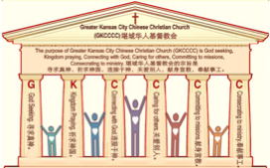

主日:二零一七年六月二十五日
Sunday: June 25, 2017
何礼义牧师 Pastor Gary Hart
题目：“遭反对的教会。”
Topic: “Opposed Church.”
经文:使徒行传13:4-12 Text: Acts 13:4-12
“他们既被圣灵差遣，…往居比路去”
(徒13:4)。
“The two of them,sent on their way by the Holy Spirit, went…to Cyprus” (Acts 13:4).
(1)

Slide 2
引言:A。使徒行传的信息。 Intro: A.Message of Acts of the Apostles.
(2)
(一)基督建造祂的教会（基督的灵借着使徒在作工）。
(二)使徒行传是圣灵的指挥,控制和赋权的事工,创立和加强了教会，并使它成长。
(三)使徒行传是一个过渡时期:从耶稣的事工到使徒的;从旧约到新约;从以色列作神的见证到教会作神的见证;从犹太教出来, 教会诞生了。
(四)使徒行传显示大使命得以遵行(1:8)从证人到耶路撒冷(1-8),到犹太和撒玛利亚(8-12)并到地极(13-28)。
(五)圣灵将继续在教会作工，书写使徒行传28章(加上）。
(1)Christ builds His Church(the Acts of the Spirit of Christ through the Apostles). (2)The Acts were the Spirit’s directing, controlling, and empowering ministry that founded and strengthened the church and caused it to grow.
(3)The Acts is a time of transitions: from ministry of Jesus to that of the apostles; from the Old Covenant to the New Covenant; from Israel as God’s witness to the Church as God’s witness; from Judaism is going out and Church is coming in.
(4)The Acts show the fulfillment of the Great Commission(1:8) from the witness to Jerusalem(1-8), to Judea and Samaria(8-12), and to the ends of earth(13-28).
(5)The Acts are the continuing Acts of the Spirit in Churches in 28 chapters(plus).

Slide 3
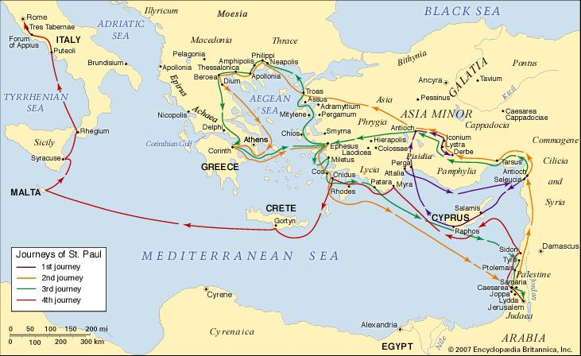
B。居比路的地理位置。B. Cyprus location.
(3)

Slide 4
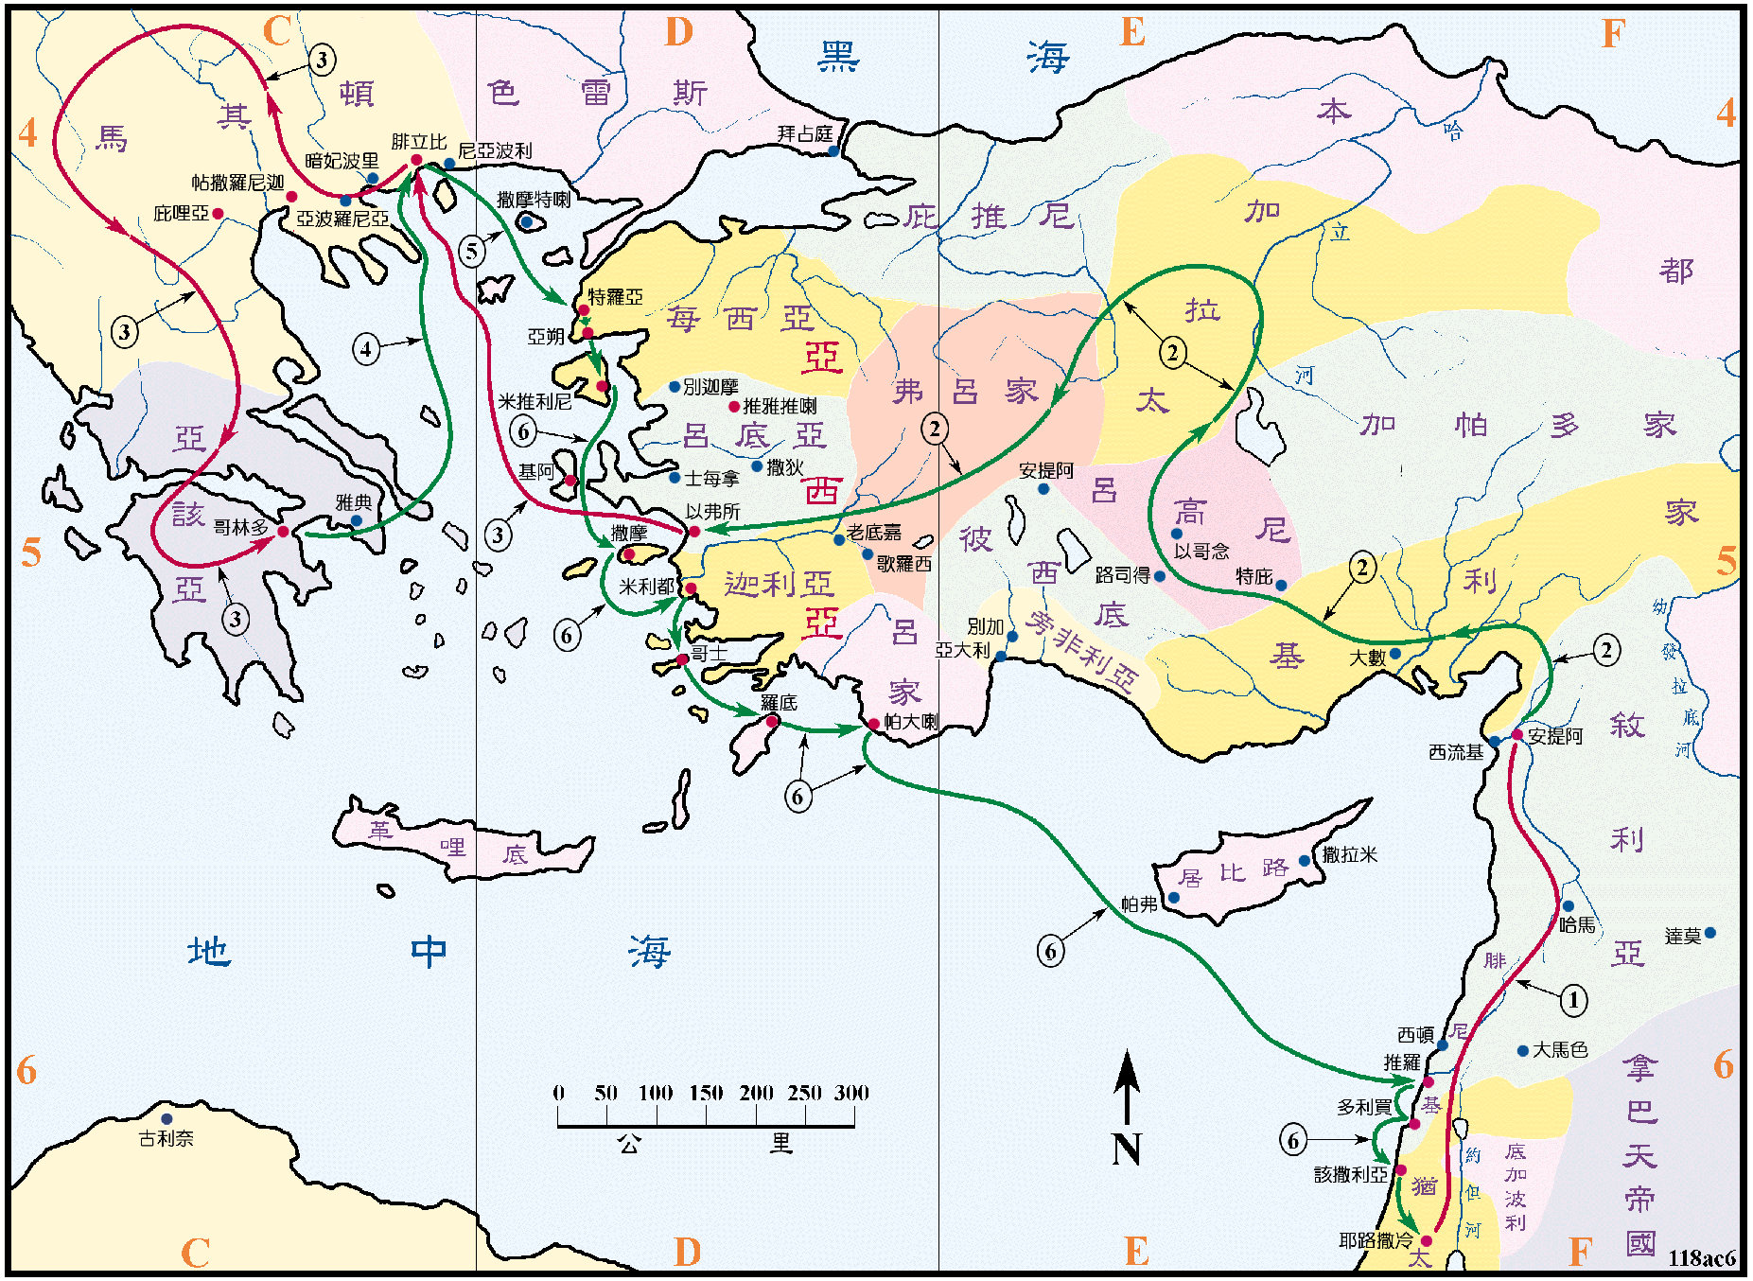
B。居比路的地理位置。B. Cyprus location.
(3)

Slide 5
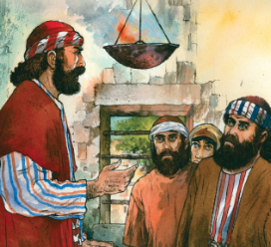
C。居比路的历史背景。C. Cyprus historical background.
(4)
(一)居比路是地中海东部的一个大岛（长138英里，宽60英里）（称为“基提海岛”，赛23:1;耶2:10）。 撒拉米（意为“动摇，测试，殴打”）是居比路岛东端的大商业中心。 帕弗（意为“沸腾，热”）在西端，是居比路岛的首都。
(二)居比路教会或是由巴拿巴（他的出生地4:36）或是或是由被逼迫分散的信徒创立的（11:19-20）。
(三)居比路教会代表“遭反对的教会”。
(四)居比路意思是“公平或公正”。
(1) Cyprus was a large island(138 miles long and 60 miles wide)in the eastern Mediterranean Sea (called “Kittim/Chittim” Isa.23:1; Jer.2:10). Salamis (means “shaken, tested, beaten”) was the great commercial center on the east end of the island of Cyprus. Paphos(means “boiling, hot”) was the
capital of Cyprus and on the west end of the island.
(2) Cyprus church was founded by Barnabas (his birth-
place 4:36)or those scattered by the persecution(11:19-20).
(3) Cyprus church represents the “Opposed Church”.
(4) Cyprus means “fair or fairness”.

Slide 6
(5)
一。基督之灵的称许。1. Spirit of Christ’s commendation.
“他们既被圣灵差遣，就下到西流基，从那里坐船往居比路去。到了撒拉米，就在犹太人各会堂里传讲神的道。也有约翰作他们的帮手”(13:4-5)。
A。他们被差遣。(一)被安提阿教会差遣。“按手在他们头上，就打发他们去了”(13:3)。(二)被圣灵差遣。“他们既被圣灵差遣”
(13:4)。(三)被差遣所经往的地方。“从那里坐船往居比路去。到了撒拉米，就在犹太人各会堂里…经过全岛，直到帕弗”(13:4-6a)。
“The two of them,sent on their way by the Holy Spirit,went down to Seleucia and sailed from there to Cyprus.When they arrived at Salamis,they proclaimed the word of God in the Jewish synagogues.John was with them as their helper”
(13:4-5).
A. They were commissioned. (1) Commissioned by the Antioch Church. “They placed their hands on them and sent them off”(13:3). (2) Commissioned by the Holy Spirit. “Sent on their way by the Holy Spirit”(13:4). (3) Commissioned to place(s). “Sailed from there to Cyprus…they arrived at Salamis…in the Jewish synagogues…they traveled through the whole island until they came to Paphos (13:4-6a).

Slide 7

一。基督之灵的称许。1. Spirit of Christ’s commendation.
(6)
B。他们准备好了。 “传讲神的道”(13:5)。“务要传道。无论得时不得时，总要专心，并用百般的忍耐，各样的教训，责备人，警戒人，劝勉人”（提后4:2）。（一）去圣经学院做准备。（二）学习圣经做装备（提后2:15）。
C。他们得到了协助。“也有约翰作他们的帮手”(13:5b)。（一）借助他人的祷告。 （二）借助他人的事工。 （三）借助他人的礼物（属灵的和财务的）。
应用:你被谁差遣?准备好了吗?谁作你的助手和你在一起(诗54:4)?
B. They were prepared. “They proclaimed the word of God”(13:5). “Preach the word; be prepared in season and out of season; correct, rebuke and encourage—with great patience and careful instruction”(2Ti.4:2). (1)Go to Bible College to get prepared. (2)Study the Bible to get prepared(2Ti.2:15).
C. They were assisted. “John was with them as their helper”
(13:5b).(1)Assisted by prayers of others.(2)Assisted by ministry
of others. (3)Assisted by gifts (spiritual and financial) of others.
Application: Who commissioned you? Are you prepared?
Who is with you as your helper (Ps.54:4)?

Slide 8
(7)
二。基督之灵的责备。2. Spirit of Christ’s condemnation.
“经过全岛，直到帕弗，在那里遇见一个有法术假充先知的犹太人，名叫巴耶稣。这人常和方伯士求保罗同在…只是那行法术的以吕马，（这名翻出来就是行法术的意思）敌挡使徒，要叫方伯不信真道。扫罗又名保罗，被圣灵充满定睛看他，说，你这充满各样诡诈奸恶，魔鬼的儿子，众善的仇敌，你混乱主的正道还不止住吗？现在主的手加在你身上。你要瞎眼，暂且不见日光。他的眼睛立刻昏蒙黑暗，四下里求人拉着手领他”(13:6,7a,8-11)。
“They traveled through the whole island until they came to Paphos.There they met a Jewish sorcerer and false prophet named Bar-Jesus, who was an attendant of the proconsul…But Elymas the sorcerer opposed them and tried to turn the proconsul from the faith. Then Saul, who was also called Paul, filled with the Holy Spirit,looked straight at Elymas and said, “You are a child of the devil and an enemy of everything that is right! You are full of all kinds of deceit and trickery. Will you never stop perverting the right ways of the Lord? Now the hand of the Lord is against you. You are going to be blind for a time, not even able to see the light of the sun.” Immediately mist and darkness came over him, and he groped about, seeking someone to lead him by the hand”(13:6,7a,8-11).

Slide 9
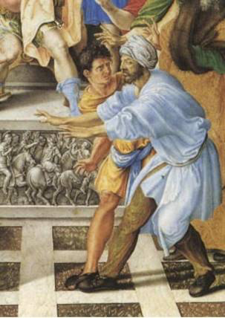
(8)
二。基督之灵的责备。2. Spirit of Christ’s condemnation.
A。反对者的名字。（一）“以吕马”就是行法术的意思。 “犹太巫师”是指犹太魔术师。 （二）“假先知”是指传播虚假信息和教义的人，声称说神的话。 当心假先知（太7:15-20）。 （三）“巴耶稣”是指“耶稣/约书亚的儿子”。 他们声称属于基督。 当心假门徒（太7:21-23）。 （四）“省长的随从”是有正式头衔的人员。
A. Names of opposition. (1) “Elymas” means “sorcerer”. “A Jewish Sorcerer” means a Jewish magician. (2) “False prophet” means a person who spreads false messages and teachings, claiming to speak God’s words. Beware of false prophets(Mt.7:15-20). (3) “Bar-Jesus” means “son of Jesus/Joshua”. They claim to belong to Christ. Beware of false disciples(Mt.7:21-23). (4)An “attendant of the proconsul” is one with an official title.

Slide 10

(9)
二。基督之灵的责备。2. Spirit of Christ’s condemnation.
B。关于反对者的描述。（一）“魔鬼的孩子”是指属于魔鬼（意指“欺骗者”约8:42,44）。 （二）“一切真道的敌人”，就像“你的敌人恶魔一样，像一只咆哮的狮子寻找某人吞噬”（彼后5:8）。 （三）欺骗者:“你们充满了各种各样的欺骗和欺骗”，就像骗子和谎言之父的恶魔（约8:44）。 （四）被教者:“颠覆主的正确道路？” “邪恶”怀疑神的话，然后否认神的话（创3:1,4）。
B. Descriptions of opposition. (1) “A child of the devil” means belongs to the Devil (means “Deceiver”-Jn.8:42,44). (2) “An enemy of every-thing that is right” like “your enemy the devil prowls around like a roaring lion looking for someone to devour”(2Pet.5:8). (3) A deceiver: “you are full of all kinds of deceit and trickery” like the devil who is a liar and the father of lies(Jn.8:44). (4) A pervert: “perverting the right ways of the Lord?” "Evil" doubts God’s Word, and then denies God’s Word (Gen.3:1,4).

Slide 11
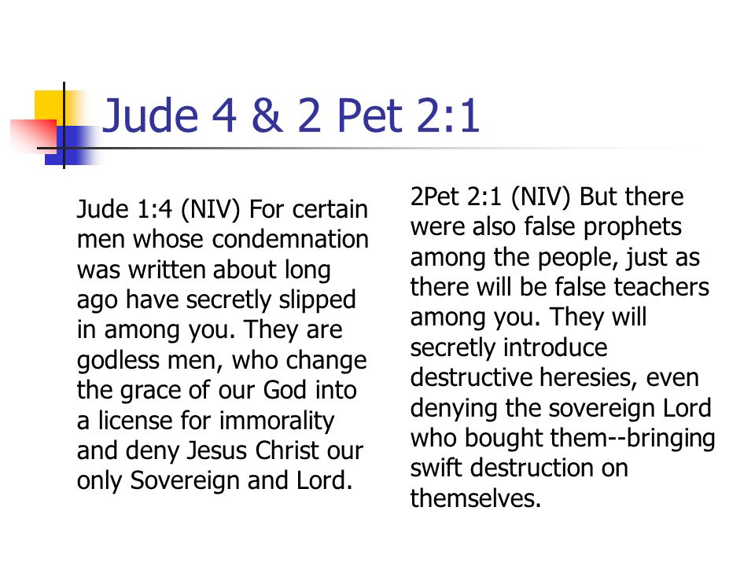
(10)
二。基督之灵的责备。2. Spirit of Christ’s condemnation.
C。对于反对者的审判。（一）神的手施以审判。 “现在耶和华的手反对你。”（二）神让他失明了。 “甚至不能看到太阳的光芒”（三）迷失在黑暗中。 “薄雾和黑暗立即过来了，他摸索着，寻求有人用手领着他。”
应用：反对派有许多不同的名字，描述和受到的或暂时或永久的审判（犹4;彼后2:1）。
C. Judgment upon opposition. (1) Judged by God’s hand. “Now the hand of the Lord is against you.” (2) Blinded by God. “Not even able to see the light of the sun.” (3) Lost in darkness. “Immediately mist and darkness came over him,and he groped about,seeking someone to lead him by the hand.”
Application: Opposition comes with many different names, descriptions, and certain judgment whether temporary or eternal(Jude 4;2Pet.2:1).

Slide 12
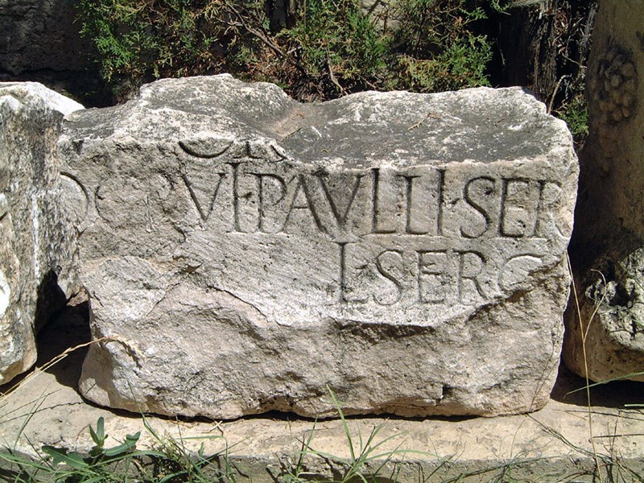
三。基督之灵的忠告。3. Spirit of Christ’s counsel.
(11)
“士求保罗是个通达人。他请了巴拿巴和扫罗来，要听神的道…方伯看见所作的事，很希奇主的道，就信了”(13:7b,12)。
A。得到了一个新身份。塞尔吉乌斯·保罗（Sergius Paulus）是一个地方总督，在罗马的政府体系中负责监督省内民事和军事事务的管理。 他们对罗马的参议院负责。 当他看到他所发生的事情时， 他成了信徒（约一4:4）。
“Sergius Paulus, the proconsul, an intelligent man, sent for Barnabas and Saul because he wanted to hear the word of God…When the proconsul saw what had happened,he believed,for he was amazed at the teaching about the Lord”(13:7b,12).
A. Receive a new title. Sergius Paulus was a proconsul which an office in the Roman government who oversaw the administration of civil and military matters in a province. They were responsible to the senate in Rome. When he saw what had happened, he became a believer (1Jn.4:4).

Slide 13
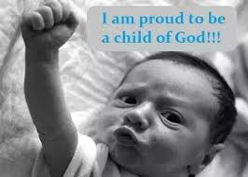
三。基督之灵的忠告。3. Spirit of Christ’s counsel.
(12)
B。接受了新的描述。 塞尔古斯·保罗斯是一个聪明的人，他成了一个属灵的人。 “弟兄们哪，可见你们蒙召的，按着肉体有智慧的不多，有能力的不多，有尊贵的也不多”（林前1:26）。
C。接受了新的观点。 塞尔古斯·保罗希望听到上帝的话语......他对关于主的教导感到惊讶。“他来到寻求并离开了惊讶。
应用：你的新身份，新的描述和新的观点是什么？(我为成为上帝的孩子而感到自豪！！！)。
B. Receive a new description. Sergius Paulus was an intelligent man, and he became a spiritual man. “Brothers and sisters, think of what you were when you were called. Not many of you were wise by human standards; not many were influential;not many were of noble birth”(1Cor.1:26).
C. Receive a new perspective. Sergius Paulus
wanted to hear the word of God. “He was amazed
at the teaching about the Lord.” He came seeking
and left amazed.
Application: What is your new title, new
description, and new perspective?

Slide 14


(13)
四。基督之灵的挑战。4. Spirit of Christ’s challenge.
“只是那行法术的以吕马，（这名翻出来就是行法术的意思）敌挡使徒，要叫方伯不信真道”(13:8)。
A。他们反对领导人。从前雅尼和佯庇怎样敌挡摩西(提后3:8a)。
B。他们反对真道。“这等人也怎样敌挡真道。他们的心地坏了，在真道上是可废弃的” (提后3:8b)。
C。他们反对福音消息。“你也要防备他。因为他极力敌挡了我们的话”(提后4:15)。
应用：反对领导人，反对真道，反对福音信息。
“But Elymas the sorcerer…opposed them and tried to
turn the proconsul from the faith”(13:8).
A. They oppose leaders.“Jannes and Jambres opposed Moses”(2Ti.3:8a).
B. They oppose truth. “So also these teachers oppose the truth.They are men of depraved minds,who,as far as the faith is concerned,are rejected” (2Ti.3:8b).
C. They oppose gospel message. “You too should be on your guard against him,because he strongly opposed our message”(2Ti.4:15).
Application: Opposition will come against leaders, against the truth, and against the gospel message.

Slide 15
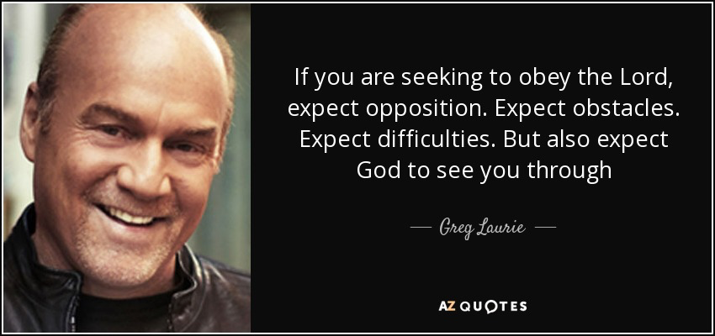
(14)
结论：Conclusion:
你可能认为这是不公平的，但你可以预计到遭受反对。“如果你寻求顺服主，就能预期到你将遭到反对，碰上障碍，遇到困难，但也能预期到神将与你同在”-Greg Laurie。他们遭到反对，碰上碍和遇到困难。
You may think that it is not fair, but you can expect opposition. “If you are seeking to obey the Lord, expect opposition.Expect obstacles. Expect difficulties. But also expect God to see you through.” They faced opposition,obstacles,and difficulties.

