Slide 1
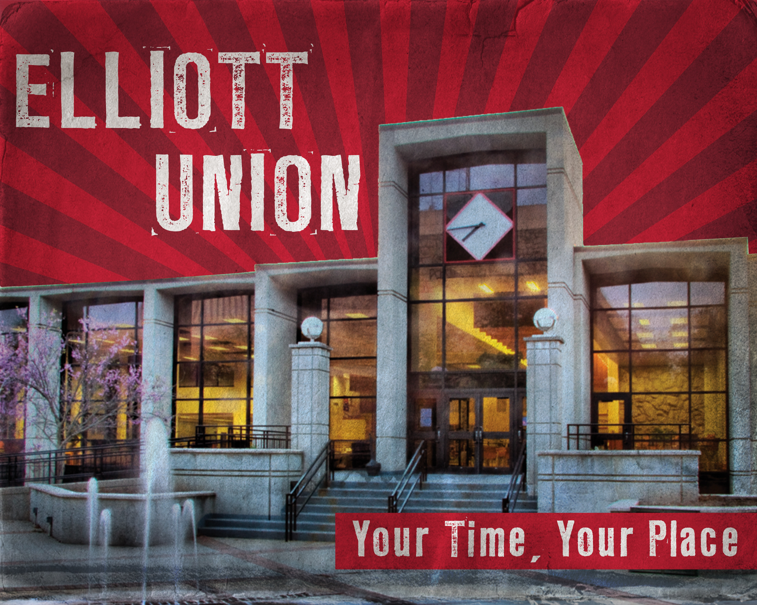
堪城华人基督教会夏令营2017年6月9-11日
GKCCCC Summer Retreat: June 9-11, 2017
地点Place: UCM Elliott Student Union
Warrensburg, MO 64093
主题：“跟着耶稣”
Topic: “Follow Jesus”
联络人：郦一明
Contact: Yiming Li
电话号码:
Phone: (913)952-1209
Website:www.gkcccc.org

Slide 2
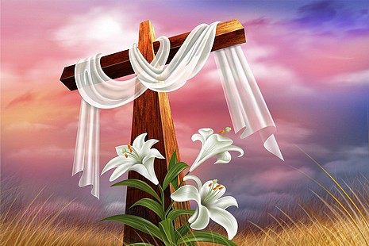
复活节:二零一七年四月十六日
Easter Sunday: April 16, 2017
早上10点受浸礼10 am Baptism Service
早上10点30分聚会10:30 am Service

Slide 3
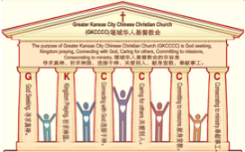
复活节:二零一七年四月十六日
Easter Sunday: April 16, 2017
何礼义牧师 Pastor Gary Hart
题目：“充满恩典的教会 。”
Topic: “Full of Grace Church.”
经文:使徒行传9:1-22
“叫你能看见…”(徒9:17).
Text: Acts 9:1-22
“So that you may see again…”(Ac.9:17).
(1)

Slide 4
引言:A。使徒行传的信息。 Intro: A.Message of Acts of the Apostles.
(2)
(一)基督建造祂的教会（基督的灵借着使徒在作工）。
(二)使徒行传是圣灵的指挥,控制和赋权的事工,创立和加强了教会，并使它成长。
(三)使徒行传是一个过渡时期:从耶稣的事工到使徒的;从旧约到新约;从以色列作神的见证到教会作神的见证;从犹太教出来, 教会诞生了。
(四)使徒行传显示大使命得以遵行(1:8)从证人到耶路撒冷(1-8),到犹太和撒玛利亚(8-12)并到地极(13-28)。
(五)圣灵将继续在教会作工，书写使徒行传28章(加上）。
(1)Christ builds His Church(the Acts of the Spirit of Christ through the Apostles). (2)The Acts were the Spirit’s directing, controlling, and empowering ministry that founded and strengthened the church and caused it to grow.
(3)The Acts is a time of transitions: from ministry of Jesus to that of the apostles; from the Old Covenant to the New Covenant; from Israel as God’s witness to the Church as God’s witness; from Judaism is going out and Church is coming in.
(4)The Acts show the fulfillment of the Great Commission(1:8) from the witness to Jerusalem(1-8), to Judea and Samaria(8-12), and to the ends of earth(13-28).
(5)The Acts are the continuing Acts of the Spirit in Churches in 28 chapters(plus).

Slide 5
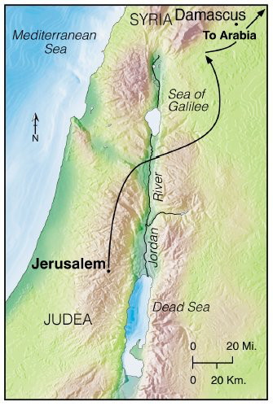
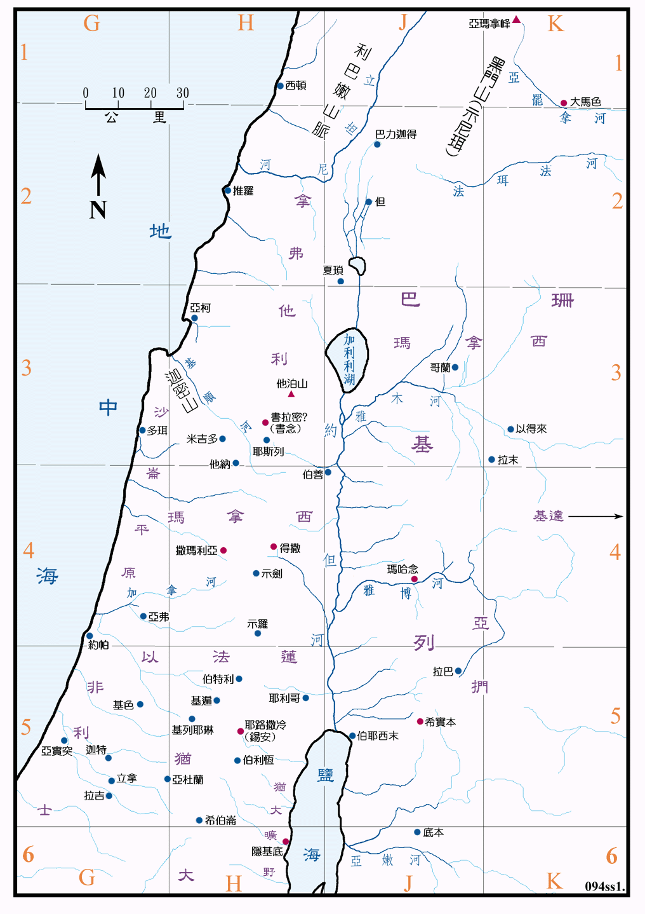
B。大马色的地理位置。
B. Damascus location.
(3)

Slide 6
C。大马色的历史背景。C. Damascus historical background.
（一）大马色城是位于罗马的叙利亚省。它声称是世界上最古老的不断存在的城市。它在耶路撒冷以北约150英里。这是一个主要的贸易和运输中心。
（二）大马色教会是亚拿尼亚创立的。
（三）大马色教会代表充满恩典的教会。
（四）大马色教会的意思是指“红地”，被称为“东方之眼”。基督徒领袖迫害基督徒的首领大数人扫罗的转变，也许是圣灵在五旬节降临后教会历史上最大的事件。
(1) The city of Damascus was located in the Roman province of Syria. It claims to be the oldest continuously existing city in the world. It was about 150 miles north of Jerusalem. It was a major trade and transportation center.
(2) Damascus church was founded by Ananias.
(3) Damascus church represents the “grace filled” church.
(4) Damascus means “red land” and was known as “the eye of the east.” The conversion of Saul of Tarsus, the leading persecutor of Christians, was perhaps the greatest event in church history after the coming of the Spirit at Pentecost.
(4)

Slide 8
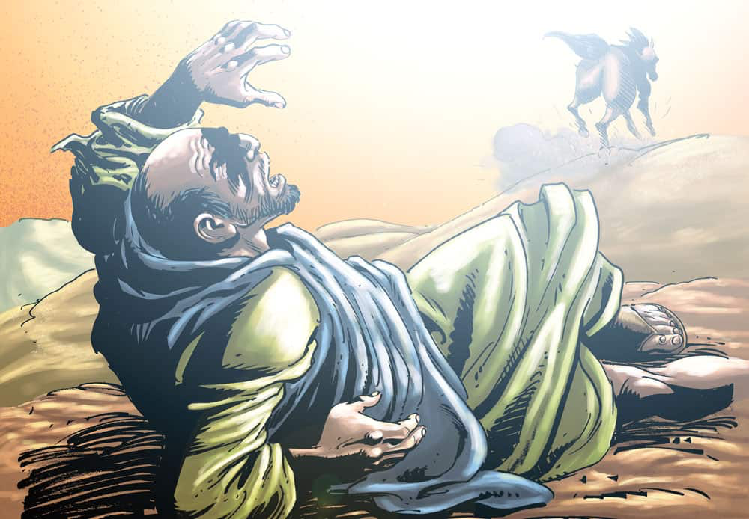
(5)
一。基督之灵的称许。1. Spirit of Christ’s commendation.
“扫罗仍然向主的门徒，口吐威吓凶杀的话，去见大祭司，求文书给大马色的会堂，若是找着信奉这道的人，无论男女，都准他捆绑带到耶路撒冷”(徒9:1-2)。扫罗是在出去逮捕别人的时候被主逮着的（腓3:12）。
“Meanwhile, Saul was still breathing out murderous threats against the Lord’s disciples. He went to the high priest and asked him for letters to the synagogues in Damascus, so that if he found any there who belonged to the Way, whether men or women, he might take them
as prisoners to Jerusalem”(9:1-2).
Saul was out to arrest others, when
the Lord arrested him(Phil.3:12).

Slide 9
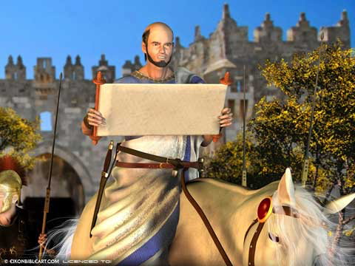

Slide 10
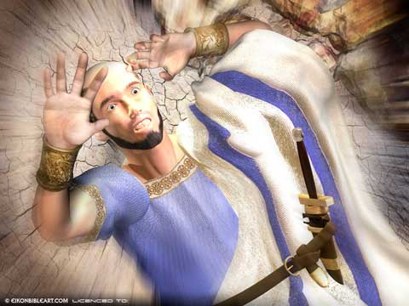
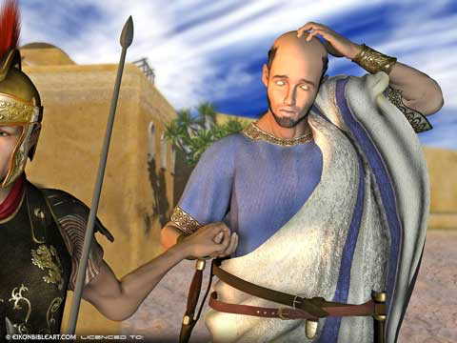

Slide 11
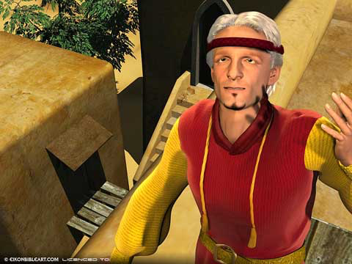
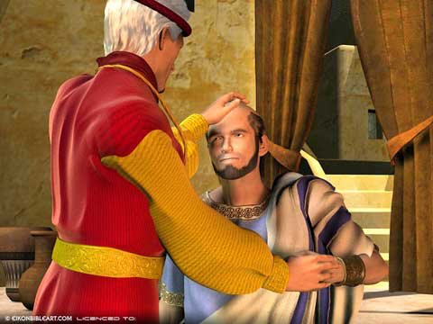

Slide 12
一。基督之灵的称许。1. Spirit of Christ’s commendation.
(6)
A。他们是见证人。“见证人”是使徒行传中的一个关键词,用作动词或名词有二十九次。证人是告诉他所看见和听见的人(4:19-20)。 英文单词“殉道者”来自希腊语“见证人”。很多人都是通过舍弃生命成为见证的。所有神的子民都要为他们所知道的作见证。有超过520 人见证了基督的复活（林前15:3-8）。
A. They were “witnesses”. “Witness” is a key word in the book of Acts and is used 29 times as either a verb or noun.A witness is somebody who tells what he had seen and heard(4:19-20). The English word “martyr” comes from the Greek word for “witness.”Many people have been witnesses by laying down their lives. All of God’s people should be witnesses of what they know. There are over 520 witnesses to Christ’s resurrection(1Co.15:3-8).
目击者

Slide 13
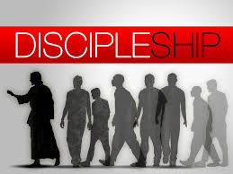
(7)
一。基督之灵的称许。1. Spirit of Christ’s commendation.
B。他们是“门徒”。门徒是跟随者，学习者或学生。 他们是“耶稣的追随者”（9:1,10,25-26,36,38）。耶稣叫他的门徒“跟从我”(路加福音五章27节)，门徒的任务是学习和传扬主人的言语和教义。圣经中使用了“门徒”296次（OT-2x） - 神的门徒（赛8:16）或者王（19:11），马太（78x），马可（59x），路加 （50x），约翰（89x）和使徒行传（26x）。 “门徒”是使徒行传中最常用的名字。 它是指所有相信复活主的人。
B. They were “disciples”. A disciple means a follower,learner or student. They were “followers of Jesus”(9:1,10,25-26,36,38).Jesus called His disciples to “follow me”(Lk.5:27).It was the task of the disciple to learn and pass on the say-ings and teachings of the master.“Disciple” is used 296 times in the Bible:(OT-2x) -Disciple of God(Isa.8:16) or a King(19:11) and
Matt.(78x), Mark(59x),Luke(50x),John(89x)and
Acts(26x).“Disciples” is the name that is used
most in the book of Acts. It refers to all those
who believe in the risen Lord.

Slide 14
(8)
一。基督之灵的称许。1. Spirit of Christ’s commendation.
C。他们是“属于这道的人”。“这道”在使徒行传中使用了9次(9:2;;16:17;18:25,26;19:9,23;22:4;24:14,22)。耶稣称自己为道路。
D。他们被称为“圣徒”，“圣民”和主的百姓。 他们被神分别出来（9:13,32,41）。 书信中最常用的名字（新约书信）。 他们称耶稣为主，他们也是耶稣的忠实的和真正的见证人（在启示录13次）。
E。他们是“凡求告主名的”。 “凡求告主名的,就必得救”（2:21; 9:14,21;22:16）。
C. They were “those who belonged to the Way”. “The Way” is used 9 times in Acts(9:2;16:17;18:25,26;19:9,23;22:4;24:14,22).Jesus called Himself “the way.”
D. They were called “saints”, “holy people”, and the Lord’s people. They are “set apart” by God(9:13,32,41). Most frequently used name in the Epistles (NT Letters). They name Jesus as Lord, they are also faithful and true witnesses for Jesus (in Rev.13x).
E. They were “all that call on God’s name”. “And everyone who called on the name of the Lord will be saved”(2:21;9:14,21;22:16).

Slide 15
(9)
一。基督之灵的称许。1. Spirit of Christ’s commendation.
F。他们被称为“兄弟”。 这个称呼在使徒行传中使用了31次。 我们是上帝家庭中的“兄弟”和“姐妹”（兄弟扫罗9:17）。
G。他们被称为“信徒”。 这个称呼在使徒行传中使用了28次。 “信徒”是相信基督的人（9:30,41,42）。
H。他们被称为“基督徒”。 然而，这个名字直到后来才出现，只有三次在新约（11:26; 26:28; 1Pe.4:16）。“有一个门徒，名叫名叫亚拿尼亚”（9:10）来自希伯来文名哈尼亚尼，意思是“ 耶和华是有恩典的“（9:10;22:12）他充满恩典（约1:14）。
F. They were called “brothers”. This term is used 31 times in Acts. We are “brothers” and “sisters” in God’s family(brother Saul-9:17).
G. They were called “believers”. This term is used 28 times in Acts. “Believer” is one who believes in Christ(9:30,41,42).
H. They were called “Christians”. Yet that name did not appear until later and only 3 times in NT(11:26;26:28;1Pe.4:16).“There was a disciple named Ananias” (9:10;22:12) from the Hebrew name Hananiah meaning “the LORD is gracious”(Dan.1:6).He is full of grace(Jn1:14).

Slide 16
(10)
二。基督之灵的责备。2. Spirit of Christ’s condemnation.
“扫罗行路，将到大马色，忽然从天上发光，四面照着他。他就仆倒在地，听见有声音对他说，扫罗，扫罗，你为什么逼迫我。他说，主啊，你是谁。主说，我就是你所逼迫的耶稣。起来，进城去，你所当作的事，必有人告诉你。同行的人，站在那里，说不出来，听见声音，却看不见人。扫罗从地上起来，睁开眼睛，竟不能看什么。有人拉他的手，领他进了大马色。三日不能看见，也不吃，也不喝。”
“As he neared Damascus on his journey, suddenly a light from heaven flashed around him.He fell to the ground and heard a voice say to him,“Saul,Saul,why do you persecute me?” “Who are you,Lord?” Saul asked.“I am Jesus,whom you are persecuting,”he replied.“Now get up and go into the city,and you will be told what you must do.”The men traveling with Saul stood there speechless;they heard the sound but did not see anyone. Saul got up from the ground, but when he opened his eyes he could see nothing. So they led him by the hand into Damascus. For three days he was blind, and did not eat or drink anything”(9:3-9).

Slide 17
(11)
二。基督之灵的责备。2. Spirit of Christ’s condemnation.
A。为什么要抵挡？“扫罗，扫罗，你为什么逼迫我。他说，主啊，你是谁。主说，我就是你所逼迫的耶稣”（9:4-5）。 逼迫教会就是逼迫基督，因为教会是他的身体（林前12:27;弗1:22-23）。
B。为什么没有意义？“同行的人…听见声音，却看不见人”(9:7)。
C。为什么看不见？“扫罗从地上起来，睁开眼睛，竟不能看什么。有人拉他的手，领他进了大马色。三日不能看见”(9:8-9)。尽管学识渊博（26:24），扫罗在属灵上是盲目的（2Co.3:12-18），不明白旧约对关于弥赛亚的教训。
A. Why resistant? “Saul,Saul,why do you persecute me?”“Who are you, Lord?” Saul asked.“I am Jesus, whom you are persecuting” (9:4-5). To persecute the church is to persecute Christ,for the church is His body(1Co.12:27;Eph.1:22-23).
B. Why mindless? “The men traveling with Saul…heard the sound but did not see anyone”(9:7).
C. Why sightless? “Saul got up from the ground,but when he opened his eyes he could see nothing. So they led him by the hand into Damascus.For three days he was blind”(9:8-9). In spite of his great learning(26:24),Saul was spiritually blind(2Co.3:12-18)and did not understand what OT taught about the Messiah.

Slide 18
三。基督之灵的忠告。3. Spirit of Christ’s counsel.
(12)
“主对亚拿尼亚说，你只管去。他是我所拣选的器皿，要在外邦人宣扬我的名”(9:15)。
A。需要服从！ “主在异象中对他说：亚拿尼亚。他说：主，我在这里”（9:10）。彼得却说：“主啊，这是不可以的”（10:14）。
（一）异议。主啊，我听见许多人说，这人怎样在耶路撒冷多多苦害你的圣徒”(9:13)。
（二）借口。“并且他在这里有从祭司长得来的权柄捆绑一切求告你名的人”（9:14）。
“Lord said to Ananias,“Go!This man is my chosen instrument to proclaim my name to the Gentiles (9:16).
A. Need to obey! “The Lord called to him in a vision,“Ananias!”“Yes,Lord,” he answered”(9:10). “No,Lord”(10:14),Peter answered.
(1) Objections.“Lord,”…I have heard many reports about this man and all the harm he has done to your holy people in Jerusalem”(9:13).
(2) Excuses. “And he has come here with authority from the chief priests to arrest all who call on your name”(9:14).

Slide 19
三。基督之灵的忠告。3. Spirit of Christ’s counsel.
(13)
B。需要去。 “主对他说，起来，往直街去，在犹大的家里，访问一个大数人名叫扫罗。他正祷告。又看见了一个人，名叫亚拿尼亚，进来按手在他身上，叫他能看见…主对亚拿尼亚说，你只管去。他是我所拣选的器皿，要在外邦人宣扬我的名。我也要指示他，为我的名必须受许多的苦难”(9:11,12,15)。“亚拿尼亚就去了，进入那家”（9:17a）。
B. Need to go! “The Lord told him,“Go to the house of Judas on Straight Street and ask for a man from Tarsus named Saul,for he is praying In a vision he has seen a man named Ananias come and place his hands on him to restore his sight…But the Lord said to Ananias,“Go!This man is my chosen instrument to proclaim my name to the Gentiles and their kings and to the people of Israel.I will show him how much he must suffer for my name”(9:11,12,15,16). “Then Ananias went to the house and entered it”(9:17a).

Slide 20
(14)
四。基督之灵的挑战。4. Spirit of Christ’s challenge.
“叫他能看见…凡听见的人，都惊奇” (9:17,21)。
A。听圣灵所说的。 “凡听见的人，都惊奇”(9:21)。
B。看圣灵所做的。“把手按在扫罗身上说，兄弟扫罗，在你来的路上，向你显现的主，就是耶稣，打发我来，教你能看见，又被圣灵充满。扫罗的眼睛上，好像有鳞立刻掉下来，他就能看见，于是起来受了洗。吃过饭就健壮了。扫罗和大马色的门徒同住了些日子就在各会堂里宣传耶稣，说他是神的儿子”（9:17-20）。
“See again…All those who heard him were astonished”(9:17,21).
A. Hear what the Spirit says. “All those who heard him were astonished”(9:21).
B. See what the Spirit is doing. “Placing his hands on Saul, he said, “Brother Saul, the Lord—Jesus, who appeared to you on the road as you were coming here—has sent me so that you may see again and be filled with the Holy Spirit.” Immediately, something like scales fell from Saul’s eyes, and he could see again. He got up and was baptized, and after taking some food, he regained his strength. Saul spent several days with the disciples in Damascus. At once he began to preach in the synagogues that Jesus is the Son of God. (9:17-20).

Slide 21
(15)
结论：Conclusion:
一个聪明的人给了FBMeyer一些实用的建议。男人建议，Meyer祈祷，“你的甜蜜，主”，当他感到烦躁的时候。Amy Carmichael 把建议放在她的心理并且建立在它的基础上，说：“与你的诱惑相反， 命名相反的”：谎言 - 你的真理，主，不诚实 - 你的慈爱，主，不耐烦 - 你的耐心，主，罪恶，你的恩典，主。“我原是使徒中最小的，不配称为使徒，因为我从前逼迫神的教会。然而我今日成了何等人，是蒙神的恩才成的。并且他所赐我的恩不是徒然的…这原不是我，乃是神的恩与我同在”(林前15:9-10)。“他对我说，我的恩典够你用的…”（林后12:9）。
A wise man gave F.B.Meyer some practical advice.The man suggested that Meyer pray,“Thy sweetness,Lord” when he felt irritated.Amy Carmichael took the advice to heart and built upon it,saying,“Take the opposite of your temptation, naming that opposite”: Untruth—Your truth,Lord;unkindness—Your kindness,Lord;impatience—Your patience,Lord;sinfulness,Your grace, Lord. “For I am the least of the apostles and do not even deserve to be called an apostle, because I persecuted the church of God.But by the grace of God I am what I am …”(1Co.15:9-10).“But He said to me,My grace is sufficient for you…”(2Co.12:9).

Slide 22
(16)
恩典是神的部分。
信心是人的部分。
神的
丰富
在于
基督的
摆上
放弃
所有
我
接受
祂
是本乎恩，
也因着信。
信心
人
死亡
恩典
神
生命
耶
稣

