Slide 1

Thank you all!
谢谢大家！

Slide 2


在星期三晚上，请你和我们一起学习教牧书信 ，教会的带领手册，。
You are invited to join our study on Wednesday nights at 7:30 pm as we study the Leadership Manual for the Church, the Pastoral Epistles.

Slide 3
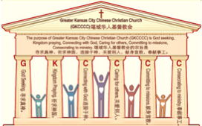

主日:二零一七年七月三十日
Sunday: July 30, 2017
何礼义牧师 Pastor Gary Hart
题目：“守律法的教会。”
Topic: “Legalistic Church.”
经文:徒14:21-28 Text: Acts 14:21-28
“劝他们恒守所信的道” (徒14:22)。
“Encouraging them to remain true to the faith” (Ac.14:22).
(1)

Slide 4
引言:A。使徒行传的信息。 Intro: A.Message of Acts of the Apostles.
(2)
(一)基督建造祂的教会（基督的灵借着使徒在作工）。
(二)使徒行传是圣灵的指挥,控制和赋权的事工,创立和加强了教会，并使它成长。
(三)使徒行传是一个过渡时期:从耶稣的事工到使徒的;从旧约到新约;从以色列作神的见证到教会作神的见证;从犹太教出来, 教会诞生了。
(四)使徒行传显示大使命得以遵行(1:8)从证人到耶路撒冷(1-8),到犹太和撒玛利亚(8-12)并到地极(13-28)。
(五)圣灵将继续在教会作工，书写使徒行传28章(加上）。
(1)Christ builds His Church(the Acts of the Spirit of Christ through the Apostles). (2)The Acts were the Spirit’s directing, controlling, and empowering ministry that founded and strengthened the church and caused it to grow.
(3)The Acts is a time of transitions: from ministry of Jesus to that of the apostles; from the Old Covenant to the New Covenant; from Israel as God’s witness to the Church as God’s witness; from Judaism is going out and Church is coming in.
(4)The Acts show the fulfillment of the Great Commission(1:8) from the witness to Jerusalem(1-8), to Judea and Samaria(8-12), and to the ends of earth(13-28).
(5)The Acts are the continuing Acts of the Spirit in Churches in 28 chapters(plus).

Slide 5
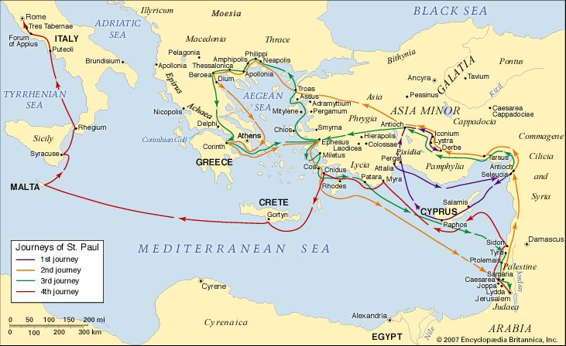
B。特庇地理位置。B. Derbe location.
(3)

Slide 6
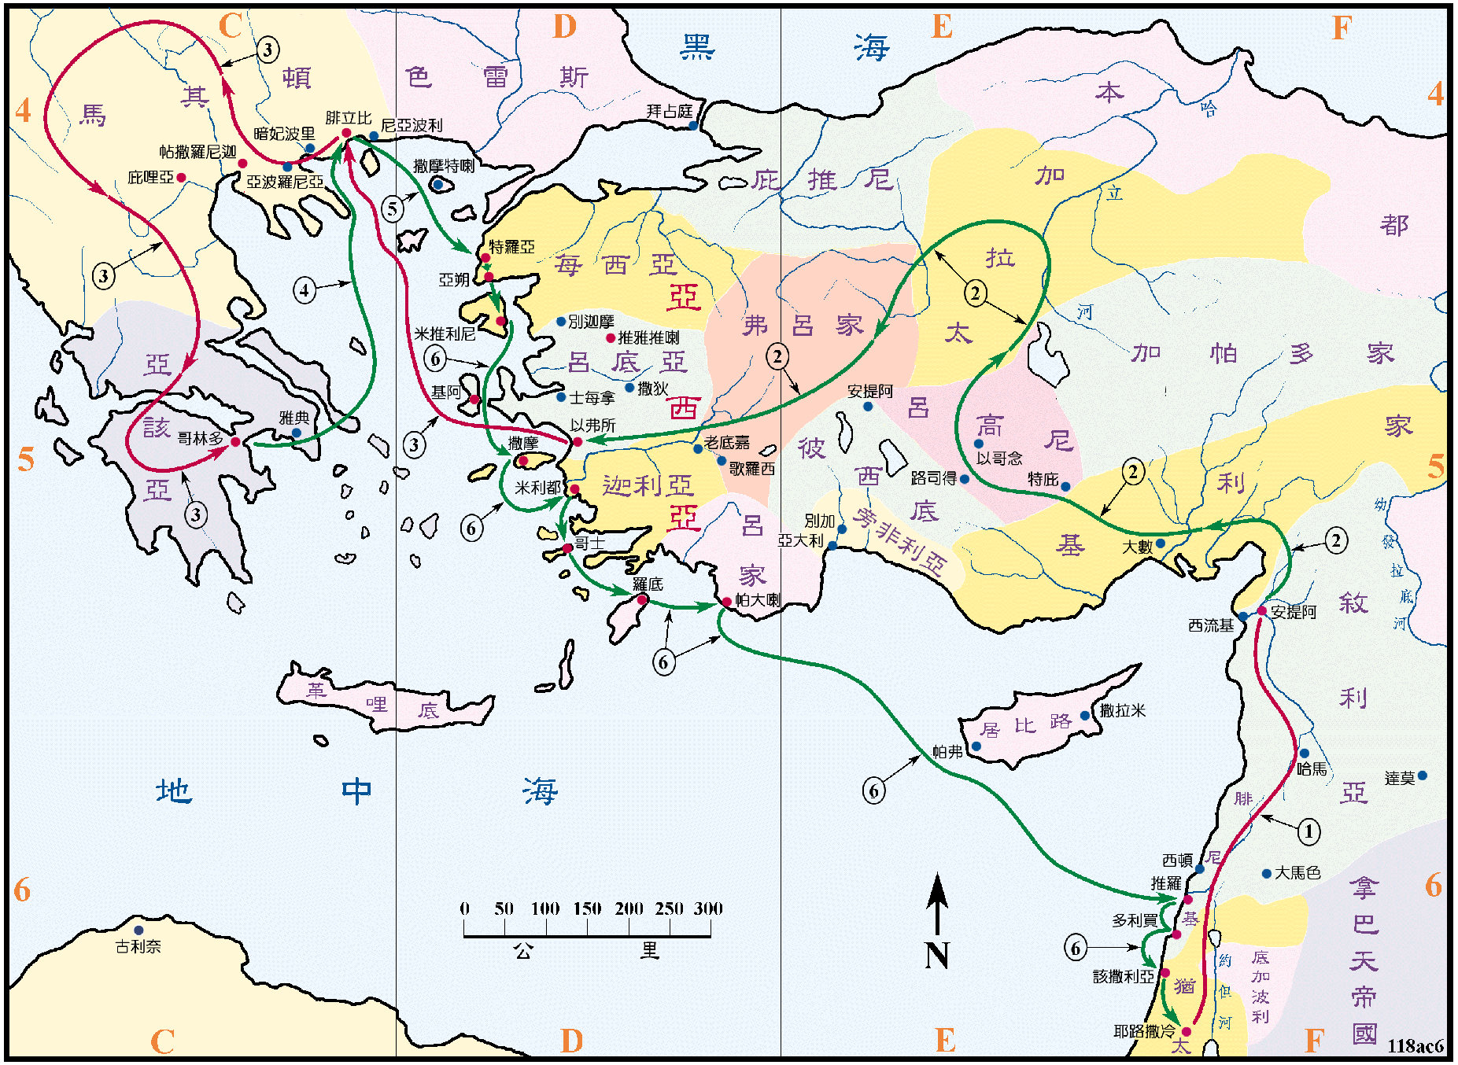
B。特庇地理位置。B. Derbe location.
(4)

Slide 7
(5)
C。特庇的历史背景。C. Derbe historical background.
(1)特庇是小亚细亚加拉太省吕高尼地区的重要城市。 保罗在他的第一次传教旅程中（14:6,20,21;16:1;18:23）访问了特庇。保罗的同胞该犹来自特庇（20：4）。
(2)特庇的教会是由保罗创立的。
(3)特庇的教会代表“守律法的教会”。
(4)特庇的意思是“刺”。 律法主义是一个“墨守律法”。 “犹太律法主义者”访问了加拉太人，他们反对保罗所教导的。在对基督的信心之外，他们的教义所围绕的中心是对摩西律法的顺服。
(1) Derbe was an important city in the region of Lycaonia in the province of Galatia in Asia Minor. Paul visited Derbe on his first missionary journey(14:6, 20,21; 16:1;18:23).Paul’s fellow minister, Gaius was from Derbe(20:4).
(2) Derbe church was founded by Paul.
(3) Derbe church represents “Legalistic Church”.
(4) Derbe means “a sting”. Legalism is a “strict literal adherence to the law.” “Judaizers” visited the Galatians espousing views contrary to what Paul had taught. Their teachings centered around the need to add to faith in Christ with obedience to the law of Moses.

Slide 8
(6)
一。基督之灵的称许。1. Spirit of Christ’s commendation.
“第二天，同巴拿巴往特庇去”（14:20b）。
A。福音(寻求)事工： “对那城里的人传了福音”（14:21a）。
B。门徒事工：使好些人作门徒，就回…去，坚固门徒的心，劝他们亨受所信的道，又说:“我们进入神的国，必须经历许多艰难”(14:21b-22)。 （1）得门徒（新生，11:26）。 （2）作门徒（太28:19-20）。 （3）测试门徒（徒14:22）。
C。领导(崇拜)事工： “二人在各个教会中选立了长老”(14:23; 多1:5,7)。
“The next day he and Barnabas left for Derbe”(14:20b).
A. Gospel(Seeker’s) ministry. “They preached the gospel in that city”(14:21a). B. Discipleship ministry.Won a large number of disciples.Then they returned…strengthening the disciples and encouraging them to remain true to the faith.We must go through many hardships to enter the kingdom of God,they said(14:21b- 22). (1)Win disciples(by new birth, 11:26). (2)Make disciples(by teaching, Mt.28:19-20). (3)Test disciples(by hardships,14:22).
C. Leadership(Worship) ministry. “ Paul and Barnabas appointed elders for them in each church”(14:23a;Ti.1:5,7).Had elders elected.

Slide 9
一。基督之灵的称许。1. Spirit of Christ’s commendation.
(7)
D。祷告事工： “又禁食祷告，就把他们交托所信的主”(14:23b)。
E。宣道事工：“…从那里坐船，往安提阿去。当初他们被众人所托蒙神之恩，要办现在所作之工，就是在这地方。到了那里，聚集了会众，就述说神借他们所行的一切事，并神怎样为外邦人开了信道的门”（14：24-27）。 （1）完成第一次传教旅程。 （2）聚集第一次传教会议。 （3）报告宣教团的第一次成果。 走过开着的门。
F。团契事工：“二人就在那里同门徒住了多日”（14:28）。
D. Prayer ministry. “With prayer and fasting, committed them to the Lord, in whom they had put their trust”(14:23b).
E. Missions ministry. “…They sailed back to Antioch, where they had been committed to the grace of God for the work they had now completed. On arriving there, they gathered the church together and reported all that God had done through them and how he had opened a door of faith to the Gentiles”(14:24-27). (1) Completed first missionary journey. (2) Gathered for first mission conference. (3) Reported first mission team results. Walk through the open door.
F. Fellowship ministry.“They stayed there a long time with the disciples”(14:28).

Slide 10
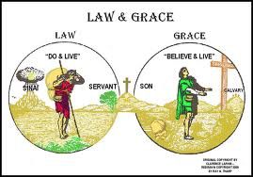

二。基督之灵的责备。2. Spirit of Christ’s condemnation.
(8)
“有几个人从犹太下来，教训弟兄们…”（15:1a）。
A。欺骗。 “你们若不按摩西的规条受割礼，不能得救”（15:1b）。混杂了恩典和律法，信心和作工。
“Certain people came down from Judea to Antioch and were teaching the believers…”(15:1a).
A. Deception. “Unless you are circumcised, according to the custom taught by Moses, you cannot be saved”(15:1b).Mix grace and law, faith and works.

Slide 11
二。基督之灵的责备。2. Spirit of Christ’s condemnation.
(9)
B。纷争和辩论。“保罗巴拿巴与他们大大地分争辩论，众门徒就定规，叫保罗，巴拿巴和本会中几个人，为所辩论的，上耶路撒冷去，见使徒和长老。于是教会送他们起行，他们经过腓尼基，撒玛利亚，随处传说外邦人归主的事，叫众弟兄都甚欢喜。到了耶路撒冷，教会和使徒并长老，都接待他们，他们就述说神同他们所行的一切事。惟有几个信徒是法利赛教门的人，起来说，必须给外邦人行割礼，吩咐他们遵守摩西的律法。”（15:2-5）。
B. Disputation and debate. “This brought Paul and Barnabas into sharp dispute and debate with them. So Paul and Barnabas were appointed, along with some other believers, to go up to Jerusalem to see the apostles and elders about this question.The church sent them on their way,…they told how the Gentiles had been converted.This news made all the believers very glad.When they came to Jerusalem,they were welcomed by the church and the apostles and elders,to whom they reported everything God had done through them.Then some of the believers who belonged to the party of the Pharisees stood up and said,The Gentiles must be circumcised and required to keep the law of Moses” (15:2-5).

Slide 12

(9)
二。基督之灵的责备。2. Spirit of Christ’s condemnation.
C。讨论。 “使徒和长老，聚会商议这事辩论已经多了…”(15:6, 7a)。 (1)彼得回顾过去（15:7b-11）。 (2)保罗和巴拿巴报道了现在（15:12）。 (3)雅各把这一切都关联到未来（15:13-18）。
D。决定。圣灵引导整个教会和教会带领人作出了决定。 （1）关于救恩的教义的决定。 （2）关于如何过基督徒生活的实际决定。
C. Discussion. “The apostles and elders met to consider this question. After much discussion…”(15:6,7a). (1) Peter reviewed the past (15:7b-11). (2) Paul and Barnabas reported on the present(15:12). (3) James related it all to the future(15:13-18).
D. Decision. The leaders and the whole church
directed by the Holy Spirit made a decision.
(1) A doctrinal decision about salvation.
(2) A practical decision about how to live the
Christian life.

Slide 13
(10)
二。基督之灵的责备。2. Spirit of Christ’s condemnation.
E。分歧。 保罗与巴拿巴之间（15:36-41）。 （1）巴拿巴选择马可。 （2）保罗选择西拉斯。
F。遗弃。“我希奇你们这么快离开那借着基督之恩召你们的,去从别的福音。那并不是福音不过有些人搅扰你们，要把基督的福音更改了。但无论是我们,是天上来的使者,若传福音给你们,与我们所传给你们的不同,他就应当被咒诅。我们已经说了,现在又说,若有人传福音给你们,与你们所领受的不同,他就应当被咒诅”(加1:6-9)。
”
E. Disagreement. Between Paul and Barnabas(15:36-41). (1)Barnabas took Mark. (2) Paul chose Silas.
F. Desertion. “I am astonished that you are so quickly deserting the one who called you to live in the grace of Christ and are turning to a different gospel—which is really no gospel at all. Evidently some people are throwing you into confusion and are trying to pervert the gospel of Christ.But even if we or an angel from heaven should preach a gospel other than the one we preached to you, let them be under God’s curse!As we have already said, so now I say again: If anybody is preaching to you a gospel other than what you accepted, let them be under God’s curse!”(Gal.1:6-9).

Slide 14
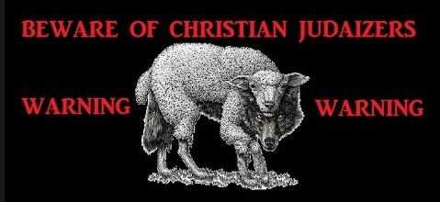
守律法的人是披着羊皮的狼。
犹太律法主义者：基督复临安息日会。
传统主义者：门诺派和阿米什人。
Legalists are wolves in sheep clothing.
Judaizers: Seventh Day Adventists.
Traditionalists: Mennonites and Amish.

Slide 15

三。基督之灵的忠告。3. Spirit of Christ’s counsel.
(11)
因信耶稣而得到救恩的好消息是世界上最重要的信息。 但现在这个信息正在受到攻击，保罗出来捍卫福音的真理。
A。神的认可。“我现在是要得人的心呢？还是要得神的心呢？我岂是讨人的喜欢吗?若仍旧讨人的喜欢,我就不是基督的仆人了”(1:10)。
The good news of salvation through faith in Christ is the most important message in the world. But now this message was being attacked, and Paul was out to defend the truth of the gospel.
A. Approval of God. “Am I now trying to win the approval of human beings, or of God? Or am I trying to please people? If I were still trying to please people, I would not be a servant of Christ”(1:10).

Slide 16
(12)
三。基督之灵的忠告。3. Spirit of Christ’s counsel.
B。神的呼召。“你们听见我从前在犹太教中所行的事，怎样极力逼迫残害神的教会。我又在犹太教中，比我本国许多同岁的人更有长进，为我祖宗的遗传更加热心。然而那把我从母腹里分别出来，又施恩召我的神，既然乐意将他儿子启示在我心里，叫我把他传在外邦人中,我就没有与属血气的人商量,也没有上耶路撒冷去,见那些比我先作使徒的。惟独往亚拉伯去。后又回到大马色”(1: 13-17)。
B.Calling by God.“For you have heard of my previous way of life in Judaism,
how intensely I persecuted the church of God and tried to destroy it.I was advan-cing in Judaism beyond many of my own age among my people and was extre-mely zealous for the traditions of my fathers.But when God,who set me apart from my mother’s womb and called me by his grace,was pleased to reveal his Son in me so that I might preach him among the Gentiles,my immediate res-ponse was not to consult any human being. I did not go up to Jerusalem to see those who were apostles before I was, but I went into Arabia. Later I returned to Damascus”(1:13-17).

Slide 17
(12)
三。基督之灵的忠告。3. Spirit of Christ’s counsel.
C。使徒的接受。 “反倒看见了主托我传福音给那未受割礼的人，正如托彼得传福音给那受割礼的人”(2:7)。
D。对抗的虚伪。 “后来矶法到了安提阿，因他有可责之处，我就当面抵挡他。从雅各那里来的人，未到以先，他和外邦人一同吃饭。及至他们来到，他因怕奉割礼的人，就退去与外邦人隔开了。其余的犹太人，也都随着他装假。甚至连巴拿巴也随伙装假”(2:11-13)。
C. Acceptance by Apostles. “They recognized that I had been entrusted with the task of preaching the gospel to the uncircumcised, just as Peter had been to the circumcised”(2:7).
D. Confrontation with hypocrisy. “When Cephas came to Antioch, I opposed him to his face, because he stood condemned. For before certain men came from James, he used to eat with the Gentiles. But when they arrived, he began to draw back and separate himself from the Gentiles because he was afraid of those who belonged to the circumcision group. The other Jews joined him in his hypocrisy, so that by their hypocrisy even Barnabas was led astray”(2:11-13).

Slide 18

(12)
三。基督之灵的忠告。3. Spirit of Christ’s counsel.
E。因信得到恩典的救恩。 “连我们也信了基督耶稣，使我们因信基督称义，不因行律法称义，因为凡有血气的，没有一人因行律法称义”(2:16b;3:1-2)。
F。因信心靠恩典成长。 “那赐给你们圣灵，又在你们中间行异能的，是因你们行律法呢？是因你们听信福音呢？正如，亚伯拉罕信神，这就算为他的义”（3:5-6）。
E. Salvation by grace through faith. “So we, too, have put our faith in Christ Jesus that we may be justified by faith in Christ and not by the works of the law, because by the works of the law no one will be justified”(2:16b;3:1-2).
F. Growth by grace through faith.
“So again I ask, does God give you his Spirit
And work miracles among you by the works
of the law, or by your believing what you heard?
So also Abraham “believed God, and it was
credited to him as righteousness”(3:5-6).

Slide 19

(13)
四。基督之灵的挑战。4. Spirit of Christ’s challenge.
不要生活在律法之下。要生活在圣灵掌管中。
A。我被基督释放了，我不再受法律的捆绑（5:1-12）。
B。我需要某事/某人来控制我内心的生活。 那是圣灵(5:13-26)。
C。通过圣灵的爱。 我渴望为别人而活,而不是为自己而活(6:1-10)。
D。这个自由的生活是如此美妙。我想要为神的荣耀而活；因为他能使之成为可能（6:11-18）。
Don’t choose to live under the law. Choose to live in the Spirit.
A. I have been set free by Christ.I am no
longer under bondage to the law (5:1-12).
B. I need something/someone to control
my life from within. That someone is the
Holy Spirit(5:13-26).
C. Through the Spirit’s love. I have a
desire to live for others, not for self(6:1-10).
D. This life of liberty is so wonderful.
I want to live it to the glory of God;for He is
the One making it possible(6:11-18).

Slide 20

(14)
结论：Conclusion:
按照特殊饮食习惯，做月子有许多的传统，吃特殊的食物，遵守各种禁忌，保护身体免受“风”的侵害。 婆婆说:“不能吃这个或那个。”妈妈说: “不能碰水。”姐姐说:“不能洗头。”妹妹说:“不能洗澡。”但有些确实是不科学的。
There are traditions for a month following childbirth, following a special diet, and observing various taboos to protect the body from exposure to the “wind”. Mother-in-law says, “Don’t eat this or that.” Mother says, “Don’t touch water.” Older sister says, “Don’t wash your hair.” Younger sister says, “Don’t take a shower.” But some are really unscientific.

Slide 21
(14)
结论：Conclusion:
还有一些成为或做一个基督徒的传统。 “不要做这个或是那个。” 但有些是法律上的，真正的不合圣经的。 所以，保罗在他的信的末尾，他以与开始一样的方式结束“愿恩惠…归与你们！(1:3)。 “兄弟们，愿我主耶稣基督的恩常在你们心里。阿门！”(6:18)。 是恩典，不是律法，是自由而不是捆绑。“律法本是藉着摩西传的， 恩典和真理都是由耶稣基督来的”（约1:17）。 “你会知道真相，真理会让你自由”（8:32）。
There are also some traditions for becoming or being a Christian. “Don’t do this or that.” But some are legalistic and really unbiblical. So, Paul comes to the end of his letter; and he closes just the way he began: “Grace…to you!(1:3). “The grace of our Lord Jesus Christ be with your spirit,brothers and sisters. Amen”
(6:18).It is grace, not law;freedom, not bondage. “For the law was given through Moses; grace and truth came through Jesus Christ”(Jn.1:17). “You will know the
truth, and the truth will set you free”(8:32).

