Slide 1
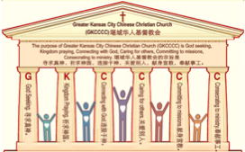

主日：二零一七年一月二十二日
Sunday: January 22, 2017
何礼义牧师 Pastor Gary Hart
题目：“无爱心的教会 。”
Topic: “Loveless Church.”
经文:启示录2:1-7
“你把起初的爱心离弃了。”(启示录2:4)
Text:Rev.2:1-7
“You have forsaken the love you had at first.”(Rev.2:4)
(1)

Slide 2
堪城华人基督教会2017年教会祷告:GKCCCC2017 Congregation Prayer:
Please stand, and pray together with me: O God,…
We thank You that You are our Father and by faith we are God’s family.
We thank You that Christ is our Head and by grace we are Christ’s body.
We thank You that the Holy Spirit is our Anointing, by His power we live.
We thank You the Bible is Your Book, by inspiration we have God’s Word.
We ask You to anoint and open our ears to hear God’s Word.
We ask You to anoint and open our eyes to understand God’s Word.
We ask You to anoint and open our hearts to receive God’s Word.
We ask You to anoint and change our minds to follow God’s will.
We ask You to anoint and use our hands to do God’s will.
We ask You to anoint and use our feet to walk in God’s will.
We ask You to anoint and speak Your message through Your servant.
We ask You to anoint and help Your church to be God seeking, Kingdom praying, Connecting with God, Caring for others, Committing to missions, Consecrating to ministry. We pray in Jesus name, Amen.

Slide 3
堪城华人基督教会2017年教会祷告:GKCCCC2017 Congregation Prayer:
请站起来，跟我一起祷告：神啊，…
我们感谢您因您是我们的父也因着信我们是神家中的人。
我们感谢您因基督是我们的头也因着恩典我们是基督的身体。
我们感谢您因圣灵是我们的恩膏也因着祂的能力我们活着。
我们感谢您因圣经是您的书也因着感召我们有神的话。
我们祈求您恩膏和打开我们的耳朵因着可以听神的话。
我们祈求您恩膏和打开我们的眼睛因着可以明白神的话。
我们祈求您恩膏和打开我们的心因着可以接受神的话。
我们祈求您恩膏和改变我们的思想因着可以跟从神的旨意。
我们祈求您恩膏和用我们的手因着可以照着神的旨意而做。
我们祈求您恩膏和用我们的脚因着可以在神的旨意上行走。
我们祈求您恩膏和使用您的仆人因着他能向我们表达您的信息。
我们祈求您恩膏和帮助您的教会寻求真神，祈求神国，连接于神，关爱别人，献身宣教，奉献事工。我们奉耶稣的名祷告，阿们。

Slide 4
引言：
Introduction:
(2)
使徒约翰说：“我约翰就是你们的弟兄，和你们在耶稣的患难，国度，忍耐里一同有分。为神的道，并为给耶稣作的见证，曾在那名叫拔摩的海岛上。当主日我被圣灵感动，听见在我后面有大声如吹号说，你所看见的，当写在书上，达与以弗所，士每拿，别迦摩，推雅推喇，撒狄，非拉铁非，老底嘉，那七个教会”（启示录1:9-11）。
The Apostle John wrote: I, John, your brother and companion in the suffering and kingdom and patient endurance that are ours in Jesus, was on the island of Patmos because of the word of God and the testimony of Jesus.On the Lord’s Day I was in the Spirit, and I heard behind me a loud voice like a trumpet, which said: “Write on a scroll what you see and send it to the seven churches:to Ephesus, Smyrna, Pergamum,Thyatira,Sardis,Philadelphia and Laodicea” (Rev.1:9-11).

Slide 5

引言：甲。七个教会的信息。
Intro: A. The messages to the seven churches.
(3)
（一）这七个教会是在约翰的时代在亚洲的实际教会。
（二）这七个教会代表教会历史的七个时期。
（三）这七个教会是今天存在的教会种类。
（四）这七个教会代表任何教会可嫩存在的特点。
（五）这七个教会代表撒旦攻击教会七个的方法。
(1)These seven churches were literal churches in Asia of John’s day.
(2)These seven churches represent seven periods of Church History.
(3)These seven churches are types of churches that exist today.
(4)These seven churches show characteristics that can exist in any church.
(5)These seven churches show seven
methods of attack by Satan on the church.

Slide 6
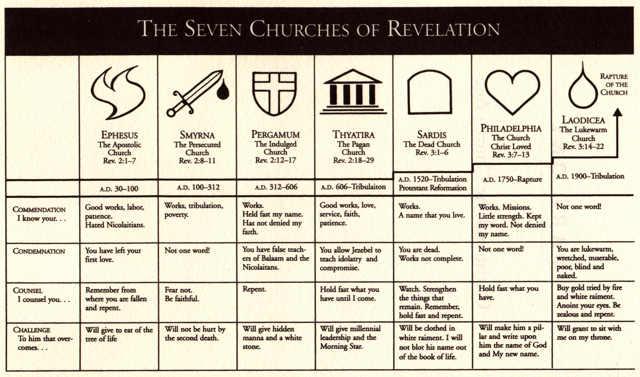
引言：甲。七个教会的信息。
Intro: A. The messages to the seven churches.
(4)

Slide 7
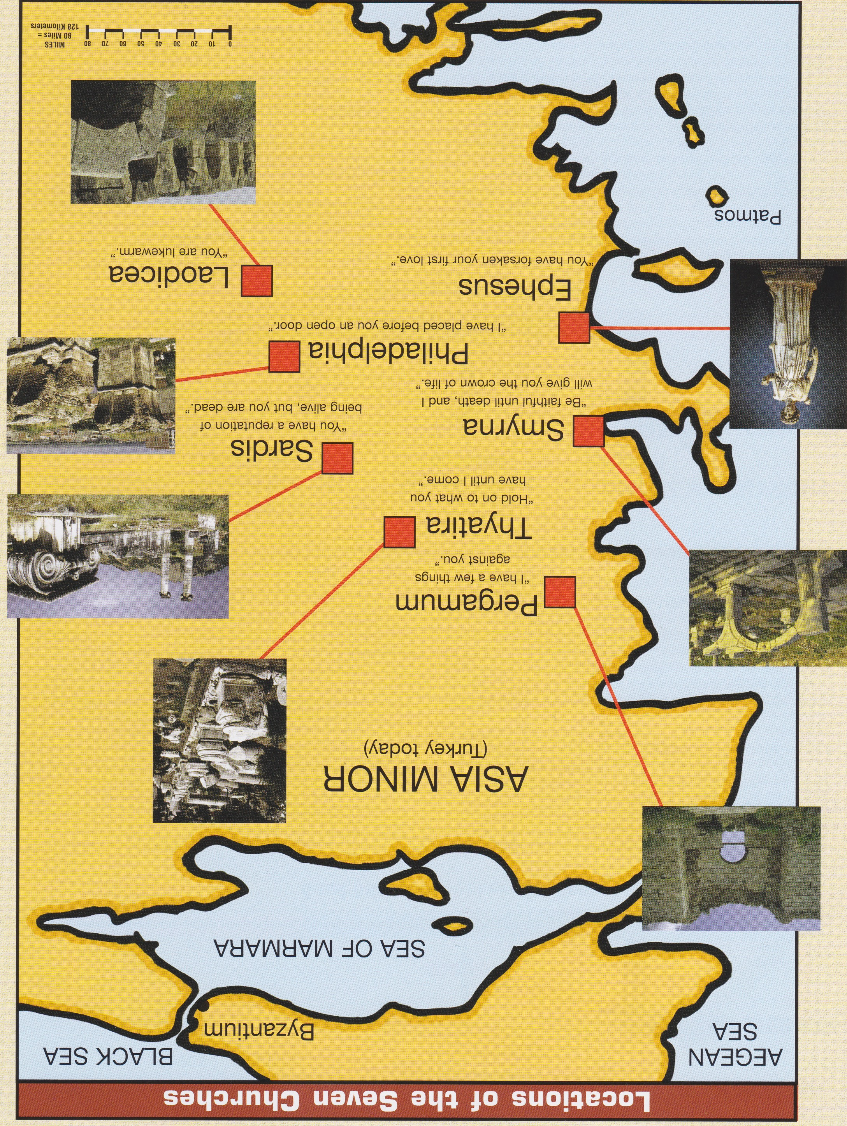
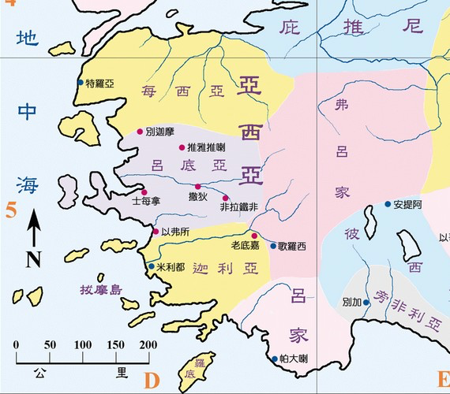
引言：乙。七个教会的地方。
Intro:B. 7 Churches locations.
爱瑟海
拔摩

Slide 8
引言：丙。以弗所历史背景。
Intro: C. Historical background of Ephesus.
(6)
（一）以弗所城靠近爱琴海，是半希腊殖民地。它所著名的是图书馆，戴安娜（罗马女神）神庙和亚底米（希腊女神）神庙。
（二）以弗所教会是保罗创立的（使徒行传18:19-20）。
（三）以弗所教会代表使徒教会（主后30-100）。
（四）以弗所名字是“所愿的”的意思。
（五）早期教会将福音传到世界各地（罗马书10:18）。
(1) The city of Ephesus was colonized by the Greeks and was located near the Aegean Sea.It was a center of trade and great wealth.It was famous for library,Temple of Diana(Roman goddess)and Temple of Artemis(Greek goddess).
(2) The Ephesus church was founded by Paul (Acts 18:19-20).
(3) The Ephesus church represents the Apostolic church(AD 30-100).
(4) The name Ephesus means “desired one.”
(5) The early church preached the gospel around the world(Ro10:18).

Slide 9
一。基督的称许。
1. Christ’s commendation.
(7)
甲。一个服事的教会.“你要写信给以弗所教会的使者.说,那右手拿着七星，在七个金灯台中间行走的，说，我知道你的行为，劳碌，忍耐”(2:1,2).“你们得救是本乎恩,也因着信，这并不是出于自己,乃是神所赐的.也不是出于行为,免得有人自夸.我们原是他的工作,在基督耶稣里造成的，为要叫我们行善，就是神所豫备叫我们行的 ”(弗2:8-10).
A. A serving Church. “To the angel of the church in Ephesus write: These are the words of him who holds the seven stars in his right hand and walks among the seven golden lampstands.I know your deeds, your hard work and your perseverance”(2:1,2a).“For it is by grace you have been saved,through faith—and this is not from yourselves,it is the gift of God—not by works, so that no one can boast.For we are God’s handiwork,created in Christ Jesus to do good works,which God prepared in advance for us to do”(Eph.2:8-10).

Slide 10
一。基督的称许。
1. Christ’s commendation.
(8)
乙。一个分别为圣的教会.“知道你不能容忍恶人”(2:2b)
（一）从假道分别为圣。“你也曾试验那自称为使徒却不是使徒的，看出他们是假的来”（2:2c；约一4:1-3)。
（二）从假行为分别为圣。“然而你还有一个可取的事，就是你恨恶尼哥拉一党人的行为，这也是我所恨恶的”（2:6）。“尼哥拉”是“胜过人民”的意思。
B. A separated Church. “I know that you cannot tolerate wicked people”(2:2b).
(1) Separate from false doctrine. “I know…that you have tested those who claim to be apostles but are not, and have found them false”
(2:2c;1Jn.4:1-3).
(2) Separate from false deeds. “But you have this in your favor: You hate the practices of the Nicolaitans, which I also hate”(2:6). “Nicolaitan” means “to conquer the people.”

Slide 11

一。基督的称许。
1. Christ’s commendation.
(9)
甲。一个坚定的教会。“你也能忍耐，曾为我的名劳苦，并不乏倦”（2:3）。他们忍耐负轭，劳苦且不倦乏 。外面（在他们的工作上）他们好像完美，但是里面（在他们的心）他们有问题。
C. A steadfast Church. “You have persevered and have endured hardships for my name,and have not grown weary”(2:3).They patiently bore their burdens and toiled without fainting. Outwardly(in their works) they seemed perfect,but inwardly(in their heart) they had problems.

Slide 12
二。基督的责备。2. Christ’s condemnation.
(10)
“然而有一件事我要责备你，就是你把起初的爱心离弃了”
（2:4）。只有一个责备，但是很严重。虽然以弗所信徒爱主，但是他们失去了起初自发的爱心。
甲。婚姻的榜样。夫妇开始彼此把对方认为是理所当然的。“蜜月的爱”变成“婚后的例行公事。”
乙。基督徒的榜样。信徒开始把神的恩典认为是理所当然的。“起初的爱”变成“基督徒的例行公事。”
“Yet I hold this against you: You have forsaken the love you had at first”(2:4). Only one condemnation, but it serious. Although the Ephesians believers loved the Lord, they had lost the spontaneous sparkle of their first love.
A. Illustrated by marriage. Husband and wife begin taking each other for granted. “Honeymoon love” becomes “routine married life.”
B. Illustrated by Christians. Believers begin taking God’s grace for granted. “First love experience” becomes “routine Christian life.”

Slide 13
二。基督的责备。
2. Christ’s condemnation.
(11)
应用：以弗所书至少有20次提到“爱”。什么是“起初的爱”？它是对基督的热爱。这常常是初信者的特征：热情的、个人的、不受压抑的、兴奋的和公开的展示。虽然成熟婚姻之爱能随着年月的增长而深化醇厚，但另一方面，“蜜月期”的新鲜、兴奋之爱也应该永远不要失去。
Application: The book of Ephesians has at least 20 references to “love”. What is “first love”? It is the devotion to Christ that so often characterizes the new believer: fervent, personal, uninhibited, excited, and openly displayed. While it is true that mature married love deepens and grow richer, it is also true that it should never lose the excitement and wonder of those “honeymoon days.”

Slide 14

三。基督的忠告。
3. Christ’s counsel.
(12)
“所以应当回想你是从那哪坠落的，并要悔改，行起初所行的事。你若不悔改，我就临到你那里，把你的灯台从原处挪去”（2:5）。
甲。回想（“继续回想”）。我跟基督一天一天的交通和爱怎么样？有没有变冷（太24:12）？
“Consider how far you have fallen! Repent and do the things you did at first. If you do not repent, I will come to you and remove your lampstand from its place”(2:5).
A. Remember (“keep on remembering”).
How is my day-by-day fellowship
and love for Christ? Has it grown cold
(Matt.24:12)?

Slide 15
三。基督的忠告。
3. Christ’s counsel.
(13)
乙。悔改。改变我们的思想并承认我们的罪。从冷淡和不关心他人（无情），变成与基督恢复生命的关系。
恢复关系。
丙。行起初所行的事。恢复关系。“你们若爱我，就必遵守我的命令”（约14:15）。
应用：彼得的故事：从“我不会否认你”到“3次否认”到3次承认他对基督的爱（约21:15-17）。
B. Repent. Change our minds and confess our sins.Turn back from coldness and indifference(apathy) to a vital relationship with Christ.
C. Repeat. Restore fellowship.“If you love me, keep my commands”
(Jn.14:15).
Application:The story of Peter: from “I will never deny you” to “deny-ing 3 times” to confirming his love for Christ 3 times(Jn.21:15-17).

Slide 16
四。基督的挑战。
4. Christ’s challenge.
(14)
“圣灵向众教会所说的话，凡有耳的，就应当听。得胜的，我必将神乐园中生命树的果子赐给他吃”（2:7）。
甲。听圣灵所说的（太13:9）。三种人：
（一）那些没有耳朵可听。
（二）那些听不进去（来5:11）。
（三）那些愿意听圣灵所说的（雅1:22）。
“Whoever has ears, let them hear what the Spirit says to the churches. To the one who is victorious, I will give the right to eat from the tree of life, which is in the paradise of God”(2:7).
A. Hear what the Holy Spirit says to the churches. 3 kinds of people:
(1) Those are without ears to hear(Mt.13:9).
(2) Those are dull of hearing(Heb.5:11).
(3) Those are willing to hear what the Holy Spirit says (Ja.1:22).

Slide 17
四。基督的挑战。
4. Christ’s challenge.
(15)
乙。得胜的得永生。
（一）生命树代表永生（22:2）。
（二）得胜的就是那些因相信基督而胜过世界的。“因为凡从神生的，就胜过世界。使我们胜了世界的，就是我们的信心。胜过世界的是谁呢。不是那信耶稣是神儿子的麽”(约一5:4-5) 。
B. Eternal life for overcomers.
(1) Tree of life is a symbol of eternal life(22:2).
(2) Overcomers are those who overcome the world by putting their faith in Christ. “For everyone born of God overcomes the world. This is the victory that has overcome the world, even our faith.Who is it that overcomes the world? Only the one who believes that Jesus is the Son of God”(I Jn.5:4-5).

Slide 18
结论：
Conclusion:
(16)
早期的教会很幸运有一本圣经复本，可以在每一个主日的时候阅读; 只有通过记住在教会听到的话语，大多数基督徒才能在主日之间的平常日子里让神的话语继续供应他们的属灵生活。我们现代的基督徒没有这样的借口 – 普通基督徒随时可以取用3-10 本圣经 。信徒保持他们起初的爱心的最好的办法是通过每天读经、学习和诵记，让神的道充充满满、丰丰富富地住在你们心里。
Early churches were fortunate to have one Bible copy that could be read each Lord’s Day; only by memorizing the Word heard at church could most Christians feed their spiritual life on God’s Word between Sundays. We modern Christians have no such excuse—the average Christian has access to 3-10 Bibles at any time. The best way for believers to retain their first love is to let the Word of God dwell in you richly, by reading, studying and memorizing it on a daily basis.

