Slide 1


V=假期
B=圣经
S=学校

Slide 2
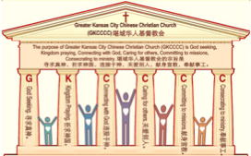

主日:二零一七年七月十六日
Sunday: July 16, 2017
何礼义牧师 Pastor Gary Hart
题目：“分裂的教会。”
Topic: “Divided Church.”
经文:徒14:1-7 Text: Acts 14:1-7
“二人在以哥念同进犹太人的会堂”(徒14:1)。
“At Iconium Paul and Barnabas went as usual into the Jewish synagogue”(Ac.14:1).
(1)

Slide 3
引言:A。使徒行传的信息。 Intro: A.Message of Acts of the Apostles.
(2)
(一)基督建造祂的教会（基督的灵借着使徒在作工）。
(二)使徒行传是圣灵的指挥,控制和赋权的事工,创立和加强了教会,并使它成长。
(三)使徒行传是一个过渡时期:从耶稣的事工到使徒的;从旧约到新约;从以色列作神的见证到教会作神的见证;从犹太教出来, 教会诞生了。
(四)使徒行传显示大使命得以遵行(1:8)从证人到耶路撒冷(1-8),到犹太和撒玛利亚(8-12)并到地极(13-28)。
(五)圣灵将继续在教会作工，书写使徒行传28章(加上）。
(1)Christ builds His Church(the Acts of the Spirit of Christ through the Apostles). (2)The Acts were the Spirit’s directing, controlling, and empowering ministry that founded and strengthened the church and caused it to grow.
(3)The Acts is a time of transitions: from ministry of Jesus to that of the apostles; from the Old Covenant to the New Covenant; from Israel as God’s witness to the Church as God’s witness; from Judaism is going out and Church is coming in.
(4)The Acts show the fulfillment of the Great Commission(1:8) from the witness to Jerusalem(1-8), to Judea and Samaria(8-12), and to the ends of earth(13-28).
(5)The Acts are the continuing Acts of the Spirit in Churches in 28 chapters(plus).

Slide 4
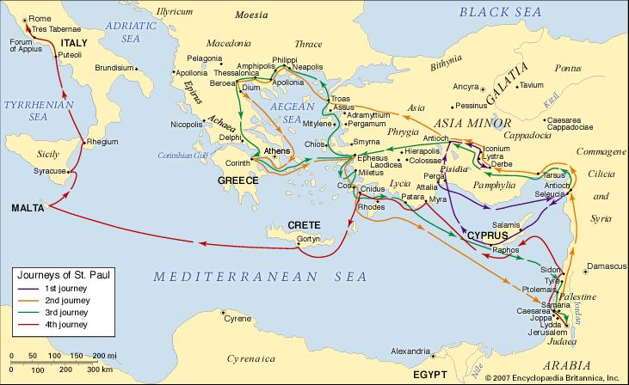
B。以哥念地理位置。
B. Iconium location.
(3)

Slide 5
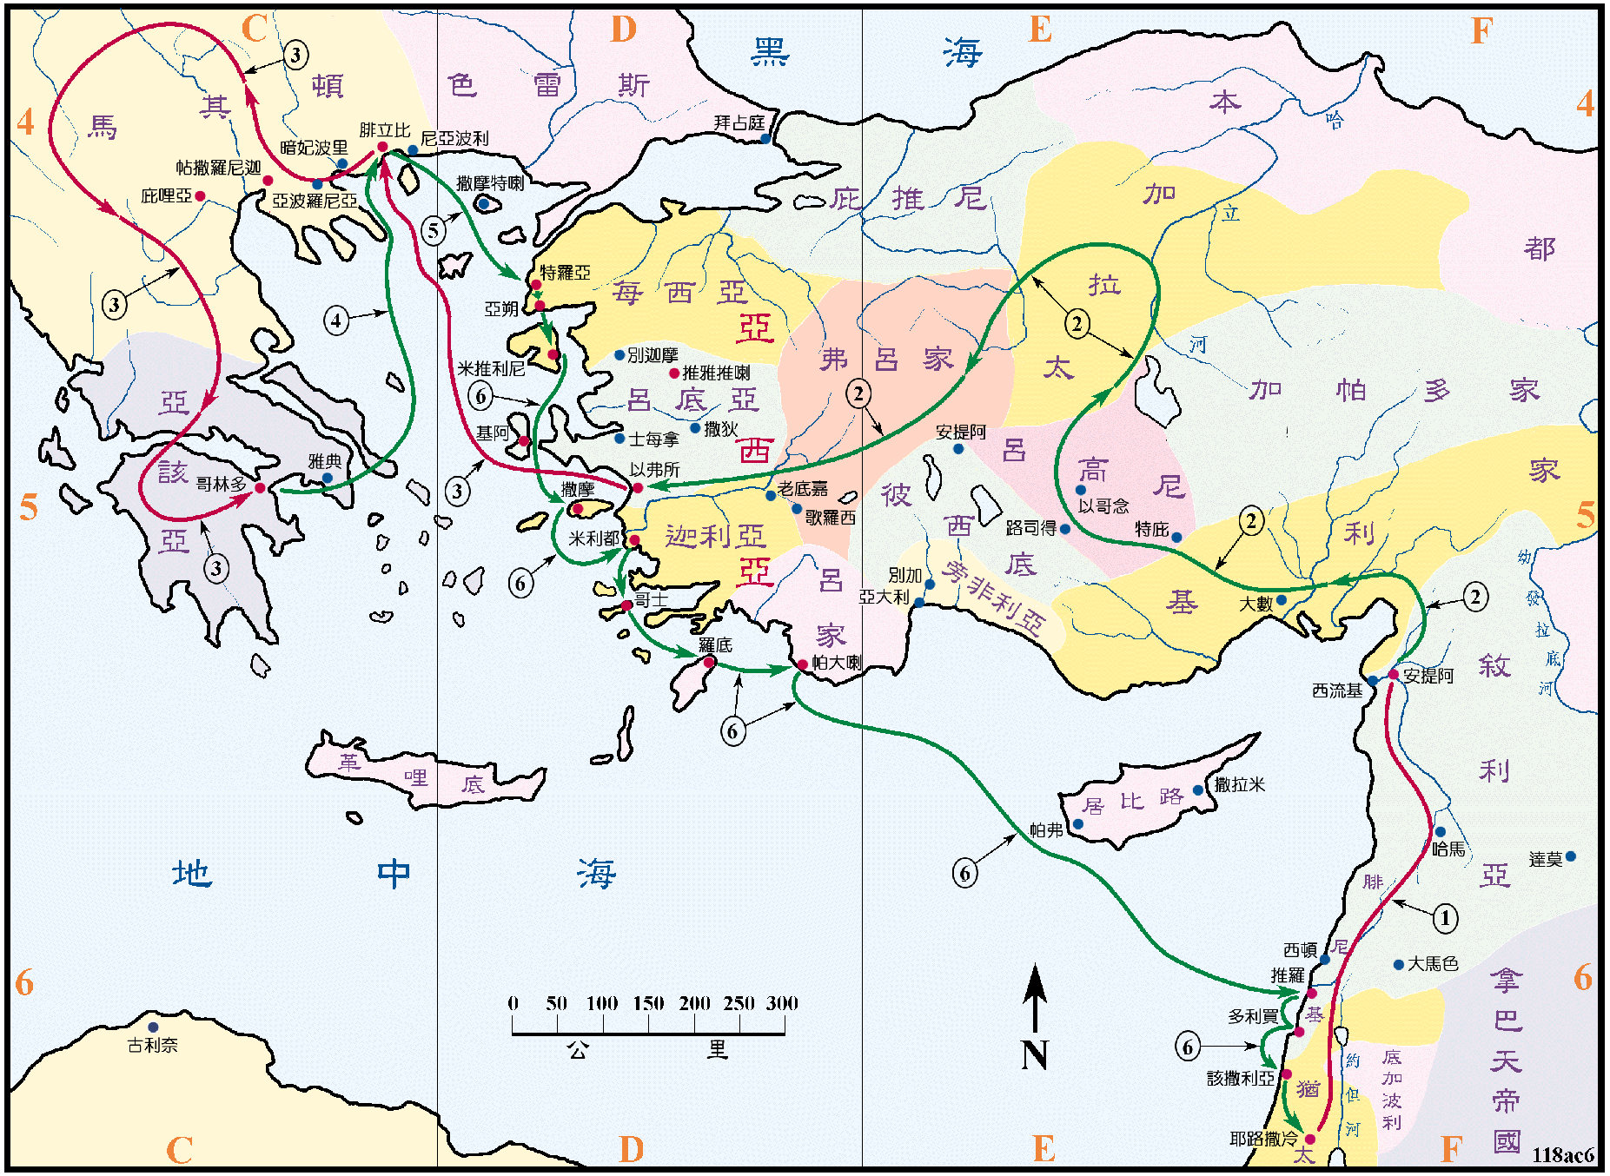
B。以哥念地理位置。B. Iconium location.
(4)

Slide 6

(5)
C。以哥念的历史背景。C. Iconium historical background.
(1)以哥念是小亚细亚的城市，保罗在第一次宣教旅程中去了那里(13:51; 14:1,19,21;16:2)。
(2)以哥念教会是由保罗创立的。他在那里忍受了痛苦和迫害。
(3)以哥念教会代表“分裂的教会”。
(4)以哥念是“形象之城”。人是以神的形象被创造的（创1:27），但因罪而失去了形象。 基督是神的本象（林后4:4;林前1:15），他的追随者是基督形象裡的新造（林后5:17;罗8:29）。
(1) Iconium was a city of Asia Minor, that Paul traveled to during his first missionary journey(13:51;14:1,19,21;16:2).
(2) Iconium church was founded by Paul.
He endured sufferings and persecution there(2Ti.3:11).
(3) Iconium church represents the “Divided Church”.
(4) Iconium means “city of the image”. Man was created
in the image of God (Gen.1:27), but lost that image
because of sin. Christ is the image of God (2Co.4:4;
Col.1:15), His followers are a new creation in the image
of Christ (2Co.5:17;Ro.8:29).

Slide 7
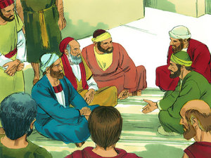
(6)
一。基督之灵的称许。1. Spirit of Christ’s commendation.
“二人在以哥念同进犹太人的会堂，在那里讲的，叫犹太人和希利尼人信的很多”（14:1）。
A。他们接受领导权的改变。（1）巴拿巴领导(“巴拿巴和保罗”8x- 11:26,30; 12:25; 13:2,7;14:14; 15:12,25)。 （2）然后保罗领导(“保罗和巴拿巴”11x-13:42,43,46,50;14:1,3,23;15:2,22,35, 36)。团结一致的领导权过渡。
“At Iconium Paul and Barnabas went as usual into the Jewish synagogue. There they spoke so effectively that a great number of Jews and Greeks believed”
(14:1).
A. They were accepting of change in
leadership. (1)Barnabas lead(“Barnabas and Paul”8x-11:26;30;12:25;13:2,7;14:14; 15:12,25).
(2) Then Paul lead (“Paul and Barnabas”11x-
13:42 ,43,46,50;14:1,3,23;15:2,22,35,36).
There was a united transition in leadership.

Slide 8
一。基督之灵的称许。1. Spirit of Christ’s commendation.
(7)
B。不断地撒种。保罗和巴拿巴在犹太会堂讲道(21x-9:20;13:5,14,15, 42;14:1;15:21;17:1,2,10,17;18:17,19,26; 19:8;22:19;24:12;26:11)。去传福音（可16:15）。 请记住:“少种的少收，多种的多收。这话是真的”（林后9:6）。
C。他们有效地收获。许多犹太人和希腊人相信。让我们不要厌倦 行善,因为如果我们不放弃,在适当的时候我们将获得丰收(加6:9)。
D。应用:你和领导人团结一致吗?你是否一直播种?你有好的收获吗?
B. They were consistent in sowing. Paul and Barnabas preached in Jewish synagogues(21x-9:20;13:5,14,15,42;14:1;15:21;17:1,2,10,17;18:4,7,8,17,19,26; 19:8;22:19;24:12; 26:11). Go and preach the gospel(Mk.16:15). Remember this: “Whoever sows sparingly will also reap sparingly, and whoever sows generously will also reap generously”(2Co.9:6).
C. They were effective in reaping. A great number of Jews and Greeks believed. “Let us not become weary in doing good, for at the proper time we will reap a harvest if we do not give up”(Gal.6:9).
D. Application. Are you united with the leaders? Are you consistent in sowing?
Are you effective in reaping?

Slide 9
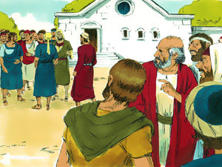
(8)
二。基督之灵的责备。2. Spirit of Christ’s condemnation.
但那不顺从的犹太人耸动外邦人，叫他们心里恼恨弟兄。…城里的众人就分了党。有附从犹太人的，有附从使徒的。那时，外邦人和犹太人，并他们的官长，一齐拥上来，要凌辱使徒，用石头打他们(14:2,4,5)。
A。第一波反对：他们拒绝相信。他们有“硬心，僵硬的脖子，盲目的眼睛，耳聋，反叛的态度”。
“But the Jews who refused to believe stirred up the other Gentiles and poisoned their minds against the brothers…The people of the city were divided; some sided with the Jews, others with the apostles. There was a plot afoot among both Gentiles and Jews, together with their leaders, to mistreat them and stone them”(14:2,4,5).
A. First wave of opposition:They refused to
believe. They had “hard hearts,stiff necks,
blind eyes,deaf ears, and rebellious attitudes.”

Slide 10
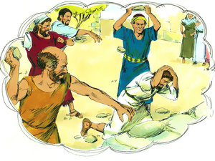
(9)
二。基督之灵的责备。2. Spirit of Christ’s condemnation.
B。第二波反对：他们引起了麻烦。“耶和华所恨恶的有六样，连他心所憎恶的共有七样：就是高傲的眼，撒谎的舌，流无辜人血的手，图谋恶计的心，飞跑行恶的脚，吐谎言的假见证，并弟兄中布散纷争的人”（箴6:16-19）。
C。第三波反对：（1）他们以恶念对待他们的弟兄。（2）他们策划阴谋。（3）他们虐待弟兄，拿石头打他们。
B. Second wave of opposition: They stirred up trouble. “There are six things the Lord hates, seven that are detestable to him:haughty eyes, a lying tongue, hands that shed innocent blood, a heart that devises wicked schemes, feet that are quick to rush into evil, a false witness who
pours out lies and a person who stirs up conflict
in the community”(Pr.6:16-19).
C. Third wave of opposition: They divided
the people. (1)They poisoned their minds
against the brothers. (2)They plotted. (3)They
mistreated and stoned them.

Slide 11
(10)
二。基督之灵的责备。2. Spirit of Christ’s condemnation.
D。应用：小心并警戒那些造成分裂的人。 “弟兄们，那些离间你们，叫你们跌倒，背乎所学之道的人，我劝你们要留意躲避他们。
因为这样的人不服事我们的主基督，只服事自己的肚腹。用花言巧语，诱惑那些老实人的心”（罗16:17-18）。“要远避无知的辩论，和家谱的空谈，以及分争，并因律法而起的争竞。因为这都是虚妄无益的。分门结党的人，警戒过一两次，就要弃绝他”（多3:10）。
D. Application: Beware and warn those who cause divisions. “I urge you, brothers and sisters, to watch out for those who cause divisions and put obstacles in your way that are contrary to the teaching you have learned. Keep away from them. For such people are not serving our Lord Christ, but their own appetites. By smooth talk and flattery they deceive the minds of naive people”
(Ro.16:17-18). “But avoid foolish controversies and genealogies and arguments and quarrels about the law, because these are unprofitable and useless. Warn a divisive person once, and then warn them a second time. After that, have nothing to do with them”(Titus 3:10).

Slide 12
三。基督之灵的忠告。3. Spirit of Christ’s counsel.
(11)
“二人在那里住了多日，倚靠主放胆讲道。主借他们的手，施行神迹奇事，证明祂的恩道”（14:3）。
A。他们花了相当多的时间在那里。花时间去认识别人。
B。他们大胆地说话。祈求大胆地说出神的话语（弗6:19-20）。
C。他们用神迹和奇事证实。信仰不是基于神迹和奇事，但它们能加強信仰（15:12;加3:5;希2:4）。
D。应用:通过花时间在一起,大胆地为主说话,并神迹证实,达到合一
“So Paul and Barnabas spent considerable time there, speaking boldly for the Lord, who confirmed the message of his grace by enabling them to perform signs and wonders”(14:3).
A. They spent considerable time there.Take time to get to know someone else.
B. They spoke boldly. Pray to speak boldly God’s Word (Eph.6:19-20).
C. They confirmed with signs and wonders. Faith is not based on signs and wonders, but bolstered by them(15:12;Ga.3:5;Heb.12:4).
D. Application. Be united by spending time together, speaking boldly for the Lord, and confirming signs.

Slide 13
(12)
四。基督之灵的挑战。4. Spirit of Christ’s challenge.
“使徒知道了，就逃往吕高尼的路司得，特庇，两个城，和周围地方去。在那里传福音”（14:6-7）。
A。他们与分裂做斗争。 “你要为真道打那美好的仗”（提前6:12）。 “那美好的仗我已经打过了。当跑的路我已经跑尽了。所信的道我已经守住了”（提后4:7）。
B。他们逃避了分裂。 “弟兄们，我借我们主耶稣基督的名，劝你们都说一样的话。你们中间也不可分党。只要一心一意彼此相合。 ”（林前1:10）。
“But they found out about it and fled to the Lycaonian cities of Lystra and Derbe and to the surrounding country, where they continued to preach the gospel”
(14:6-7).
A. They fought against divisions. “Fight the good fight of the faith”(1Ti.6:12). “I have fought the good fight, I have finished the race, I have kept the faith”(2Ti.4:7).
B. They fled from divisions. “I appeal to you, brothers and sisters, in the name of our Lord Jesus Christ, that all of you agree with one another in what you say and that there be no divisions among you, but that you be perfectly united in mind and thought”(1Cor.1:10).

Slide 14
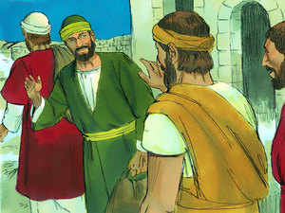
(13)
四。基督之灵的挑战。4. Spirit of Christ’s challenge.
C。他们团结一致。“在这一切之外，要存着爱心。爱心就是联络全德的”（西3:14）。 “用和平彼此联络，竭力保守圣灵所赐合而为一的心。…直等到我们众人在真道上同归于一，认识神的儿子，得以长大成人，满有基督长成的身量”（ 弗4:3,13）。他们也继续传福音。
D。应用。有时候你们与分裂做斗争，有时候你们逃避分爭，但总是要为合一而努力。
C. They worked for unity. “Over all these virtues put on love, which binds them all together in perfect unity”(Col.3:14). “Make every effort to keep the unity of the Spirit through the bond of peace…until we all reach unity in the faith and in the knowledge of the Son of God and become mature,attaining to the whole measure of the fullness of Christ”(Eph.4:3,13). They also continued to preach the gospel.
D. Application. Sometimes you fight against
divisions and sometimes you flee from
divisions, but always working for unity.

Slide 15

(14)
结论：Conclusion:
当你与来自不同背景，不同文化，不同性格，不同年龄，不同性别的个人进行紧密联系时，迟早会产生误解和冲突。如果在当地教会中将人数扩大到100个以上，那么发生冲突的可能性就处于警報阶段！信徒之间的合一是圣经中的一大要点。耶稣在祂上十字架前就为此祷告。 “你所赐给我的荣耀，我已赐给他们，使他们合而为一，像我们合而为一。我在他们里面，你在我里面，使他们完完全全的合而为一”（约17:22-23）。
When you put into close contact individuals from different backgrounds, different cultures, different personalities, different ages, and different genders, sooner or later there will be misunderstandings and conflict. If you expand the numbers to 100 or more in a local church, the potential for conflict is at the alert stage! Unity among believers is a big deal in the Bible. Jesus prayed for it just before He went to the cross.“I have given them the glory that you gave me, that they may be one as we are one—I in them and you in me—
so that they may be brought to complete unity”
(Jn.17:22-23).

Slide 16

(14)
结论：Conclusion:
保罗花了以弗所书的前三章，强调上帝的永恒的旨意是将万物在基督里同归于一。 “使天上地上一切所有的，都在基督里面同归于一”（1:10）。他表明，福音的奥秘包括神将两个以前疏远和敌对的团体，犹太人和外邦人聚集在一起。他使他们成为一个新人，建立和平（2:14-16）。在基督里，两个群体都由一个圣灵进入父（2:18）。我们一起被建造成圣殿或者神的居所（2:21-22）。基督正在建造祂的教会。
Paul spent the first three chapters of Ephesians arguing that God’s eternal purpose is to sum up all things in Christ. “To bring unity to all things in heaven and on earth under Christ” (1:10). He has shown that the mystery of the gospel includes God bringing together two formerly alienated and hostile groups, the Jews and the Gentiles. He has made them into
one new man, establishing peace (2:14-16). In
Christ, both groups have access in one Spirit to
the Father(2:18). Together, we are being built
into a holy temple or dwelling place of God in
the Spirit(2:21-22).Christ is building His Church.

