Slide 1
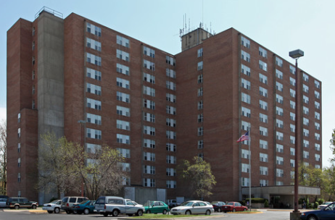
Welcome to Wednesday Bible Study!
欢迎来参加星期三查经班！
Santa Fe Towers Apartments in the Community Room
8101 Santa Fe Drive
Overland Park, KS 66103
In English and in Chinese. 用英文和中文。
Wednesdays from 10 to 11:30 a.m.
星期三早上从十点到十一点半。
Pastor Gary Hart 何礼义牧师
Starting April 12,2017. 2017年4月12日开始。

Slide 2
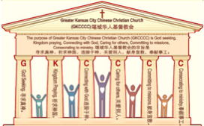

主日:二零一七年三月二十六日
Sunday: March 26, 2017
何礼义牧师 Pastor Gary Hart
题目：“圣灵充满的教会 。”
Topic: “Spirit filled Church.”
经文:使徒行传2:1-4,42-47
“他们就都被圣灵充满”(徒2:4a).
Text: Acts 2:1-4,42-47
“All of them were filled with the Holy Spirit”(Ac.2:4a).
(1)

Slide 3
引言:A。使徒行传的信息。 Intro: A.Message of Acts of the Apostles.
(2)
（一）基督建造祂的教会（基督的灵借着使徒行传）。
（二）使徒行传是圣灵的指挥，控制和赋权的事工，创立和加强了教会，并使它成长。
（三）使徒行传是一个过渡时期:从耶稣的事工到使徒的;从旧约到新约;从以色列作神的见证到教会作神的见证;从犹太教出来，教会来了。
（四）使徒行传显示大使命(1:8)从证人到耶路撒冷(1-8),到犹太和撒玛利亚(8-12)并到地极(13-28)。
（五）使徒行传在教会中继续圣灵的行传（徒29…）。
(1)Christ builds His Church(the Acts of the Spirit of Christ through the Apostles). (2)The Acts were the Spirit’s directing, controlling, and empowering ministry that founded and strengthened the church and caused it to grow.
(3)The Acts is a time of transitions: from ministry of Jesus to that of the apostles; from the Old Covenant to the New Covenant; from Israel as God’s witness to the Church as God’s witness; from Judaism is going out and Church is coming in.
(4)The Acts show the fulfillment of the Great Commission(1:8) from the witness to Jerusalem(1-8), to Judea and Samaria(8-12), and to the ends of earth(13-28).
(5)The Acts are the continuing Acts of the Spirit in Churches (Acts29...)

Slide 4
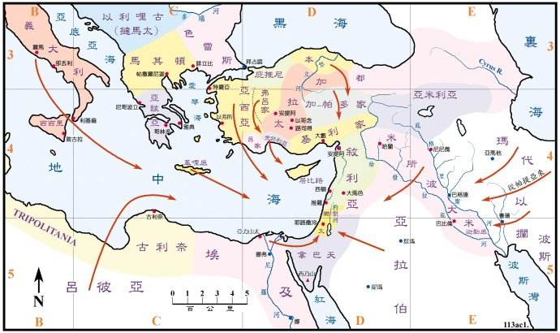
B。耶路撒冷的地理位置。
B. Jerusalem location.

Slide 5
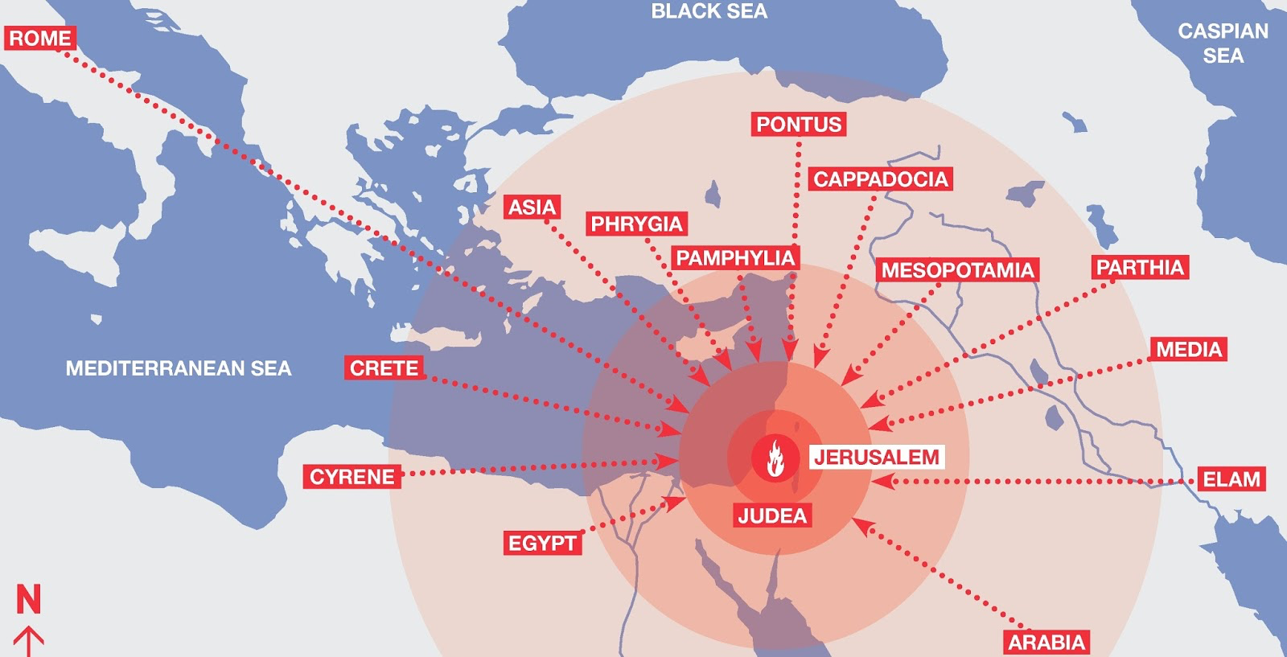
B。教会的地理位置。
B. Church location.

Slide 6
C。耶路撒冷的历史背景。
C. Historical background of Jerusalem.
(5)
（一）犹大的耶路撒冷是犹太教，基督教和回教的“圣城”。它是“大卫城”（首都）。它有摩利亚山（创22:2），圣殿，骷髅地和空的坟墓（耶稣死亡和复活）。
（二）耶路撒冷教会是在五旬节由使徒创立的。
（三）耶路撒冷代表圣灵充满的教会。
（四）耶路撒冷意的思是“和平之城”。“并且人要奉他的名传悔改赦罪的道，从耶路撒冷起直传到万邦”（路24:47）。
(1) The city of Jerusalem in Judea is a “holy city” to Judaism, Christianity, and Islam. It is “the City of David”(capital city). It has Mount Moriah(Ge.22:2), the Temple, Calvary and empty Tomb(Jesus’ death & resurrection).
(2)Jerusalem church was founded by 12 Apostles on the day of Pentecost. (3)Jerusalem church represents Spirit-filled church.
(4)Jerusalem means“the City of Peace.”Repentance for the forgiveness of sins is to be preached to all the nations “beginning at Jerusalem”(Lk.24:47).

Slide 7

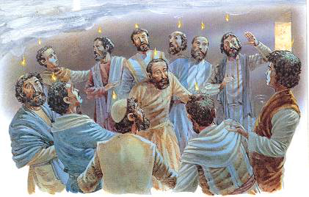

(6)
一。基督之灵的称许。1. Spirit of Christ’s commendation.
“五旬节到了，门徒都聚集在一处。忽然从天上有响声下来,好像一阵大风吹过,充满了他们所坐的屋子。又有舌头如火焰显现出来,分开落在他们各人头上。他们就都被圣灵充满,按着圣灵所赐的口才,说起别国的话来”(徒2:1-4)
“When the day of Pentecost came, they were all together in one place. Suddenly a sound like the blowing of a violent wind came from heaven and filled the whole house where they were sitting. They saw what seemed to be tongues of fire that separated and came to rest on each of them. All of them were filled with the Holy Spirit and began to speak in other tongues as the Spirit enabled them”(Ac.2:1-4).

Slide 8
一。基督之灵的称许。1. Spirit of Christ’s commendation.
(7)
A。他们有能力。“但圣灵降临在你们身上，你们就必得着能力”(1:8a)。受圣灵的洗(林前12:13)和被圣灵充满(4:8,31;9:17)。
（一）有一阵大风吹过。
（二）有许多奇事神迹。
（a）有舌头如火焰落在他们的头上。
（b）有口才说起别国的话来。
（c）有行了神迹。
（d）有使徒从监狱被释放了（5:19）。
（三）有大能力的见证（4:33）。
A. They had power. “Receive power when the Holy Spirit comes upon you”(1:8a).Spirit baptism(1Co.12:13)vs.filling(4:8,31;9:17;13:9).
(1) There was a mighty wind.
(2) There were mighty signs and wonders.
(a)Tongues of fire rested on their heads. (c)Miracles performed.
(b)Tongues of languages were spoken. (d)Apostles delivered from prison(5:19).
(3) There was a mighty testimony (4:33).

Slide 9

(8)
一。基督之灵的称许。1. Spirit of Christ’s commendation.
B。他们有同心合意。“同心合意”(1:14;2:1,44,46;4:24;加3:28)。
（一）他们在教义上一致。“都恒心遵守使徒的教训”(2:42a)。
（二）他们在团契上一致(2:42b,47)。从120,到3000(2:41),到5000(4:4)。
（三）他们在祷告上一致(4:24-30)。
（四）他们在心思意念一致(4:32) 。
B. They had unity. “One accord”(1:14;2:1,44,46;4:24;5:12;Ga.3:28).
(1) They had unity in doctrine. “They devoted themselves to the apostles’ teaching”(2:42a).
(2) They had unity in fellowship(2:42b,47). From 120,to 3000(2:41),to 5000(4:4).
(3) They had unity in prayer(4:24-30).
(4) They had unity in heart and mind (4:32).

Slide 10
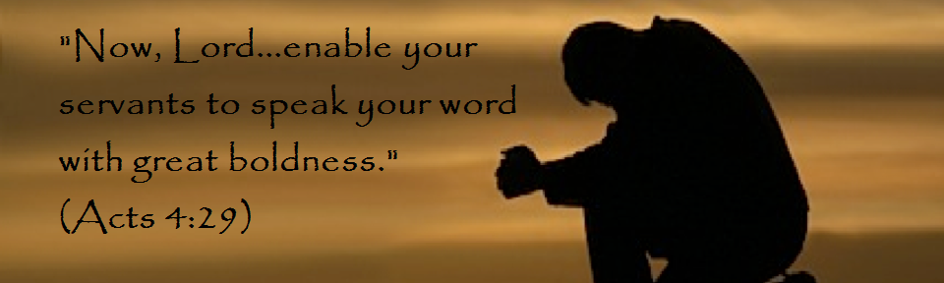
(9)
一。基督之灵的称许。1. Spirit of Christ’s commendation.
C。他们有放胆的心。“祷告完了，聚会的地方震动，他们就都被圣灵充满，放胆讲论神的道”(4:31)。“顺从神，不顺从人，是应当的”(5:29)。
D。他们有传福音的热心。“他们就每日在殿里，在家里，不住地教训人，传耶稣是基督”(5:42)。
C. They had boldness. “After they prayed, the place where they were meeting was shaken. And they were all filled with the Holy Spirit and spoke the word of God boldly”(4:31). “We must obey God rather than human beings!”(5:29).
D. They had evangelistic zeal. “Day after day, in the temple courts and from house to house, they never stopped teaching and proclaiming the good news that Jesus is the Messiah”(5:42).

Slide 11

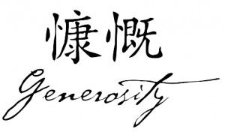
(10)
一。基督之灵的称许。1. Spirit of Christ’s commendation.
E。他们有慷慨的行为。“内中也没有一个缺乏的，因为人人将田产房屋都卖了，把所卖的价银拿来，放在使徒脚前。照各人所需用的，分给各人。有一个利未人，生在居比路，名叫约瑟，使徒称他为巴拿巴。（巴拿巴翻出来，就是劝慰子）。他有田地，也卖了，把价银拿来，放在使徒脚前。”(4:34-37)。
E. They had generosity. “That there were no needy persons among them. For from time to time those who owned land or houses sold them,brought the money from the sales and put it at the apostles’ feet, and it was distributed to anyone who had need.Joseph, a Levite from Cyprus,whom the apostles called Barnabas (which means “son of encouragement”), sold a field he owned and brought the money and put it at the apostles’ feet”(4:34-37).

Slide 12
(11)
二。基督之灵的责备。2. Spirit of Christ’s condemnation.
也有一些问题，被基督的灵责备。
A。他们欺哄。亚拿尼亚和撒非喇，卖了田产。把价银私自留下几分，其余的几分，拿来放在使徒脚前。他们欺哄圣灵（5:1-10）。
B。他们发怨言。“有说希利尼话的犹太人，向希伯来人发怨言。因为在天天的供给上忽略了他们的寡妇”（6:1）。
C。他们有对大使命的忽略。他们忽略在耶路撒冷以外做见证（1:8）。有大使命的省略。
There were also some problems, that the Spirit of Christ condemned.
A. They lied. Ananias and Sapphira sold a piece of property and kept back part of the money for himself, but bought the rest and put it at the apostles’ feet. They lied to the Spirit(5:1-10).
B. They complained. “The Hellenistic Jews among them complained against the Hebraic Jews because their widows were being overlooked in the daily distribution of food”(6:1).
C. They neglected. They neglected to be witnesses beyond Jerusalem(1:8). There was an omission to the Great Commission.

Slide 13
三。基督之灵的忠告。3. Spirit of Christ’s counsel.
(12)
A。需要遭逼迫。“从这日起，耶路撒冷的教会，大遭逼迫。除了使徒以外，门徒都分散在犹太和撒玛利亚各处”（8:1）。
B。需要负责任。 “十二使徒叫众门徒来，对他们说，我们撇下神的道，去管理饭食，原是不合宜的。所以弟兄们，当从你们中间选出七个有好名声，被圣灵充满，智慧充足的人，我们就派他们管理这事。但我们要专心以祈祷传道为事”(6:2-4)。
C。需要受管教。 “全教会，和听见这事的人，都甚惧怕”(5:11)。
A. Need for persecution. “On that day a great persecution broke out against the church in Jerusalem, and all except the apostles were scattered throughout Judea and Samaria”(8:1).
B. Need for delegating. “So the Twelve gathered all the disciples together and said,It would not be right for us to neglect the ministry of the word of God in order to wait on tables. Brothers and sisters, choose seven men from among you who are known to be full of the Spirit and wisdom. We will turn this responsibility over to them and will give our attention to prayer and the ministry of the word”(6:2-4).
C. Need for discipline. “Great fear seized the whole church and all who heard about these events”(God’s Discipline-5:11).

Slide 14



(13)
四。基督之灵的挑战。4. Spirit of Christ’s challenge.
“这件事你们当知道，也当侧耳听我的话” (4:14-41)。
A。听圣灵所说的。 “也当侧耳听我的话。”“圣灵向众教会所说的话，凡有耳的，就应当听。”
“Let me explain this to you; listen carefully to what I say”(2:14-41).
A. Hear what the Spirit says. “Listen carefully to what I say.” “Whoever has ears, let them hear what the Spirit says to the churches.”

Slide 15
(14)
四。基督之灵的挑战。4. Spirit of Christ’s challenge.
B。明白圣灵的解释。“这件事你们当知道”。
(一)不是你想的。“你们想这些人是醉了，其实不是醉了”(2:15)。
(二)是末后的日子。 “神说，在末后的日子，我要将我的灵浇灌凡有血气的”（2:17-21；约珥书2:28-32）。
(三)是救恩的邀请。“凡求告主名的，就必得救”(2:21;罗10:13)。
(四)是耶稣的故事。“神借着拿撒勒人耶稣，在你们中间施行异能，奇事，神迹，将他证明出来”(2:22-36)。
(五)要求反应。 “我们当怎样行”（2:37-41）。
B. Understand the Spirit’s explanation. “Let me explain this to you.”
(1)It is not what you suppose.“These people are not drunk,as you suppose”(2:15)
(2)It is a fulfillment of the last days. “In the last days, God says,I will pour out my Spirit on all people…”(2:17-21;Joel 2:28-32).
(3)It is an invitation to salvation. “And everyone who calls on the name of the Lord will be saved”(2:21;Ro.10:13).
(4)It is the story of Jesus.“Jesus of Nazareth was a man accredited by God to you by miracles, wonders and signs…”(2:22-36).
(5)It demands a response.“What shall we do?”(2:37-41).

Slide 16
(15)
结论：Conclusion:
耶路撒冷教会相信基督的复活（1：1-11），他们相信彼此（1：12-14），他们相信祷告（1：15,24-25），他们相信神的带领（1：16-23）。“我们不能通过批评或是附从使这个世界改变，但可以借着被神的灵点燃的生命从内部来推动它”-Vance Havner。为什么？因为他们被神的灵燃烧。
Jerusalem church believed in the risen Christ(1:1-11),they believed in each other(1:12-14),they believed in prayer(1:15,24-25), and they believed in God’s leading(1:16-23). “We are not going to move this world by criticism of it nor conformity to it, but by the combustion within it of lives ignited by the Spirit of God”-Vance Havner. Why? Because they were “ignited by the Spirit of God.”

Slide 17
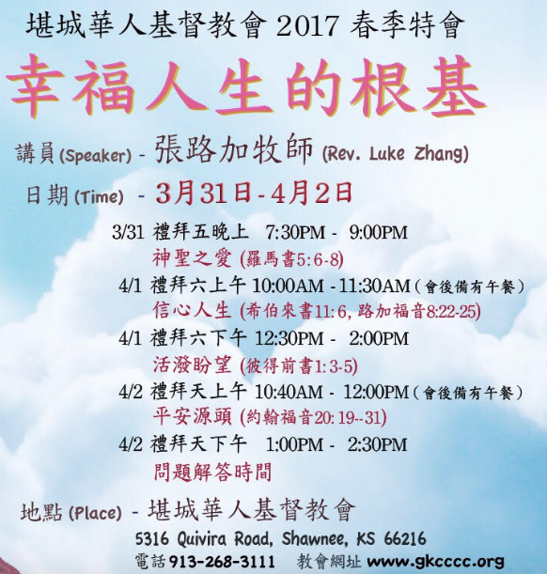
We invite you to come
Mar.31-Apr.2, 2017 Special Meetings
“Basis for Happy Life”
Speaker:Luke Zhang
March 31, 7:30-9 pm
God’s Holiness & Love.
April 1, 10-11:30 am
Faith Life
April 1, 12:30-2 pm
Living Hope
April 2,10:40am-12pm
Source of Peace
April 2, 1-2:30 pm
Questions & Answers
Hymn #252 “Spirit of the Living God”
“我神，求你用圣灵再充满我。”

