Slide 1

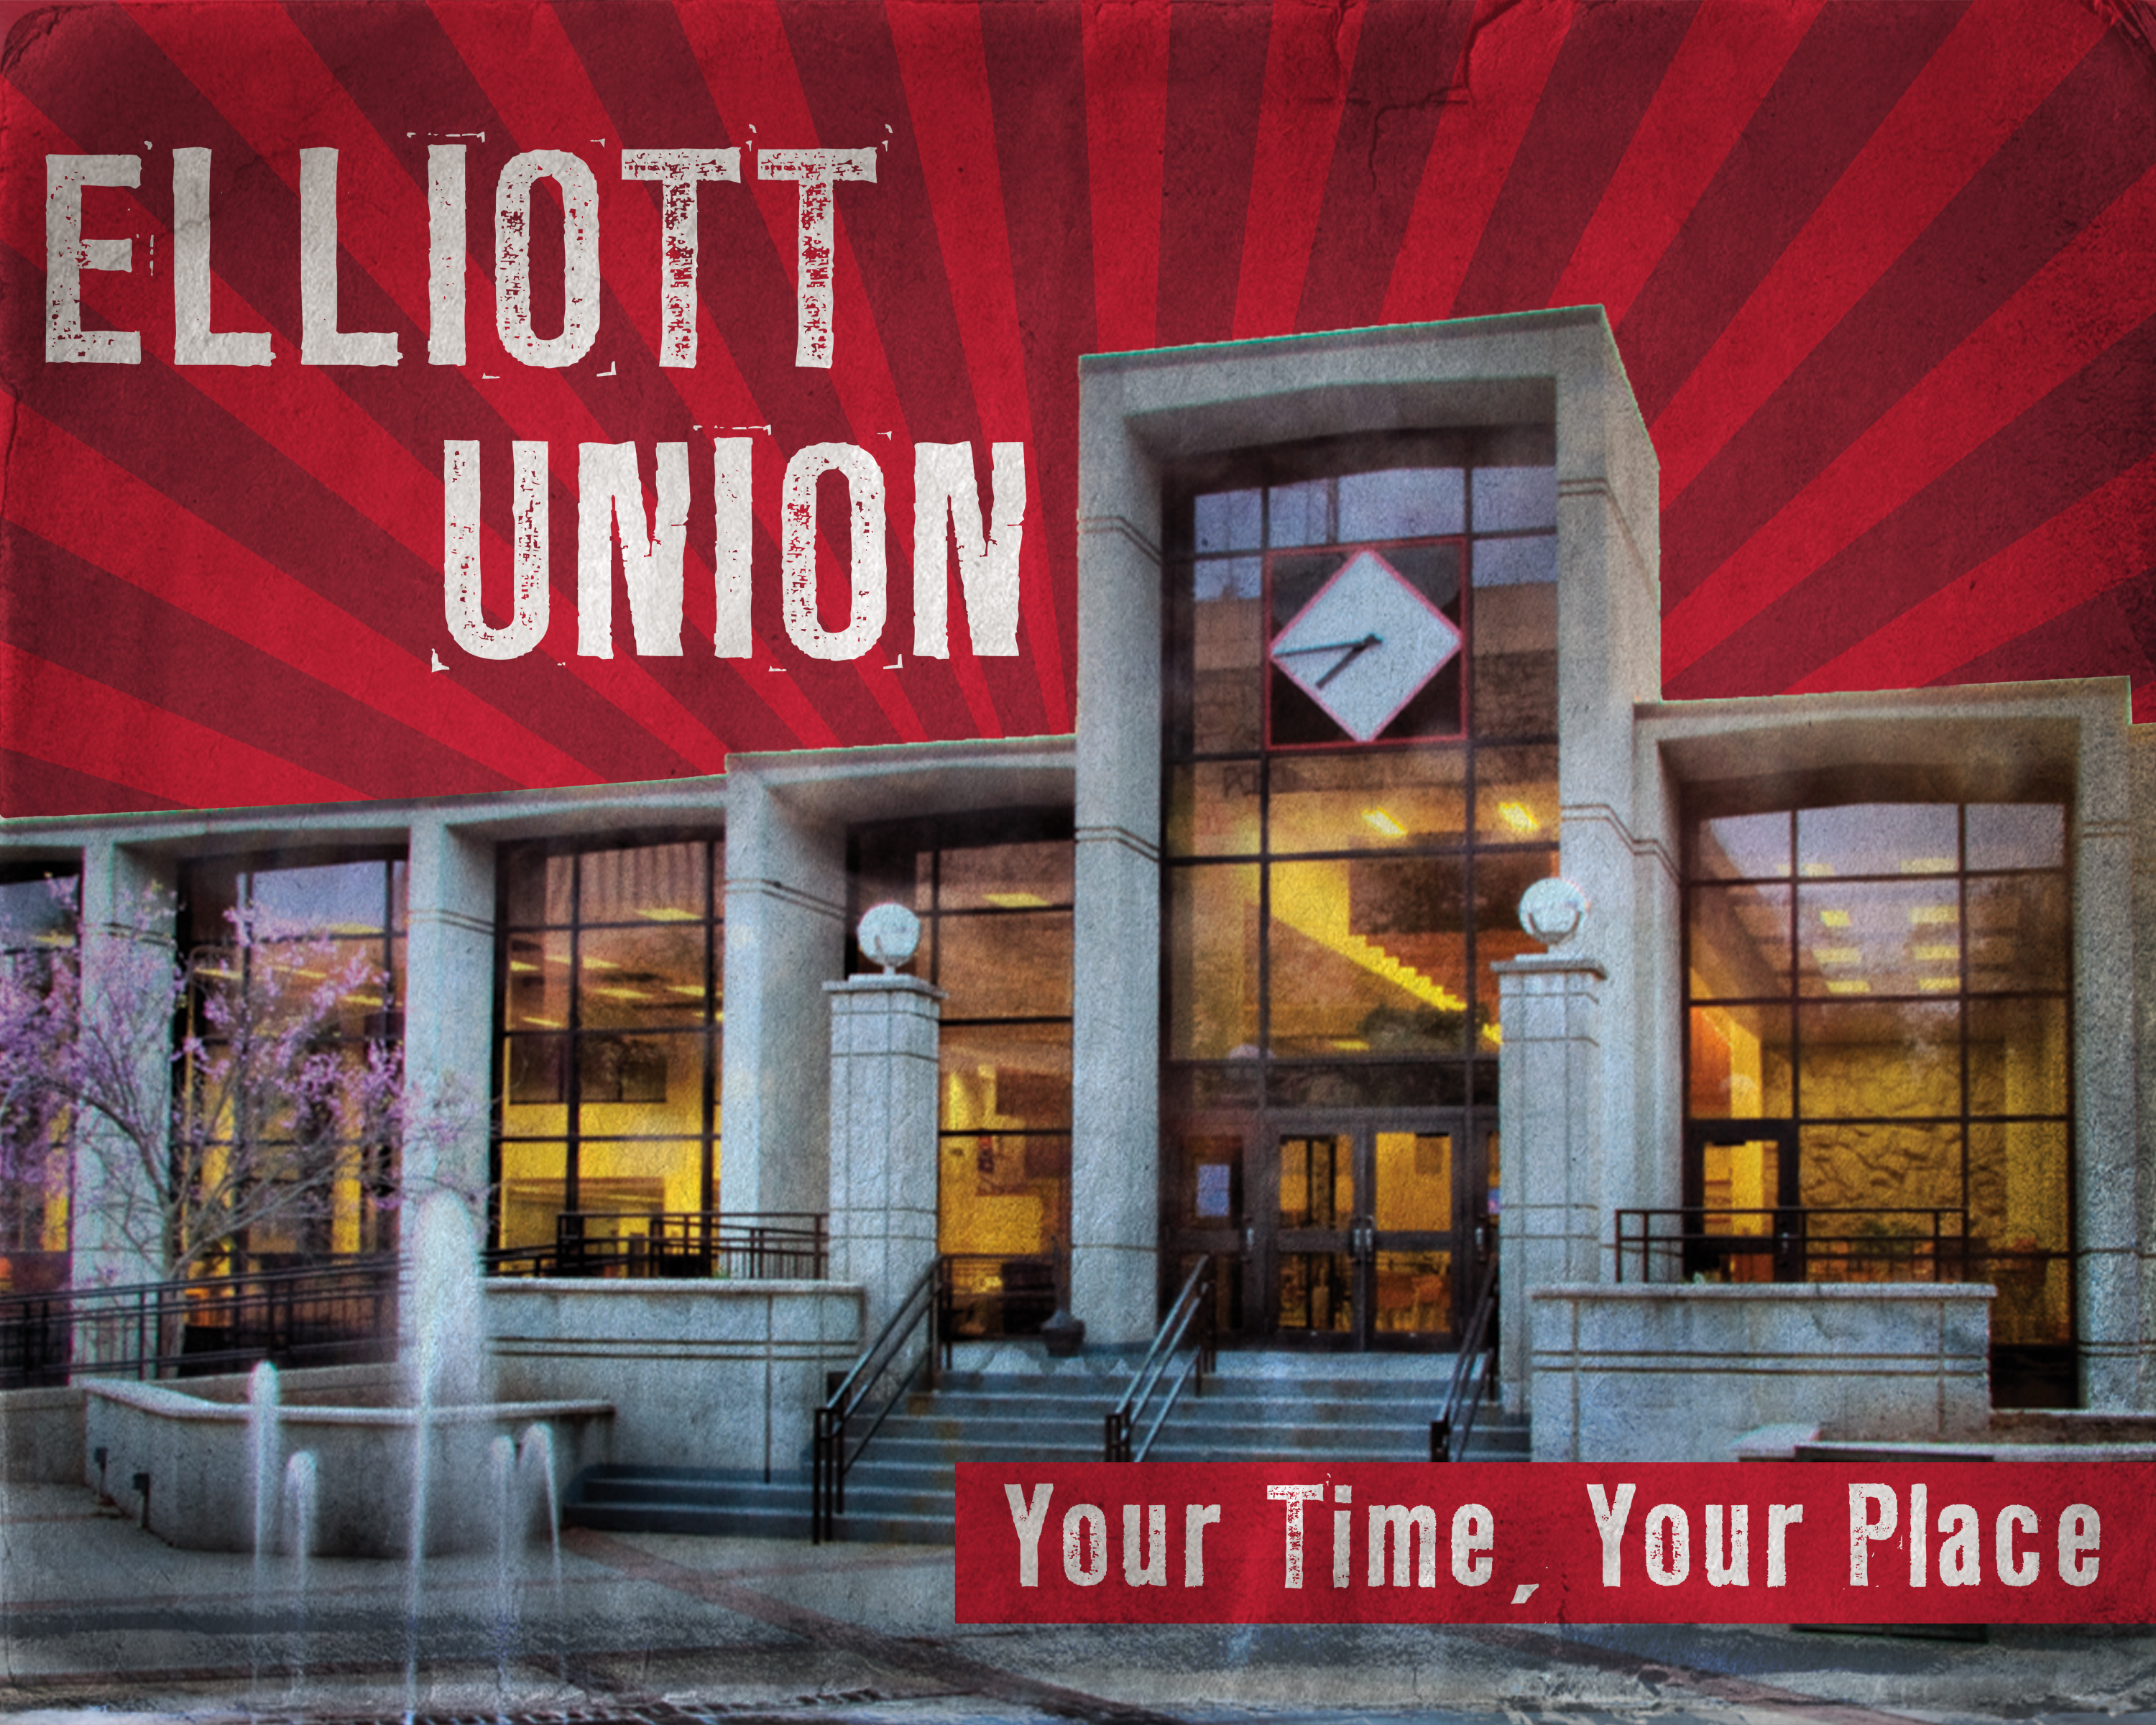
堪城华人基督教会夏令营2017年6月9-11日
GKCCCC Summer Retreat: June 9-11, 2017
地点Place: UCM Elliott Student Union
Warrensburg, MO 64093
主题：“跟随耶稣”
Topic: “Follow Jesus”
联络人：郦一明
Contact: Yiming Li
电话号码:
Phone: (913)952-1209
Website:www.gkcccc.org

Slide 2
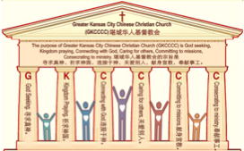

主日:二零一七年五月二十一日
Sunday: May 21, 2017
何礼义牧师 Pastor Gary Hart
题目：“美丽的教会 。”
Topic: “Beautiful Church.”
经文:使徒行传9:36-43
“这事传谝了约帕，就有许多人信了主”(徒9:42)。
Text: Acts 9:36-43
“This became known all over Joppa, and many people believed in the Lord”(Ac.9:42).
(1)

Slide 3
引言:A。使徒行传的信息。 Intro: A.Message of Acts of the Apostles.
(2)
(一)基督建造祂的教会（基督的灵借着使徒在作工）。
(二)使徒行传是圣灵的指挥,控制和赋权的事工,创立和加强了教会，并使它成长。
(三)使徒行传是一个过渡时期:从耶稣的事工到使徒的;从旧约到新约;从以色列作神的见证到教会作神的见证;从犹太教出来, 教会诞生了。
(四)使徒行传显示大使命得以遵行(1:8)从证人到耶路撒冷(1-8),到犹太和撒玛利亚(8-12)并到地极(13-28)。
(五)圣灵将继续在教会作工，书写使徒行传28章(加上）。
(1)Christ builds His Church(the Acts of the Spirit of Christ through the Apostles). (2)The Acts were the Spirit’s directing, controlling, and empowering ministry that founded and strengthened the church and caused it to grow.
(3)The Acts is a time of transitions: from ministry of Jesus to that of the apostles; from the Old Covenant to the New Covenant; from Israel as God’s witness to the Church as God’s witness; from Judaism is going out and Church is coming in.
(4)The Acts show the fulfillment of the Great Commission(1:8) from the witness to Jerusalem(1-8), to Judea and Samaria(8-12), and to the ends of earth(13-28).
(5)The Acts are the continuing Acts of the Spirit in Churches in 28 chapters(plus).

Slide 4
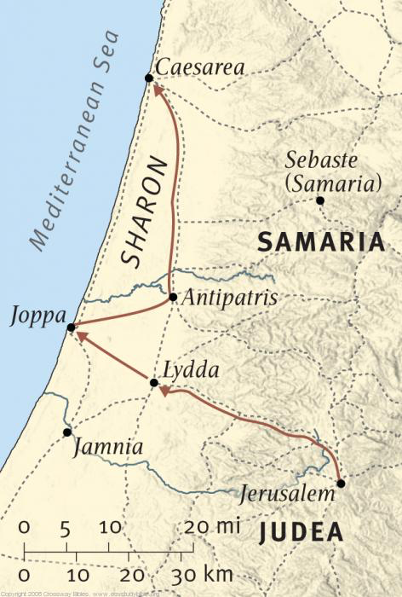
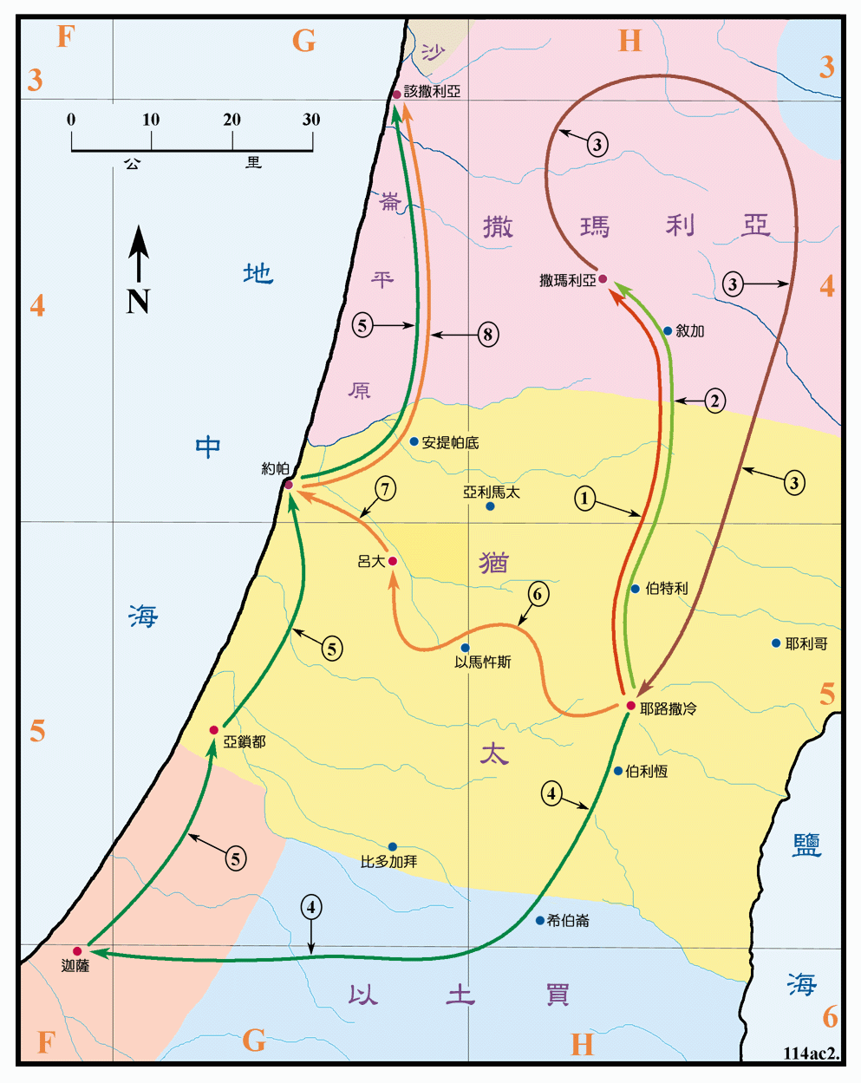
B。约帕的地理位置。
B. Joppa location.
(3)

Slide 5
C。约帕的历史背景。C. Joppa historical background.
(4)
(一) 约帕城，现代称为雅法，位于耶路撒冷西北35英里的海岸上，是世界上最古老的海港之一。这个城市属于但支派，在圣经里很重要(约书19:46)。从那里，雪松原木被漂浮运送到耶路撒冷建造圣殿。 (代下2:16;以斯3:7)。当约拿试图逃离神的时候，他上了船(拿1:3)。(二)约帕教会是由五旬节的信徒或是大逼迫期间分散的忠实信徒创立的。
(三) 约帕教堂代表着“美丽的”教会。
(四) 约帕意思是“美丽”。
(1) The city of Joppa, the modern Jaffa, is located on the seacoast 35 miles NW of Jerusalem.It is one of the most ancient seaports in the world. The city is important in Bible history as belonging to tribe of Dan(Josh.19:46), the place from which cedar logs were floated to be transported to Jerusalem for the temple (2Chron.2:16;Ez.3:7).Jonah embarked when he tried to flee from God(Jonah1:3).
(2) Joppa church was founded by believers from Pentecost or faithful believers who had been scattered during the great persecution.
(3) Joppa church represents the “beautiful” church.
(4) Joppa means “beautiful”.

Slide 6
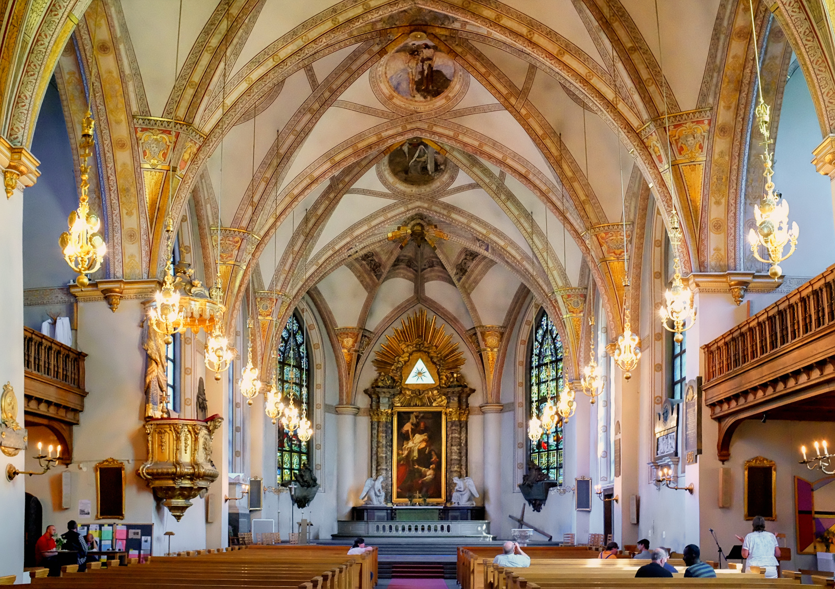
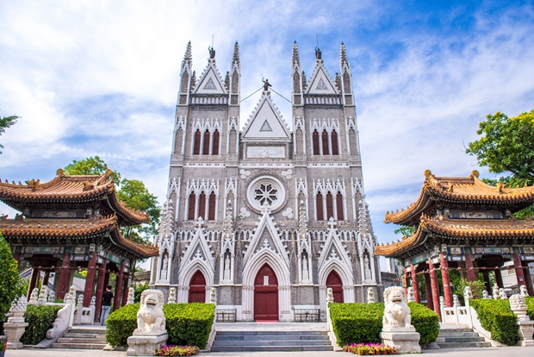
C。约帕的历史背景。C. Joppa historical background.
(5)
什么是一个“美丽的”教会？ 是建筑还是人民？“那报佳音，传平安，报好信，传救恩的，…这人的脚登山何等佳美”（赛52:7；罗10:15）。
What is a “beautiful” Church? Is it the building or the people? “How
beautiful on the mountains are the feet of those who bring good news, who proclaim peace,who bring good tidings,who proclaim salvation”(Isa.52:7;Ro.10:15).

Slide 7
(6)
一。基督之灵的称许。1. Spirit of Christ’s commendation.
“在约帕有一个女徒，名叫大比大，翻希利尼话就是多加。她广行善事，多施周济”（9:36）。
A。她叫“大比大”(“多加”)。“大比大”(阿拉姆语)和“多加” (希腊语)意思是“羚羊”。
B。她广行善事。“神怎样以圣灵和能力，膏拿撒勒人耶稣，这就都是你们知道的。他周流四方，行善事，医好凡被魔鬼压制的人，因为神与他同在”（10:38）。
C。她帮助穷人。“怜悯贫穷的，就是借给耶和华，他的善行，耶和华必偿还（箴19:17）”
“In Joppa there was a disciple named Tabitha she was always doing good and helping the poor”(9:36).
A. She was named “Tabitha”(“Dorcas”). “Tabitha”/“Dorcas” means “gazelle.”
B. She was always doing good.“How God anointed Jesus of Nazareth with the Holy Spirit and power,and how he went around doing good and healing all who were under the power of the devil, because God was with him”(10:38;Gal.6:9).
C. She was helping the poor. “Whoever is kind to the poor lends to the Lord, and he will reward them for what they have done” (Prov.19:17).

Slide 8
一。基督之灵的称许。1. Spirit of Christ’s commendation.
(7)
D。她做衣服。“彼得就起身和他们同去。到了，便有人领他上楼。众寡妇都站在彼得旁边哭，拿多加与他们同在时所做的里衣外衣给他看”（9:39）。教会有义务帮助真正有需要的人（6:1；提前5:3-16；雅1:27）。
应用：“用平安的福音，当作预备走路的鞋穿在脚上”(弗6:15)。你准备好通过善行与人建立关系，帮助穷人，帮助寡妇来分享福音，然后向他们传福音。
D. She was making clothes. “Peter went with them, and when he arrived he was taken upstairs to the room. All the widows stood around him, crying and showing him the robes and other clothing that Dorcas had made while she was still with them”(9:39). The church has an obligation to help people who are truly in need(6:1;1Tim.5:3-16;Jam.1:27).
Application: “And with your feet fitted with the readiness that comes from the gospel of peace”(Eph.6:15). Are you ready to share the gospel by building relationships through doing good, helping poor, helping widows, and so forth; then telling them the gospel.

Slide 9
(8)
二。基督之灵的责备。2. Spirit of Christ’s condemnation.
“当时，她患病而死，有人把她洗了，停在楼上。吕大原与约帕相近。门徒听见彼得在那里，就打发两个人去见他，央求他说：快到我们那里去，不要耽延。…彼得叫他们都出去…”(9:37-38;40a)。
A。她患病而死。“赏赐的是耶和华，收取的也是耶和华；耶和华的名是应当称颂的”（伯1:21）。
B。她被洗了，放在楼上的房间里。这是犹太人的习惯，首先要洗尸体，然后用香料涂抹，以便埋葬。
“About that time she became sick and died,and her body was washed and placed in an upstairs room. Lydda was near Joppa; so when the disciples heard that Peter was in Lydda, they sent two men to him and urged him, “Please come at once!Peter sent them all out of the room…”(9:37-38,40a).
A. She became sick and died. “The LORD gave, and the LORD has taken away; may the name of the LORD be praised”(Job.1:21).
B. She was washed and placed in an upstairs room. It was the Jewish custom to wash the dead body, and then to anoint it with spices for burial.

Slide 10
(9)
二。基督之灵的责备。2. Spirit of Christ’s condemnation.
C。快到那里去。使徒行传中没有任何记录使徒可以叫人从死里复活，所以他们派人去请彼得证明了他们对复活的基督的能力有信心。当我们的主在地上服事的时候，他能叫人从死里复活，为什么他在高天宝座上不能叫死了的人复活呢？
D。把它们全部送出去。彼得叫多加从死里复活与我们主叫睚鲁的女儿从死里复活对比(可5:34-43)。 在这两种情况下，哀悼的人都被赶出去了房间，所说的话几乎相同。
C. Please come at once. There is no previous record in Acts that any of the apostles had raised the dead, so their sending for Peter was an evidence of their faith in the power of the risen Christ. Jesus raised the dead, so why would He not be able to raise the dead from His exalted throne?
D. Sent them all out. The account of Peter’s raising of Dorcas should be compared with the account of our Lord’s raising of Jairus’s daughter(Mk5:34-43). In both cases, the mourning people were put out of the room and the words spoken are almost identical.

Slide 11
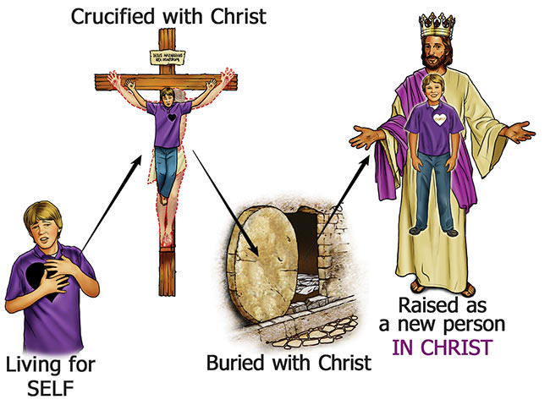
(10)
二。基督之灵的责备。2. Spirit of Christ’s condemnation.
应用：耶稣责备疾病，死亡，传统和不信。 上帝的力量将死了的人从死里复活，因为死了的人肯定不能行使信仰。“我已经与基督同订十字架，现在活着的不再是我，乃是基督在我里面活着；并且我如今在肉身活着，是因信神的儿子而活，他是爱我，为我舍己”(加2:20)。
Application: Jesus rebukes sickness, death, traditions, and disbelief. It was the power of God that raised the person from the dead, for the dead person certainly could not exercise faith. “I have been crucified with Christ and I no longer live, but Christ lives in me.
The life I now live in the body,I live by faith in the Son of God, who loved me and gave himself for me”(Gal.2:20).

Slide 12
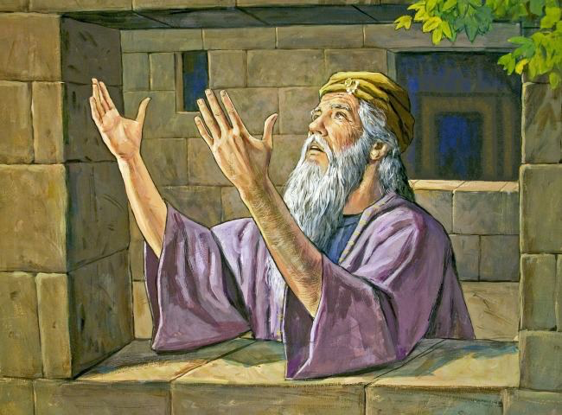
三。基督之灵的忠告。3. Spirit of Christ’s counsel.
(11)
“就跪下祷告，转身对着死人说：大比大，起来！…彼得伸手扶她起来，叫众圣徒和寡妇进去，把多加活活地交给他们…此后，彼得在约帕一个硝皮匠西门的家里住了多日”（9:40b-41,43）。
A。跪下祷告。“但以理知道这禁令盖了玉玺，就到自己家里，（他楼上的窗户开向耶路撒冷，）一日三次，双膝盖跪在他神面前，祷告感谢，与素常一样”（但6:10）。
“Then he got down on his knees and prayed. Turning toward the dead woman, he said, “Tabitha, get up.”…He took her by the hand and helped her to her feet. Then he called for the believers, especially the widows, and presented her to them alive…Peter stayed in Joppa for some time with a tanner named Simon.” (9:40b-41,43).
A. Get down on your knees and pray. “Now when
Daniel learned that the decree had been published,
he went home to his upstairs room where the windows
opened toward Jerusalem.Three times a day he got
down on his knees and prayed,giving thanks to his
God, just as he had done before”(Da.6:10).

Slide 13
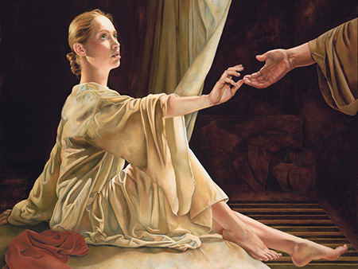
三。基督之灵的忠告。3. Spirit of Christ’s counsel.
(12)
B。起来。“现在你为什么担忧呢？起来！求告他的名受洗，洗去你的罪”（22:16；罗6:3-4）。
C。他伸手扶她起来。耶稣不害怕通过触摸死者而被玷污。彼得在多加活过来后用手拉她起来。
D。他在约帕住了多日。彼得借此机会帮助新信徒将信心建立在神话语的真理上，因为仅仅建立在神迹上的信仰是不牢靠的。
B. Get up. “And now what are you waiting for? Get up, be baptized and wash your sins away, calling on his name”(22:16; Rom.6:3-4).
C. He took her by the hand and helped her to her feet. Jesus was not afraid of becoming ceremonially defiled by touching the dead. Peter took Dorcas by the hand after she had come to life.
D. He stayed in Joppa for some time.Peter took
the opportunity to ground these new believers in
the truth of the Word, for faith built on miracles
alone is not substantial.

Slide 14
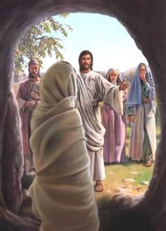
三。基督之灵的忠告。3. Spirit of Christ’s counsel.
(13)
应用：“耶稣说：我不是对你说过，你若信，就必看见神的荣耀吗？他们就把石头挪开。耶稣举目望天说：父啊，我感谢你，因为你已经听我。我也知道你常听我，但我说这话，是为周围站着的众人，叫他们信是你差了我来。说了这话，就大声呼叫说：拉撒路出来”
（约11:40-43）。
Application: “Then Jesus said, “Did I not tell you that if you believe, you will see the glory of God?” So they took away the stone. Then Jesus looked up and said, Father,I thank you that you have heard me.I knew that you always hear me, but I said this for the benefit of the people standing here, that they may believe that you sent me…Jesus called in a loud voice, “Lazarus, come out!” (Jn.11:40-43).

Slide 15
(14)
四。基督之灵的挑战。4. Spirit of Christ’s challenge.
“她就睁开眼睛，见了彼得，便坐起来，这事传遍了约帕，就有许多人信了主”(9:40c,42)。
A。她睁开眼睛。“第三日，神叫他复活，显现出来”(10:40)。
B。她坐起来。“那死人就做起，并且说话。耶稣便把他交给他的母亲”（路7:15）。
C。她复活了。圣经中有9个人从死里复活（三个人在旧约从死里复活，耶稣让三个人从死里复活，彼得和保罗都叫一个人从死里复活，还有耶稣自己复活）。
“She opened her eyes, and seeing Peter she sat up…This became known all over Joppa, and many people believed in the Lord.”(9:40c,42).
A. She opened her eyes. “But God raised him from the dead on the third day and caused him to be seen”(10:40).
B. She sat up. “The dead man sat up and began to talk, and Jesus gave him back to his mother”(Lk.7:15).
C. She was alive. 9 people in the Bible were raised from the dead(3 were raised from the dead in the OT,3 were raised from the dead by Jesus, both Peter and Paul raised a person from the dead and Jesus himself was resurrected).

Slide 16
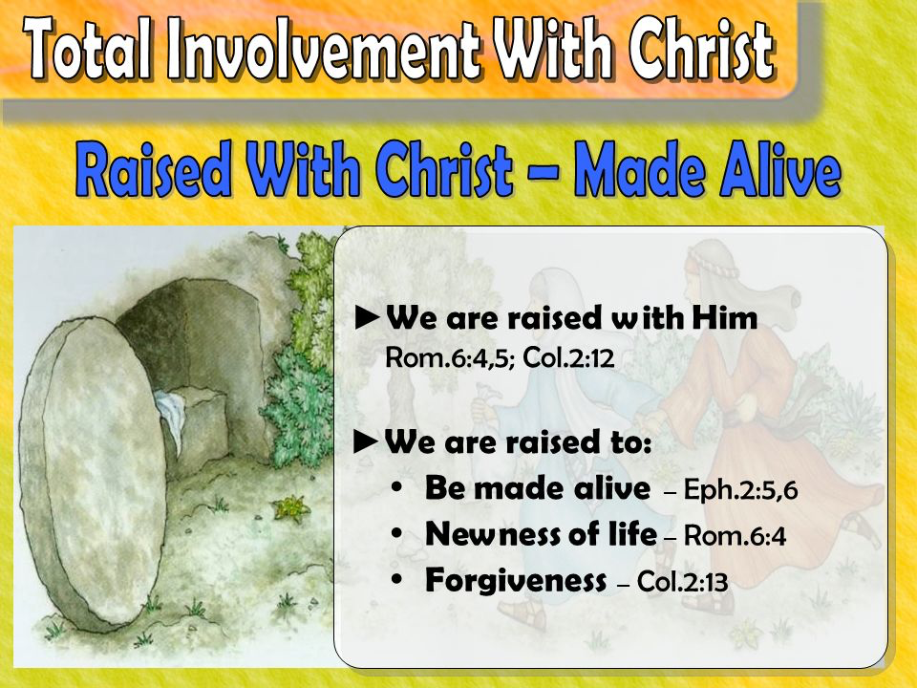
(15)
四。基督之灵的挑战。4. Spirit of Christ’s challenge.
D。许多人信了。拉撒路的复活结果，“那些来看马利亚的犹太人见了耶稣所作的是，就多有信他的”（约11:45）。
应用：耶稣叫寡妇的儿子从死里复活（加7:14），睚鲁的女儿（太9:25），拉撒路（约11:43）。彼得叫大比大从死里复活，保罗叫犹推古从死里复活（20:9-12）。 “当我们死在过犯中的时候，便叫我们与基督一同活过来。（你们得救本乎恩）他又叫我们与基督耶稣一同复活”（弗2:5-6）。
D. Many believed. As a result of Lazarus, “many of the Jews who had come to visit Mary, and had seen what Jesus did, believed in him”(Jn.11:45).
Application: Jesus raised widow’s son(Lk.7:14), Jairus’ daughter(Mt.9:25), Lazarus (Jn.11:43). Peter raised Tabitha, Paul raised Eutychus (20:9-12). God“made us alive with Christ even when we were dead in transgressions--It is by grace you have been saved. And God raised us up with Christ”(Eph.2:5-6).

Slide 17
(16)
结论：Conclusion:
(羊＋大＝美)
什么是美丽的？美丽的汉字是“大羊羔”。“看哪，神的羔羊，除去世人罪孽的”（约1:29，36）。“从全美的锡安中，神已经发光了”（诗50:2）。“有一件事，我曾求耶和华，我仍要寻求；就是一生一世住在耶和华的殿中，瞻仰他的荣美，在他的殿里求问”（27:4）。那么一个美丽的教会是什么？ 这是一个教会，信徒因注目耶稣而有美丽的眼睛，因反照基督的美丽而有美丽的心灵，因告诉他人神羔羊的美丽而有美丽的脚踪。
What is beautiful? The Chinese character for beautiful is the “great lamb”. “Look, the Lamb of God, who takes away the sin of the world!”(Jn.1:29,36). “From Zion, perfect in beauty, God shines forth”(Ps.50:2). “One thing I ask from the Lord, this only do I seek: that I may dwell in the house of the Lord all the days of my life, to gaze on the beauty of the Lord and to seek him in his temple”(Ps.27:4).So what is a beautiful church? It is a church where believers have beautiful eyes from gazing on the beauty of the Lord, beautiful hearts from reflecting the beauty of Christ, and beautiful feet from telling others of the beauty of the Great Lamb.

