Slide 1
经文:创41:45-52 Text: Gen.41:45-52
题目:“约瑟和亚西纳”Topic: “Joseph & Asenath”
引言Introduction
一 梦想 1.Dreams
生活应用一 Life Application #1
生活应用二 Life Application #2
二 困难 2.Difficulties
生活应用三 Life Application #3
三 愿望 3.Desires
生活应用四 Life Application #4
结论 Conclusion

Slide 2

何礼义牧师 Pastor Gary Hart
经文:创41:45-52 Text: Gen.41:45-52
题目:“约瑟和亚西纳”Topic: “Joseph & Asenath”
“法老赐名给约瑟，叫撒发那忒巴内亚，又将安城的祭司波提非拉的女儿亚西纳给他为妻”(创41:45)。
“Pharaoh gave Joseph the name Zaphenath-Paneah and gave him Asenath daughter of Potiphera, priest of On, to be his wife”(Ge.41:45).
主日:二零一八年三月十一日Sunday: March 11, 2018
(1)
Notes:
Tímù:“Yuē sè hè yà xī nà”
“fǎlǎo cì míng gěi yuē sè, jiào sā fā nà tè bā nèi yǎ, yòu jiāng ānchéng de jìsī bō tí fēi lā de nǚ'ér yà xī nà gěi tā wèi qī”(chuàng 41:45).

Slide 3
引言:当两个人结婚时，他们总是把自己的过去（好与坏）带入婚姻。 我们对亚西纳知之甚少，只知她是一个埃及人，也是安城的祭司波提非拉的女儿。 他们的婚姻是被包办的，他们有完全不同的过去。 她是异教祭司的女儿。 他被他的兄弟们拒绝了，刚刚离开监狱13年。 你可以想象，婚姻带来的伤痛与约瑟带来的痛苦一样痛苦吗？如果你和你的配偶能够帮助对方理解你过去的困难，达到你现在的愿望，并且知道你未来的梦想，你能想象结婚会是什么样的吗？问你的配偶:“你的梦想，困难和欲望是什么？”
Introduction: When two people get married, they always bring their pasts (good and bad) into the marriage. We know little about Asenath except that she was an Egyptian and the daughter of Potiphera, a priest in the city of On.They had an arranged marriage,but had two completely different pasts. She was the daughter of a pagan priest. He had been rejected by his brothers, and just got out of being in prison for 13 years. Can you imagine entering marriage with wounds as painful as the ones Joseph carried?Can you imagine what marriage could be if you and your spouse would help each other understand your past difficulties, reach your present desires, and know your future dreams? Ask your spouse: “What are your dreams, difficulties, and desires?”
(2)
Notes:
Yǐnyán: Dāng liǎng gèrén jiéhūn shí, tāmen zǒng shì bǎ zìjǐ de guòqù (hǎo yǔ huài) dài rù hūnyīn. Wǒmen duì yà xī nà zhīzhī shèn shǎo, zhǐ zhī tā shì yīgè āijí rén, yěshì ānchéng de jìsī bō tí fēi lā de nǚ'ér. Tāmen de hūnyīn shì bèi bāobàn de, tāmen yǒu wánquán bùtóng de guòqù. Tā shì yì jiào jìsī de nǚ'ér. Tā bèi tā de xiōngdìmen jùjuéle, gānggāng líkāi jiānyù 13 nián. Nǐ kěyǐ xiǎngxiàng, hūnyīn dài lái de shāng tòng yǔ yuē sè dài lái de tòngkǔ yīyàng tòngkǔ ma? Rúguǒ nǐ hé nǐ de pèi'ǒu nénggòu bāngzhù duìfāng lǐjiě nǐ guòqù de kùnnán, dádào nǐ xiànzài de yuànwàng, bìngqiě zhīdào nǐ wèilái de mèngxiǎng, nǐ néng xiǎngxiàng jiéhūn huì shì shénme yàng de ma? Wèn nǐ de pèi'ǒu:“Nǐ de mèngxiǎng, kùnnán hé yùwàng shì shénme?”

Slide 4

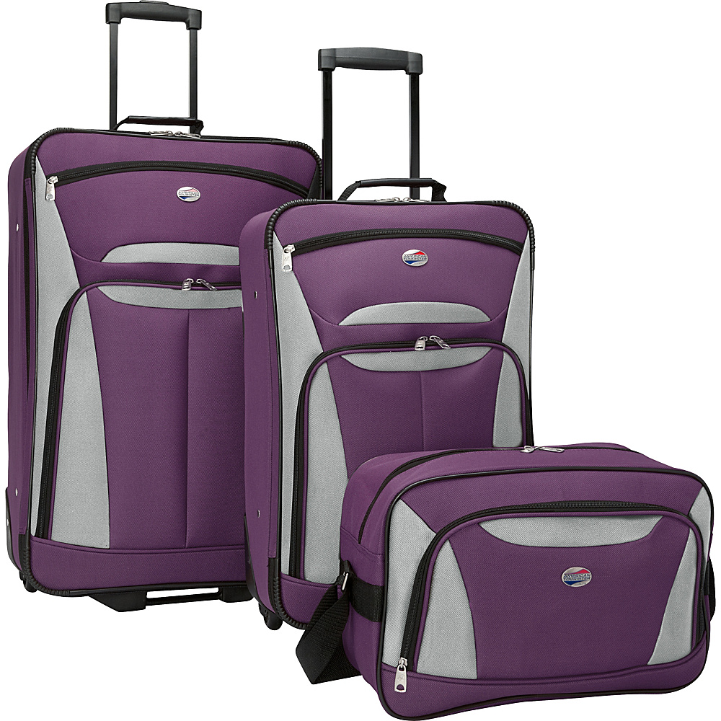

引言:Introduction:
当两个人结婚时，
他们总是带着他们的行李
进入婚姻。
问你的配偶:
“你的梦想，困难和欲望
是什么？”
When two people get married,
they always bring their baggage
into the marriage.
Ask your spouse:
“What are your dreams, difficulties, and desires?”
(2)
Notes:
Dāng liǎng gèrén jiéhūn shí, tāmen zǒng shì dàizhe tāmen de xínglǐ jìnrù hūnyīn.
Wèn nǐ de pèi'ǒu:“Nǐ de mèngxiǎng, kùnnán hé yùwàng shì shénme?”

Slide 5
一。梦想。 A。他有两个梦想。
（1）他会统治他的兄弟。“约瑟对他们说，请听我所作的梦我们在田里捆禾稼，我的捆起来站着，你们的捆来围着我的捆下拜。他的哥哥们回答说，难道你真要作我们的王吗？难道你真要管辖我们吗？”（37:6-8a）。
（2）他的父母和兄弟会向他下拜。“后来他又作了一梦，也告诉他的哥哥们说，看哪，我又作了一梦，梦见太阳，月亮，与十一个星向我下拜…你作的这是什么梦。难道我和你母亲，你弟兄果然要来俯伏在地，向你下拜吗？”（37:9,10b）。
1. Dreams. A. He had two dreams.
(1)He would rule over his brothers. “His brothers said to him, Do you intend to reign over us? Will you actually rule us?”(37:6-8a).
(2)His parents and brothers would bow down to him. “Then he had another dream, and he told it to his brothers. Listen, he said, I had another dream, and this time the sun and moon and eleven stars were bowing down to me…What is this dream you had? Will your mother and I and your brothers actually come and bow down to the ground before you?”(37:9,10b).
(3)

Slide 6

B。他的梦想走了弯路。“耶和华说，我知道我向你们所怀的意念是赐平安的意念，不是降灾祸的意念，要叫你们末后有指望”(耶29:11)。 “从前你们的意思是要害我，但神的意思原是好的，要保全许多人的性命，成就今日的光景”(50:20)。“我们晓得万事都互相效力，叫爱神的人得益处，就是按他旨意被召的人…效法他儿子的榜样”(罗8:28-29)。
B. His dreams had detours. “For I know the plans I have for you, declares the LORD, plans to prosper you and not to harm you, plans to give you hope and a future”(Jer.29:11). “You intended to harm me, but God intended it for good to accomplish what is now being done, the saving of many lives”(50:20). “We know that in all things God works for the good of those who love him,who have been
called according to his purpose…to be
conformed to the image of his Son”(Ro.8:28-29).
正在施工🚧
谢谢你的耐心
生活应用一：当神给我们一个梦想时，
我们需要耐心。
Life Application #1:When God gives us a dream,
we need patience on our part.
(5)
Notes:
Joseph went from a shepherd to a slave, then from a prisoner to the prime minister.
约瑟从牧人到奴隶，然后从囚犯到总理。Yuē sè cóng mùrén dào núlì, ránhòu cóng qiúfàn dào zǒnglǐ.
B. Tā de mèngxiǎng zǒule wānlù.“Yēhéhuá shuō, wǒ zhīdào wǒ xiàng nǐmen suǒ huái de yìniàn shì cì píng'ān dì yìniàn, bùshì jiàng zāihuò de yìniàn, yào jiào nǐmen mòhòu yǒu zhǐwàng”(yé 29:11). “Cóngqián nǐmen de yìsi shì yàohài wǒ, dàn shén de yìsi yuán shì hǎo de, yào bǎoquán xǔduō rén dì xìngmìng, chéngjiù jīnrì de guāngjǐng”(50:20).“Wǒmen xiǎodé wànshì dōu hùxiāng xiàolì, jiào ài shén de rén dé yìchu, jiùshì àn tā zhǐyì bèi zhào de rén…xiàofǎ tā érzi de bǎngyàng”(luō 8:28-29).
Zhèngzài shīgōng xièxiè nǐ de nàixīn. Shēnghuó yìngyòng yī: Dāng shén gěi wǒmen yīgè mèngxiǎng shí,
wǒmen xūyào nàixīn.

Slide 7
C。他的梦想实现了。
（1）他把计划献给法老。任命一名监督员,专员,并在好的和不好的年份收集和储存食物(41:36)。
（2）他被任命为总理。“法老和他一切臣仆都以这事为妙。法老对臣仆说，像这样的人，有神的灵在他里头，我们岂能找得着呢？法老对约瑟说，神既将这事都指示你，可见没有人象你这样有聪明有智慧。你可以掌管我的家。我的民都必听从你的话。惟独在宝座上我比你大。法老又对约瑟说，我派你治理埃及全地”(41:37-40)。
（3）他的兄弟去了埃及向他下拜(42:6-47:12)。
C. His dreams were fulfilled.
(1)He gave his plan to Pharaoh.Appoint an overseer,commissioners,and
collect and store food for the good and the bad years (41:33-36).
(2)He was appointed as Prime Minister. “The plan seemed good to Pharaoh and to all his officials. So Pharaoh asked them,Can we find anyone like this man, one in whom is the spirit of God? Then Pharaoh said to Joseph,Since God has made all this known to you, there is no one so discerning and wise as you.You shall be in charge of my palace,
and all my people are to submit to your orders” (41:37-40).
(3)His brothers went to Egypt and bowed before him(42:6-47:12).
(6)
Notes:
C. Tā de mèngxiǎng shíxiànle.
(1) Tā bǎ jìhuà xiàn gěi fǎlǎo. Rènmìng yī míng jiāndū yuán, zhuānyuán, bìng zài hǎo de hé bù hǎo de niánfèn shōují hé chúcún shíwù (41:36).
(2) Tā bèi rènmìng wèi zǒnglǐ.“Fǎlǎo hé tā yīqiè chén pū dōu yǐ zhè shì wèi miào. Fǎlǎo duì chén pū shuō, xiàng zhèyàng de rén, yǒu shén de líng zài tā lǐtou, wǒmen qǐ néng zhǎo dé zháo ne? Fǎlǎo duì yuē sè shuō, shén jì jiāng zhè shì dōu zhǐshì nǐ, kějiàn méiyǒu rén xiàng nǐ zhèyàng yǒu cōngmíng yǒu zhìhuì. Nǐ kěyǐ zhǎngguǎn wǒ de jiā. Wǒ de mín dōu bì tīngcóng nǐ dehuà. Wéidú zài bǎozuò shàng wǒ bǐ nǐ dà. Fǎlǎo yòu duì yuē sè shuō, wǒ pài nǐ zhìlǐ āijí quán de”(41:37-40).
(3) Tā de xiōngdì qùle āijí xiàng tā xià bài (42:6-47:12).

Slide 8


我的爸爸跟随他的梦想，于1960年开始创办Coinco，27岁。后来他们添加了Morco和Comor。
My dad followed his dream and started Coinco in 1960 at the age of 27.Later they added Morco and Comor.
我跟随我的梦想去台湾，并于1983年建立六宝教会，时年29岁。今年他们正在庆祝教会成立35周年。
I followed my dream to go to Taiwan and to start LiuBau Church in 1983 at the age of 29. This year they are celebrating their 35 Anniversary.
生活应用二：当神给我们一个梦想时，
我们需要忠诚，决心和努力。
Life Application #2: When God gives us a dream, we need
faithfulness, determination, and effort on our part.
(7)
Notes:
Wǒ de bàba gēnsuí tā de mèngxiǎng, yú 1960 nián kāishǐ chuàngbàn Coinco,27 suì. Hòulái tāmen tiānjiāle Morco hé Comor. Wǒ gēnsuí wǒ de mèngxiǎng qù táiwān, bìng yú 1983 nián jiànlì liù bǎo jiàohuì, shí nián 29 suì. Jīnnián tāmen zhèngzài qìngzhù jiàohuì chénglì 35 zhōunián.
Shēnghuó yìngyòng èr: Dāng shén gěi wǒmen yīgè mèngxiǎng shí,wǒmen xūyào zhōngchéng, juéxīn hé nǔlì.

Slide 9
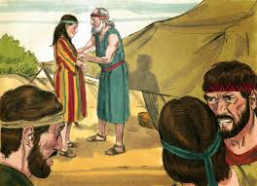
二。困难。 A。他的家庭困难。 （1）他被他的兄弟们所恨。
（a）他告发了他的兄弟。 “约瑟十七岁与他哥哥们一同牧羊…约瑟将他哥哥们的恶行报给他们的父亲”（37:2）。
（b）他受到父亲的偏爱。 “以色列原来爱约瑟过于爱他的众子，因为约瑟是他年老生的。他给约瑟作了一件彩衣。约瑟的哥哥们见父亲爱约瑟过于爱他们，就恨约瑟，不与他说和睦的话”(37:3-4)。
2. Difficulties. A. His family difficulties. (1)He was hated by his brothers. (a)He tattled on his brothers. “Joseph, a young man of seventeen, was tending the flocks with his brothers… and he brought their father a bad report about them”(37:2).
(b)He was favored by his father. “Now Israel loved Joseph more than any of his other sons, because he had been born to him in his old age; and he made an ornate robe for him.When his brothers saw that their father loved him more than any of them, they hated him and could not speak a kind word to him”(37:3-4).
(8)
(6)
Notes:
Èr. Kùnnán. A. Tā de jiātíng kùnnán. (1) Tā bèi tā de xiōngdìmen suǒ hèn.
(A) tā gàofāle tā de xiōngdì. “Yuē sè shíqī suì yǔ tā gēgēmen yītóng mùyáng…yuē sè jiāng tā gēgēmen de è xíng bào gěi tāmen de fùqīn”(37:2).
(B) tā shòudào fùqīn de piān'ài. “Yǐsèliè yuánlái ài yuē sè guòyú ài tā de zhòng zi, yīnwèi yuē sè shì tā nián lǎoshēng de. Tā gěi yuē sè zuòle yī jiàn cǎi yī. Yuē sè dí gēgēmen jiàn fùqīn ài yuē sè guòyú ài tāmen, jiù hèn yuē sè, bù yǔ tā shuō he mù dehuà”(37:3-4).

Slide 10

（c）他更为他的梦想而遭恨。 “约瑟作了一梦，告诉他哥哥们，他们就越发恨他…他们就因为他的梦和他的话越发恨他…他哥哥们都嫉妒他”（37:5，8B，11A）。
（2）他被父亲斥责。 “约瑟将这梦告诉他父亲和他哥哥们，他父亲就责备他... 他父亲却把这话存在心里”（37:10a，11b）。
（3）他在十七岁时被卖为奴隶（37:12-36）。
(c)He was hated more for his dream. “Joseph had a dream, and when he told it to his brothers, they hated him all the more…And they hated him all the more because of his dream and what he had said…His brothers were jealous of him”(37:5,8b,11a).
(2)He was rebuked by his father. “When he told his father as well as his brothers, his father rebuked him… but his father kept the matter in mind”(37:10a,11b).
(3) He was sold into slavery at the age of 17 (37:12-36).
梦想的终结
是你不再相信
需要完成的工作。
(9)
(6)
Notes:
(C) tā gèng wèi tā de mèngxiǎng ér zāo hèn. “Yuē sè zuòle yī mèng, gàosù tā gēgēmen, tāmen jiù yuèfā hèn tā…tāmen jiù yīnwèi tā de mèng hé tā dehuà yuèfā hèn tā…tā gēgēmen dōu jídù tā”(37:5,8B,11A).
(2) Tā bèi fùqīn chìzé. “Yuē sè jiāng zhè mèng gàosù tā fùqīn hé tā gēgēmen, tā fùqīn jiù zébèi tā... Tā fùqīn què bǎ zhè huà cúnzài xīnlǐ”(37:10A,11b).
(3) Tā zài shíqī suì shí bèi mài wèi núlì (37:12-36).
Mèngxiǎng de zhōngjié shì nǐ bù zài xiāngxìn xūyào wánchéng de gōngzuò.

Slide 11
B.他的道德诱惑。（1）波提乏的妻子诱惑他。“约瑟原来秀雅俊美。这事以后，约瑟主人的妻以目送情给约瑟，说，你与我同寝吧”(39:6b-7)。“后来她天天和约瑟说，约瑟却不听从她，不与她同寝，也不和她在一处。有一天，约瑟进屋里去办事，家中人没有一个在那屋里,妇人就拉住他的衣裳,说,你与我同寝吧”(39:10-12)。
（2）约瑟拒绝了试探。“约瑟不从…我怎能作这大恶，得罪神呢?…约瑟却不听从她，不与她同寝，也不和她在一处…妇人就拉住他的衣裳…约瑟把衣裳丢在妇人手里，跑到外边去了(39:8-10,12)。
B. His moral temptations. (1)Potiphar’s wife enticed him. “Now Joseph was well-built and handsome,and after a while his master’s wife took notice of Joseph and said, Come to bed with me!”(39:6b-7). “She spoke to Joseph day after day…One day he went into the house to attend to his duties, and none of the household servants was inside. She caught him by his cloak and said, Come to bed with me!”(39:10-12).
(2)Joseph resisted the temptation.“But he refused…How then could I do such a wicked thing and sin against God?...He refused to go to bed with her or even be with her… But he left his cloak in her hand and ran out of the house”(39:8-10,12).
(10)
Notes:
B. Tā de dàodé yòuhuò. (1) Bō tí fá de qīzi yòuhuò tā.“Yuē sè yuánlái xiùyǎ jùnměi. Zhè shì yǐhòu, yuē sè zhǔrén de qī yǐ mùsòng qíng gěi yuē sè, shuō, nǐ yǔ wǒ tóng qǐn ba”(39:6B-7).“Hòulái tā tiāntiān héyuē sè shuō, yuē sè què bù tīngcóng tā, bù yǔ tā tóng qǐn, yě bù hé tā zài yī chù. Yǒu yītiān, yuē sè jìn wū li qù bànshì, jiāzhōng rén méiyǒu yīgè zài nà wū li, fù rén jiù lā zhù tā de yīshang, shuō, nǐ yǔ wǒ tóng qǐn ba”(39:10-12).
(2) Yuē sè jùjuéle shìtàn.“Yuē sè bù cóng…wǒ zěn néng zuò zhè dà è, dézuì shén ne?…Yuē sè què bù tīngcóng tā, bù yǔ tā tóng qǐn, yě bù hé tā zài yī chù…fù rén jiù lā zhù tā de yīshang…yuē sè bǎ yīshang diū zài fù rénshǒu lǐ, pǎo dào wàibian qùle (39:8-10,12).

Slide 12


有互联网有更多的诱惑：色情和聊天室。
为什么真爱等待
With the internet there are more temptations: pornography and chat rooms.
如何保护您的孩子在线。
生活应用三：当受到不道德的性诱惑时，
我们需要抵制，拒绝和逃跑。
Life Application #3: When tempted with sexual immorality,
we need to resist, refuse and run.
(11)
Notes:
Yǒu hùliánwǎng yǒu gèng duō de yòuhuò: Sèqíng hé liáotiān shì.
Rúhé bǎohù nín de háizi zàixiàn.
Wèishéme zhēn'ài děngdài.
Shēnghuó yìngyòng sān: Dāng shòudào bù dàodé dì xìng yòuhuò shí,
wǒmen xūyào dǐzhì, jùjué hé táopǎo.

Slide 13
（3）波提乏的妻子诬告他。“妇人看见约瑟把衣裳丢在她手里跑出去了，就叫了家里的人来，对他们说，你们看。他带了一个希伯来人进入我们家里，要戏弄我们。他到我这里来，要与我同寝，我就大声喊叫。他听见我放声喊起来，就把衣裳丢在我这里，跑到外边去了。妇人把约瑟的衣裳放在自己那里，等着他主人回家，就对他如此如此说，你所带到我们这里的那希伯来仆人进来要戏弄我，我放声喊起来，他就把衣裳丢在我这里，跑出去了”(39:13-18)。
（4）波提乏把他关进监狱（39:20a）。
(3)Potiphar’s wife falsely accused him. “When she saw that he had left his cloak in her hand and had run out of the house,she called her household servants. Look,she said to them, this Hebrew has been brought to us to make sport of us! He came in here to sleep with me, but I screamed.When he heard me scream for help,he left his cloak beside me and ran out of the house” (39:13-18).
(4)Potiphar put him in prison (39: 20a).
(12)
Notes:
(3) Bō tí fá de qīzi wúgào tā.“Fù rén kànjiàn yuē sè bǎ yīshang diū zài tā shǒu lǐ pǎo chūqùle, jiù jiàole jiālǐ de rén lái, duì tāmen shuō, nǐmen kàn. Tā dàile yīgè xī bó lái rén jìnrù wǒmen jiālǐ, yào xìnòng wǒmen. Tā dào wǒ zhèlǐ lái, yào yǔ wǒ tóng qǐn, wǒ jiù dàshēng hǎnjiào. Tā tīngjiàn wǒ fàngshēng hǎn qǐlái, jiù bǎ yīshang diū zài wǒ zhèlǐ, pǎo dào wàibian qùle. Fù rén bǎ yuē sè de yīshang fàng zài zìjǐ nàlǐ, děngzhe tā zhǔrén huí jiā, jiù duì tā rúcǐ rúcǐ shuō, nǐ suǒ dài dào wǒmen zhèlǐ dì nà xī bó lái púrén jìnlái yào xìnòng wǒ, wǒ fàngshēng hǎn qǐlái, tā jiù bǎ yīshang diū zài wǒ zhèlǐ, pǎo chūqùle”(39:13-18).
(4) Bō tí fá bǎ tā guān jìn jiānyù (39:20A).

Slide 14

三。愿望。
A。他正在寻找神。（1）神的同在。“约瑟住在他主人埃及人的家中，耶和华与他同在，他就百事顺利”(39:2)。“约瑟在那里坐监。但耶和华与约瑟同在，向他施恩，使他在司狱的眼前蒙恩”
(39:20b-21)。
3. Desires.
A.He was seeking God.(1)God’s presence.
“The Lord was with Joseph so that he prospered, and he lived in the house of his Egyptian master”(39:2).“But while Joseph was there in the prison,the Lord was with him; he showed him kindness and granted him favor in the eyes of the prison warden”
(39:20b-21).
“人非有信就不能得神的喜悦。因为到神面前来的人，必须信有神，且信他赏赐那寻求他的人” (来11:6)。
(13)
Notes:
Sān. Yuànwàng.
A. Tā zhèngzài xúnzhǎo shén.(1) Shén de tóng zài.“Yuē sè zhù zài tā zhǔrén āijí rén de jiāzhōng, yēhéhuá yǔ tā tóng zài, tā jiù bǎishì shùnlì”(39:2).“Yuē sè zài nàlǐ zuò jiān. Dàn yēhéhuá yǔ yuē sè tóng zài, xiàng tā shī ēn, shǐ tā zài sī yù de yǎnqián méng ēn”
(39:20B-21).
“Rén fēi yǒu xìn jiù bùnéng dé shén de xǐyuè. Yīnwèi dào shén miànqián lái de rén, bìxū xìn yǒu shén, qiě xìn tā shǎngcì nà xúnqiú tā de rén” (lái 11:6).

Slide 15
（2）神的祝福。“他主人见耶和华与他同在，又见耶和华使他手里所办的尽都顺利，约瑟就在主人眼前蒙恩，伺候他主人，并且主人派他管理家务，把一切所有的都交在他手里。自从主人派约瑟管理家务和他一切所有的，耶和华就因约瑟的缘故赐福与那埃及人的家”(39:3-4)。“司狱就把监里所有的囚犯都交在约瑟手下。他们在那里所办的事都是经他的手。凡在约瑟手下的事，司狱一概不察，因为耶和华与约瑟同在。耶和华使他所作的尽都顺利”(39: 22-23)。
(2)God’s blessing.“When his master saw that the Lord was with him and that the Lord gave him success in everything he did,Joseph found favor in his eyes and became his attendant. Potiphar put him in charge of his household, and he entrusted to his care everything he owned. From the time he put him in charge of his household and of all that he owned, the Lord blessed the household of the Egyptian because of Joseph”(39: 3-4).“So the warden put Joseph in charge of all those held in the prison, and he was made responsible for all that was done there. The warden paid no attention to anything under Joseph’s care, because the Lord was with Joseph and gave him success in whatever he did”(39:22-23).
(14)
Notes:
(2) Shén de zhùfú.“Tā zhǔrén jiàn yēhéhuá yǔ tā tóng zài, yòu jiàn yēhéhuá shǐ tā shǒu lǐ suǒ bàn de jǐn dōu shùnlì, yuē sè jiù zài zhǔrén yǎnqián méng ēn, cìhòu tā zhǔrén, bìngqiě zhǔrén pài tā guǎnlǐ jiāwù, bǎ yīqiè suǒyǒu de dōu jiāo zài tā shǒu lǐ. Zìcóng zhǔrén pài yuē sè guǎnlǐ jiāwù hé tā yīqiè suǒyǒu de, yēhéhuá jiù yīn yuē sè de yuángù cì fú yǔ nà āijí rén de jiā”(39:3-4).“Sī yù jiù bǎ jiān lǐ suǒyǒu de qiúfàn dōu jiāo zài yuē sè shǒuxià. Tāmen zài nàlǐ suǒ bàn de shì dōu shì jīng tā de shǒu. Fán zài yuē sè shǒuxià de shì, sī yù yīgài bù chá, yīnwèi yēhéhuá yǔ yuē sè tóng zài. Yēhéhuá shǐ tā suǒzuò de jǐn dōu shùnlì”(39: 22-23).

Slide 16
（3）神的荣耀。“解梦不是出于神吗？”（40:8）。“约瑟回答法老说，这不在乎我，神必将平安的话回答法老(41:16)。“神已将所要作的事指示法老了”（41:25）。
B。他正在寻找神的旨意。“荒年未到以前，安城的祭司波提非拉的女儿亚西纳给约瑟生了两个儿子。约瑟给长子起名叫玛拿西（就是使之忘了的意思），因为他说，神使我忘了一切的困苦和我父的全家。他给次子起名叫以法莲（就是使之昌盛的意思），因为他说，神使我在受苦的地方昌盛”（41:50-52）。
(3)God’s glory. “Do not interpretations belong to God?”(40:8). “I cannot do it, Joseph replied to Pharaoh, but God will give Pharaoh the answer he desires”(41:16). “God has revealed to Pharaoh what he is about to do”(41:25).
B.He was seeking God’s will.“Before the years of famine came,two sons were born to Joseph by Asenath daughter of Potiphera, priest of On. Joseph named his firstborn Manasseh(“forget”)and said,It is because God has made me forget all my trouble and all my father’s household. The second son he named Ephraim(“twice fruitful”) and said, “It is be-cause God has made me fruitful in the land of my suffering”(41:50-52)
(15)
Notes:
(3) Shén de róngyào. “Jiěmèng bùshì chū yú shén ma?”(40:8). “Yuē sè huídá fǎlǎo shuō, zhè bùzàihū wǒ, shén bì jiāng píng'ān dì huà huídá fǎlǎo (41:16). “Shén yǐ jiāng suǒyào zuò de shì zhǐshì fǎlǎole”(41:25).
B. Tā zhèngzài xúnzhǎo shén de zhǐyì.“Huāng nián wèi dào yǐqián, ānchéng de jìsī bō tí fēi lā de nǚ'ér yà xī nà gěi yuē sè shēngle liǎng gè er zi. Yuē sè gěi zhǎngzǐ qǐmíng jiào mǎ ná xī (jiùshì shǐ zhī wàngle de yìsi), yīnwèi tā shuō, shén shǐ wǒ wàngle yīqiè de kùnkǔ hé wǒ fù de quánjiā. Tā gěi cì zǐ qǐmíng jiào yǐ fǎ lián (jiùshì shǐ zhī chāngshèng de yìsi), yīnwèi tā shuō, shén shǐ wǒ zài shòukǔ dì dìfāng chāngshèng”(41:50-52).

Slide 17

在生活中你有选择：苦毒或更好？
选择更好，忘记苦毒。
生活应用四：当受到苦毒的试探时，我们需要原谅和忘记，
并寻求神和神的旨意会更好。
Life Application #4:When tempted to be bitter, we need to forgive
and forget, and be better by seeking God and God’s will.
(16)
Notes:
Zài shēnghuó zhōng nǐ yǒu xuǎnzé: Kǔ dú huò gèng hǎo?
Xuǎnzé gèng hǎo, wàngjì kǔ dú.
Shēnghuó yìngyòng sì: Dāng shòudào kǔ dú dí shìtàn shí, wǒmen xūyào yuánliàng hé wàngjì,
bìng xúnqiú shén hé shén de zhǐyì huì gèng hǎo.

Slide 18
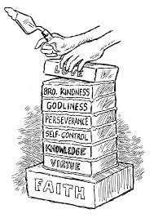
结论:约瑟的希伯来文名字的意思是“加”。
“正因这缘故，你们要分外地殷勤。有了信心，又要加上德行。
有了德行，又要加上知识。
有了知识，又要加上节制。
有了节制，又要加上忍耐。
有了忍耐，又要加上虔敬。
有了虔敬，又要加上爱弟兄的心。
有了爱弟兄的心，又要加上爱众人的心”
(彼后1:5-7)。
Conclusion: Joseph’s Hebrew name means “add.” “For this very reason, make every effort to add to your faith goodness;
and to goodness, knowledge;
and to knowledge, self-control;
and to self-control, perseverance;
and to perseverance, godliness;
and to godliness, mutual affection;
and to mutual affection, love”(2Pe.1:5-7).
(17)
Notes:
Jiélùn: Yuē sè de xī bó lái wén míngzì de yìsi shì “jiā”.
“Zhèng yīn zhè yuángù, nǐmen yào fèn wàidì yīnqín. Yǒule xìnxīn, yòu yào jiā shàng déxíng.
Yǒule déxíng, yòu yào jiā shàng zhīshì.
Yǒule zhīshì, yòu yào jiā shàng jiézhì.
Yǒule jiézhì, yòu yào jiā shàng rěnnài.
Yǒule rěnnài, yòu yào jiā shàng qiánjìng.
Yǒule qiánjìng, yòu yào jiā shàng ài dìxiōng de xīn.
Yǒule ài dìxiōng de xīn, yòu yào jiā shàng ài zhòngrén de xīn”(bǐ hòu 1:5-7).

Slide 19
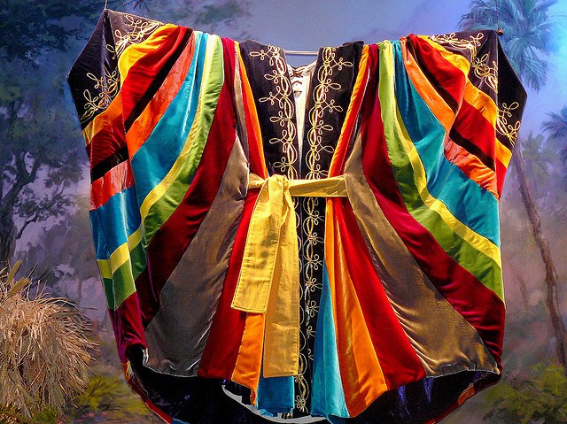
约瑟的埃及名是撒发那忒巴内亚(丰盛的生命)。神给了他丰盛的生命:善良在仇恨和嫉妒中;
知识在梦想和解释中;
自制在试探和试炼中;
忍耐在奴役和监狱中;
敬虔在埃及和家人面前;
相互亲情在妻子和孩子面前;
和爱在他的兄弟面前。“总要披戴主耶稣基督”(罗13:14)。这是像约瑟的多种颜色的外衣。
Joseph’s Egyptian name is Zaphenath-Paneah(abundant life). God gave him abundant life: goodness in midst of hatred and jealousy;
knowledge of dreams & interpretations;
self-control in temptations and trials;
perseverance in slavery and prison;
godliness in Egypt and before his family;
mutual affection for his wife and children;
and love for his brothers. “Clothe your-
selves with the Lord Jesus Christ”(Ro.13:14).
This is like Joseph’s coat of many colors.
(18)
Notes:
Joseph added to his faith(Heb.11:22),goodness, knowledge, self-control, perseverance, godliness, mutual affection, and love.约瑟为他的信仰加上了信仰(来11:22),善良,知识,自制,坚忍,敬虔,互相亲情和爱。
Yuē sè wèi tā de xìnyǎng jiā shàngle xìnyǎng (lái 11:22), Shànliáng, zhīshì, zìzhì, jiānrěn, jìngqián, hùxiāng qīnqíng hé ài.
Yuē sè de āijí míng shì sā fā nà tè bā nèi yǎ (fēngshèng de shēngmìng). Shén gěile tā fēngshèng de shēngmìng: Shànliáng zài chóuhèn hé jídù zhōng;
zhīshì zài mèngxiǎng hé jiěshì zhōng;
zìzhì zài shìtàn hé shì liàn zhōng;
rěnnài zài núyì hé jiānyù zhōng;
jìngqián zài āijí hé jiārén miànqián;
xiānghù qīnqíng zài qīzi hé háizi miànqián; hé ài zài tā de xiōngdì miànqián.“Zǒng yào pī dài zhǔ yēsū jīdū”(luō 13:14). Zhè shì xiàng yuē sè de duō zhǒng yánsè de wàiyī.

Slide 20
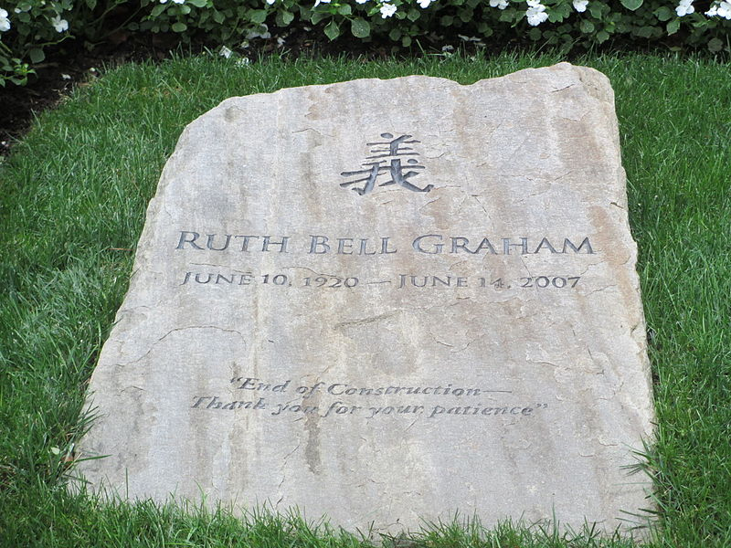
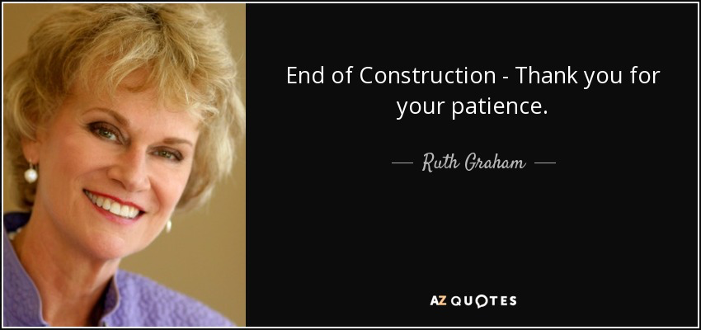
Ruth Bell Graham (Billy Graham的妻子)要求在墓碑上写下这些词:“施工结束 – 谢谢您的耐心。”因为她在中国长大她也在其上有义的汉字。
Ruth Bell Graham(Billy Graham’s wife) asked that these words be written on her tomb-stone:“End of con-struction—Thank you for your patience.” Because she grew up in China,she also has the Chinese character for “righteousness” on it.
施工结束 – 谢谢您的耐心。
(19)
Notes:
Ruth Bell Graham (Billy Graham de qīzi) yāoqiú zài mùbēi shàng xiě xià zhèxiē cí:“Shīgōng jiéshù – xièxiè nín de nàixīn.” Yīnwèi tā zài zhōngguó zhǎng dà tā yě zài qí shàng yǒu yì de hànzì.

