Slide 1
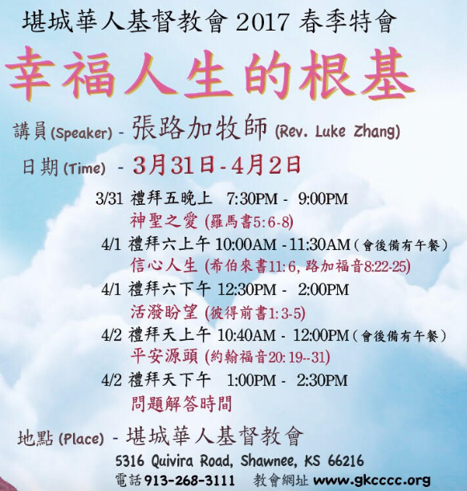
We invite you to come
(1) March 25-8-9 am
Prayer 9-9:30 am
Doug Brown: How to share your testimony.
(2) Mar.31-Apr.4, 2017 Special Meetings
“Basis for Happy Life”
Speaker:Luke Zhang
March 31, 7:30-9 pm
God’s Holiness & Love.
April 1, 10-11:30 am
Faith Life
April 1, 12:30-2 pm
Living Hope
April 2,10:40am-12pm
Source of Peace
April 2, 1-2:30 pm
Questions & Answers

Slide 2
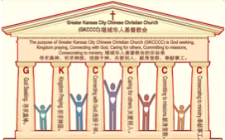
主日:二零一七年三月十九日
Sunday: March 19, 2017
何礼义牧师 Pastor Gary Hart
题目：“不冷不热教会 。”
Topic: “Lukewarm Church.”
经文:启示录3:14-22
“你既如温水，也不冷也不热”(启3:16a).
Text:Rev.3:14-22
“You are lukewarm—neither hot nor cold”(Rev.3:16a).
(1)

Slide 3
引言：A。七个教会的信息。
Intro: A. The messages to the seven churches.
(2)
（一）这七个教会是在约翰的时代在亚洲的七个实际教会。
（二）这七个教会代表教会历史的七个时期。
（三）这七个教会代表当今不同种类的教会。
（四）这七个教会代表任何教会都可能有的的特点。
（五）这七个教会代表撒旦攻击教会的七个方法。
(1)These seven churches were literal churches in Asia of John’s day.
(2)These seven churches represent seven periods of Church History.
(3)These seven churches are types of churches that exist today.
(4)These seven churches show characteristics that can exist in any church.
(5)These seven churches show seven
methods of attack by Satan on the church.

Slide 4
A。给七个教会的信息。
A. The messages to the seven churches.
(3)

Slide 5
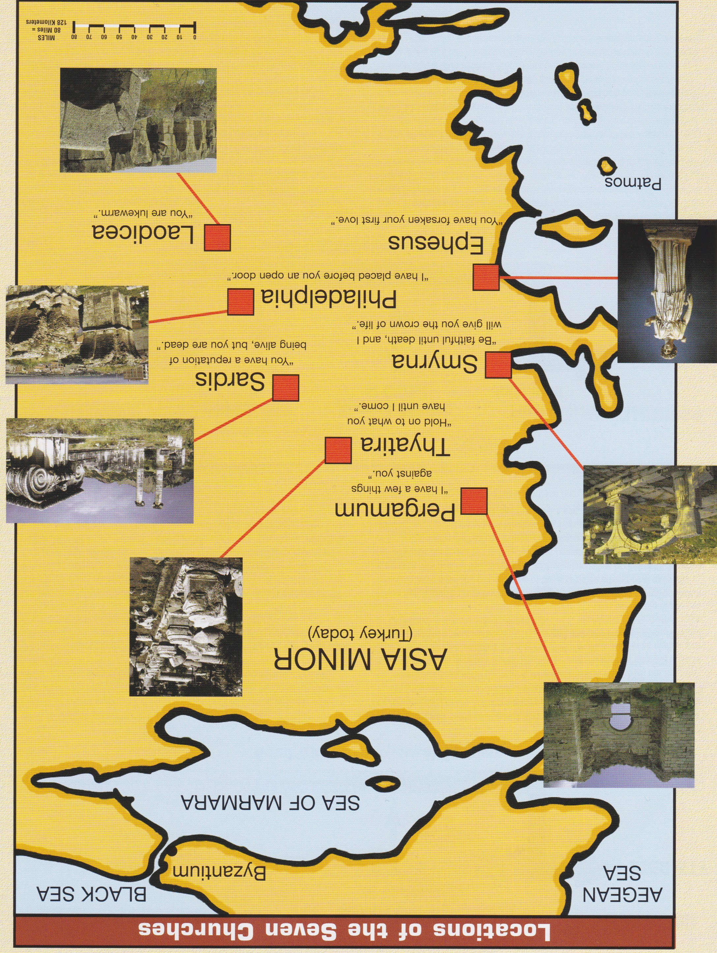
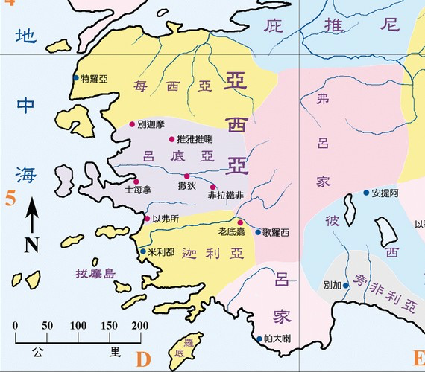
B。七个教会的地理位置。
B. 7 Churches locations.
爱瑟海
拔摩

Slide 6
C。老底嘉的历史背景。
C. Historical background of Laodicea.
(5)
（一）老底嘉城以银行（财富）和昂贵的布料（有光泽的黑色羊毛布）的制造而闻名。它的医学院以研制一种眼药而著称。它位于有温泉的希拉波立和有纯净冷水的歌罗西附近。
（二）老底嘉教会的创立人大概是以巴弗（西1:7;4:12,13)。
（三）老底嘉教会代表不冷不热的教会(主后1900－现在)。
（四）老底嘉这个词是“人们的意见”的意思。通过社交媒体和民意调查，许多人的信念基于会改变的意见，而不是上帝不改变的话语。
(1) The city of Laodicea was known for banking(wealth) and the manufacture of expensive cloth(glossy black wool cloth). Its medical school was famous for the development of an eye salve. It was located near Hieropolis where there were hot springs, and Colossae where there was pure cold water.
(2) Laodicea church was probably founded by Epaphras(Col.1:7;4:12,13).
(3) Laodicea church represents lukewarm church(AD1900-present).
(4)Laodicea means“people’s opinions.” With social media and opinion polls,many base their beliefs on changing opinions and not on the unchanging Word of God.

Slide 7
(6)
一。基督的称许。1. Christ’s commendation.
“你要写信给老底嘉教会的使者，说，那为阿们的，为诚信真实见证的，在神创造万物之上为元首的，说我知道的行为…”（启3:14,15a）。基督是“阿门的”（“真理”赛65:16）。祂是真理（约14:6）并说真理。基督是“为诚信真实见证的”（约3:11）。祂是“在神创造万物之上为元首的。”祂是创造的来源（约1:3；来1:2-3；西1:15-17）。对于冷漠和自满，基督是意义和目的的源泉。
“To the angel of the church in Laodicea write: These are the words of the Amen, the faithful and true witness, the ruler of God’s creation. I know your deeds…”
(Rev.3:14,15a). Christ is the “Amen”(“Truth”-Isa.65:16). He is the truth(Jn.14:6) and speaks the truth.Christ is “the faithful and true witness”(Jn.3:11). He is “the ruler of God’s creation.” He is the source or origin of creation (Jn.1:3;Heb.1:2-3; Col.1:15-17). To the indifferent and
complacent, Christ is the source of
meaning and purpose.

Slide 8
一。基督的称许。1. Christ’s commendation.
(7)
A。行为。“我知道你的行为”（2:2,19;3:1,8,15）五个教会，但是只有老底嘉教会没有可称许的事。
B。没有称许。连一个都没有称许的话。基督找不到一件事可以称许老底嘉教会。
A. Deeds. “I know your deeds”(2:2,19;3:1,8,15)-5 churches, but only Laodicea Church had no deeds that Christ commended.
B. No commendation. Not one word of commendation. Christ could not find one thing on which to commend the Laodicea Church.

Slide 9
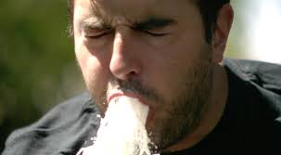
(8)
二。基督的责备。2. Christ’s condemnation.
“我知道的行为，你也不冷也不热。我巴不得你或冷或热。你既如温水，也不冷也不热，所以我必从我口中把你吐出去。你说，我是富足，已经发了财，一样都不缺。却不知道你是那困苦，可怜，贫穷，瞎眼，赤身的”(3:15-17)。
“I know your deeds, that you are neither cold nor hot. I wish you were either one or the other! So, because you are lukewarm—neither hot nor cold—I am about to spit you out of my mouth. You say, ‘I am rich; I have acquired wealth and do not need a thing.’ But you do not realize that you are wretched, pitiful, poor, blind and naked”(3:15-17).

Slide 10
(9)
二。基督的责备。2. Christ’s condemnation.
A。他们生病了－不冷不热。在基督徒的生命中，有三种“属灵温度”：一种是热心，为神火热(路24:32;罗12:11)，一种冷心（太24:12）还有一种是不冷不热的心（3:16）。不冷不热的基督徒是舒适，自满，并没有意识到自己的需要。来自歌罗西的冷水和来自希拉波立的热水在通过管道输送到老底嘉时将是温的。我们喜欢或是冷或是热的饮料，不喜欢温的。基督正要从他嘴里吐出他们。
A. They are sick—lukewarm. In the Christian life, there are three “spiritual temperatures”: a burning heart, on fire for God(Lk.24:32;Ro. 12:11), a cold heart(Mt.24:12), and a lukewarm heart(3:16).The lukewarm Christian is comfortable, complacent, and doe not realize its need. Both the cold water from Colosse and the hot water from Hieropolis would be lukewarm by the time it was piped to Laodicea. We enjoy a beverage that is hot or cold, but not lukewarm. Christ was about to vomit them out of His mouth.

Slide 11
(10)
二。基督的责备。2. Christ’s condemnation.
B。他们受欺骗－自己骗自己。所有的欺骗都是邪恶的，但最具毁灭性的欺骗是自欺欺人。
（一）。老底嘉的描述。你说，“我富有;我已经获得财富，一样都不缺。物质丰富不利于属灵生命力。
（二）。基督的描述。但你没有意识到你是困苦的，可怜的，贫穷的，瞎眼的和赤身的（太7：22-23）。他们不快乐，属灵上的贫穷，灵性上的瞎眼和属灵上的赤身。
B. They are deceived—self-deception. All deception is evil, but the most devastating deception is self-deception.
(1) Laodicea’s description. You say, ‘I am rich; I have acquired wealth and do not need a thing.’ Material abundance is not conducive to spiritual vitality.
(2) Christ’s description. But you do not realize that you are wretched, pitiful, poor, blind and naked (Mt.7:22-23). They were unhappy, spirit-ually poor, spiritually blind, and spiritually naked.

Slide 12
三。基督的忠告。3. Christ’s counsel.
(11)
“我劝你向我买火炼的金子，叫你富足。又买白衣穿上，叫你赤身的羞耻不露出来。又买眼药擦你的眼睛，使你能看见。凡我所疼爱的，我就责备管教他。所以你要发热心，也要悔改。看哪，我站在门外叩门。若有听见我声音就开门的，我要进到他那里去，我与他，他与我一同坐席”
（3:18-20）。他们没有需要的感觉。
“I counsel you to buy from me gold refined in the fire,so you can be-come rich;and white clothes to wear,so you can cover your shameful nakedness; and salve to put on your eyes, so you can see. Those whom I love I rebuke and discipline. So be earnest and repent. Here I am! I stand at the door and knock.If anyone hears my voice and opens the door, I will come in and eat with that person, and they with me”(3:18-20). They had no sense of need.

Slide 13
三。基督的忠告。3. Christ’s counsel.
(12)
A。需要受苦。他们需要买在火中精炼的金子。他们太舒服了，需要试炼的火（彼前1：7）。
B。需要衣服。他们需要穿着白色的公义衣服，遮盖他们可耻的赤身的罪 （启19：8）。
C。需要看见。他们需要买眼药擦眼睛，使他们能看见。他们需要有属灵的视力(彼得前书1:5－9;箴言29:18)。
A. Need for suffering. They needed to buy gold refined in the fire. They were too comfortable and needed the fire of trials(1Pet.1:7).
B. Need for clothing. They needed to be clothed in white clothes of righteousness to cover their shameful sins of nakedness(Rev.19:8).
C. Need for seeing. They needed to have salve for their sore eyes to see again.They needed to have spiritual vision(2Pe1:5-9;Pr.29:18).

Slide 14
三。基督的忠告。3. Christ’s counsel.
(13)
D。需要解释。基督爱这批信徒，虽然他们对他的爱已经冷淡了。他计划磨练他们来证明对他们的爱。 （箴言3:11-12;希伯来书12:5-6）。
E。需要忠告。要悔改并大发热心。他们必须悔改自己的骄傲，在主面前谦卑自己。
D. Need for explanation. Christ loved this believers even though their love for Him had grown cold.He planned to chasten them as proof of His love(Prov.3:11-12;Heb.12:5-6).
E. Need for exhortation. Be zealous and repent. They had to repent of their pride and humble themselves before the Lord.

Slide 15
三。基督的忠告。3. Christ’s counsel.
(14)
F。需要邀请。上帝邀请人类“不花钱”地来买他们所需的（赛55:1）。救恩不是通过人类的努力可以买来的。它是以基督在十字架上死为代价替我们买来的。谦卑的人，呼求主的名，相信他。主在老底嘉教会之外！他对个人说(“如果有人”)。他呼吁个人。基督怎样敲门？
F. Need for invitation. God’s invitation to human beings to come and buy what they need “without money and without cost”(Isa.55:1). Sal-vation is not purchased through human efforts. It has been purchas-ed for us by the death of Christ on the cross. Humble oneself, call on the name of the Lord and believe in Him. The Lord was outside the Laodicean church! He spoke to the individual(“if any man”). He appeals to the individual. How does Christ knock?

Slide 16
三。基督的忠告。3. Christ’s counsel.
(15)
（一）通过他的话。我们必须听从上帝的话得救(约5:24).
（二）通过他的子民。“没有人向他们讲道，他们怎么能听见”（路10：14）耶稣使用传道人和人的见证。
（三）通过他的圣灵。他差遣圣灵定罪“罪和正义与审判”人的心（约14：8）。
（四）通过他的恩典。许多人被神的恩典所感动。
(1) Through His Word. We must hear God’s Word to be saved(Jn.5:24).
(2) Through His people.“How can they hear without someone preaching to them”
(Ro.10:14).Jesus uses preachers and the witness of people.
(3) Through His Holy Spirit. He sent the Holy Spirit to convict the heart of man of “sin and righteousness and judgment”(Jn.14:8).
(4) Through His providence. Many have been touched by the providence of God.

Slide 17
(16)
四。基督的挑战。4. Christ’s challenge.
“得胜的，我要赐他在我宝座上与我同坐，就如我得了胜，在我父的宝座上与他同坐一般。圣灵向众教会所说的话，凡有耳的，就应当听” (3:21-22)。
A。听圣灵所说的。三种人：
（一）那些有耳朵可听见的（太13:9）。
（二）那些听不进去的（来5:11）。
（三）那些愿意听圣灵所说的（雅1:22）。
“To the one who is victorious, I will give the right to sit with me on my throne, just as I was victorious and sat down with my Father on his throne. Whoever has ears, let them hear what the Spirit says to the churches”(3:21-22).
A. Hear what the Holy Spirit says. There are three kinds of people:
(1) Those with ears to hear(Mt.13:9).
(2) Those who are dull of hearing(Heb.5:11).
(3) Those who are willing to hear what the Spirit(Ja.1:22).

Slide 18
(17)
四。基督的挑战。4. Christ’s challenge.
B。得胜的。胜利者是“得胜者”或“重生的信徒”。
（一）在这个叛教的时代，灵性死亡和冷漠会增加。 “然而,当人子来的时候,他会在地上找到信吗?”(路18:8)。
（二）得胜的将与基督一同坐在他的宝座上。
（三）基督是得胜的。
（四）基督与他的父坐在他的宝座上。
B. Victorious. The victorious are “overcomers” or “born-again believers”.
(1) In this age of apostasy, deadness, and indifference will increase. “However, when the Son of Man comes, will he find faith on the earth?”(Lk.18:8).
(2) The victorious will sit with Christ on His throne.
(3) Christ was victorious.
(4) Christ sat down with His Father on His throne.

Slide 19
(18)
结论：Conclusion:
给七个教会的信是神的X光，给我们，使我们可以检查我们自己的生活和教会的生活。审判将要到这个世界，但它首先在神的家里开始（彼得前书4：17）。在这些信件中，我们发现鼓励和责备。愿耶和华帮助我们听见圣灵今天对教会和教会中的人所说的话！
The letters to the seven churches are God’s X-rays, given to us so that we might examine our own lives and the life of the church. Judgment is going to come to this world, but it first begins at God’s house(1Pet.4:17). In these letters we find encouragement as well as rebuke. May the Lord help us to hear what the Spirit is saying today to the church, and to the individuals in the churches!

Slide 20
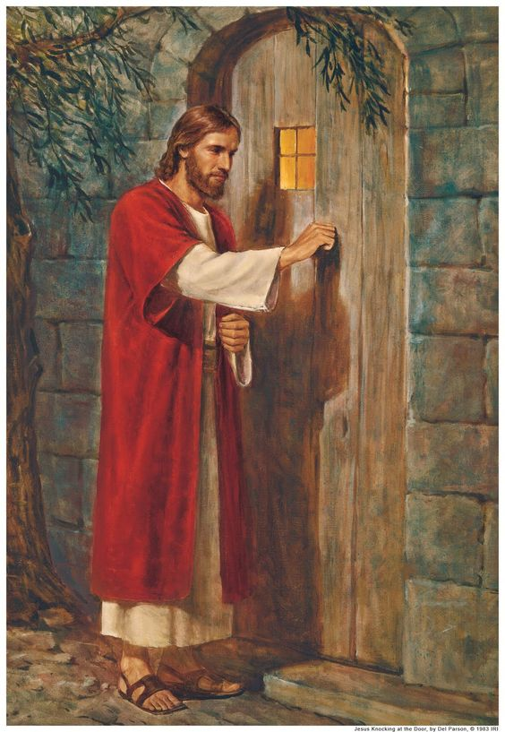
结论：Conclusion:
在霍尔曼·亨特的绘画【基督敲向心门】的图片中，请注意亨特没有包括一个门闩，这表明唯一打开心门的方法，是从内部打开。
In the picture of Holman Hunt’s painting of Christ knocking at the heart’s door notice that Hunt did not include a door latch, indicating that the only way the door that represented their hearts could be opened was from the inside.
(19)

Slide 21
We invite you to come
(1) March 25-8-9 am
Prayer 9-9:30 am
Doug Brown: How to share your testimony.
(2) Mar.31-Apr.4, 2017 Special Meetings
“Basis for Happy Life”
Speaker:Luke Zhang
March 31, 7:30-9 pm
God’s Holiness & Love.
April 1, 10-11:30 am
Faith Life
April 1, 12:30-2 pm
Living Hope
April 2,10:40am-12pm
Source of Peace
April 2, 1-2:30 pm
Questions & Answers

