Slide 1

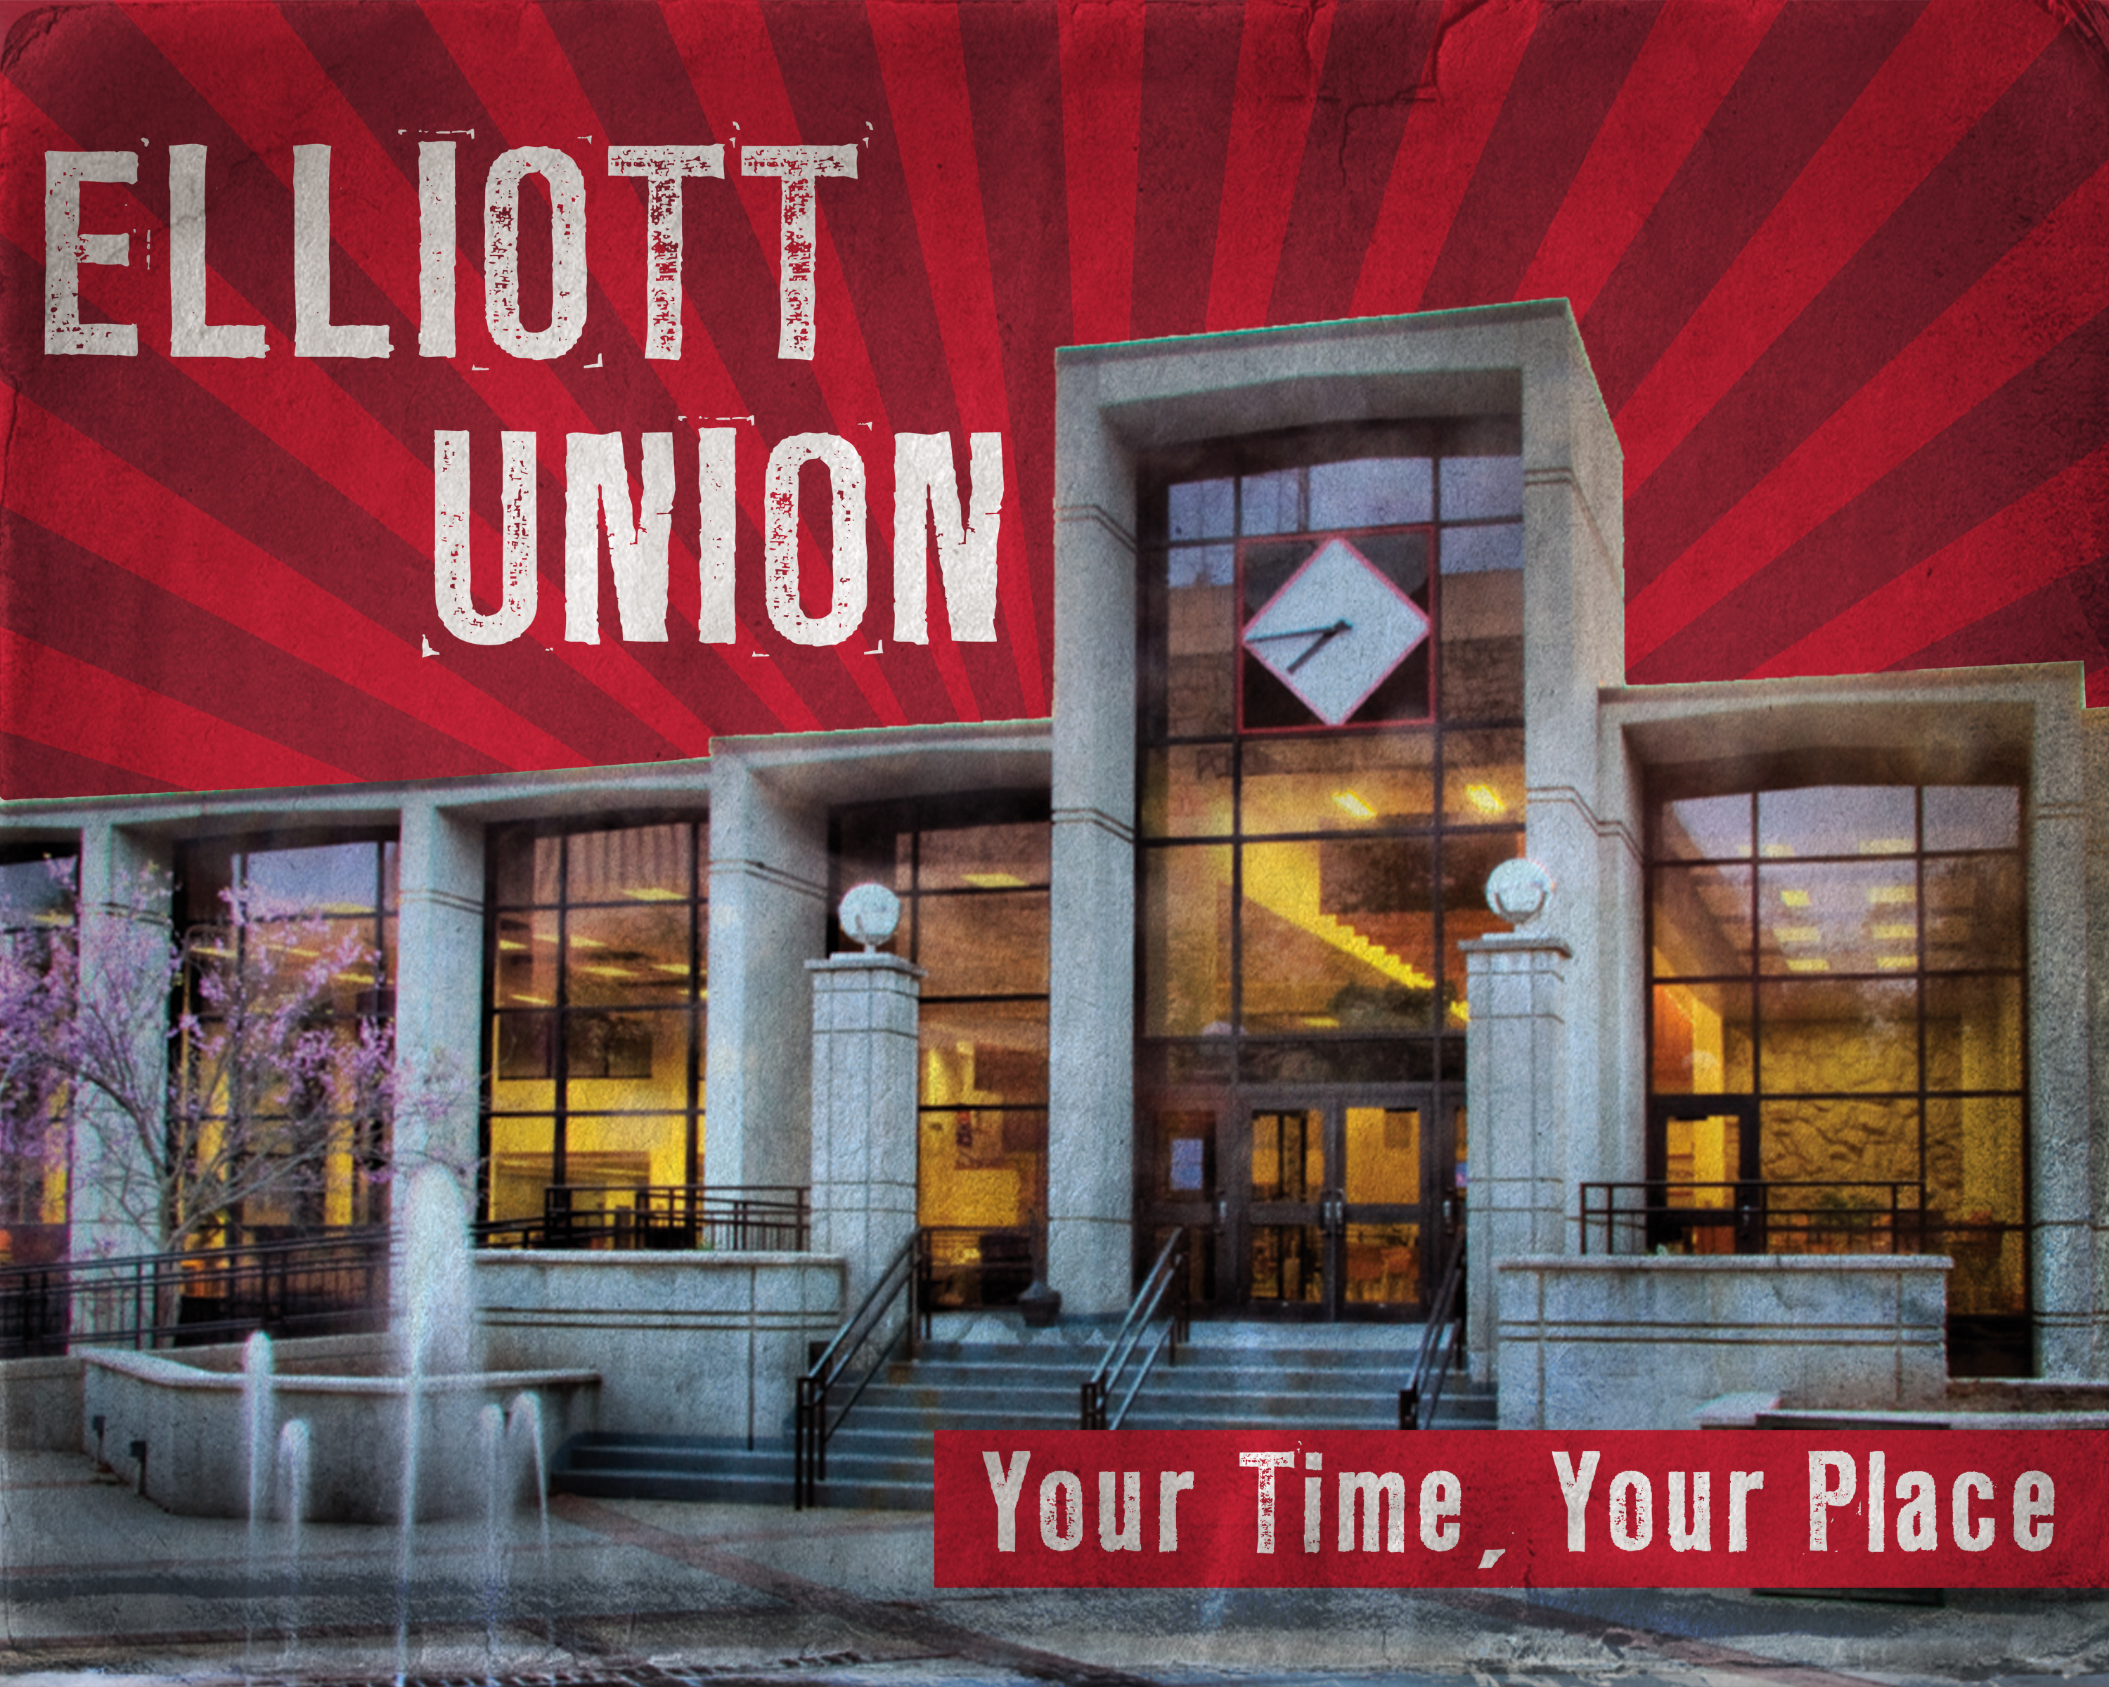
堪城华人基督教会夏令营2017年6月9-11日
GKCCCC Summer Retreat: June 9-11, 2017
地点Place: UCM Elliott Student Union
Warrensburg, MO 64093
主题：“跟随耶稣”
Topic: “Follow Jesus”
联络人：郦一明
Contact: Yiming Li
电话号码:
Phone: (913)952-1209
Website:www.gkcccc.org

Slide 2
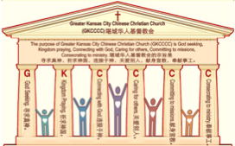

主日:二零一七年四月三十日
Sunday: April 30, 2017
何礼义牧师 Pastor Gary Hart
题目：“满得医治的教会 。”
Topic: “Full of Healing Church.”
经文:使徒行传9:32-35
“他到了居住吕大的圣徒那里”(徒9:32).
Text: Acts 9:32-35
“He went to visit the Lord’s people who lived in Lydda” (Ac.9:32).
(1)

Slide 3
引言:A。使徒行传的信息。 Intro: A.Message of Acts of the Apostles.
(2)
(一)基督建造祂的教会（基督的灵借着使徒在作工）。
(二)使徒行传是圣灵的指挥,控制和赋权的事工,创立和加强了教会，并使它成长。
(三)使徒行传是一个过渡时期:从耶稣的事工到使徒的;从旧约到新约;从以色列作神的见证到教会作神的见证;从犹太教出来, 教会诞生了。
(四)使徒行传显示大使命得以遵行(1:8)从证人到耶路撒冷(1-8),到犹太和撒玛利亚(8-12)并到地极(13-28)。
(五)圣灵将继续在教会作工，书写使徒行传28章(加上）。
(1)Christ builds His Church(the Acts of the Spirit of Christ through the Apostles). (2)The Acts were the Spirit’s directing, controlling, and empowering ministry that founded and strengthened the church and caused it to grow.
(3)The Acts is a time of transitions: from ministry of Jesus to that of the apostles; from the Old Covenant to the New Covenant; from Israel as God’s witness to the Church as God’s witness; from Judaism is going out and Church is coming in.
(4)The Acts show the fulfillment of the Great Commission(1:8) from the witness to Jerusalem(1-8), to Judea and Samaria(8-12), and to the ends of earth(13-28).
(5)The Acts are the continuing Acts of the Spirit in Churches in 28 chapters(plus).

Slide 4
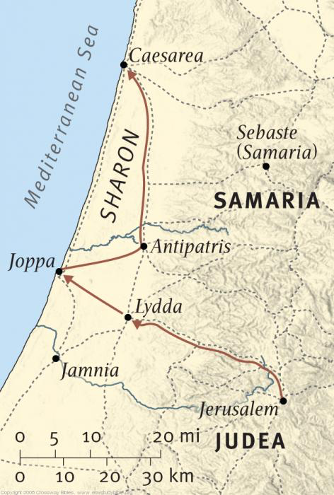
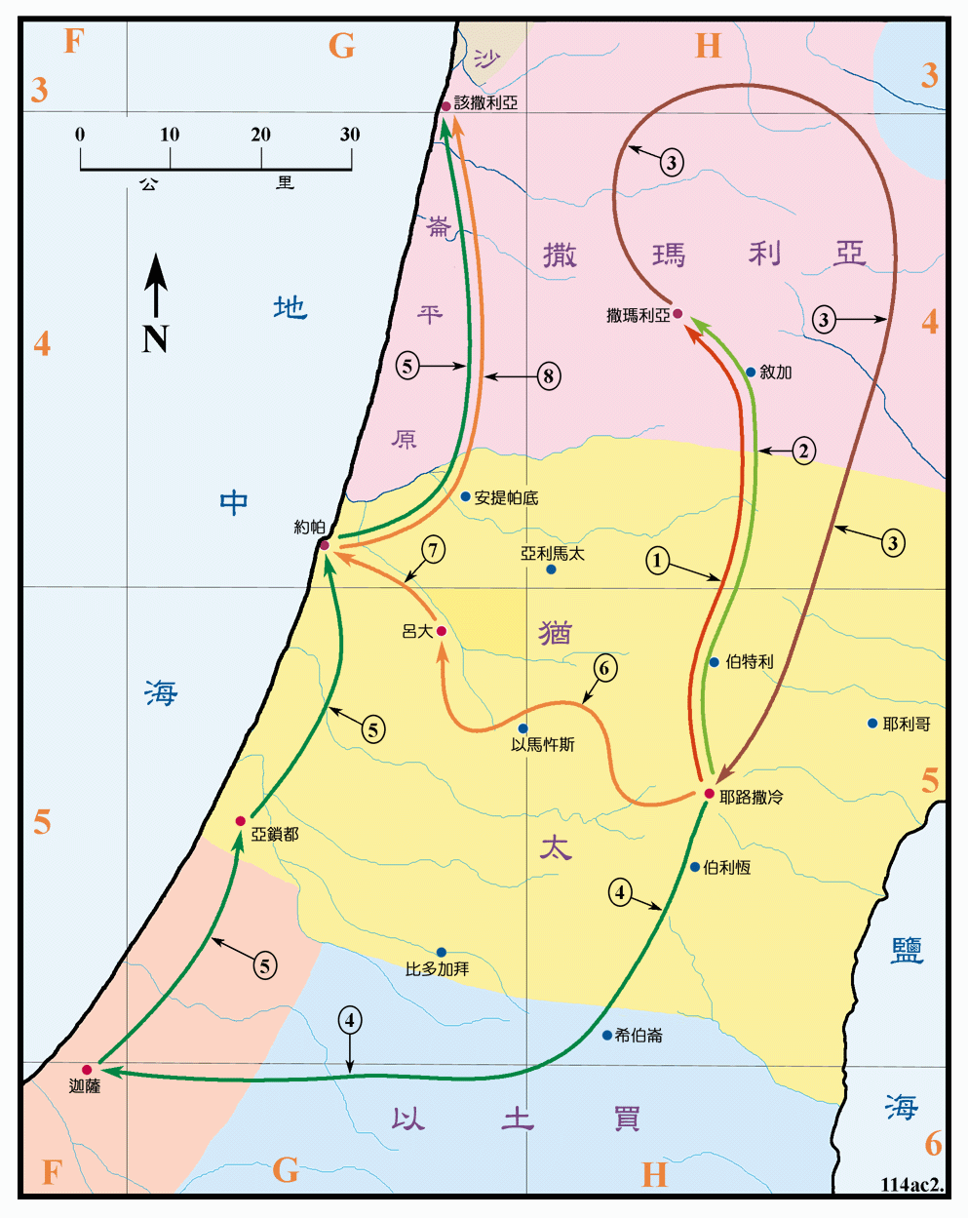
B。吕大的地理位置。
B. Lydda location.
(3)

Slide 5
C。吕大的历史背景。C. Lydda historical background.
(4)
(一)吕大城或罗德城(代上8:12)是沙仑附近的便雅悯的小城。在约帕以东约9英里，从海港到耶路撒冷的路上。
(二)吕大教会是由五旬节的信徒创立的，在大逼迫期间分散的忠实信徒，还有传道人腓利，也在那里服事(8:40)。
(三)吕大教会代表“满得医治”的教会。
(四)吕大意思是“冲突”。 我们与罪恶，冲突和悲伤斗争。
(1) The city of Lydda or Lod (1Chr.8:12)was a Benjaminite town near the Plain of Sharon.It is about 9 miles east of Joppa, on the road from the seaport to Jerusalem.
(2) Lydda church was founded by believers from Pentecost, faithful believers who had been scattered during the great persecution, or Philip the evangelist had also ministered there (8:40).
(3) Lydda church represents the “full of healing” church.
(4) Lydda means “strife”. We struggle with sin, strife, and sorrow.

Slide 6
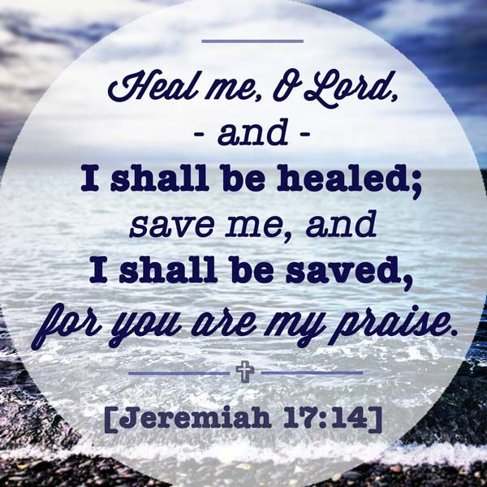
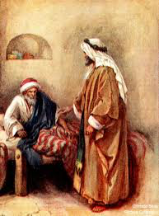
(5)
一。基督之灵的称许。1. Spirit of Christ’s commendation.
“彼得周流四方的时候，也到了居住吕大的圣徒哪里。遇见一个人，名叫以尼雅，得了瘫痪，在褥子上躺卧八年。彼得对他说，以尼雅，耶稣基督医好你了。起来收拾你的褥子。他就立刻起来了。凡住吕大和沙仑的人都看见了他，就归服主。”（9:32-35）
“As Peter traveled about the country,he went to visit the Lord’s people who lived in Lydda.There he found a man named Aeneas,who was paralyzed and had been bedridden for eight years. “Aeneas,” Peter said to him, “Jesus Christ heals you.
Get up and roll up your mat.”Immediately Aeneas got up.All those who lived in Lydda and Sharon saw him and turned to the Lord(9:32-35).
耶和华啊，
求你医治我，我便痊愈，
拯救我，
我便得救。
因你是
我所赞美的。
（耶17:14）

Slide 7
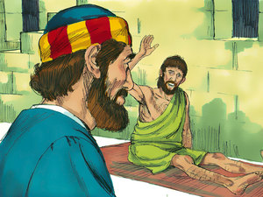
一。基督之灵的称许。1. Spirit of Christ’s commendation.
(6)
A。他名叫以尼雅。以尼雅意思是“赞美”或“值得赞美”。 彼得去拜访主的百姓（信徒），找到了以尼雅。 他是一位称赞上帝的信徒，并承认神值得称赞。
B。他瘫痪了。他瘫痪并且害病。 他瘸腿并且无奈。 在罪中，我们灵里无助（罗3:10; 23）。
C。他在褥子上躺卧八年。他因为自己的疾患与虚弱八年受困于病床。
A. He was named Aeneas. Aeneas means “praise” or “praiseworthy”. Peter went to visit the Lord’s people(believers) and found Aeneas. He was a believer who praised God and acknowledged that God is worthy of praise.
B. He was paralyzed.He had been palsied and
sick. He was crippled and helpless.We are
spiritually helpless in sin(Ro.3:10;23).
C. He was bedridden for eight years. He was
confined to bed because of his infirmity and
weakness.

Slide 8

(7)
一。基督之灵的称许。1. Spirit of Christ’s commendation.
D。他被医好了。“彼得对他说，以尼雅，耶稣基督医好你了”(9:
34)。耶稣医治了许多人。 使徒也医治了许多人。“我们因信他的名，他的名便叫你们所看见所认识的这人，健壮了。正是他所赐的信心，叫这人在你们众人面前全然好了”(3:16)。“他们众人，和以色列百姓，都当知道，站在你们面前的这人得痊愈，是因你们所钉十字，神叫他从死里复活的拿撒勒人耶稣基督的名”(4:10)。
D. He received healing. “Peter said to him, “Jesus Christ heals you”(9:34). Jesus healed many. The apostles also healed many. “By faith in the name of Jesus, this man whom you see and know was made strong. It is Jesus’ name and the faith that comes through him that has completely healed him, as you can all see”(3:16). “Then know this, you and all the people of Israel: It is by the name of Jesus Christ of Nazareth, whom you crucified but whom God raised from the dead, that this man stands before you healed”(4:10).

Slide 9
(8)
一。基督之灵的称许。1. Spirit of Christ’s commendation.
应用：(一) 根据上帝的旨意，有身体的治愈。“出于信心的祈祷，要救那病人，主必叫他起来。他若犯了罪，也必蒙赦免。所以你们要彼此认罪，互相代求，使你们可以得医治。义人祈祷所发的力量，是大有功效的（雅5:15-16）。” (二) 借着上帝的恩典也有属灵的治愈。“我的弟兄们，你们中间若有失迷真道的，有人使他回转。这人该知道叫一个罪人从迷路上转回，便是救一个灵魂不死，并且遮盖许多的罪（5:19-20）”
Application: (1)There is physical healing according to God’s will. “And the prayer offered in faith will make the sick person well; the Lord will raise them up. If they have sinned, they will be forgiven. Therefore confess your sins to each other and pray for each other so that you may be healed. The prayer of a righteous person is powerful and effective”(Ja.5:15-16). (2)There is also spiritual healing by God’s grace. “My brothers and sisters, if one of you should wander from the truth and someone should bring that person back, remember this: Whoever turns a sinner from the error of their way will save them from death and cover over a multitude of sins”(5:19-20).

Slide 10
(9)
二。基督之灵的责备。2. Spirit of Christ’s condemnation.
“远离纷争是人的尊荣；愚妄人都爱争闹（箴20:3）。
A。冲突来自心里和嘴巴。”“主啊，求你吞灭他们，变乱他们的舌头！因为我在城中见了强暴争竞的事”（诗55:9）。“设筵满屋，大家相争，不如有块饼吃，大家相安”（箴7:1）。“愚昧人张嘴启争端，开口招鞭打”（18:6）。
B。冲突来自骄傲和激起愤怒。“骄傲只启争竟；听劝言的，却有智慧”（13:10）。“摇牛奶必成奶油，扭鼻子必出血；照样，激动怒气必起争端”（30:33）。
“It is to one’s honor to avoid strife, but every fool is quick to quarrel”(Prov.20:3). A. Strife comes from the heart and the mouth. “Lord,confuse the wicked, con-found their words, for I see violence and strife in the city.”(Ps.55:9). “Better a dry crust with peace and quiet than a house full of feasting, with strife” (Pr.17:1). “The lips of fools bring them strife, and their mouths invite a beating”(18:6).
B. Strife comes from pride and stirring up anger. “Where there is strife, there is pride, but wisdom is found in those who take advice” (13:10). “For as churning cream produces butter, and as twisting the nose produces blood, so stirring up anger produces strife” (30:33).

Slide 11
(10)
二。基督之灵的责备。2. Spirit of Christ’s condemnation.
C。冲突来自嘲弄和争吵。“赶出亵慢人，争端就消除；纷争和羞辱也必止息”(22:10)。“好争竟的人煽或争端，就如余火加炭，火上加柴一样”（26:21）。
D。冲突来自缺乏自我控制。“谁有祸患？谁有忧愁？谁有争斗？谁有哀叹？谁无故受伤？谁眼目红赤？就是那流连饮酒，常去寻找调和酒的人”（23:29-30）。
应用： “他是自高自大，一无所知，专好问难，争辩言词，从此就生出嫉妒，纷争，毁谤，妄疑”（提前6:4）。
C. Strife comes from mocker and quarrelsome. “Drive out the mocker, and out goes strife; quarrels and insults are ended” (22:10).“As charcoal to embers and as wood to fire, so is a quarrelsome person for kindling strife”(26:21).
D.Strife comes from lack of self-control.“Who has woe?Who has sorrow?Who has strife?Who has complaints? Who has needless bruises? Who has bloodshot eyes?Those who linger over wine,who go to sample bowls of mixed wine”(23:29-30)
Application: “They are conceited and understand nothing. They have an unhealthy interest in controversies and quarrels about words that result in envy, strife, malicious talk, evil suspicions”(1Ti.6:4).

Slide 12
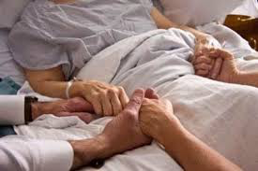
三。基督之灵的忠告。3. Spirit of Christ’s counsel.
(11)
“起来收拾你的褥子。他就立刻起来了”（9:34-35a）。
A。起来。“但要叫你们知道，人子在地上有赦罪的权柄；就对瘫子说：起来！拿你的褥子回家去吧”（太9:6）。 “你起来站着，我特意向你显现，要派你作执事，作见证，将你所看见的事和我将要指示你的事证明出来”(徒26:16)。当你医好的时候，就起来。当你跌倒了的时候，就起来。当你伤心的时候，就起来。以尼雅就立刻起来了。
“Get up and roll up your mat. Immediately Aeneas got up”(9:34-35a).
A. Get up. “But I want you to know that the Son of Man has authority on earth to forgive sins.So he said to the paralyzed man,“Get up, take your mat and go home”(Mt.9:6). “‘Now get up and stand on your feet. I have appeared to you to appoint you as a servant and as a witness of what you have seen and will see of me”(Ac.26:16). When you are healed, get up.
When you fall down, get up. When you feel down,
get up. “Immediately Aeneas got up.”

Slide 13
三。基督之灵的忠告。3. Spirit of Christ’s counsel.
(12)
B。收拾你的褥子。“卷起袖子开始工作。” 当有冲突的时候，在教会里应该做些什么（太18:15-17)。
应用：解决冲突的步骤是什么？(一)“倘若你的弟兄得罪你，你就去趁着只有他和你在一处的时候，指出他的错来。他若听你，你便得了你的弟兄。”(二)“他若不听，你就另外带一两个人同去，要凭两三个人的口作见证，句句都可定准。”(三)“若是不听他们，就告诉教会。”(四)“若是不听教会，就看他像外邦人和税吏一样。” 教会就像医院一样是治愈和对付罪的地方。
B. Roll up your mat. “Roll up your sleeves and get to work.” When there is a conflict,here is what should be done in the church(Mt.18:15-17).
Application:What are the steps to conflict resolution?(1)“If your brother or sister sins,go and point out their fault,just between the two of you.If they listen to you,you have won them over.”(2)“But if they will not listen,take one or two others along,so that every matter may be established by the testimony of two or three witnesses.”(3)“If they still refuse to listen,tell it to the church.”(4)“If they refuse to listen even to the church,treat them as you would a pagan or a tax collector.” A church is like a hospital,it is a place for healing and for dealing with sin.

Slide 14
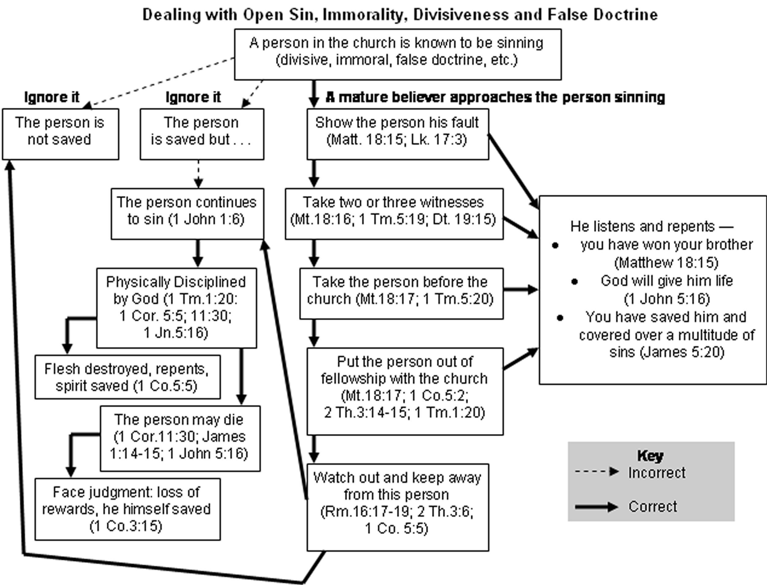

Slide 15
处罚公开的罪，不道德，分裂和虚虚假的教义。
知道教会中有一个人犯罪 （分裂的，不道德的，虚假的教义等）。
忽略它。
忽略它。
一个成熟的信徒指出犯罪的人。
没有 得救的。
得救的， 但是…
指出他的错来 （太18:15;路17:3）。
他听和悔改 – 你得了你的弟兄(太18:15)。 神会给他生命(约一5:16)。 你救了他，并且遮盖了许多罪(雅5:20)。
那人继续犯罪 （约一1：6）。
带两三个证人（太18：16;提前5:19;申19:15）。
神的惩罚（提前1:20;林前5:5; 11:30;约翰一5:16）。
把那人带到教会前（太18:17;提前5:20）。
败坏肉体；悔改，灵魂得救（林前5:5）。
把那个人从教会赶出去（太18:17;林前5:2;提前5:20）。
肉体被神管教（提前1:20;林前5:5; 11:30）。
键： - ->不正确 → 正确
小心和远离那个人（罗16:17-19;林前5:5）。
面对判断：丧失奖励，他自己得救（林前3:15）。

Slide 16
(14)
四。基督之灵的挑战。4. Spirit of Christ’s challenge.
“凡住吕大和沙仑的人都看见了他，就归服主”(9:35)。
A。看见了病得医治。看到治愈和和解的神迹。 他成了一个行走的神迹！
B。归服主。“主与他们同在，信而归主的人就很多了”(徒11:21)。
应用：所有与吕大和沙仑的以尼雅接触的人都证明了这个神迹，转向主。
“All those who lived in Lydda and Sharon saw him and turned to the Lord”(9:35). A. See the healing. See the miracle of healing and reconciliation. He became a walking miracle!
B. Turn to the Lord. “The Lord’s hand was with them, and a great number of people believed and turned to the Lord”(11:21).
Application: All those who had contact with Aeneas in Lydda and Sharon saw proof of the miracle and turn to the Lord.

Slide 17
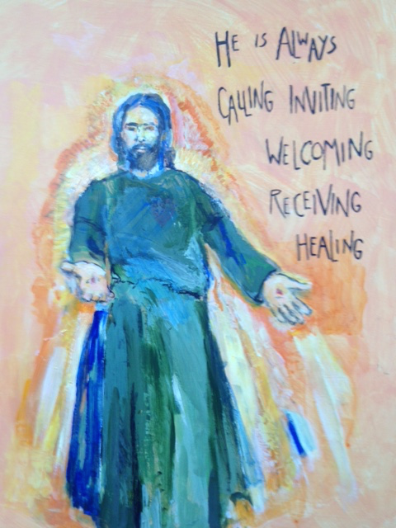
(15)
结论：Conclusion:
上帝能为我们做的最大的神迹是什么？ 有些人会称医好身体是上帝最伟大的神迹，而其他人会投投票给叫死人复活。但是，我认为，最伟大的神迹就是救恩一个失丧的罪人得着救恩和和解一对兄弟和解。为什么？因为救恩与和解代价最大，所产生的结果最大，带给上帝的荣耀也最大。 “一切都是出于神；他借着基督使我们与他和好，又将劝人与他和好的职分赐给我们”(林后5:18)。 “所以，你们要彼此接纳，如同基督接纳你们一样，使荣耀归于神”(罗15:7)。
What is the greatest miracle that God can do for us?Some would call the healing of the body God’s greatest miracle,while others would vote for the raising of the dead.However,I think that the greatest miracle of all is the salvation of a lost sinner and the reconciliation of a brother.Why?Because salvation and recon-ciliation cost the greatest price,it produces the greatest results, and it brings the greatest glory to God.“All this is from God,who reconciled us to himself through Christ and gave us the ministry of reconciliation…”(2Co.5:18).“Accept one another,then,just as Christ accepted you,in order to bring praise to God”(Ro.15:7).

