Slide 1

堪城华人基督教会
GKCCCC
何礼义牧师
Pastor Gary Hart
经文:创6:9-22
Text: Gen.6:9-22
题目:“诺亚和妻子”
Topic: “Noah and Wife”
“挪亚的后代记在下面”(创6:9a)。
“This is the account of Noah and his family”(Gen.6:9a).”
主日:二零一八年一月二十一日 Sunday: Jan.21, 2018
(1)
Notes:
Tímù:“Nuò yǎ hé qīzi”
“Nuó yà de hòudài jì zài xiàmiàn”(chuàng 6:9A).

Slide 2

引言：A。亚当的家谱。 “亚当的后代记在下面”(5:1a)。我们的家谱都可以追溯到亚当。
B。挪亚的家谱。 “给他起名叫挪亚，说，这个儿子必为我们的操作和手中的劳苦安慰我们。这操作劳苦是因为耶和华咒诅地”(5:29)。我们的家谱都可以追溯到挪亚。所有的人种和文化都来自亚当和挪亚。 挪亚的意思是“安慰”。
Introduction: A.Adam’s Family Tree.
“This is the written account of Adam’s
family”(5:1a).We can all trace our
family tree back to Adam.
B.Noah’s Family Tree. “He name him Noah and said, He will comfort us in the labor and painful toil of our hands caused by the ground the LORD has cursed”(5:29).We can all trace our family tree back to Noah.All races and cultures come from Adam and Noah. Noah means “comfort.”
(2)
Notes:
Yǐnyán:A. Yàdāng de jiāpǔ. “Yàdāng de hòudài jì zài xiàmiàn”(5:1A). Wǒmen de jiāpǔ dōu kěyǐ zhuīsù dào yàdāng.
B. Nuó yà de jiāpǔ. “Gěi tā qǐmíng jiào nuó yà, shuō, zhège érzi bì wèi wǒmen de cāozuò hé shǒuzhōng de láokǔ ānwèi wǒmen. Zhè cāozuò láokǔ shì yīnwèi yēhéhuá zhòu zǔ de”(5:29). Wǒmen de jiāpǔ dōu kěyǐ zhuīsù dào nuó yà. Suǒyǒu de rén zhǒng hé wénhuà dōu láizì yàdāng hé nuó yà. Nuó yà de yìsi shì “ānwèi”.

Slide 3
C。家庭问题：(1)通婚。“神的儿子们看见人的女子美貌，就随意挑选，娶来为妻”(6:2)。“神的儿子”可能是指敬虔的男人。“人的女子” 可能是指犯罪的女人。这描述了创世纪第5章塞特的后裔(神的儿子)与创世纪第4章该隐的后裔(人的女子)的通婚，表明两个分离群体的融合。“你们和不信的原不相配，不要同负一轭。义和不义有什么相交呢？光明和黑暗有什么相通呢？基督和彼列有什么相和呢？信主的和不信主的有什么相干呢？”(林后6:14- 15)。
C.Family issues:(1)Intermarriage. “The sons of God saw that the daughters of humans were beautiful,and they married any of them they chose”(6:2).“Sons of God possibly refers to godly men,and “daughters of humans” possibly refers to sinful women(6:2,4).It could describe inter-marriage of the Sethites(sons of God) of Gen.5 with the Cainites (daugh-ters of humans)of Gen.4,indicating a breakdown in the separation of the two groups. “Do not be yoked together with unbelievers. For what do righteousness and wickedness have in common? Or what fellowship can light have with darkness? What harmony is there between Christ and Belial?Or what does a believer have in common with an unbeliever?”
(2Cor.6:14-15).
(3)
Notes:
C. Jiātíng wèntí:(1) Tōnghūn.“Shén de érzimen kànjiàn rén de nǚzǐ měimào, jiù suíyì tiāoxuǎn, qǔ lái wèi qī”(6:2).“Shén de érzi” kěnéng shì zhǐ jìngqián de nánrén.“Rén de nǚzǐ” kěnéng shì zhǐ fànzuì de nǚrén. Zhè miáoshùle chuàngshìjì dì 5 zhāng sāi tè de hòuyì (shén de érzi) yǔ chuàngshìjì dì 4 zhāng gāi yǐn de hòuyì (rén de nǚzǐ) de tōnghūn, biǎomíng liǎng gè fēnlí qúntǐ de rónghé.“Nǐmen hé bùxìn de yuán bù xiāngpèi, bùyào tóng fù yī è. Yì hé bù yì yǒu shé me xiàngjiāo ne? Guāngmíng hé hēi'àn yǒu shé me xiāngtōng ne? Jīdū hé bǐ liè yǒu shé me xiāng hé ne? Xìn zhǔ de hé bùxìn zhǔ de yǒu shé me xiānggān ne?”(Lín hòu 6:14- 15).

Slide 4

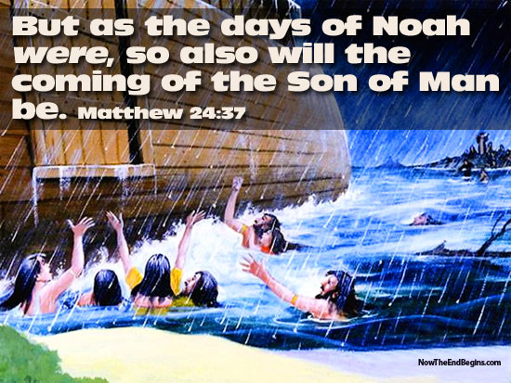
（2）世俗邪恶。“耶和华见人在地上罪恶很大，终日所思想的尽都是恶”(创6:5)。 “世界在神面前败坏，地上满了强暴。神观看世界，见是败坏了。凡有血气的人，在地上都败坏了行为”(6:11-12)。这显示了人类彻底的败坏。
(2) Worldly wickedness. “The LORD saw how great the wickedness of the human race had become on the earth, and that every inclination of the thoughts of the human heart was only evil all the time”(Ge.6:5). “Now the earth was corrupt in God’s sight and was full of violence.God saw how corrupt the earth had become,for all the people on earth had corrupted their ways”(6:11-12). This shows the total depravity of mankind.
挪亚的日子如此，
人子的降临也将如此。
(4)
Notes:
(2) Shìsú xié'è.“Yēhéhuá jiàn rén zài dìshàng zuì'è hěn dà, zhōngrì suǒ sīxiǎng de jǐn dōu shì è”(chuàng 6:5). “Shìjiè zài shén miànqián bàihuài, dìshàng mǎnle qiángbào. Shén guānkàn shìjiè, jiàn shì bàihuàile. Fán yǒu xuèqì de rén, zài dìshàng dū bàihuàile xíngwéi”(6:11-12). Zhè xiǎnshìle rénlèi chèdǐ de bàihuài.
Nuó yà de rìzi rúcǐ, rén zǐ de jiànglín yě jiàng rúcǐ.

Slide 5
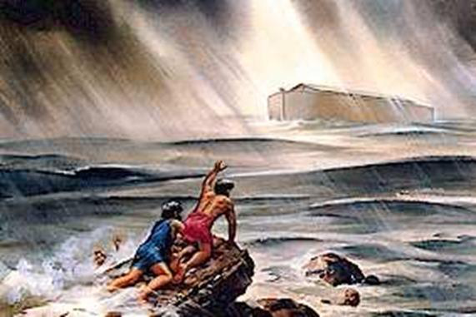
(3)神圣的审判。 “耶和华说，我要将所造的人和走兽，并昆虫，以及空中的飞鸟，都从地上除灭”(6:7)。“神就对挪亚说，凡有血气的人，他的尽头已经来到我面前。因为地上满了他们的强暴，我要把他们和地一并毁灭”(6:13)。
(3)Godly judgment. “So the LORD said, I will wipe from the face of the earth the human race I have created”(6:7). “So God said to Noah, I am going to put an end to all the people, for the earth is filled with violence because of them. I am surely going to destroy both them and the earth”(6:13).
(5)
Notes:
(3) Shénshèng de shěnpàn. “Yēhéhuá shuō, wǒ yào jiāng suǒ zào de rén hé zǒushòu, bìng kūnchóng, yǐjí kōngzhōng de fēiniǎo, dōu cóng dìshàng chú miè”(6:7).“Shén jiù duì nuó yà shuō, fán yǒu xuèqì de rén, tā de jìntóu yǐjīng lái dào wǒ miànqián. Yīnwèi dìshàng mǎnle tāmen de qiángbào, wǒ yào bǎ tāmen hé dì yī bìng huǐmiè”(6:13).

Slide 6

一。属灵领袖带来的安慰。 有一位属灵领袖的标志是什么？ 看看诺亚的例子。
A。恩典是从神得到不配得的恩惠。“惟有挪亚在耶和华眼前蒙恩”(6:8)。
1. The comfort of a spiritual leader. What are the marks of a spiritual leader? Look at Noah’s example.
A. Grace is undeserved favor of God. “But Noah found favor in the eyes of the LORD”(6:8).
自由地给予，
不应得到，
不应得的,
恩典。
(6)
Notes:
Yī. Shǔ líng lǐngxiù dài lái de ānwèi. Yǒuyī wèi shǔ líng lǐngxiù de biāozhì shì shénme? Kàn kàn nuò yǎ de lìzi.
A. Ēndiǎn shì cóng shén dédào bùpèi dé de ēnhuì.“Wéiyǒu nuó yà zài yēhéhuá yǎnqián méng ēn”(6:8).

Slide 7

B。正义既是内在的，也是外在的。
(1)挪亚在神面前是义的。“挪亚是个义人”(6:9a)。
(2)挪亚在他人面前是义的。“在当时的世代是个完全人”( 6:9b)。(3)诺亚在他这世代中是义人。“耶和华对挪亚说，你和你的全家都要进入方舟，因为在这世代中，我见你在我面前是义人”(7:1)。
(4)传义道的挪亚(彼后2:5;西14:14,20)。
B. Righteousness is both inward and outward. (1)Noah was right with God.“Noah was a righteous man”(6:9a).
(2)Noah was right with others.“Blameless among the people of his time”(6:9b).
(3)Noah was right in his generation. “The Lord then said to Noah,Go into the ark,
you and your whole family, because I have found you righteous in this generation”(7:1).
(4)Noah was a preacher of righteousness (2Pe.2:5:Ezek.14:14,20).
(7)
Notes:
B. Zhèngyì jìshì nèizài de, yěshì wài zài de.
(1) Nuó yà zài shén miànqián shì yì de.“Nuó yà shìgè yì rén”(6:9A).
(2) Nuó yà zài tārén miànqián shì yì de.“Zài dāngshí de shìdài shìgè wánquán rén”(6:9B).(3) Nuò yǎ zài tā zhè shìdài zhōng shì yì rén.“Yēhéhuá duì nuó yà shuō, nǐ hé nǐ de quánjiā dōu yào jìnrù fāngzhōu, yīnwèi zài zhè shìdài zhōng, wǒ jiàn nǐ zài wǒ miànqián shì yì rén”(7:1).
(4) Chuán yì dào de nuó yà (bǐ hòu 2:5; Xī 14:14,20).

Slide 8

C。信念是一种信仰和行为。 (1)挪亚的信心是以神的话语为眼见。“挪亚因着信，既蒙神指示他未见的事，动了敬畏的心，预备了一只方舟，使他全家得救。因此就定了那世代的罪，自己也承受了那从信而来的义”(来11:7)。(2)挪亚的信心是忠心地与神同行。“挪亚与神同行”(创6:9c)。 “以诺与神同行”(5:22,24)。应用：教导我们的孩子和子孙相信神。
C. Faith is a belief and a walk. (1)Noah’s faith was seeing what God said.“By faith Noah,when warned about things not yet seen,in holy fear built an ark to save his family.By his faith he condemned the world and became heir of the righteousness that is in keeping with faith”(Heb.11: 7).(2)Noah’s faith was walking with God faithfully.“He walked faithfully with God”
(Ge.6:9c). “Enoch walked faithfully with God(5:22, 24). Application: Teach our children and grandchildren to trust God.
信仰看不可见的，相信不可信的，接受不可能的事。
(8)
Notes:
C. Xìnniàn shì yī zhǒng xìnyǎng hé xíngwéi. (1) Nuó yà de xìnxīn shì yǐ shén de huàyǔ wèi yǎnjiàn.“Nuó yà yīn zhexìn, jì méng shén zhǐshì tā wèi jiàn de shì, dòngle jìngwèi de xīn, yùbèile yī zhǐ fāngzhōu, shǐ tā quánjiā déjiù. Yīncǐ jiù dìngle nà shìdài de zuì, zìjǐ yě chéngshòule nà cóng xìn ér lái de yì”(lái 11:7).(2) Nuó yà de xìnxīn shì zhōngxīn dì yǔ shén tóngxíng.“Nuó yà yǔ shén tóngxíng”(chuàng 6:9C). “Yǐ nuò yǔ shén tóngxíng”(5:22,24). Yìngyòng: Jiàodǎo wǒmen de háizi hé zǐsūn xiāngxìn shén.
Xìnyǎng kàn bùkějiàn de, xiāngxìn bù kě xìn de, jiēshòu bù kěnéng de shì.

Slide 9

D。听从神的命令，并遵行神的命令。
(1)挪亚听从神而服从。“要造一只方舟...”(6:14a)。
(2)挪亚遵行神所说的话。 “挪亚就这样行。凡神所吩咐的，他都照样行了”(6:22; 7:5)。 应用：当你不知道该怎么做。 做你所知道的事情。诺亚的妻子，儿子和
他们的妻子也与诺亚站在一起。
D. Obedience is listening to God’s commands and doing God’s commands.
(1) Noah obeyed by listening to God. “So make yourself an ark…”(6: 14a). (2)Noah obeyed by doing what God said. “Noah did everything just as God commanded him”(6:22;7:5). Application: Noah’s wife, sons, and their wives also stood with Noah.
顺从一小步，
神会给你下一步...
和下下步。
(9)
Notes:
D. Tīngcóng shén de mìnglìng, bìng zūnxíng shén de mìnglìng.
(1) Nuó yà tīngcóng shén ér fúcóng.“Yào zào yī zhǐ fāngzhōu...”(6:14A).
(2) Nuó yà zūnxíng shén suǒ shuō dehuà. “Nuó yà jiù zhèyàng xíng. Fán shén suǒ fēnfù de, tā dōu zhàoyàng xíngle”(6:22; 7:5). Yìngyòng: Dāng nǐ bù zhīdào gāi zěnme zuò. Zuò nǐ suǒ zhīdào de shìqíng. Nuò yǎ de qīzi, érzi hé tāmen de qīzi yě yǔ nuò yǎ zhàn zài yīqǐ.
Shùncóng yī xiǎo bù, shén huì gěi nǐ xià yībù…hé xià xià bù.

Slide 10
E。公约是一项涉及义务和利益的协议。(1)神与诺亚立约。“我却要与你立约”(6:18a，9:8-17)。(2)神与诺亚和他的家人立约。 “你同你的妻，与儿子，儿妇，都要进入方舟”(6:18b)。 “挪亚就同他的妻和儿子，儿妇，都进入方舟，躲避洪水”(7:7,13)。 “耶和华就把他关在方舟里头”(7:16b）。“只留下挪亚和那些与他同在方舟里的”(7:23b)。 “神对挪亚说，你和你的妻子，儿子，儿妇都可以出方舟”(8:15,16,18)。 方舟里有八口(人)是船的中文字。
E. Covenant is an agreement that involves obligations and benefits. (1) God’s covenant was with Noah. “But I will establish my covenant with you”(6:18a,9:8-17). (2) God’s covenant was with Noah and his family. “You and your sons and your wife and your sons’ wives with you”(6: 18b). “And Noah and his sons and his wife and his sons’ wives entered the ark to escape the waters of the flood” (7:7,13). “Then the LORD shut him in”(7:16b).“Only Noah was left,and those with him in the ark” (7:
23b). “Then God said to Noah,Come out of the ark, you and your wife and your sons and their wives”(8:15,16,18). There were eight mouths (people) in the Ark which is the Chinese character for boat(船).
(10)
Notes:
E. Gōngyuē shì yī xiàng shèjí yìwù hé lìyì de xiéyì.(1) Shén yǔ nuò yǎ lìyuē.“Wǒ què yào yǔ nǐ lìyuē”(6:18A,9:8-17).(2) Shén yǔ nuò yǎ hé tā de jiārén lìyuē. “Nǐ tóng nǐ de qī, yǔ érzi, er fù, dōu yào jìnrù fāngzhōu”(6:18B). “Nuó yà jiù tóng tā de qī hé érzi, er fù, dōu jìnrù fāngzhōu, duǒbì hóngshuǐ”(7:7,13). “Yēhéhuá jiù bǎ tā guān zài fāngzhōu lǐtou”(7:16B).“Zhǐ liú xià nuó yà hé nàxiē yǔ tā tóng zài fāngzhōu lǐ de”(7:23B). “Shén duì nuó yà shuō, nǐ hé nǐ de qīzi, érzi, er fù dōu kěyǐ chū fāngzhōu”(8:15,16,18). Fāngzhōu li yǒu bā kǒu (rén) shì chuán de zhōngwén zì.

Slide 11

F。坛是给神建造的。 “挪亚为耶和华筑了一座坛，拿各类洁净的牲畜，飞鸟献在坛上为燔祭“（8:20）。 应用：诺亚带领他的家庭崇拜。 家庭祭坛：听到神的话语，祷告，一起敬拜神。
F. Altar is built to God. “Then Noah built an altar to the Lord and, taking some of all the clean animals and clean birds, he sacrificed burnt offerings on it” (8:20). Application: Noah lead his family worship. Family altar: to hear God’s Word, to pray, and to worship God together.
家庭祭坛可以改变一个家庭。
(11)
Notes:
F. Tán shì gěi shén jiànzào de. “Nuó yà wèi yēhéhuá zhùle yīzuò tán, ná gè lèi jiéjìng de shēngchù, fēiniǎo xiàn zài tán shàng wèi fánjì “(8:20). Yìngyòng: Nuò yǎ dàilǐng tā de jiātíng chóngbài. Jiātíng jìtán: Tīng dào shén de huàyǔ, dǎogào, yīqǐ jìng bài shén.
Jiātíng jìtán kěyǐ gǎibiàn yīgè jiātíng.

Slide 12
2。属灵之家的安慰。神指示建造方舟的指示是什么？ 看一下方舟的例子。A。强壮。“用歌斐木造一只方舟”(6:14)。“凡听见我这话就去行的，好比一个聪明人，把房子盖在磐石上。雨淋，水冲，风吹，撞着那房子，房子总不倒塌。因为根基立在磐石上。凡听见我这话不去行的，好比一个无知的人，把房子盖在沙土上。雨淋，水冲，风吹，撞着那房子，房子就倒塌了。并且倒塌得很大”(太7:24-27)。应用：它是为了抵御雨水，溪流和风而建造的。 “你们要靠着主，倚赖他的大能大力，作刚强的人”(弗6:10)。
2. The comfort of a spiritual home.What were the instructions from God to build the ark? Look at the example of the Ark.A.Strong.“Ark of cypress wood”
(6:14b).“Therefore everyone who hears these words of mine and puts them into practice is like a wise man who built his house on the rock.The rain came down, the streams rose, and the winds blew and beat against that house; yet it did not fall,because it had its foundation on the rock.But everyone who hears these words of mine and does not put them into practice is like a foolish man who built his house on sand.The rain came down,the streams rose,and the winds blew and beat against that house,and it fell with a great crash”(Mt.7:24-27). Application: It was built to withstand rain,streams,and winds. “Be strong in the Lord and in his mighty power” (Eph.6:10).
(12)
Notes:
2. Shǔ líng zhī jiā de ānwèi. Shén zhǐshì jiànzào fāngzhōu de zhǐshì shì shénme? Kàn yīxià fāngzhōu de lìzi.A. Qiángzhuàng.“Yòng gē fěi mùzào yī zhǐ fāngzhōu”(6:14).“Fán tīngjiàn wǒ zhè huà jiù qù xíng de, hǎobǐ yīgè cōngmíng rén, bǎ fángzi gài zài pánshí shàng. Yǔ lín, shuǐ chōng, fēng chuī, zhuàngzhe nà fángzi, fángzi zǒng bù dǎotā. Yīnwèi gēnjī lì zài pánshí shàng. Fán tīngjiàn wǒ zhè huà bù qù xíng de, hǎobǐ yīgè wúzhī de rén, bǎ fángzi gài zài shātǔ shàng. Yǔ lín, shuǐ chōng, fēng chuī, zhuàngzhe nà fángzi, fángzi jiù dǎotāle. Bìngqiě dǎotā dé hěn dà”(tài 7:24-27). Yìngyòng: Tā shì wèile dǐyù yǔshuǐ, xīliú héfēng ér jiànzào de. “Nǐmen yào kàozhe zhǔ, yǐlài tā de dà néng dàlì, zuò gāngqiáng de rén”(fú 6:10).

Slide 13
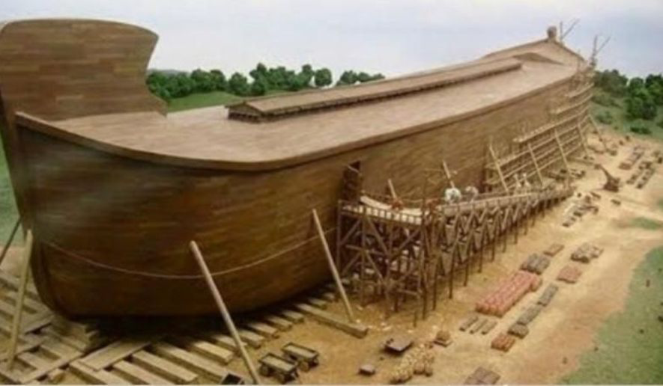
B。宽敞。“分一间一间地造”(6:14c)。 它有动物，食物和诺亚家庭的房间。应用:它是为了好客而建造的(来13:2)。
C。防水。“里外抹上松香”(6:14d)。 应用:它建在水中，但它内没有水(约17:14-15)。
D。大小。“方舟的造法乃是这样，要长三百肘，宽五十肘，高三十肘”(6:15)。即长约450英尺，宽75英尺，高45 或长约135米，宽23米，高14米。 应用:它形状不像船，而像房子。 它被建造浮动，而不是导航。
B. Roomy. “Make rooms in it”(6:14c). It had rooms for animals, food, and Noah’s family. Application:It was built for hospitality(Heb.13:2).
C.Watertight.“Coat it with pitch inside and out”(6:14d).Application:It was built to be in water,but not water in it(Jn.17: 4-15).
D. Size.“This is how you are to build it:The ark is to be 300 cubits long,50 cubits wide and 30 cubits high”(6:15).That is,about 450 feet long,75 feet wide and 45 feet high or about 135 meters long,23 meters wide and 14 meters high. Application:It was not shaped like a boat,but like a house.It was built to float, not to navigate.
(13)
Notes:
B. Kuānchǎng.“Fēn yī jiàn yī jiàn de zào”(6:14C). Tā yǒu dòngwù, shíwù hé nuò yǎ jiātíng de fángjiān. Yìngyòng: Tā shì wèile hàokè ér jiànzào de (lái 13:2).
C. Fángshuǐ.“Lǐ wài mǒ shàng sōngxiāng”(6:14D). Yìngyòng: Tā jiàn zài shuǐzhōng, dàn tā nèi méiyǒu shuǐ (yuē 17:14-15).
D. Dàxiǎo.“Fāngzhōu de zào fǎ nǎi shì zhèyàng, yào zhǎng sānbǎi zhǒu, kuān wǔshí zhǒu, gāo sānshí zhǒu”(6:15). Jí zhǎng yuē 450 yīngchǐ, kuān 75 yīngchǐ, gāo 45 huò zhǎng yuē 135 mǐ, kuān 23 mǐ, gāo 14 mǐ. Yìngyòng: Tā xíngzhuàng bù xiàng chuán, ér xiàng fángzi. Tā bèi jiànzào fúdòng, ér bùshì dǎoháng.

Slide 14
E。窗口。 “方舟上边要留透光处，高一肘(18英寸)”(6: 16b)。
“过了四十天，挪亚开了方舟的窗户，放出一只乌鸦去。那乌鸦飞来飞去，直到地上的水都干了。他又放出一只鸽子去，要看看水从地上退了没有。但遍地上都是水，鸽子找不着落脚之地，就回到方舟挪亚那里，挪亚伸手把鸽子接进方舟来。他又等了七天，再把鸽子从方舟放出去。到了晚上，鸽子回到他那里，嘴里叼着一个新拧下来的橄榄叶子”(8:6-11)。叼着橄榄枝的鸽子是全世界熟悉的和平象征。 应用：窗户用于照明和通风。
E. Window. “Leaving below the roof an opening one cubit(18 inches) high all around”(6:16b).“After forty days Noah opened a window he had made in the ark and sent out a raven, and it kept flying back and forth until the water had dried up from the earth.Then he sent out a dove to see if the water had receded from the surface of the ground.But the dove could find nowhere to perch because there was water over all the surface of the earth; so it returned to Noah in the ark. He reached out his hand and took the dove and brought it back to himself in the ark. He waited seven more days and again sent out the dove from the ark.When the dove returned to him in the evening, there in its beak was a freshly plucked olive leaf!”(8:6-11). A dove bearing an olive branch is a familiar symbol of peace around the world. Application:The window is for light and ventilation.
(14)
Notes:
E. Chuāngkǒu. “Fāngzhōu shàngbian yào liú tòu guāng chù, gāo yī zhǒu (18 yīngcùn)”(6: 16B).
“Guòle sìshí tiān, nuó yà kāile fāngzhōu de chuānghù, fàngchū yī zhǐ wūyā qù. Nà wūyā fēi lái fēi qù, zhídào dìshàng de shuǐ dū gànle. Tā yòu fàngchū yī zhǐ gēzi qù, yào kàn kàn shuǐ cóng dìshàng tuìle méiyǒu. Dàn biàndì shàng dū shì shuǐ, gēzi zhǎo bùzháo luòjiǎo zhī dì, jiù huí dào fāngzhōu nuó yǎ nàlǐ, nuó yà shēnshǒu bà gēzi jiē jìn fāngzhōu lái. Tā yòu děngle qītiān, zài bǎ gēzi cóng fāngzhōu fàng chūqù. Dàole wǎnshàng, gē zǐ huí dào tā nàlǐ, zuǐ lǐ diāozhe yīgè xīn níng xiàlái de gǎnlǎn yèzi”(8:6-11). Diāozhe gǎnlǎnzhī de gēzi shì quán shìjiè shúxī de hépíng xiàngzhēng. Yìngyòng: Chuānghù yòng yú zhàomíng hé tōngfēng.

Slide 15
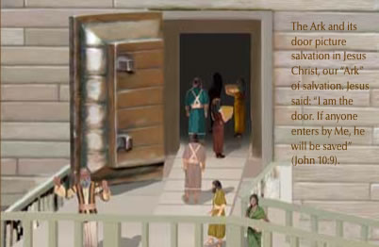
F。门。“方舟的门要开在旁边”(6:16c)。 打开进入。 应用：门是救赎的方式。
F. Door. “Put a door in the side of the ark”(6:16c). Opening for entering. Application: The door is the way of salvation.
方舟和它的门预表耶稣基督拯救，我们得救的“方舟”。
耶稣说：我就是门。凡从我进来的，必然得救(约10:9)。
(15)
Notes:
F. Mén.“Fāngzhōu de mén yào kāi zài pángbiān”(6:16C). Dǎkāi jìnrù. Yìngyòng: Mén shì jiùshú de fāngshì.
Fāngzhōu hé tā de mén yù biǎo yēsū jīdū zhěngjiù, wǒmen déjiù de “fāngzhōu”.
Yēsū shuō: Wǒ jiùshì mén. Fán cóng wǒ jìnlái de, bìrán déjiù (yuē 10:9).

Slide 16
3。属灵祝福的安慰和属灵咒诅的警告。 什么是祝福和诅咒？看看诺亚的儿子的榜样。
A。属灵的祝福。(1)繁殖生命。“神赐福给挪亚和他的儿子，对他们说，你们要生养众多，遍满了地”(9:1)。 神更新了他原来的祝福(1:28)和他对人类食物的供应(9:3)。(2)保护生命。“凡流人血的，他的血也必被人所流。因为神造人是照自己的形像造的”(9:6)。 神在这地球上建立了三个机构：婚姻/家庭(1:26-28; 2:18-25)，人类管理(9:6)和教会(太16:13-19;徒2)。(3)享受生活。 神与挪亚的约。 圣约的标志是彩虹。
3. The comfort of spiritual blessings and warning of spiritual curses. What were the blessings and curses?Look at Noah’s sons example.
A. Spiritual blessings. (1)Multiplying life.“Then God blessed Noah and his sons, saying to them,Be fruitful and increase in number and fill the earth”(9:1). God renewed his original blessing(1:28) and his provision for humanity’s food(9:3).(2)Protecting life.“Whoever sheds human blood, by humans shall their blood be shed; for in the image of God has God made mankind”(9:6). God ordained and established three institutions on this earth: marriage/family (1:26-28;2:18- 25),human government(9:6), and the church(Mt.16:13-19;Ac.2).(3)Enjoying life. God’s covenant with Noah. The covenant sign was the rainbow.
(16)
Notes:
3. Shǔ líng zhùfú de ānwèi hé shǔ líng zhòu zǔ de jǐnggào. Shénme shì zhùfú hé zǔzhòu? Kàn kàn nuò yǎ de érzi de bǎngyàng.
A. Shǔ líng de zhùfú.(1) Fánzhí shēngmìng.“Shén cì fú gěi nuó yà hé tā de érzi, duì tāmen shuō, nǐmen yào shēngyǎng zhòngduō, biàn mǎnle de”(9:1). Shén gēngxīnle tā yuánlái de zhùfú (1:28) Hé tā duì rénlèi shíwù de gōngyìng (9:3).(2) Bǎohù shēngmìng.“Fán liú rén xuè de, tā de xuè yě bì bèi rén suǒ liú. Yīnwèi shén zào rén shì zhào zìjǐ de xíng xiàng zào de”(9:6). Shén zài zhè dìqiú shàng jiànlìle sān gè jīgòu: Hūnyīn/jiātíng (1:26-28; 2:18-25), Rénlèi guǎnlǐ (9:6) Hé jiàohuì (tài 16:13-19; Tú 2).(3) Xiǎngshòu shēnghuó. Shén yǔ nuó yà de yuē. Shèng yuē de biāozhì shì cǎihóng.

Slide 17

B。属灵的诅咒。(1)家庭悲剧的。(a)羞耻。便醉了，在帐棚里赤着身子”(9:20-21)。 他的醉酒和赤身裸体是可耻的(弗5:18)。 “这个人先是喝了第一杯酒，然后一杯接一杯停不下来，直到全人被酒控制。”(b)不尊敬。“迦南的父亲含，看见他父亲赤身，就到外边告诉他两个弟兄”(9:22)。 含显示出他的后代会出现一个弱点。
B. Spiritual curses. (1)A family tragedy. (a)Disgrace. “Noah,a man of the soil, proceeded to plant a vineyard.When
he drank some of its wine, he became drunk and lay uncovered inside his tent”(9:20- 21).His drunkenness and nakedness were disgraceful(Eph.5:18). “First the man takes a drink, then the drink takes a drink, and then the drink takes the man.”
不要醉酒，酒能使人放荡，乃要被圣灵充满（弗：5:18）。
(b)Disrespect. “Ham, the father of Canaan, saw his father naked and told his two brothers outside”(9:22). Ham revealed a weakness in his character that would show up in his descendants.
(17)
Notes:
B. Shǔ líng de zǔzhòu.(1) Jiātíng bēijù de.(A) xiūchǐ. Biàn zuìle, zài zhàng péng lǐ chìzhe shēnzi”(9:20-21). Tā de zuìjiǔ hé chìshēn luǒtǐ shì kěchǐ de (fú 5:18). “Zhège rén xiānshi hēle dì yībēi jiǔ, ránhòu yībēi jiē yī bēi tíng bù xiàlái, zhídào quán rén bèi jiǔ kòngzhì.”(B) bù zūnjìng.“Jiā nán de fùqīn hán, kànjiàn tā fùqīn chìshēn, jiù dào wàibian gàosù tā liǎng gè dìxiōng”(9:22). Hán xiǎnshì chū tā de hòudài huì chūxiàn yīgè ruòdiǎn.
Bùyào zuìjiǔ, jiǔ néng shǐ rén fàngdàng, nǎi yào bèi shènglíng chōngmǎn (fú:5:18).

Slide 18
(d)端正。“于是闪和雅弗，拿件衣服搭在肩上，倒退着进去，给他父亲盖上。他们背着脸就看不见父亲的赤身”(9:23)。“爱能遮掩许多的罪”(彼后4:8;箴10:12)。对未承认的罪没有遮掩。
(2)家庭的预言。
(a)迦南作奴仆的(9:25)。
(b) 闪成为富足。“又说，耶和华闪的神，是应当称颂的，愿迦南作闪的奴仆”(9:26)。
(c)雅弗扩张。 “愿神使雅弗扩张”(9:27)。
(d)Decency. “But Shem and Japheth took a garment and laid it across their shoulders; then they walked in backward and covered their father’s naked body.Their faces were turned the other way so that they would not see their father naked”(9:23). “Love covers all sins”(1Pe.4:8; Pr.10:12).There is no covering for unconfessed sin.
(2)A family prophecy.
(a)Canaan enslaved(9:25).
(b)Shem enriched.“Praise be to the Lord, the
God of Shem! May Canaan be the slave of Shem”(9:26).
(c)Japheth enlarged. “God will enlarge Japheth”(9:27).
(18)
Notes:
(D) duānzhèng.“Yúshì shǎn hé yǎ fú, ná jiàn yīfú dā zài jiān shàng, dàotuìzhe jìnqù, gěi tā fùqīn gài shàng. Tāmen bèizhe liǎn jiù kàn bùjiàn fùqīn de chìshēn”(9:23).“Ài néng zhēyǎn xǔduō de zuì”(bǐ hòu 4:8; Zhēn 10:12). Duì wèi chéngrèn de zuì méiyǒu zhēyǎn.
(2) Jiātíng de yùyán.
(A) jiā nán zuò núpú de (9:25).
(B) shǎn chéngwéi fùzú.“Yòu shuō, yēhéhuá shǎn de shén, shì yīngdāng chēngsòng de, yuàn jiā nán zuò shǎn de núpú”(9:26).
(C) yǎ fú kuòzhāng. “Yuàn shén shǐ yǎ fú kuòzhāng”(9:27).

Slide 19
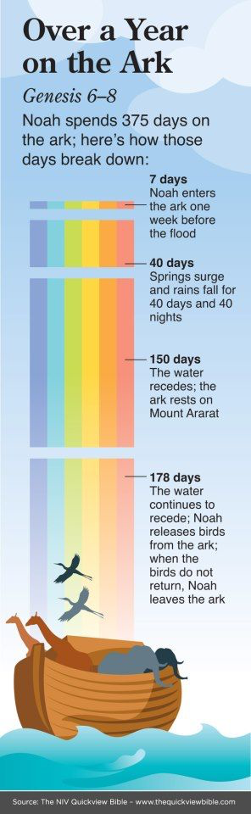
结论：无论生命中的风暴多大，神仍稳坐在宝座上，让万事互相效力。 在生命的风雨中，总是寻找神的盟约承诺的彩虹。 像约翰一样(启4:3;10:1)，你可能在风暴之前看到彩虹; 像以西结(1:28)，你可能在风暴中看见它; 或者挪亚(创9:13,14,16)，你可能要等到暴风雨过后。 但是如果你凭信心看，你总能看到神应许的彩虹。我们的家园将成为生活风暴中的“庇护所”。你的家是不是家甜蜜的家？
Conclusion:No matter how great the storms of life may be,God is still on the throne causing everything to work together for good. In the storms of life, always look for the rainbow of God’s covenant promise.Like John (Rev.4:3;10:1), you may see the rainbow before the storm; like Ezekiel (1:28),you may see it in the midst of the storm;or like Noah(Gen.9:13,14, 16),you may have to wait until after the storm. But you will always see the rainbow of God’s promise if you look by faith. Our homes are to be shelters in the midst of the storms
of life. Is your home “Home sweet home”?
(19)
Notes:
Jiélùn: Wúlùn shēngmìng zhòng de fēngbào duōdà, shén réng wěn zuò zài bǎozuò shàng, ràng wànshì hùxiāng xiàolì. Zài shēngmìng de fēngyǔ zhōng, zǒng shì xúnzhǎo shén de méngyuē chéngnuò de cǎihóng. Xiàng yuēhàn yīyàng (qǐ 4:3;10:1), Nǐ kěnéng zài fēngbào zhīqián kàn dào cǎihóng; xiàng yǐxī jié (1:28), Nǐ kěnéng zài fēngbào zhòng kànjiàn tā; huòzhě nuó yà (chuàng 9:13,14,16), Nǐ kěnéng yào děngdào bàofēngyǔ guòhòu. Dànshì rúguǒ nǐ píng xìnxīn kàn, nǐ zǒng néng kàn dào shén yīngxǔ de cǎihóng. Wǒmen de jiāyuán jiāng chéngwéi shēnghuó fēngbào zhōng de “bìhù suǒ”. Nǐ de jiā shì bùshì jiā tiánmì de jiā?

Slide 20
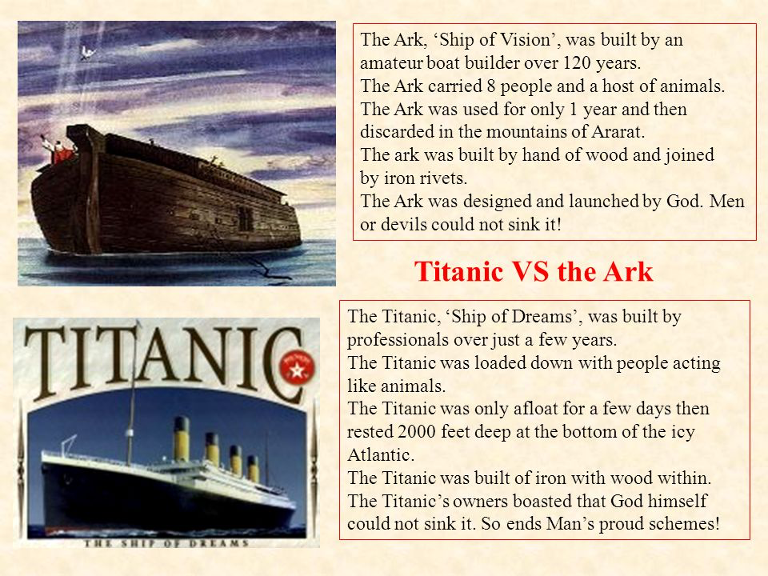
方舟是“异象之船。”
泰坦尼克是“梦想之船。”
Would you rather be in the Ark or the Titanic?
Notes:
Fāngzhōu shì “yì xiàng zhī chuán”.
Tàitǎn níkè hào shì “mèngxiǎng zhī chuán”.

Slide 21
Pastor’s Prayer Guide | Week: January 22-28, 2018
Pray God’s Name: Ask in His Name. | The Most High God(El Elyon,Gen.14:17-22).
Praise and Thanksgiving: | For parents(Eph.6:2).
God Seeking: Seekers. | For prodigals(Lk.15:12-24).
Kingdom Praying: Individual prayer time. | Prayer promise: Performs all things (Ps.57:2).
Connecting with God: Abraham&Sarah(Ge.6:9-22)(Jan.28,2018) | Message: Pastor Gary Hart Leader: Michael Zuo Music: Grace Zuo
Caring for others: Fellowship. | Families.
Committing to missions: Missionaries. | America: Davis family and ministry. Britain: Hannah Cashman Children’s ministry.
Consecrating to ministry: Discipleship. | Direction’s Class.
Sickness/Special needs: | Liu XueJiao eye cornea problem. Zhang Jie knee surgery recovery. Shu JiaNiang cancer treatment.
牧师的祷告指南 | 周:2018年1月22-28日
奉神的名字求: 奉祂的名祈求。 | 至高的神(以罗伊，创14:17-22)。
赞美和感恩： | 为父母(弗6:2)。
寻求真神： 寻求者。 | 为浪子（路15:12-14）。
祈求神国： 个人祈祷时间。 | 祷告应许：成全诸事(诗57:2)。
连接于神:亚伯拉罕和撒拉(创18:1-15) (2018年1月28日) | 信息：何礼义牧师 领会：伍雷 司琴：
关爱别人： 团契。 | 家庭。
奉献宣教： 宣教士们。 | 美国：Davis家庭和事工。 英国：Cashman儿童事工。
奉献事工： 门徒训练。 | 方向指引的课程。
疾病/特别需要： | 刘雪娇眼角膜脱落。 張捷的膝盖开刀恢复。 舒嘉宁的癌症治疗。

