Slide 1

堪城华人基督教会
GKCCCC
何礼义牧师
Pastor Gary Hart
经文:创2:15-25
Text: Gen.2:15-25
题目:“完美的同伴”
Topic: “Perfect Companions.”
“因此，人要离开父母与妻子连合，二人成为一体”
(创2:24)。
“That is why a man leaves his father and mother and is united to his wife, and they become one flesh”(Gen.2:24).
主日:二零一七年十二月三十一日 Sunday: Dec.31, 2017
(1)
Notes:
Tímù:“Wánměi de tóngbàn”
“Yīncǐ, rén yào líkāi fùmǔ yǔ qīzi lián hé, èr rén chéngwéi yītǐ” (chuàng 2:24).

Slide 2


引论：A。2017年教会主题：基督要建造祂的教会（太16：18）。 神建立了教会的制度。
B。2018年教会主题：基督是我家之主（诗篇127：1）。“若不是耶和华建造房屋，建造的人就枉然劳力。若不是耶和华看守城池，看守的人就枉然儆醒。”神建立了家庭制度，并颁发了祂的婚姻和家庭手册。“从前所写的圣经都是为教训我们写的，叫我们因圣经所生的忍耐和安慰，可以得着盼望...”（罗十五：4）。
Introduction: A.2017 Church Theme: Christ will build His Church(Mt.16:18). God established the institution of the Church.
B.2018 Church Theme: Christ is the Head of this House(Ps.127:1). “Unless the LORD builds the house, the builders labor in vain.”God established the institution of the Family, and has given His Marriage and Family Manual. “For everything that was written in the past was written to teach us…” (Ro.15:4).
婚前咨询手册。
婚姻手册。
(2)
Notes:
Yǐn lùn:A.2017 Nián jiàohuì zhǔtí: Jīdū yào jiànzào tā de jiàohuì (tài 16:18). Shén jiànlìle jiàohuì de zhìdù.
B.2018 Nián jiàohuì zhǔtí: Jīdū shì wǒjiā zhī zhǔ (shīpiān 127:1).“Ruò bùshì yēhéhuá jiànzào fángwū, jiànzào de rén jiù wǎngrán láolì. Ruò bùshì yēhéhuá kānshǒu chéngchí, kānshǒu de rén jiù wǎngrán jǐng xǐng.” Shén jiànlìle jiātíng zhìdù, bìng bānfāle tā de hūnyīn hé jiātíng shǒucè.“Cóngqián suǒ xiě de shèngjīng dōu shì wèi jiàoxùn wǒmen xiě de, jiào wǒmen yīn shèngjīng suǒ shēng de rěnnài hé ānwèi, kěyǐ dézháo pànwàng...”(Luō shíwǔ:4).
Hūnqián zīxún shǒucè.
Hūnyīn shǒucè.

Slide 3


C。你们是怎么见面的？ 我喜欢问夫妇这个问题。 我们对第一个婚姻和家庭有什么了解？第一对夫妇是怎么见面的？ 是神圣的设计还是意外？ 一见钟情吗？ 日久生情吗？
C. How did you meet? I enjoy asking couples this question. What do we know about the first marriage and family?How did the first couple meet? Was it by divine design or accident? Was it love at first sight? Was it love that grew?
一见钟情
后见钟情
每见钟情。
祝你有一天复一天又一年复一年的爱情。
(3)
Notes:
C. Nǐmen shì zěnme jiànmiàn de? Wǒ xǐhuān wèn fūfù zhège wèntí. Wǒmen duì dì yī gè hūnyīn hé jiātíng yǒu shé me liǎojiě? Dì yī duì fūfù shì zěnme jiànmiàn de? Shì shénshèng de shèjì háishì yìwài? Yījiànzhōngqíng ma? Rì jiǔshēng qíng ma?
Yījiànzhōngqíng, hòu jiàn zhōngqíng, měi jiàn zhōngqíng.
Zhù nǐ yǒu yītiān fù yītiān yòu yī nián fù yī nián de àiqíng.

Slide 4
一。一个完美的男性伴侣。 他是完美的。 你在找真命天子吗？
A。他的家。(1)他来自完美的家庭 。神是他的创造者和父亲。 “神就照着自己的形像造人，乃是照着他的形像造男造女”（创1：27）。 “神看着一切所造的（好，1：4,10,12,18,21,25），都甚好”（1：31）。“耶和华神用地上的尘土造人，将生气吹在他鼻孔里，他就成了有灵的活人，名叫亚当”（2：7）。 （2）他来自一个完美的环境 - 伊甸园是他的家园。 “耶和华神将那人安置在伊甸园 ”（意思是“喜乐”天堂2：15a）。
1. A perfect male companion.He was perfect.Are you looking for Mr. Right? A.His home. (1)He came from perfect home. God was His Creator and Father. “So God created mankind in his own image, in the image of God he created them;male and female he created them”(Ge.1:27). “God saw all that he had made,(good-1:4,10,12,18,21,25)and it was very good”(1:31).“Then the Lord God formed a man from the dust of the ground and breathed into his nostrils the breath of life, and the man became a living being”(2:7). (2)He came from a perfect environment. Eden was His home. “The Lord God took the man and put him in the Garden of Eden” (means “delight” a paradise 2:15a).
(4)
Notes:
Yī. Yīgè wánměi de nánxìng bànlǚ. Tā shì wánměi de. Nǐ zài zhǎo zhēn mìng tiānzǐ ma?
A. Tā de jiā.(1) Tā láizì wánměi de jiātíng. Shén shì tā de chuàngzào zhě hé fùqīn. “Shén jiù zhàozhe zìjǐ de xíng xiàng zào rén, nǎi shì zhàozhe tā de xíng xiàng zào nán zào nǚ”(chuàng 1:27). “Shén kànzhe yīqiè suǒ zào de (hǎo,1:4,10,12,18,21,25), Dōu shén hǎo”(1:31). “Yēhéhuá shén yòngdì shàng de chéntǔ zào rén, jiāng shēngqì chuī zài tā bíkǒng lǐ, tā jiù chéngle yǒu líng de huó rén, míng jiào yàdāng”(2:7). (2) Tā láizì yīgè wánměi de huánjìng - yīdiànyuán shì tā de jiāyuán. “Yēhéhuá shén jiāng nà rén ānzhì zài yīdiànyuán ”(yìsi shì “xǐlè” tiāntáng 2:15A).

Slide 5
一。一个完美的男性伴侣。
B。他的目的。(1)他是他父亲所造之物的统治者。 “神说，我们要照着我们的形像，按着我们的样式造人，使他们管理海里的鱼，空中的鸟，地上的牲畜，和全地，并地上所爬的一切昆虫”(1:26)。 “耶和华神用土所造成的野地各样走兽和空中各样飞鸟都带到那人面前，看他叫什么。那人怎样叫各样的活物，那就是它的名字”(2: 19)。(2)他是他父亲的花园的看守者。 “耶和华神将那人安置在伊甸园，使他修理看守”（2:15b）。
1. A perfect male companion.
B.His purpose. (1) He was a ruler over his Father’s creation. “Then God said,Let us make mankind in our image,in our likeness,so that they may rule over the fish in the sea and the birds in the sky, over the livestock and all the wild animals, and over all the creatures that move along the ground”(1:26). “Now the Lord God had formed out of the ground all the wild animals and all the birds in the sky. He brought them to the man to see what he would name them; and whatever the man called each living creature, that was its name”(2:19). (2)He was a caretaker of his Father’s garden. “Put him in the Garden of Eden to work it and take care of it”(2:15b).
(5)
Notes:
Yī. Yīgè wánměi de nánxìng bànlǚ.
B. Tā de mùdì.(1) Tā shì tā fùqīn suǒ zào zhī wù de tǒngzhì zhě. “Shén shuō, wǒmen yào zhàozhe wǒmen de xíng xiàng, ànzhe wǒmen de yàngshì zào rén, shǐ tāmen guǎnlǐ hǎilǐ de yú, kōngzhōng de niǎo, dìshàng de shēngchù, hé quán de, bìng dìshàng suǒ pá de yīqiè kūnchóng”(1:26). “Yēhéhuá shén yòngtǔ suǒ zàochéng de yědì gè yàng zǒushòu hé kōngzhōng gè yàng fēiniǎo dōu dài dào nà rén miànqián, kàn tā jiào shénme. Nà rén zěnyàng jiào gè yàng de huó wù, nà jiùshì tā de míngzì”(2:19).(2) Tā shì tā fùqīn de huāyuán de kānshǒu zhě. “Yēhéhuá shén jiāng nà rén ānzhì zài yīdiànyuán, shǐ tā xiūlǐ kānshǒu”(2:15B).

Slide 6

一。一个完美的男性伴侣。
C。他的命令。（1）正面命令。“耶和华神吩咐他说，园中各样树上的果子，你可以随意吃”（2:16）。（2）负面命令。 “只是分别善恶树上的果子，你不可吃”（2：17a）。“现在恐怕他伸手又摘生命树的果子吃，就永远活着”（3：22b）。（3）严重的后果。 “因为你吃的日子必定死”（2：17b）。
1. A perfect male companion. C. His commands. (1)Positive commands. “And the Lord God command-ed the man, “You are free to eat from any tree in the garden”(2:16). (2)Negative commands. “But you must not eat from the tree of the knowledge of good and evil”(2:17a). “He must not be allowed to reach out his hand and take also from the tree of life and eat, and live forever”(3:22b). (3) Serious consequences. “For when you eat from it you will certainly die”(2:17b).
生命树
分别善恶树
两棵树在伊甸园的中间。
(6)
Notes:
Yī. Yīgè wánměi de nánxìng bànlǚ.
C. Tā de mìnglìng.(1) Zhèngmiàn mìnglìng.“Yēhéhuá shén fēnfù tā shuō, yuán zhōng gè yàng shù shàng de guǒzi, nǐ kěyǐ suíyì chī”(2:16).(2) Fùmiàn mìnglìng. “Zhǐshì fēnbié shàn è shù shàng de guǒzi, nǐ bùkě chī”(2:17A).“Xiànzài kǒngpà tā shēnshǒu yòu zhāi shēngmìng shù de guǒzi chī, jiù yǒngyuǎn huózhe”(3:22B).(3) Yánzhòng de hòuguǒ. “Yīnwèi nǐ chī de rìzi bìdìng sǐ”(2:17B).

Slide 7


一。一个完美的男性伴侣。
D。他的长处。（1）他的“田野”或工作。 （2）他的“能力”或力量。 汉字为男（男）领域加上力量。
E。他的弱点。（1）不好独处。 “耶和华神说，那人独居不好”
（2:18a）。（2）需要一个同伴：“我要为他造一个配偶帮助他”（2:18b）。“那人便给一切牲畜和空中飞鸟，野地走兽都起了名。只是那人没有遇见配偶帮助他”（2：20b）。 没有狗或任何动物是合适的帮手。
1. A perfect male companion.
D. His strengths. (1)His “field” or work.
(2)His “power” or strength. Chinese
character for male (男) field plus power.
E.His weaknesses. (1)Not good to be alone. “The Lord God said, “It is not good for the man to be alone”(2:18a).(2)Need for a companion.“I will make a helper suitable for him”(2:18b).“So the man gave names to all the livestock, the birds in the sky and all the wild animals. But for Adam no suitable helper was found”(2:20b). No dog or any animal was a suitable helper.
人最好的
朋友。
我要为他造一个配偶帮助他。
(7)
Notes:
Yī. Yīgè wánměi de nánxìng bànlǚ.
D. Tā de cháng chù.(1) Tā de “tiányě” huò gōngzuò. (2) Tā de “nénglì” huò lìliàng. Hànzì wèi nán (nán) lǐngyù jiā shàng lìliàng.
E. Tā de ruòdiǎn.(1) Bù hǎo dúchǔ. “Yēhéhuá shén shuō, nà rén dújū bù hǎo” (2:18A). (2) Xūyào yīgè tóngbàn:“Wǒ yào wèi tā zào yīgè pèi'ǒu bāngzhù tā”(2:18B).“Nà rén biàn gěi yīqiè shēngchù hé kōngzhōng fēiniǎo, yědì zǒushòu dōu qǐle míng. Zhǐshì nà rén méiyǒu yùjiàn pèi'ǒu bāngzhù tā”(2:20B). Méiyǒu gǒu huò rènhé dòngwù shì héshì de bāngshǒu.

Slide 8
二。一个完美的女性伴侣。 她是完美的。 你在找环球小姐吗？
A。她的家。(1)她来自完美的家庭 。神是她的创造者和父亲。 “神就照着自己的形像造人，乃是照着他的形像造男造女”(创1:27)。 “神看着一切所造的，都甚好”（1：31）。“耶和华神使他沉睡，他就睡了。于是取下他的一条肋骨，又把肉合起来。耶和华神就用那人身上所取的肋骨，造成一个女人，领她到那人跟前”（2：21-22）。 （2）她来自一个完美的环境 - 伊甸园是他的家园。
2. A perfect female companion. She was perfect.Are you looking for Miss Universe?A.Her home.(1)She came from perfect home:God was Her Creator and Father. “So God created mankind in his own image,in the image of God he created them;male and female he created them”
(Ge.1:27). “God saw all that he had made,and it was very good”(1:31).
“So the Lord God caused the man to fall into a deep sleep;and while he was sleeping, he took one of the man’s ribs and then closed up the place with flesh.Then the Lord God made a woman from the rib he had taken out of the man, and he brought her to the man”(2:21-22). (2)She came from a perfect environment:Eden was Her home.
(8)
Notes:
Èr. Yīgè wánměi de nǚxìng bànlǚ. Tā shì wánměi de. Nǐ zài zhǎo huánqiú xiǎojiě ma?
A. Tā de jiā.(1) Tā láizì wánměi de jiātíng. Shén shì tā de chuàngzào zhě hé fùqīn. “Shén jiù zhàozhe zìjǐ de xíng xiàng zào rén, nǎi shì zhàozhe tā de xíng xiàng zào nán zào nǚ”(chuàng 1:27). “Shén kànzhe yīqiè suǒ zào de, dōu shén hǎo”(1:31).“Yēhéhuá shén shǐ tā chénshuì, tā jiù shuìle. Yúshì qǔ xià tā de yītiáo lèigǔ, yòu bǎ ròu hé qǐlái. Yēhéhuá shén jiù yòng nà rén shēnshang suǒ qǔ de lèigǔ, zàochéng yīgè nǚrén, lǐng tā dào nà rén gēnqián”(2:21-22). (2) Tā láizì yīgè wánměi de huánjìng - yīdiànyuán shì tā de jiāyuán.

Slide 9

“她不是从他的头里被造出，来统治他的。也不是从他脚里被造出，来受践踏的，而是从他的勒内被造出，与他平等的，在他的胳膊下受到保护，在他的心脏附近被爱。”
“She was not made out of his head to rule over him,nor out of his feet to be trampled upon by him,but out of his side to be equal with him, under his arm to be protected,and near his heart to be loved”(MHenry).
(9)
Notes:
“Tā bùshì cóng tā de tóu li bèi zào chū, lái tǒngzhì tā de. Yě bùshì cóng tā jiǎo lǐ bèi zào chū, lái shòu jiàntà de, ér shì cóng tā de lēi nèi bèi zào chū, yǔ tā píngděng de, zài tā de gēbó xià shòudào bǎohù, zài tā de xīnzàng fùjìn bèi ài.”

Slide 10
二。一个完美的女性伴侣。
B。她的目的。(1)她是他父亲所造之物的统治者。 “神说，我们要照着我们的形像，按着我们的样式造人，使他们管理海里的鱼，空中的鸟，地上的牲畜，和全地，并地上所爬的一切昆虫”（1:26）。 (2) 她是她家的管理者。 “治理家务”（提前5：14）。这并不意味着她不能在家外工作，而是有一种筑巢的本能。拿一个单身男子的公寓和一个单身女子的公寓相比，通常来说，前者可能是一个凌乱的洞穴，后者则是一个井井有条的家。
2. A perfect female companion. B.Her purpose.(1)She was a ruler over his Father’s creation.“Then God said,Let us make mankind in our image, in our likeness,so that they may rule over the fish in the sea and the birds in the sky,over the livestock and all the wild animals, and over all the creatures that move along the ground”(1:26).(2)She was a manager of her home.“To manage their homes”(1Ti.5:14).This does not mean that she cannot work outside of the home,but that she has a nesting instinct.Look at a bachelor’s apartment compared to a bachelorette’s apartment.Generally speaking,a man may have a “messy” cave,but a woman has a “good housekeeping” home.
(10)
Notes:
Èr. Yīgè wánměi de nǚxìng bànlǚ.
B. Tā de mùdì.(1) Tā shì tā fùqīn suǒ zào zhī wù de tǒngzhì zhě. “Shén shuō, wǒmen yào zhàozhe wǒmen de xíng xiàng, ànzhe wǒmen de yàngshì zào rén, shǐ tāmen guǎnlǐ hǎilǐ de yú, kōngzhōng de niǎo, dìshàng de shēngchù, hé quán de, bìng dìshàng suǒ pá de yīqiè kūnchóng”(1:26). (2) Tā shì tā jiā de guǎnlǐ zhě. “Zhìlǐ jiāwù”(tíqián 5:14). Zhè bìng bù yìwèizhe tā bùnéng zàijiā wài gōngzuò, ér shì yǒuyī zhǒng zhù cháo de běnnéng. Ná yīgè dānshēn nánzǐ de gōngyù hé yīgè dānshēn nǚzǐ de gōngyù xiāng bǐ, tōngcháng lái shuō, qiánzhě kěnéng shì yīgè língluàn de dòngxué, hòu zhě zé shì yīgè jǐngjǐngyǒutiáo de jiā.

Slide 11
二。一个完美的女性伴侣。
C。她的命令。（1）正面命令。“耶和华神吩咐他说，园中各样树上的果子，你可以随意吃”（2:16）。（2）负面命令。 “只是分别善恶树上的果子，你不可吃”（2：17a）。“现在恐怕他伸手又摘生命树的果子吃，就永远活着”（3：22b）。（3）严重的后果。 “因为你吃的日子必定死”（2：17b）。
2. A perfect female companion. C.Her commands. (1)Positive commands. “And the Lord God command-ed the man, “You are free to eat from any tree in the garden”(2:16). (2)Negative commands. “But you must not eat from the tree of the knowledge of good and evil”(2:17a). “He must not be allowed to reach out his hand and take also from the tree of life and eat, and live forever”(3:22b). (3) Serious consequences. “For when you eat from it you will certainly die”(2:17b).
生命树
分别善恶树
两棵树在伊甸园的中间。
(11)
Notes:
1. Yīgè wánměi de nǚxìng bànlǚ.
C. Tā de mìnglìng.(1) Zhèngmiàn mìnglìng.“Yēhéhuá shén fēnfù tā shuō, yuán zhōng gè yàng shù shàng de guǒzi, nǐ kěyǐ suíyì chī”(2:16).(2) Fùmiàn mìnglìng. “Zhǐshì fēnbié shàn è shù shàng de guǒzi, nǐ bùkě chī”(2:17A).“Xiànzài kǒngpà tā shēnshǒu yòu zhāi shēngmìng shù de guǒzi chī, jiù yǒngyuǎn huózhe”(3:22B).(3) Yánzhòng de hòuguǒ. “Yīnwèi nǐ chī de rìzi bìdìng sǐ”(2:17B).

Slide 12
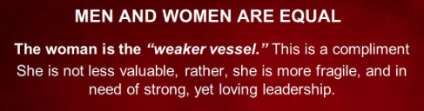
二。一个完美的女性伴侣。
D。她的长处。 （1）她优美的步伐。 （2）她的美丽。 汉字（女）优雅地走路。
E。她的弱点：（1）身体不健壮。 “较弱的器皿”（彼前3：7）（2）需要一个伴侣，“你必恋慕你丈夫”（创3：16）。
2. A perfect female companion.
D. Her strengths. (1) Her graceful walk. (2) Her beauty. Chinese character for female (女) gracefully walking.
E. Her weaknesses.(1)Not as strong physically. “Weaker vessel”(1Pe.3:7).(2)Need for a companion.“Your desire will be for your husband”
(Ge.3:16).
男人和女人是平等的。 女人是“较弱的器皿”。 这是一个恭维。她不是不及男人那么有价值，而是比较脆弱，需要强大而又有爱心的领导。
(12)
Notes:
Èr. Yīgè wánměi de nǚxìng bànlǚ.
D. Tā de cháng chù. (1) Tā yōuměi de bùfá. (2) Tā dì měilì. Hànzì (nǚ) yōuyǎ de zǒulù.
E. Tā de ruòdiǎn:(1) Shēntǐ bù jiànzhuàng. “Jiào ruò de qìmǐn”(bǐ qián 3:7)(2) Xūyào yīgè bànlǚ,“nǐ bì liànmù nǐ zhàngfū”(chuàng 3:16).
Nánrén hé nǚrén shì píngděng de. Nǚrén shì “jiào ruò de qìmǐn”. Zhè shì yīgè gōngwéi. Tā bùshì bùjí nánrén nàme yǒu jiàzhí, ér shì bǐjiào cuìruò, xūyào qiángdà ér yòu yǒu àixīn de lǐngdǎo.

Slide 13
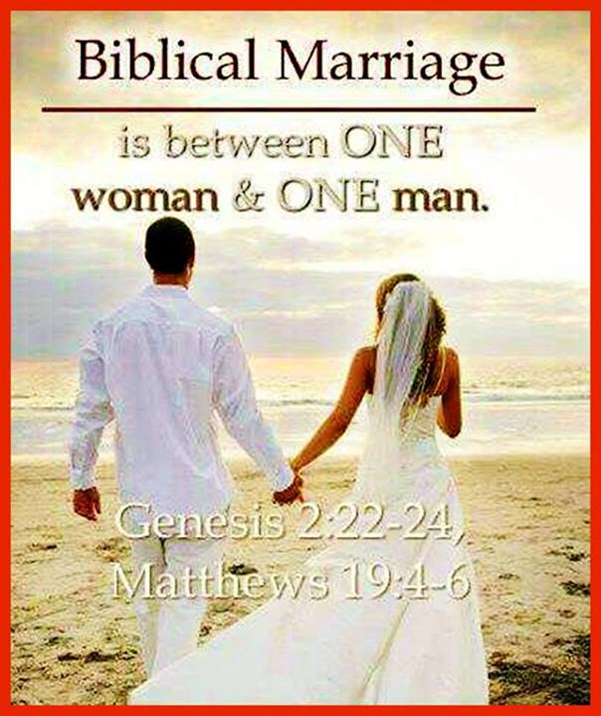
三。结婚的同伴。婚姻是一男一女。 汉字为内人(内人)。神谴责其他不道德的关系。神作为夏娃的父亲把夏娃护送到等候的亚当身边。
A。欢喜快乐。 “那人说，这是我骨中的骨，肉中的肉，可以称她为女人，因为她是从男人身上取出来的”(创2:23)。她是美丽的花！
3. Married companions. Marriage is one man + one woman. Chinese character for inside person(内人). God condemns other immoral relationships. God as Eve’s Father escorted Eve to the waiting Adam.
A. Happiness. “The man said, This is now bone of my bones and flesh of my flesh;she shall be called woman, for she was taken out of man”(Ge.2:23). The Man said, “Finally! Bone of my bone, flesh of my flesh! Name her Woman for she was made from Man.”(Msg) She is beautiful flower!
圣经的婚姻是一男一女。
(13)
Notes:
Sān. Jiéhūn de tóngbàn. Hūnyīn shì yīnán yī nǚ. Hànzì wèi nèi rén (nèi rén). Shén qiǎnzé qítā bù dàodé de guānxì. Shén zuòwéi xiàwá de fùqīn bǎ xiàwá hùsòng dào děnghòu de yàdāng shēnbiān.
A. Huānxǐ kuàilè. “Nà rén shuō, zhè shì wǒ gǔ zhōng de gǔ, ròu zhōng de ròu, kěyǐ chēng tā wèi nǚrén, yīnwèi tā shì cóng nánrén shēnshang qǔ chūlái de”(chuàng 2:23).

Slide 14
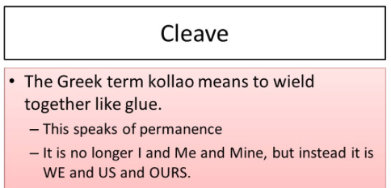
三。结婚的同伴。
B。目的。“因此，人要离开父母与妻子连合，二人成为一体”（2：24：太19：5;弗5：31）。 （1）离开以前的家庭（父母）。 （2）成为一个新的家庭（与自己的伴侣）。（3）成为一个身体，“当时夫妻二人赤身露体，并不羞耻”（2:25）。
3. Married companions.
B. Purpose.“That is why a man leaves his father and mother and is united to his wife,and they become one flesh”(2:24:Mt.19:5;Eph.5:31). (1) Leaving former family(father and mother). (2)Cleaving to form a new family(with one’s mate).(3)Become one flesh.“Adam and his wife were both naked,and they felt no shame” (2:25)
粘着
意味着像胶水一样运动。 这说到永久性。 它不再是我和我的，而是我们和我们的。
(14)
Notes:
Sān. Jiéhūn de tóngbàn.
B. Mùdì.“Yīncǐ, rén yào líkāi fùmǔ yǔ qīzi lián hé, èr rén chéngwéi yītǐ”(2:24: Tài 19:5; Fú 5:31). (1) Líkāi yǐqián de jiātíng (fùmǔ). (2) Chéngwéi yīgè xīn de jiātíng (yǔ zìjǐ de bànlǚ).(3) Chéngwéi yīgè shēntǐ,“dāngshí fūqī èr rén chìshēn lù tǐ, bìng bù xiūchǐ”(2:25).
Niánzhe
yìwèizhe xiàng jiāoshuǐ yīyàng yùndòng. Zhè shuō dào yǒngjiǔ xìng. Tā bù zài shì wǒ hé wǒde, ér shì wǒmen hé wǒmende.

Slide 15
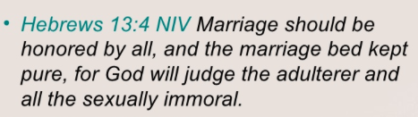
三。结婚的同伴。
C。命令。 （1）富有成效 “神就赐福给他们，又对他们说，要生养众多，遍满地面”（1:28）。 （2）被尊荣（来13：4）。
D。祝福。（1）基督的同在。 耶稣的第一个神迹是在迦南举行婚礼（约2:1-2）。（2）基督和他的新娘，教会的图片。
3. Married companions.
C. Commands. (1)Be fruitful. “God blessed them and said to them, Be fruitful and increase in number”(1:28). (2)Honor marriage(He.13:4).
D. Blessings.(1)The presence of Christ. Jesus first miracle was at a wedding in Cana(Jn.2:1-2).(2)The picture of Christ and His Bride,the Church.
婚姻，人人都当尊重，床也不可污秽。因为苟合行淫的人神必要审判(来13:4)。
(15)
Notes:
Sān. Jiéhūn de tóngbàn.
C. Mìnglìng. (1) Fùyǒu chéngxiào “shén jiù cì fú gěi tāmen, yòu duì tāmen shuō, yào shēngyǎng zhòngduō, biàn mǎn dìmiàn”(1:28). (2) Bèi zūn róng (lái 13:4).
D. Zhùfú.(1) Jīdū de tóng zài. Yēsū de dì yī gè shénjī shì zài jiā nán jǔxíng hūnlǐ (yuēhàn èr shū 1-2).(2) Jīdū hé tā de xīnniáng, jiàohuì de túpiàn.
Hūnyīn, rén rén dōu dāng zūnzhòng, chuáng yě bùkě wūhuì. Yīnwèi gǒuhé xíng yín de rén shén bìyào shěnpàn (lái 13:4)

Slide 16
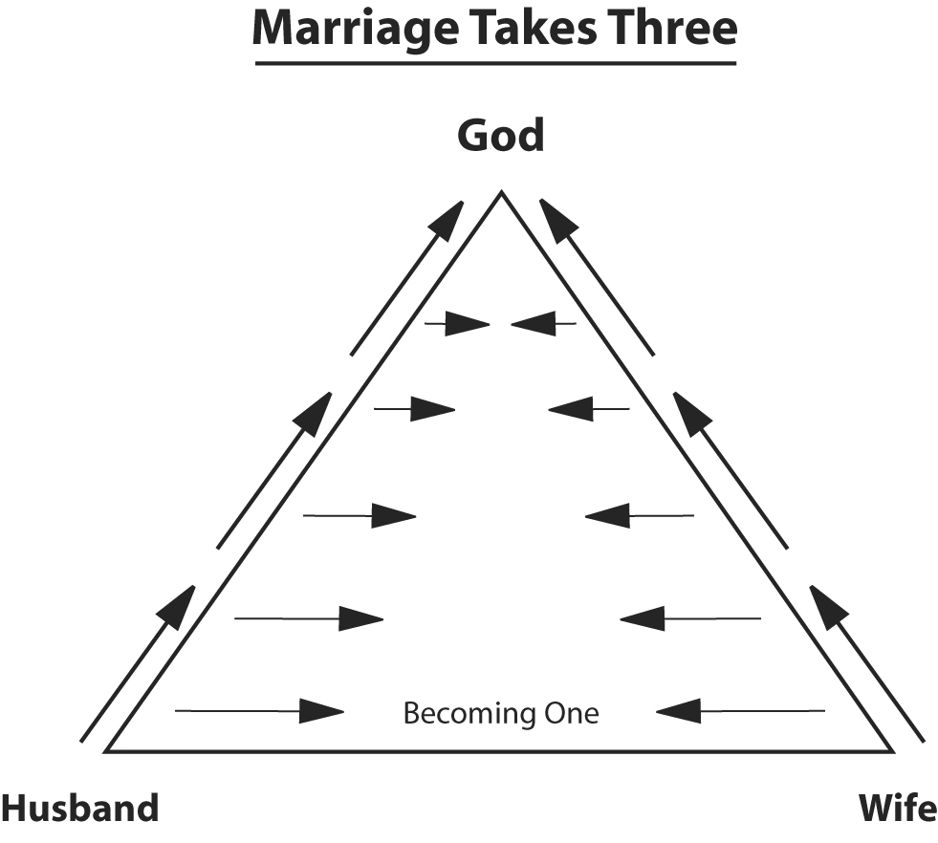
四。神圣的同伴。
A。神的计划。 “让我们”（创1：26-27）。 神是三合一的（三位一体的）。
B。神的目的。婚姻是三合一(三角形=上帝+丈夫+妻子)。(1)神的责任。 基督是一家之主。 “又当存敬畏基督的心，彼此顺服”(弗5:21)。
4.Divine companions.
A.Divine Plan. “Let us”(Ge.1:26- 27). God is three in one(trinity in unity).
B.Divine Purpose.Marriage is three in one (Triangle=God+Husband+Wife). (1)God’s responsibilities. Christ is the Head of this House. “Submit to one another out of reverence for Christ” (Eph.5:21).
婚姻需要三方
上帝
丈夫
妻子
(16)
Notes:
Sì. Shénshèng de tóngbàn.
A. Shén de jìhuà. “Ràng wǒmen”(chuàng 1:26-27). Shén shì sān hé yī de (sānwèiyītǐ de). Èrshísān.
B. Zhēnyán. Hūnyīn shì sān hé yī (sānjiǎoxíng =shàngdi +zhàngfū +qīzi).(1) Shén de zérèn. Jīdū shì yījiā zhī zhǔ. “Yòu dāng cún jìngwèi jīdū de xīn, bǐcǐ shùnfú”(fú 5:21).

Slide 17
（2）丈夫的责任。“你们作丈夫的，要爱你们的妻子，正如基督爱教会，为教会舍己。要用水借着道，把教会洗净，成为圣洁，可以献给自己，作个荣耀的教会，毫无玷污皱纹等类的病，乃是圣洁没有瑕疵的。丈夫也当照样爱妻子，如同爱自己的身子。爱妻子，便是爱自己了。从来没有人恨恶自己的身子，总是保养顾惜，正像基督待教会一样。因我们是他身上的肢体。为这个缘故，人要离开父母，与妻子连合，二人成为一体…然而你们各人都当爱妻子，如同爱自己一样 ”(弗5:25-31,33a)。
(2)Husband’s responsibilities. “Husbands, love your wives, just as Christ loved the church and gave himself up for her to make her holy, cleans-
ing her by the washing with water through the word, and to present her to himself as a radiant church, without stain or wrinkle or any other blemish,but holy and blameless.In this same way,husbands ought to love their wives as their own bodies.He who loves his wife loves him-self. After all, no one ever hated their own body, but they feed and care for their body, just as Christ does the church—or we are members of his body. For this reason a man will leave his father and mother and be united to his wife,and the two will become one flesh…However, each one of you also must love his wife as he loves himself”(5:25-31,33a).
(17)
Notes:
(2) Zhàngfū de zérèn.“Nǐmen zuò zhàngfū de, yào ài nǐmen de qīzi, zhèngrú jīdū ài jiàohuì, wèi jiàohuì shě jǐ. Yào yòngshuǐ jièzhe dào, bǎ jiàohuì xǐ jìng, chéngwéi shèngjié, kěyǐ xiàn jǐ zìjǐ, zuò gè róngyào de jiàohuì, háo wú diànwū zhòuwén děng lèi de bìng, nǎi shì shèngjié méiyǒu xiácī de. Zhàngfū yě dāng zhàoyàng ài qīzi, rútóng ài zìjǐ de shēnzi. Ài qīzi, biàn shì ài zìjǐle. Cónglái méiyǒu rén hèn è zìjǐ de shēnzi, zǒng shì bǎoyǎng gùxī, zhèng xiàng jīdū dài jiàohuì yīyàng. Yīn wǒmen shì tā shēnshang de zhītǐ. Wèi zhège yuángù, rén yào líkāi fùmǔ, yǔ qīzi lián hé, èr rén chéngwéi yītǐ…rán'ér nǐmen gè rén dōu dāng ài qīzi, rútóng ài zìjǐ yīyàng”(fú 5:25-31,33A).

Slide 18

“丈夫，好好爱你的妻子！你的孩子们注意到你是怎样对待她的，你正在教你的儿子如何对待女人，并且正在教你的女儿他们应该从男人那里得到什么。”
(18)
Notes:
“Zhàngfū, hǎohǎo ài nǐ de qīzi! Nǐ de háizimen zhùyì dào nǐ shì zěnyàng duìdài tā de, nǐ zhèngzài jiào nǐ de érzi rúhé duìdài nǚrén, bìngqiě zhèngzài jiào nǐ de nǚ'ér tāmen yīnggāi cóng nánrén nàlǐ dédào shénme.”

Slide 19
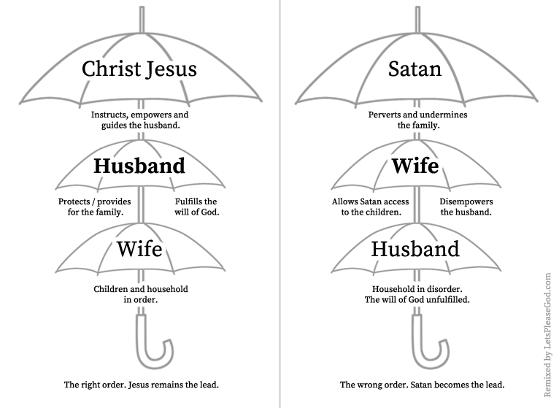
（3）妻子的责任。“你们作妻子的，当顺服自己的丈夫，如同顺服主。因为丈夫是妻子的头，如同基督是教会的头。他又是教会全体的救主。教会怎样顺服基督，妻子也要怎样凡事顺服丈夫。...妻子也当敬重她的丈夫”(弗5:22-24,33a)。
(3)Wife’s responsibilities. “Wives,submit yourselves to your own husbands as you do to the Lord. For the husband is the head of the wife as Christ is the head of the church, his body, of which he is the Savior. Now as the church submits to Christ, so also wives should submit to their husbands in everything… and the wife must respect her husband”
(5:22-24,33b).
基督耶稣
撒旦
指导授权和引导丈夫。
变态和破坏家庭。
丈夫
妻子
保护为家庭提供。
允许撒旦影响儿童。
妻子
丈夫
孩子和家庭秩序。
家庭混乱。
正确的顺序： 基督仍然是主角。
错误的顺序： 撒旦成为主角。
(19)
Notes:
(3) Qīzi de zérèn.“Nǐmen zuò qīzi de, dāng shùnfú zìjǐ de zhàngfū, rútóng shùnfú zhǔ. Yīnwèi zhàngfū shì qīzi de tóu, rútóng jīdū shì jiàohuì de tóu. Tā yòu shì jiàohuì quántǐ de jiù zhǔ. Jiàohuì zěnyàng shùnfú jīdū, qīzi yě yào zěnyàng fánshì shùnfú zhàngfū.... Qīzi yě dāng jìngzhòng tā de zhàngfū”(fú 5:22-24,33A).
Zhǐdǎo shòuquán hé yǐndǎo zhàngfū. Bǎohù wéi jiātíng tígōng. Háizi hé jiātíng zhìxù. Zhèngquè de shùnxù: Jīdū réngrán shì zhǔjiǎo.
Biàntài hé pòhuài jiātíng. Yǔnxǔ sādàn yǐngxiǎng értóng. Jiātíng hǔnluàn. Cuòwù de shùnxù: Sādàn chéngwéi zhǔjiǎo.

Slide 20

(20)
五。爱的伴侣。这是完美的爱情。
A。爱是...“爱是恒久忍耐，又有恩慈，…只喜欢真理。凡事包容。凡事相信。凡事盼望。凡事忍耐。爱是永不止息”（歌林13：4-8a）。
B。爱情不是... “爱是不嫉妒。爱是不自夸。不张狂。不作害羞的事。不求自己的益处。不轻易发怒。不计算人的恶。不喜欢不义”
（13：4-8a）。选择爱。
5. Love companions. This is perfect love.
A. Loves is… “Love is patient, love is kind,…rejoices with the truth. It always protects, always trusts,always hopes, always perseveres. Love never fails” (1Cor. 13:4-8).
B. Loves does not… “It does not envy,it does not boast,it is not proud. It does not dishonor others, it is not self-seeking, it is not easily angered, it keeps no record of wrongs. Love does not delight in evil”(13:4-8). Choose love.
选择爱
Notes:
Wǔ. Ài de bànlǚ. Zhè shì wánměi de àiqíng.
A. Ài shì...“Ài shì héngjiǔ rěnnài, yòu yǒu ēncí,…zhǐ xǐhuān zhēnlǐ. Fánshì bāoróng. Fánshì xiāngxìn. Fánshì pànwàng. Fánshì rěnnài. Ài shì yǒng bù zhǐxī”(gē lín 13:4-8A).
B. Àiqíng bùshì... “Ài shì bù jídù. Ài shì bù zìkuā. Bù zhāngkuáng. Bùzuò hàixiū de shì. Bù qiú zìjǐ de yìchu. Bù qīngyì fānù. Bù jìsuàn rén de è. Bù xǐhuān bù yì”
(13:4-8A). Xuǎnzé ài.

Slide 21

结论：在婚礼上，在神和见证人面前发誓。 “我（姓名）带你（姓名）成为我的（妻子/丈夫）从今日起，无论好坏，更富，更贫穷，疾病和健康， 爱和珍惜; 从今天直到死亡，我们的一部分。 而且我向你保证我的信实。”
Conclusion: At weddings, vows are given before God and witnesses. “I,(name), take you (name), to be my (wife/husband),to have and to hold from this day forward, for better or for worse, for richer, for poorer, in sickness and in health, to love and to cherish; from this day forward until death do us part. And hereto I pledge you my faithfulness.”
(20)
Notes:
Jiélùn: Zài hūnlǐ shàng, zài shén hé jiànzhèng rén miànqián fāshì. “Wǒ (xìngmíng) dài nǐ (xìngmíng) chéngwéi wǒ de (qīzi/zhàngfū) cóng jīnrì qǐ, wúlùn hǎo huài, gèng fù, gèng pínqióng, jíbìng hé jiànkāng, ài hé zhēnxī; cóng jīntiān zhídào sǐwáng, wǒmen de yībùfèn. Érqiě wǒ xiàng nǐ bǎozhèng wǒ de xìnshí.”

Slide 22
在婚姻纪念日(25年=银周年，50年=金周年，75年=钻石周年)誓言需要常常更新。在这除夕，让我们也重申我们的婚姻誓言和承诺。
“我今天站在家人面前，我们的朋友和你，我的丈夫或妻子，重申我的婚姻誓言。 若干年前，我们站在教堂里，说了写给我们的话。今天我不是简单地发誓，我用自己的话语发誓和承诺。在过去的多少年里，我对你的爱更深了。有些时候，我认为摆在我们面前的问题太大，难以克服，经历的痛苦，不能原谅。我们的经历让我了解到，我比你想像的更爱你，足以克服和宽恕我们过去的失败的承诺。今天，我愿意顺服在这强烈的爱之下，重新向你承诺。我今天更爱你，因为我们所经历的一切，也因为你愿意以更新的承诺向前迈进。我承诺，从今天起，随着时间的推移我会更深爱你，信任你。我保证当你生病，受伤害，需要安慰，或者当你只是想分享你的一天时，我会在你身边。我保证让你感到你的重要，并赞赏你为我的生活带来的一切。今天，我站在我们的家庭，我们的朋友和你，我的丈夫或妻子面前，承诺，只要我们都活着，我就会把我所有的最好的东西给你。”
(21)
Notes:
Zài hūnyīn jìniàn rì (25nián=yín zhōunián,50nián=jīnzhōunián,75nián=zuànshí zhōunián) shìyán xūyào chángcháng gēngxīn. Zài zhè chúxì, ràng wǒmen yě chóngshēn wǒmen de hūnyīn shìyán hé chéngnuò.
“Wǒ jīntiān zhàn zài jiārén miànqián, wǒmen de péngyǒu hé nǐ, wǒ de zhàngfū huò qīzi, chóngshēn wǒ de hūnyīn shìyán. Ruògān nián qián, wǒmen zhàn zài jiàotáng lǐ, shuōle xiě gěi wǒmen dehuà. Jīntiān wǒ bùshì jiǎndān de fāshì, wǒ yòng zìjǐ de huàyǔ fāshì hé chéngnuò. Zài guòqù de duō shào nián lǐ, wǒ duì nǐ de ài gēngshēnle. Yǒuxiē shíhòu, wǒ rènwéi bǎi zài wǒmen miànqián de wèntí tài dà, nányǐ kèfú, jīnglì de tòngkǔ, bùnéng yuánliàng. Wǒmen de jīnglì ràng wǒ liǎojiě dào, wǒ bǐ nǐ xiǎngxiàng de gèng ài nǐ, zúyǐ kèfú hé kuānshù wǒmen guòqù de shībài de chéngnuò. Jīntiān, wǒ yuànyì shùnfú zài zhè qiángliè de ài zhī xià, chóngxīn xiàng nǐ chéngnuò. Wǒ jīntiān gèng ài nǐ, yīnwèi wǒmen suǒ jīnglì de yīqiè, yě yīnwèi nǐ yuànyì yǐ gēngxīn de chéngnuò xiàng qián màijìn. Wǒ chéngnuò, cóng jīntiān qǐ, suízhe shíjiān de tuīyí wǒ huì gēng shēn ài nǐ, xìnrèn nǐ. Wǒ bǎozhèng dāng nǐ shēngbìng, shòu shānghài, xūyào ānwèi, huòzhě dāng nǐ zhǐshì xiǎng fēnxiǎng nǐ de yītiān shí, wǒ huì zài nǐ shēnbiān. Wǒ bǎozhèng ràng nǐ gǎndào nǐ de zhòngyào, bìng zànshǎng nǐ wèi wǒ de shēnghuó dài lái de yīqiè. Jīntiān, wǒ zhàn zài wǒmen de jiātíng, wǒmen de péngyǒu hé nǐ, wǒ de zhàngfū huò qīzi miànqián, chéngnuò, zhǐyào wǒmen dōu huózhe, wǒ jiù huì bǎ wǒ suǒyǒu de zuì hǎo de dōngxī gěi nǐ.”

Slide 23
At anniversaries(25years=Silver Anniversary,50years=Golden Anniversary,75years=Diamond Anniversary) vows are often renewed. At this New Year’s Eve, let us also renew our marriage vows and commitments. “I stand today in front of our family, our friends and you, my husband/wife, to reaffirm my marriage vows. X years ago we stood in our church and said words that were written for us. Today I am not simply taking a vow; I am giving you a vow and a promise in words that are my own. My love for you has grown over the last
X years. There have been times when I believed the problems before us were too big to overcome, too painful to forgive. I have since learned that I love you more than I could ever have imagined and that it is enough to overcome and forgive the broken promises in our past. Today I give in to that love and the overwhelming desire to recommit myself to you. I love you more today because of all that we have been through and because of your willingness to move forward with renewed commitment.I promise, from this day forward, to love and trust you even more as time passes. I promise to be there for you when you are sick,hurt,in need of comfort or when you just want to share your day. I promise to make you feel needed and appreciated for all that you bring to my life.Today I stand in front of our family, our friends and you, my husband and promise to give you all of the best of me for as long as we both live.”
(21)

Slide 24

马丁路德称婚姻“是一个性格的学校。” 当两个人一起生活在圣洁的婚姻中时，经验要么带出最好的，要么是最糟糕的。 婚姻不是50-50; 离婚是50-50。 婚姻必须是100-100。 它并不是把所有东西都分开，而是把所有的东西都拿出来！
Martin Luther called marriage “a school for character.” As two people live together in holy matrimony, the experience either brings out the best in them or the worst in them. Marriage is not 50-50; divorce is 50-50. Marriage has to be 100-100. It’s not splitting everything in half, but giving everything you’ve got!(Dave Willis).
(22)
Notes:
Mǎdīng lù dé chēng hūnyīn “shì yīgè xìnggé de xuéxiào.” Dāng liǎng gèrén yīqǐ shēnghuó zài shèngjié de hūnyīn zhòng shí, jīngyàn yàome dài chū zuì hǎo de, yàome shì zuì zāogāo de. Hūnyīn bùshì 50-50; líhūn shì 50-50. Hūnyīn bìxū shì 100-100. Tā bìng bùshì bǎ suǒyǒu dōngxī dū fēnkāi, ér shì bǎ suǒyǒu de dōngxī dū ná chūlái!

Slide 25

祝大家…
新年快乐,
婚姻快乐,
和家庭快乐！
愿基督成为我家之主！
Wishing everyone… a Happy New Year, a Happy Marriage, and a Happy Home!
May Christ be the head of this house!
Notes:
Zhù dàjiā…Xīnnián kuàilè, Hūnyīn kuàilè, Hé jiātíng kuàilè! Yuàn Jīdū chéngwéi wǒjiā zhī zhǔ!

Slide 26
Pastor’s Prayer Guide | Week: January 1-7,2018
Pray God’s Name: Ask in His Name. | Our Heavenly Father(Mt.6: 9-13).
Praise and Thanksgiving: | New Year and new opportunities.
God Seeking: Seekers. | Seeking friends and welcoming visitors.
Kingdom Praying: Prayer Meeting. | Prayer promise: Ask, Seek, Knock (Mt.7:7-11).
Connecting with God: Lord’s Supper and Sharing Testimonies(Jan.7). | Message: Leader: Gary Hart Music: Zheng ShengMin
Caring for others: Fellowship. | Wed(am) Bible Study Fri(pm) Bible Study
Committing to missions: Missionaries. | China and Taiwan:
Consecrating to ministry: Sunday School. | Chinese/English Sunday School classes & teachers.
Sickness/Special needs: | Sister Lily Lin, Brother Mike Jarratt
牧师的祷告指南 | 周:2018年1月1-7日
奉神的名字求: 奉祂的名祈求。 | 我们在天上的父(太6:9-13)。
赞美和感恩： | 新年和新的机会。
寻求真神： 寻求者。 | 慕道朋友和欢迎拜访者。
祈求神国： 祷告聚会。 | 祷告应许：祈求，寻找，叩门(太7:7- 11)。
连接于神: 擘饼聚会并 交通见证(1月7日)。 | 信息： 领会：何礼义 司琴：郑圣民
关爱别人： 团契。 | 周三早上查经 周五晚上查经
奉献宣教： 宣教士们。 | 中国和台湾：
奉献事工：主日学。 | 中文/英文主日学课和老师。
疾病/特别需要： | 林姐妹， Mike弟兄。

