Slide 1
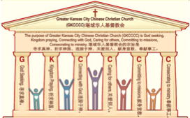

主日:二零一七年二月十二日
Sunday: February 12, 2017
何礼义牧师 Pastor Gary Hart
题目：“妥协的教会 。”
Topic: “Compromising Church.”
经文:启示录2:12-17
“然而有几件事我要责备你”(启示录2:14a).
Text:Rev.2:12-17
“I have a few things against you” (Rev.2:14a).
(1)

Slide 2
堪城华人基督教会2017年教会祷告:GKCCCC2017 Congregation Prayer:
Please stand, and pray together with me: O God,…
We thank You that You are our Father and by faith we are God’s family.
We thank You that Christ is our Head and by grace we are Christ’s body.
We thank You that the Holy Spirit is our Anointing, by His power we live.
We thank You the Bible is Your Book, by inspiration we have God’s Word.
We ask You to anoint and open our ears to hear God’s Word.
We ask You to anoint and open our eyes to understand God’s Word.
We ask You to anoint and open our hearts to receive God’s Word.
We ask You to anoint and change our minds to follow God’s will.
We ask You to anoint and use our hands to do God’s will.
We ask You to anoint and use our feet to walk in God’s will.
We ask You to anoint and speak Your message through Your servant.
We ask You to anoint and help Your church to be God seeking, Kingdom praying, Connecting with God, Caring for others, Committing to missions, Consecrating to ministry. We pray in Jesus name, Amen.

Slide 3
堪城华人基督教会2017年教会祷告:GKCCCC2017 Congregation Prayer:
请站起来，跟我一起祷告：神啊，…
我们感谢祢，祢是我们的父，我们因着信我们是神家中的人。
我们感谢祢，因基督是我们的头，我们因着恩典我们是基督的身体。
我们感谢祢，圣灵是我们的恩膏，我们因着祂的能力我们活着。
我们感谢祢，圣经是祢的书，是神默示给我们的话。
求祢恩膏并开我们的耳朵，使我们可以听神的话。
求祢恩膏并开我们的眼睛，使我们可以明白神的话。
求祢恩膏并开我们的心，使我们可以接受神的话。
求祢恩膏并改变我们的思想，使我们可以跟从神的旨意。
求祢恩膏并用我们的手，使我们可以照着神的旨意而做。
求祢恩膏并用我们的脚，使我们可以在神的旨意上行走。
求祢恩膏并使用您的仆人，使他能向我们传达祢的信息。
求祢恩膏并帮助您的教会寻求真神，祈求神国，连接于神，
关爱别人，献身宣教，奉献事工。我们奉耶稣的名祷告，阿们。

Slide 4

引言：A。七个教会的信息。
Intro: A. The messages to the seven churches.
(2)
（一）这七个教会是在约翰的时代在亚洲的七个实际教会。
（二）这七个教会代表教会历史的七个时期。
（三）这七个教会代表当今不同种类的教会。
（四）这七个教会代表任何教会都可能有的的特点。
（五）这七个教会代表撒旦攻击教会的七个方法。
(1)These seven churches were literal churches in Asia of John’s day.
(2)These seven churches represent seven periods of Church History.
(3)These seven churches are types of churches that exist today.
(4)These seven churches show characteristics that can exist in any church.
(5)These seven churches show seven
methods of attack by Satan on the church.

Slide 5
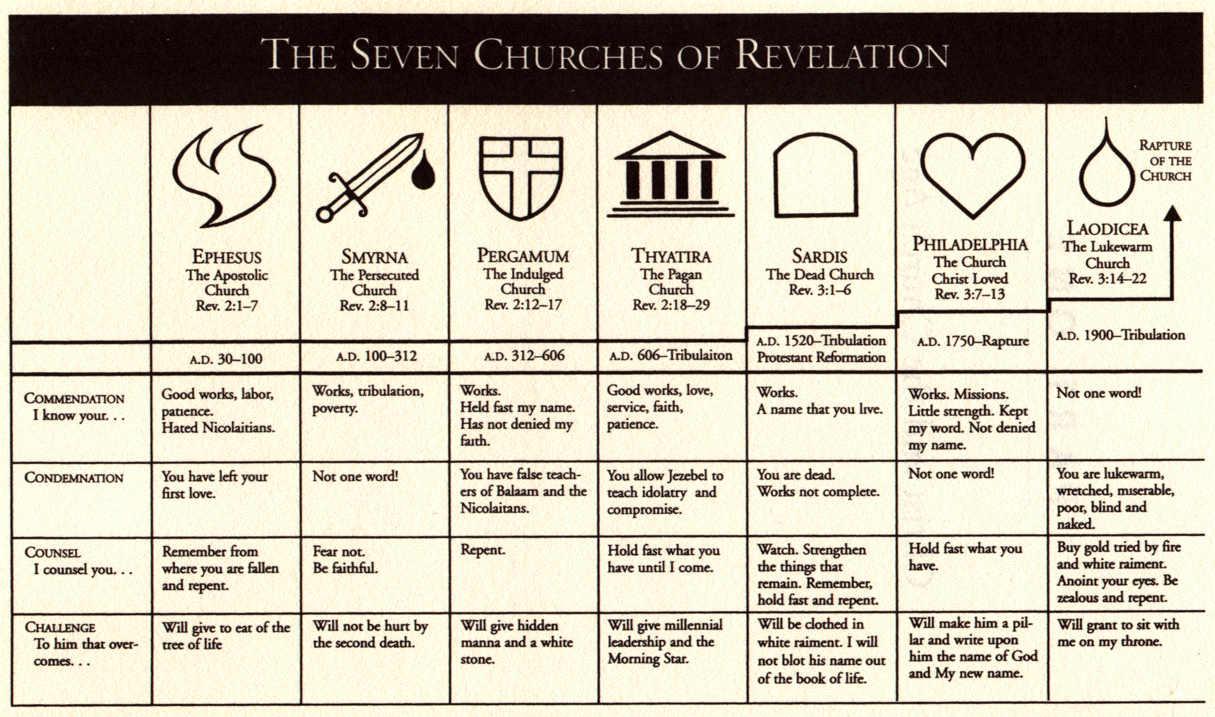
A。给七个教会的信息。
A. The messages to the seven churches.
(3)

Slide 6
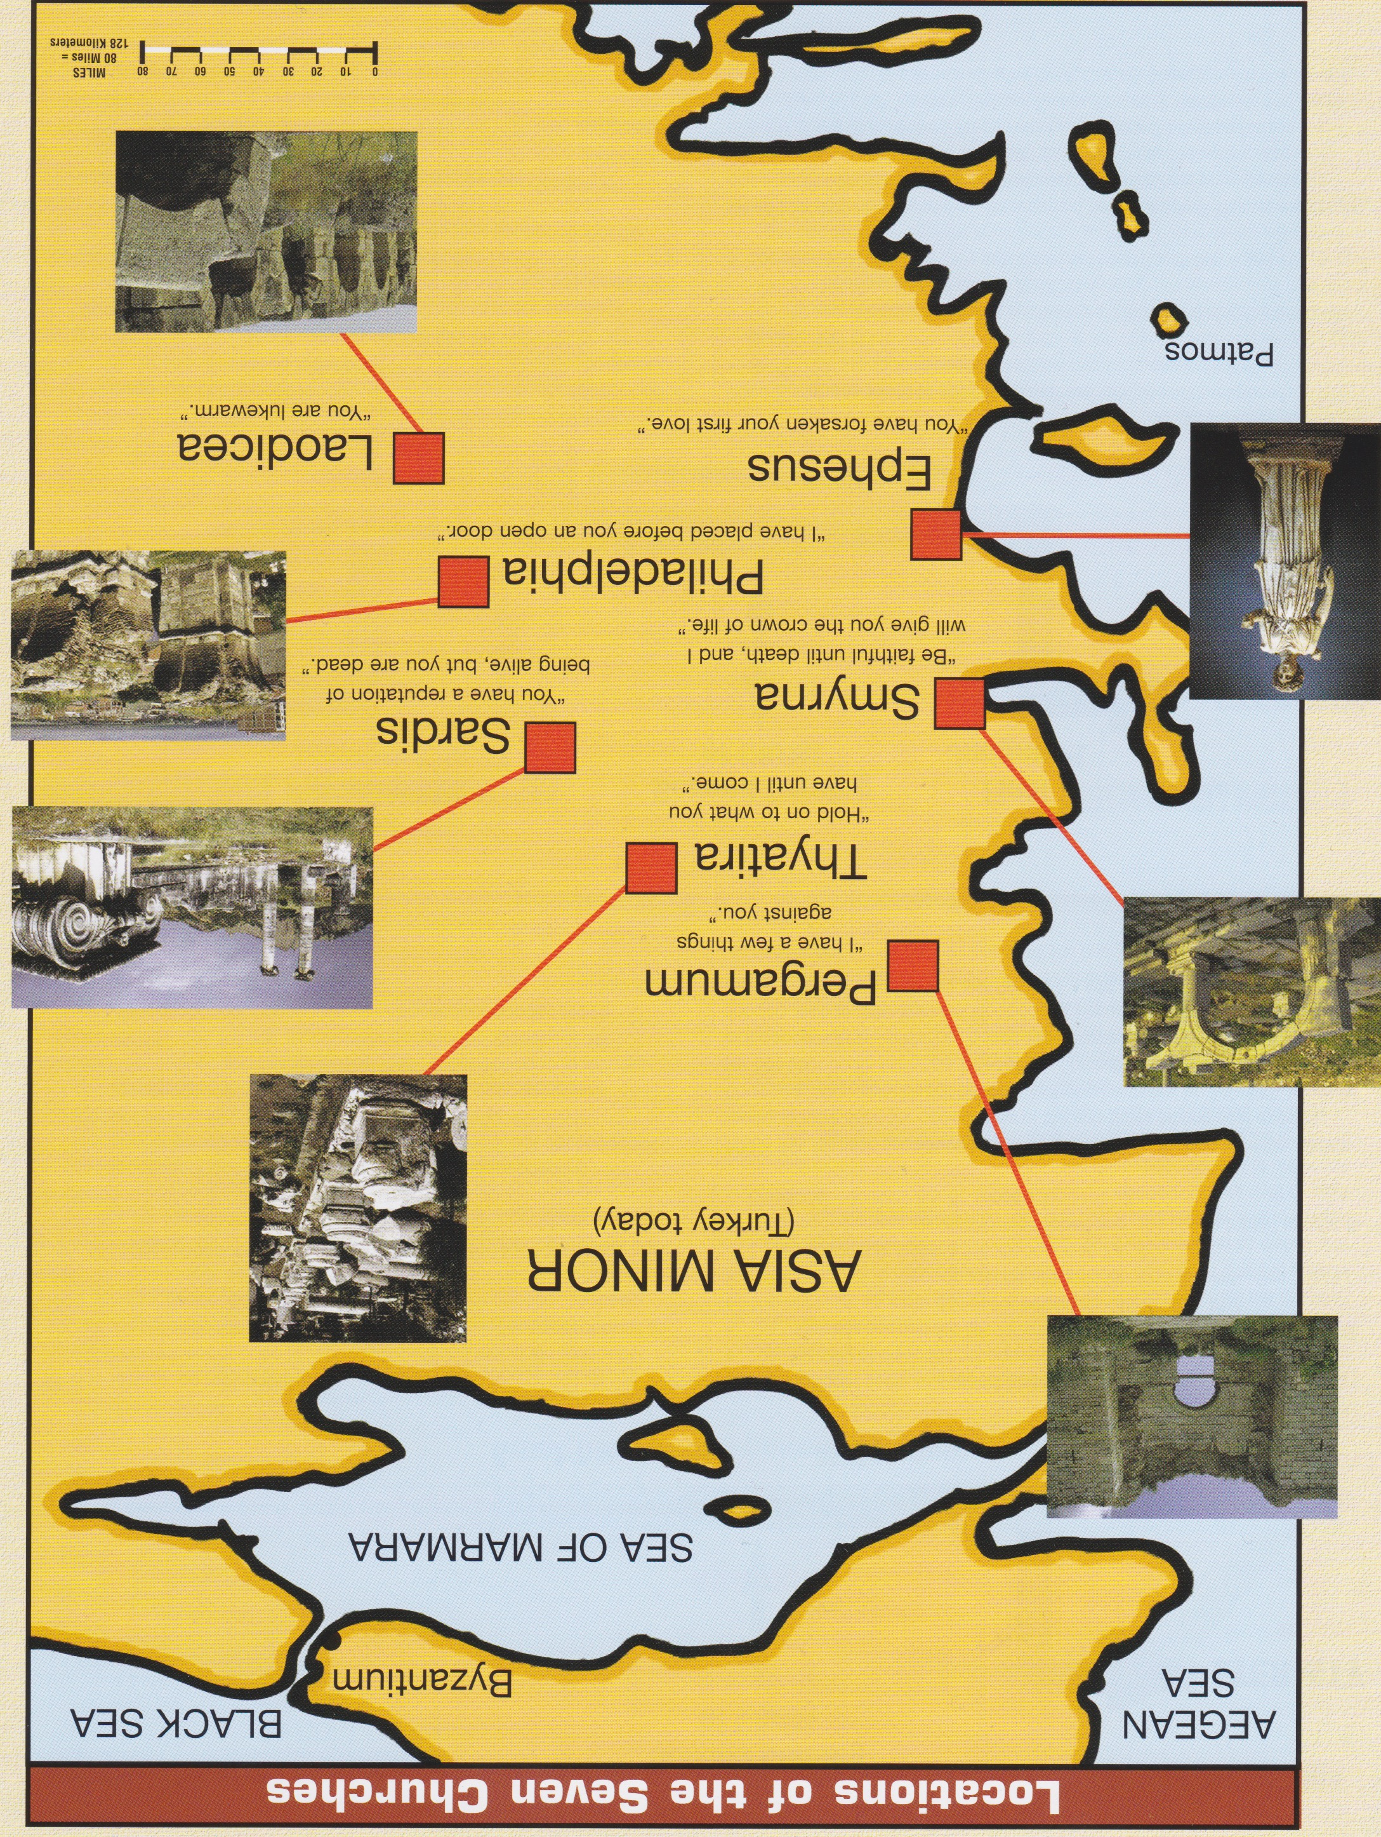
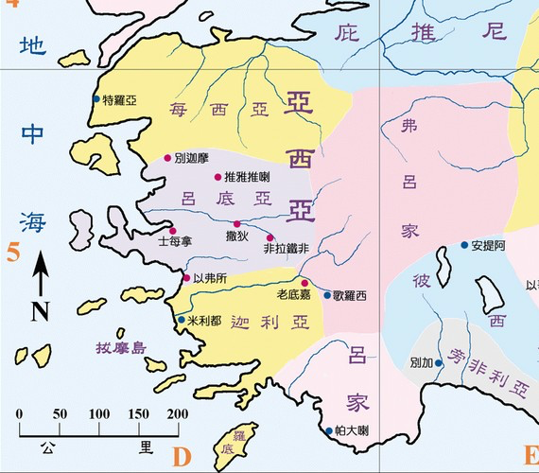
B。七个教会的地理位置。
B. 7 Churches locations.
爱瑟海
拔摩

Slide 7
C。别迦摩的历史背景。
C. Historical background of Pergamum.
(5)
（一）别迦摩城曾是罗马亚细亚省会。它是学习，医药，和宗教书的中心。那里的人敬拜宙斯，罗马皇帝，和阿斯克勒庇俄斯（医药神）。
（二）别迦摩教会大概是盖尤斯创立的。
（三）别迦摩教会代表属世界的教会（主后312－606）。
（四）别迦摩这个词是“结婚”或“提高”的意思。当教会与政权结婚，被高抬而接受，祂的属灵能力就减小。
(1) The city of Pergamum was the capital city of the Roman province of Asia.It was a center of learning,medicine,and religious books. They worshipped Zeus, the Roman emperor, and Asclepius(god of healing).
(2) Pergamum church was probably founded by Gaius.
(3) Pergamum church represents worldly church(AD 312-606).
(4) Pergamum means“marriage” or “elevation.” As the church became married to power and elevated to acceptance, it declined in spiritual power.

Slide 8
(6)
一。基督的称许。1. Christ’s commendation.
“你要写信给别迦摩教会的使者，说，那有两刃利剑的说”(启示录2:12）。这指的是神的话能使人圣洁（约17：17），清洁（15：3），并带来喜乐（15：11）和平安（16：33）。
A. 教会困难的地方。“我知道你的居所，就是有撒但座位之处”（2:13a）。君士坦丁皇帝看到一个火热的十字架在天空的异象，听到一个声音说，“凭此而胜”。然后，他发表了宽容基督教的守则，并给基督教会许多好处。政府为教会的运作提供了钱，许多异教寺庙被基督徒接管。
“To the angel of the church in Pergamum write: These are the words of him who has the sharp, double-edged sword”(Rev.2:12).This refers to the Word of God which sanctifies(Jn.17:17), cleanses(15:3), brings joy(15:11), and peace(16:33).
A. Difficult location for the Church. “I know where you live—where Satan has his throne”(2:13a). Emperor Constantine saw a vision of a fiery cross in the sky and heard a voice saying,“In this sign conquer.” Then he issued the Edict of Tolerance for Christianity and gave many favors to the Christian Church. The government provided money for the operation of the church and many of the pagan temples were taken over by Christians.

Slide 9
一。基督的称许。
1. Christ’s commendation.
(7)
B。教会的可靠反应。“你还坚守我的名”（2:13b）。这个教会对基督是真实的。
C.教会的理想地位。“当我忠心的见证人安提帕在你们中间，撒但所住的地方被杀之时…没有弃绝我的道”
(2:13c) 。这个教会受到迫害，有一个忠实的殉道者。
B. Dependable reaction of the Church. “Yet you remain true to my name”(2:13b). This church was true to Christ.
C. Desirable position of the Church. “You did not renounce your faith in me, not even in the days of Antipas, my faithful witness, who was put to death in your city—where Satan lives”(2:13c). This church was persecuted and had a faithful martyr.

Slide 10
(11)
二。基督的责备。2. Christ’s condemnation.
“然而有几件事我要责备你”（2:14a)。撒旦也装作光明的天使（林后11:14）。
A。巴兰的教训。“因为在你那里，有人服从巴兰的教训。这巴兰曾教导巴勒将绊脚石放在以色列人面前，叫他们吃祭偶像之物，行奸淫的事”(2:14b；民22-25）。
（一）摩押王巴拉克雇用巴兰来说预言来诅咒以色列人。
（二）每次巴兰开口要咒诅以色列人，说出的却是祝福。
（三）巴兰给了巴拉克一个引诱以色列人犯罪的主意，就是让以色列人与摩押人通婚，建立不圣洁的联盟。
“Nevertheless, I have a few things against you”(2:14a). Satan also comes as angel of light(2Cor.11:14).
A. Doctrine of Balaam. “There are some among you who hold to the teaching of Balaam, who taught Balak to entice the Israelites to sin so that they ate food sacrificed to idols and committed sexual immorality”(2:14b;Nu.22-25).
(1) Balak, the king of Moab, hired Balaam to prophesy a curse against Israel.
(2) Every time Balaam opened his mouth to curse Israel, out came a blessing.
(3) Balaam gave Balak the suggestion of enticing Israelites to make an unholy
alliance with Moabites through intermarriage with them.

Slide 11

妥协或不妥协，这就是问题!

Slide 12
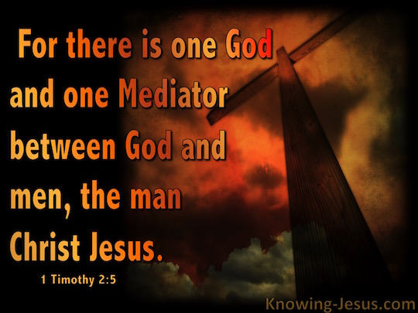
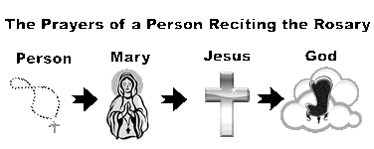
(11)
二。基督的责备。2. Christ’s condemnation.
B。尼哥拉一党人的教训。“你那里也有人照样服从了尼哥拉一党人的教训”（2:16）。这是教会等级制度统治俗人的教义。
B. Doctrine of Nicolaitans. “Likewise, you also have those who hold to the teaching of the Nicolaitans”(2:16). The Nicolaitan system places a human intermediary between individual believers and God.
因为只有一位神，在神和人中间，只有一位中保，乃是降世为人的基督耶稣。
（提前2:5）

Slide 13
三。基督的忠告。3. Christ’s counsel.
(12)
“所以你当悔改。若不悔改，我就快临到你那里，用我口中的剑，攻击他们”（2:16）。
A。悔改是心灵的转变。 “因为他们自己已经表明我们是怎样进到你们那里，你们是怎样离弃偶像归向神，要服事那又真又活的神”（帖前1:9）。
B。放弃所有虚伪的教义。“你们要谨慎，恐怕有人用他的理学，和虚空的妄言，不照着基督，乃照人间的遗传，和世上的小学，就把你们掳去。 ”（西2:8）。
“Repent therefore! Otherwise, I will soon come to you and will fight against them with the sword of my mouth”(2:16)
A. Repentance is a change of heart and mind. “They tell how you turned to God from idols to serve the living and true God”(1Thes.1:9).
B. Renounce all false doctrine. “See to it that no one takes you captive through hollow and deceptive philosophy, which depends on human tradition and the elemental spiritual forces of this world rather than on Christ” (Col..2:8).

Slide 14
四。基督的挑战。
4. Christ’s challenge.
(13)
“圣灵向众教会所说的话，凡有耳的就应当听”(2:17a)。
A。听圣灵所说的。三种人：
（一）那些有耳朵可听见的（太13:9）。
（二）那些听不进去的（来5:11）。
（三）那些愿意听圣灵所说的（雅1:22）。
“Whoever has ears, let them hear what the Spirit says to the churches.”(2:17a).
A. Hear what the Holy Spirit says to the churches. 3 kinds of people:
(1) Those are with ears to hear(Mt.13:9).
(2) Those are dull of hearing(Heb.5:11).
(3) Those are willing to hear what the Holy Spirit says (Ja.1:22).

Slide 15
四。基督的挑战。
4. Christ’s challenge.
(14)
B。得胜的将要收到。“得胜的，我必将那隐藏的吗哪赐给他。并赐他一块白石，石上写着新名。除了那领受的以外。没有人能认识”(2:17b)。
（一）吗哪。吗哪是上帝在沙漠里给以色列人的天上的食物。它代表神在他话语中所提供的精神食粮 。
（二）白石。在古代，白石意味着无罪。它也被用作盛宴的入场券 。
C. 审判将要来临。这不是指我们主的再临，而是当一个教会不服从神的道时所受的现时的审判。
B. Victorious will receive. “To the one who is victorious, I will give some of the hidden manna. I will also give that person a white stone with a new name written on it, known only to the one who receives it”(2:17b).
(1) Hidden Manna. Manna was heavenly food sent by God to children of Israel in the desert.It typifies the spiritual food provided by God in His Word.
(2) White Stone. In ancient times a white stone meant acquittal of sin. It was also used liked a “ticket” to gain admission to a feast.
C. Judgment will come. This is not a reference to our Lord’s return but to a pres-ent judgment that comes to a church when it is disobedient to the Word of God.

Slide 16
(15)
结论：Conclusion:
教会与基督结婚，必须保持纯洁（林后11:1-4）。世界体系是一个妓女;教会是一个新娘。与世界妥协以避免遭受痛苦或取得成功的教会或信徒犯下了“属灵的通奸”，不忠于主。 “我不求你叫他们离开世界，只求你保守他们脱离那恶者。他们不属世界，你怎样差我到世上，我也照样差他们到世上。正如我不属世界一样。求你用真理使他们成圣。你的道就是真理。你怎样差我到世上，我也照样差他们到世上。我为他们的缘故，自己分别为圣，叫他们也因真理成圣”（约17:15-19）。神也吩咐我们要分别为圣（林后6:14-18）。
The church is married to Christ and must be kept pure (2Cor.11:1-4). The world system is a harlot; the church is a bride. The church or believer that com-promises with the world just to avoid suffering or achieve success is committing “spiritual adultery” and being unfaithful to the Lord. “My prayer is not that you take them out of the world but that you protect them from the evil one. They are not of the world, even as I am not of it. Sanctify them by the truth; your word is truth. As you sent me into the world, I have sent them into the world. For them I sanctify myself, that they too may be truly sanctified”(Jn.17:15-19). God also commands us to be separate(2Co.6:14-18).

