Slide 1
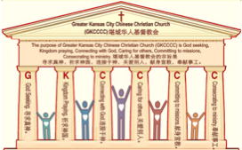

主日:二零一七年三月十二日
Sunday: March 12, 2017
何礼义牧师 Pastor Gary Hart
题目：“活的教会 。”
Topic: “Living Church.”
经文:启示录3:7-13
“曾遵守我的道，没有弃绝我的名”(启3:8b).
Text:Rev.3:7-13
“You have kept my word and have not denied my name”(Rev.3:8b).
(1)

Slide 2

引言：A。七个教会的信息。
Intro: A. The messages to the seven churches.
(2)
（一）这七个教会是在约翰的时代在亚洲的七个实际教会。
（二）这七个教会代表教会历史的七个时期。
（三）这七个教会代表当今不同种类的教会。
（四）这七个教会代表任何教会都可能有的的特点。
（五）这七个教会代表撒旦攻击教会的七个方法。
(1)These seven churches were literal churches in Asia of John’s day.
(2)These seven churches represent seven periods of Church History.
(3)These seven churches are types of churches that exist today.
(4)These seven churches show characteristics that can exist in any church.
(5)These seven churches show seven
methods of attack by Satan on the church.

Slide 3
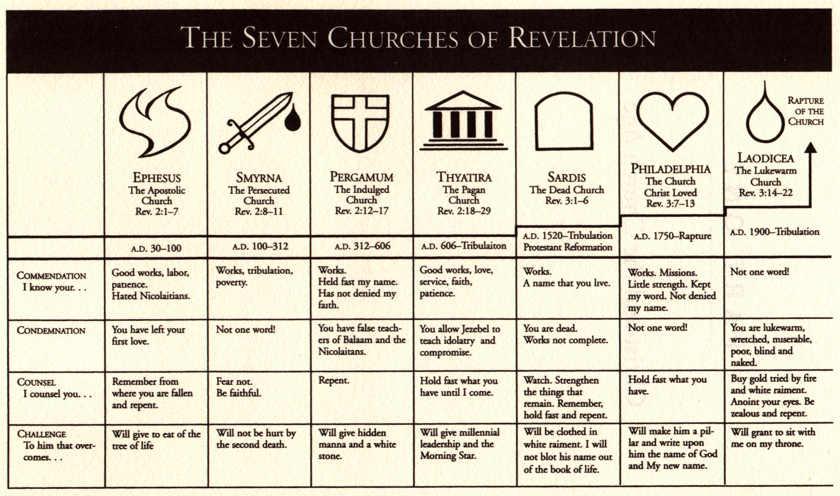
A。给七个教会的信息。
A. The messages to the seven churches.
(3)

Slide 4
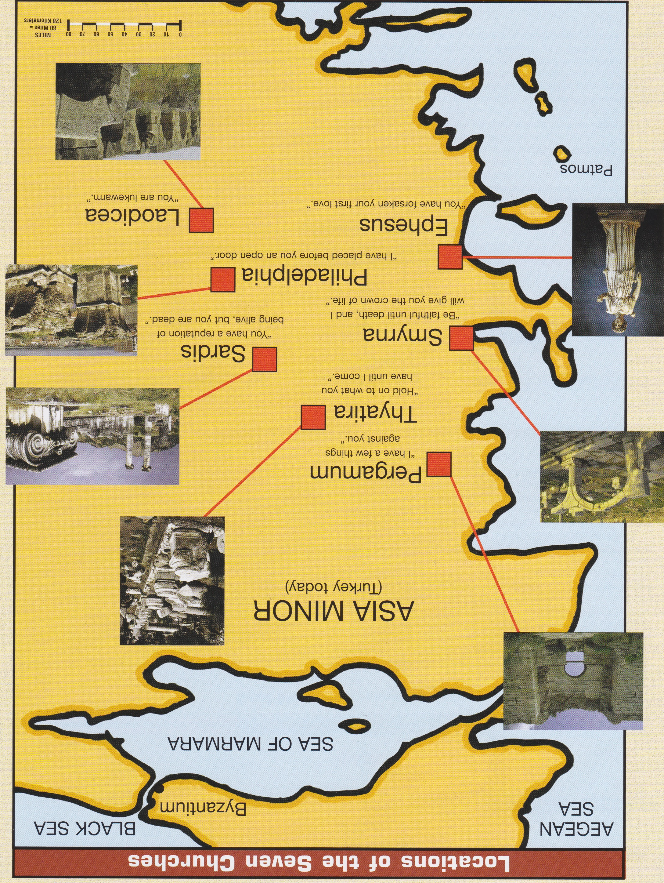
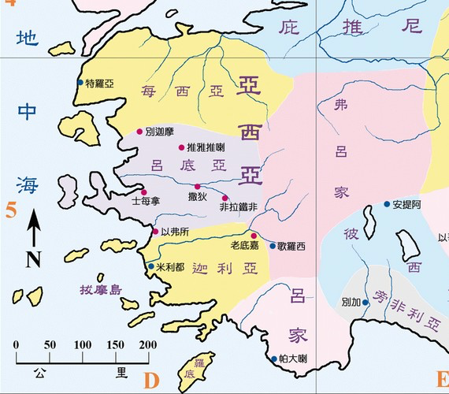
B。七个教会的地理位置。
B. 7 Churches locations.
爱瑟海
拔摩

Slide 5
C。非拉铁非的历史背景。
C. Historical background of Philadelphia.
(5)
（一）非拉铁非城曾叫“东方的门户”（以葡萄和纺织原料闻名）并“小雅典”（许多寺庙：太阳神和蛇神）。
（二）非拉铁非教会的创立人详情不知。
（三）非拉铁非教会代表活的教会(主后1750－1900)。
（四）非拉铁非这个词是“兄弟的爱”的意思。 我们“蒙了神的教训，叫你们彼此相爱”(帖前4:9；约一4:19；约13:34；罗5:5)。我们应该爱神，基督徒和失丧的人。
(1) The city of Philadelphia was called “the gateway to the East” (famous for grapes and textiles) and “little Athens” (many temples: sun and serpent gods).
(2) Philadelphia church was founded by an unknown.
(3)Philadelphia church represents living church(AD1750-1900,Missions). (4)Philadelphia means “brotherly love.” We are to “taught of God to love one another”(1Thes.4:9;1Jn.4:19;Jn.13:34;Rom.5:5). We should love God,Christians, and the lost world.

Slide 6
(6)
一。基督的称许。1. Christ’s commendation.
“你要写信给非拉铁非教会的使者，说，那圣洁，真实，拿着大卫的钥匙，开了就没有人能关，关了就没有人能开的，说，（启3:7）。基督的品德，语言，行动和目标是圣洁的。基督也是真神（林前8:5，6）。祂有开门和关门的权柄(太7:7-8)。“开门”就是事工的机会（徒14:27；林后2:12；西4:3）。
“To the angel of the church in Philadelphia write:These are the words of him who is holy and true,who holds the key of David What he opens no one can shut, and what he shuts no one can open”(Rev.3:7). Christ is holy in His character, words, actions, and purposes. Christ is also the true God(1Co.8:5,6). He has the authority to open and close doors(Mt.7:7-8). “Open door” speaks of opportunity for ministry(Ac.14:27;2Co.2:12;Col.4:3).

Slide 7



Slide 8
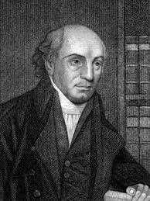
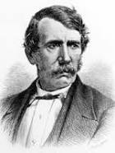
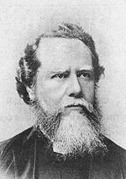
一。基督的称许。1. Christ’s commendation.
(7)
A。行为和机会。“我知道你的行为…看哪，我在你面前给你一个敞开的门，是无人能关的”（3:8a）。这是宣教的运动（ 威廉凯里，大卫利文斯顿，戴德生 ，等）。他们是忠心并有在印度，非洲，中国，日本，韩国，南美洲和很多其他的地方传福音的大机会。
A. Deeds and opportunities. “I know your deeds. See,I have placed before you an opened door that no one can shut”(3:8a). This is the Missionary Movement(William Carey,David Livingstone,James Hudson Taylor,etc).They
were faithful and had great
opportunities for ministry in
India,Africa,China,Japan,
Korea,S.America and many
other areas.

Slide 9
一。基督的称许。1. Christ’s commendation.
(8)
B。胜过软弱的妨碍。“我知道…你略有一点力量，也曾遵守我的道，没有弃绝我的名”（3:8b）。不是教会的大小和力量决定了它的事工，而是对主呼招和命令的信心 。教会不仅相信神的道，而且顺服它。“因我什么时候软弱，什么时候就刚强了”（林后12:9-10）。
B. Overcame obstacle of little strength. “I know that you have little strength,yet you have kept my word and have not denied my name”
(3:8b). It is not the size and strength of a church that determines its ministry, but faith in the call and command of the Lord. The church not only believed the Word of God, but obeyed it. “For when I am weak, then I am strong”(2Cor.12:9-10).

Slide 10
一。基督的称许。1. Christ’s commendation.
(9)
C。胜过撒但一会的阻挡。。“那撒但一会的，自称是犹太人，其实不是犹太人，乃是说谎话的，我要使他们来在你脚前下拜，也使他们知道我是已经爱你了”（3:9）。我们并不是与属血气的争战（弗6:12）。他们怎么反对的？
（一）反对派排斥犹太信徒参加。
（二）反对派使用欺骗的方法（12:10）。有阻碍也有机会。 （林前16:9）。不信看到阻碍，信则看到机会。
C. Overcame obstacle of Satanic opposition. “I will make those who are of the synagogue of Satan, who claim to be Jews though they are not, but are liars—I will make them come and fall down at your feet and acknowledge that I have loved you”(3:9). We do not battle against flesh and blood(Eph.6:12).How were they opposed? (1) Opposition excluded Jewish believers from attending.
(2) Opposition used false accusations(12:10).There were obstacles and opportunities(1Cor.16:9).Unbelief sees the obstacles,faith sees the opportunities.

Slide 11
(10)
一。基督的称许。1. Christ’s commendation.
D。支取神的应许。“你既遵守我忍耐的道，我必在普天下人受试炼的时候，保守你免去你的试炼”(3:4）。
（一）神会管理我的仇敌。如果我们管理神的工作，神就会管理我们的战争。
（二）神会保守信徒免去大患难。这是指“雅各的患难时间”（16-19）。七年灾难以前教会要被提（4:1-2）。
D. Claimed God’s promises. “Since you have kept my command to endure patiently,I will also keep you from the hour of trial that is going to come on the whole world to test the inhabitants of the earth”(3:10).
(1) God would take care of our enemies. If we take care of God’s work, God will take care of our battles.
(2) God would keep believers from Tribulation. This is a reference to the “time of Jacob’s trouble”(Rev.6-19). Church will be raptured before the Tribulation Period of 7 years(4:1-2).

Slide 12
(11)
二。基督的责备。2. Christ’s condemnation.
没有责备的话给受逼迫的教会（2:8-11）和活的教会。
A。没有无爱但有爱。这是“弟兄相爱”的教会。
B。没有妥协但忠心。这是没有弃绝神的名。
C。没有腐败但顺服。这是保守神道的教会。
D。没有死了但活着。这是遵守神忍耐的道。
There is no word of condemnation for persecuted Church(2:8-11) and living Church.
A. Not loveless, but loving. This is the church of “brotherly love.”
B. Not compromising, but faithful. This is the church not denying God’s name.
C. Not corrupt, but obedient. This is the church keeping God’s word.
D. Not dead, but living. This is the church kept God’s command to endure patiently.

Slide 13
三。基督的忠告。3. Christ’s counsel.
(12)
“我必快来，你要持守你所有的，免得人夺去你的冠冕”(3:11)。
A。预备好了！基督快要再来。基督的比喻警告，“所以你们要儆醒，因为那日子，那时辰，你们不知道”（太25:13）。
B。等一下！基督的赞美，“你这又良善又忠心的仆人。你在不多的事上有忠心，我把许多事派你管理”(25:23)。
“I am coming soon. Hold on to what you have, so that no one will take your crown” (3:11).
A. Be ready! Christ is coming soon. Christ’s parable warns, “Keep watch, because you do not know the day or the hour”(Mt.25:13).
B. Hold on! Hang in there. Christ’s praise, “Well done,good and faithful servant! You have been faithful with a few things;I will put you in charge of many things” (Mt.25:23).

Slide 14
三。基督的忠告。3. Christ’s counsel.
(13)
C。夺去你的冠冕。基督的奖品，“可以进来享受你主人的快乐”（太25:23）。给宝座冠冕（林后5:10）。
（一）得胜的冠冕。“凡较力争胜的，诸事都有节制。他们不过是要得能坏的冠冕。我们却是要得不能坏的冠冕”（林前9:25）。“人若在场上比武，非按规矩，就不能得冠冕”(提后2:5）。
C. Take your crown! Christ’s reward,“Come and share your master’s happiness!” (Mt.25:23).5 Bema seat crowns are given(2Co.5:10).
(1) Victor’s Crown. “Everyone who competes in the games goes into strict training.They do it to get a crown that will not last,but we do it to get a crown that will last forever”(1Co.9:25). “Similarly, anyone who competes as an athlete does not receive the victor’s crown except by competing according to the rules”(2Ti.2:5).

Slide 15
三。基督的忠告。3. Christ’s counsel.
(14)
（二）带门徒的冠冕。“我们的盼望和喜乐，并所夸的冠冕，是什么呢。岂不是我们主耶稣来的时候你们在他面前站立得住麽”（帖前2:19）。“我所亲爱所想念的弟兄们，你们就是我的喜乐，我的冠冕。我亲爱的弟兄，你们应当靠主站立得稳”（腓4:1）。
（三）公义的冠冕。“从此以后，有公义的冠冕为我存留，就是按着公义审判的主到了那日要赐给我的。不但赐给我，也赐给凡爱慕他显现的人”（提前4:8）。
(2) Discipler’s Crown. “For what is our hope, our joy, or the crown in which we will glory in the presence of our Lord Jesus when he comes? Is it not you?”
(1Thes.2:19). “Therefore, my brothers and sisters, you whom I love and long for, my joy and crown, stand firm in the Lord in this way, dear friends!”(Phil.4:1).
(3) Crown of righteousness. “Now there is in store for me the crown of righteous-ness, which the Lord, the righteous Judge, will award to me on that day—and not only to me, but also to all who have longed for his appearing”(2Tim.4:8).

Slide 16
三。基督的忠告。3. Christ’s counsel.
(15)
（四）生命的冠冕。“忍受试探的人是有福的。因为他经过试验以后，必得生命的冠冕，这是主应许给那些爱他之人的”（呀：12）。“你务要至死忠心，我就赐给你那生命的冠冕”（启2:10）。
（五）荣耀的冠冕。“到了牧长显现的时候，你们必得那永不衰残的荣耀冠冕”（彼前5:4）。“身穿白衣，头上戴着金冠冕…又把他们的冠冕放在宝座前”(启4:4，10）。
C. Take your crown! Christ’s reward.
(4) Crown of life. “Blessed is the one who perseveres under trial because, having stood the test, that person will receive the crown of life”(Ja.1:12).“Be faithful,even to the point of death, and I will give you life as your victor’s crown”(Rev.2:10).
(5) Crown of glory. “And when the Chief Shepherd appears, you will receive the crown of glory that will never fade away”(1Pet.5:4). “They were dressed in white and had crowns of gold on their heads…they lay their crowns before the throne…”(Rev.4:4,10).

Slide 17
(16)
四。基督的挑战。4. Christ’s challenge.
“得胜的，我要叫他在我神殿中作柱子，他也必不再从那里出去。我又要将我神的名，和我神城的名，（这城就是从天上从我神那里降下来的新耶路撒冷）并我的新名，都写在他上面。圣灵向众教会所说的话，凡有耳的，就应当听。 (3:12-13)。
A。听圣灵所说的。三种人：
（一）那些有耳朵可听见的（太13:9）。
（二）那些听不进去的（来5:11）。
（三）那些愿意听圣灵所说的（雅1:22）。
“The one who is victorious I will make a pillar in the temple of my God. Never again will they leave it. I will write on them the name of my God and the name of the city of my God, the new Jerusalem, which is coming down out of heaven from my God; and I will also write on them my new name. Whoever has ears, let them hear what the Spirit says to the churches.”(3:12-13).
A. Hear what the Holy Spirit says. There are three kinds of people:
(1) Those with ears to hear(Mt.13:9).
(2) Those who are dull of hearing(Heb.5:11).
(3) Those who are willing to hear what the Spirit(Ja.1:22).

Slide 18
(17)
四。基督的挑战。4. Christ’s challenge.
B。得胜的生命。
（一）在天堂我神的殿中作柱子（不是在地上在那里他们雕刻名字在寺庙柱子）。
（二）永远安全 （不再从那里出去像地震）。
（三）写我神的名，和我神城的名。他们与基督联为一体。
（四）写我的新名（“新该撒利亚”在主后17年地震以后）。
“若有人在基督里，他就是新造的人。旧事已过，都变成新的了”（林后5:17）。
B. Victorious life.
(1) Make a pillar in the temple of my God in heaven(not earth where they carved names on temple pillars).
(2) Forever secure (no more go out like at earthquakes).
(3) Write the name of God and God’s city. They are identified with Christ.
(4) Write my new name (“New Caesar” after the earthquake AD17). “Therefore if anyone is in Christ,the new creation has come”(2Co.5:17).

Slide 19

(18)
结论：Conclusion:
神在我们面前没置了许多机会之门。如果他打开门，我们必须进入和工作;如果祂关上门，我们必须停下来等候。首先，我们必须忠心于祂，并看到机会，而不是障碍。如果我们错过了我们的机会，就失去了我们的冠冕，这意味着当他再来时，我们将在他面前羞愧（约一2:28）。
God has set before us many open doors of opportunity. If He opens doors,we must go and work;if He shuts doors,we must stop and wait. Above all, we must be faithful to Him and see the opportunities, not the obstacles.If we miss our opportunities,we lose our crowns, and this means being ashamed before Him when He comes(1Jn.2:28).

Slide 20
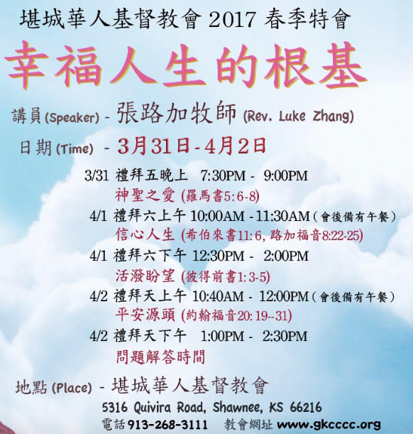
We invite you to come
(1) March 25-8-9 am
Prayer 9-9:30 am
Doug Brown: How to share your testimony.
(2) Mar.31-Apr.4, 2017 Special Meetings
“Basis for Happy Life”
Speaker:Luke Zhang
March 31, 7:30-9 pm
God’s Holiness & Life.
April 1, 10-11:30 am
Faith Life
April 1, 12:30-2 pm
Living Hope
April 2,10:40am-12pm
Source of Peace
April 2, 1-2:30 pm
Questions & Answers

Slide 21
为其它的机会祷告：
Other opportunities to pray about:
(3) 2017年4月5日周三早上10-11:30 查经地点。
April 5, 2017-Wednesday 10-11:30 am Bible Study Location.
(4) 2017年4月9日周日下午1:30－3:30 帮助ESL课。
April 9, 2017-Sunday 1:30-3:30 pm assist with ESL Class.
(5) 2017年4月16日复活节浸礼(早上10点)和聚会(10:30)。
April 16, 2017, Easter Sunday Baptism(10am) and Service(10:30am).
(6) 2017年暑假圣经学校。
Summer, 2017 Vacation Bible School.
(7) 2017年8月1-5个从中国再HCA男生住在家庭。
August, 2017 Housing 1-5 Boy Students at HCA from China.
发邮件或打电话给何牧师[hart4china@aol.com(816)519-2092]。
Email or call Pastor Gary Hart [hart4china@aol.com (816)519-2092].

