Slide 1
特别祷告事项 Special Prayer Request:
在2017年，7月24-28日GKCCCC将与Shawnee圣经教会合作进行VBS。
On July 24-28,2017 GKCCCC will be partnering with Shawnee Bible Church for VBS.
假期圣经学校

Slide 2
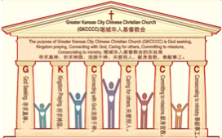
主日:二零一七年七月九日
Sunday: July 9, 2017
何礼义牧师 Pastor Gary Hart
题目：“福音的教会。”
Topic: “Gospel Church.”
经文:徒13:13-52 Text: Acts 13:13-52
“他们来到彼西底的安提阿”(徒13:14)。
“They went to Pisidian Antioch”(Ac.13:14).
(1)

Slide 3
引言:A。使徒行传的信息。 Intro: A.Message of Acts of the Apostles.
(2)
(一)基督建造祂的教会（基督的灵借着使徒在作工）。
(二)使徒行传是圣灵的指挥,控制和赋权的事工,创立和加强了教会，并使它成长。
(三)使徒行传是一个过渡时期:从耶稣的事工到使徒的;从旧约到新约;从以色列作神的见证到教会作神的见证;从犹太教出来, 教会诞生了。
(四)使徒行传显示大使命得以遵行(1:8)从证人到耶路撒冷(1-8),到犹太和撒玛利亚(8-12)并到地极(13-28)。
(五)圣灵将继续在教会作工，书写使徒行传28章(加上）。
(1)Christ builds His Church(the Acts of the Spirit of Christ through the Apostles). (2)The Acts were the Spirit’s directing, controlling, and empowering ministry that founded and strengthened the church and caused it to grow.
(3)The Acts is a time of transitions: from ministry of Jesus to that of the apostles; from the Old Covenant to the New Covenant; from Israel as God’s witness to the Church as God’s witness; from Judaism is going out and Church is coming in.
(4)The Acts show the fulfillment of the Great Commission(1:8) from the witness to Jerusalem(1-8), to Judea and Samaria(8-12), and to the ends of earth(13-28).
(5)The Acts are the continuing Acts of the Spirit in Churches in 28 chapters(plus).

Slide 4
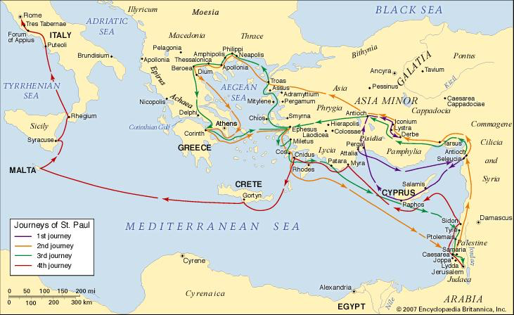
B。彼西底的安提阿地理位置。
B. Pisidian Antioch location.
(3)

Slide 5
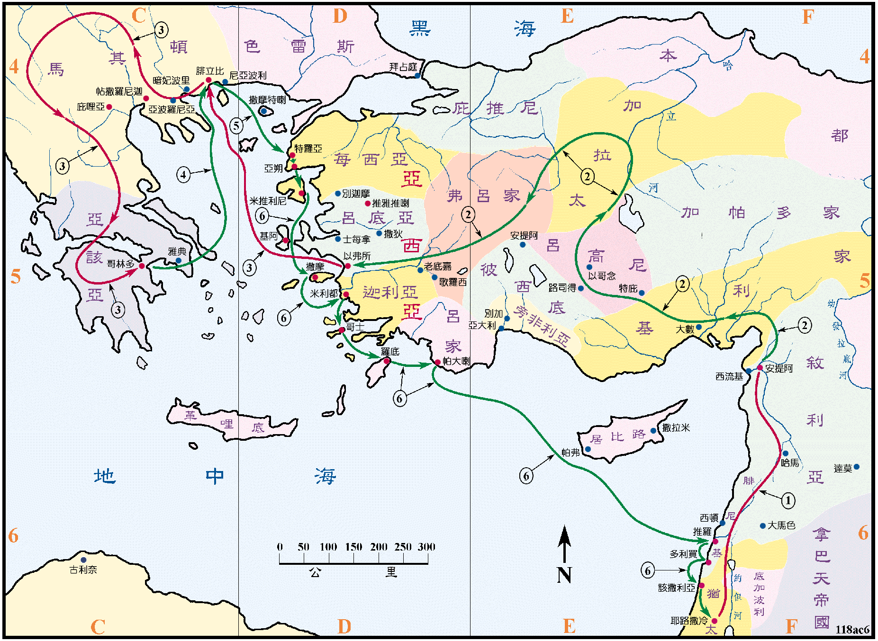
B。彼西底的安提阿地理位置。B.Pisidian Antioch location.
(4)

Slide 6
(5)
C。彼西底的安提阿的历史背景。
C. Pisidian Antioch historical background.
(一)彼西底的安提阿像叙利亚的安提阿，这个安提阿是由塞琉古创立的。 它是小亚细亚南部加拉太省彼西底的首都。 离别加有110英里。
(二)彼西底的安提阿教会是由保罗创立的。 他在那里的会堂里传道（13:14）。 他回到那里坚固教会（14:21）。
(三)彼西底的安提阿教会代表“福音的教会”。
(四)彼西底的安提阿意思是“草地”（诗23:2a）。
(1) Pisidian Antioch like the Syrian Antioch, this Antioch was founded by Seleucus Nicator. It was capital of Pisidia in the province of Galatia in southern Asia Minor.
(2) Pisidian Antioch church was founded by Paul.
He preached in a synagogue there(13:14).He
returned there to strengthen the church(14:21).
(3) Pisidian Antioch church represents the“Gospel
Church”.
(4) Pisidian Antioch means “grassy meadows”
(Ps.23:2a).

Slide 7
(6)
一。基督之灵的称许。1. Spirit of Christ’s commendation.
这是保罗在“使徒行传”(13:16-52;路4:18;赛61:1)中记载的第一个讲道。 他的讲道有三个部分。
A。准备（13:16-25）保罗回顾了以色列的历史。历史是他（神）的故事。神一直在为应许的弥赛亚的到来做准备，但以色列民族经常背逆神。（1）神的大能引领他们出了埃及（13:17）（2）神的忍耐忍受了他们在旷野的行为。（3）神的供应，给他们迦南，士师，先知撒母耳，扫罗王，大卫王（一个寻求神心意的人，愿意做所有神要他做的事），传悔改和洗礼的施洗约翰和救主耶稣。
This is the first of Paul’s sermons recorded in the book of Acts(13:16-52; Cf.Lk.4:18;Is.61:1 ). There are three parts to his sermon.
A. Preparation(13:16-25). Paul reviewed the history of Israel.History is His story. God was at work preparing the way for the coming of the promised Messiah, but the nation of Israel often rebelled. (1)God’s power led them out of Egypt(13:17). (2)God’s patience endured their conduct in the wilderness. (3)God’s provision in giving them Canaan,Judges, Prophet Samuel, King Saul, King David (a man after God’s own heart who will do everything I want him to do), John the Baptist who preached repentance and baptism; and the Savior Jesus.

Slide 8
一。基督之灵的称许。1. Spirit of Christ’s commendation.
(7)
B.公告（13:26-37）。保罗的宣教对象是犹太人和“敬畏上帝”的外邦人。 他宣扬福音（林前15:3-4）。 （1）十字架:（2）埋葬和复活：“但神将他从死里复活”（13:30）。 他的见证被人看见（13:31）。 “对我们来说，这个救恩的信息已经发送”
（13:26）。 “我们告诉你一个好消息：上帝应许我们的祖先（13:32）。 （3）根据圣经：他用旧约圣经支持他的论证。 （a）他援引诗篇2:7（13:33）。 （b）他援引以赛亚书55:3（13:34）。
（c）他引用了诗篇16:10（13:35）。这个应许是应用于弥赛亚的（2:24-28）。
B. Proclamation(13:26-37). Paul addressed both the Jews and the Gentiles “God-fearers”. He preached the gospel(1Cor.15:3-4). (1) Crucifixion: (2) Burial and resurrection: “But God raised him from the dead”(13:30). As seen by His witnesses(13:31). “It is to us that this message of salvation has been sent”
(13:26). “We tell you the good news: What God promised our ancestors(13:32). (3) According to the Scriptures: He used the OT Scriptures to support his argument. (a) He quoted Ps.2:7(13:33). (b)He quoted Isa.55:3(13:34). (c)He quoted from Ps.16:10(13:35).This promise applied to the Messiah(2:24-28).

Slide 9
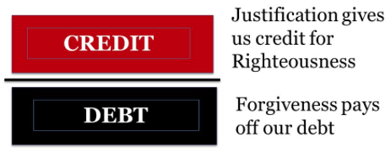
一。基督之灵的称许。1. Spirit of Christ’s commendation.
(8)
C。应用（13:38-52）。 保罗作个人应用。 （1）神的宽恕。 通过信耶稣罪得赦免（13:38）。 （2）神的理由。 通过信靠耶稣的释罪（13:39）。 神不但赦免了我们的罪，而且还给了我们基督的义，把他的义归在我们的帐上。 （3）神的难以置信的工作。 神使用邪恶的异教迦勒底人惩罚他自己所拣选的人（哈1:5;13:40-41）。 神正在用外邦人惩罚犹太人。 现在神正在用犹太人拯救外邦人（13:42-43）。 结果是什么？许多犹太人和外邦人信了神。
C. Application(13:38-52). Paul made the personal application. (1) God’s forgiveness. Through faith in Jesus the forgiveness of sins (13:38). (2) God’s justification. Through faith in Jesus the justification (13:39). God not only forgives our sins, but He also gives us the righteousness of Christ and puts it on our account. (3) God’s unbelievable work. God used the evil pagan Chaldeans to punish His own chosen people(Hab.1:5;13:40
-41).God was using Gentiles to punish Jews.
Now God was using the Jews to save the
Gentiles(13:42-43). What was the result?
Many Jews and Gentiles believed God.

Slide 10
(9)
二。基督之灵的责备。2. Spirit of Christ’s condemnation.
谁被谴责？ A。约翰马可(13:13)。“保罗和他的同伴们在旁非利航行到佩尔加，约翰离开他们回到耶路撒冷。”约翰·马可为什么要离弃他的朋友，回到耶路撒冷呢？ （1）也许他想家了，（2）也许他对保罗开始接管马可表兄巴拿巴（“保罗和他的同伴”）的领导权不满。（3）也许作为一个奉献的犹太人，他可能觉得与得救的外邦人在一起不舒服。 （4）也许当他们进入困难地区时，恐怕会有危险。是无论他逃离的原因是什么，约翰马可犯了一个很严重的错误，以致保罗不要他再回到他的“团队” (15:37-39)
Who is rebuked? A. John Mark(13:13). “Paul and his companions sailed to Perga in Pamphylia,where John left them to return to Jerusalem.” Why did John Mark desert his friends and return to Jerusalem? (1)Perhaps he was homesick, (2)Perhaps he may have become unhappy because Paul had begun to take over the leadership from Mark’s cousin Barnabas. (3)Perhaps as a devoted Jew, he may have felt uncomfortable with the saved Gentiles. (4)Perhaps the fear of danger as they moved into difficult area. But whatever the cause of his defection, John Mark did something so serious that Paul did not want him back on his “team.”(15:37-39).

Slide 11
(10)
二。基督之灵的责备。2. Spirit of Christ’s condemnation.
B。犹太领袖（13:50）。 （1）他们与他们有争议。 （二）对他们采取法律行动，将其驱逐出境。
C。应用：保罗，巴拿巴和他们的同伴继续他们的传教之旅。 他们忠于他们的呼召。
B. Jewish leaders(13:50). (1)They disputed with them. (2)They brought legal action against them and expelled them from their borders.
C. Application: Paul, Barnabas, and their companions continued on in their missionary journey. They were faithful to their calling.

Slide 12
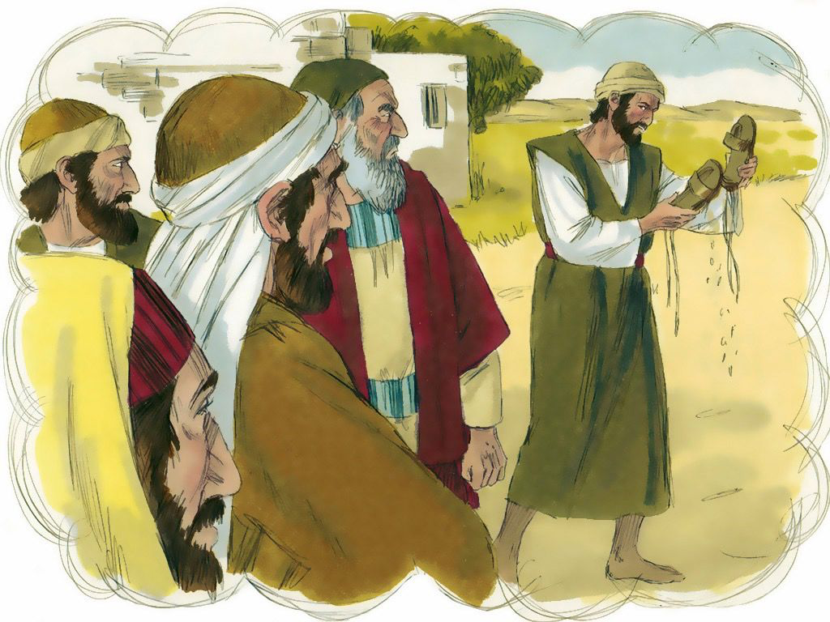
三。基督之灵的忠告。3. Spirit of Christ’s counsel.
(11)
“二人对着众人跺下脚上的尘土，就往以哥念去了”（13:51）。
A。一个警告。 他们再次抖落脚下的尘土（路加福音9:5;10:11）。 表表示责任的解除和拒绝那些拒绝他们的信息，给耶和华的仆人带来痛苦的人。
“So they shook the dust off their feet as a warning to them and went to Iconium” (13:51).
A. Warning. They shook off the dust of their feet again them(Lk.9:5;10:11). To show the severance of responsibility and the repudiation of those who had rejected their message and had brought suffering to the servants of the Lord.

Slide 13
三。基督之灵的忠告。3. Spirit of Christ’s counsel.
(12)
B。鼓励。 他们并不气馁，他们被鼓励，去了下一个城镇。
C。应用。 发出警告并进入下一个地方。
B. Encouragement. They were not discouraged, they were encouraged and went to the next town.
C. Application. Give a warning and go on to the next place.

Slide 14
(13)
四。基督之灵的挑战。4. Spirit of Christ’s challenge.
“门徒满心喜乐，又被圣灵充满”（13:52）。
A。充满欢乐。 “因为耶和华的喜乐是你的力量”（尼8:10）。
B。被圣灵充满。 “要被圣灵充满”（弗5:18）是一个命令。
C。应用。当你宣告福音时要满心喜乐，并被圣灵充满。
“And the disciples were filled with joy
and with the Holy Spirit”(13:52).
A. Filled with joy. “For the joy of the
Lord is your strength”(Neh.8:10).
B. Filled with Holy Spirit. “Be filled
with the Spirit” is a command
(Eph.5:18).
C. Application. As you proclaim the
gospel, be filled with joy and with the
Holy Spirit.

Slide 15
(14)
结论：Conclusion:
什么是福音?不单单是因为神是爱我们，我们就好了，不单是神要成为我们的朋友，要重新创造我们。我们不制作福音，我们宣告福音。福音是我们宣告的消息，不是我们手上正在做的工作，而是神已经做的，正在做的和将要做的！福音不是被动的，而是主动的。福音要求回应。那么福音所要求的是什么回应呢？当我们感觉到我们的需要，当我们理解了神是谁，耶稣是谁并他所做的，我们该做什么呢？我们的回应应该是悔改和相信。 神呼召我们悔改我们的罪，并相信基督(20:21)。 忏悔和信仰实际上是同一枚硬币的两面。 你听过圣经关于神的伟大信息吗？ 听起来好像你听过的最好的消息吗？ 旧罪被原谅了新生活开始了!你与神，你的创造者建立了个人的关系，从现在到永远!
What is the gospel? It is not simply that we are okay, that God is love, that Jesus wants to be our friend,that God will renew creation.We don’t do the gospel,we proclaim the gospel. The gospel is news we proclaim not about what we’re doing, but about what God has done, is doing, and will do! The gospel is not passive, but active. The gospel demands a response. So what response does the gospel call for? What should we do when we sense our need, our understanding of who God is and who Jesus is and what He had done? Our response should be to repent and believe. God calls us to repent of our sins and to believe in Christ alone(20:21). Repentance and faith are actually two sides of the same coin. Does it sound like the best news you’ve ever heard? Old sins forgiven! New life begun! A personal relationship with God, your Creator, now and forever!

Slide 16
(15)
结论：Conclusion:
Could you tell the gospel in one minute or less?

Slide 17
(15)
结论：Conclusion:
你能在一分钟之内说出什么是福音吗？
福音是神借耶稣基督道成肉身成为人的好消息。他在地上活出了我们应该活出的生命，受了我们应该受的死，在我们的地方。 三天后，他从死里复活，证明他是神的儿子，给予所有愿意悔改和相信福音的人救恩的恩赐。

