Slide 1
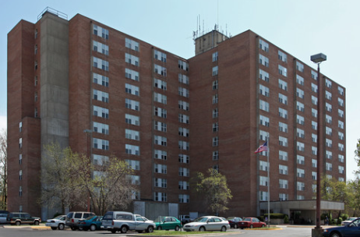
Welcome to Wednesday Bible Study!
欢迎来参加星期三查经班！
Santa Fe Towers Apartments in the Community Room
8101 Santa Fe Drive
Overland Park, KS 66103
In English and in Chinese. 用英文和中文。
Wednesdays from 10 to 11:30 a.m.
星期三早上从十点到十一点半。
Pastor Gary Hart 何礼义牧师
Starting April 12,2017. 2017年4月12日开始。

Slide 2
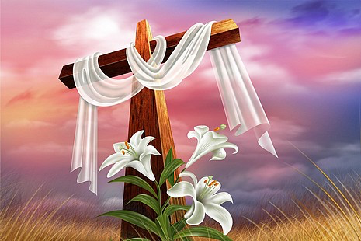
复活节:二零一七年四月十六日
Easter Sunday: April 16, 2017
早上10点受浸礼10 am Baptism Service
早上10点30分聚会10:30 am Service

Slide 3
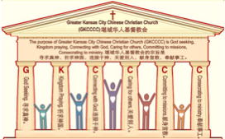

棕榈主日:二零一七年四月九日
Palm Sunday: April 9, 2017
何礼义牧师 Pastor Gary Hart
题目：“喜乐的教会 。”
Topic: “Joyful Church.”
经文:使徒行传8:4-13
“在那城里，就大有欢喜”(徒8:8).
Text: Acts 8:4-13
“So there was great joy in that city”(Ac.8:8).
(1)

Slide 4
引言:A。使徒行传的信息。 Intro: A.Message of Acts of the Apostles.
(2)
(一)基督建造祂的教会（基督的灵借着使徒在作工）。
(二)使徒行传是圣灵的指挥,控制和赋权的事工,创立和加强了教会，并使它成长。
(三)使徒行传是一个过渡时期:从耶稣的事工到使徒的;从旧约到新约;从以色列作神的见证到教会作神的见证;从犹太教出来, 教会诞生了。
(四)使徒行传显示大使命得以遵行(1:8)从证人到耶路撒冷(1-8),到犹太和撒玛利亚(8-12)并到地极(13-28)。
(五)圣灵将继续在教会作工，书写使徒行传28章(加上）。
(1)Christ builds His Church(the Acts of the Spirit of Christ through the Apostles). (2)The Acts were the Spirit’s directing, controlling, and empowering ministry that founded and strengthened the church and caused it to grow.
(3)The Acts is a time of transitions: from ministry of Jesus to that of the apostles; from the Old Covenant to the New Covenant; from Israel as God’s witness to the Church as God’s witness; from Judaism is going out and Church is coming in.
(4)The Acts show the fulfillment of the Great Commission(1:8) from the witness to Jerusalem(1-8), to Judea and Samaria(8-12), and to the ends of earth(13-28).
(5)The Acts are the continuing Acts of the Spirit in Churches in 28 chapters(plus).

Slide 5
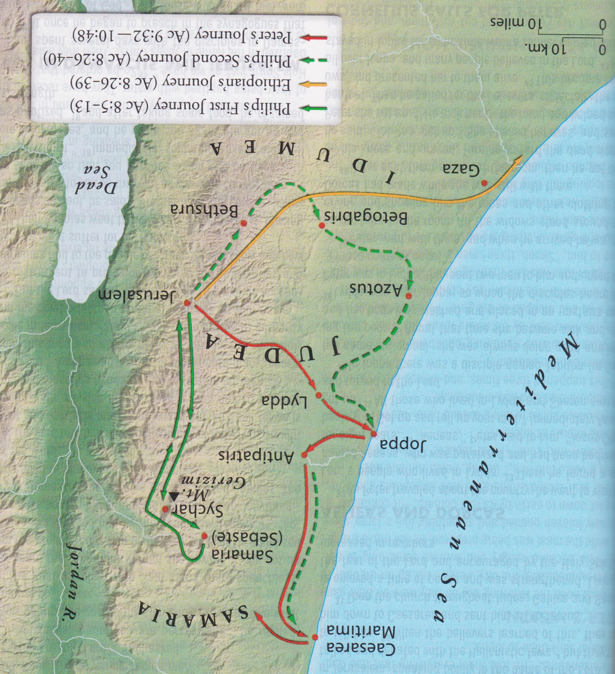
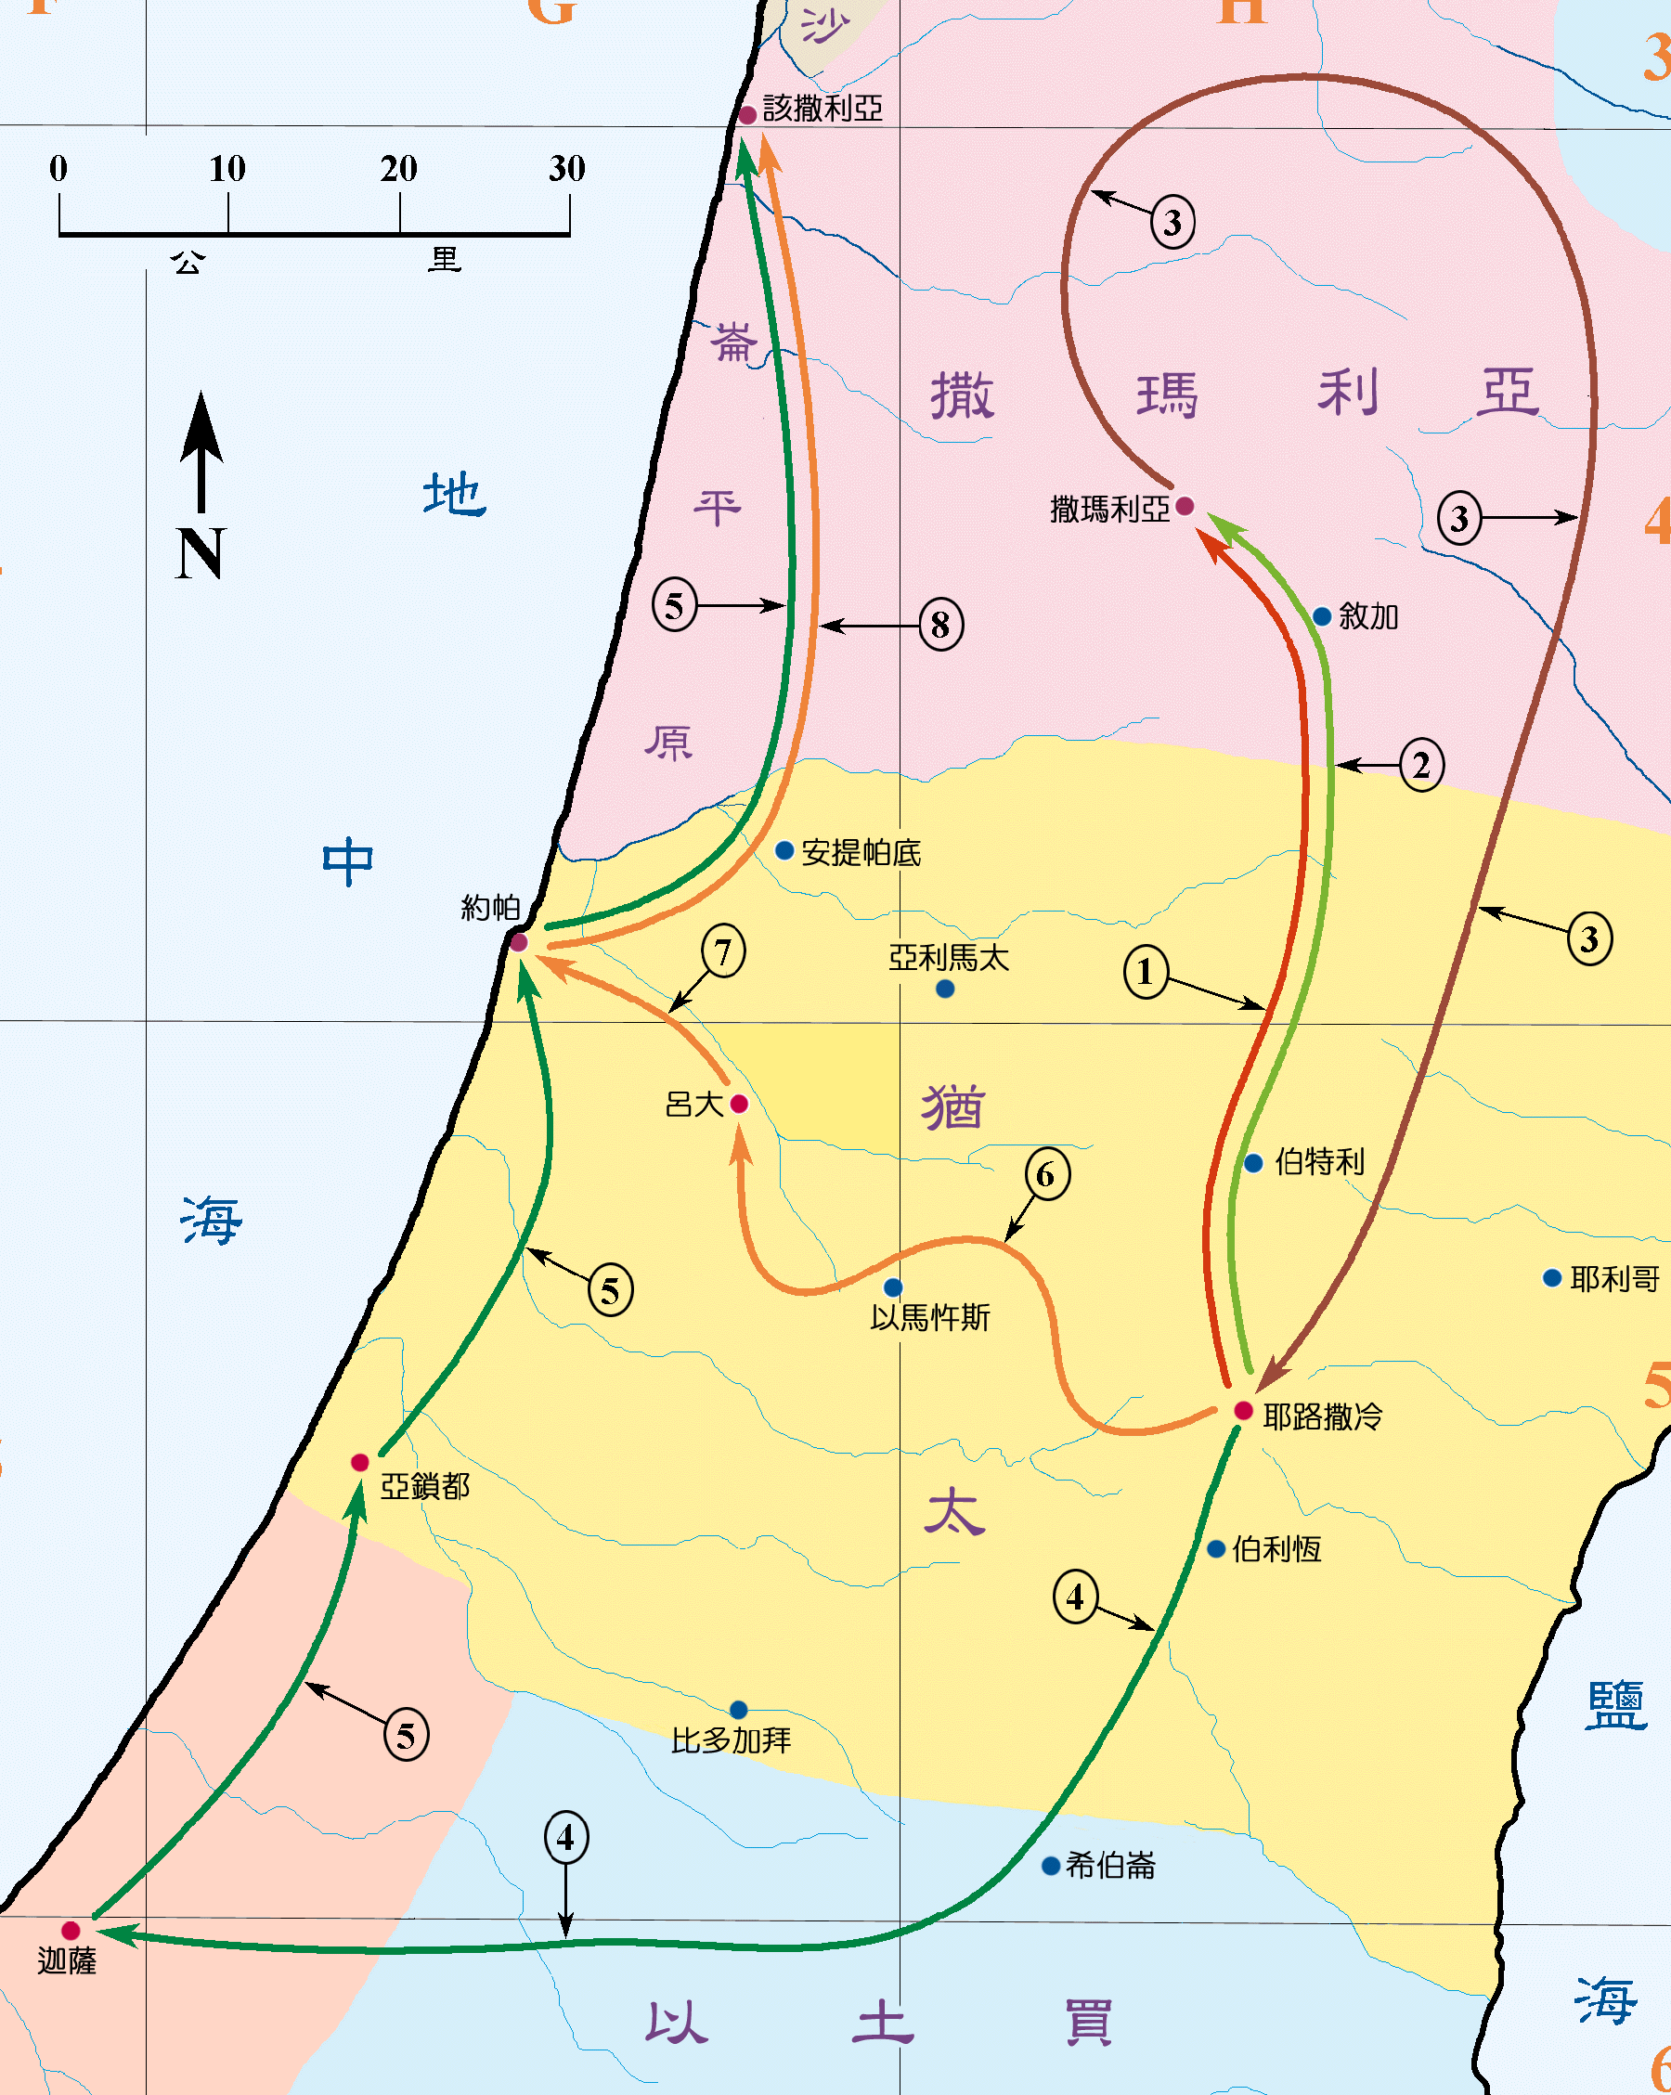
B。撒玛利亚的地理位置。
B. Samaria location.
(3)

Slide 6
C。撒玛利亚的历史背景。C.Samaria historical background.
（一）撒马利亚城在耶路撒冷以北42英里。撒马利亚人是一个“混血”的民族，犹太人和外邦人的混血后代。耶稣责备他的门徒对撒马利亚人的敌意(路9:55-56),医治了一个撒玛利亚麻风病人(17:16),荣耀了一个撒玛利亚的好邻舍 (10:30-37),称赞了一个有感恩之心的撒玛利亚人 (17:11-18),问一个撒玛利亚妇人要水喝 (约4:7),并向他们传教 (约4:40-42)。
（二）撒马利亚教会由腓利在他的第一次旅程中创立。
（三）撒马利亚教会代表喜乐的教会。
（四）撒马利亚的意思是“守望之山 ”(基利心山,约4:20;申27:12)。
(1) The city of Samaria is 42 miles north of Jerusalem. Samaritans were a “half-breed” people, a mixture of Jew and Gentile. Jesus rebuked His disciples for their hostility to Samaritans(Lk.9:55-56),healed a Samaritan(17:16),honored a Samar-itan for his neighborliness(10:30-37),praised a Samaritan for his gratitude(17:11- 18),asked a drink of a Samaritan woman(Jn.4:7),preached to them(Jn.4:40-42).
(2)Samaria church was founded by Philip during his first journey.
(3)Samaria church represents the joyful church.
(4)Samaria means “mountain of watching”(Mt.Gerizim,Jn.4:20;Deut.27:12)
(4)

Slide 7

(5)
一。基督之灵的称许。1. Spirit of Christ’s commendation.
“那些分散的人，往各处去传道。腓利下撒玛利亚城去，宣讲基督。众人听见了，又看见腓利所行的神迹，就同心合意地听从他的话。因为有许多人被污鬼附着，那些鬼大声呼叫，从他们身上出来。还有许多瘫痪的，瘸腿的，都得了医治。在那城里，就大有欢喜。”(徒8:4-8)
“Those who had been scattered preached the word wherever they went. Philip went down to a city in Samaria and proclaimed the Messiah there. When the crowds heard Philip and saw the signs he performed,they all paid close attention to what he said.For with shrieks, impure spirits came out of many, and many who were paralyzed or lame were healed.So there was great joy in that city.”(Ac8:4-8)

Slide 8

一。基督之灵的称许。1. Spirit of Christ’s commendation.
(6)
A。他们受了逼迫。“从这日起，耶路撒冷的教会，大遭逼迫”
（8:1a)。“那些因司提反的事遭患难四散的门徒，直走到腓尼基，和居比路，并安提阿。他们不向别人讲道,只向犹太人讲”(11:19 )。
B。他们被分散。“除了使徒以外，门徒都分散在犹太和撒玛利亚各处”(8:1b)。“四散的门徒”（11:19）。散居的意思是“散播种子”。
A. They were persecuted. “On that day a great persecution broke out against the church in Jerusalem, and all except the apostles were scattered throughout Judea and Samaria”(8:1a). “Now those who had been scattered by the persecution that broke out when Stephen was killed traveled as far as Phoenicia, Cyprus and Antioch, spreading the word only among Jews”(11:19).
B. They were scattered. “Scattered throughout
Judea and Samaria…Those who had been
scattered”(8:1b,4a;11:19).
Diaspora means “to scatter seed.”

Slide 9
(7)
一。基督之灵的称许。1. Spirit of Christ’s commendation.
C。他们是传福音的。“他们往各处去传道”（8:4b）。
(一)腓利是一个执事(6:5)并“下撒玛利亚城去，宣讲基督”(8:5)。
(二)腓利是一个传道者。后来他来到该撒利亚（21:8）。
(三)腓利是一个行神迹者。众人听见了，又看见腓利所行的神迹，就同心合意地听从他的话。因为有许多人被污鬼附着，那些鬼大声呼叫,从他们身上出来。还有许多瘫痪的,瘸腿的,都得了医治(8:6,7)。
(四)腓利是施洗约翰（约3:23）和耶稣（4:4）的劳动的收割者。
D。他们充满了喜乐。“在那城里，就大有欢喜”(徒8:8).
C. They were evangelists. “They preached the word wherever they went”(8:4b). (1)Philip was a deacon(6:5) and “went down to a city in Samaria and proclaimed the Messiah there”(8:5).
(2)Philip was an evangelist. Later he went to Caesarea(21:8).
(3)Philip was a“sign”worker.“When the crowds heard Philip and saw the signs he performed,they all paid close attention to what he said.For with shrieks, impure spirits came out of many,many who were paralyzed or lame were healed”(8:6,7).
(4)Philip was a reaper to the labors of John the Baptist(Jn.3:23) and Jesus(Jn.4).
D. They were filled with joy. “So there was great joy in that city.”(Ac.8:8).

Slide 10
(8)
一。基督之灵的称许。1. Spirit of Christ’s commendation.
E。他们相信和受洗。“及至他们信了腓利所传神国的福音，和耶稣基督的名，连男带女就受了洗”(8:12)。
F。他们受圣灵的洗并被圣灵充满。“使徒在耶路撒冷，听见撒玛利亚人领受了神的道，就打发彼得约翰往他们那里去。两个人到了，就为他们祷告，要叫他们受圣灵。因为圣灵还没有降在他们一个人身上。他们只奉主耶稣的名受了洗。于是使徒按手在他们头上，他们就受了圣灵”(8:14-17)。
E. They believed and were baptized. “But when they believed Philip as he proclaimed the good news of the kingdom of God and the name of Jesus Christ, they were baptized, both men and women”(8:12).
F. They were baptized and filled with the Holy Spirit. “When the apostles in Jerusalem heard that Samaria had accepted the word of God, they sent Peter and John to Samaria. When they arrived, they prayed for the new believers there that they might receive the Holy Spirit, because the Holy Spirit had not yet come on any of them; they had simply been baptized in the name of the Lord Jesus. Then Peter and John placed their hands on them, and they received the Holy Spirit”(8:14-17).

Slide 11
(9)
二。基督之灵的责备。2. Spirit of Christ’s condemnation.
神撒了他的真信徒，撒但撒了他的假冒(太13:24-30,36-43)。
A。西门的工作是被撒旦激动的。 “有一个人，名叫西门，向来在那城里行邪术…使撒玛利亚的百姓惊奇”（8:9a)。
B。西门的骄傲被肉体所加大。“妄自尊大”（8:9b)。
C。西门的赞美是世界的激情。 “无论大小，都听从他，说，这人就是那称为神的大能者。他们听从他，因他久用邪术，使他们惊奇”(8:10-11)。
God sows His true believers,Satan sows his counterfeits(Mt.13:24-30,36-43).
A. Simon’s works were energized by Satan.“Now for some time a man named Simon had practiced sorcery in the city and amazed all the people of Samaria”
(8:9a).
B. Simon’s pride was energized by the flesh. “He boasted that he was some-one great”(8:9b).
C. Simon’s praise was energized by the world.“And all the people,both high and low,gave him their attention and exclaimed,‘This man is rightly called the Great Power of God.’They followed him because he had amazed them for a long time with his sorcery”(8:10-11).

Slide 12
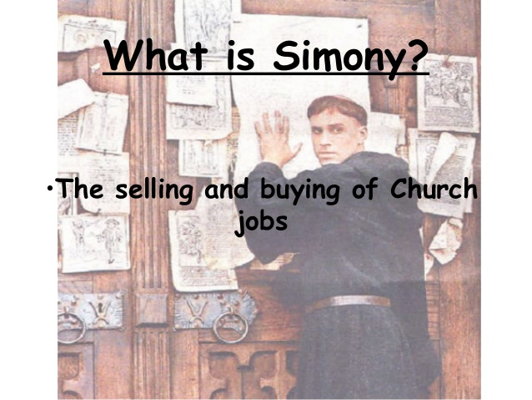
(10)
二。基督之灵的责备。2. Spirit of Christ’s condemnation.
D。西门的决定是受到个人利益的激动。“西门自己也信了。既受了洗，就常与腓利在一处。看见他所行的神迹和大异能，就甚惊奇…西门看见使徒按手，便有圣灵赐下。就拿钱给使徒，说，把这权柄也给我，叫我手按着谁。谁就可以受圣灵。彼得说，你的银子，和你一同灭亡吧。因你想神的恩赐，是可以用钱买的。你在这道上，无分无关。因为在神面前，你的心不正”(8:13,18-21)。
“Simony”正在买卖教堂职位或特权。
D. Simon’s decision was energized by personal gain.“Simon himself believed and was baptized.And he followed Philip everywhere, astonished by the great signs and miracles he saw…When Simon saw that the Spirit was given at the laying on of the apostles’ hands,he offered them money and said, Give me also this ability so that everyone on whom I lay my hands may receive the Holy Spirit. Peter answered:May your money perish with you,because you thought you could buy the gift of God with money! You have no part or share in this
ministry, because your heart is not right before God”(8:13,18-21).
“Simony” is buying and selling of church positions or privileges.

Slide 13

(11)
二。基督之灵的责备。2. Spirit of Christ’s condemnation.
E。西门心中充满了苦毒。“我看出你正在苦胆之中，被罪恶捆绑”(8:23;申29:18;来12:15)。[苦尽甘来]。
F。西门的祷告充满了自私。“西门说，愿你们为我求主，叫你们所说的，没有一样临到我身上”（8:24）。你必须承认自己的罪。没有人能为你做悔改的祷告。
E. Simon’s heart was energized by bitterness.“For I see that you are full of bitterness and captive to sin”(8:23;He.12:15).[Bitterness ends,sweetness begins]
F. Simon’s prayer was energized by selfishness. “Then Simon answered, “Pray to the Lord for me so that nothing you have said may happen to me”(8:24). You have to confess your own sin. No one can pray repenting prayer for you.
快乐取决于情况，
喜乐取决于神。

Slide 14

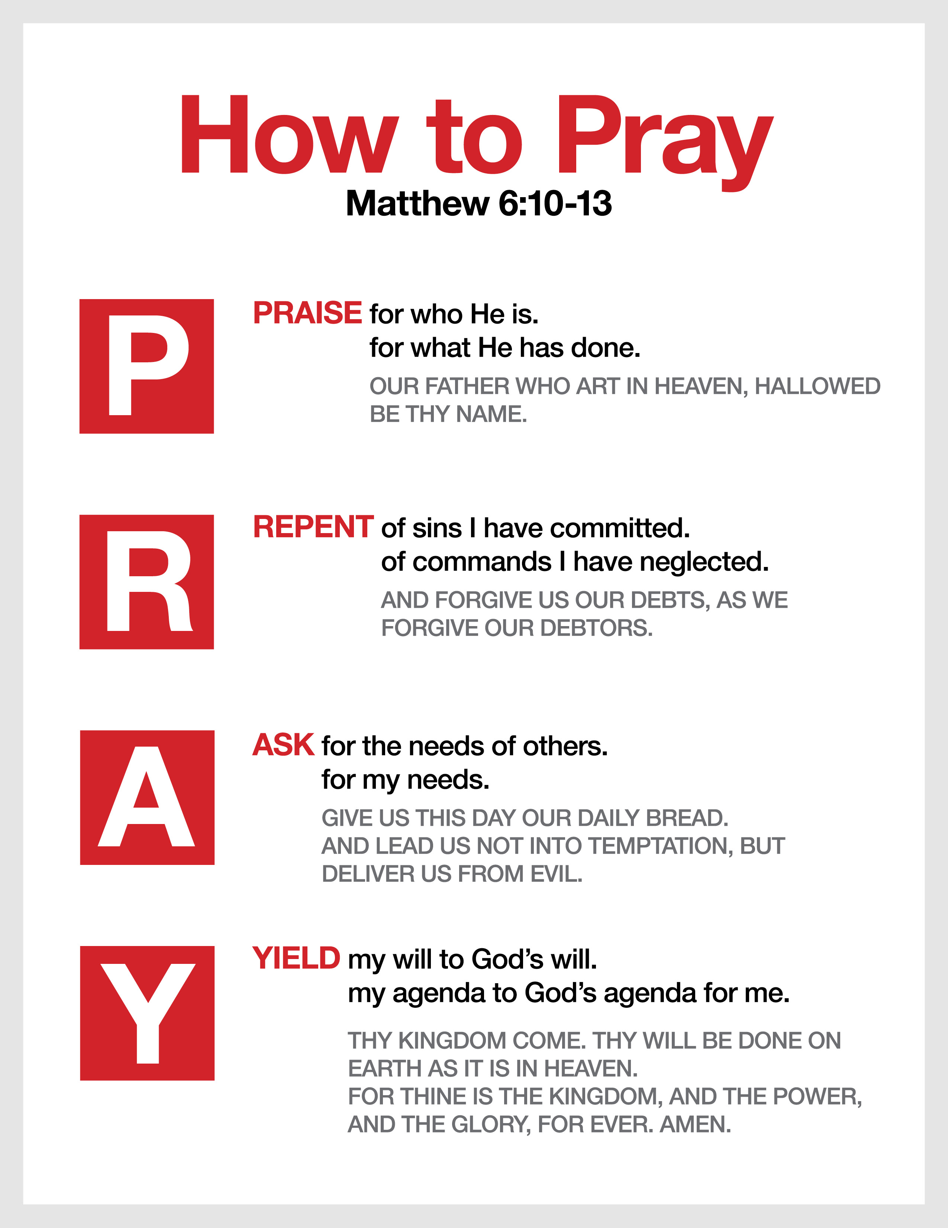
三。基督之灵的忠告。3. Spirit of Christ’s counsel.
(12)
“你当懊悔你这罪恶,祈求主。或者你心里的意念可得赦免”(8:22)。
A。需要悔改。 “你当懊悔你这罪恶”(8:22a)。
B。需要祷告。 “祈求主。或者你心里的意念可得赦免”(8:22b)。
“Repent of this wickedness and pray to the Lord in the hope that he may forgive you for having such a thought in your heart”(8:22)
A. Need for repentance. “Repent of this wickedness”(8:22a).
B. Need for prayer. “And pray to the Lord in the hope that he may forgive you for having such a thought in your heart”(8:22b).

Slide 15


(13)
四。基督之灵的挑战。4. Spirit of Christ’s challenge.
“众人听见了…撒玛利亚人领受了神的道” (8:6,14)。
A。听圣灵所说的。 “众人听见了”(8:6)。
B。领受神的道。“撒玛利亚人领受了神的道”（8:14）。
“When the crowds heard…Samaria had accepted the word of God”(8:6,14).
A. Hear what the Spirit says. “When the crowds heard”(8:6).
B. Accept the Word of God. “Samaria had accepted the word of God”(8:14).
要
常常喜乐。
(帖前：
5:16)

Slide 16
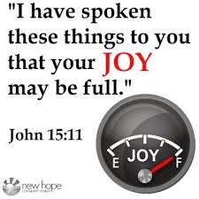

(14)
结论：Conclusion:
耶稣借着向井边的撒玛利亚妇人宣告他就是基督，给撒玛利亚人撒下了神道的种子。耶稣也说撒种者和收割者可以一起高兴（4:36）。耶稣和撒玛利亚妇人做了“辛苦的工作，你（菲利普）得到了劳动的好处”（4:38）。 “那个镇上的许多撒马利亚人因为这个女人的见证而相信他,因为他更多的话变成了信徒”(4:41)他们知道他是“世界的救主”（4:42）。
Jesus had sown the seed in Samaria to the Samaritan woman by the well and declared to her that He was the Messiah(Jn.4:4-26). Jesus also said that the sower and the reaper may be glad together(4:36). Jesus and the Samaritan woman did “the hard work, and you (Philip) reaped the benefits of their labor”
(4:38).“Many of the Samaritans from that town believed
in him because of the woman’s testimony…and because
of his words many more became believers” (4:41).They
know that He is “the Savior of the world”(4:42).
Look up,
see joy!

