Slide 1
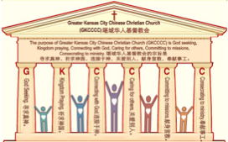

主日:二零一七年二月二十六日
Sunday: February 26, 2017
何礼义牧师 Pastor Gary Hart
题目：“死的教会 。”
Topic: “Dead Church.”
经文:启示录3:1-6
“按名你是活的，其实是死的”(启3:1b).
Text:Rev.3:1-6
“You have a reputation of being alive, but you are dead” (Rev.3:1b).
(1)

Slide 2
堪城华人基督教会2017年教会祷告:GKCCCC2017 Congregation Prayer:
Please stand, and pray together with me: O God,…
We thank You that You are our Father and by faith we are God’s family.
We thank You that Christ is our Head and by grace we are Christ’s body.
We thank You that the Holy Spirit is our Anointing, by His power we live.
We thank You the Bible is Your Book, by inspiration we have God’s Word.
We ask You to anoint and open our ears to hear God’s Word.
We ask You to anoint and open our eyes to understand God’s Word.
We ask You to anoint and open our hearts to receive God’s Word.
We ask You to anoint and change our minds to follow God’s will.
We ask You to anoint and use our hands to do God’s will.
We ask You to anoint and use our feet to walk in God’s will.
We ask You to anoint and speak Your message through Your servant.
We ask You to anoint and help Your church to be God seeking, Kingdom praying, Connecting with God, Caring for others, Committing to missions, Consecrating to ministry. We pray in Jesus name, Amen.

Slide 3
堪城华人基督教会2017年教会祷告:GKCCCC2017 Congregation Prayer:
请站起来，跟我一起祷告：神啊，…
我们感谢祢，祢是我们的父，我们因着信我们是神家中的人。
我们感谢祢，因基督是我们的头，我们因着恩典我们是基督的身体。
我们感谢祢，圣灵是我们的恩膏，我们因着祂的能力我们活着。
我们感谢祢，圣经是祢的书，是神默示给我们的话。
求祢恩膏并开我们的耳朵，使我们可以听神的话。
求祢恩膏并开我们的眼睛，使我们可以明白神的话。
求祢恩膏并开我们的心，使我们可以接受神的话。
求祢恩膏并改变我们的思想，使我们可以跟从神的旨意。
求祢恩膏并用我们的手，使我们可以照着神的旨意而做。
求祢恩膏并用我们的脚，使我们可以在神的旨意上行走。
求祢恩膏并使用您的仆人，使他能向我们传达祢的信息。
求祢恩膏并帮助您的教会寻求真神，祈求神国，连接于神，
关爱别人，献身宣教，奉献事工。我们奉耶稣的名祷告，阿们。

Slide 4

引言：A。七个教会的信息。
Intro: A. The messages to the seven churches.
(2)
（一）这七个教会是在约翰的时代在亚洲的七个实际教会。
（二）这七个教会代表教会历史的七个时期。
（三）这七个教会代表当今不同种类的教会。
（四）这七个教会代表任何教会都可能有的的特点。
（五）这七个教会代表撒旦攻击教会的七个方法。
(1)These seven churches were literal churches in Asia of John’s day.
(2)These seven churches represent seven periods of Church History.
(3)These seven churches are types of churches that exist today.
(4)These seven churches show characteristics that can exist in any church.
(5)These seven churches show seven
methods of attack by Satan on the church.

Slide 5
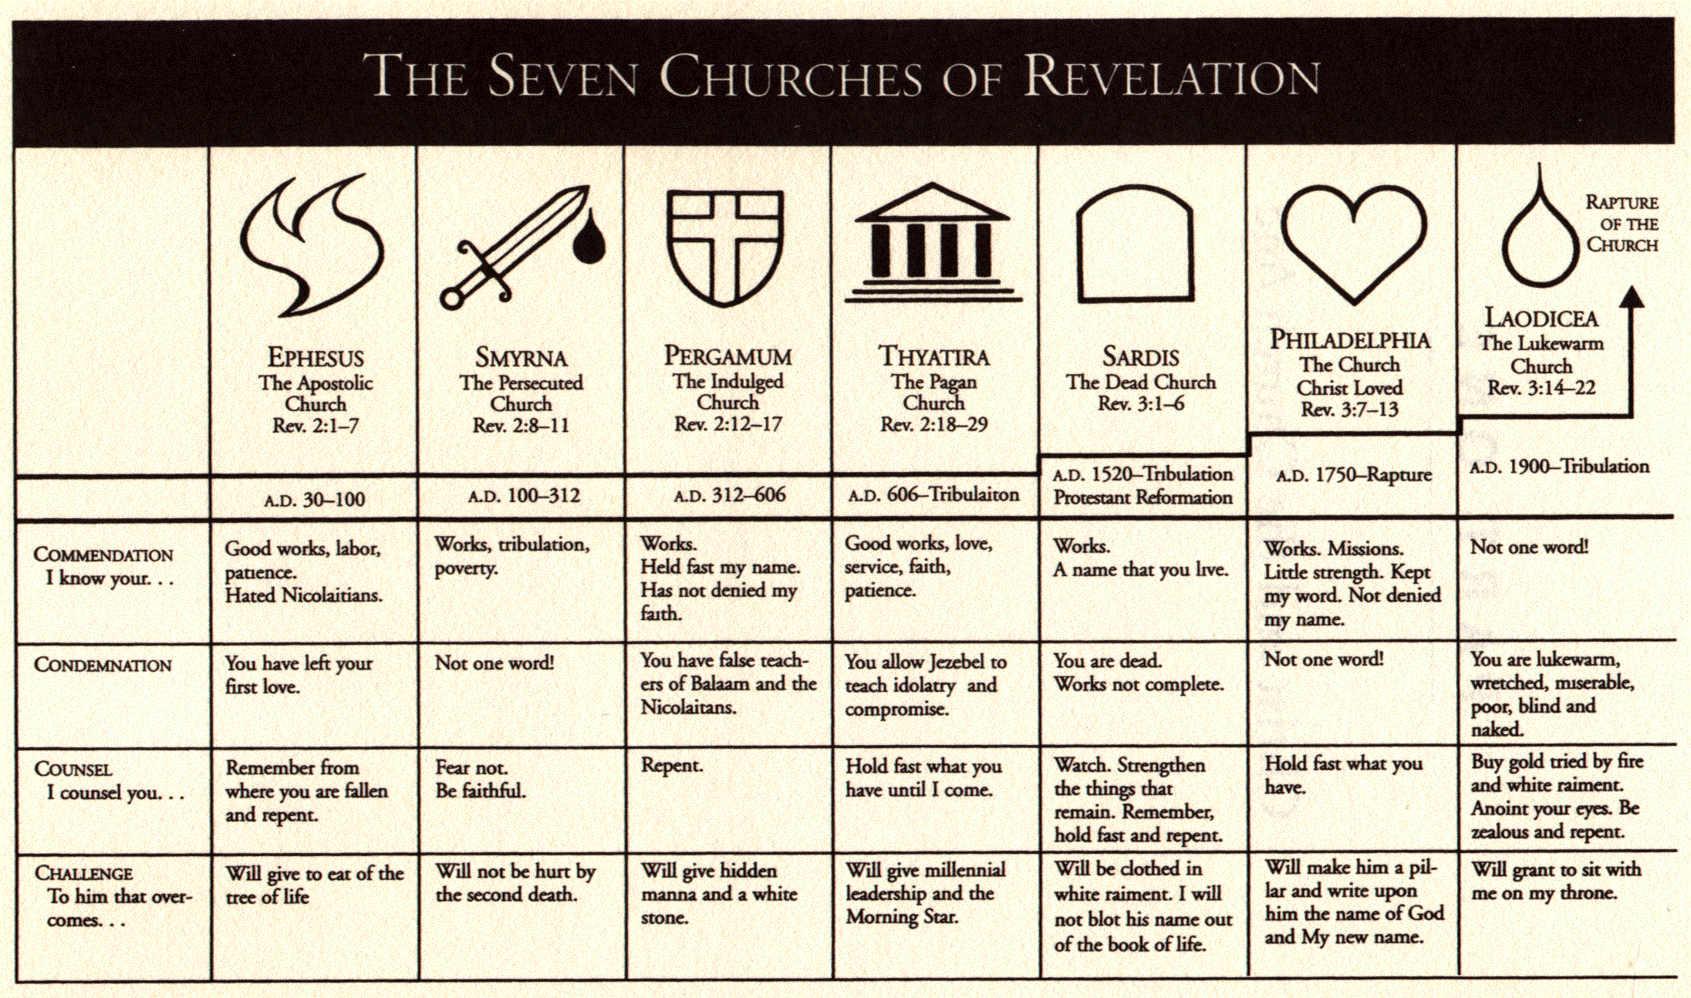
A。给七个教会的信息。
A. The messages to the seven churches.
(3)

Slide 6
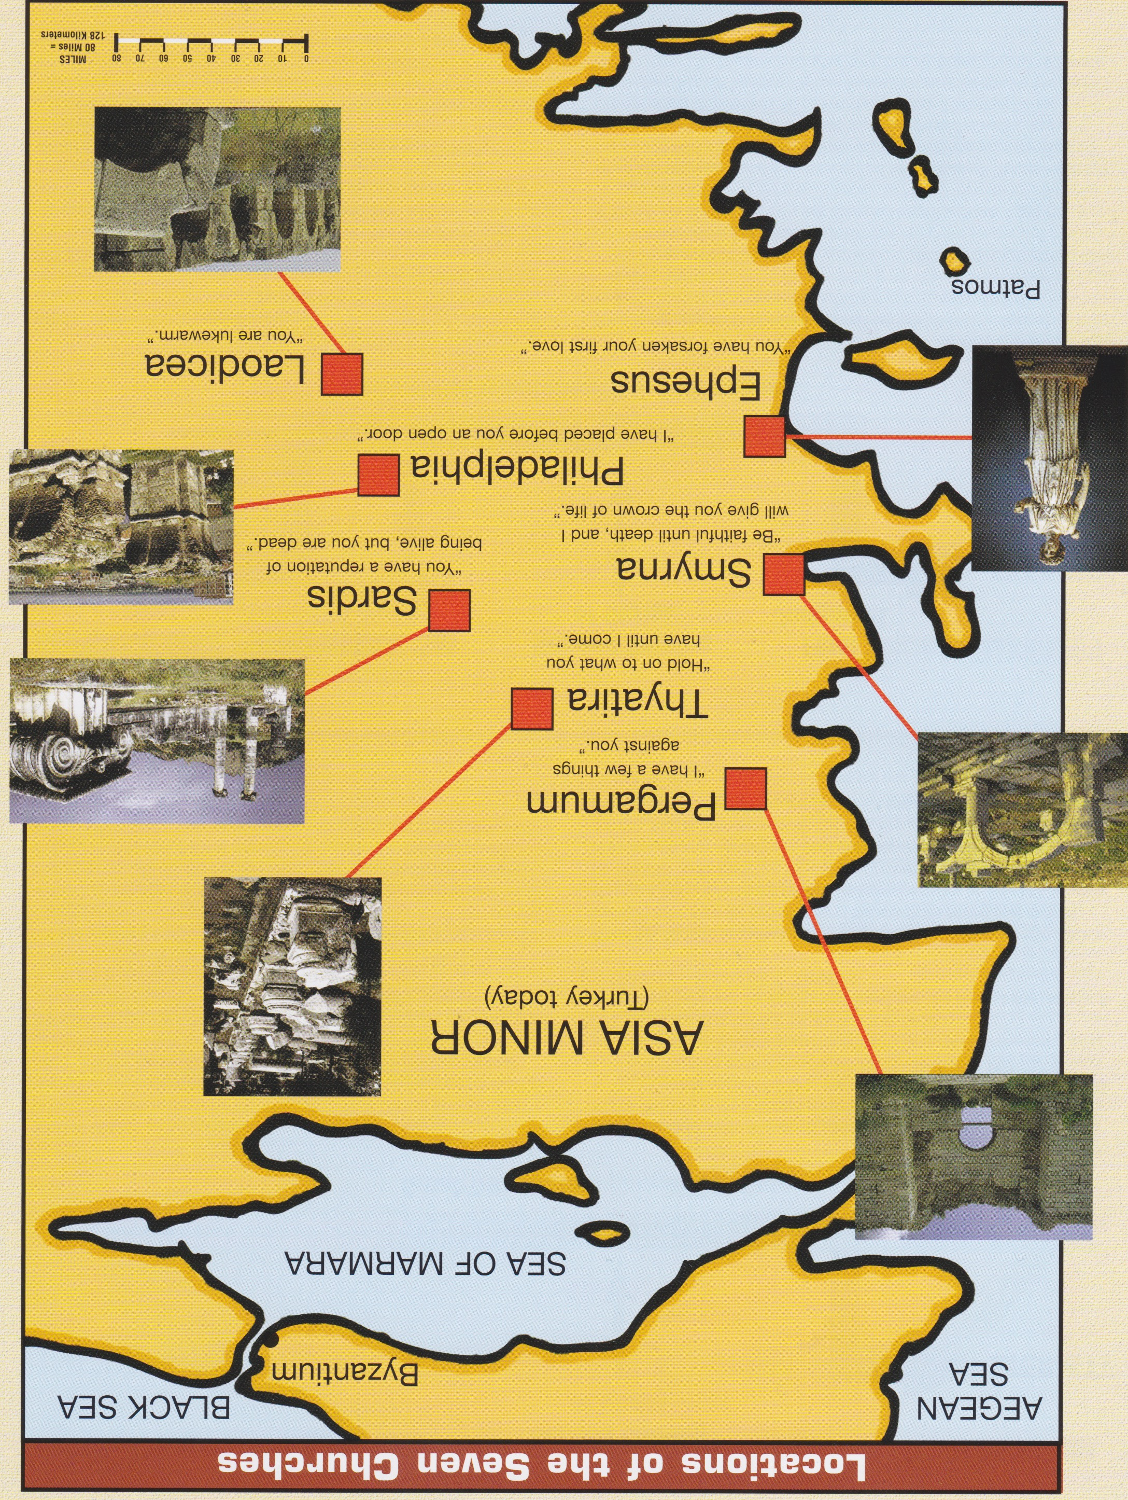
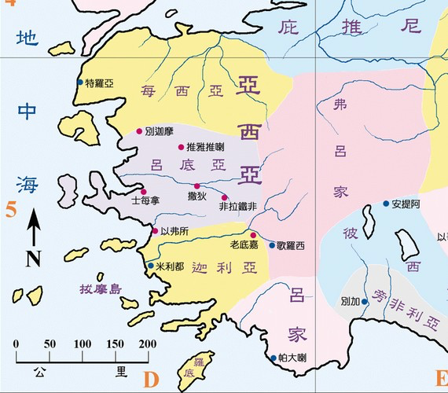
B。七个教会的地理位置。
B. 7 Churches locations.
爱瑟海
拔摩

Slide 7
C。别迦摩的历史背景。
C. Historical background of Sardis.
(5)
（一）撒狄城曾是吕底亚省会并重要城市。它是贸易的中心（毛料衣服）和军队中心（在高原上）。那里的人敬拜阿尔特弥斯（大自然邪教）相信死亡和再生。
（二）撒狄教会创立的人是无名氏。
（三）撒狄教会代表死亡的的教会（主后1517－1750）。
（四）撒狄这个词是“逃逸者”或“出去”的意思。新教改革逃脱了“罗马天主教会”，但他们生活在过去的荣耀里。
1) The city of Sardis was the capital of Lydia and a most important city. It was a trade center(wool garments and rugs) and a military center(on a plateau). They worshiped Artemis (“nature cult”) that believed the idea of death and rebirth.
(2) Sardis church was founded by an unknown.
(3) Sardis church represents dead church(AD 1517-1750,The Reformation).
(4) Sardis means “escaping ones” or “come out.” The Protestant Reformation escaped the “Roman Catholic Church” but they were living on past glory.

Slide 8
(6)
一。基督的称许。1. Christ’s commendation.
“你要写信给撒狄教会的使者，说，那有神的七灵和七星的，说，我知道你的行为，按名你是活的…然而在撒狄你还有几名是未曾污秽自己衣服的。他们要穿白衣与我同行。因为他们是配得过的（启3:1，4）。七灵代表圣灵，七星代表教会的天使或使者。
A。行为。“我知道你的行为”（3:1）。这可能指的是改革的早期阶段，当时马丁路德和其他人选藐视罗马当局，遵守圣经因信称义的教训，甚至不顾惜自己的生命。
“To the angel of the church in Sardis write: These are the words of him who holds the seven spirits of God and the seven stars. I know your deeds; you have a reputation of being alive…Yet you have a few people in Sardis who have not soiled their clothes. They will walk with me, dressed in white, for they are worthy”(Rev.3:1,4). The seven spirits refer to the Holy Spirit and the seven stars are the angels or messengers to the churches.
A. Deeds.“I know your deeds”(3:1).This may well refer to the early stages of the Reformation when Martin Luther and others chose to defy Roman authority, even at the risk of their own lives, to obey the Bible’s teaching on salvation by faith.

Slide 9
一。基督的称许。1. Christ’s commendation.
(7)
B。有名。“按名”（3:1c）。这可能指的是宗教改革教会在运动的早期有一个忠实于基督的教会的名声。
C。活的。“你是活的”(3:1d) 。在教会里有一些生命;教会有一些成长。
D。 忠实的“在撒狄你还有几名是未曾污秽自己衣服的。他们要穿白衣与我同行。因为他们是配得过的”（3:4）。
B. Reputation. “You have a reputation”(3:1c). This probably refers to the fact that the Reformation church had a reputation as a church faithful to Christ in the earlier days of the movement.
C. Alive. “Of being alive”(3:1d). There was some life in the church; there was some growth in the church.
D. Some faithful. “Yet you have a few people in Sardis who have not soiled their clothes. They will walk with me, dressed in white, for they are worthy”(3:4).

Slide 10
(8)
二。基督的责备。2. Christ’s condemnation.
“其实是死的…因我见你的行为，在我神面前，没有一样是完全的”。（3:1e,2b）
A。死的。“其实是死的”。一些垂死的教会的迹象是什么？
（一）当一个教会对外在事物比对属灵事物更感兴趣时，他们就有死亡的危险。
（二）当一个教会开始容忍那些希望从圣经脱离的人时，他们就有死亡的危险。
（三）当一个教会对其现状感到满足时，他们就有死亡的危险。
“But you are dead…for I have found your deeds unfinished in the sight of my God” (3:1e,2b).
A. Dead. “But you are dead”(3:1d). What are the signs of a dying church?
(1) A church is in danger of dying when it becomes more interested in external things than in spiritual things.
(2) A church is in danger of dying when it begins to tolerate those who wish to turn it from the Bible.
(3) A church is in danger of dying when it is satisfied with its present condition.

Slide 11

(9)
二。基督的责备。2. Christ’s condemnation.
B。道德上反常的。“因我见你的行为，在我神面前，没有一样是完全的”（3:2b)。虽然改革领导人开始很好，但没有彻底完成教会改革的工作，圣经标准缺失 。“我小子阿，我为你们再受生产之苦，直等到基督成形在你们心里”（加4:19）。
B. Deformed. “For I have found your deeds unfinished in the sight of my God”
(3:2b). Although the Reformation leaders began well, but did not proceed to com-plete the work of reforming the church,but stopped short of Biblical standards. “My dear children,for whom I am again in the pains of childbirth until Christ is formed in you”(Ga4:19).

Slide 12

三。基督的忠告。3. Christ’s counsel.
(10)
“你要儆醒，坚固那剩下将要衰微的…所以要回想你是怎样领受，怎样听见的。又要遵守，并要悔改。若不儆醒，我必临到你那里如同贼一样。我几时临到，你也决不能知道。”（3:2a-3）。
A。要儆醒。这个词用于圣经其它地方是指神的儿女的生活态度应该与基督再临的应许相称。 （罗13:11；弗5:14）。
“Wake up! Strengthen what remains and is about to die…Remember, therefore, what you have received and heard; hold it fast,and repent.But if you do not wake up,I will come like a thief,and you will not know at what time I will come to you” (3:2a-3).
A. Wake up! The word used here is used in other Bible
passages to indicate the attitude of life that should
characterize God’s children in view of Christ’s promised
return (Rom.13:11;Eph.5:14).

Slide 13
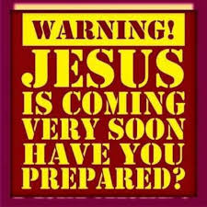
三。基督的忠告。3. Christ’s counsel.
(11)
B。坚固那剩下。哪里有生命，哪里就有希望！
C。要回想你是怎样领受的。有需要依靠神并搜索圣经。
D。要遵守。有需要服从圣经。
E。要悔改。悔改是以顺从的心转向上帝的行为。
F。谨防。若不儆醒，我必临到你那里如同贼一样。我几时临到，你也决不能知道。”（3:3c;16:15）。
B. Strengthen what remains. Where there is life, there is hope!
C. Remember what you have received and heard. There is the need to depend on God and search the Bible.
D. Hold it fast. There is the need to obey the Bible.
E. Repent. Repentance is an act of turning to God
with a submissive heart.
F. Beware. “But if you do not wake up, I will come
like a thief, and you will not know at what time I will
come to you” (3:3c;16:15).

Slide 14
(12)
四。基督的挑战。4. Christ’s challenge.
“凡得胜的，必这样穿白衣。我也必不从生命册上涂抹他的名。且要在我父面前，和我父众使者面前认他的名。圣灵向众教会所说的话，凡有耳的，就应当听 ”(3:5-6)。
A。听圣灵所说的。三种人：
（一）那些有耳朵可听见的（太13:9）。
（二）那些听不进去的（来5:11）。
（三）那些愿意听圣灵所说的（雅1:22）。
“The one who is victorious will, like them, be dressed in white. I will never blot out the name of that person from the book of life, but will acknowledge that name before my Father and his angels. Whoever has ears, let them hear what the Spirit says to the churches”(3:5-6).
A. Hear what the Holy Spirit says. There are three kinds of people:
(1) Those with ears to hear(Mt.13:9).
(2) Those who are dull of hearing(Heb.5:11).
(3) Those who are willing to hear what the Spirit(Ja.1:22).

Slide 15
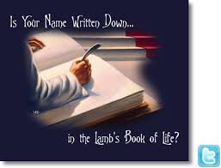
(13)
四。基督的挑战。4. Christ’s challenge.
B。得胜的。
（一）穿白衣（林后5:21）。
（二）信徒的安全感。“我也必不从生命册上涂抹他的名。”
当不信的人死了，他们的名字从书中删除;因此，在最后的判决，这本书只包含信徒的名字（启20:12-15）。它成为“羔羊的生命册”（21:27），因为只有那些被基督救赎了的人有他们的名字。
B. Victorious.
(1) Dressed in white(2Cor.5:21).
(2) Security of the believer. “I will never blot out the name of that person from the book of life.” As unbelievers die, their names are removed from the book; thus, at the final judgment,the book contains
only the names of believers (Rev.20:12-15). It then
becomes “the Lamb’s Book of Life” (21:27), because
only those saved by the Christ have their names in it.

Slide 16


(14)
结论：Conclusion:
这里的警告是，我们不能在教会里过于安逸，以免我们发现自己慢慢死亡。（死于安逸）。让我们受勉励的是没有一个教会是没有希望的，只要这个教会还有余民愿意坚固所余存的东西。（牵牛花）
The warning here is that we not grow comfortable in our churches, lest we find ourselves slowly dying. The encouragement is that no church is beyond hope as long as there is a remnant in it, willing to strengthen the things that remain. (Morning Glory flower)

