Slide 1
恭贺新禧！鸡年！Gōnghè xīnxǐ! Jī nián!

Slide 2
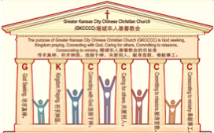
主日:二零一七年一月二十九日
Sunday: January 29, 2017
何礼义牧师 Pastor Gary Hart
题目：“得冠冕的教会 。”
Topic: “Crowned Church.”
经文:启示录2:8-11“你们必受患难十日。你务要至死忠心，我就赐给你那生命的冠冕。”
(启示录2:10b)
Text:Rev.2:8-11 “You will suffer persecution for ten days. Be faithful, even to the point of death, and I will give you life as your victor’s crown”(Rev.2:10b).
(1)

Slide 3
堪城华人基督教会2017年教会祷告:GKCCCC2017 Congregation Prayer:
Please stand, and pray together with me: O God,…
We thank You that You are our Father and by faith we are God’s family.
We thank You that Christ is our Head and by grace we are Christ’s body.
We thank You that the Holy Spirit is our Anointing, by His power we live.
We thank You the Bible is Your Book, by inspiration we have God’s Word.
We ask You to anoint and open our ears to hear God’s Word.
We ask You to anoint and open our eyes to understand God’s Word.
We ask You to anoint and open our hearts to receive God’s Word.
We ask You to anoint and change our minds to follow God’s will.
We ask You to anoint and use our hands to do God’s will.
We ask You to anoint and use our feet to walk in God’s will.
We ask You to anoint and speak Your message through Your servant.
We ask You to anoint and help Your church to be God seeking, Kingdom praying, Connecting with God, Caring for others, Committing to missions, Consecrating to ministry. We pray in Jesus name, Amen.

Slide 4
堪城华人基督教会2017年教会祷告:GKCCCC2017 Congregation Prayer:
请站起来，跟我一起祷告：神啊，…
我们感谢祢，祢是我们的父，我们因着信我们是神家中的人。
我们感谢祢，因基督是我们的头，我们因着恩典我们是基督的身体。
我们感谢祢，圣灵是我们的恩膏，我们因着祂的能力我们活着。
我们感谢祢，圣经是祢的书，是神默示给我们的话。
求祢恩膏并开我们的耳朵，使我们可以听神的话。
求祢恩膏并开我们的眼睛，使我们可以明白神的话。
求祢恩膏并开我们的心，使我们可以接受神的话。
求祢恩膏并改变我们的思想，使我们可以跟从神的旨意。
求祢恩膏并用我们的手，使我们可以照着神的旨意而做。
求祢恩膏并用我们的脚，使我们可以在神的旨意上行走。
求祢恩膏并使用您的仆人，使他能向我们传达祢的信息。
求祢恩膏并帮助您的教会寻求真神，祈求神国，连接于神，
关爱别人，献身宣教，奉献事工。我们奉耶稣的名祷告，阿们。

Slide 5
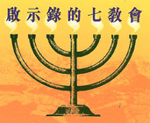
引言：甲。七个教会的信息。
Intro: A. The messages to the seven churches.
(2)
（一）这七个教会是在约翰的时代在亚洲的七个实际教会。
（二）这七个教会代表教会历史的七个时期。
（三）这七个教会表现当今不同种类的教会。
（四）这七个教会表现任何教会都可能有的的特点。
（五）这七个教会表现撒旦攻击教会的七个的方法。
(1)These seven churches were literal churches in Asia of John’s day.
(2)These seven churches represent seven periods of Church History.
(3)These seven churches are types of churches that exist today.
(4)These seven churches show characteristics that can exist in any church.
(5)These seven churches show seven
methods of attack by Satan on the church.

Slide 6
引言：甲。七个教会的信息。
Intro: A. The messages to the seven churches.
(3)

Slide 7
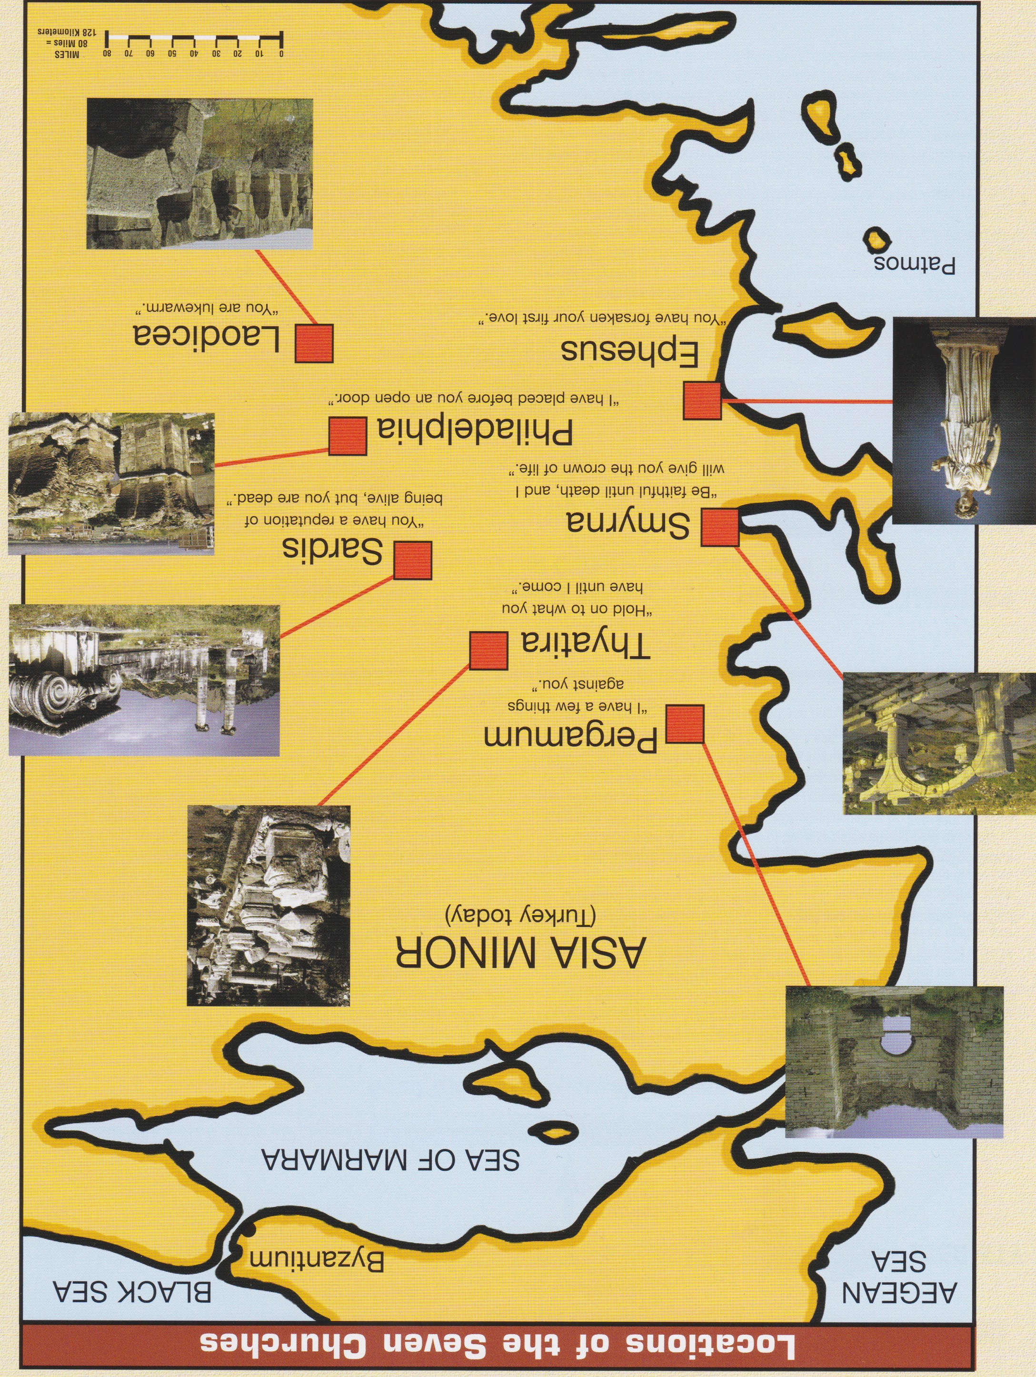
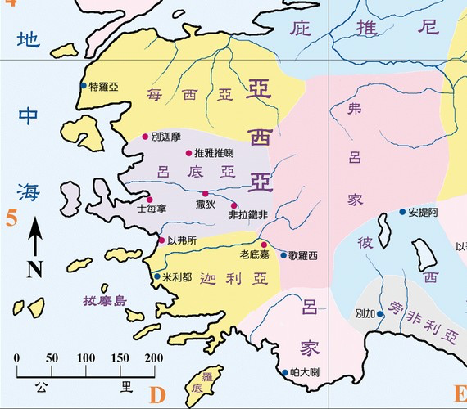
引言：乙。七个教会的地方。
Intro:B. 7 Churches locations.
爱瑟海
拔摩

Slide 8
引言：丙。士每拿历史背景。
Intro: C. Historical background of Smyrna.
(5)
（一）士每拿是个海港城市，现在叫伊兹密尔。它曾是小亚细亚贸易中心，也曾是个非常富有的城市。
（二）士每拿教会大概是以弗所信徒创立的教会。
（三）士每拿教会代表受逼迫的教会（主后100－312）。
（四）士每拿这个字是“没药”的意思。没药是一种将开花的没药树的树皮压榨而得的香料。
（五）受苦的教会发出了基督的馨香之气 。
(1) The city of Smyrna is a seaport city now called Izmir. It was a trade center of Asia Minor and a city of great wealth.
(2) Smyrna church was probably founded by believers from Ephesus.
(3) Smyrna church represents the Persecuted church(AD 100-312).
(4) The name Smyrna means “myrrh,” a fragrant spice or perfume obtained when the bark of a flowering myrrh tree is crushed.
(5) The afflicted church gave off the fragrance of Christ.

Slide 9
一。基督的称许。
1. Christ’s commendation.
(6)
“你要写信给士每拿教会的使者说，那首先的，末后的，死过又活的说”（启示录2:8）。 这个强调基督永远的本质（“那首先的，末后的”），祂的死（“死过”）和祂的复活（“又活了的”）。我们不敬拜死人，或者为死人献上自己的生命，但是基督复活了。
“To the angel of the church in Smyrna write:These are the words of him who is the First and the Last, who died and came to life again”
(Rev.2:8).This emphasizes Christ’s eternal nature(“the First and the Last”), His dead(“who died”) and His resurrection(“came to life again”).We do not worship or give our life for a dead man but Christ who is alive.

Slide 10
一。基督的称许。
1. Christ’s commendation.
(7)
A。受逼迫的教会。“我知道你的患难”（2:9a）。他们受很多患难。有的被钉十字架（彼得）；其它的被砍头（保罗）；有的被烧死在柱子上 ;有的被着动物的毛皮，被野狗折磨死。有的被浇上焦油，点上火，作火炬。有的在油中被煮沸 。有一个教会历史学家估计在这期间，有500万基督徒为了基督的见证而殉道 。
A. Persecuted Church. “I know your afflictions…”(2:9a). They had many persecutions. Some were crucified(Peter);others were behead-ed (Paul); some burned at the stake;others were covered with animal skins and tortured to death by wild dogs; some were covered with tar and set on fire to serve as torches;some were boiled in oil. One church historian has estimated that during this period,5 million Christians were martyred for the testimony of Christ.

Slide 11
一。基督的称许。1. Christ’s commendation.
(8)
B。一个贫穷的教会。“我知道…你的贫穷（你却是富足的）”(2:9b).“贫穷”是非常贫困，绝对没有任何财产。
（一）士每拿教会的信徒是贫穷的。
（二）士每拿教会的信徒却是富足的。他们在金钱不能买到的东西上富足：喜乐，平安，幸福，满足和永生。他们“…似乎贫穷，却是叫许多人富足的；似乎一无所有，却是样样都有的”（林后6:10；8:9）。
B. Poor Church. “I know…your poverty—yet you are rich!”(2:9b). “Poverty” means extreme poverty, possessing absolutely nothing.
(1) The believers in Smyrna were poor.
(2) The believers in Smyrna were rich. They were rich in this life in the things that money cannot buy:joy,peace,happiness,contentment and eternal life. They were “…poor, yet making many rich;having nothing,and yet possessing everything”(2Co.6:10;8:9).

Slide 12
一。基督的称许。1. Christ’s commendation.
(9)
C。“被推动”的教会。“我知道那自称是犹太人所说的毁谤话”（2:9c）。真正的犹太人不是身体或种族上的，而是属灵的(罗2:29；7:17-29）。仅仅律法上遵守圣经的教训是不够的。神希望我们向祂献上我们的心，而不是仅仅守着一套规则。律法主义者，混合法律和恩典的犹太化人在当时的教会推波助澜。你不要被她们推动了。
C. “Pushed” Church. “I know about the slander of those who say they are Jews and are not”(2:9c). A true Jew is not one physically or racially but spiritually(Ro.2:29;7:17-29). It is never sufficient to obey the teachings of the Word legalistically. It is submission of the heart to God, not keeping a set of rules, is His desire for us. You can be pushed by legalism or Judaizers who mixed law and grace.

Slide 13
一。基督的称许。
1. Christ’s commendation.
(10)
D。“被拉动”的教会。“我知道撒旦一会的人”（2:9d）。撒旦有他的教会，叫“撒旦一会”。有撒旦教会和现代撒旦教会。他们传讲别的“福音”，否认基督的神性。
D. “Pulled” Church. “I know about the slander of those who are a synagogue of Satan”(2:9d). Satan has his own churches, called “synagogues of Satan.”There is the Satanic Church and Modern Church of Satan.They preach another gospel which denies the deity of Christ.

Slide 14
(11)
二。基督的责备。2. Christ’s condemnation.
受迫害的教会，连一个责备的话都没有。
A。不是“无爱心”，而是充满基督的爱。你不会为一个你不爱的人舍命。“原来基督的爱激励我们。因我们想，一人既替众人死，众人就都死了”（林后5:14）。
B。不是生命的“完美”，而是生命的“纯洁”。“凡向他有这指望的，就洁净自己，像他洁净一样”(约一3:3)。
Not one word of condemnation is found for the persecuted Church.
A. Not “loveless” but full of love for Christ. You do not give of your life for someone you do not love.“For Christ’s love compels us,because we are convinced that one died for all,and therefore all died”(2Cor.5:14).
B. Not “perfect” but purity of life. “All who have this hope in him purify themselves, just as he is pure”(IJn.3:3).

Slide 15
三。基督的忠告。
3. Christ’s counsel.
(12)
“你将要受的苦你不用怕。魔鬼要你们中间几个人下在监里，叫你们被试炼。你们必受患难十日。你务要至死忠心，我就赐给你那生命的冠冕。”（2:10）。
A。不用怕。基督预言这个教会要受苦。“十日”代表“一段时间”（创24:55；使徒行传25:6）。
B。要忠心。基督应许生命的冠冕（雅各书1:12）。
“Do not be afraid of what you are about to suffer. I tell you, the devil will put some of you in prison to test you, and you will suffer persecution for ten days. Be faithful, even to the point of death, and I will give you life as your victor’s crown”(2:10).
A. Do not be afraid. Christ predicted the suffering that would come to this church. “Ten days” signifies “a brief time”(Gen.24:55;Ac.25:6).
B. Be faithful. Christ promises the crown of life (Ja.1:12).

Slide 16
四。基督的挑战。
4. Christ’s challenge.
(13)
“圣灵向众教会所说的话，凡有耳的，就应当听。得胜的，必不受第二次死的害”（2:7）。
A。听圣灵所说的。三种人：
（一）那些有耳朵可听见的（太13:9）。
（二）那些听不进去的（来5:11）。
（三）那些愿意听圣灵所说的（雅1:22）。
“Whoever has ears, let them hear what the Spirit says to the churches. The one who is victorious will not be hurt at all by the second death”(2:11).
A. Hear what the Holy Spirit says to the churches. 3 kinds of people:
(1) Those are with ears to hear(Mt.13:9).
(2) Those are dull of hearing(Heb.5:11).
(3) Those are willing to hear what the Holy Spirit says (Ja.1:22).

Slide 17
四。基督的挑战。
4. Christ’s challenge.
(14)
B。得胜的，必不在火湖里受第二次死的苦（启示录20:14；21:8）。
（一）第一次死的就是肉体的死，灵魂和身体分离。
（二）第二次死的就是属灵的死，永远的死。不悔改的罪人在火湖里和神永远分离。
B. Overcomers will not be hurt by the judgment of the second death which is the lake of fire(Rev.20:14-15;21:8).
(1) The first death is physical death, the separation of the soul and the body.
(2) The second death is spiritual or eternal death, the separation of the unrepentant sinner forever from God in the lake of fire.

Slide 18
结论：
Conclusion:
(15)
要做一个奉献的基督徒，在一些地方比别的地方要付更多的代价。每个月有322个基督徒为了他们的信仰被杀害，每个月有214个教会和基督徒的产业被毁坏，每个月有772种对基督徒的暴力被施行 。
It costs to be a dedicated Christian, in some places more than others.
( www.opendoorsusa.org).

Slide 19
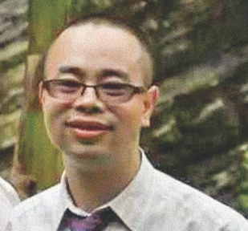
(16)
结论：Conclusion:
在中国，活石教会的仰华牧师因为“泄露国家机密”被法官于1月5日判处两年零六个月的监禁。仰牧师，本名李国石，自2015年12月9日起就被关押起来。教会从2009年的最初20名成员增长到今天的700多人。
In China,Pastor YangHua was sentenced for“divulging state secrets,” a judge sentenced the pastor of Living Stone Church on Jan. 5 to two years and six months in prison. Pastor Yang, also known by his legal name, Li Guoshi, has been held since Dec. 9, 2015. The church has grown from its original 20 members in 2009
to more than 700 today The Voice of the Martyrs(www.persecution.com).

