Slide 1
GKCCCC Fall, 2017 Special Meetings
Speaker: Pastor JianAn Li
Topic: “After God’s Heart” Church
Friday, September 8, from 7:30-9:30 pm
After God’s Heart Church-1 (Jn.2:1-25)
Sunday, September 10 from 10:30am-12 pm
After God’s Heart Church-2 (Jn.2:1-25)
Sunday, September 10 from 1:15-3:15 pm
After God’s Heart Church-3 (Jn.2:1-25)
Q&A Session
Address: 5316 Quivira Rd. Shawnee, KS 66216
Tel:(913)268-3111 Website: www.gkcccc.org

Slide 2
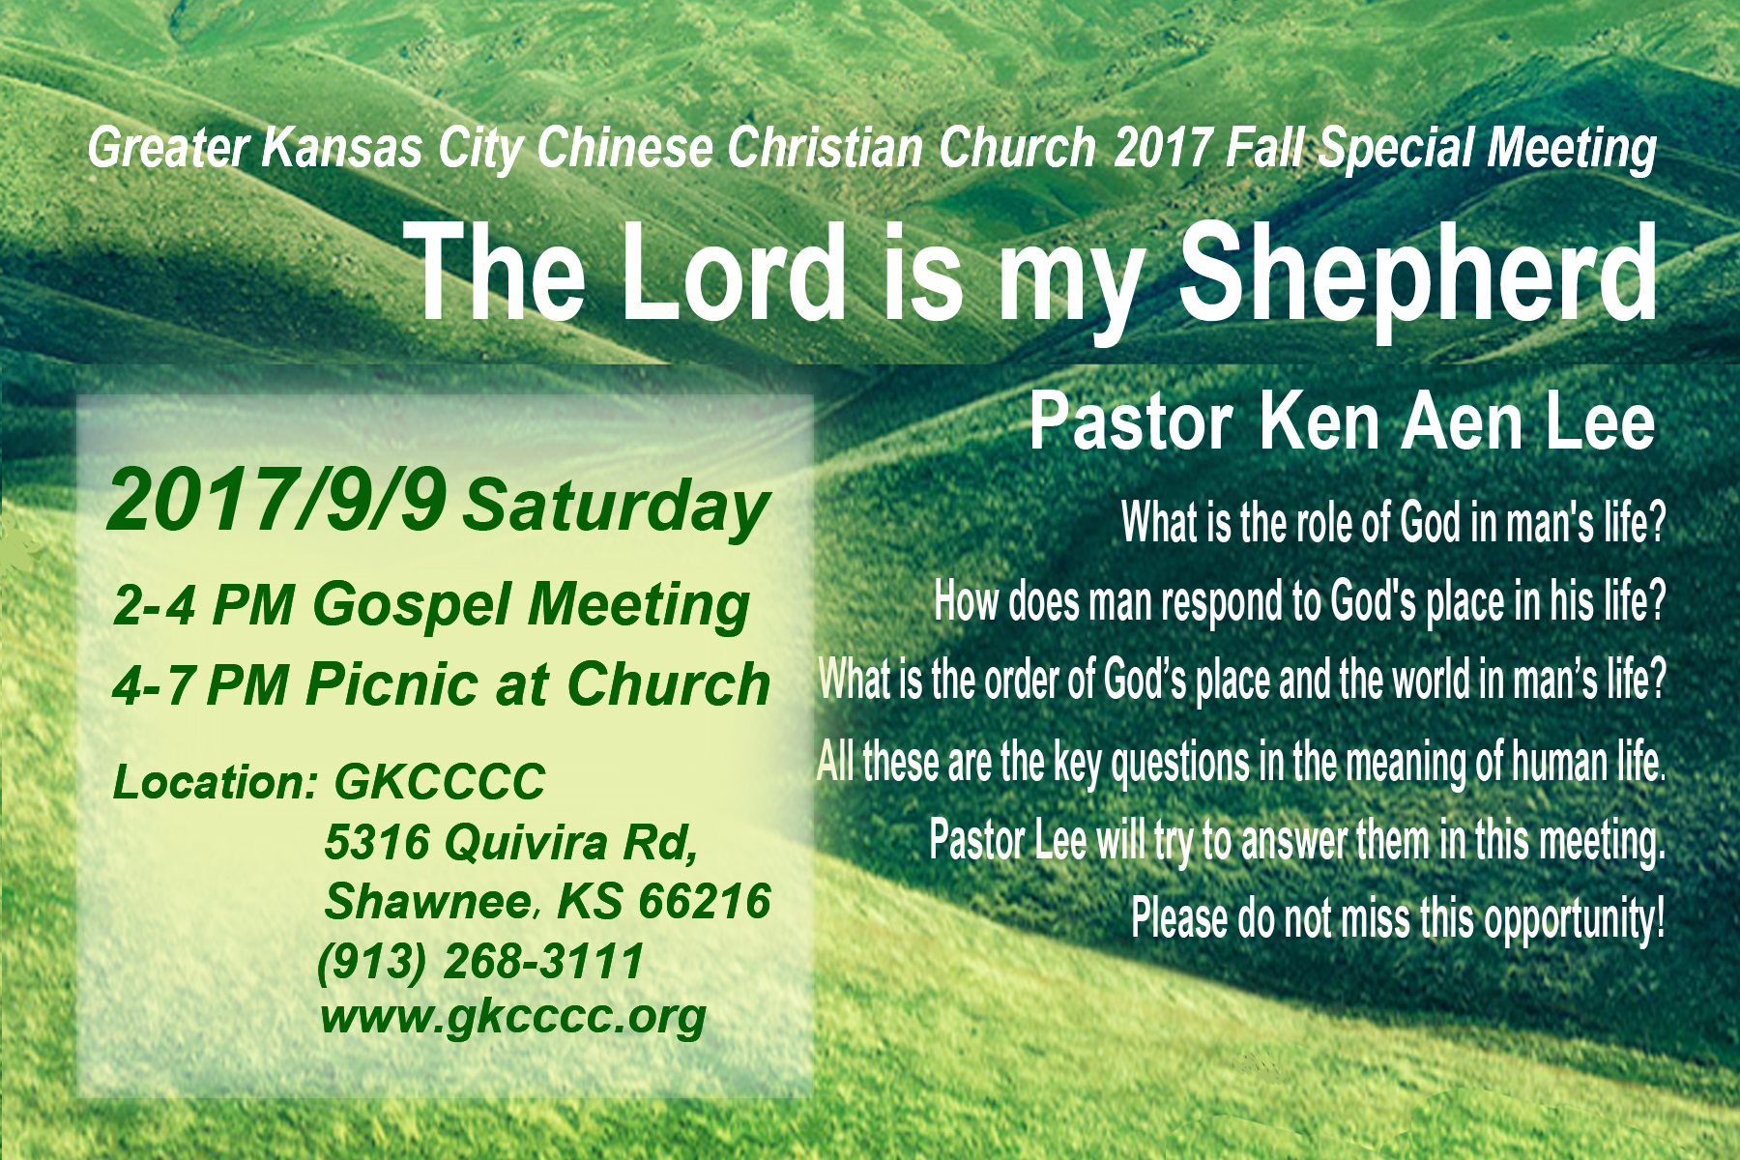

Slide 3


Slide 4


Slide 5
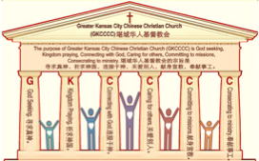

主日:二零一七年八月二十七日
Sunday: August 27, 2017
何礼义牧师 Pastor Gary Hart
题目：“布道的教会。”
Topic: “Preaching Church.”
经文:徒17:1-9 Text: Acts 17:1-9
“他们中间有些人听了劝…”(徒17:4)。
“Some of the Jews were persuaded…”(17:4).
(1)

Slide 6
引言:A。使徒行传的信息。 Intro: A.Message of Acts of the Apostles.
(2)
(一)基督建造祂的教会（基督的灵借着使徒在作工）。
(二)使徒行传是圣灵的指挥,控制和赋权的事工,创立和加强了教会，并使它成长。
(三)使徒行传是一个过渡时期:从耶稣的事工到使徒的;从旧约到新约;从以色列作神的见证到教会作神的见证;从犹太教出来, 教会诞生了。
(四)使徒行传显示大使命得以遵行(1:8)从证人到耶路撒冷(1-8),到犹太和撒玛利亚(8-12)并到地极(13-28)。
(五)保罗继续了他的第二次传教旅程。
(1)Christ builds His Church(the Acts of the Spirit of Christ through the Apostles). (2)The Acts were the Spirit’s directing, controlling, and empowering ministry that founded and strengthened the church and caused it to grow.
(3)The Acts is a time of transitions: from ministry of Jesus to that of the apostles; from the Old Covenant to the New Covenant; from Israel as God’s witness to the Church as God’s witness; from Judaism is going out and Church is coming in.
(4)The Acts show the fulfillment of the Great Commission(1:8) from the witness to Jerusalem(1-8), to Judea and Samaria(8-12), and to the ends of earth(13-28).
(5) Paul continues his second missionary journey.

Slide 7
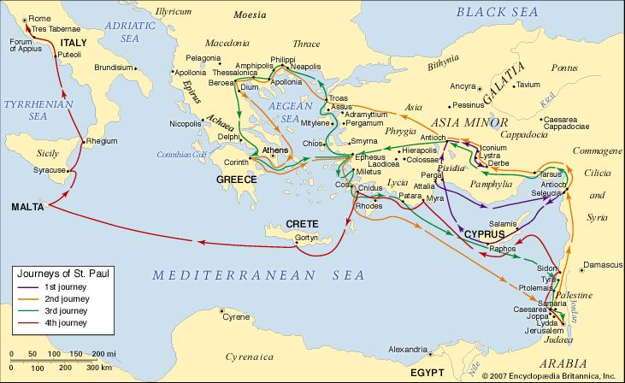
B。帖撒罗尼迦地理位置。B. Thessalonica location.
(3)

Slide 8
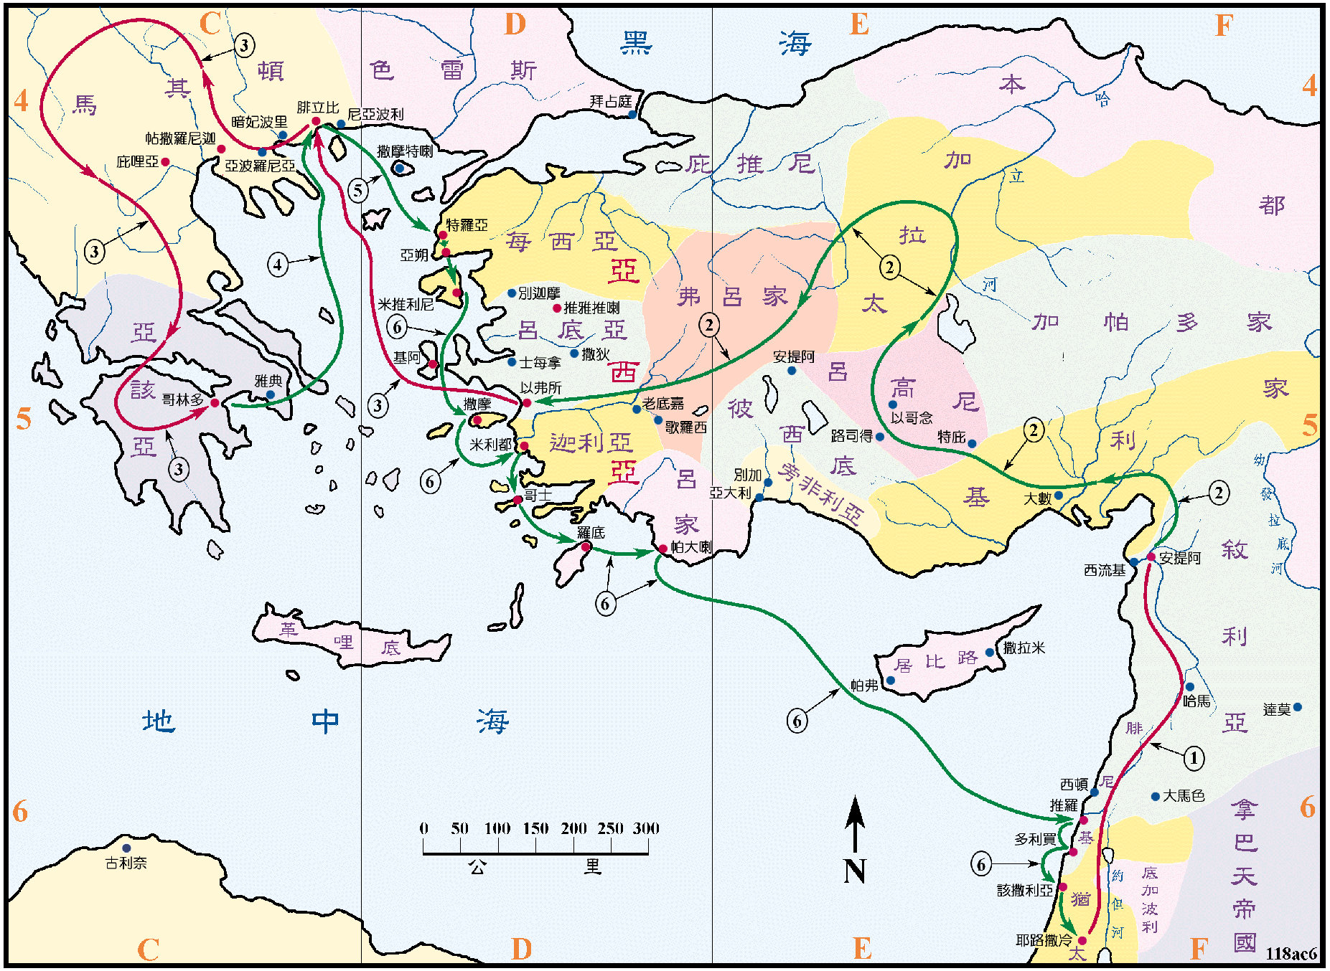
B。帖撒罗尼迦地理位置。B. Thessalonica location.
(4)

Slide 9
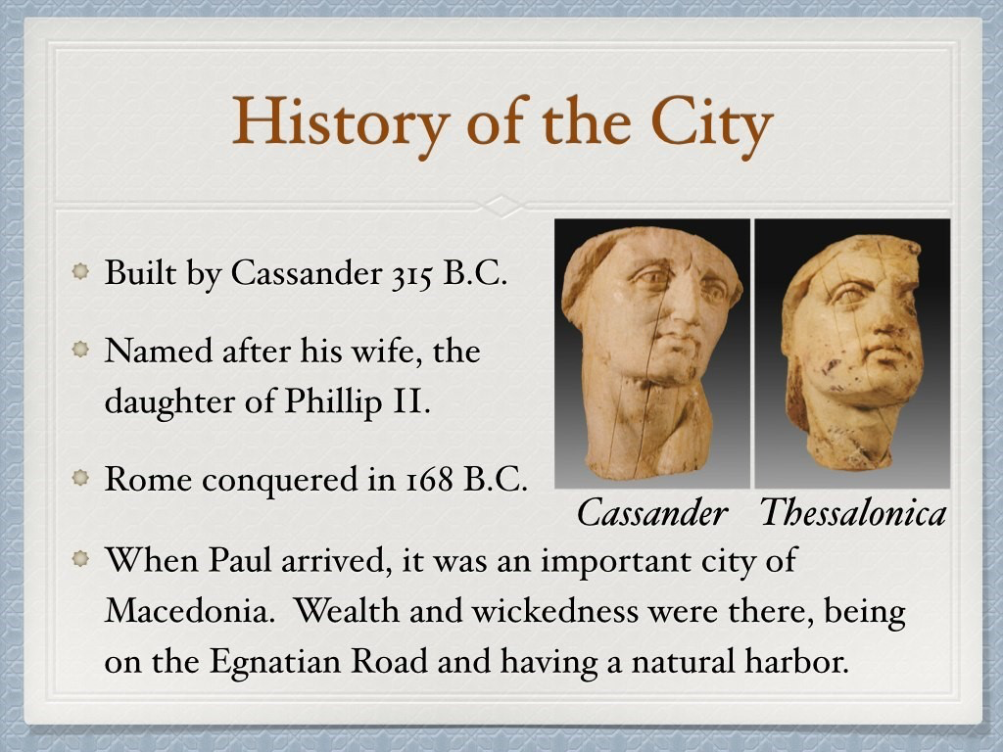
C。帖撒罗尼迦的历史背景C.Thessalonica historical background.
(5)
(1)帖撒罗尼迦是马其顿的首都和商业中心(17:1)。
(2)帖撒罗尼迦教会是由保罗创立的(17:2-4; 帖前1:1;帖后1:1)。
(3)帖撒罗尼迦教会代表“布道的教会”。
(4)帖撒罗尼迦来自卡桑德的妻子的名字。丈夫是亚历山大大帝的将军，建造了这座城市。 妻子是腓利普二世的女儿。 这意味着对撒哈拉人的胜利。
(1) Thessalonica was the capital city of Macedonia and a center for business (17:1).
(2) Thessalonica church was founded
by Paul(17:2-4; 1Thes.1:1;2Thes.1:1).
(3) Thessalonica church represents
“Preaching Church”.
(4)Thessalonica comes from name of
Cassander’s wife.He was a general of
Alexander the Great and built the city.
She was the daughter of Philip II. It
means victory against Thessalians.

Slide 10
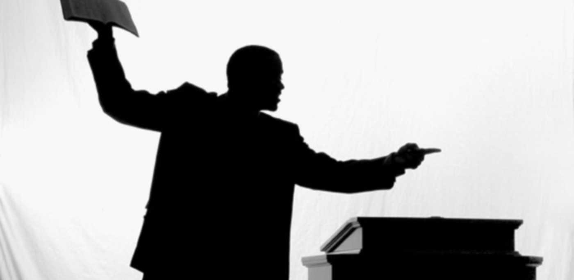
(6)
一。用布道说服。1. Persuaded by preaching.
“保罗和西拉，经过暗妃波里，亚波罗尼亚，来到帖撒罗尼迦，在那里有犹太人的会堂。保罗照他素常的规矩进去，一连三个安息日…”(徒17:1-2a)。
A。布道的内容。你讲什么？ 什么永远持久？ 神，祂的名，祂的爱，和祂的公义永远长存。“草必枯干，花必凋残，惟有我们神的话，必永远立定”(赛40:8)。“惟有主的道是永存的。所传给你们的福音就是这道”(彼前1:25)。
“When Paul and his companions had passed through Amphipolis and Apollonia, they came to Thessalonica, where there was a Jewish synagogue.As was his custom,Paul went into the synagogue,and on three Sabbath days…”(Ac17:1-2a).
A. The content of preaching. What do you preach? What endures forever? God, His name, His love, and His righteousness endures forever. “The grass withers and the flowers fall, but the word of our
God endures forever”(Isa.40:8).“The word of the
Lord endures forever. And this is the word that
was preached to you”(1Pe.1:25).

Slide 11
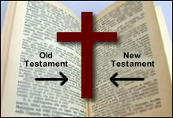
一。用布道说服。1. Persuaded by preaching.
(7)
(一)。在旧约。这是一个审判的信息(结20:46; 21:2;摩7:16;拿3:4)和盼望的信息(赛40:1-2,9; 52:7-10;摩9:11-15)。
(二) 在新约。这是一个消息，就是救恩的好消息(林前1:21)，基督十字架(林前2:1-2)，基督的复活(徒2:14-36;4:12-26;13:16-41;林前15:3-5)，审判来临(徒10: 42; 17:31)，并呼吁悔改和相信(可1:15;徒2:38;10:43;26:20)。 “基督是来喂养我们的灵魂，为自己辩解，放下自己，救他，如果他相信布道”（路德）。
(1) In the Old Testament. It was a message of judgment(Ez.20:46;21:2;Am.7:16;Jonah3:4)and a message of hope(Isa.40:1-2,9;52:7-10;Am.9:11-15).
(2) In the New Testament. It was a message of good news of salvation(1Co.1:21), the cross of Christ(1Co.2:1-2), the resurrection of Christ(Ac.2:14-36;4:12- 26;13:16-41;1Co.15:3-5),judgment to come(Ac.10:42;17:31), and a call to repent and believe (Mk.1:15; Ac. 2:38;10:43;26:20). “To preach
Christ is to feed the soul, to justify it, to set it free,and to
save it, if it believes the preaching”(M.Luther).

Slide 12

一。用布道说服。1. Persuaded by preaching.
(8)
B。布道的方法。 你怎么传讲神的话语？ 这是关于讲道的四个关键词。
(一)辩论。“本着圣经与他们辩论”(17:2b)。这意味着与圣经的问题和答案进行辩论。
(二) 讲解。“讲解”(17:3a)。意思是打开。“于是耶稣开他们的心窍，使他们能明白圣经”(路24:45)。
B. The method of preaching. How do you preach the Word of God? Here are four key words about preaching.
(1) Reasoned. “He reasoned with them from the Scriptures”(17:2b). It means to discuss with questions and answers from the Bible.
(2) Explaining. “Explaining”(17:3a). It means to open. “He opened their minds so they could understand the Scriptures” (Lk.24:45).

Slide 13

(9)
一。用布道说服。1. Persuaded by preaching.
(三)陈明。 “陈明”(诗17:3b)。这意味着通过提供证据来指称和证明(路24:27,44)。
(四)传道。“基督必须受害，从死里复活。又说，我所传与你们的这位耶稣，就是基督”(17:3c)。这意味着宣布和传讲耶稣是谁：救主(太1:21)，以马内利(太1:23)，弥赛亚/基督(太16:16)，神的儿子(约20:31)，羊羔 (约11:29,36），主(罗10:9)和王(约12:13)。
(3) Proving. “Proving that the Messiah had to suffer and rise from the dead”
(17:3b). It means alleging and proving by presenting evidence(Lk.24:27,44).
(4) Proclaiming. “This Jesus I am proclaiming to you is the Messiah,” he said”(Ac.17:3c). It means announcing and preaching who Jesus is: Savior (Mt.1:21), Immanuel(Mt.1:23), Messiah/Christ(Mt.16:16), Son of God(Jn.20:31), Lamb of God(Jn.1:29,36), Lord (Ro.10:9)and King(Jn.12:13).

Slide 14
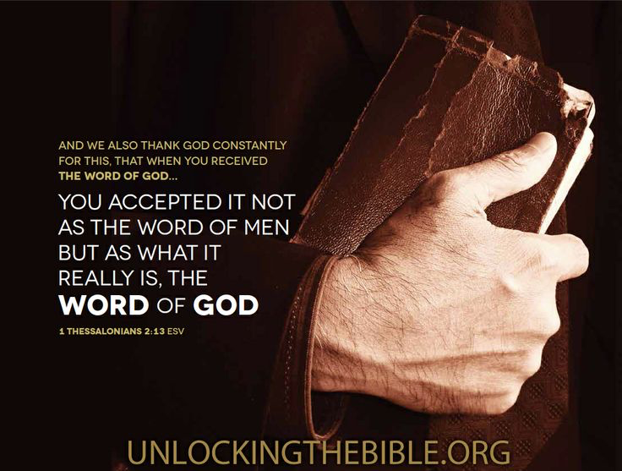
(10)
一。用布道说服。1. Persuaded by preaching.
C。布道的结果。 人们如何回应布道？
(一) 领受神的道。“为此，我们也不住地感谢神，因你们听见我们所传神的道，就领受了，不以为是人的道，乃以为是神的道。这道实在是神的，并且运行在你们信主的人心中”(帖前2:13)。
(二) 用道说服。“他们中间有些人听了劝，就附从保罗和西拉。并有许多虔敬的希利尼人，尊贵的妇女也不少”(徒17:4)。
C. The results of preaching. How do people respond to preaching?
(1) Received the Word of God. “And we also thank God continually because, when you received the word of God, which you heard from us, you accepted it not as a human word, but as it actually is, the word of God, which is indeed at work in you who believe”(1Thes.2:13).
(2) Persuaded by the Word. “Some of the
Jews were persuaded and joined Paul and
Silas, as did a large number of God-fearing
Greeks and quite a few prominent women”
(Ac.17:4).

Slide 15
(11)
一。用布道说服。1. Persuaded by preaching.
(三)被道改变。 “因为我们的福音传到你们那里，不独在乎言语，也在乎权能和圣灵，并充足的信心，正如你们知道我们在你们那里，为你们的缘故是怎样为人。并且你们在大难之中，蒙了圣灵所赐的喜乐，领受真道，就效法我们，也效法了主。甚至你们作了马其顿和亚该亚，所有信主之人的榜样。因为主的道从你们那里已经传扬出来，你们向神的信心不但在马其顿和亚该亚，就是在各处，也都传开了”(帖前1:5-8a)。
(3) Changed by the Word. “Because our gospel came to you not simply with words but also with power,with the Holy Spirit and deep conviction.You know how we lived among you for your sake. You became imitators of us and of the Lord, for you welcomed the message in the midst of severe suffering with the joy given by the Holy Spirit.And so you became a model to all the believers in Macedonia and Achaia. The Lord’s message rang out from you not only in Macedonia and Achaia—your faith in God has become known everywhere”
(1Thes.1:5-8a).

Slide 16
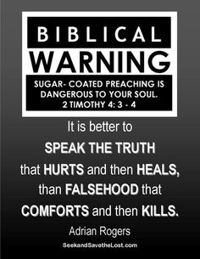
(12)
一。用布道说服。1. Persuaded by preaching.
(四)被道鼓励和建立。“所以你们当用这些话彼此劝慰…所以你们该彼此劝慰，互相建立，正如你们素常所行的”(帖前4:18;5:11)。 “务要传道。无论得时不得时，总要专心，并用百般的忍耐，各样的教训，责备人，警戒人，劝勉人”(提前4:2)。
圣经的警告：涂糖的布道对你的灵魂是危险的(提后4:3-4)。“说出伤害然后愈合的真理，而不是虚伪，然后杀死”--Adrian Rogers。
(4) Encouraged and built up by the Word. “Therefore encourage one another with these words… Therefore encourage one another and build each other up, just as in fact you are doing”(1Thes.4:18;5:11). “Preach the word; be prepared in season and out of season; correct, rebuke and encourage—with great patience and careful instruction”(2Tim.4:2).

Slide 17
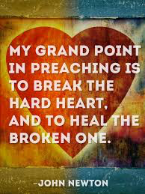
(13)
二。抵挡布道。2. Resistant to preaching.
为什么有些抵挡布道？“他们心地昏昧，与神所赐的生命隔绝了，都因自己无知，心里刚硬”(弗4:18)。
A。硬心。“但那不信的犹太人心里嫉妒”(徒17:5a)。 “使心硬如金钢石，不听律法，和万军之耶和华用灵借从前的先知所说的话。故此，万军之耶和华大发烈怒”(亚7:12)。“我讲道的重点是打破硬心，治愈破碎的心”（约翰·牛顿）。
Why are some resistant to preaching? “They are darkened in their understanding and separated from the life of God because of the ignorance that is in them due to the hardening of their hearts”(Eph.4:18).
A. Hard hearts. “But other Jews were jealous”(Ac.17:5a).
“They made their hearts as hard as flint and would not
listen to the law or to the words that the Lord Almighty had
sent by his Spirit through the earlier prophets. So the Lord
Almighty was very angry”(Zech.7:12). “My grand point in
preaching is to break the hard heart,and to heal the broken
one”(John Newton).

Slide 18
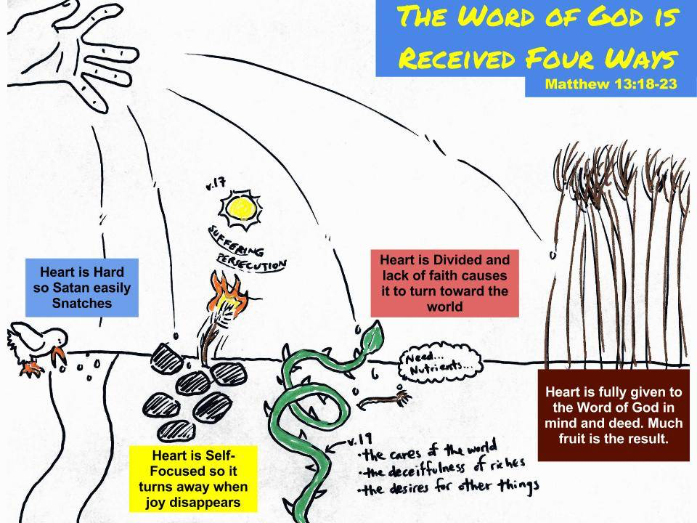
神的道受到四种反应（太13:18-23）。
心是自我中心的所以当快乐消失时它就会消失。
心是全心全意的相信神的道。 结果很多果子。
心是半心半意的，缺乏信心就会转向世界。
心很硬，所以撒旦很容易抢。
(14)

Slide 19
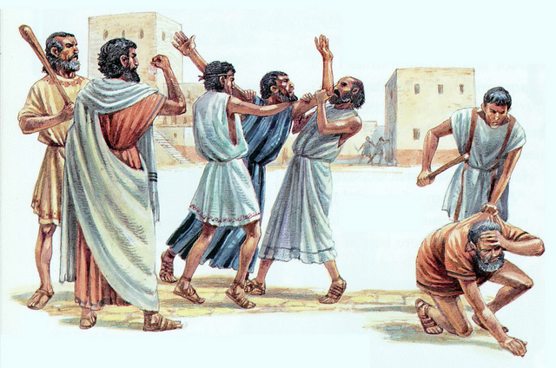
(15)
二。抵挡布道。2. Resistant to preaching.
B。邪恶的行为。“招聚了些市井匪类，搭伙成群，耸动合城的人，闯进耶孙的家，要将保罗西拉带到百姓那里。找不着他们，就把耶孙和几个弟兄，拉到地方官那里”(17:5b-6a)。
B. Evil actions. “So they rounded up some bad characters from the market-place, formed a mob and started a riot in the city. They rushed to Jason’s house in search of Paul and Silas in order to bring them out to the crowd. But when they did not find them, they dragged Jason and some other believers before the city officials…”(17:5b-6a).

Slide 20
(16)
二。抵抗讲道。2. Resistant to preaching.
C。虚假的指责。“喊叫说，那搅乱天下的，也到这里来了。耶孙收留他们。这些人都违背该撒的命令，说另有一个王耶稣。众人和地方官，听见这话，就惊慌了。于是取了耶孙和其余之人的保状，就释放了他们”(17:6b-9)。
D。拒绝教导。“所以那弃绝的，不是弃绝人，乃是弃绝那赐圣灵给你们的神”(帖前4:8)。
C. False accusations. “Shouting: “These men who have caused trouble all over the world have now come here, and Jason has welcomed them into his house They are all defying Caesar’s decrees, saying that there is another king, one called Jesus.” When they heard this, the crowd and the city officials were thrown into turmoil. Then they made Jason and the others post bond and let them go”
(17:6b-9).
D. Reject instructions. “Therefore, anyone who rejects this instruction does not reject a human being but God, the very God who gives you his Holy Spirit”
(1Thes.4:8).

Slide 21
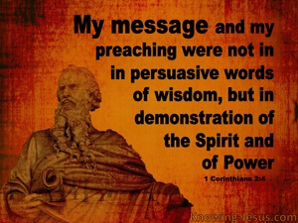
(17)
结论：Conclusion:
为什么布道？施洗约翰来传道(太3:1;可1:4;路3:3)。耶稣也来传道(可1:39;路4:44)。使徒传道(徒8:25,40)。 保罗传道(16:6; 17:13,18; 18:5; 罗1:9)。“我说的话，讲的道，不是用智慧委婉的言语，乃是用圣灵和大能的明证。叫你们的信不在乎人的智慧，只在乎神的大能”(林前2:4-5)。“你要以宣读，劝勉，教导为念，直等到我来”
(提前4:13)。
Why preaching? John the Baptist came preaching(Mt.3:1;Mk.1:4;Lk.3:3).Jesus also came preaching(Mk.1:39;Lk.4:44).The Apostles preached(Ac.8:25,40). Paul preached(16:6;17:13,18;18:5;Ro.1:9). “My message and my preaching were not with wise and persuasive words,but with a demonstration of the Spirit’s power, so that your faith might not rest on human wisdom,
but on God’s power”(1Co.2:4-5). “Devote
yourself to the public reading of Scripture,
to preaching and to teaching” (1Ti.4:13).

Slide 22
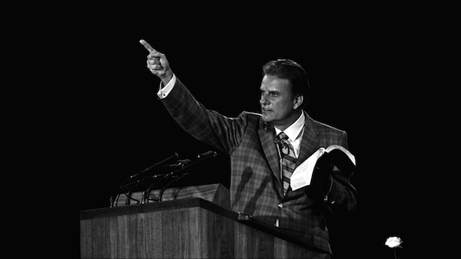
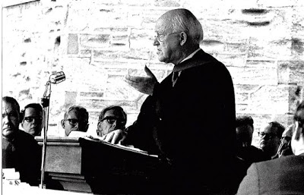
(18)
结论：Conclusion:
“当我们传讲或教导圣经时，我们为圣灵开门，做他的工作。 神没有答应赐雄辩的布道或是聪明的布道。 他答应祝福他的话”(比利·格雷厄姆)。 “布道的工作是任何人都可以称之为最高，最伟大，最光荣的呼召”(马丁·劳埃德·琼斯)。
“When we preach or teach the Scriptures, we open the door for the Holy Spirit to do His work. God has not promised to bless oratory or clever preaching. He has promised to bless His Word”(Billy Graham). “The work of preaching is the highest and greatest and most glorious calling to which anyone can ever be called”
(Martyn Lloyd Jones).

Slide 23
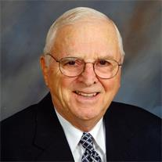
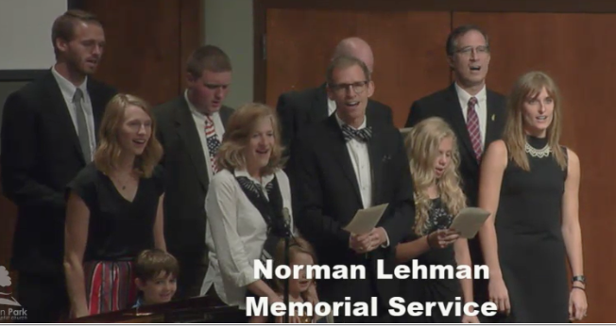
Norman Leon Lehman was born September 9, 1928 in Berne, IN and passed away August 21, 2017. He and his wife, Nadine served as church-planting missionaries in Taiwan (1960 to 1995).
His family sang “Jesus Loves Me” in English+Taiwanese. Mark Lehman preached “Three Musts” (Lk.24).

