Slide 1
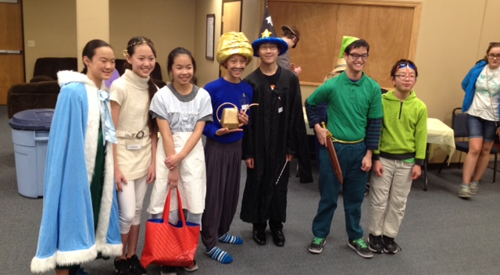
奥秘排队Mystery Party(CYIA)

Slide 2
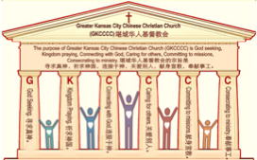

主日:二零一七年二月十九日
Sunday: February 19, 2017
何礼义牧师 Pastor Gary Hart
题目：“腐败的教会 。”
Topic: “Corrupt Church.”
经文:启示录2:18-29
“然而，有一件事我要责备你，就是你容让那自称是先知的妇人耶洗别”(启示录2:20a).
Text:Rev.2:18-29
“I have this against you: You tolerate that woman Jezebel”(Rev.2:20a).
(1)

Slide 3
堪城华人基督教会2017年教会祷告:GKCCCC2017 Congregation Prayer:
Please stand, and pray together with me: O God,…
We thank You that You are our Father and by faith we are God’s family.
We thank You that Christ is our Head and by grace we are Christ’s body.
We thank You that the Holy Spirit is our Anointing, by His power we live.
We thank You the Bible is Your Book, by inspiration we have God’s Word.
We ask You to anoint and open our ears to hear God’s Word.
We ask You to anoint and open our eyes to understand God’s Word.
We ask You to anoint and open our hearts to receive God’s Word.
We ask You to anoint and change our minds to follow God’s will.
We ask You to anoint and use our hands to do God’s will.
We ask You to anoint and use our feet to walk in God’s will.
We ask You to anoint and speak Your message through Your servant.
We ask You to anoint and help Your church to be God seeking, Kingdom praying, Connecting with God, Caring for others, Committing to missions, Consecrating to ministry. We pray in Jesus name, Amen.

Slide 4
堪城华人基督教会2017年教会祷告:GKCCCC2017 Congregation Prayer:
请站起来，跟我一起祷告：神啊，…
我们感谢祢，祢是我们的父，我们因着信我们是神家中的人。
我们感谢祢，因基督是我们的头，我们因着恩典我们是基督的身体。
我们感谢祢，圣灵是我们的恩膏，我们因着祂的能力我们活着。
我们感谢祢，圣经是祢的书，是神默示给我们的话。
求祢恩膏并开我们的耳朵，使我们可以听神的话。
求祢恩膏并开我们的眼睛，使我们可以明白神的话。
求祢恩膏并开我们的心，使我们可以接受神的话。
求祢恩膏并改变我们的思想，使我们可以跟从神的旨意。
求祢恩膏并用我们的手，使我们可以照着神的旨意而做。
求祢恩膏并用我们的脚，使我们可以在神的旨意上行走。
求祢恩膏并使用您的仆人，使他能向我们传达祢的信息。
求祢恩膏并帮助您的教会寻求真神，祈求神国，连接于神，
关爱别人，献身宣教，奉献事工。我们奉耶稣的名祷告，阿们。

Slide 5

引言：A。七个教会的信息。
Intro: A. The messages to the seven churches.
(2)
（一）这七个教会是在约翰的时代在亚洲的七个实际教会。
（二）这七个教会代表教会历史的七个时期。
（三）这七个教会代表当今不同种类的教会。
（四）这七个教会代表任何教会都可能有的的特点。
（五）这七个教会代表撒旦攻击教会的七个方法。
(1)These seven churches were literal churches in Asia of John’s day.
(2)These seven churches represent seven periods of Church History.
(3)These seven churches are types of churches that exist today.
(4)These seven churches show characteristics that can exist in any church.
(5)These seven churches show seven
methods of attack by Satan on the church.

Slide 6
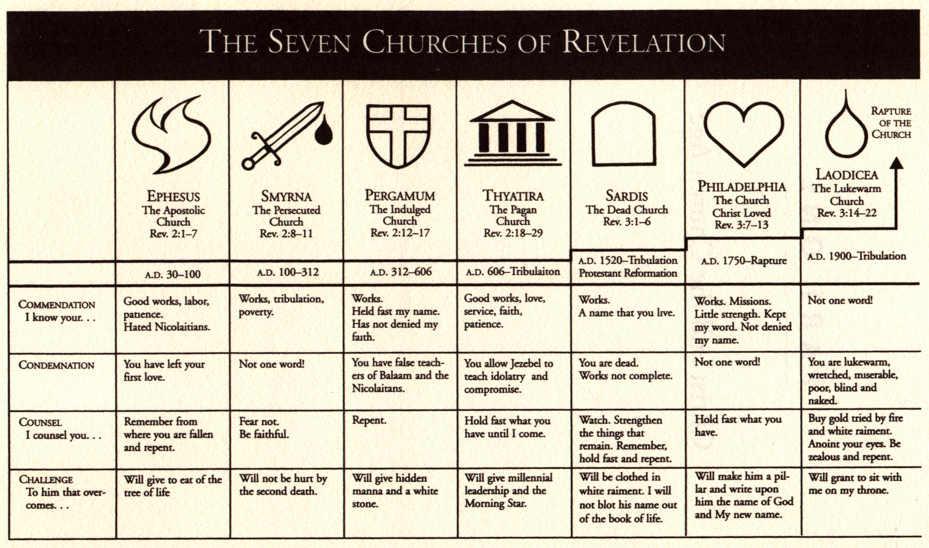
A。给七个教会的信息。
A. The messages to the seven churches.
(3)

Slide 7
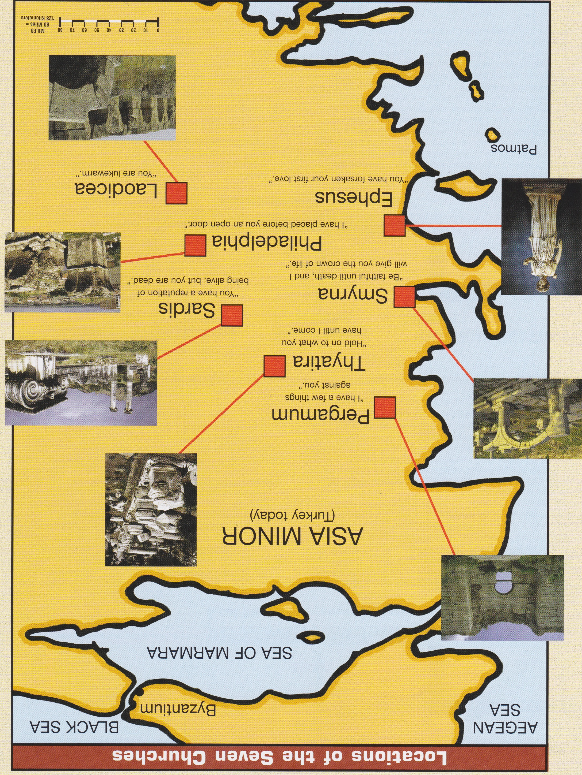
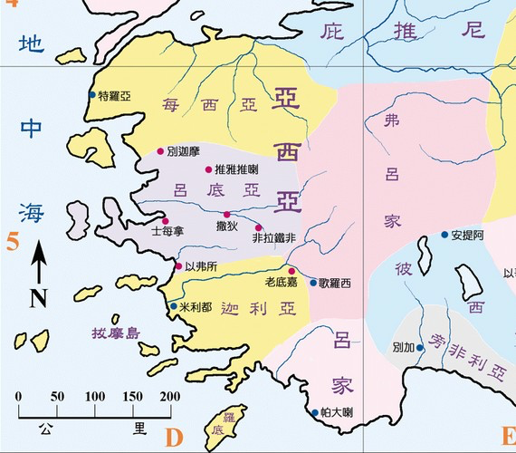
B。七个教会的地理位置。
B. 7 Churches locations.
爱瑟海
拔摩

Slide 8
C。推呀推啦的历史背景。
C. Historical background of Thyatira:
(5)
（一）推雅推喇城是军事并贸易中心。他们敬拜阿波罗（太阳神）。
（二）推雅推喇教会大概是吕底亚创立的（徒16:14）。
（三）推雅推喇教会代表异教徒的教会（主后606－1517，黑暗时代）。
（四）推雅推喇这个词是“继续牺牲”的意思。他们否认基督完成的牺牲。人借着自己的功劳，苦修和赎罪券得救。
(1) The city of Thyatira was a military city as well as a commercial center. They worshipped Apollo, the “sun god”.
(2) Thyatira church was probably founded by Lydia(Acts 16:14).
(3) Thyatira church represents pagan church(AD606-1517,Dark Ages)
(4) Thyatira means “continual sacrifice.” They deny the finished work of Christ and emphasize a continual sacrifice.People to try to earn their own salvation by works, penance, and indulgences.

Slide 9
(6)
一。基督的称许。1. Christ’s commendation.
“你要写信给推雅推喇教会的使者，说，那眼目如火焰，脚像光明铜的神之子，说”（启2:18）。耶稣是“人子”（人的本性，1:13）和“神子”（神的本性，约20:31），不是“玛利亚的儿子”（天主教）。那眼目如火焰，脚像光明铜指的是基督给教会的审判。
“To the angel of the church in Thyatira write: These are the words of the Son of God, whose eyes are like blazing fire and whose feet are like burnished bronze.”(Rev.2:18).Jesus is the “son of man”
(humanity,1:13) and “Son of God’(deity, Jn.20:31), not “Son of Mary”
(Catholic Church). Eyes like blazing fire and feet like burnished bronze refers to Christ’s judgment on the church.

Slide 10
(7)
一。基督的称许。1. Christ’s commendation.
尽责任的行为。“我知道你的行为”（2:19a）。
忠诚的爱。“我知道…你的爱心”（2:19b）。
忠实的信心。“我知道…你的信心”（2:19c）。
奉献的勤劳。“我知道…你的勤劳”（2:19d）。
耐心的忍耐。“我知道…你的忍耐”（2:19e）。
更多的善事。“又知道你末后所行的善事，比起初所行的更多”(2:19f)。
A. Dutiful deeds. “I know your deeds”(2:19a).
B. Loyal love. “I know…your love”(2:19b).
C. Faithful faith. “I know…your faith”(2:19c).
D. Sacrificial service. “I know…your service”(2:19d).
E. Patient perseverance. “I know…your perseverance”(2:19e).
F. Increasing works. “That you are now doing more than you did at first”(2:19f).

Slide 11
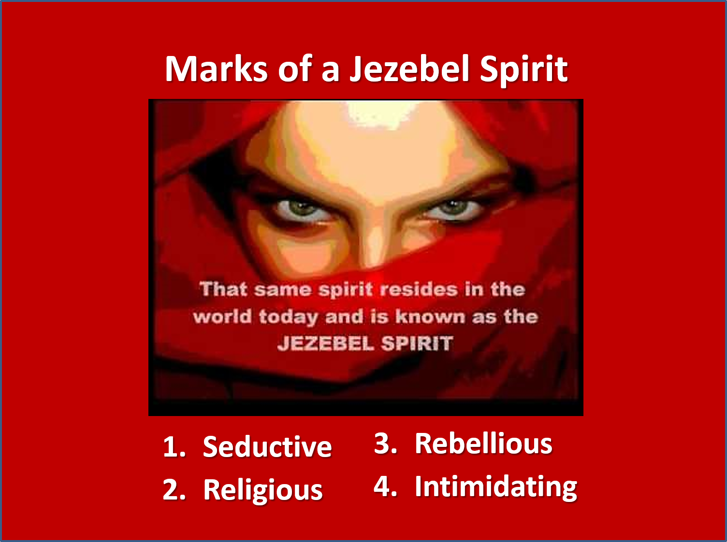
(8)
二。基督的责备。2. Christ’s condemnation.
“然而有一件事我要责备你，就是你容让那自称是先知的妇人耶洗别”（2:20a）。
A。耶洗别的教导。“那自称是先知的妇人耶洗别教导我的仆人，引诱他们行奸淫，吃祭偶像之物。 ”
“Nevertheless, I have this against you: You tolerate that woman Jezebel”(2:20a).
A.Teaching of Jezebel.“Jezebel,who calls herself a prophet.By her teaching she misleads my servants into sexual immorality and the eating of food sacrificed to idols”(2:20b).

Slide 12
(9)
二。基督的责备。2. Christ’s condemnation.
（一）耶洗别带巴力到以色列并使它堕落（王上16:31；21:25），别的人带异教徒的到教会使它堕落。
（二）有妇人把酵放在面里（太13:33）。她把假道和真理放在一起。
（三）她引诱他们行奸淫。在教会里不能容让不道德的事。
（四）她吃祭偶像之物。在教会里不能容让拜偶像。
(1) Jezebel brought Baalism into Israel and perverted it(1Ki.16:31;
21:25), others brought paganism into the Church and perverted it.
(2) The woman who mixed yeast into the flour (Mt.13:33). She mixed false teaching with truth.
(3) She misleads into sexual immorality. Immorality cannot be tolerated in the church.
(4) She misleads in the eating of food sacrificed to idols. Idolatry cannot be tolerated in the church.

Slide 13
(10)
二。基督的责备。2. Christ’s condemnation.
应用：有的人问我天主教和基督教有什么差别。
（一）苦修。圣经说，我们得救是本乎恩（弗2:8－9）。
（二）黑暗。圣经说，“但行真理的必来就光”(约3:21)。
（三）奥秘。圣经说，听道并明白（太13:23）。
Application: Some ask me what is the difference between Catholic Church and Christian Church.
(1) Doing penance. The Bible says, we are saved by grace(Eph.2:8-9).
(2) Darkness.The Bible says,“Whoever lives by the truth comes into the light” (Jn.3:21).
(3) Mystery. The Bible says, to hear the Word and understand it(Mt.13:23).

Slide 14
(11)
二。基督的责备。2. Christ’s condemnation.
（四）拜偶像。圣经说，不可拜偶像（出20:4）。
（五）念经。圣经说，不可向外邦人用许多重复话（太6:7）。
（六）玛利亚。圣经说，“使他可以在凡事上居首位”
（西1:18）。
（七）基督受难像。圣经说，基督完成献祭和复活（太28:6）。
(4) Idolatry. The Bible says, Do not commit idolatry (Ex.20:4).
(5) Chanting. The Bible says, Do not keep on babbling like pagans(Mt.6:7).
(6) Mary.The Bible says,“that in everything Christ might have the supremacy(Col.1:18).
(7) Crucifix. The Bible speaks of Christ’s completed sacrifice and resurrection(Mt.28:6).

Slide 15
(12)
二。基督的责备。2. Christ’s condemnation.
B。耶洗别的藐视。“我曾给他悔改的机会，他却不肯悔改他的淫行”（2:21）。
C。耶洗别的审判。“看哪，我要叫他病卧在床，那些与他行淫的人，若不悔改所行的，我也要叫他们同受大患难。我又要杀死他的党类”（2:22-23a）
D。耶洗别的警告。“叫众教会知道，我是那察看人肺腑心肠的。并要照你们的行为报应你们各人”（2:23b）
B. Defiance of Jezebel. “I have given her time to repent of her immorality,but she is unwilling”(2:21).
C. Judgment of Jezebel.“So I will cast her on a bed of suffering, and I will make those who commit adultery with her suffer intensely, un-less they repent of her ways.I will strike her children dead”(2:22-23a).
D. Warning of Jezebel. “Then all the churches will know that I am he who searches hearts and minds, and I will repay each of you according to your deeds”(2:23b).

Slide 16
三。基督的忠告。3. Christ’s counsel.
(13)
“至于你们推雅推喇其馀的人，就是一切不从那教训，不晓得他们素常所说撒但深奥之理的人。我告诉你们，我不将别的担子放在你们身上。但你们已经有的，总要持守，直等到我来”(2:24-25)。
A。不从那教训。不可以学习撒但所谓的深奥道理。小心假道。
B。总要持守。等到基督再来，教会被提（帖前4:13-18）。
“Now I say to the rest of you in Thyatira, to you who do not hold to her teaching and have not learned Satan’s so-called deep secrets, ‘I will not impose any other burden on you, except to hold on to what you have until I come”(2:24-25).
A. Do not hold onto false doctrine. Do not learn Satan’s so-called deep secrets. Beware of all false teaching.
B. Hold onto true doctrine. Until Christ’s return, the rapture of the church (1Thes.4:13-18).

Slide 17
四。基督的挑战。
4. Christ’s challenge.
(14)
“那得胜又遵守我命令到底的，我要赐给他权柄制伏列国。他必用铁杖辖管他们，将他们如同窑户的瓦器打得粉碎。像我从我父领受的权柄一样。我又要把晨星赐给他。圣灵向众教会所说的话，凡有耳的就应当听。”
“To the one who is victorious and does my will to the end, I will give authority over the nations-that one ‘will rule them with an iron scepter and will dash them to pieces like pottery’-just as I have received authority from my Father.I will also give that one the morning star. Whoever has ears,let them hear what the Spirit says to the churches”(2:26-29).

Slide 18
四。基督的挑战。
4. Christ’s challenge.
(15)
“圣灵向众教会所说的话，凡有耳的就应当听”(2:29)。
A。听圣灵所说的。三种人：
（一）那些有耳朵可听见的（太13:9）。
（二）那些听不进去的（来5:11）。
（三）那些愿意听圣灵所说的（雅1:22）。
“Whoever has ears,let them hear what the Spirit says to the churches” (2:29).
A. Hear what the Holy Spirit says to the churches. 3 kinds of people:
(1) Those are with ears to hear(Mt.13:9).
(2) Those are dull of hearing(Heb.5:11).
(3) Those are willing to hear what the Holy Spirit says (Ja.1:22).

Slide 19
四。基督的挑战。
4. Christ’s challenge.
(16)
B。领首的地位。
（一）权柄制伏列国。
（二）晨星。耶稣基督是“明亮的晨星”（22:16）。在赛14:12，撒但叫路西弗(Lucifer)是“明亮之星，早晨之子。”
B. Position of leadership.
(1) Authority over nations.
(2) Morning star. Jesus Christ is “the Bright and Morning star”(22:16). In Isaiah 14:12, Satan is named Lucifer, which in Hebrew means “brightness, bright star.”

Slide 20
(17)
结论：Conclusion:
当你复习头四个给教会的信息，你可以看到神的选民所面临的危险。像以弗所，我们可以是热心和正统的，但同时却失去了多基督起初的爱心和奉献。像推雅推喇，我们的爱可以增多，但是却缺乏保守教会纯净的辨别的能力。像别加摩和推雅推喇，我们可能容忍罪恶以至于让主担忧，并招致他的审判。士每拿被撒但之会攻击，别加摩在撒但的座位之处，而推雅推喇已经堕落在撒但的深奥道理之中。这是一个过程：当起初的爱失落后，妥协就来了，并导致对罪恶的容让。
Conclusion As you review these first four messages to the churches,you can see the dangers that still exist for the people of God. Like Ephesus, we can be zealous and orthodox, but at the same time lose our love and devotion to Christ. Like Thyatira, our love can be increasing, yet lacking in the kind of discernment that is necessary to keep the church pure. Like Pergamum and Thyatira, we may be so tolerant of evil that we grieve the Lord and invite His judgment.Smyrna was assaulted by a synagogue of Satan, Pergamum was in the throne of Satan, but Thyatira had fallen into the deep things of Satan. There is a progression. When love is left behind, compromise follows and leads to toleration of sin.

