Slide 1
主日：二零一六年九月十一日
Sunday: September 11, 2016
何礼义牧师 Pastor Gary Hart
题目：“比天使更尊贵。”
Topic: “Greater than Angels.”
经文:希伯来书1:4“他所承受的名，既比天使的名更尊贵，就远超过天使。”
Text:Heb.1:4 “So he became as much superior to the angels as the name he has inherited is superior to theirs.”
(1)

Slide 2
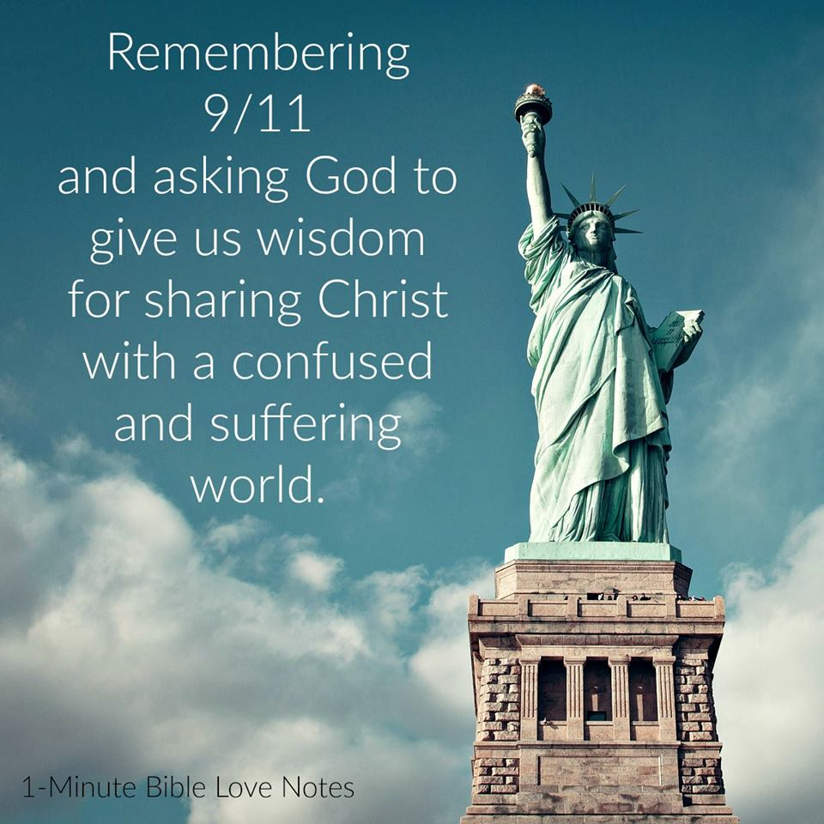

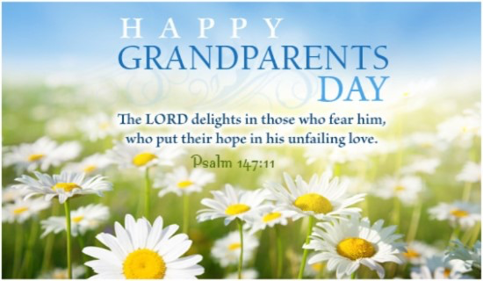
What is today? Today is…
今天是什么日子？
今天是…

Slide 3
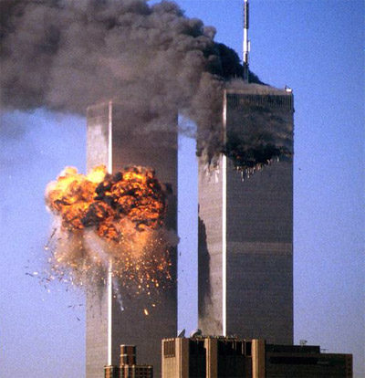
引言：改变了的美国的今天。
Intro: Today is a day that changed America.
因为9/11我们的生活有很多的改变：（1）飞机场，（2）移民／驱逐出境，（3）国内监视活动，（4）对政府信赖，（5）旅游，（6）打仗，（7）惧怕。那时很多人开始祷告和归向神，但是现在很多人远离神。
Because of 9/11 our lives changed forever in many ways: (1) airports, (2) immigration/deportation, (3) domestic spying, (4) trust in government, (5) tourism, (6) ongoing wars, (7) fear. At that time many people begin to pray and turn to God, but now many are drifting away from God.
(2)

Slide 4
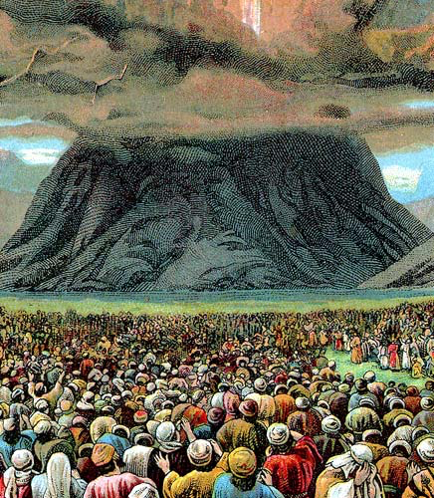
今天我们对天使着迷。有的时候我们的英雄被称呼“天使”，像“天使在南京”中的陈思。天使的定义是“属灵的生物，比人更有能力和聪明。”在犹太教天使很重要，因为在西奈山有很多天使帮忙颁布律法（申33:2；徒7:53）。谁比天使更大并拿走我们的惧怕？
Today, we are obsessed with angels. Sometimes our heroes are called “angels”, like Chen Si “Angel of Nanjing”. Angels are defined as “spiritual beings superior to humans in power and intelligence.” Angels were most important in the Jewish religion, because thousands of angels assisted in the giving of the law at Mt.Sinai(Dt.33:2;Ac.7:53).Who is greater than angels and takes away our fears?
(3)

Slide 5
确认之事：基督比天使更大(1:4-14)。从旧约有七个引语肯定我们的信仰。
1. Affirmation: Christ is greater than angels (1:4-14). There are 7 quotations from the OT are cited to affirm our beliefs.
A.基督是儿子（1:4-5）。当天使被称为“神的众子”
（约伯记1:6）。基督是独一“神子”（诗篇2:7）。这个经节在使徒行傳13:33也被引述在基督的复活成就了。 “我要作他的父，他要作我的子”（撒母耳记上7:14）。这是应验在基督，因为祂“比所罗门更大 ”（太12:42）。
A. Christ is the Son (1:4-5). While the angels collectively may be called “the sons of God” (Job 1:6). Christ is uniquely “the Son of God” (Ps.2:7). This is quoted also in Acts 13:33 as fulfilled in Christ’s resurrection(Ro.1:4). “I will be his Father, and he will be my Son”(2Sa.7:14). The application is to Christ, because He is “greater than Solomon”(Mt.12:42).
(4)

Slide 6
确认之事：基督比天使更大(1:4-14)。从旧约有七个引语肯定我们的信仰。
1. Affirmation: Christ is greater than angels (1:4-14). There are 7 quotations from the OT are cited to affirm our beliefs.
B.基督是长子并接受敬拜（1:6）。“长子”是一个称号和尊荣。基督是“是首生的，在一切被造的以先”因为祂创造万物。祂来到世界的时候，天使敬拜祂。天使跟基督比较因着敬拜祂称呼祂为大。
B. Christ is the Firstborn who receives worship (1:6). “Firstborn” is a title of rank and honor.Christ is the “Firstborn of all creation” (Col.1:15) because He created all things. When He came into the world, the angels worshipped Him (Deut.32:43). The angels with whom Christ is being compared proclaim His superiority by worshiping him.
(5)

Slide 7
确认之事：基督比天使更大(1:4-14)。从旧约有七个引语肯定我们的信仰。
1. Affirmation: Christ is greater than angels (1:4-14). There are 7 quotations from the OT are cited to affirm our beliefs.
C.基督被天使事奉（1:7）。“神以风为使者，以火焰为仆役”（诗篇104:4）。基督在地上的时候，天使有的时候事奉祂（太4:11；路22:43），并现在服事祂和我们。
C. Christ is served by the angels (1:7). “He makes his angels spirits, and his servants flames of fire” (Ps.104:4). Angels sometimes served Christ when He was on earth (Mt.4:11; Lk.22:43), and they serve Him and us now.
(6)

Slide 8
确认之事：基督比天使更大(1:4-14)。从旧约有七个引语肯定我们的信仰。
1. Affirmation: Christ is greater than angels (1:4-14). There are 7 quotations from the OT are cited to affirm our beliefs.
D.基督是神，被神按立在宝座上和被膏的（1:8-9）。“神阿，你的宝座是永永远远的，你的国权是正直的。你喜爱公义，恨恶罪恶。所以神就是你的神，用喜乐油膏你，胜过膏你的同伴”（诗篇45:6-7）
D. Christ is God enthroned and anointed (1:8-9). “Your throne, O God, will last for ever and ever; a scepter of justice will be the scepter of your kingdom. You have loved righteousness and hated wickedness; therefore God, your God, has set you above your companions by anointing you with the oil of joy” (Ps.45:6-7).
(7)

Slide 9
确认之事：基督比天使更大(1:4-14)。从旧约有七个引语肯定我们的信仰。
1. Affirmation: Christ is greater than angels (1:4-14). There are 7 quotations from the OT are cited to affirm our beliefs.
E.基督是永远的创造者（1:10-12)。“主阿，你起初立了地的根基，天也是你手所造的。天地都要灭没，你却要长存。天地都要像衣服渐渐旧了。你要将天地卷起来，像一件外衣，天地都改变了。惟有你永不改变，你的年数没有穷尽”(诗篇102:25-27)天使是被创造的，基督是创造者。
E. Christ is the eternal Creator (1:10-12). “In the beginning, Lord, you laid the foundations of the earth, and the heavens are the work of your hands. They will perish, but you remain; they will all wear out like a garment.You will roll them up like a robe; like a garment they will be changed. But you remain the same, and your years will never end”(Ps.102:25-27). Angels were created, Christ is the Creator.
(8)

Slide 10
确认之事：基督比天使更大(1:4-14)。从旧约有七个引语肯定我们的信仰。
1. Affirmation: Christ is greater than angels (1:4-14). There are 7 quotations from the OT are cited to affirm our beliefs.
F.基督做王；天使做奴仆(1:13-16）。“你坐在我的右边，等我使你仇敌作你的脚凳”(诗篇110:1)。现在基督在天父右边，今天天使服事我们。祂比律法更大。
应用：这是基督比天使更大的根据。你不但不能不理这个根据，而且让它坚固你对基督的信心。
F. Christ is the Sovereign; angels are the servants (1:13-16). “Sit at my right hand until I make your enemies a footstool for your feet”(Ps.110:1). Christ is now at the Father’s right hand(place of honor). The angels today are serving us. He is greater than the law.
Application: Here is evidence that Christ is greater than angels. You cannot ignore this evidence, instead let it affirm your faith in Christ.
(9)

Slide 11

2. 警告：听道而且不偏离正道（2:1-4）。
2. Admonition: Heed the Word and don’t drift (2:1-4).
这个目标是鼓励所有的读者专心听神的话和遵守它。神并没有坐在一边并允许他的儿女叛逆祂。祂继续不断的说话并且当需要时，祂管教属于祂的。祂鼓励基督徒专心他们从主接受大的救恩。我们却忽略神的话，祷告，跟其它屬神的人敬拜（10:25）。锚并没有移动；但是我们有。
The purpose is to encourage all readers to pay attention to God’s Word and obey it. God does not sit idly by and permit His children to rebel against Him. He will continue to speak and when necessary, He chastens His own. He was encouraging Christians to pay attention to the great salvation they have received from the Lord. We neglect God’s Word, prayer, worship with God’s people (10:25). The anchor does not move; we do.
(10)

Slide 12
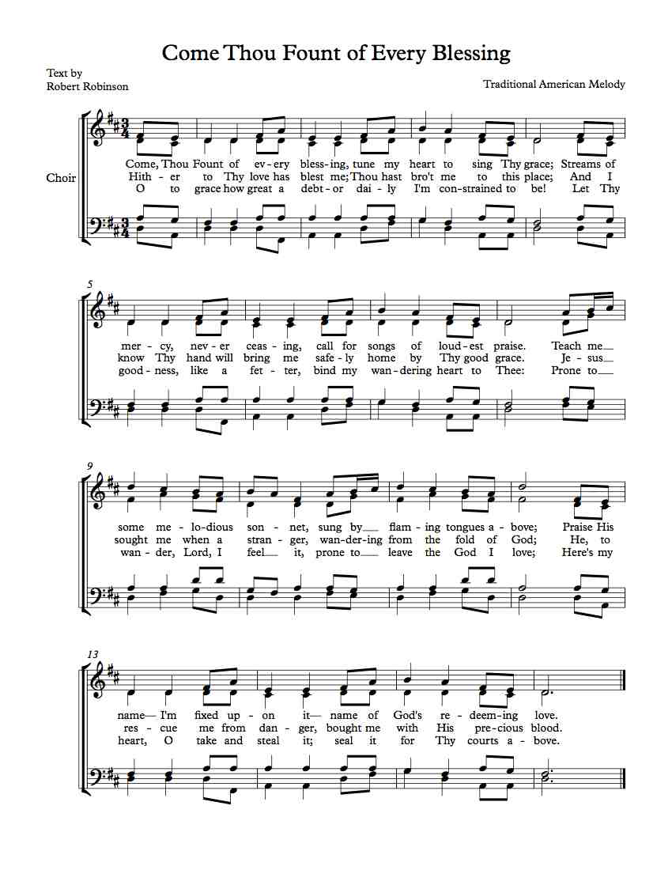
应用：“来阿，祢这万福泉源”（＃195）由Robert Robinson （在1758年）写了曲谱。他听乔治 怀特菲尔德讲道被归正，但是以后他偏离了主。他忽略了属灵的事以致他走上偏路。为了心里平安，他开始旅行。他遇到了一个年轻的女孩问他这首诗歌如何。他跪下承认他是谁并他怎么偏离主。她安慰他“怜悯江河”还会流出来。Robinson 被恢复。“信心有风险的，但是不信会致死的”（Jack Graham）。
Application:“Come,Thou Fount of Every Blessing”(#195) was composed by Robert Robinson(1758). He was con-verted under the preaching of George Whitefield, but later he drifted from the Lord.His neglect of spiritual things lead him astray.In an attempt to find peace, he began to travel. He met a young woman who asked him what he thought of this hymn. He broke down and confessed who he was and how he had been living away from the Lord. “Streams of mercy” are still flowing she assured him. Robinson was restored. “Faith is risky,but unbelief is deadly”(J.Graham).
(11)

Slide 13
3. 能力：基督比天使有更多的能力（2:5-18）。
3. Ability: Christ is more able than angels(2:5-18).
A. 基督的人格使祂重拾人所丢失的统治权(2:5-9)。人算什么，你竟顾念他，世人算什么，你竟眷顾他。你叫他比天使微小一点，赐他荣耀尊贵为冠冕，并将你手所造的都派他管理。叫万物都服在他的脚下（诗篇8:4-6）。人被创造比天使微小一点，但是人的特权将比天使高来管理这将来的世界。惟独见那成为比天使小一点的耶稣（2:9）。
A. Christ’s humanity enabled Him to regain man’s lost dominion (2:5-9).“What is mankind that you are mindful of them,a son of man that you care for him? You made them a little lower than the angels; you crowned them with glory and honor and put everything under their feet”(Ps.8:4-6).Man was created“a little lower than the angels”
(inferior to angels), but man was given privileges far higher than the angels to reign in “the world to come.” “But we see Jesus” (2:9).
(12)

Slide 14
3.能力：基督比天使有更多的能力（2:5-18）。
3. Ability: Christ is more able than angels(2:5-18).
B. 基督的人格使祂带领更多的儿女到荣耀里。救他们的元帅。祂开路所以别人可以跟随他。基督撇下祂的荣耀成为一个人，后来祂复活和升天得到祂的荣光。我们是祂的“兄弟姐妹”（诗篇22:22）。“我要倚赖祂。又说，看哪，我与神所给我的儿女”（以赛亚书7:17-18）。
B. Christ’s humanity enabled Him to bring many sons to glory (2:10-13).He is the Captain(Pioneer) of salvation.The one who opens the way for others to follow. Christ gave up His glory to become man, He regained His glory when He arose and ascended to Heaven. We are His “brothers and sisters”(Ps.22:22). “I will put my trust in him…Here am I, and the children God has given me”(Isa.7:17-18).
(13)

Slide 15
3.能力：基督比天使有更多的能力（2:5-18）。
3. Ability: Christ is more able than angels(2:5-18).
C.基督的人格使祂败坏魔鬼和从死释放了我们(2:14-16)。
撒旦还没有毁灭，但已缴械了。我们这些信靠基督的被从撒旦的管治和死亡释放。基督使我们得胜（林前15:55-58）。
C. Christ’s humanity enabled Him to disarm Satan and deliver us from death(2:14-16). Satan is not destroyed, but disarmed. We who trust in Christ have once and for all been delivered from Satan’s authority and from the terrible fear of death. Christ gives us the victory (1 Cor.15:55-58).
(14)

Slide 16
3.能力：基督比天使有更多的能力（2:5-18）。
3. Ability: Christ is more able than angels(2:5-18).
D.基督的人格使祂成为同情我们的大祭司（2:17-18）。耶稣经历了无罪但有人本性的软弱。祂知道作一个无力的婴孩，一个长大的孩子，一个成熟的年轻人。他知道疲劳，饥饿和口渴。他知道被辱骂和拒绝，被谎言和诬告。祂经验肉体的痛苦和死亡。基督怜悯人和忠于神。他能给我们胜过试探的恩典。
D. Christ’s humanity enables Him to be our sympathetic High Priest(2:17-18). Jesus experienced the sinless infirmities of human nature. He knew what it was to be a helpless baby, a growing child, a maturing adolescent. He knew the experiences of weariness, hunger, and thirst.He knew what it was to be despised and rejected,to be lied about and falsely accused. He experienced physical suffering and death. Christ is both merciful to people and faithful to God. He is able to give us the grace we need to overcome temptation.
(15)

Slide 17
3.能力：基督比天使有更多的能力（2:5-18）。
3. Ability: Christ is more able than angels(2:5-18).
应用： 我们的大祭司，我们的主能给我们祂的恩典当我们受试探时候避免犯罪。如果我们犯罪，祂就是我们的中保，在神的宝座前代表我们，并当我们诚恳向他认罪时候饶恕我们 (约翰一书1:5-2:2)。
Application: As our High Priest, our Lord is able to give us grace to keep us from sinning when we are tempted. If we do sin, than He is our Advocated to represent us before the throne of God and forgives us when we sincerely confess our sins to Him(IJn.1:5-2:2).
(16)

Slide 18
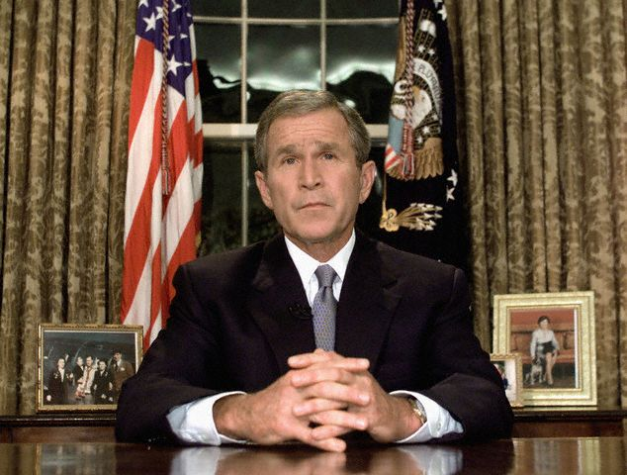
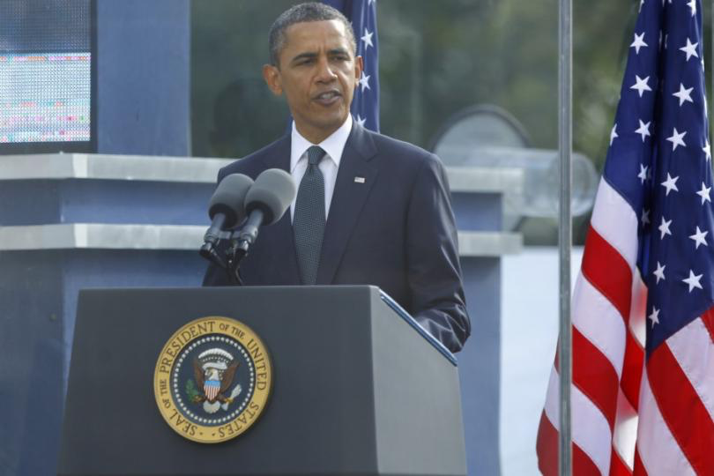
结论：神的同在和力量。
Conclusion:God’s presence and strength.
在9/11布什总统用诗篇23篇安慰美国人：“我虽然行过死阴的幽谷，也不怕遭害。因为你与我同在。”十年以后，奥巴马总统在9/11纪念堂读诗篇46篇：“神是我们的避难所，是我们的力量，是我们在患难中随时的帮助。所以地虽改变，山虽摇动到海心…万军之耶和华与我们同在。”
Conclusion: On 9/11 President Bush extended comfort to the American people from Psalm 23: "Even though I walk through the valley of the shadow of death, I fear no evil, for You are with me." Ten years later, President Obama read Psalm 46 at the 9/11 Memorial: "God is our refuge and strength, a very present help in trouble. Therefore, we will not fear, even though the earth be removed, and though the mountains be carried into the midst of the sea ... the Lord almighty is with us.”
(17)

