Slide 1
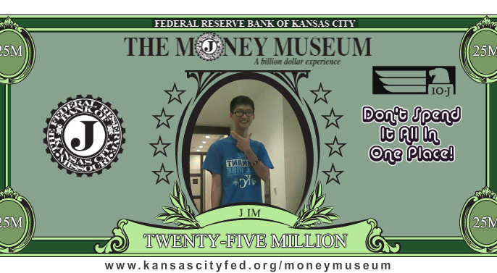
八月十七日早上，许有为要回台湾去。
On morning of August 17, Jim will return to Taiwan.

Slide 2
主日：二零一六年八月十四日
Sunday: August 14, 2016
何礼义牧师 Pastor Gary Hart
题目：“欢欢喜喜地行告成之礼。”
Topic: “Celebrate joyfully the dedication.”
经文:尼希米记 12:27“耶路撒冷城墙告成的时候，…要称谢，歌唱…
欢欢喜喜地行告成之礼。”
Text:Neh.12:27 “At the dedication of the wall of Jerusalem,…to celebrate joyfully the dedication with songs of thanksgiving and with the music….”
(1)

Slide 3

引言：你这周有没有看奥林匹克比赛？
Intro: Have you been watching the Olympics this week?
在奥林匹克比赛，运动员将最好的献给国家。Noah Webster说“奉献就是献给神的意思。致力给神。”在尼希米书，他们先重建城墙和人民，然后他们把人民和城墙献给神。
At the Olympics, the athletes give of their best to their country. Noah Webster says that meaning of dedication is the “act of consecrating to a divine Being. The act of devoting or giving to (God).” In Nehemiah, first they rebuilt the walls and the people, then they dedicated the people and the walls to God.
(2)

Slide 4
在圣经里，我们看到摩西行造成会幕之礼（民数记7:1），大卫打仗得胜后献给神的财宝（撒母耳记下8:11），所罗门行造成圣殿之礼（历代志下7:1）和以斯拉重建圣殿造成之礼（以斯拉6:16），然后尼希米造成耶路撒冷城墙之礼（尼希米记12:27）。尼希米叫人民为了城市给主三个献祭，神还要祂的子民为了祂在地上教会的建成奉献。我们应该将什么献给神？让我们来看尼希米记第11-12章。
In the Bible, we see the dedication of the Tabernacle by Moses (Num. 7:1), the dedication of the spoils of war by David (2Sa.8:11), the dedication of the Temple by Solomon(2Chr.7:1) and the rebuilt Temple by Ezra (6:16), then the dedication of the wall of Jerusalem by Nehemiah(12:27).Nehemiah calls on the people to present 3 sacrifices to the Lord for the sake of their city, sacrifices that God still calls His people to give for the sake of the church He is building in this world.What should we dedicate to God?Let us look at Neh.11-12.
(3)

Slide 5
我们必须把自己献给神(11:1-12:26)。“先把自己献给主”(林后8:5)。
1. We must give ourselves to God (11:1-12:26). “They gave them-selves first of all to the Lord”(2 Cor.8:5).
A.神需要人（活的身体）住在圣城（11:1-2）。有的乐意自愿地搬进耶路撒冷，有的是抽签被征搬进耶路撒冷“所以弟兄们，我以神的慈悲劝你们，将身体献上，当作活祭，是圣洁的，是神所喜悦的。你们如此事奉，乃是理所当然的”（罗12:1）。主啊，我愿意把所有的献给您！
A. God needed people (live bodies) in the Holy City (11:1-2). Some volunteered willingly while others had to be “drafted” to move into the City of Jerusalem. “Therefore, I urge you, brothers and sisters, in view of God’s mercy, to offer your bodies as a living sacrifice, holy and pleasing to God—this is your true and proper worship”(Rom.12:1). Lord, I will give you my all!
(4)

Slide 6
B. 众民因着把自己献上得到承认(11:3-12:26)：建城墙的人（3章），跟随所罗巴伯的人（7章），领受参加大复兴的首领（8章）， 签名立约的首领（10章）。我们天上的父会看到和记下他儿女的服事。神用许多不同的人的恩赐和才干完成他的工作。
B. People who gave of themselves are acknowledged(11:3-12:26). The people who worked on the wall (ch.3), the people who returned with Zerubbabel (ch.7), the leaders who were involved in the great revival (ch.8), the leaders who signed their names to the dedication covenant (ch.10). Our Heavenly Fathers sees and records what His children do as they serve Him. God uses many people with different gifts and skills to get His work done.
(5)

Slide 7
2. 我们必须把我们的赞美献给神（12:27-42）。
2. We must give our praise to God (12:27-42).
他们很热心地行告成之礼所以他们的欢声“传到远处”
（12:43）。唱歌（8次），感谢（6次），喜乐（7次），乐器（13次）都被提到了。“我们应当靠着耶稣，常常以颂赞为祭献给神，这就是那承认主名之人嘴唇的果子”
（来13:15）。我们不但是观看者而且是参与者。
They conducted a dedication service with such enthusiasm that their shouts and songs were heard “even afar off” (12:43). Singing (8x), thanksgiving(6x), rejoicing(7x), musical instruments(3x) are mentioned. “Through Jesus, therefore, let us continually offer to God a sacrifice of praise—the fruit of lips that openly profess his name”(Heb.13:15). We are not just spectators but also participants.
(6)

Slide 8
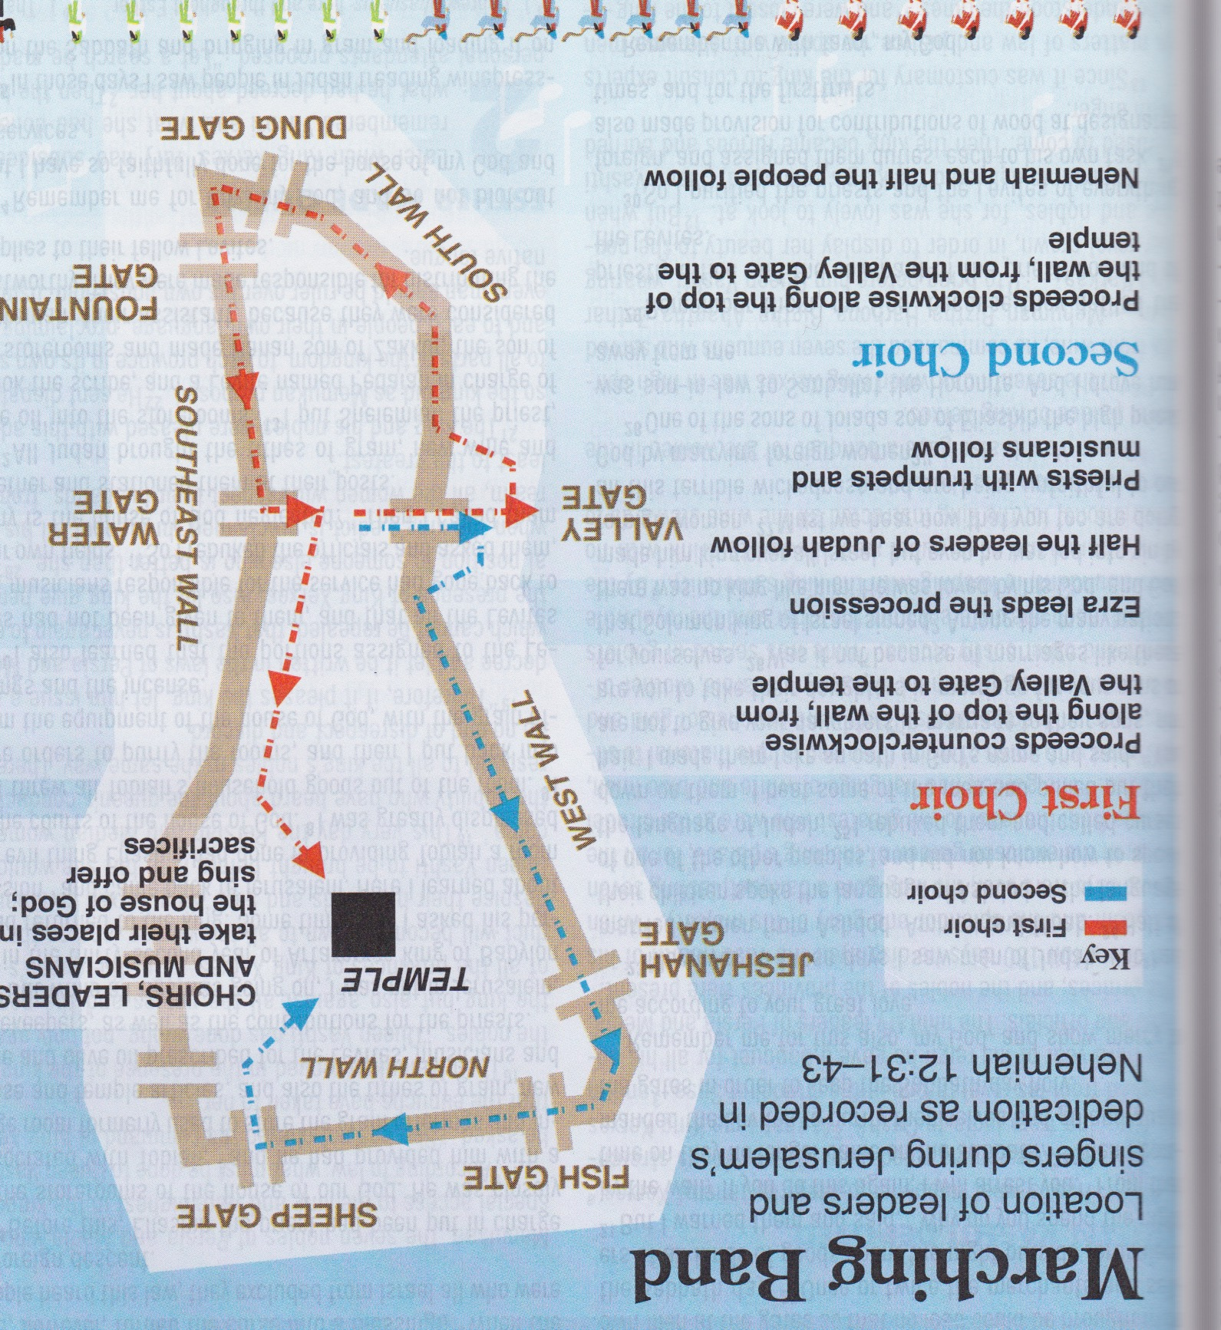
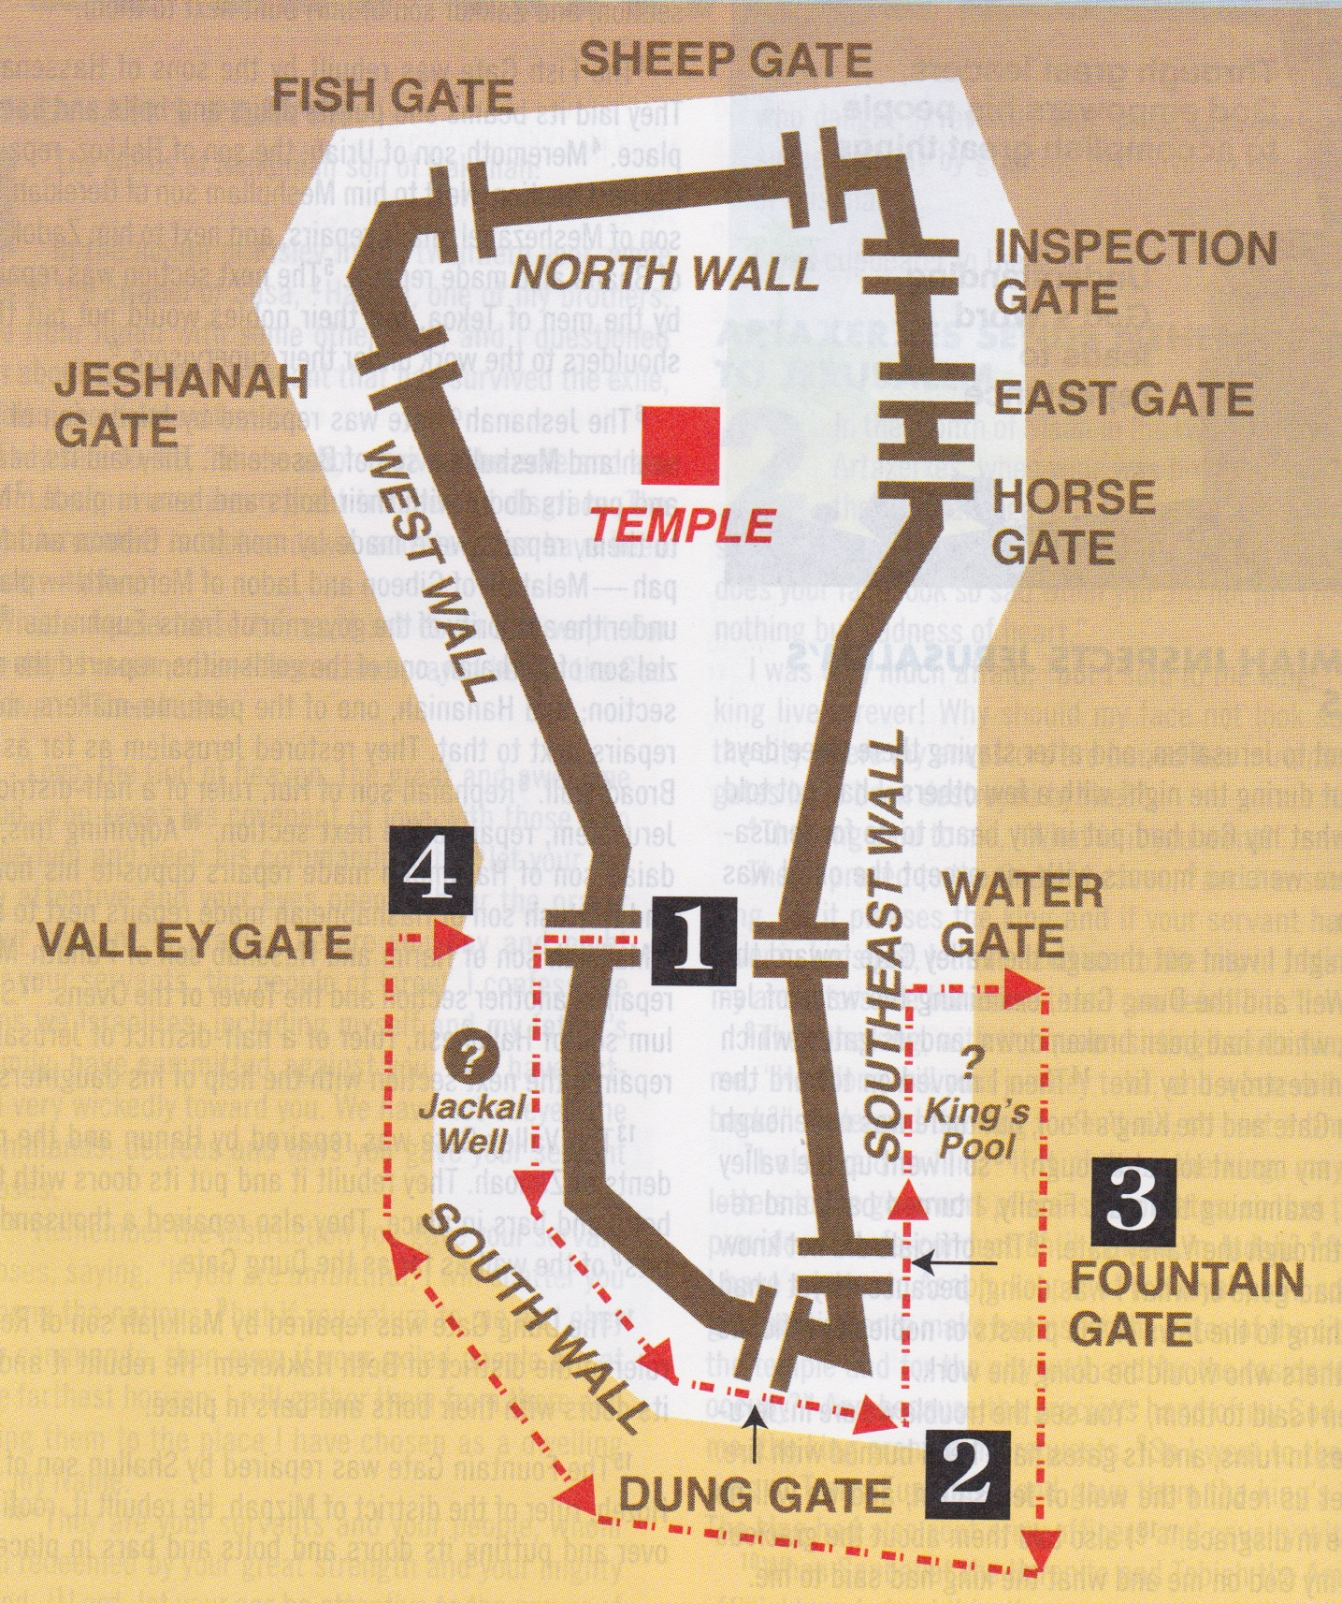
A。以斯拉带领第一个诗班
。神听到了赞美演奏。
Ezra led the first choir.
(see red on the map) God heard
the praise Marching Band.
B.尼希米带领第二个诗班。
因为神听听到了祷告的进
行（尼希米记2:13-15）。
B. Nehemiah led the second
choir. (see blue on the map)
Because God heard the prayer
march (see red on the map,
Neh.2:13-15).
(7)

Slide 9
(1) 他们把城墙和门献上，所以人可以看到和摸到他们。
They dedicated walls and gates, so the people could see and touch them.
(2) 他们给世界做见证，为了荣耀神自己。
(2) They were bearing witness to the world that God had done the work, and He alone should be glorified.
(3) 他们有机会看到功劳的结果并了解不是一个人做的（4:6）。它属于神并必须荣耀神。
(3) They had an opportunity to see the results of their labors and realize that the work had not been done by one person(4:6). It belongs to God and must be used for His glory.
(4) 他们用信心抓住神的祝福。 神对亚伯拉罕说，“你起来，纵横走遍这地，因为我必把这地赐给你”（创世纪13:17）。祂对约书亚说，“凡你们脚掌所踏之地，我都照着我所应许摩西的话赐给你们了”(约书亚记1:3)。征服耶利哥也是神的打战计划（约书亚记6）。
(4) They “stepped out by faith” to claim God’s blessing. God said to Abraham, “Arise, walk through the land…for I will give it unto thee”(Ge.13:17), and He said to Joshua,“Every place that the sole of your foot shall tread upon,that have I giv-en unto you”(Josh.1:3). The march on Jericho was God’s battle plan (Josh.6).
(8)

Slide 10
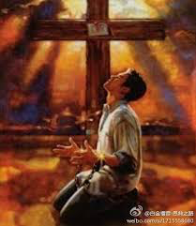
3. 我们必须把自己奉献给神（12:44-47）。
3. We must give our offerings to God (12:44-47).
人民与神立约供给圣殿(10:32-39)，并且遵守。
The people had covenanted with God to support the temple (10:32-39), and they kept their promises.
A. 人民给了他们的奉献。 “各人…不要勉强，因为捐得乐意的人，是神所喜爱的”(林后9:7 )。
A. The people brought their offerings. ”Each of you should give…not grudgingly or of necessity” but joyfully and gratefully (2Cor.9:7).
B.我们的奉献套神的喜悦。当作极美的香气，为神所收纳所喜悦的祭物。 （非4:19）
B. Our offerings please God. “The gifts you sent. They are a fragrant offering, an acceptable sacrifice, pleasing to God”(Phil.4:18).
应用:你要把什么欢欢喜喜的献给神？我要把自己，嘴巴，钱献给神。
Application: What will you joyfully dedicate to God? I will joyfully dedicate myself, my mouth, my money, my… to God.
(9)

Slide 11
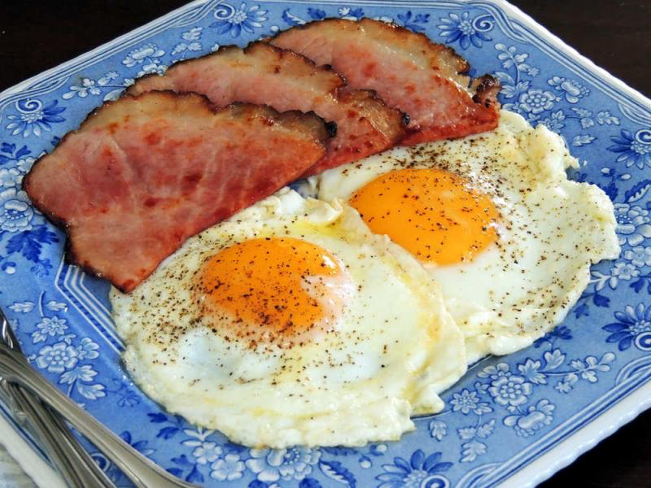
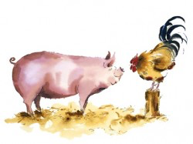
结论：参与和献身有什么不同？
Conclusion:What is difference between involvement &commitment?
Look at a plate of ham and eggs. The chicken was involved, but the pig was committed! “Give of your best to the Master” (#303).
看一盘火腿和鸡蛋。鸡只是参与，而煮献上了生命。“将你最好的献与主” (#303)
(10)

Slide 12
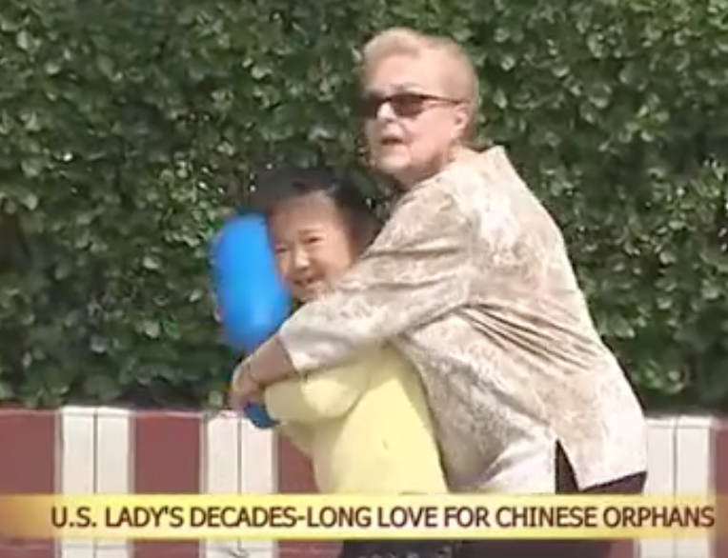
Jane Marcum a 76-year-old American from Kansas, has provided a home for over 100 orphans in central China's Henan Province. She came to China in the early 1990s to teach English and kept doing charity work in her spare time. https://www.youtube.com/watch?v=lmIIewwBSpQ&feature=youtu.be

