Slide 1
Be Strengthened in the Lord
1/17/2016
Scripture Reading: 1 Samuel 30:1 – 11; 16 – 19

Slide 2
Happy New Year 2016
New beginning and new year resolutions
New challenges come our way
Unresolved issues and carried over burdens remain
We need our strength replenished in the Lord, to be re-energized and ready for another fresh start of the year

Slide 3
We will miss you…

Slide 4
When Trouble Strikes and Fear Takes Root

Slide 5
Out of the Frying Pan into the Fire
The Philistines were about to wage war with Saul
29:9 Achish answered, "I know that you have been as pleasing in my eyes as an angel of God; nevertheless, the Philistine commanders have said, 'He must not go up with us into battle.‘
30:1 – 2 David and his men reached Ziklag on the third day. Now the Amalekites had raided the Negev and Ziklag. They had attacked Ziklag and burned it, ² and had taken captive the women and all who were in it, both young and old. They killed none of them, but carried them off as they went on their way.
30:4 So David and his men wept aloud until they had no strength left to weep.

Slide 6
What is troubling you?
El Nino – Unpredictable weather
Economy – No sense of security
Leadership – No trustworthy candidate
Moral and Ethic – No safety in community
Family Crisis – No safe haven
Faith Crisis – No purpose in life

Slide 7
What will you do?
Turn to the Lord
But how can a loving God allows evil things to happen?
The story of the barber…
Turn to God to experience healings and miracles…
Matthew 11:28 "Come to me, all you who are weary and burdened, and I will give you rest.

Slide 8
Find Strength in the Lord

Slide 9
Strength in the Daily Faith in God
30:6 But David found strength in the LORD his God.
What is your family name? Is it awesome?
Recognize who you are…
John 1:12 Yet to all who received him, to those who believed in his name, he gave the right to become children of God
Remind yourself everyday: I am a child of the awesome God

Slide 10
Strength in the Daily Pursue of God
Pursue your loved one…
Hebrews 12:14 Pursue peace with everyone, and holiness-- without it no one will see the Lord. (Holman)
1 Timothy 6:11 But you, man of God, …pursue righteousness, godliness, faith, love, endurance and gentleness.
James 4:8 Come near to God and he will come near to you.

Slide 11
Strength in the Daily Walk with God
Popeye the sailor man
Highway of blessings of God…
Joshua 1:8 - 9 Do not let this Book of the Law depart from your mouth; meditate on it day and night, so that you may be careful to do everything written in it. Then you will be prosperous and successful. ⁹ Have I not commanded you? Be strong and courageous. Do not be terrified; do not be discouraged, for the LORD your God will be with you wherever you go.“
Challenge: Finish reading the Bible in a year!

Slide 12
Stand up in the Strength of God

Slide 13
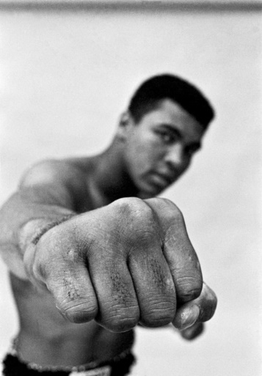
Miracle Can Happen for His Faithful Ones
Saul’s disconnection with God lead him to his own death
Muhammad Ali
David defeated the Amalekites with only 400 men
David recovered everything the Amalekites had taken… David brought everything back.(1 Samuel 30:18 – 19)

Slide 14
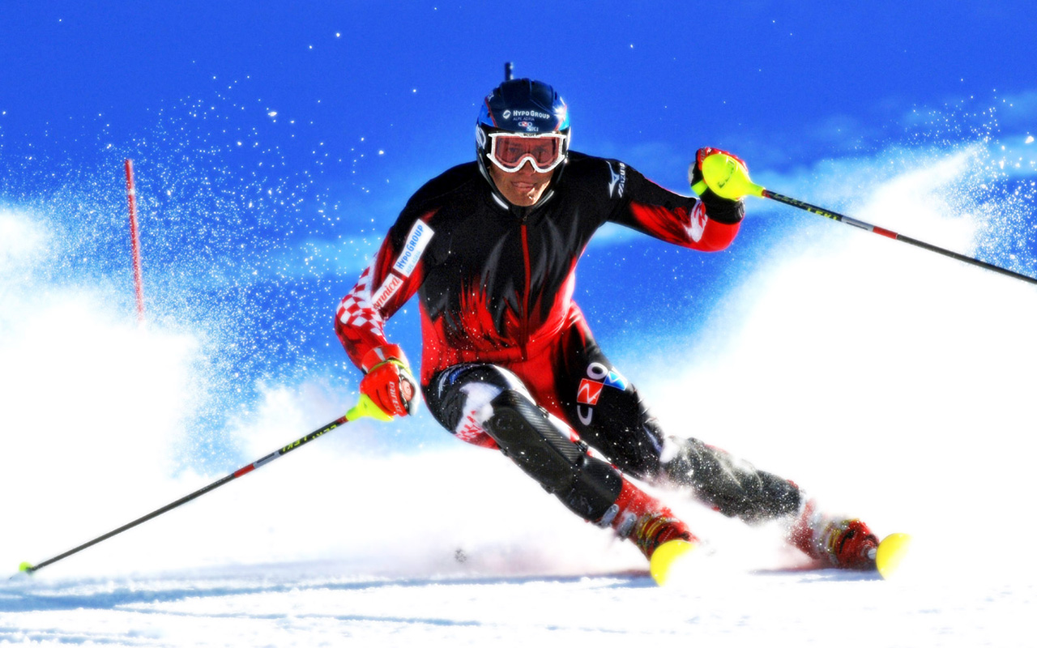
Listen and Stand up
Miracle does not happen every time
Miracle does not guarantee faith
Ski lesson 101
Every time when you feel like defeated
Listen to the Lord’s voice
Stand up again
David listened and stood up and fought again…

Slide 15
What do we learn today?
Turn to Jesus
Find strength in
Daily faith in God
Daily pursue of God
Daily walk with God
When defeated
Listen
Stand Up again

Slide 16
“Well Done My Faithful Servant”
2 Timothy 4:7 – 8 I have fought the good fight, I have finished the race, I have kept the faith. ⁸ Now there is in store for me the crown of righteousness, which the Lord, the righteous Judge, will award to me on that day-- and not only to me, but also to all who have longed for his appearing.

