Slide 1

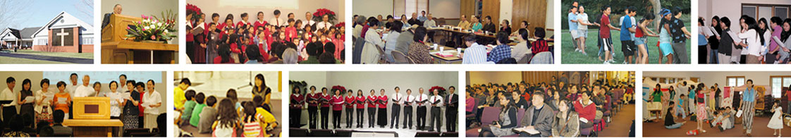
2017年堪城华人基督教会年会
2017 GKCCCC Annual Meeting
Greater Kansas City Chinese Christian Church
堪城华人基督教会
Shawnee, Kansas
March 5, 2017

Slide 2
2017年堪城华人基督教会年会
2017 GKCCCC Annual Meeting
教會使命 Our Mission
大堪萨斯城华人基督教会的弟兄姐妹，通过与耶稣基督所建立的个人关系而认识神，在神的话语上扎根，在基督里成长，在团契生活中彼此相爱，在门徒训练中受装备，顺服耶稣基督的大使命，把主的福音传给世人，走十字架生命的道路，活出耶稣基督所给的新生命，敬拜事奉主，荣神益人，显明神的爱。
By the Grace of God, the brothers and sisters of the Greater Kansas City Chinese Christian Church get to know the Lord Jesus Christ, His salvation through the cross, and the hope of the eternal life. Rooted in the word of God, growing in Christ, loving each other in fellowship, equipping in discipleship, obedience to the great mission of Jesus Christ, spreading the gospel throughout the world, walking in the path of the cross, living out new life of Jesus Christ, worshipping and serving our Lord, glorifying God and edifying people, revealing God’s love.

Slide 3
2017年堪城华人基督教会年会
2017 GKCCCC Annual Meeting
信仰宣告Statement of Faith
聖經都是神所默示，永遠旨意完整啟示
聖父聖子聖靈是神，三一真神永恆獨一
我主耶穌祂是基督，祂是永生神的兒子
道成肉身受死埋葬，復活升天主必再來
教會是永生神的家，基督身體羔羊新婦
The Bible is the inspired word of God, the complete revelation of His eternal will.
God the Father, the Son, and the Holy Spirit, the triune only true God.
Jesus is Christ and Lord, He is the Son of the Eternal God.
Word became flesh, died, was buried, and resurrected. He ascended to Heaven and will return again.
The church is the house of the Living God, the body of Christ, and the bride of the Lamb.

Slide 4
2017年堪城华人基督教会年会
2017 GKCCCC Annual Meeting
董事会成员Board Members:
  何礼义,王德南,高正修,王鸿鸣,郦一明,刘金石,李白,董振富,伍雷
  Gary Hart, Tony Wong, Robert Kao, Homer Wang, Yiming Li, Po Lee, Joseph Dong, Lei Wu
职责 Officers:
          President 会长: Robert Kao 高正修
          Vice President 副会长: Yiming Li 郦一明
          Treasurer 财务: Lei Wu 伍雷
          Secretary 书记: Hongming Wang 王鸿鸣

Slide 5
2017年堪城华人基督教会年会
2017 GKCCCC Annual Meeting
带领同工Leading Coworkers :
  何礼义(牧师) Gary Hart (Pastor)
  王德南 Tony Wong
  高正修 Robert Kao
  郦一明 Yiming Li
Notes:
Leaders meeting: twice a month. Others coworkers are invited to the meeting on a as needed basis depending on the discussion topics. Reports of the leadership meetings are presented at monthly coworkers meeting.

Slide 6

2017年3月5日堪城华人基督教会异象更新
何礼义牧师
March 5, 2017 GKCCCC Vision Update
Pastor Gary Hart

Slide 7

邀请 Invitation | “来看”（约1:39） “Come and see”(Jn.1:39)
认同 Identify | “寻找者” “Seeker”
步骤 Step | “告诉他们什么” “Tell them what”
教训 Instruction | 大呼招 （耶29:13） Great Call (Jer.29:13)
宗旨 Purpose | 寻求真神 God Seeking
行动 Actions | 阅读福音书，新约，旧约 Read Gospels,NT+OT
方向指引 Directions | 第一，二，三课 Lessons 1, 2, 3
寻求组
Seeker Group
(1)
王鸿鸣
Homer Wang

Slide 8
邀请 Invitation | “悔改，信”（可1:15） “Repent and believe”(Mk.1:15)
认同 Identify | “信徒” “Believer”
步骤 Step | “告诉他们为什么” “Tell them why”
教训 Instruction | 大祷告 （太6:9-13） Great Prayer (Mt.6:9-13)
宗旨 Purpose | 祈求神国 Kingdom praying
行动 Actions | 个人，伙伴，教会祷告Personal, partner, church prayer
方向指引 Directions | 第四，五，六课 Lessons 4, 5, 6
祷告组
Prayer Group
(2)
高正修
Robert Kao

Slide 9
邀请 Invitation | “用心灵和诚实敬拜”（约4:24） “Worship in spirit + in truth”(Jn.4:24)
认同 Identify | “敬拜者” “Worshipper”
步骤 Step | “以榜样教导他们” “Show them how”
教训 Instruction | 大诫命－爱神（太22:37） Great command- love God (Mt.22:37)
宗旨 Purpose | 连接于神 Connecting with God
行动 Actions | 敬拜带领，赞美，聚集 Worship leader, music, assembly
方向指引 Directions | 第七，八，九课 Lessons 7, 8, 9
敬拜组
Worship Group
(3)
董振富
Joseph Dong

Slide 10
邀请 Invitation | “来跟基督在一起”（可3:14） “Come+be with Christ”(Mk.3:14)
认同 Identify | “团结者” “Fellowshipper”
步骤 Step | “跟他们一起做” “Do it with them”
教训 Instruction | 大诫命－爱人（太22:39） Great command-love others(Mt.22:39)
宗旨 Purpose | 关爱别人 Caring for others
行动 Actions | 男女青年，少年组 Men,women,youth,children group
方向指引 Directions | 第十，十一，十二课 Lessons 10, 11, 12
团契组
Fellowship Group
(4)
郦一明
Yiming Li

Slide 11
邀请 Invitation | “跟从基督得人如得鱼一样” “Follow Christ+be fishers of men”
认同 Identify | “得人如得鱼”（太4:19） “Fishers of men”(Mt.4:19)
步骤 Step | “让他们做” “Let them do it”
教训 Instruction | 大使命（太28:19-20） Great commission(Mt.28:19-20)
宗旨 Purpose | 献身宣教 Committing to missions
行动 Actions | 奉献，去当地和地极宣教 Give, go local & global missions
方向指引 Directions | 第十三，十四，十五课 Lessons 13, 14, 15
宣教组
Mission Group
(5)
刘金石
Jimmy Liu

Slide 12
邀请 Invitation | “常在基督里面”（约15:5） “Abide in Christ”(Jn.15:5)
认同 Identify | “仆人／工人” “Ministers/Workers”
步骤 Step | “部署他们” “Deploy them”
教训 Instruction | 大奉献（彼前4:10） Great service(1Pet.4:10)
宗旨 Purpose | 奉献事工 Consecrating to ministry
行动 Actions | 教导，服事 Teaching, serving
方向指引 Directions | 第十六，十七，十八课 Lessons 16, 17, 18
事工组
Ministry Group
(6)
王德南
Tony Wong

Slide 13
“他所赐的有使徒，有先知。有传福音的。有牧师和教师。为要成全圣徒，各尽其职，建立基督的身体。直等到我们众人在真道上同归于一，认识神的儿子，得以长大成人，满有基督长成的身量”（弗4:11-13） 。
“So Christ himself gave the apostles, the prophets, the evangelists, the pastors and teachers, to equip his people for works of service, so that the body of Christ may be built up until we all reach unity in the faith and in the knowledge of the Son of God and become mature, attaining to the whole measure of the fullness of Christ. (Eph.4:11-13)
所以牧师／教师做什么？So what does the Pastor/Teacher do?
(1)为要成全圣徒，各尽其职。Equips his people for service.
(2)建立基督的身体。Builds up the body of Christ.
(3)众人在真道上同归于一。Promotes unity in the faith.
(4)得以长大成人，满有基督长成的身量。Become mature attaining to the whole measure of the fulness of Christ.

Slide 14
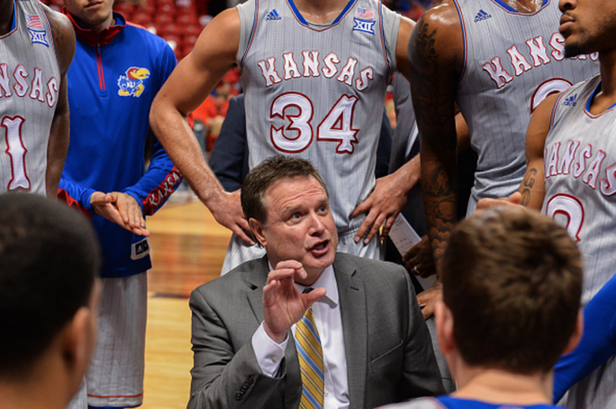
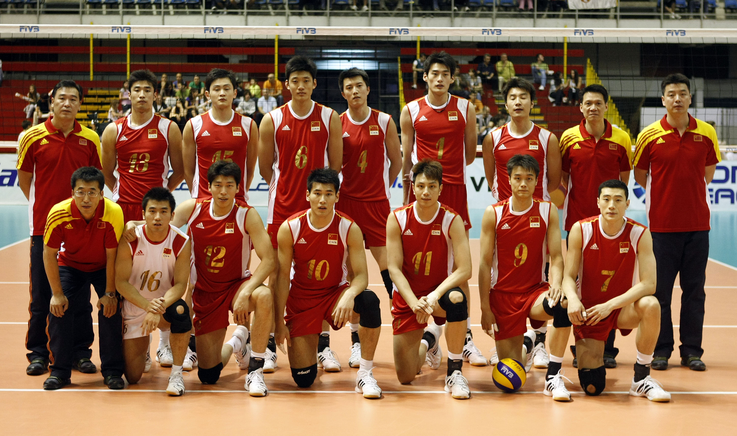
一个牧师／教师就像一个教练。
A Pastor/Teacher is like a Coach.

Slide 15
2017年堪城华人基督教会年会
2017 GKCCCC Annual Meeting
教会异象执行小组:
(1) 寻求组 Seeker group: 王鸿鸣 Hongming Wang
(2) 祷告组 Prayer group: 高正修 Robert Kao
(3) 敬拜组 Worship group: 董振富 Zhenfu Dong.
(4) 团契组 Fellowship: 郦一明 Yiming Li.
(5) 宣教组 Mission group: 刘金石 Jingshi Liu.
(6) 事工组 Ministry group:王德南Tony Wong

Slide 16
邀请 Invitation | “来看”（约1:39） “Come and see”(Jn.1:39)
认同 Identify | “寻找者” “Seeker”
步骤 Step | “告诉他们什么” “Tell them what”
教训 Instruction | 大呼招 （耶29:13） Great Call (Jer.29:13)
宗旨 Purpose | 寻求真神 God Seeking
行动 Actions | 阅读福音书，新约，旧约 Read Gospels,NT+OT
方向指引 Directions | 第一，二，三课 Lessons 1, 2, 3
寻求组
Seeker Group
(1)
王鸿鸣
Homer Wang

Slide 17
  寻求：是对神呼召的回应，是得救的开始，是一生的追求 （马太福音 7:7， 8）
  7 你们祈求，就给你们；寻找，就寻见；叩门，就给你们开门。
  8 因为凡寻求的，就得着；寻找的，就寻见；叩门的，就给他开门。
  共同寻求是神的命令 （马太福音 28：19）
    19 所以，你们要去使万民作我的门徒，奉父，子，圣灵的名给他们施洗。

Slide 18
寻找 组的事工
  接待初来寻求者：初来进门接待，联络信息记录，聚会后接待。
  探访初来寻求者：在初来一周内探访。教会组织探访或离初来寻求者居住地较近的团契小组。
  给初来需求者介绍团契小组：与团契组长沟通。
  给初来需求者介绍合宜的主日学小组：与主日学组长沟通。
  持续的关怀探访。
  根据初来寻求者的生命状况与其他功能小组沟通配搭，目标是使初来寻求者寻到和继续成长。

Slide 19
邀请 Invitation | “悔改，信”（可1:15） “Repent and believe”(Mk.1:15)
认同 Identify | “信徒” “Believer”
步骤 Step | “告诉他们为什么” “Tell them why”
教训 Instruction | 大祷告 （太6:9-13） Great Prayer (Mt.6:9-13)
宗旨 Purpose | 祈求神国 Kingdom praying
行动 Actions | 个人，伙伴，教会祷告Personal, partner, church prayer
方向指引 Directions | 第四，五，六课 Lessons 4, 5, 6
祷告组
Prayer Group
(2)
高正修
Robert Kao

Slide 20
祷告组报告 Prayer Group
教会的祷告聚会:
  每周三晚祷: 7:30-8:45
  每月一次周六晨祷: 每月第四个周六早上 8:00-9:15
Church Prayer Meetings:
  Weekly Prayer Meeting: Wednesday, 7:30 to 8:45 p.m.
  Monthly Prayer Meeting: The fourth Saturday of each month, 8:00-9:15 a.m.

Slide 21
祷告组报告 Prayer Group
藉着与神的祷告: (歌罗西书 1:3,9-12)
  我们感谢神主耶稣基督的父
  我们能满心知道神的旨意
  我们能得属灵的智慧悟性
  我们能行事为人对得起主，凡事蒙他喜悦
  我们能在一切善事上结果子，渐渐地多知道神
  我们凡事能欢欢喜喜地忍耐宽容
  我们能与众圣徒在光明中同得基业
Through our prayers to God,
  we give thanks to Him, the Father of our Lord Jesus Christ.
  we ask Him to give us complete knowledge of His will.
  we ask Him to give us spiritual wisdom and understanding.
  we live the way that will always honor and please the Lord.
  we live the lives that will produce every kind of good fruit and know Him better and better.
  we have all endurance and patience we need, and be filled with joy.
  we share in the inheritance that belongs to His people who live in the light.

Slide 22
邀请 Invitation | “用心灵和诚实敬拜”（约4:24） “Worship in spirit + in truth”(Jn.4:24)
认同 Identify | “敬拜者” “Worshipper”
步骤 Step | “以榜样教导他们” “Show them how”
教训 Instruction | 大诫命－爱神（太22:37） Great command- love God (Mt.22:37)
宗旨 Purpose | 连接于神 Connecting with God
行动 Actions | 敬拜带领，赞美，聚集 Worship leader, music, assembly
方向指引 Directions | 第七，八，九课 Lessons 7, 8, 9
敬拜组
Worship Group
(3)
董振富
Joseph Dong

Slide 23
敬拜组 Worship Group (1/2)
2016 主题 Theme: 持定和前来, 向着大祭司耶稣 Hold Fast, Come Boldly, and Reach Forward to the Great High Priest Jesus
2017 主题 Theme: 基督要建立祂的教会(太16:18) Christ Will Build His Church” Matthew 16:18
敬拜聚會 Worship Service:
  祷告 Prayer: 9:15-9:30 Sunday
  英文聚会 English Service
    9:30-10:30 Sunday; Message: Pastor Gary
  中文聚会 Chinese Service
    10:40-12:00 Sunday; 信息: 何牧师

Slide 24
敬拜组 Worship Group (1/2)
擘餅聚會 Communion
  9:30-10:30 First Sunday/Month (每月第一个主日)
  何礼义 (Gary Hart) 、 高正修(Robert)、王德南(Tony)
施浸 Baptism
  何礼义 (Gary Hart); 高正修(Robert); 王德南(Tony)
儿童主日聚会 Children Sunday Service
  10:50-12:00 Sunday
特别聚会 Special Meeting
2016年 | 2017年
3/18-3/20 (潘秋松牧师) 6/17-6/19 (Pastor Brown) 11/5-11/6 (赵约翰牧师) | 福音特会: 3/31-4/2 (张路加牧师) 夏季退休会: 6/9-6/11 (Randy Dolan) 特别聚会: 9/8-9/10 (李健安牧师)

Slide 25
主日学 Sunday School
事工组之一 Part of the Ministry Group
成人主日學 Adult Sunday School
  福音組 Seeker:
    毕程鹏; 内容 - 路加福音 + 使徒行传 (Luke; Acts)
  基要真理組 Basic Doctrine:
    李树明、王军; 内容 – 方向指引 Directions (2016); 使徒行传 Acts (2017)
  聖徒生活組 Christian Living:
    伍雷、张正卿;内容 – 方向指引 Directions (2016); 使徒行传 Acts (2017)
  明年计划 Plan of Next Year
英文組 English
  青年组 Young Adults: 郦臻祺 George Li
  高中組 High School: 王德南、孙约礼、董振富
兒童主日學 Children Sunday School
  (See slides for Children’s Education)

Slide 26
邀请 Invitation | “来跟基督在一起”（可3:14） “Come+be with Christ”(Mk.3:14)
认同 Identify | “团结者” “Fellowshipper”
步骤 Step | “跟他们一起做” “Do it with them”
教训 Instruction | 大诫命－爱人（太22:39） Great command-love others(Mt.22:39)
宗旨 Purpose | 关爱别人 Caring for others
行动 Actions | 男女青年，少年组 Men,women,youth,children group
方向指引 Directions | 第十，十一，十二课 Lessons 10, 11, 12
团契组
Fellowship Group
(4)
郦一明
Yiming Li

Slide 27
  为什么我们要相交 （约 翰一书 1:3， 7）
  3 我们将所看见、所听见的传给你们，使你们与我们相交。我们乃是与父并他儿子耶稣基督相交的。
  7 我们若在光明中行，如同神在光明中，就彼此相交，他儿子耶稣的血也洗净我们一切的罪
  相交的定义 （腓立比書 1：4 – 8）
    彼此代祷
    在福音的事工上有分
    主成全这善功
    同享神的恩典
    真心的关怀

Slide 28
相交的榜样
  罗伯特.戚伯门（Robert Clever Chapman）: “There are many who preach Christ, but not so many who live Christ; my great aim will be to live Christ.”
相交的事工
團契小組
  北區 – 李白
  東南區 – 伍雷
  尋求組 – 王鴻鳴
  教会青年成人 – 郦一明，刘金石，董振富
  长青 – 萬壽蓮/黃圓珠
细胞小组-

Slide 29
關懷探訪
協調教會的探訪關懷事項，特别对身体上软弱的弟兄
合區聚會 - 庆祝新年（年轻人和成人）
交通
維護教會的網頁平台，使之成為弟兄姊妹的交通的工具。
问自己的问题
我在教会中是否有真正的属灵的朋友和伙伴？
我是否有一个团契的地方？
我是否愿意找人交通？
我是否愿意探访别人？
我是否愿意邀别人探访或接受别人探访？

Slide 30
邀请 Invitation | “跟从基督得人如得鱼一样” “Follow Christ+be fishers of men”
认同 Identify | “得人如得鱼”（太4:19） “Fishers of men”(Mt.4:19)
步骤 Step | “让他们做” “Let them do it”
教训 Instruction | 大使命（太28:19-20） Great commission(Mt.28:19-20)
宗旨 Purpose | 献身宣教 Committing to missions
行动 Actions | 奉献，去当地和地极宣教 Give, go local & global missions
方向指引 Directions | 第十三，十四，十五课 Lessons 13, 14, 15
宣教组
Mission Group
(5)
刘金石
Jimmy Liu

Slide 31
献身宣教。往后看宣教组2016年的报告：
1。本地宣教：去年夏天有4位青少年参加了“基督青少年在行动”的暑期培训和宣道，他们在大堪城组织了由青少年孩童参加的五天布道营。八月份我们教会与Shawnee 圣经教会一起举办了暑期圣经学校。我们在平安夜去Brookdale老人院给老人们表演圣诞节目，并于圣诞节的当天在本教会表演了同样的节目。我们在堪萨斯大学医学院开始了查经班，有两人接受主耶稣做他们的救主.
2。全球宣教：我们收到以下宣教士的报告，台湾的洪虹，洪佳 以及Marc and Jamie Heckman, Rick and Barb Beard。在中国宣教的Sue Koch, and Jane Marcum，在日本宣教的Eusey 夫妇。接待台湾来访的许有为。我们对这些宣教士和他们的事工有爱心奉献。
C=Committing to missions. Missions Report looking back at 2016:
1. Local Missions: 4 Youth worked with CYIA during the summer,2016 doing 5-day Bible Clubs in the Kansas City area.Augst,2016 GKCCCC and Shawnee Bible Church work together to do VBS. We did Christmas Eve program at Brookdale Assisted Living in Shawnee and Christmas Day at GKCCCC. We started a Bible Study at KU MC where 2 people accepted Christ as their Savior.
2. Global Missions: We had Missionary reports from Taiwan: Davina and Charissa Hong, Marc and Jamie Heckman, Rick and Barb Beard; from China: Sue Koch, and Jane Marcum; and from Japan: Evan and Audrey Eusey. Jim Xu visited from Taiwan. Also gifts were given to missionary support and projects.

Slide 32
献身宣教。往前看宣教组2017年的报告：
1。本地宣教：3/31-4/2 张路加的福音布道会，现在有9位青少年考虑参加2017年的基督青年在行动。我们也为暑假圣经学校祷告。我们也希望继续组织圣诞节目。
2。全球宣教：我们计划继续支持台湾和中国的宣传士和事工。我们为开展新的宣教事工祷告。
3。宣教目标：我们的目标是至少拿出教会预算的10%用于宣道。我们也希望宣道祷告小组为现在与我们有联络的宣教士祷告并藉此给他们鼓励和支持。
C=Committing to missions. Missions Report looking forward to 2017:
1. Local Missions: We will have Evangelistic Services 3/31-4/2 with Pastor Luke Zhang. 9 Youth are considering working with CYIA summer,2017. We are praying about VBS for this summer. We hope to continue Christmas programs.
2. Global Missions: We plan to continue missionary support and projects to Taiwan and China. We are also praying about new missionary support and projects.
3. Missions Objectives: It is our objective to give at least 10% of our Church budget to Missions. It is also our objective to have Missionary Prayer Teams to pray for and to encourage the missionaries that we have contact with.

Slide 33
邀请 Invitation | “常在基督里面”（约15:5） “Abide in Christ”(Jn.15:5)
认同 Identify | “仆人／工人” “Ministers/Workers”
步骤 Step | “部署他们” “Deploy them”
教训 Instruction | 大奉献（彼前4:10） Great service(1Pet.4:10)
宗旨 Purpose | 奉献事工 Consecrating to ministry
行动 Actions | 教导，服事 Teaching, serving
方向指引 Directions | 第十六，十七，十八课 Lessons 16, 17, 18
事工组
Ministry Group
(6)
王德南
Tony Wong

Slide 34
2017年堪城华人基督教会年会
2017 GKCCCC Annual Meeting
Children’s Education
Train a child in the way he should go, and when he is old he will not turn from it. 教養孩童，使他走當行的道，就是到老他也不偏離。(Proverbs 22:6)
Purpose: To reach the next generation with the gospel of Jesus Christ
Teaching the Word of God- the knowledge of God produce faith
  Awareness of God
  Reconcile with God
Discussing the Word of God and shepherding the students.
  Daily connection with God through reading the Bible and prayer
  Become a follower of Christ through personal encounter with God

Slide 35
2017年堪城华人基督教会年会
2017 GKCCCC Annual Meeting
Children’s Education
Teachers
Sunday school
Pre/K Hai Yan, Shirley Wang
1-3 Wu Lihong, Sun Wie, Gloria
4&5 Wang Ping, Stella, Grace
6-8 Song Yin, Wang Lijun, Li Yiming, Sharon Hart
Children’s Worship for Preschool through 3rd Grade
Xiong Li, Gloria Li, Geng Xin

Slide 36
2017年堪城华人基督教会年会
2017 GKCCCC Annual Meeting
总务组 (General Affairs)-鄧斌 David Deng
厨房 (Kitchen) – Pearl
清洁 (Cleaning) – Youbin Xiang
图书 (Library) – Youbin Xiang
检查 (Building Inspection) - Jean
洗地毯 (Carpet Cleaning)
除草 (Lawn service)
场地保养 (Facility Maintenance)
购买 (Purchasing) – Yong Zuo
除雪 (Snow removal)
杀虫 (Pest Control)

Slide 37
2017年堪城华人基督教会年会
2017 GKCCCC Annual Meeting
2016年 Completed Items (完成项目)
Roof 屋顶
Outside Painting 外部油漆
HVAC 空调维修
Fall leaves cleanup 秋季树叶清理
2017年 Need more coworkers 需要更多同工

Slide 38
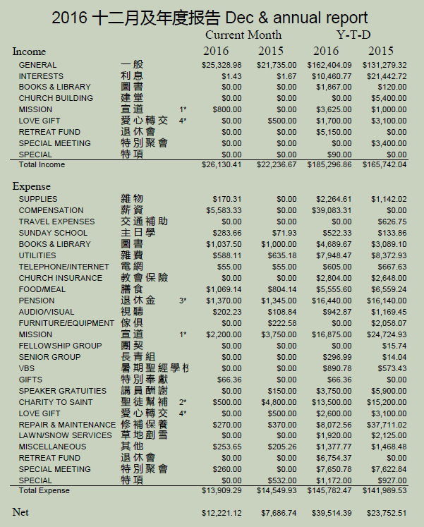
2016年堪城华人基督教会年会 財務報告 Financial Report

Slide 39
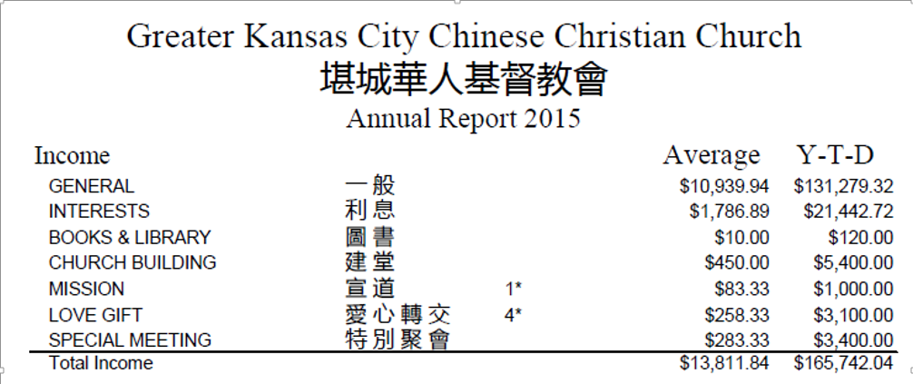
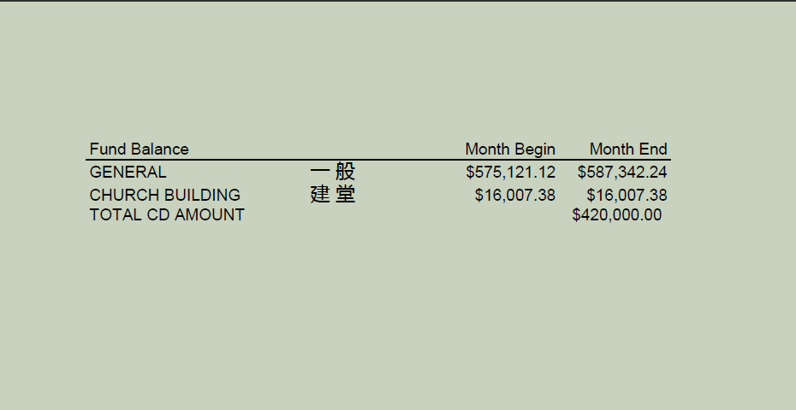
財務報告 Financial Report

