Slide 1
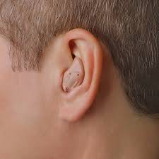
Pastor Gary Hart 8-28-16
Text:Heb.1:1-3
Sermon Title: Is anybody listening?
Introduction: A man from England,visited his doctor to have his hearing checked. The doctor removed the man’s hearing aid, and his hearing immediately improved! He had been wearing the device in the wrong ear for over 20 years!There is a difference between listening and really hearing. Jesus often said, “Whoever has ears to hear, let him hear”(Mk.4:9;23). “Whoever has ears, let them hear what the Spirit says to the churches”(Rev.2-3). This statement suggests that it takes more than physical ears to hear the voice of God. It also requires a receptive heart. “So, as the Holy Spirit says:‘Today, if you hear his voice,do not harden your hearts as you did in the rebellion,during the time of testing in the wilderness”(Heb.3:7-8).We are not told who the author Hebrews is.It was an anonymous letter written to Jews facing persecution who were tempted to turn back, rather than go forward. Let us begin our study of Hebrews by looking at five characteristics of this book. May our hearts and ears be open to hear the message of this book of Hebrews.
(1)

Slide 2
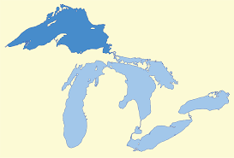
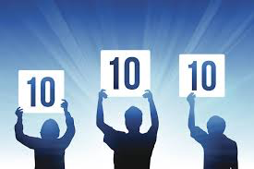
1. It is a Book of Evaluation. 3 key words show the superiority of Jesus Christ and His salvation over the Hebrew religion(1:4).
A. “Superior/Better” is used 15 times:Christ is “superior” to angels with “superior” name(1:4), “superior” ministry and mediator(8:6). Christ has a “better” salvation(6:9), a “better” hope(7:19), a “better” covenant(7:22), “better” promises(8:6), “better” sacrifices(9:23), so that we can have “better” possessions(10:34), “better” offerings(11:4), “better” country(11:16), “better” resurrection(11:35), “better” plan (11:40), and “better” word(12:24).
B. “Perfect” is used 14 times. It means a “perfect” standing before God (2:10;5:9). This perfection could never be accomplished by the Levitical priesthood(7:11), nor by the law (7:19), nor by the blood of animal sacrifices(10:1). Jesus Christ gave Himself as one offering for sin, and by this He has “made perfect forever those who are being made holy”(10:14). He is also the “perfector of our faith”(12:2).
(2)

Slide 3
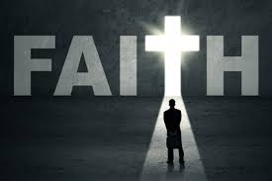
C. “Eternal/Forever” is use 15 times. Christ is the source of “eternal” salvation(5:9), “eternal” redemption(9:12), “eternal” inheritance (9:15), His throne is “forever”(1:8), He is a priest “forever” (5:6;6:20;7:17,21). Jesus Christ, the same yesterday, and to day, and forever” (13:8). Jesus Christ and the Christian life He gives us are better because these blessings are eternal and they give us a perfect standing before God. Other religions (Judaism, Buddhism, Taoism, Islam, etc.) are inferior, temporary, and imperfect.
*Application: Why were they asked to evaluate their faith? Because they were going through difficult times and were being tempted to go back to the Jewish religion. These people were second-generation believers, having been won to Christ by those who had known Jesus during His earthly ministry (2:3). They were true believers (3:1), but they were at a standstill spiritually and in danger of going backward (5:12ff), some of them had even forsaken the regular worship services(10:25) and were not making spiritual progress(6:1).
(3)
(2)

Slide 4
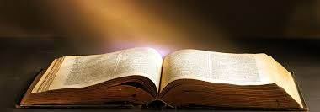
2. It is a Book of Exhortation. This means “encouragement.” Not written to frighten people, but to encourage people(13:22). “God…has spoken to us by his Son”(1:1-2). “See to it that you do not refuse him who speaks”(12:25). The theme of Hebrews is “God has spoken; we have His Word. What are we doing about it?” We need to hear God’s Word. If you do not listen to God’s Word and really hear it,
then you will start to take a
downward
path.
A. Drifting from the Word (2:1-4)—leads to neglect.
B. Doubting the Word (3:7-4:13)—leads to a hard heart.
C. Dullness toward the Word (5:11-6:20)—leads to sluggishness.
D. Despising the Word (10:26-39)—leads to willfulness.
E. Defying the Word (12:14-29)—refusing to hear.
(4)
(2)

Slide 5
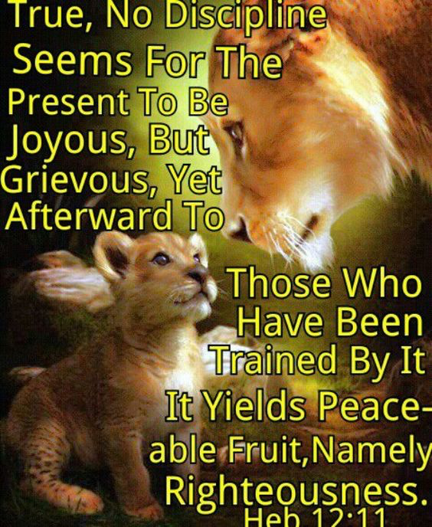
*Application: What does God do while this spiritual downward spiral is going on? He keeps speaking to us, encouraging us to get back to the Word. If we fail to listen and obey, then He begins to discipline us. God does not allow His children to become “spoiled brats” by permitting them to willfully defy His Word. He always disciplines in love. Hear and heed the Word of God, lest you regress spiritually and experience the chastening hand of God.
(5)
(2)

Slide 6
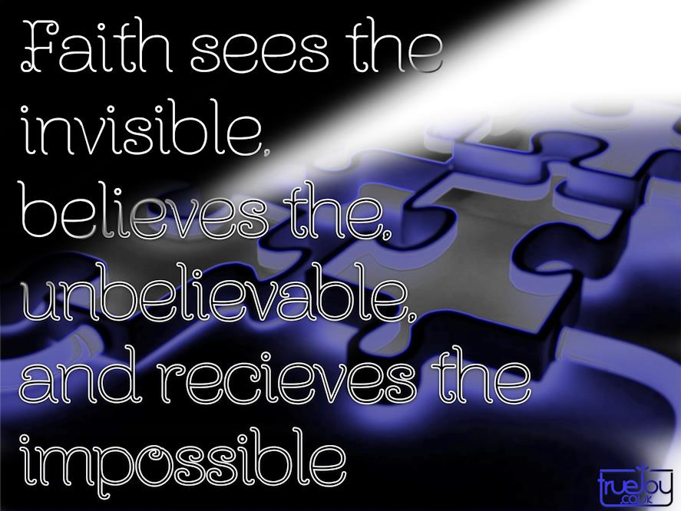
3. It is a Book of Examination. What am I really trusting? Am I trusting the Word of God, or am I trusting the things of this world that are shaking and ready to fall away?
A. The Day is approaching(10:25). In a few years the temple and the city would be destroyed and the Jewish nation would be scattered. We are living in the last days.
B. Depend upon the foundation not the scaffolding. “Established” is used 8 times. It means “to be solidly grounded, to stand firm on your feet.” “You can be secure while everything around you is falling apart!” We have a “kingdom which cannot be moved”(12:28). God’s Word is steadfast (2:2) and so is the hope we have in Him (6:10).
C. Live by faith not unbelief. “Faith” appears 35 times. “Let us hold firmly to the faith we profess”(4:14).
*Application: “But my righteous one will live
by faith. And I take no pleasure in the one who
shrinks back”(10:38).
(6)
(2)

Slide 7
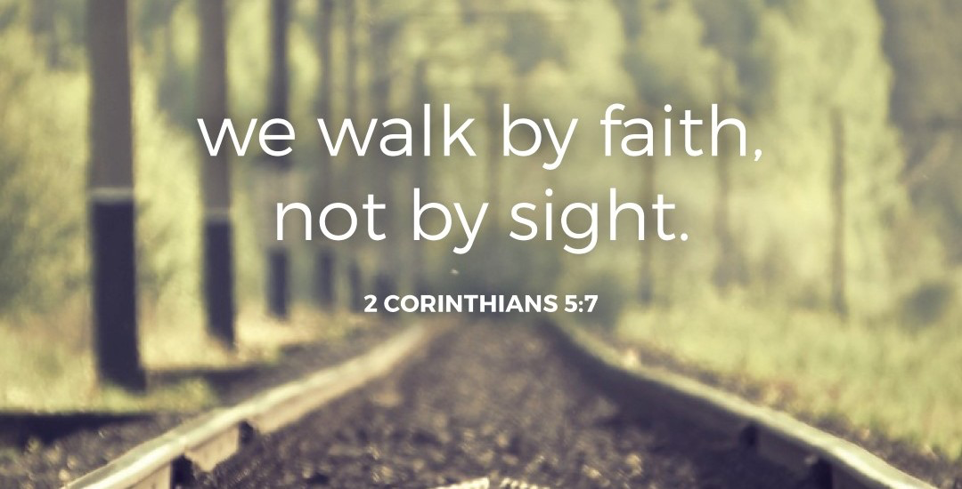
4. It is a Book of Expectation. We are looking for that future city of God (11:10-16,26).
A. Abraham was first of all God’s servant, a pilgrim and a stranger, who lived in a tent in the plains.
B. Lot chose to abandon the pilgrim life and move into the evil city of Sodom.
*Application: Don’t live for what the world will promise you today! Live for what God has promised you in the future! Be a stranger and a pilgrim on this earth! Walk by faith,not by sight!
(7)
(2)

Slide 8
5. It is a Book of Exhaltation. Hebrews exalts the person and the work of our Lord Jesus Christ. Jesus is superior to the prophets.
A. In His person, Christ is superior to the prophets. He is the Son of God, not merely men called by God (Prophets). “Radiance of his glory” refers to the glory of God that dwelt in the tabernacle(Ex.40:34-38) and temple(1 K.8:10).What the rays of the sun are to the sun. He is “exact representation” of the very substance of God. When you see Christ, you see the glory of God (Jn.1:14;14:9).
B. In His work, Christ is also superior to the prophets. He is the Creator of the Universe, for by Him, God “made the worlds”(1:2).Not only did Christ create all things by His Word(Jn.1:1-5),but He also “sustains” all things by that same powerful Word(1:3).He is one Son, they are many prophets. He has a final and complete message, the prophets had a fragmentary and incomplete message. He is priest who “purged our sins”(1:3) and King who reigns(1:3). “He sat down on the right hand of the Majesty in heaven”(1:3).
(8)
(2)

Slide 9
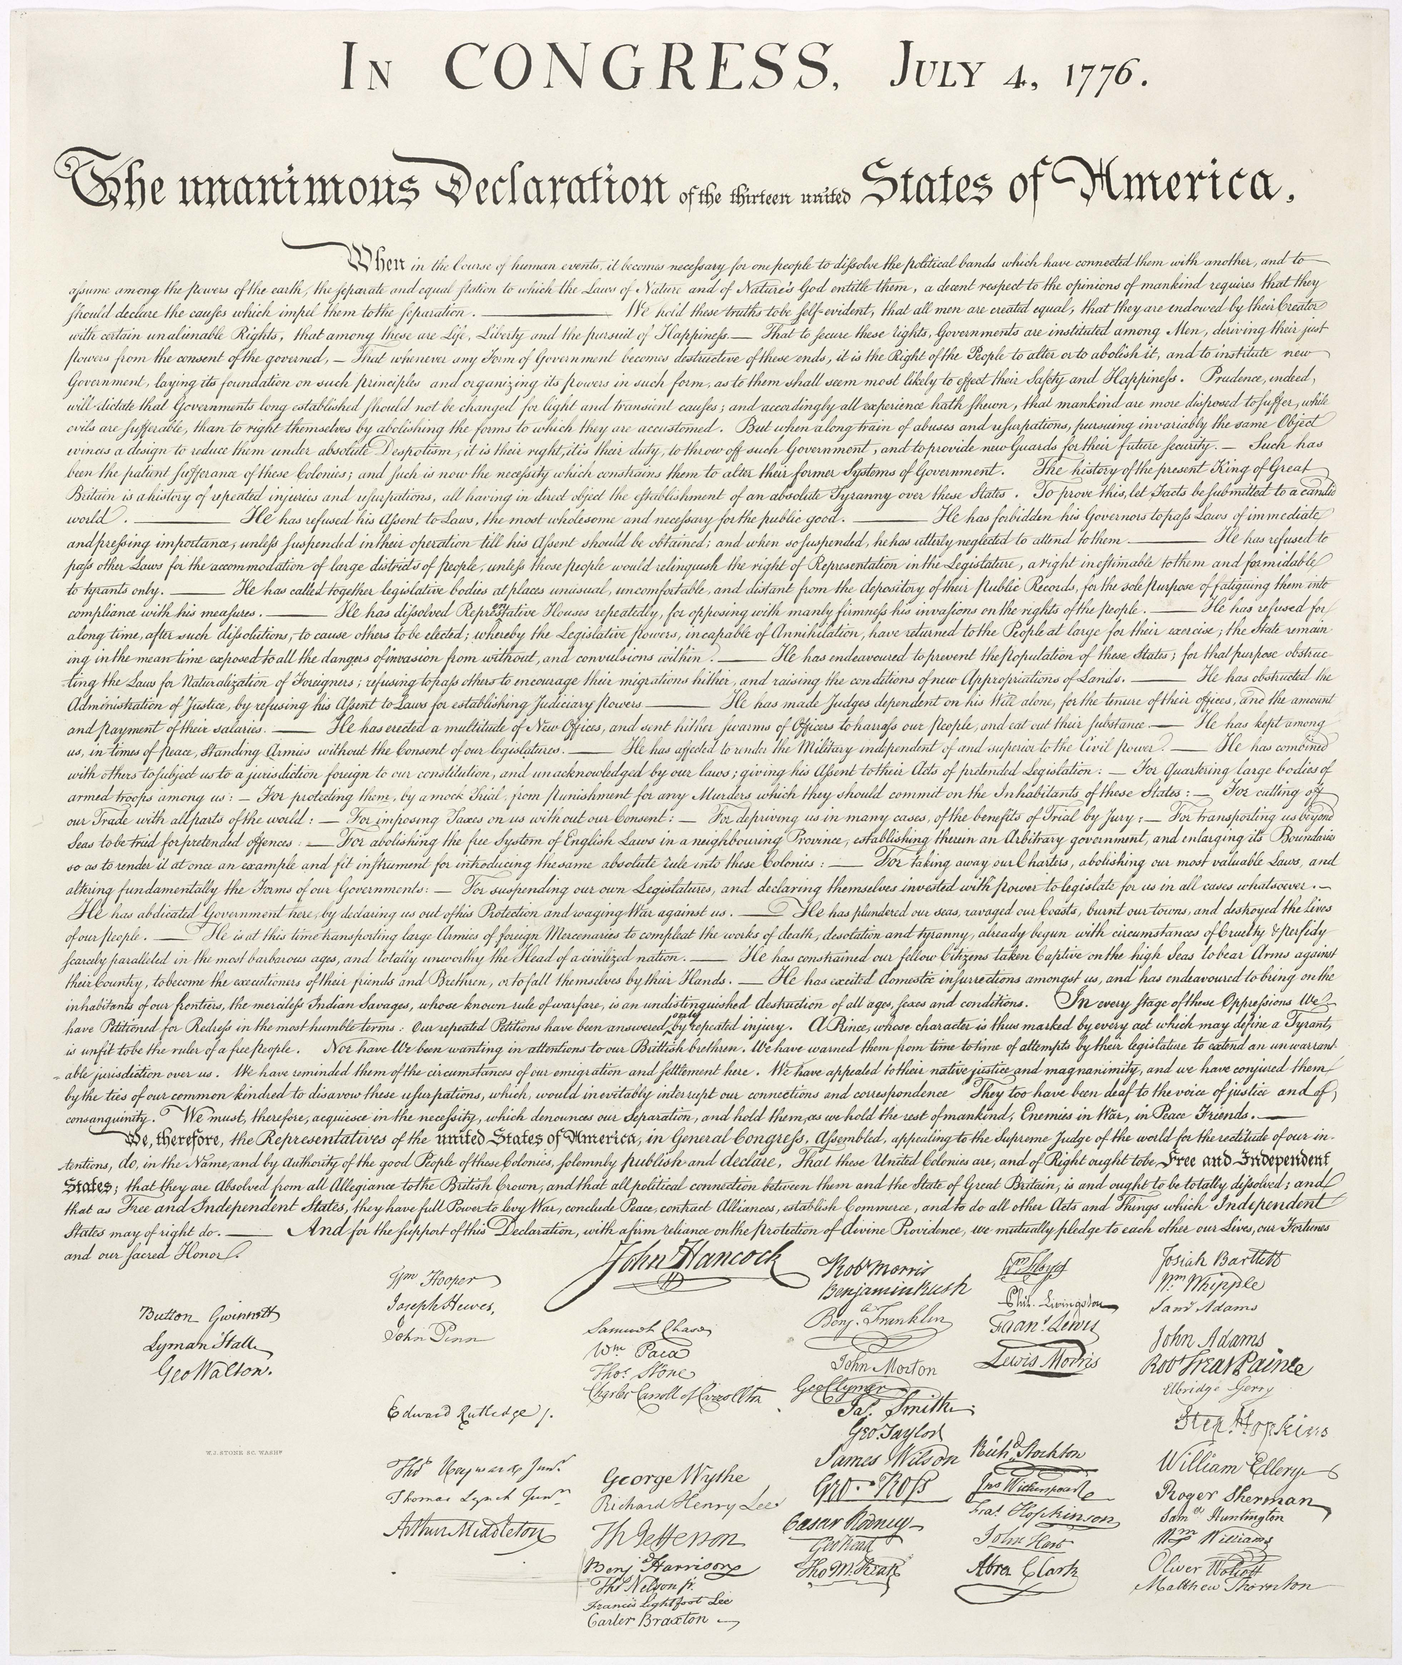
Conclusion: “In 1989, a person from Philadelphia purchased an oil painting for four dollars at a garage sale. Later, he discovered an old folded copy of the Declaration of Independence behind the painting. A friend encouraged him to have it appraised. The document turned out to be one of 23 remaining copies of the very first printing of the Declaration of Independence and sold for $2.42 million dollars at auction. The original owner didn’t recognize its value and practically gave it away. People who don’t have faith in God and hear the gospel are just like that person who gave away a valuable document; they don’t understand its worth.” “Good news came…but the message they heard did not benefit them”(4:2)
(9)
(2)

