Slide 1
母亲节快乐！
Happy Mother’s Day!
妈妈我爱您！
Mom I love you!
何礼义牧师 Pastor Gary Hart
题目：“母亲节。” Topic: “Mother’s Day.”
经文:箴言31:28-31 Text: Proverbs 31:28-31
二零一七年五月十四日 May 14, 2017

Slide 2
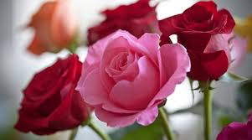
引言:母亲节是五月份的第二个星期日，为对母亲们表示敬意。“母亲”可以指大自然，祖国，母语等。“母亲”在圣经中有八种不同的用法。“她的儿女起来称她有福。她的丈夫也称赞她，说才得的女子很多，惟独你超过一切。艳丽是虚假的。美容是虚浮的。惟敬畏耶和华的妇女，必得称赞。愿她享受操作所得的。愿她的工作，在城门口荣耀她”（箴31:28-31）。
Introduction: Mother’s Day is the second Sunday in May, observed in honor of mothers. While mother can refer to Mother Nature, mother country, motherland, mother tongue, etc. Mother is used in the Bible to refer to eight different kinds of mothers. “Her children arise and call her blessed;her husband also,and he praises her: Many women do noble things, but you surpass them all. Charm is deceptive, and beauty is fleeting; but a woman who fears the Lord is to be praised. Honor her for all that her hands have done, and let her works bring her praise at the city gate” (Prov.31:28-31).

Slide 3
1。生母是指怀孕和生下孩子女人（亲生母亲）。
A。夏娃是生活的母亲。“亚当给他妻子起名叫夏娃，因为她是众生之母”（创3:20）。
B。撒拉是众生之母。“我要赐福给她，她也要作多国之母。必有百姓的君王从她而出”（17:16）。
应用：生母是爱的劳动者。“妇人生产的时候，就忧愁，因为她的时候到了。既生了孩子，就不再纪念那苦楚，因为｀喜欢世上生了人”（约16:21）。
1. Birth mother means the woman who conceives and gives birth to a child (biological or natural mother).
A. Eve is the mother of all the living. “Adam named his wife Eve, because she would become the mother of all the living”(Gen.3:20).
B. Sarah is the mother of nations. “I will bless her so that she will be the mother
of nations; kings of peoples will come from her”(17:16).
Application: Birth mother is a labor of love. “A woman giving birth to a child has pain because her time has come; but when her baby is born she forgets the anguish because of her joy that a child is born into the world”(Jn.16:21).

Slide 4
2。养母是指通过法律手段获得权力来养育孩子的女人。
A。撒拉可以收养以利谢。“亚伯兰说，主耶和华阿，我既无子，你还赐我什么呢？并且要承受我家业的是大马色人以利谢”(创15:2)。
B。法老的女儿收养了摩西。“孩子渐长，妇人把他带到法老女儿那里，就作了她的儿子。他给孩子起名叫摩西”（出2:10）。
应用：养母是爱的旅程。 “爱之旅”是指去中国从孤儿院领养小孩的母亲。
2. Adoptive mother means the woman who takes through legal means and raises as one’s own child.
A. Sarah could adopt Eliezer. “But Abram said,Sovereign Lord,what can you give me since I remain childless and the one who will inherit my estate is Eliezer of Damascus?”(Gen.15:2).
B. Pharaoh’s daughter adopted Moses. “When the child grew older, she took him to Pharaoh’s daughter and he became her son. She named him Moses”(Ex.2:10).
Application: Adoptive mother is a journey of love. The “journey of love” refers to the mothers who go to China to adopt a child from an orphanage.

Slide 5
基督徒是神所收养的孩子。“所以你们因信基督耶稣，都是神的儿子”（加3:26）。“爱的旅程”是当神就差遣他的儿子的时候…要把律法以下的人赎出来，叫我们得着儿子的名分（4:4,5）。
Christians are God’s adopted children. “So in Christ Jesus you are all children of God through faith”(Ga.3:26).The “journey of love” was when “God sent his Son…to redeem those under the law, that we might receive adoption to sonship(4:4,5).

Slide 6
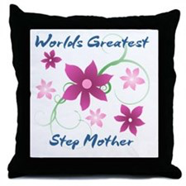
3。后母是指孩子父亲的妻子，将孩子当作自己的孩子养育。
A。撒拉是以实玛利的后母。“后来夏甲给亚伯兰生了一儿子，亚伯兰给它起名叫以实玛利”(创16:15)。
B。拉结是利亚七个孩子的后母（创29:31-35; 30:16-21）。
C。利亚是拉结两个孩子的后母（创30:22-24; 35:18）。
应用：后母是爱的教育。后母往往声誉不佳，但他们可以学习去爱他们的继子女。
3. Step mother means the wife of one’s father and raises as one’s own child.
A. Sarah was a step mother to Ishmael. “So Hagar bore Abram a son, and Abram gave the name Ishmael to the son she had borne” (Gen.16:15).
B. Rachel was a step mother to Leah’s seven children (Gen.29:31-35;30:16-21).
C. Leah was a step mother to Rachel’s two children (Gen.30:22-24;35:18).
Application: Step mother is an education of love.Step
mothers often have a bad reputation, but they can learn
to love their step children.

Slide 7
4。岳母是指妻子的母亲， 婆婆是指丈夫的母亲。
A。拿俄米是离开她的奥尔巴的婆婆。“两个儿妇又放声而哭，饿珥巴婆婆亲嘴而别” (得1:14)。
B。拿俄米是路得舍不得的婆婆。 “两个儿妇又放声而哭…只是路德舍不得拿俄米”（得1:14）。
应用：婆婆是爱的努力。“路得的婆婆拿俄米对她说：女儿啊，我不当为你找个安身之处，使你享福吗？”（得3:1）。
4. Mother-in-law means the mother of one’s wife or husband.
A. Naomi was a mother-in-law to Orpah who left her. “At this they wept aloud again. Then Orpah kissed her mother-in-law goodbye” (Ruth 1:14).
B. Naomi was a mother-in-law to Ruth who clung her. “At this they wept aloud again…Ruth clung to her”(Ruth 1:14).
Application: Mother-in-law is an effort of love. “One day Ruth’s mother-in-law Naomi said to her, “My daughter, I must find a home for you, where you will be well provided for”(Ruth 3:1).

Slide 8
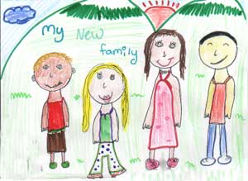
5。养母是指为无母亲照顾的孩子提供抚育的女人。
A。善良的女人将手伸向有需要的人（箴言31:20）。
B。女人照顾孤儿。 “在神我们的父面前，那清洁没有玷污的虔诚，就是看顾在患难中的孤儿寡妇”（雅1:27）。
应用：寄养母亲是照顾爱情，伸展给需要帮助的孩子。
5. Foster mother means a woman who provides care and nurture to the motherless.
A. Virtuous woman extends her hands to the needy (Prov.31:20).
B. Woman looks after orphans. “Religion that God our Father accepts as pure and faultless is this: to look after orphans and widows in their distress”(Ja.1:27).
Application: Foster mother is a care of love that reaches out to children in need.

Slide 9
2。祖母是指父亲或母亲的母亲。
A。玛迦是亚撒的祖母。“亚撒王贬了他祖母玛迦太后地位，因她造了可憎的偶像亚舍拉。亚撒砍下她的偶像，捣得粉碎，烧在汲沦溪边”(创15:2)。
B。罗以是提摩太的祖母。“想到你心里无伪之心，这信是先在你外祖母罗以和你母亲友尼基心里的，我深信也在你的心里”（提后1:5）。
应用：祖母是爱的例子。 祖母对他们的孙子有很大的影响力。
6. Grandmother means the mother of one’s father or mother.
A. Maakah was a grandmother to Asa. “King Asa also deposed his grand-mother Maakah from her position as queen mother,because she had made a repulsive image for the worship of Asherah. Asa cut it down, broke it up and burned it in the Kidron Valley”(2Chron.15:16).
B. Lois was a grandmother to Timothy. “I am reminded of your sincere faith, which first lived in your grandmother Lois and in your mother Eunice and, I am persuaded, now lives in you also”(2Tim.1:5).
Application: Grandmother is an example of love. Grandmothers have an grand influence on their grandchildren.

Slide 10
7。指导母亲是一位聪明而值得信赖的辅导员或老师。
A。老年妇女教导什么是好的。“又劝老年妇人举止行动要恭敬，不说谗言，不给酒做奴仆，用善道教训人”(多2:3)。
B。老年妇女教年轻妇女。“好指教少年妇人，爱丈夫，爱儿女，谨守贞洁，料理家务，待人有恩，顺服自己的丈夫，免得神的道理被毁谤”（多2:4-5）。
应用：指导母亲是一位教导老师，教导年轻女人和其他人神的道路。
7. Mentoring mother means a wise and trusted counselor or teacher.
A. Older women teach what is good. “Likewise, teach the older women to be reverent in the way they live, not to be slanderers or addicted to much wine, but to teach what is good”(Titus 2:3).
B. Older women teach young women. “They can urge the younger women to love their husbands and children,to be self-controlled and pure, to be busy at home, to be kind, and to be subject to their husbands, so that no one will malign the word of God”(2:4-5).
Application: Mentoring mother is a teacher of love who teaches younger women and others the ways of God.

Slide 11
8。守护母亲是指看守或保护孩子的女人。 像一个照顾和护理一个孩子的保姆。
A。米里暗姆是她弟弟摩西的守护母亲。“孩子的姐姐…说:我去在希伯来妇人中叫一个妈妈来，为你奶这孩子，可以不可以”(出2:7)。
B。玛丽是约翰的守护母亲。“耶稣见母亲和他所爱的那门徒站在旁边，就对他母亲说：母亲，看你的儿子！又对那门徒说：看你的母亲！从此那门徒就接她到自己家里去了”（约19:26-27）。
应用：守护母亲是一个爱的守护者，看守、保护着。
8. Guardian mother means a woman who watches over or protects. Like a nanny who takes care of and nurses a child.
A. Miriam was a guardian mother to her brother,Moses. “Then his sister asked… Shall I go and get one of the Hebrew women to nurse the baby for you?”(Ex.2:7).
B. Mary was a guardian mother to John. “When Jesus saw his mother there, and the disciple whom he loved standing nearby, he said to her, “Woman, here is your son,” and to the disciple, “Here is your mother.” From that time on, this disciple took her into his home”(Jn.19:26-27).
Application: Guardian mother is a loving protector who watches over to protect.

Slide 12
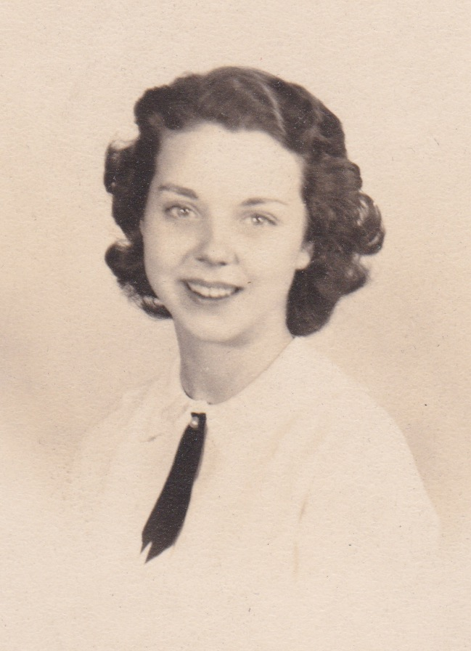
结论：母亲的职责是什么？母亲爱（王上3:26;赛49:15），关心（得4:16;赛66:13; 帖前2:13），保护（出2:1-3；来11:23）教育（箴31:1,26; 提后1: 5;3:15），看守着她的孩子（创27:5-11; 王上1:11-31;箴31:15,27）。我为生母、养母、岳母、婆婆、祖母、指导母亲和守护母亲感谢上帝。我也为我的母亲何玛丽安赞颂上帝，她不仅是我的生母，也是我属灵的母亲。 因为我的母亲，我有一个身体和属灵的诞生。
Conclusion:What are the duties of a mother? A mother loves (1Ki.3:26;Isa49:15), cares(Ruth4:16;Isa.66:13;1Thes. 2:13),
protects (Ex.2:1-3;Heb.11:23), educates (Prov.31:1,26;2Tim.1:5;3:15)and watches over her children(Gen.27:5-11;1Ki.1:11-31;Prov.31:15,27).I am thankful to God for birth mothers, adoptive mothers, step mothers, mother-in-laws, foster mothers, grandmothers, mentoring mothers, and guardian mothers. I am also praise God for my mother, Marian Hart who is not only my physical mother but also my spiritual mother. Because of my mother I have a physical and a spiritual birth.

Slide 13
我们感谢母亲的劳动、旅程、教育、努力、关怀、榜样、教导、和保护之爱。母亲对他人有很大的影响。 你会感谢那些已经和现在对你生活有影响的不同母亲吗？ 你可以亲自对他们说话，给他们打个电话，或者给他们写一张卡片或信件。 “谢谢你像我母亲一样。”谢谢你们我们所有的母亲！
We are grateful for mothers’ labor, journey, education, effort, care, example, teaching, and protecting love. Mothers have a great impact on others. Will you thank the different mothers who have had and now have an impact on your life? You can speak to them in person, give them a phone call, or write them a card or letter of appreciation. “Thank you for being like a mother to me.” Thank you to all our mothers!

