Slide 1
Pastor Gary Hart January 24,2016 Text:Nehemiah1:1-11
(1)
1 The words of Nehemiah son of Hakaliah:In the month of Kislev in the twentieth year,while I was in the citadel of Susa, 2 Hanani one of my brothers, came from Judah with some other men, and I questioned them about the Jewish remnant that had survived the exile, and also about Jerusalem. 3 They said to me,“Those who survived the exile and are back in the province are in great trouble and disgrace.The wall of Jerusalem is broken down,and its gates have been burned with fire.” 4 When I heard these things, I sat down and wept.For some days I mourned and fasted and prayed before the God of heaven. 5 Then I said:“Lord, the God of heaven, the great and awesome God, who keeps his covenant of love with those who love him and keep his commandments, 6 let your ear be attentive and your eyes open to hear the prayer your servant is praying before you day and night for your servants, the people of Israel. I

Slide 2
confess the sins we Israelites, including myself and my father’s family, have committed against you.7 We have acted very wickedly toward you. We have not obeyed the commands, decrees and laws you gave your servant Moses. 8 “Remember the instruction you gave your servant Moses, saying, ‘If you are unfaithful, I will scatter you among the nations, 9 but if you return to me and obey my commands, then even if your exiled people are at the farthest horizon, I will gather them from there and bring them to the place I have chosen as a dwelling for my Name.’ 10 “They are your servants and your people, whom you redeemed by your great strength and your mighty hand. 11 Lord, let your ear be attentive to the prayer of this your servant and to the prayer of your servants who delight in revering your name. Give your servant success today by granting him favor in the presence of this man.” I was cupbearer to the king. (Nehemiah 1:1-11)
(2)

Slide 3
Sermon Title: “A vision is born.” Intro: What is a vision? Helen Keller said, “The only thing worse than having no sight is to have sight but no vision.” Nehemiah was a regular guy (not a king, priest, or prophet) who had a divine vision of what could and should be. Nehemiah’s name means, “Yahweh has comforted.” Because God’s vision is born in Nehemiah’s heart many who were troubled would receive comfort.
1. The News about the Jewish remnant and also about Jerusalem (1:1-3). Some good news and some bad news, what do you want to hear first?
A. Good News: The Jewish remnant is surviving
in Jerusalem. They are survivors! They are alive!
B. Bad News: They are in great trouble and
disgrace. The wall of Jerusalem is broken down, and its gates have been burned with fire.They are not thriving, but in great trouble! They are dying! It was bad, but now it’s worse?
(3)

Slide 4
2. The Responses to the bad news. What are different responses to the situation?
A. “So what? Ask me if I care? I don’t care” (indifferent).
B. “What about me? I care a little, but have too many troubles. Don’t bother me” (other concerns).
C. “What can I do? I care and want to do something about it. I am concerned” (I have a burden).
(4)

Slide 5
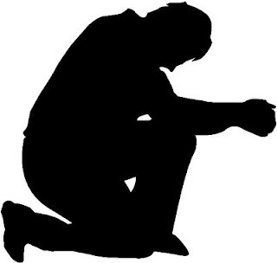
3. The Vision is born. Where does a vision come from and how does it grow?
A. A vision begins as a burden (a concern for others). It gets your attention to think about it. “He sat down.”
B. A vision breaks your heart (feelings are moved by God). It comes from God. “He wept.”
(5)

Slide 6
C. A vision waits upon God. It requires patience. Here am I Lord send me. What would you have me to do?
(1) He mourned. (2) He fasted. (3) He prayed (12 Neh. prayers).
(a) Adoration: He praises God (1:5-6a).
(b) Confession: He confesses sins (1:6b-7).
(c) Petitions: He claimed God’s promises(1:8-10).Remember your word to Moses “I will scatter you among the nations and will draw out my sword and pursue you.Your land will be laid waste, and your cities will lie in ruins.”(Lev.26:33)And when you and your children return to the Lord your God and obey him with all your heart and with all your soul according to everything I command you today, then the Lord your God will restore your fortunes and have compassion on you and gather you again from all the nations where he scattered you. Even if you have been banished to the most distant land under the heavens, from there the Lord your God will gather you and bring you back. He will bring you to the land that belonged to your ancestors, and you will take possession of it. He will make you more prosperous and numerous than your ancestors. (Deut.30:2-5)
(6)

Slide 7
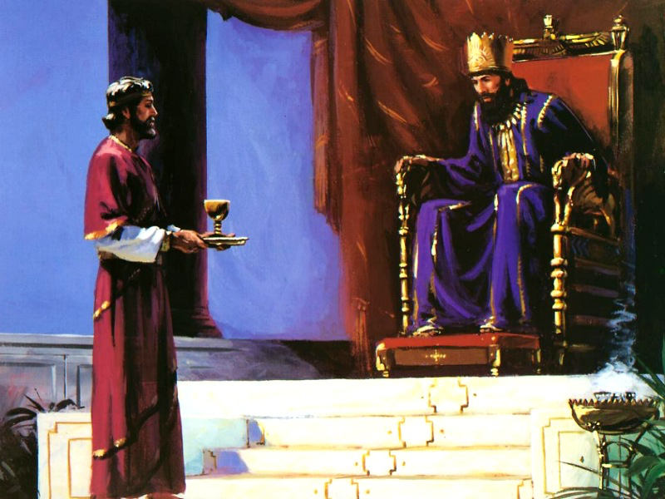
He asks for opportunity (1:11a). “Dreamers dream about things being different. Visionaries envision themselves making a difference.” He prepared. Opportunity apart from preparation results in missed opportunity.
He asks for favor with the King Artaxerxes (1:11b). I am a cupbearer. This was not an excuse. What can a cupbearer do? But he was in the right place, at the right time (Cf. Queen Esther), and with the right attitude (faithful to God and trusting God). A cupbearer was an officer of high rank in royal courts, whose duty it was to serve the drinks at the royal table. The King’s heart is in the Lord’s hand.
“In the Lord’s hand the king’s heart
is a stream of water that he
channels toward all who please
him.” (Prov.21:1)
(7)

Slide 8
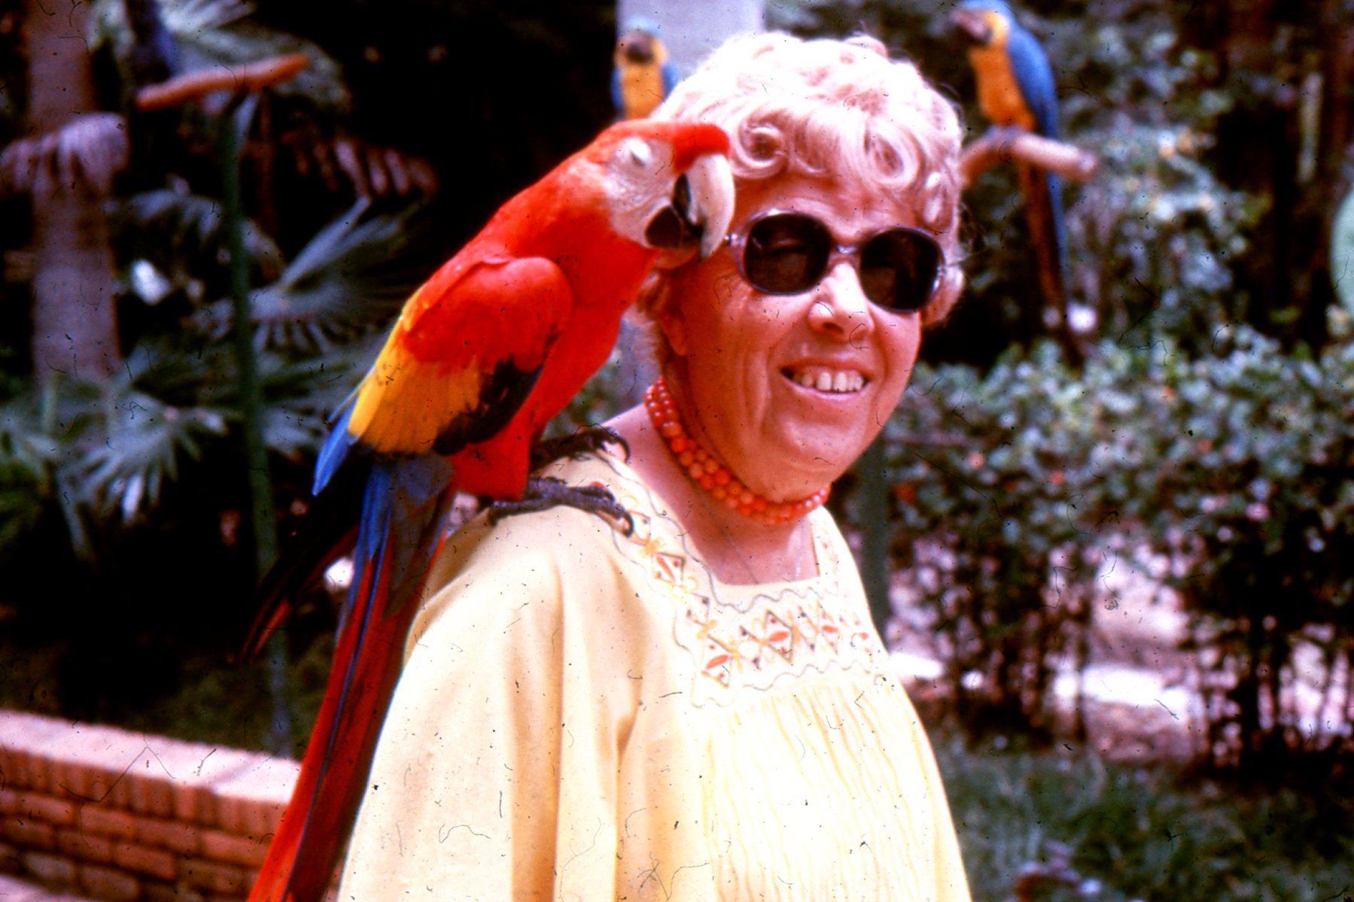
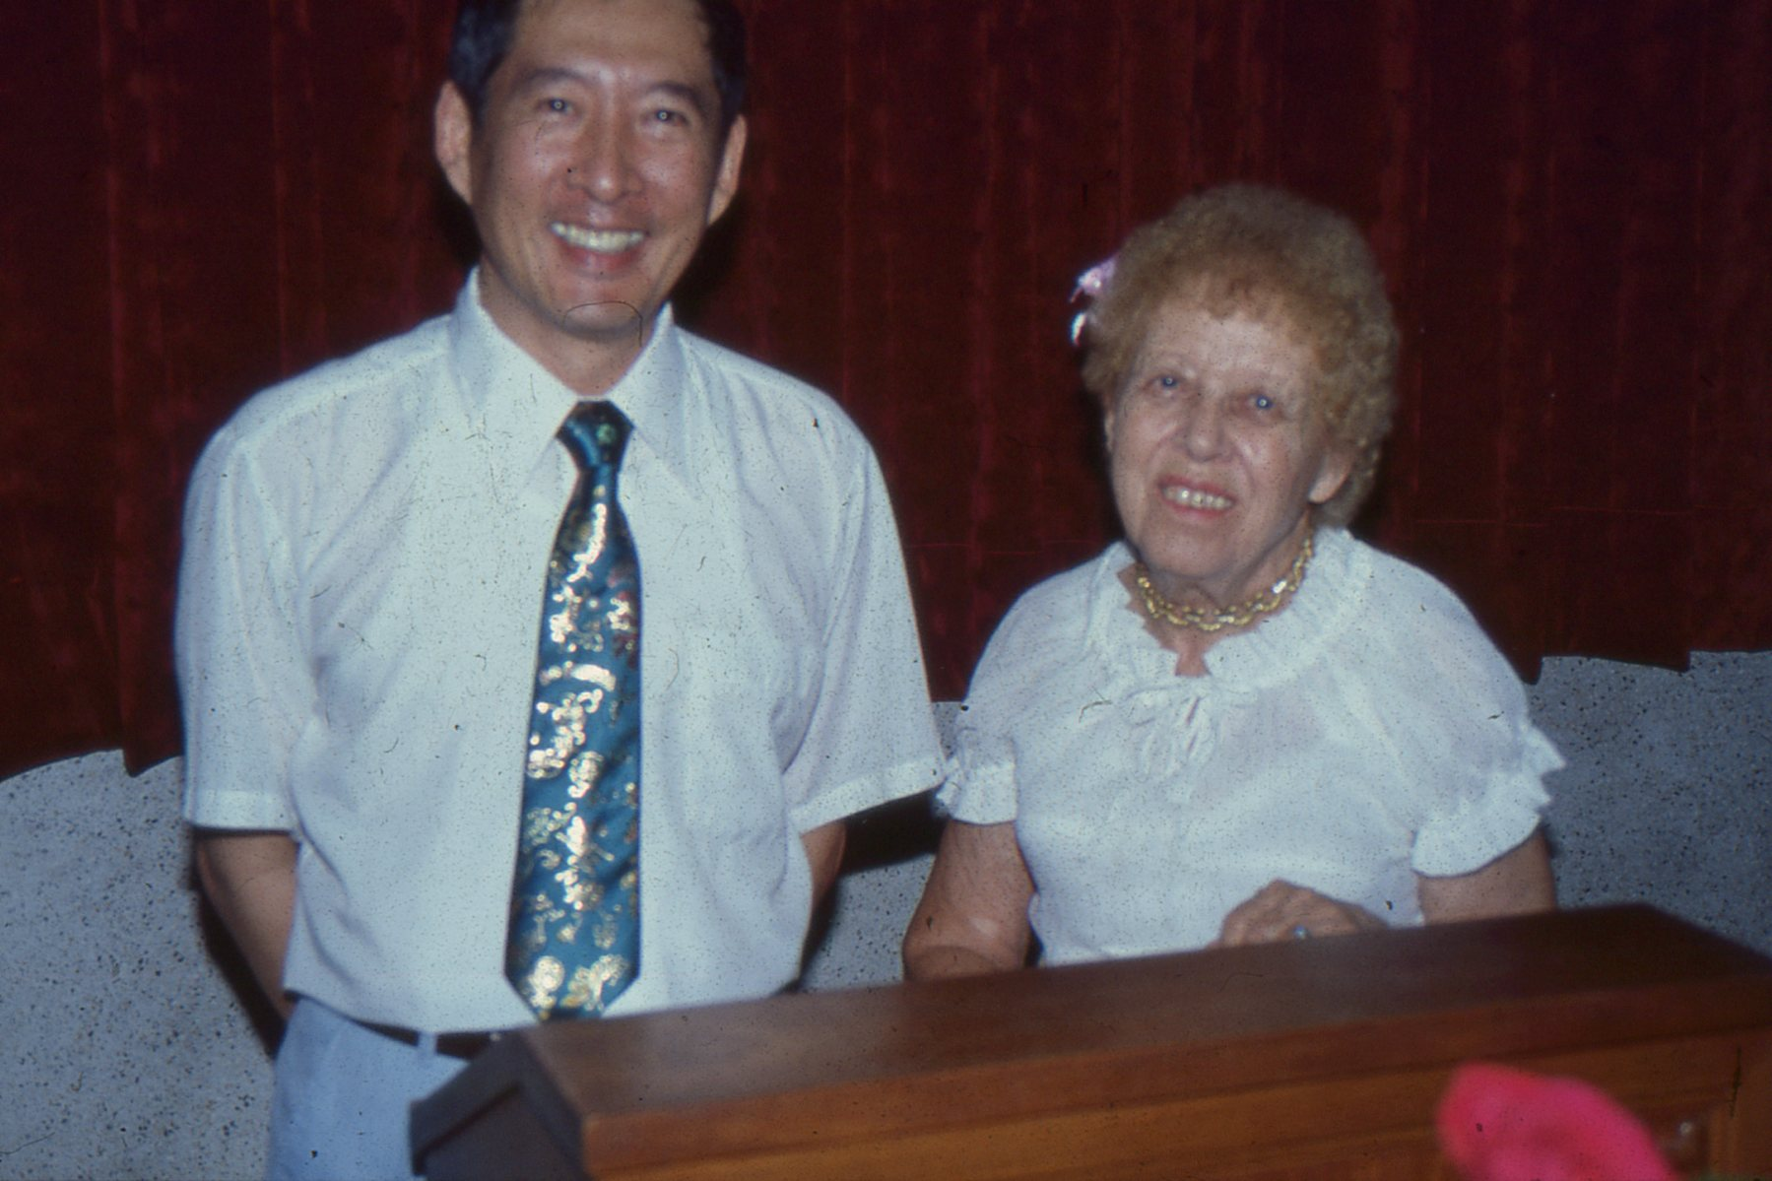
Conclusion: What is God’s vision for you? How to apply:
(1) Have a vision for different times of life. Joseph as a boy had a vision to rule over his brothers.David as a man had a vision to be King. Caleb as an older man had a vision. So here I am today, eighty-five years old! I am still as strong today as the day Moses sent me out;I’m just as vigorous to go out to battle now as I was then.Now give me this hill country that the Lord promised me that day. You yourself heard then that the Anakites were there and their cities were large and fortified, but,the Lord helping me,I will drive them out just as he said.”(Jos.14:10-12)
(8)

Slide 9
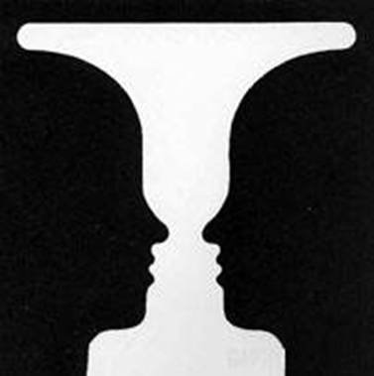
(2) Have a vision for God’s ideas, not just good ideas.Chris had a vision to share the gospel with every student at Dunwoody High School. He invited Mark a new student to his home.
(3) Have a vision for God’s way and God’s timing. Moses had a vision to rescue God’s people in his way and his timing. He killed an Egyptian and fled to the desert.
(4) Allow the vision to grow and become mature.
(5) Write down the vision for your Church, family, work, etc.
What do you see?
(9)

