Slide 1
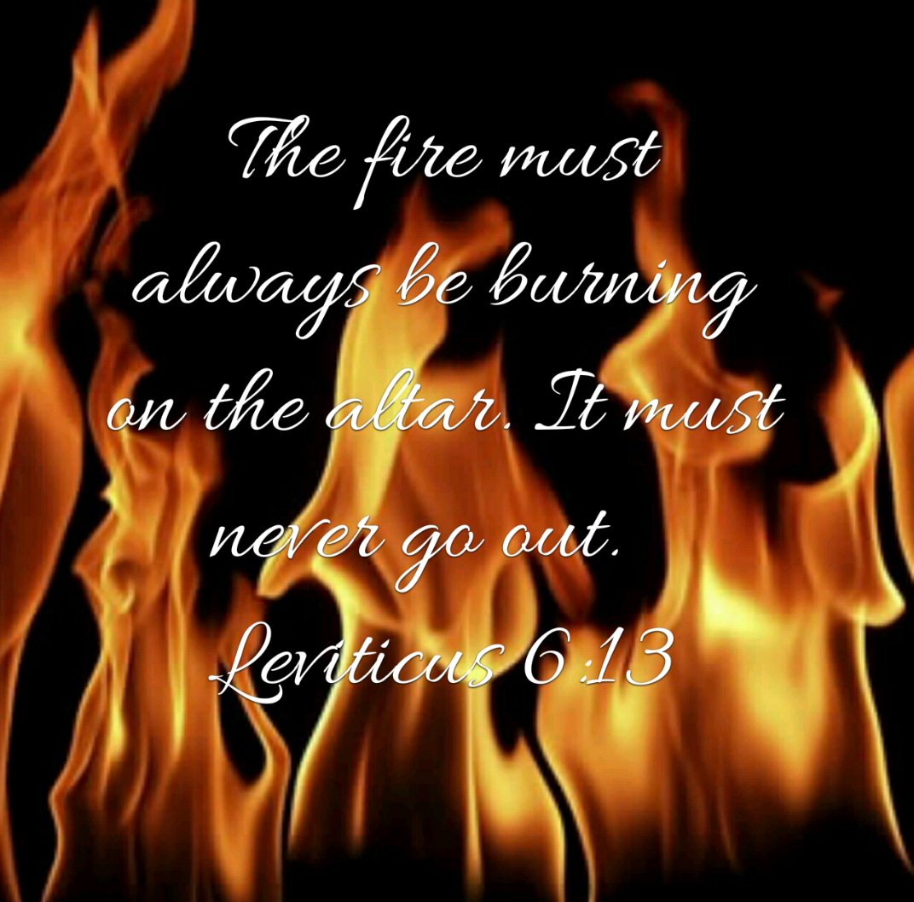
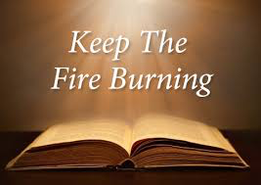
Pastor Gary Hart 8-21-16 Text:Neh.13:1-9
Sermon Title: Standing by our promises.
Intro: How do you keep a fire burning?
General William Booth, founder of the Salvation Army, once said, “I want you young men always to bear in mind that it is the nature of a fire to go out; you must keep it stirred and fed and the ashes removed.” Nehemiah discovered that the fires of devotion had gone out in Jerusalem. His first term as governor lasted for 12 years(5:14), after which he returned to the palace to report to the king(13:6).He was gone about a year,but when he returned to Jerusalem, he discovered that the situation had deteriorated, for the people were not living up to the promises they had made (ch.10). Nehemiah immediately began to act decisively to change the situation. Without spiritual leadership, God’s people are prone to stray like sheep.
(1)

Slide 2
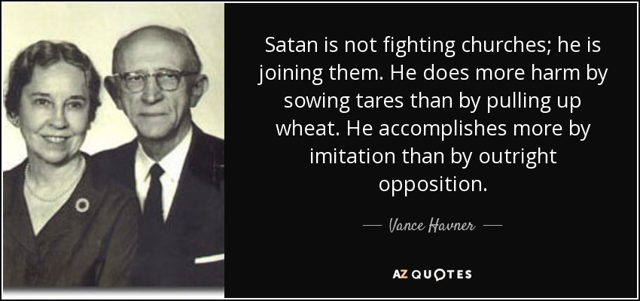
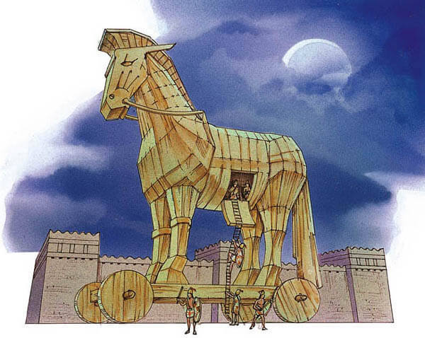
1. The separation promise (13:1-9,23-31). They discovered that there were Ammonites and Moabites in their congregation, and this was contrary to the law of Moses (Deut.23:3-4).
A. The mixed multitude (13:1-3). They had infiltrated the people of Israel in spite of previous purgings (9:2;10:28).
(1) The “mixed multitude” gave Moses trouble(Ex.12:38;Num.11:4-6).
(2) The “mixed multitude” gives the church trouble today(Mt.13:24-30). “Today the world has so infiltrated the church, that we are more beset by traitors within than by foes without…” (Story of the Trojan Horse)
(2)
(2)

Slide 3
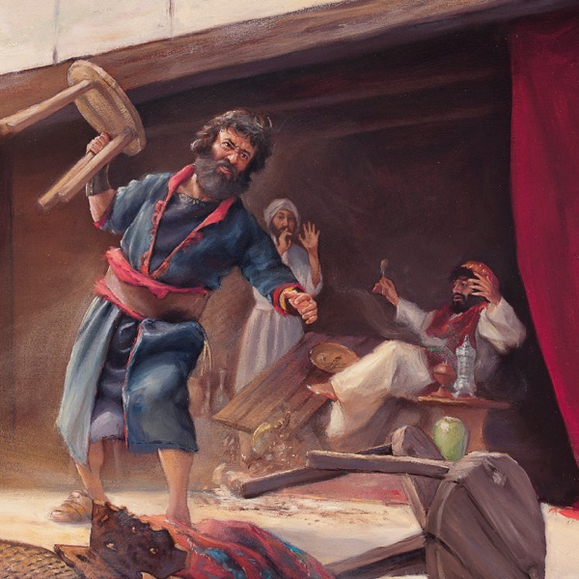
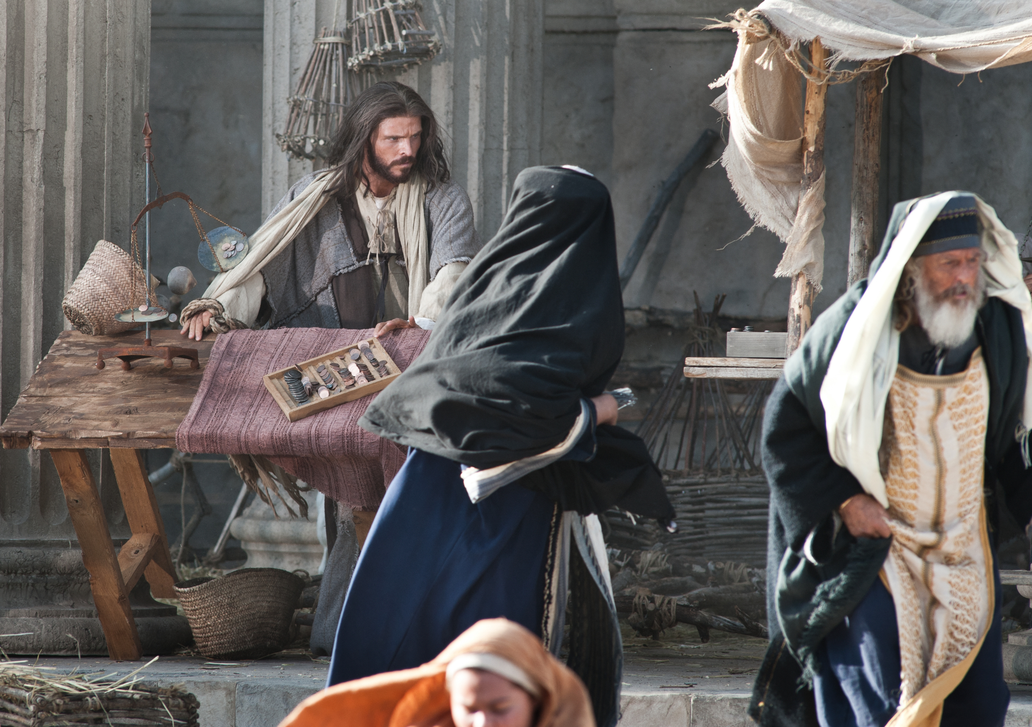
B. The enemy intruder (13:4-9). An Ammonite was living in the Jewish temple (defiled and robbed)! How did that happen?
(1) Eliashib the high priest had given Tobiah the Ammonite a room in the temple (13:28). Why?
(2) Because one of his relatives was married to Sanballat’s daughter (13:28), Sanballat and Tobiah were friends (came in the back door).
(3) Those appointed to lead had failed in their oversight.
(4) Nehemiah threw out both the man and his furniture, rededicating the room to the Lord. Jesus cleansed the temple (Mt.21:12-13).
(3)
(2)

Slide 4
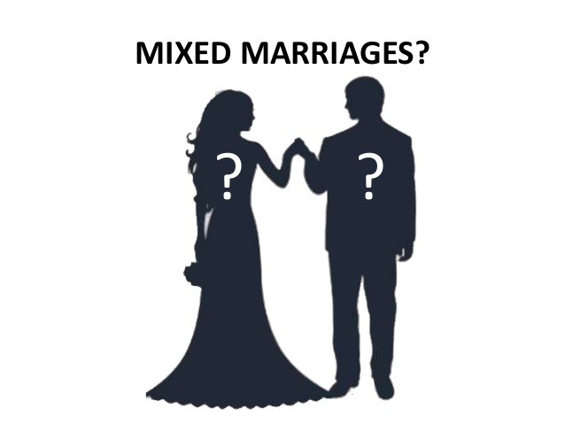
C. The mixed marriages (13:23-31). “We will not give our daughters as wives to the peoples of the land, nor take their daughters for our sons!” was the promise the Jews had made to the Lord(10:30), but they did not keep their promise.
(1) There was the problem of wrong speech. God’s people and the world’s people can be identified by their speech(I Jn.4:5-6).
(2) Nehemiah dealt with the problem. First he rebuked them (13:25), he delivered a message(13:26;1K11:4-8), then he purified the priests and made certain that only those who were qualified served(13:30; Eph.6:13).
Do not be yoked together with unbelievers. For what do righteous-ness and wickedness have in common? Or what fellowship can
light have with darkness? What harmony is there between Christ and Belial? Or what does a believer have in common with an unbeliever? What agreement is there between the temple of God and idols? For we are the temple of the living God. As God has said: “I will live with them and walk among them, and I will be their God, and they will be my people.” Therefore,“Come out from them and be separate, says the Lord. Touch no unclean thing, and I will receive you.” And, “I will be a Father to you, and you will be my sons and daughters, says the Lord Almighty.”(2Cor.6:14-18)
(4)
(2)

Slide 5
2. The support promise (13:10-14). They had promised “we will not forsake the house of our God”(10:39).This meant pay-ing the temple tax, providing wood for the altar, and bringing the required tithes and offerings to the priest and Levities.
A. There was the problem of no support. The Priests and Levities without support had to work the land to survive(13:10).
B. Nehemiah dealt with the problem. He presented God’s case and defended it from God’s law.
(1) He rebuked the leaders for breaking their promise and disobeying the law, the nobles of Judah, and the men married to foreign women(13:25).
(2) He appointed them to their place (13:11) and appointed four men to supervise the treasury and distribute the titles and offerings. These men represented the priest, Levites, scribes, and laymen. There were faithful to the Lord (1 Cor.4:2; Acts 6:1-5).
(3) He prayed (13:14,22,29,31;1:8;5:19;6:14;9:17). He is in the habit of talking to God as he served God (8 Remember Prayers/4 in ch.13). He knew that God’s blessings come only because of God’s mercy.
(5)
(2)

Slide 6
3. The Sabbath promise (13:15-22). They had promised not to do business with the Gentiles on the Sabbath Day (10:31).
A. There was the problem of doing business, daily work and carrying unnecessary burdens on the Sabbath.
B. Nehemiah took steps to change the situation.
(1) He rebuked the Jews who were working and selling on the Sabbath and made them stop (13:15).
(2) He rebuked the nobles for allowing business on the Sabbath Day, reminding them that the nation’s violation of the Sabbath was one cause for their captivity (13:16-18; Jer.17:21-27).
(3) He ordered the city gates shut on the Sabbath Day. (OT laws governing the Jewish Sabbath don’t apply to the Lord’s Day. But Sunday is a special day to God’s people because it commemorates the resurrection of Jesus Christ form the dead and the coming of the Holy Spirit at Pentecost. We ought to use the Lord’s Day to the glory of the Lord).
(6)
(2)

Slide 7
How to apply: There are 12 qualities that made Nehemiah a successful leader.
1. He knew he was called of God.
2. He depended on prayer.
3. He had vision and saw the greatness of the work.
4. He submitted to authority.
5. He was organized in his work.
6. He was able to discern the tactics of the enemy.
7. He worked hard.
8. He lived an exemplary life.
9. He sought to glorify God alone.
10. He had courage.
11. He enlisted others to work.
12. He was determined.
(7)
(2)

Slide 8
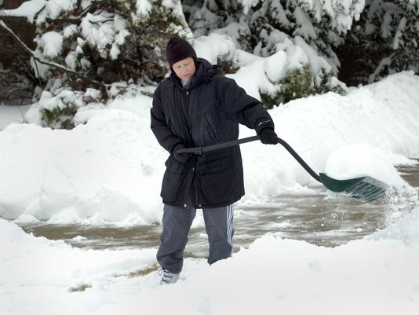
Conclusion: I read about two boys who went around their neighborhood looking for jobs shoveling snow. They say a man shoveling his driveway and asked if they could do the job. “Can’t you see I’m already half finished?” he said. “That’s why we asked,” the boys explained. “You see, we get most of our work from people who got started but weren’t able to finish.” Which of these qualities do you need today or this week? What is your “I will” statement? “I will…seek God’s will, depend on prayer, seek God’s vision, seek discernment, work hard, be an example to others, seek God’s glory, have courage, enlist others, and be determined.”
(8)
(2)

Slide 9
Qualities that make a successful leader.--Nehemiah
(1) I know that I am called of God.
(2) I will depend on prayer.
(3) I will have a vision to see the greatness of the work.
(4) I will submit to authority.
(5) I will be organized in my work.
(6) I will have discernment.
(7) I will work hard.
(8) I will be an example.
(9) I will seek to glorify God alone.
(10) I will have courage.
(11) I will enlist others to work.
(12) I will be determined to finish.

