Slide 1
Pastor Gary Hart Feb. 14, 2016 Text: Nehemiah 2:1-20
(1)
1 In the month of Nisan in the twentieth year of King Artaxerxes,when wine was brought for him, I took the wine and gave it to the king. I had not been sad in his presence before, 2 so the king asked me, “Why does your face look so sad when you are not ill? This can be nothing but sadness of heart.” I was very much afraid, 3 but I said to the king, “May the king live forever!Why should my face not look sad when the city where my ancestors are buried lies in ruins, and its gates have been destroyed by fire?” 4 The king said to me, “What is it you want?”Then I prayed to the God of heaven, 5 and I answered the king,“If it pleases the king and if your servant has found favor in his sight, let him send me to the city in Judah where my ancestors are buried so that I can rebuild it.” 6Then the king, with the queen sitting beside him, asked me, “How long will your journey take, and when will you get back?” It pleased the king to send me; so I set a time. 7 I also said to him, “If it pleases the king, may I have letters to the governors of Trans-Euphrates, so that they will provide me safe-conduct until I arrive in Judah? 8 And may I have a letter to Asaph, keeper of the royal park, so he will give me timber to make beams for the gates of the citadel by the temple and for the city wall and for the residence I will occupy?” And because the gracious hand of my God was on me, the king granted my requests. 9 So I went to the governors of Trans-Euphrates and gave them the king’s letters. The king had also sent army officers and cavalry with me. 10 When Sanballat the Horonite and Tobiah the Ammonite official heard about this, they were very much disturbed that someone had come to promote the welfare of the Israelites. 11 I went to Jerusalem, and after staying there three days 12 I set out during the night with a few others.I had not told anyone what

Slide 2
my God had put in my heart to do for Jerusalem. There were no mounts with me except the one I was riding on. 13 By night I went out through the Valley Gate toward the Jackal Well and the Dung Gate, examining the walls of Jerusalem,which had been broken down, and its gates, which had been destroyed by fire. 14 Then I moved on toward the Fountain Gate and the King’s Pool, but there was not enough room for my mount to get through; 15 so I went up the valley by night, examining the wall. Finally, I turned back and reentered through the Valley Gate. 16 The officials did not know where I had gone or what I was doing, because as yet I had said nothing to the Jews or the priests or nobles or officials or any others who would be doing the work. 17Then I said to them, “You see the trouble we are in: Jerusalem lies in ruins, and its gates have been burned with fire. Come, let us rebuild the wall of Jerusalem, and we will no longer be in disgrace.” 18 I also told them about the gracious hand of my God on me and what the king had said to me. They replied, “Let us start rebuilding.” So they began this good work. 19 But when Sanballat the Horonite, Tobiah the Ammonite official and Geshem the Arab heard about it, they mocked and ridiculed us. “What is this you are doing?” they asked. “Are you rebelling against the king?” 20 I answered them by saying, “The God of heaven will give us success. We his servants will start rebuilding, but as for you, you have no share in Jerusalem or any claim or historic right to it.”
Sermon Title: “A vision is grown.”
What are the building blocks of a vision?
(2)

Slide 3
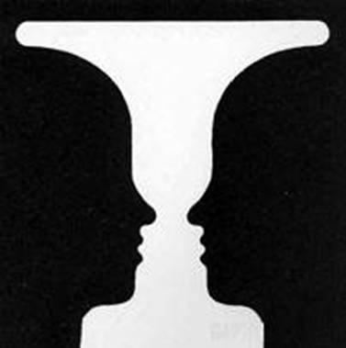
What do you see?
Intro: What do you see, a wine cup or people? Nehemiah was the King’s cupbearer, but he saw beyond the cup (his job) and saw people with needs. What is your vision? We saw how “A vision is born.” Now we see how God grows a vision. What are the first building blocks of a vision?
(3)

Slide 4
1. A vision begins as a concern.
You will hear or see something that gets your attention. Nehemiah’s concern over the condition of Jerusalem broke his heart (“When I heard these things, I sat down and wept” 1:4a).
2. A vision does not necessarily require immediate action.
A vision always requires patience. Nehemiah waited upon God in prayer. He waited days and months (“For some days I mourned and fasted and prayed” 1:4b).
(4)

Slide 5
3. Pray for opportunities and plan as if your expect God to answer your prayers.
He prayed and he planned. (“I was cupbearer to the King” 1:11b). Nehemiah made a list of his plans for rebuilding the wall. Then his plan list became his prayer list.
Step 1—Convince the king to allow me to leave his service in order to rebuild the wall around the city of Jerusalem.
Step 2—Convince the king to lend financial support to the building project.
Step 3—Receive letters from the king to the governors in the surrounding areas asking them to provide safety along the way.
Step 4—Receive letters from the king for the keeper of the king’s forest (Asaph) to provide lumber to build the gates and a home.
Step 5—Ask the king for the title of Governor of Judah.
Step 6—Organize and equip the inhabitants of Jerusalem.
Step 7—Begin construction.
(5)

Slide 6
4. God is using your circumstances to position and prepare you to accomplish his vision for your life.
Success is remaining faithful to the process God has laid out for you. Celebrate little successes along the way.Nehemiah is the King’s cupbearer.
5. What God originates, he orchestrates.
How is never a problem with God. He knows how to… The promise is that “all things are possible to him who believes” (Mk.9:23). Jesus said living faith can move mountains (Mt. 17:20). The Mountain starts to move. There are three evidences of Nehemiah’s faith.
(6)

Slide 7
A. He had the faith to wait (2:1-3). “Through faith and patience” that we inherit the promises (Heb.6:12). Weep and pray, wait and pray.
(1). “Stand still, and see the salvation of the Lord” (Ex.14:13).
(2). “Sit still…until you know how the matter will turn out” (Ruth 3:18).
(3). “Be still and know that I am God” (Ps.46:10). Nehemiah prayed, “Lord, if today is the day I speak to the king about our plans,then open the way for me.”
B. He had faith to ask (2:4-8). The king asked him, “What is it you want?” Nehemiah sent “emergency prayers”(“then I prayed to the God of heaven” 2:4; 4:4; 5:19; 6:9,14; 13:14, 22, 29, 31; Urgent prayer for wisdom Ja.1:3) that were backed up by four months of fasting and praying. “Send me (2:4-6) and “give me” (v.7-10).
C. He had faith to challenge others (2:9-20a). Traveling was a journey of at least two months’ time (2:9-10).
(1) He challenged his enemies.Sanballat was a chief political opponent and governor of Samaria. Tobiah was governor of Transjordan.
Geshem was a businessman who feared it would interfere with his spice trade. (Three spiritual enemies: Satan, World, and Flesh).
(7)

Slide 8
(2) He challenged the people. He focused on the glory and greatness of the Lord. The city was a reproach to the Lord. They accepted the challenge immediately and said, “Let us rise up and build” (2:18). God sent the Jews a leader from the outside with a new perspective on the problems and a new vision for the work. Leadership is “the art of getting people to do what they ought to do because they want to do it.” The enemies ridiculed him. Rebuilding the wall was God’s work; the Jews were God’s servants and Sanballat, Tobiah, and Geshem had no part in the matter. The Art of War, an ancient military manual by Chinese general Sun Tzu, says, “If you know the enemy and know yourself, you need not fear the result of a hundred battles.”
6. Walk before you talk; investigate before you initiate.
Nehemiah did not tell anyone(2:12). Instead, Nehemiah spent some time taking inventory of the situation. Get the facts(Lk.14:28), walk before you talk. His vision was confirmed and defined, but not aborted.
(8)

Slide 9
7. Communicate your vision as a solution to a problem that must be addressed immediately.
In order to share your vision convincingly, you must be able to state the problem your vision addresses. “You see the trouble we are in: Jerusalem lies in ruins, and its gates have been burned with fire”(2:17a). Give a solution to the problem. “Come let us rebuild the wall of Jerusalem”(2: 17b). You must be able to give a compelling reason why something must be done. “We will no longer be in disgrace”(2:17c). Then why it must be done now. “I also told them about the gracious hand of my God on me and what the king had said to me” (2:18a). This is God’s hand at work.
8. Cast your vision to the appropriate people at the appropriate time.
They replied, “Let us start rebuilding.” So they began this good work (2: 18b).To the enemies Nehemiah “answered them by saying, “The God of heaven will give us success.We his servants will start rebuilding”(20).
(9)

Slide 10
Conclusion: “If your vision is for a year, plant wheat. If your vision is for ten years, plant trees. If your vision is for a lifetime, plant people”
(Chinese Proverb). Anyone can go through life as a destroyer; God has called His people to be builders. How to apply: We need to build the children, the youth, marriages, families, and the local church using these building blocks.
On Valentine’s Day, we are reminded to build loving and listening relationships with others.What is love?We are to love others uncondition-ally and sacrificially as Christ loved us and gave himself for us.
“Love” as a verb is nothing new. Jesus Himself commanded His disciples to “love one another.” And John said that God “so loved the world” that He sent Christ to save it (John 3:16). The apostle Paul wrote his famous chapter on love in 1Corinthians 13 where he primarily talked about “love” as a noun. And even though he didn’t use the verb “to love” in 1 Corinth-ians 13, he described love in action terms: “Love suffers long and is kind; love does not envy; love does not parade itself, is not puffed up,” and so on. In other words, true love is best identified by what it does. Actions speak louder than words.
(10)

Slide 11
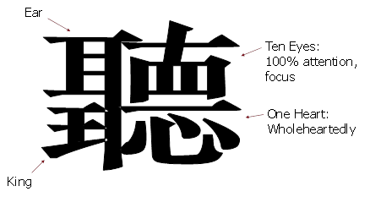
What is listening? (聽) We are to listen to others with ten eyes, one heart, ears, as to the king.
Active Listening:
-Eyes (watchfully)
-Heart (wholeheartedly)
-Ears (attentively)
-King (respectfully)
God help us to build on these building blocks of a vision.
*May we have ten eyes to see clearly God’s vision.
*May we have one heart to pursue God’s vision with all our heart.
*May we have ears to hear God’s Word.
*May we have respect and obedience to the King of Kings and the Lord of Lords.
(11)

Slide 12
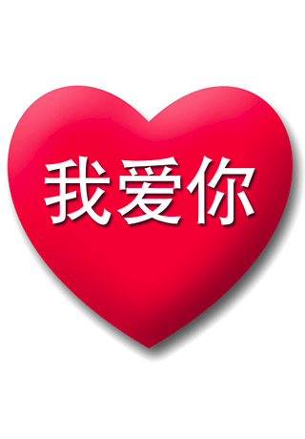
情人节快乐！
Happy Valentine’s Day!

