Slide 1
Pastor Gary Hart Apr. 17, 2016 Text: Nehemiah 3:1-32
(1)
1 Eliashib the high priest and his fellow priests went to work and rebuilt the Sheep Gate. They dedicated it and set its doors in place, building as far as the Tower of the Hundred, which they dedicated, and as far as the Tower of Hananel. 2 The men of Jericho built the adjoining section, and Zakkur son of Imri built next to them. 3 The Fish Gate was re-built by the sons of Hassenaah. They laid its beams and put its doors and bolts and bars in place. 4 Meremoth son of Uriah, the son of Hakkoz, repaired the next section. Next to him Meshullam son of Berekiah, the son of Meshezabel, made repairs, and next to him Zadok son of Baana also made repairs. 5 The next section was repaired by the men of Tekoa,but their nobles would not put their shoulders to the work under their supervisors.
Sermon Title: “A Gated Community.”
Introduction: We looked at the vision that God gave Nehemiah, now let us look at the steps in the rebuilding process:
(1) Concern over the damage (1:4).
(2) Confession of sins (1:6, 8-9).
(3) Commitment to the project (1:11).
(4) Courage to face the opposition (2:19, 20).
(5) Caution in planning (2:11-16).
In Chapter 3 we learn how Nehemiah went about this task of rebuilding. There are 3 key words: Workers, Walls, and Gates.

Slide 2
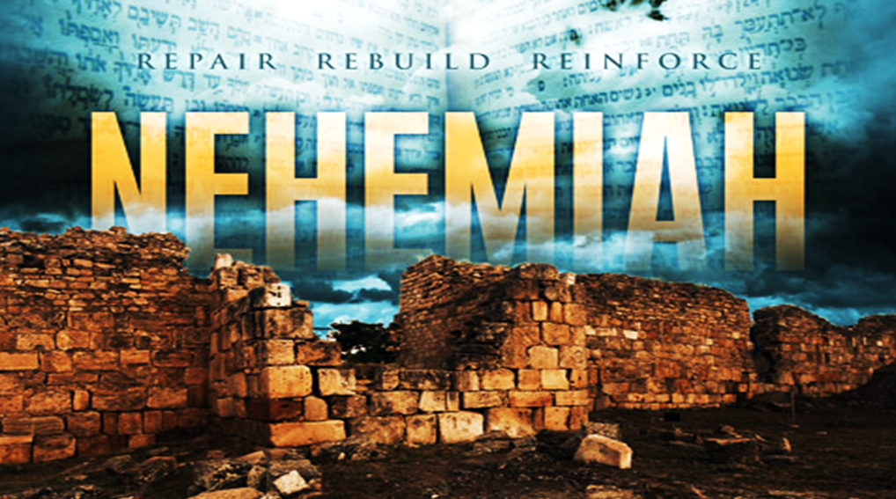
1. Workers: Workers are willing to work. “For the people had a mind to work” (4:6).
A. The Purpose of the work is the glory of God. “Let us build up the wall of Jerusalem, that we be no more a reproach” (2:17). The purpose of all ministry is the glory of God (1 Cor.1:31; 2 Co.4:5; Jn.17:4).
B. The Pattern of the work is to build or rebuild (6x). Repair is used 35x. They were focused on the work. “This one thing I do” (Phil.3:13).
C. The People in the work were assigned a place and a task (38 individual workers and 42 different groups).God uses all kinds of people.
(2)

Slide 3
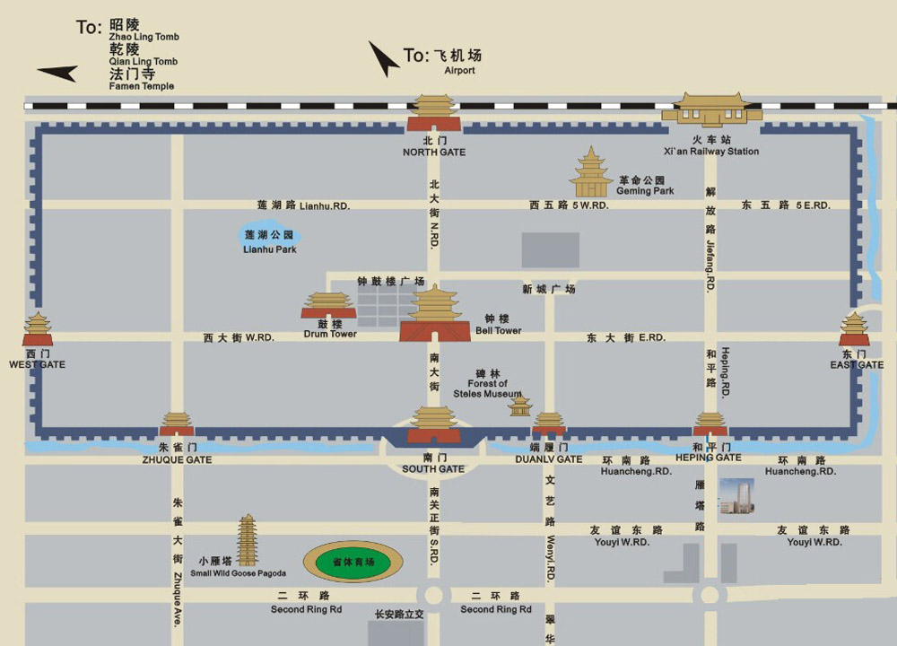
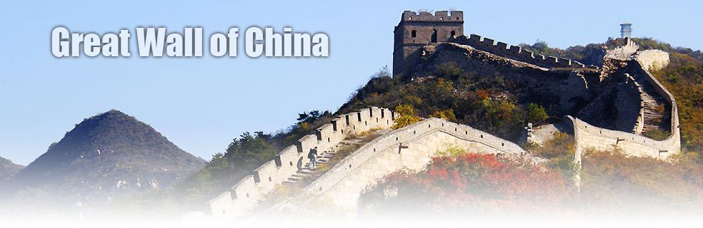
2. Walls: Walls are for defense and protection. China has the Great Wall. Xian has the City Wall. Historically, Nehemiah describes the work on the northern wall (v.1-7), western wall (v.8-13), southern wall (v.14), and eastern wall (v.15-32). Spiritually, “Like a city whose walls are broken through is a person who lacks self-control.” (Prov.25:28)
(3)
(2)

Slide 4
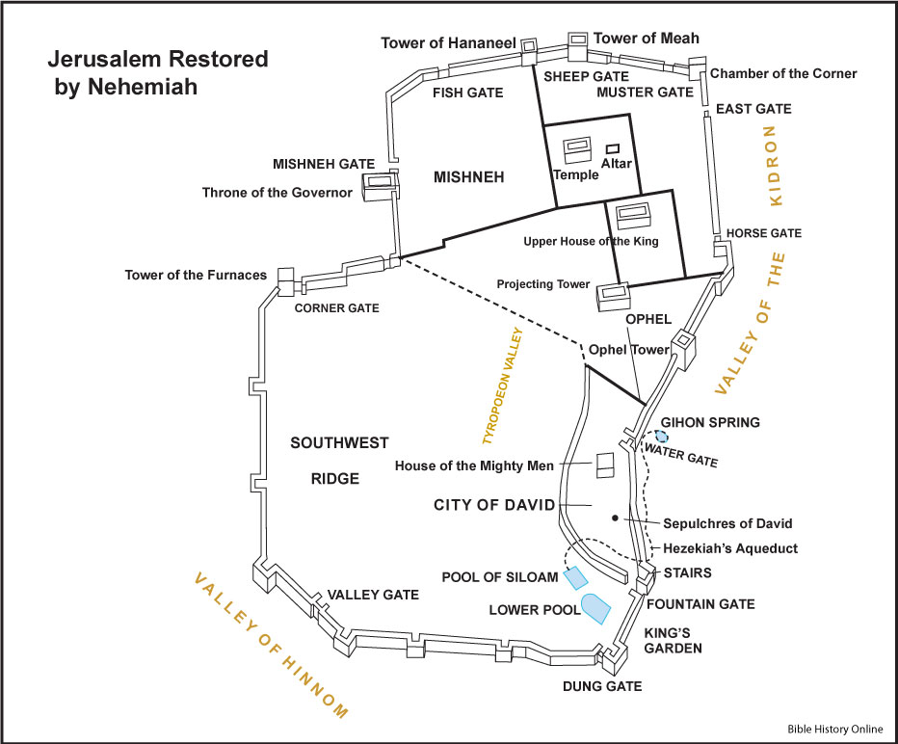
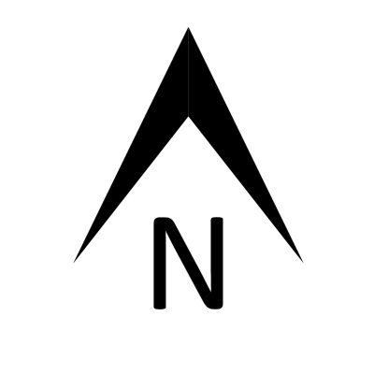
3. Gates: Gates are for access.There are 10 gates mentioned.
(1)
(10)
(2)
INSPECTION
(9)
OLD
(3)
(8)
(7)
(4)
(6)
(5)
(4)

Slide 5
Ten Gates (Neh. 3:1-32) | Meaning
(1) Sheep Gate (3:1-2,32)
(2) Fish Gate (3:3-5)
(3) Old Gate (3:6-12)
(4) Valley Gate (3:13)
(5) Dung Gate (3:14)
(6) Fountain Gate (3:15)
(7) Water Gate (3:26)
(8) Horse Gate (3:28)
(9) East Gate (3:29)
(10)Inspection Gate(3:31)
(5)
Get a life:The Lamb of God.
Share a life: Witness.
Have solid foundation:Truth.
Have good attitude:humility.
Get rid of garbage.
Be filled with God’s Spirit.
Be filled with God’s Word.
Be ready for spiritual warfare.
Be filled with hope.
Examine oneself.

Slide 6
Conclusion: No one person could have accomplished the work of repairing the walls and restoring the gates. It took leadership on Nehemiah’s part and cooperation on the part of the people. Each had a place to fill and a job to do. So it is with the church today: We must work together if we are to finish the work to the glory of God. “Therefore, my dear brothers and sisters, stand firm. Let nothing move you. Always give yourselves fully to the work of the Lord, because you know that your labor in the Lord is not in vain.” (1 Cor.15:58).
How to apply: God show us where to begin? Show what is next? Help us to work together to rebuild and to repair what needs to be done in our lives today. May we have the strength to do the work and determination to finish the work. Let us enter through each gate: the Sheep Gate (get a life:The Lamb of God), the Fish Gate (share a life: witness), the Old Gate (have a foundation:Truth), the Valley Gate (have good attitude: humility), the Dung Gate (get rid of garbage), the Fountain Gate (be filled with God’s Spirit), the Water Gate (be filled with God’s Word), the Horse Gate (be prepared for spiritual warfare), the East Gate (be filled with hope), and Inspection Gate (examine oneself).
(6)

Slide 7
Ten Gates (Neh. 3:1-32) | Meaning
(1) Sheep Gate (3:1-2,32)
(2) Fish Gate (3:3-5)
(3) Old Gate (3:6-12)
(4) Valley Gate (3:13)
(5) Dung Gate (3:14)
(6) Fountain Gate (3:15)
(7) Water Gate (3:26)
(8) Horse Gate (3:28)
(9) East Gate (3:29)
(10)Inspection Gate(3:31)

Slide 8
INSPECTION
OLD

