Slide 1
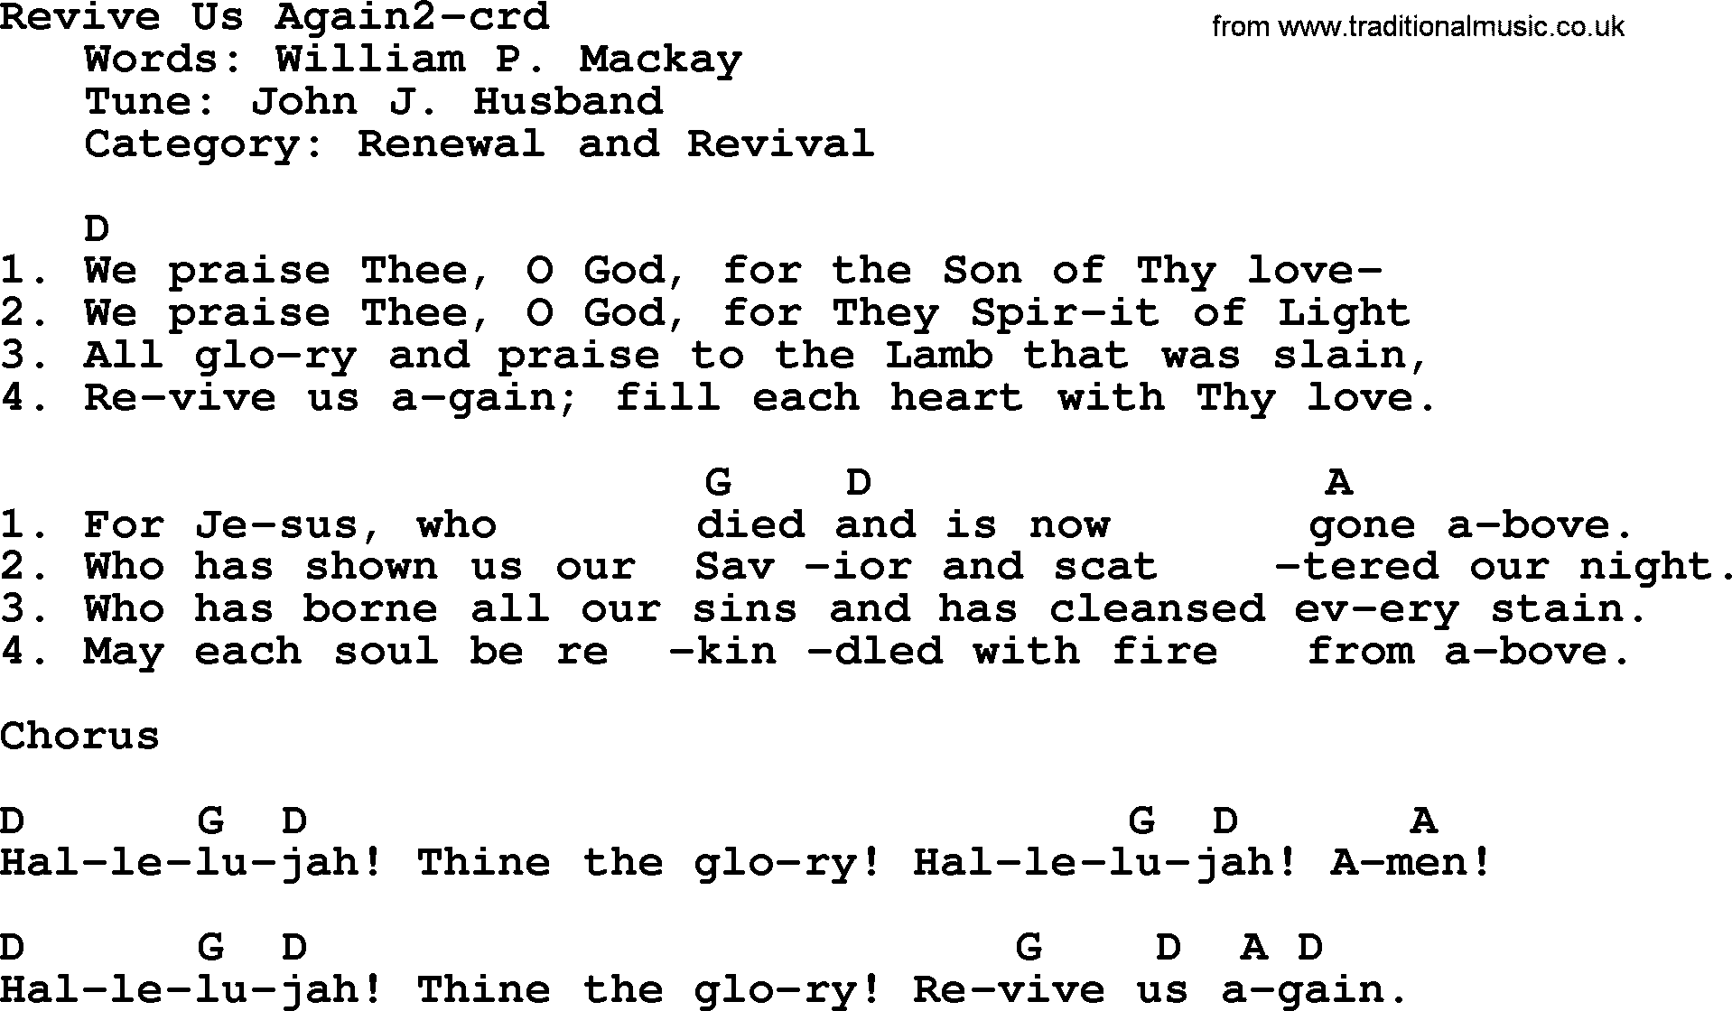

Slide 2
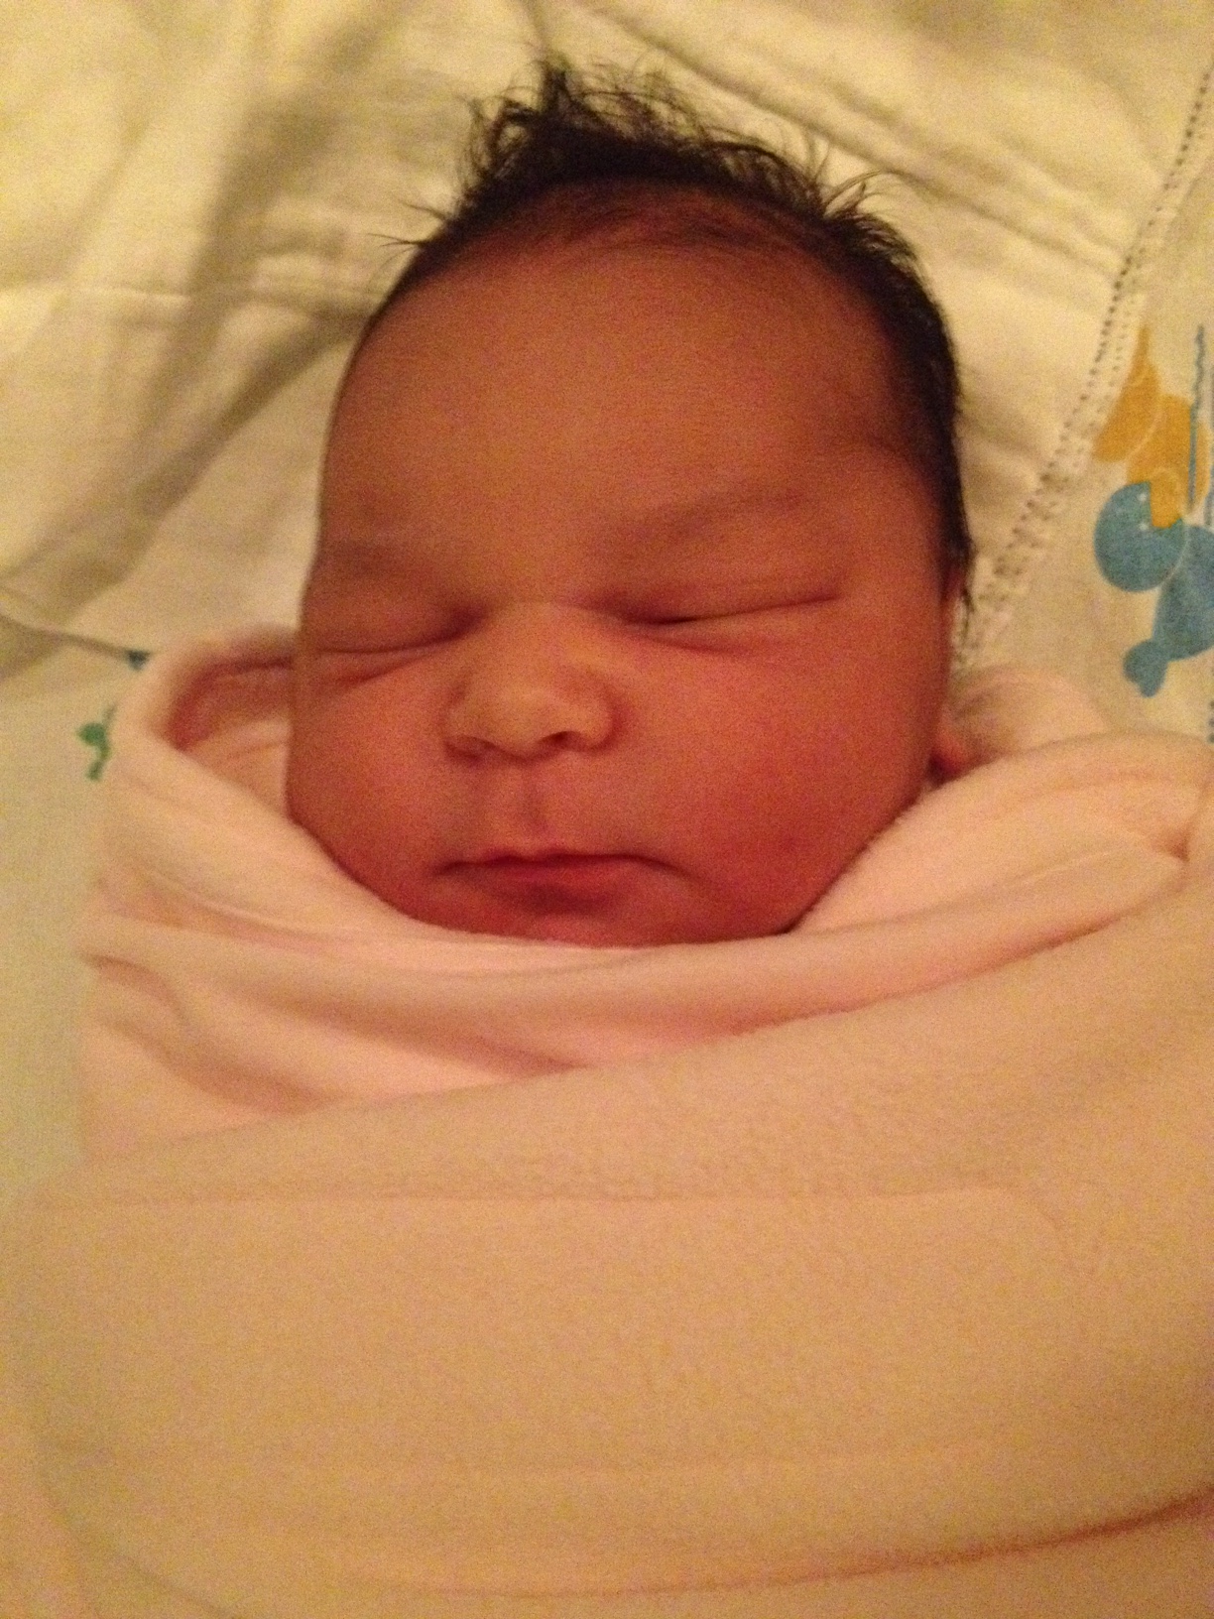
Ayila Lynn was born 5-10-16.
(8 lbs.11 oz. 19.5 inches).

Slide 3

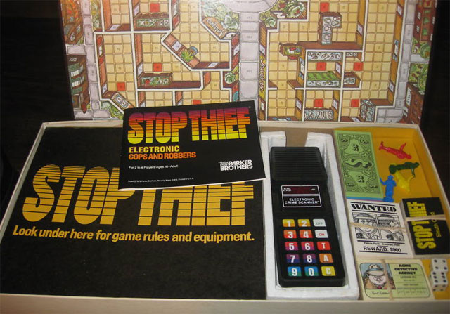
Pastor Gary Hart May 22,2016 Text:Neh. 5:1-13
Sermon Title: “Stop! Thief!”
Introduction: Stop! Thief! Do you any experiences with thieves or robbers? I have had 3 experiences of having others steal from me (Beijing, Kansas City, and Grandview). All three were reported to the police.
Nehemiah tells of attacks from outside (ch.4), and attacks from within (ch.5). In the middle of a “great work” (4:19) for a “Great God” (1:5). What would “stop” this great work?
(1)

Slide 4

1. Stop to cry out.—The great outcry. “Now the men and their wives raised a great outcry against their fellow Jews.”(5:1)
A. We must get grain. Some were saying, “We and our sons and daughters are numerous; in order for us to eat and stay alive, we must get grain.” (5:2)
B. We must mortgage our property. Others were saying, “We are mortgaging our fields, our vineyards and our homes to get grain during the famine.” (5:3).
C. We must borrow money. Still others were saying, “We have had to borrow money to pay the king’s tax on our fields and vineyards. (5:4)
D. We must subject our children to slavery. Although we are of the same flesh and blood as our fellow Jews and though our children are as good as theirs, yet we have to subject our sons and daughters to slavery. (5:5a).
E. We are powerless. Some of our daughters have already been enslaved, but we are powerless, because our fields and our vineyards belong to others.” (5:5b)
(2)
(2)

Slide 5
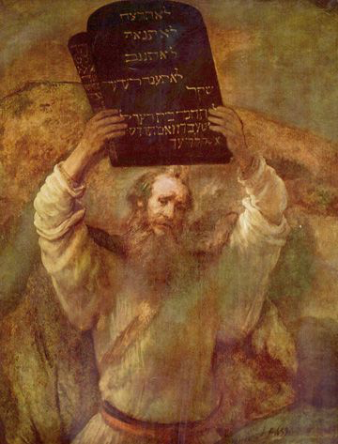
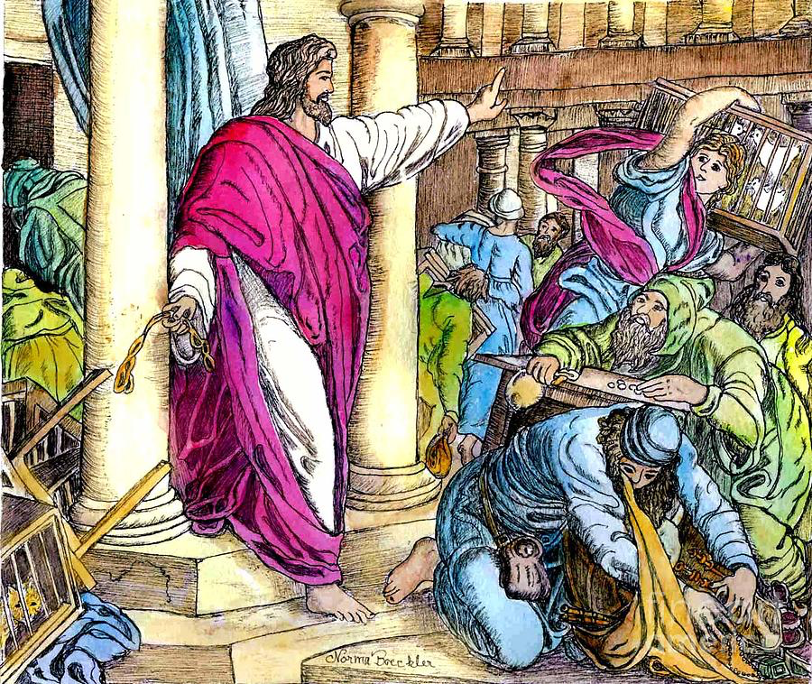
2. Stop to listen. –The great response.
A. Be a good listener. “When I heard their outcry and these charges” (5:6a).
B. Have righteous indignation. “I was very angry” (5:6b).
C. Have right thinking. “I pondered them in my mind” (5:7a).
D. Make a bold accusation. And then accused the nobles and officials. I told them, “You are charging your own people interest!” (5:7b)
(3)
(2)

Slide 6
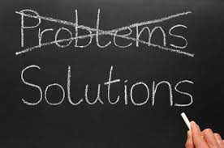
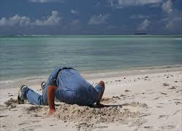
3. Stop to deal with the problem. –The great meeting. So I called together a large meeting to deal with them (5:7c).
A. Redeem others. And said: “As far as possible, we have bought back our fellow Jews who were sold to the Gentiles. Now you are selling your own people, only for them to be sold back to us!” (5:8a)
B. Silence the oppressors. They kept quiet, because they could find nothing to say. (5:8b)
C. Rebuke the oppressors. And So I continued, “What you are doing is not right. (5:9a)
D. Correct the oppressors. Shouldn’t you walk in the fear of our God to avoid the reproach of our Gentile enemies?(5:9b)
(4)
(2)

Slide 7
E. Restore others. I and my brothers and my men are also lending the people money and grain. But let us stop charging interest! Give back to them immediately their fields, vineyards, olive groves and houses, and also the interest you are charging them—one percent of the money, grain, new wine and olive oil.” (5:10-11)
F. Hold others to their word. “We will give it back,” they said. “And we will not demand anything more from them. We will do as you say.” Then I summoned the priests and made the nobles and officials take an oath to do what they had promised. I also shook out the folds of my robe and said, “In this way may God shake out of their house and posses-sions anyone who does not keep this promise.So may such a person be shaken out and emptied!”At this the whole assembly said, “Amen,” and praised the Lord. And the people did as they had promised.
(5)
(2)

Slide 8
E. Restore others. I and my brothers and my men are also lending the people money and grain. But let us stop charging interest! Give back to them immediately their fields, vineyards, olive groves and houses, and also the interest you are charging them—one percent of the money, grain, new wine and olive oil.” (5:10-11)
F. Hold others to their word. “We will give it back,” they said. “And we will not demand anything more from them. We will do as you say.” Then I summoned the priests and made the nobles and officials take an oath to do what they had promised. I also shook out the folds of my robe and said, “In this way may God shake out of their house and possessions anyone who does not keep this promise.So may such a person be shaken out and emptied!”At this the whole assembly said, “Amen,” and praised the Lord. And the people did as they had promised.
(6)
(2)

Slide 9
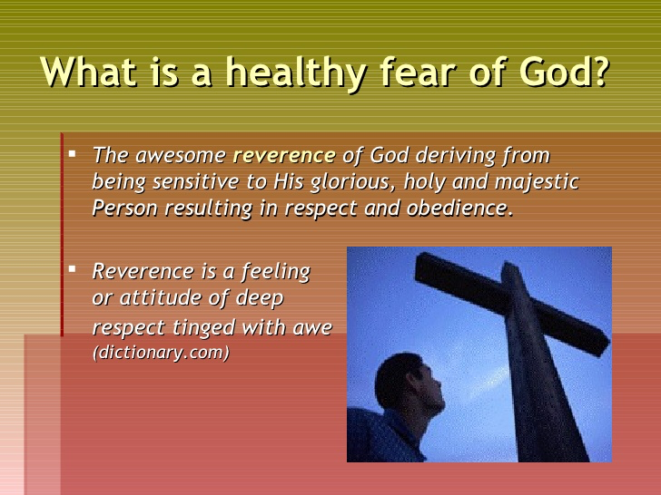
4. Stop to be an example. –The great example.
A. He did not use the official expense account for their household. Moreover, from the twentieth year of King Art-axerxes, when I was appointed to be their governor in the land of Judah, until his thirty-second year—twelve years—neither I nor my brothers ate the food allotted to the governor. (5:14)
B. He did not tax people for food or drink. But the earlier governors—those preceding me—placed a heavy burden on the people and took forty shekels of silver from them in addition to food and wine. Their assistants also lorded it over the people. But out of reverence for God I did not act like that. (5:15)
(7)
(2)

Slide 10
C. He did the work without acquiring land. Instead, I devoted myself to the work on this wall. All my men were assembled there for the work; we did not acquire any land. (5:16)
D. He shared what food he had with others. Furthermore, a hundred and fifty Jews and officials ate at my table, as well as those who came to us from the surrounding nations.Each day one ox, six choice sheep and some poultry were prepared for me, and every ten days an abundant supply of wine of all kinds. In spite of all this, I never demanded the food allotted to the governor, because the demands were heavy on these people. (5:17-18)
E. He did what he did to please the Lord. Remember me with favor, my God, for all I have done for these people.(5:19)
(8)
(2)

Slide 11
How to apply: Important lessons can be learned.
(1) Expect problems to arise among your people.
(a) There was a known problem when the greedy Jews at the time of rebuilding the walls of Jerusalem stole (Neh.5:1-19).
(b) There was an unknown problem with the covetous Achan stole at the time of Joshua (Josh.6:18-26).
(c) Is it an elephant or a mouse? “I the Lord do not change. So you, the descendants of Jacob, are not destroyed. Ever since the time of your ancestors you have turned away from my decrees and have not kept them. Return to me, and I will return to you,” says the Lord Almighty. “But you ask, ‘How are we to return?’ “Will a mere mortal rob God? Yet you rob me. “But you ask, ‘How are we robbing you?’ “In tithes and offerings. You are under a curse—your whole nation—because you are robbing me. Bring the whole tithe into the storehouse, that there may be food in my house. Test me in this,” says the Lord Almighty, “and see if I will not throw open the floodgates of heaven and pour out so much bless-ing that there will not be room enough to store it. (Malachi 3:6-10)
(9)
(2)

Slide 12
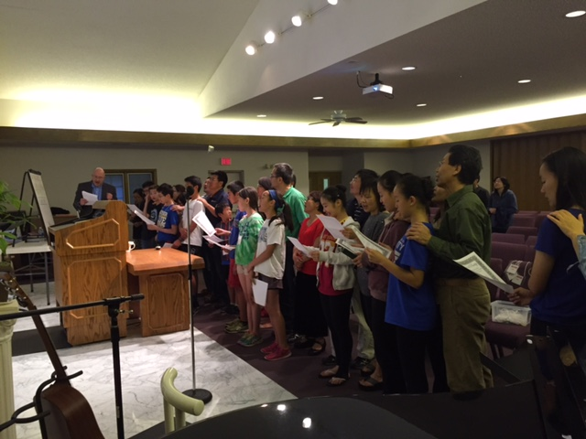
GKCCCC Youth Group said their “Purity Vow” on May 13, 2016. Also their parents stood behind them to support them. What vows do we need to promise to God? What step of obedience to God will you make?
(10)

Slide 13
(2) Confront problems courageously. Pray for God’s help and tackle the problem as soon as possible.
(3) Be sure that your own integrity is intact.
(4) See in every problem an opportunity for the Lord to work. If we depend on God’s wisdom, we will get what God can do.
#647 Revive Thy Work, O LORD
1. Revive Thy work, O Lord! Now to Thy saints appear!
Oh, speak with power to every soul, And let Thy people hear!
2. Revive Thy work, O Lord! And every sould inspire;
O kindle in each heart, we pray, The pentecostal fire!
3. Revive Thy work, O Lord! Exalt Thy precious name!
And may Thy love in every heart Be kindled to a flame!
4. Revive Thy work, O Lord! And bless to all Thy word!
And may its pure and sacred truth In living faith be heard!
5. Revive Thy work, O Lord! And make Thy servants bold;
Convict of sin and work once more As in the days of old.
6. Revive Thy work, O Lord! Give pentecostal showers!
Be Thine the glory, Thine alone! The blessing, Lord, be ours!
Chorus: Revive Thy work O Lord! While here to Thee we bow!
Descend, O gracious Lord, descend! Oh come, and bless us now!
(11)
(2)

