Slide 1
Pastor Gary Hart 6-12-16 Text: Nehemiah 6:9-16
Sermon Title: “The Miracles and the Menaces!”
Introduction: Do you know what a miracle is? Have you ever seen a miracle? Nehemiah saw several miracles? Do you know what a menace is? Do you know who is a menace? Nehemiah had several menaces. Nehemiah tells of attacks from outside (ch.4), attacks from within (ch.5), and now personal attacks (ch.6).
1. The Miracles —The words used in the Bible to describe the miraculous include sign, wonder, work, mighty work, power. These point out God’s activity in nature, history, and people.
A. Definition. A miracle is an event, which unmistakably involve an immediate and powerful action of God designed to reveal His character or purposes. A miracle is something that only God could do.
(1)

Slide 2

B. Examples: Miracles happen all the time and all around us. God’s strength and power are at work(salvation is God’s work).
(1) Mankind has certain abilities, and Nehemiah had leadership, engineering, organizing, and praying abilities.
(2) God has ultimate power to arrange for Nehemiah’s position (cupbearer), to get the King’s approval, to get the people’s cooperation, to overcome opposition from without and from within, and to get the work finished in 52 days. Only by God’s strength, mighty hand (1:10), and gracious hand (2:8,18) was this miracle completed in 52 days (6:15).
(3) Others (even their enemies) realized that this work had been done with the help of God (6:17).
(4) Times of God’s mighty works—During the times of Moses & Joshua, Elijah & Elisha, Jesus & the Apostles. Are there miracles today? “Miracles from Heaven” is based on the memoir by Christy Beam.
(2)

Slide 3
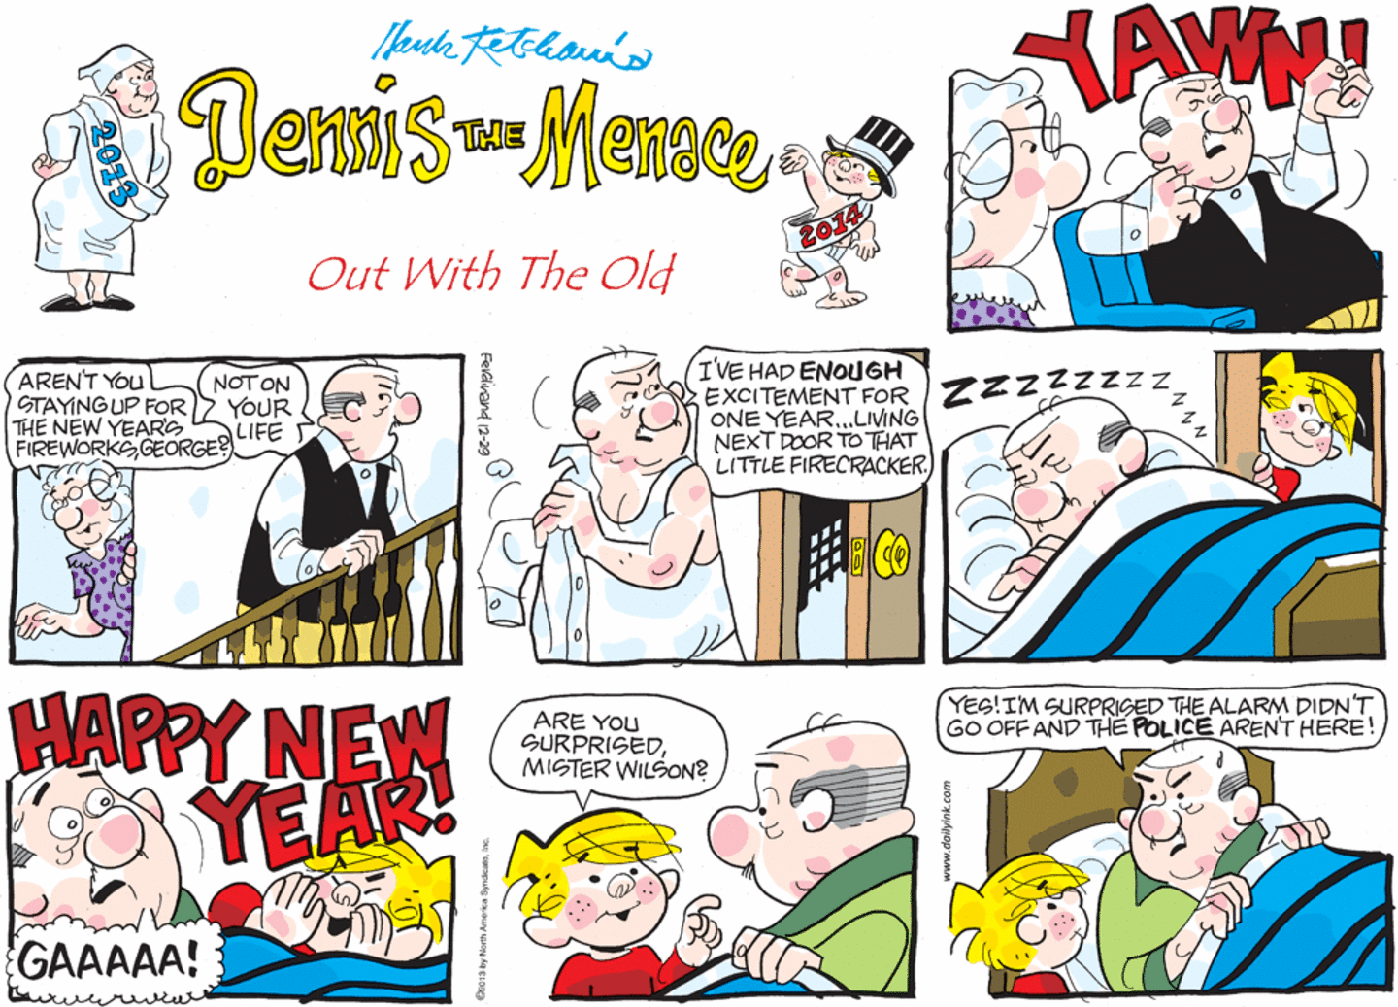
2. The Menaces — A threatening, troublesome, and annoying person. (Dennis, the Menace was always troubling Mr. Wilson).
Leaders are often blamed for things they didn’t do, criticized for things they tried to do. From without others mocked Nehemiah and from within others stole from the people. Here are 4 personal attacks against Nehemiah. What are the Enemy’s 4 strategies and God’s 4 principles?
(3)

Slide 4
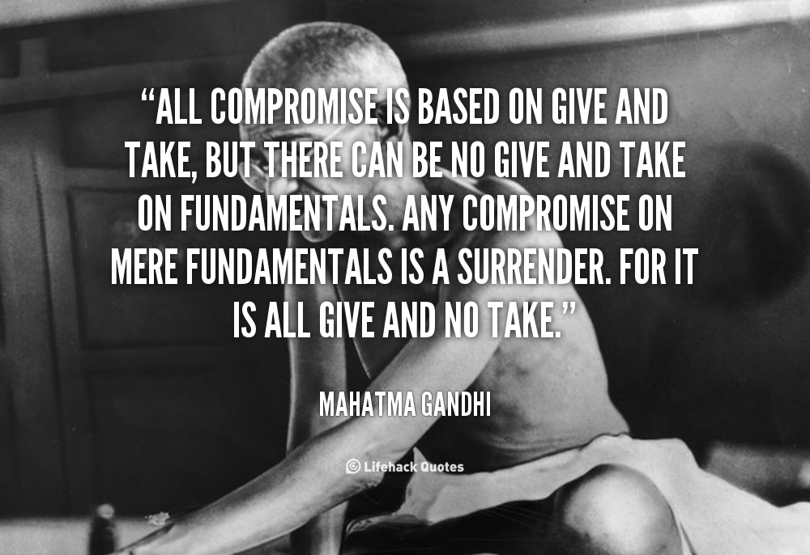
A. Compromises: “We will help you.” (6:1-4) Come, let us meet together
(attempted to lure Nehemiah
outside of Jerusalem to Ono).
(1) Enemy’s strategy #1: “If you can’t beat them, join them and then takeover.” “We will meet you halfway.” (All compromise is based on give and take…)
(2) God’s principle #1: It is good to cooperate with the right people, at the right time and for the right purpose. But reject compromise with the wrong people, at the wrong time and for the wrong reasons. Decisions based on convictions must stand. Nehemiah had discernment and determined not to compromise (Neh.2:20; 6:2-4; 2 Cor.6:14-17).
(4)
(2)

Slide 5
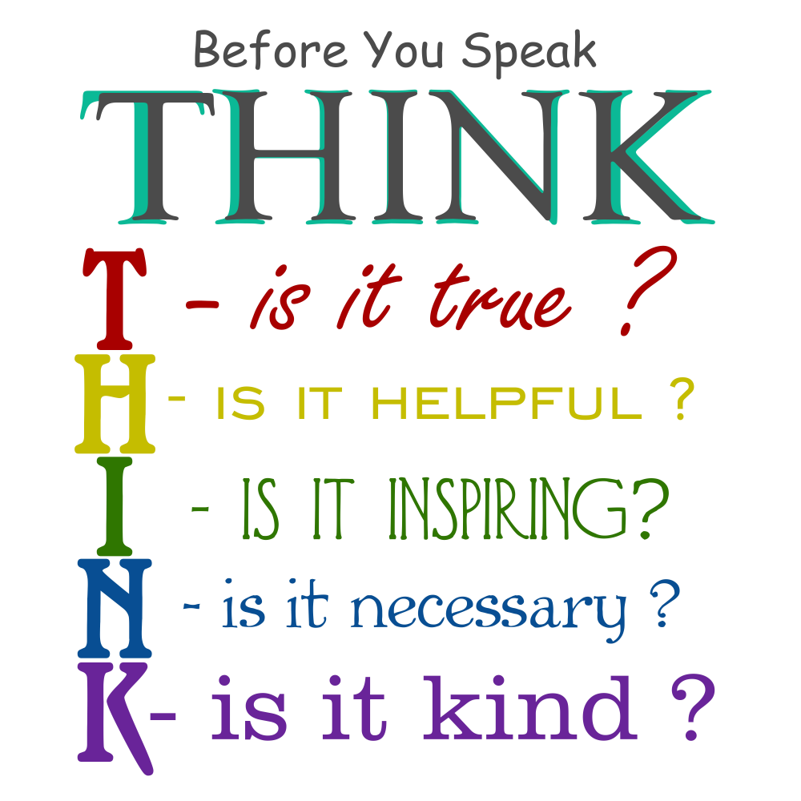
B. Slanders: “We will tell everybody about you.” (6:5-9) Sent an open letter accusing him of sedition for everybody to read.
(1) Enemy’s strategy #2: “It has been reported.” They try to divide and conquer. (Gossip is “news you have to hurry and tell somebody else before you find out if it is true.”) So before you speak THINK…
(2) God’s principle #2: Handle false accusations and gossip by seeking the truth and denying the lies. Nehemiah simply denied the reports, prayed to God for strength, and went back to work. “If we take care of our character, we can trust God to take care of our reputation.”
(5)
(2)

Slide 6
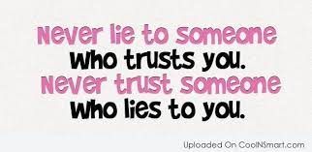

C. Lies:“We will protect your life.” (6:10-14) Let us meet in the house of God, inside the temple, and let us close the temple doors to protect you.
(1) Enemy’s strategy #3: Pay people to falsely accuse and discredit others. Shemiah was “a hired and false prophet to discredit Nehemiah, “I realized that God had not sent him, but that he had prophesied against me because Tobiah and Sanballat had hired him.” (7:12).
(6)
(2) God’s principle #3:Pray for those who falsely accuse you. “Remember…my God,because of what they have done”(7:14)

Slide 7
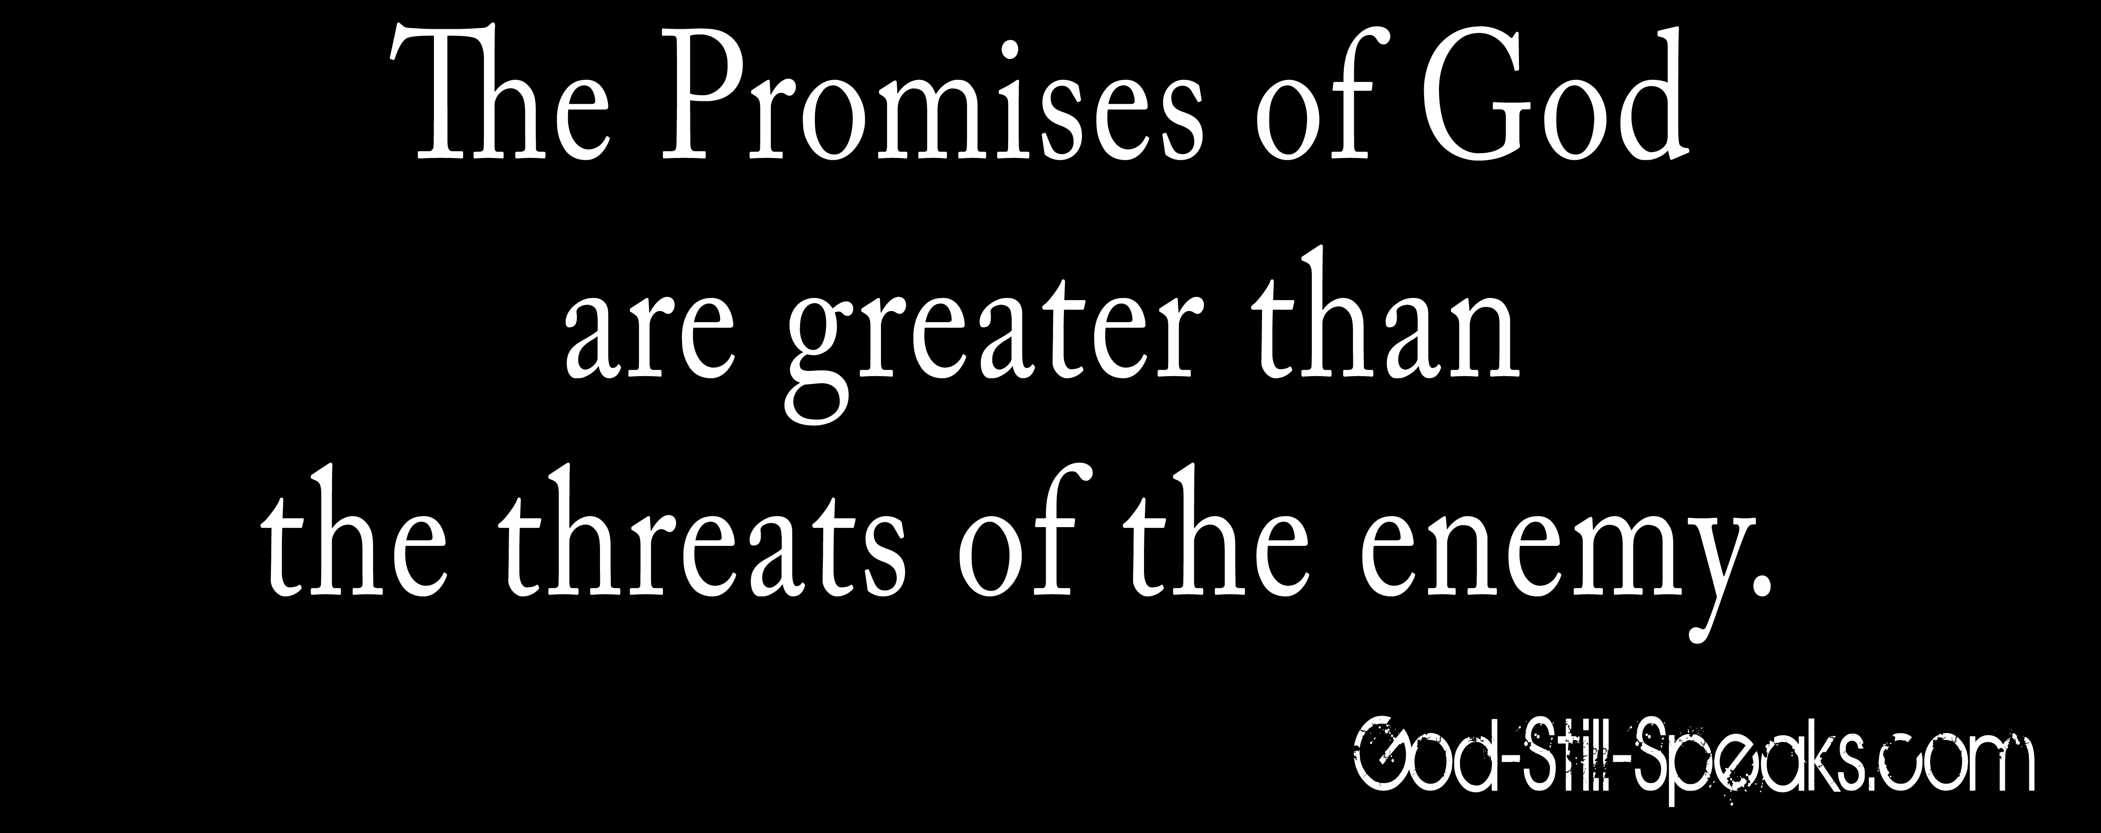
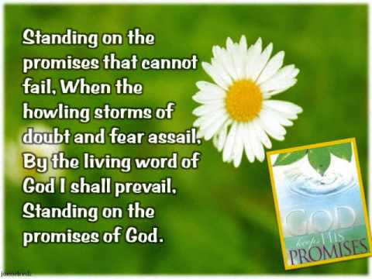
D. Threats: “We will frighten you.” (6:15-19) They were spies who wrote letters of intimidation.
(1) Enemy’s strategy #4: Campaign of intimidation. “Sending many letters to Tobiah,and replies from Tobiah kept coming to them”(6:17)
(2) God’s principle #4: When you are threatened, remember that the promises of God are greater than the threats of the enemy. (Stand on the promises). Nehemiah ignored the letters and threats and kept on working until the job was completed.
(2)
(7)

Slide 8
How to apply: Important lessons can be learned.
A. Look for the Miracles—What is God doing?
B. Beware of the Menaces—What is the opposition doing to disrupt God’s work? How can you improve the way you handle opposition?
1. Don’t compromise Biblical convictions. “The Bible says it, I believe God’s Word is truth, and that settles it.” God is true, and Satan is a liar (Jn.8:44).
2. Don’t listen or repeat gossip and slander. Also don’t believe everything you hear or read about Christian leaders. “Do not entertain an accusation against an elder unless it is brought by two or three witnesses.” (2 Timothy 5:19).
3. Ignore lies and listen to truth. Have a discernment to recognize lies and truth.
4. Ignore threats and trust God. Stand on God’s promises.
(8)
(2)

Slide 9
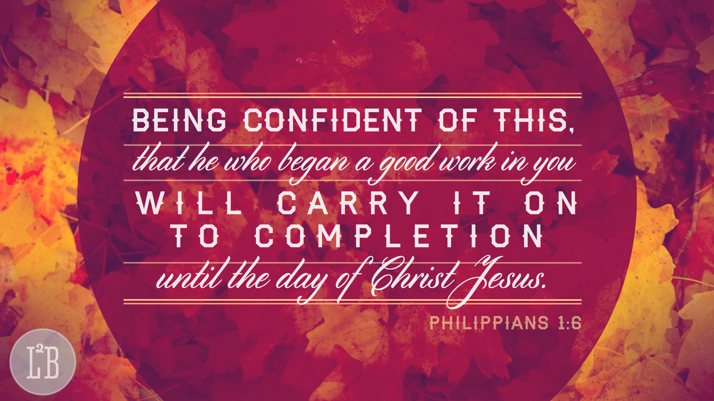
Conclusion: When God begins a work, He completes it (Phil.1:6). The story of Nehemiah began with “So I prayed” (2:4). Then we read, “So I came to Jerusalem” (2:11), “So they strengthened their hands for this good work” (2:18) is next, followed by, “So built we the wall” (4:6), “So we labored”
(4:21). Now we reach the end of this part of the story: “So the wall was finished” (6:15). But this marks a new beginning, for now Nehemiah must protect what has been accomplished. This is the theme of the rest of the book.
(9)
(2)

