Slide 1
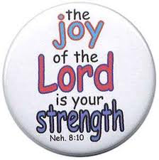
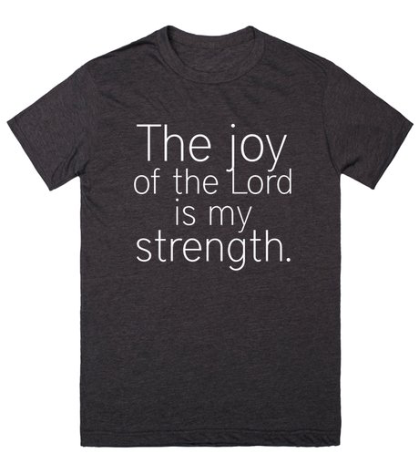
Pastor Gary Hart
Date: 7-10-16 Text: Neh.8:1-10
Intro: The physical needs of the city had been met(Neh.1-6); now it was time to focus on the spiritual needs of the people of the city(Neh.7-13). The city had been strengthened;now is the time to strengthen the people. What brings physical strength/spiritual strength? “For the joy of the Lord is your strength” (8:10).
In this world you can find temporary happiness, but in the Lord you can find lasting, great joy(15x Bible;3x Neh.8). There is “great joy in the presence of the Lord”(1Chr.29:22), which brings great revival and results in great strength.
Title: “For the joy of the Lord is your strength.”
(1)

Slide 2
1. The time for great joy — God’s timing for great revival.
A. Historical timing: It was on the 7th month 1st day (8:1-2).
(1) It was New Year’s Day. It was on October 8, 444 BC.
(2) It was the Festival of Trumpets (Num.29:1-6)
(3) It was a “holy day” (8:9,10,11).
B. Spiritual timing: It was the unity of the people (8:1-2).
(1) “All the people came together as one.” (8:1)
(2) “Men and women” and children. (8:2,3)
(3) It was a day set apart by God.
C. Application: “If my people, who are called by my name, will humble themselves and pray and seek my face and turn from their wicked ways, then I will hear from heaven, and I will forgive their sin and will heal their land.”(2Chr.7:14)
Great revivals in History.
(2)

Slide 3
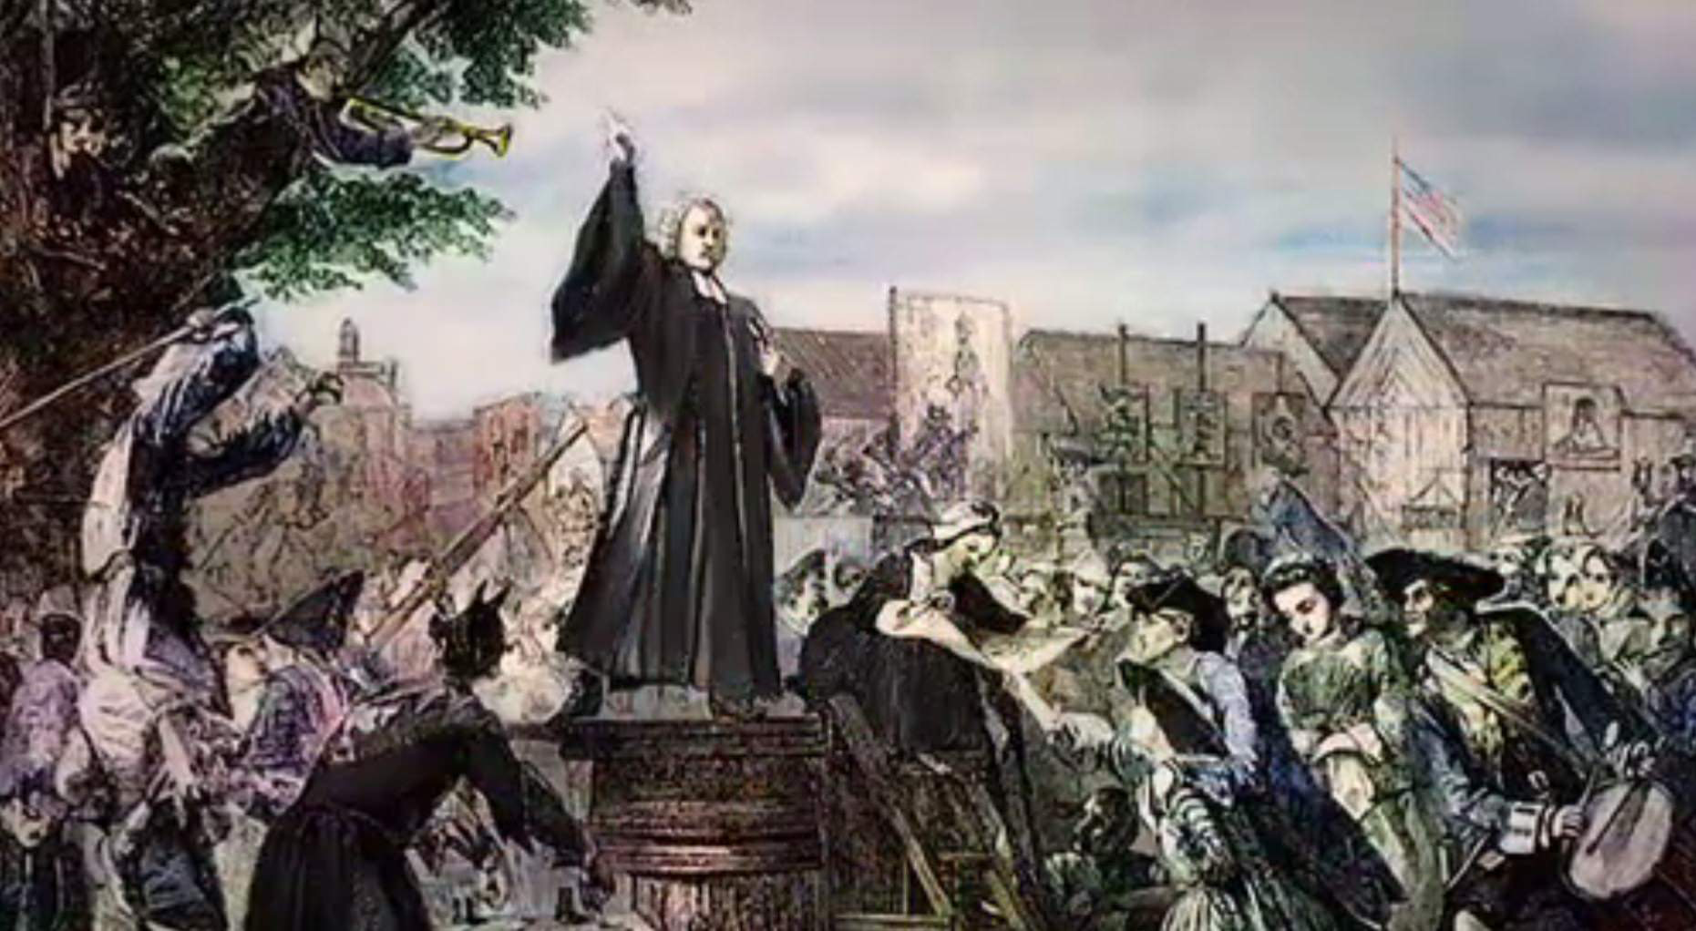
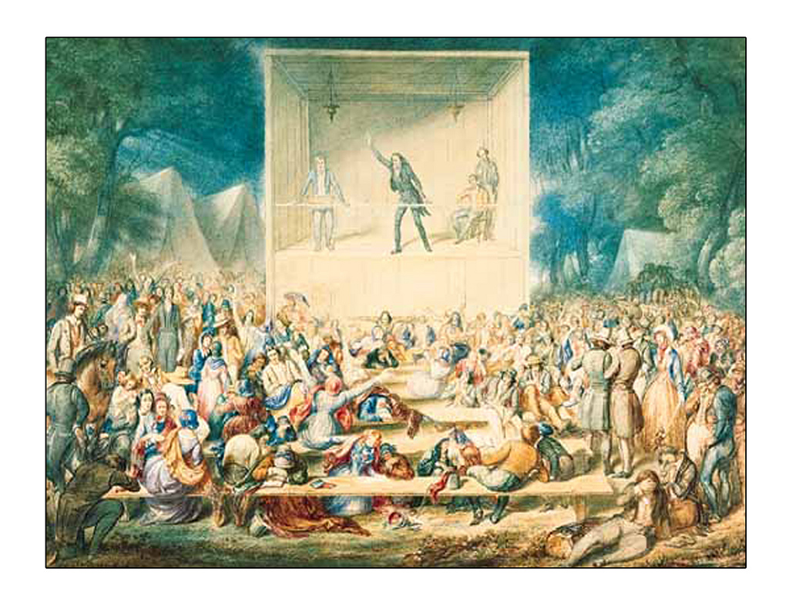
(1) America’s First Great Awakening. A revival that swept the American colonies in the 1730s and 1740s leaving a permanent impact.
(2) America’s Second Great Awakening. A revival that swept America from 1790 to 1820 also leaving a permanent impact.
(3) America’s next Great Awakening? Today revival is greatly needed in our lives. Pray for God’s timing for great revival.
(3)

Slide 4
2. The place for great joy — God’s place for great revival.
A. Historical setting: It was in Jerusalem (8:1-2).
(1) It was in the public square, a meeting place.
(2) It was before the water gate. It was a place for washing(Jn.15:3;Eph.5:26).
(3) It was before the assembly of the people and a high wooden platform (pulpit) built for the occasion.
B. Spiritual setting: It was in the City of David, Zion, Holy City, and the City of our God.
(1) It was a place for prayer.
(2) It was a place for expository preaching.
(3) It was a place for moving of God’s Spirit (Acts 2).
(4)
(2)

Slide 5
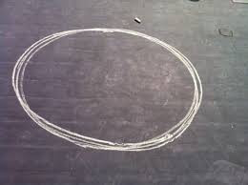
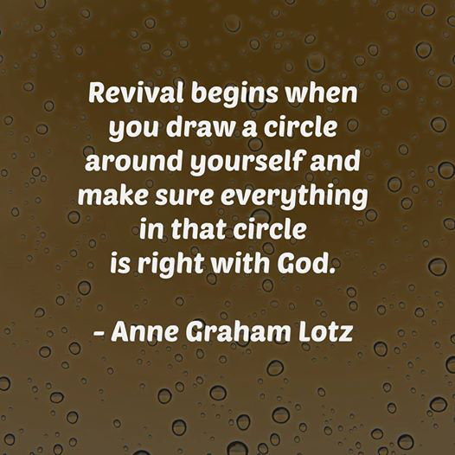
C. Application: “Do not leave Jerusalem, but wait for the gift my Father promised, which you have heard me speak about…When the day of Pentecost came, they were all together in one place.” (Acts 1:4; 2:1)
(1) Draw a circle around yourself and first pray for revival within that circle
(in your heart).
(2) Draw a circle around your family and second pray for revival within
that circle (in your family).
(3) Draw a circle around the church and the city and third pray for revival within that circle (in GKCCCC and Kansas City).
(5)
(2)

Slide 6
3. The cause for great joy-God’s movement for great revival.
A. Historical movement: It was the people and the leaders.
(1)It started with the people.“They came together as one…They told Ezra the teacher of the Law to bring out the Book of the Law of Moses”
(8:1).For Ezra had devoted himself to the study and observance of the Law of the Lord,and to teaching its decrees and laws in Israel(Ezra7:10).
(2) It continued with the leaders. “So…Ezra the priest brought the Law before the assembly”(8:2).“He read it aloud from day-break until noon.” He stood with other teachers, 13 of them (8:4). He “opened the book”(8:5).He “praised the Lord,the great God” (8:6). The Levities (13 of them) “instructed the people in the Law”(8:7). “They read from the Book of the Law of God, making it clear and giving the meaning” (8:8). “Then Nehemiah the governor, Ezra the priest and teacher of the Law, and the Levities who were instructing the people said to them all, ‘This day is holy to the LORD your God’”(8:9).
(6)

Slide 7
(3)It spread like fire with the people’s response.“All the people listened attentively to the Book of the Law”(8:3). “All the people could see him…The people all stood up”(8:5). “All the people lifted their hands and responded,‘Amen! Amen!’” (8:6). “Then they bowed down and worshiped the LORD with their faces to the ground”(8:6).“The people were standing there”
(8:7).“The people understood what was being read” (8:8). “For all the people had been weeping as they listened to the words to the words of the Law”(8:9). “Then all the people went away to eat and drink, to send portions of food and to celebrate with great joy,because they now understood the words that had been made known to them”(8:12).“The heads of the families…gathered around Ezra the teacher to give attention to the words of the Law”(8:13). “They should proclaim this word and spread it throughout their towns and in Jerusalem”(8:15).“So the people went out and brought back…and built…and lived in them” (8:16). “Their joy was very great” (8:17).
(7)

Slide 8
B. Spiritual movement: What is it like to be in a revival?
(1) It starts with God’s people praying,seeking His face, delighting in His Word.
(2) It continues with God’s leaders teaching His Word.
(3) It spreads rapidly as people respond to God’s Spirit’s moving. “And let us consider how we may spur one another on toward love and good deeds, not giving up meeting together, as some are in the habit of doing, but encouraging one another—and all the more as you see the Day approaching.” (Heb.10:24-25)
C. Application: Do you want to experience God’s revival in your life, in your family, and in your church and city?
(1) It is all about God’s timing.
(2) It is all about God’s place.
(3) It is all about God’s movement.
(8)

Slide 9
Conclusion: “Now that same day two of them were going to a village called Emmaus,about seven miles from Jerusalem. They were talking with each other about everything that had happened. As they talked and discussed these things with each other, Jesus himself came up and walked along with them; but they were kept from recognizing him. He asked them, “What are you discussing together as you walk along?” They stood still, their faces downcast. One of them, named Cleopas, asked him, “Are you the only one visiting Jerusalem who does not know the things that have happened there in these days?” “What things?” he asked.“About Jesus of Nazareth,” they replied. “He was a prophet, powerful in word and deed before God and all the people. The chief priests and our rulers handed him over to be sentenced to death, and they crucified him; but we had hoped that he was the one who was going to redeem Israel. And what is more, it is the third day since all this took place. In addition, some of our women amazed us. They went to the tomb early this morning but didn’t find his body. They came and told us that they had seen a vision of angels, who said he was alive. Then some of our companions went to the tomb and found it just as the women had said, but they did not see Jesus.”
(9)

Slide 10
He said to them, “How foolish you are, and how slow to believe all that the prophets have spoken! Did not the Messiah have to suffer these things and then enter his glory?” And beginning with Moses and all the Prophets, he explained to them what was said in all the Scriptures concerning himself. As they approached the village to which they were going, Jesus continued on as if he were going farther. But they urged him strongly, “Stay with us, for it is nearly evening; the day is almost over.” So he went in to stay with them. When he was at the table with them, he took bread, gave thanks, broke it and began to give it to them. Then their eyes were opened and they recognized him, and he disappeared from their sight. They asked each other, “Were not our hearts burning within us while he talked with us on the road and opened the Scriptures to us?” (Lk.24:13-32)
Combination of delight in God’s Word, mix with great joy, results in great strength.
(10)

Slide 11
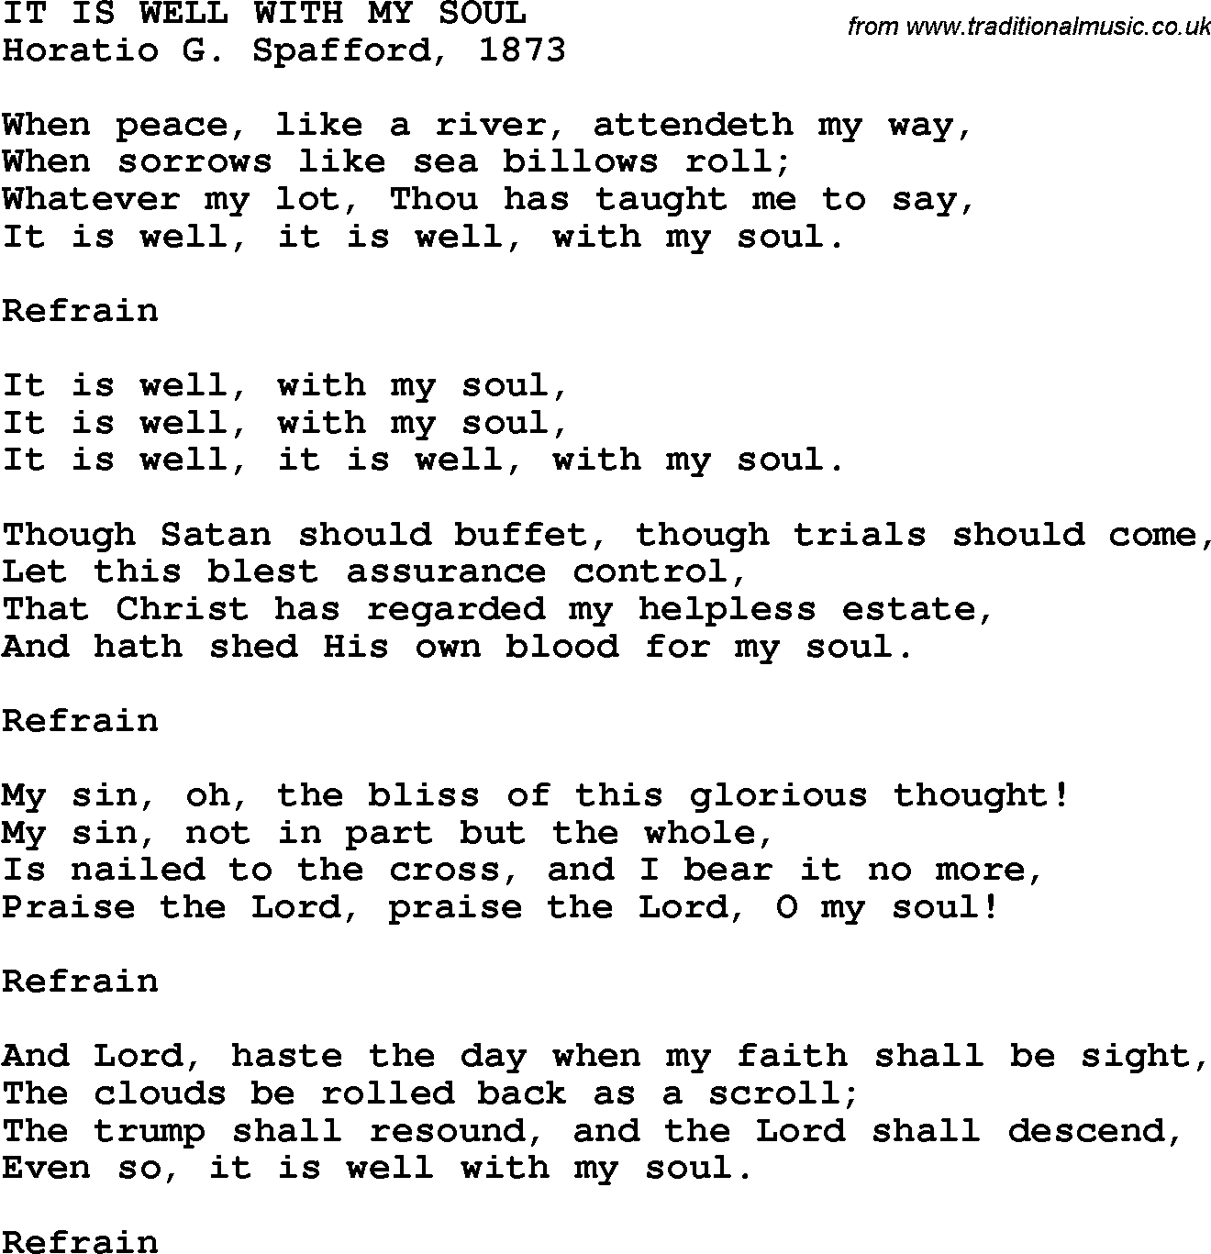
(2)
(11)

