Slide 1
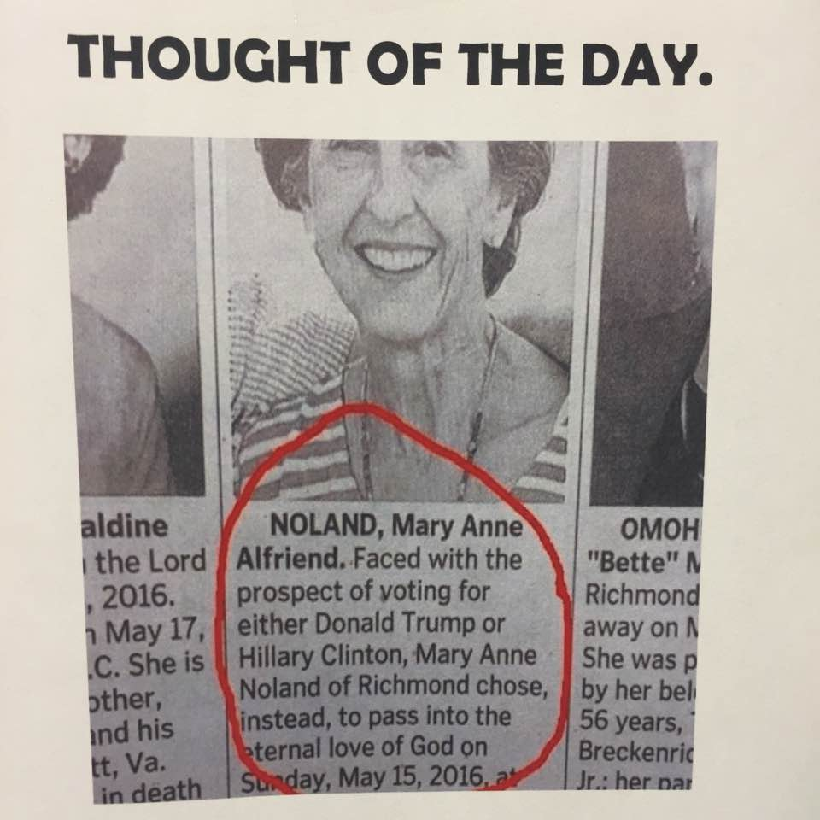
Look at the problems in America and around the world.
What lives matter?
The solution is not…
What is the solution?
(1)

Slide 2
Pastor Gary Hart
Date: 7-24-16 Text: Nehemiah 9:31-38
Introduction: In Nehemiah, we see great joy (3x-8:12;17;12:43). Great joy came from a great revival and resulted in great strength. The word “great” is found in Nehemiah (22x/7x). God is the main subject of this chapter—who He is, what He does, and what His people do. We see the majesty of God, the history of Israel, and the depravity of mankind. Ezra 9, Nehemiah 9, and Daniel 9 are devoted to confessions of national sin and prayers for God’s grace. Behind these prayers is the promise of 2 Chron.7:14, “If my people, who are called by my name, will humble themselves and pray and seek my face and turn from their wicked ways, then I will hear from heaven, and I will forgive their sin and will heal their land.” We also see the example of Moses when he interceded for the people (Ex.32-33). “History is His story”(A.T. Pierson). “Those who do not remember the past are condemned to relive it”(George Santayana). We can learn from history or repeat it. Are we are willing to humble ourselves, and receive the truth?
Title: Amazing Grace!
(1)

Slide 3
1. The Greatness of God (9:1-6)— He is the great and awesome God (1:5; 4:14). He is the great God (8:6; 9:32).
A. He receives our worship. It was on October 30, 444 BC. “The Israelites gathered together, fasting and wearing sackcloth and putting dust on their heads. Those of Israelite descent had separated themselves from all foreigners. They stood in their places and confessed their sins and the sins of their ancestors. They stood where they were and read from the Book of the Law of the Lord their God for a quarter of the day(3 hours), and spent another quarter(3 hours) in confession and in worshiping the Lord their God… They cried out with loud voices to the Lord their God…“Stand up and praise the Lord your God” (9:1-5a).
B. He is eternal. “Who is from everlasting to everlasting.Blessed be your glorious name, and may it be exalted above all blessing and praise” (9:5b).
(2)

Slide 4
C. He is unique. “You alone are the Lord” (9:6a). The first two commandments (Ex.20:1-17) declare the uniqueness of God and wickedness of idolatry.
D. He created the universe. “You made the heavens, even the highest heavens, and all their starry host, the earth and all that is on it, the seas and all that is in them” (9:6b). “In the beginning God created the heaven and the earth” (Gen.1:1). Idolatry means worshipping the serving the creature and the creation rather than the Creator (Rom.1:25).
E. He takes care of His creation. “You give life to everything”
(9:6c). God did not simply make everything and then abandon it to its own course.He is involved in the matters of His creation. “You open your hand and satisfy the desires of every living thing” (Ps.145:16).
F. The multitudes of heaven worship Him. “And the multitudes of heaven worship you” (9:6d). We have more cause to praise Him than they do? We have been saved by the greatness of God. We are His children and will dwell with Him forever! (I Jn.3:1-3)
(3)

Slide 5
*Apply: I will offer true worship by hearing the Scriptures, praising God, praying, confessing sin, and separating myself from whatever displeases God. “So here I am to worship…” Not here I am to…
(4)

Slide 6
2. The Goodness of God (9:7-31)— He has great goodness (9:25,35) and great love (13:22). He is a “giving” God (“give” 21x/4x “gave” 19x/11x). God gave them so much, but they failed to appreciate His gifts.
A. He made a covenant with Abraham. God chose Abraham and made a covenant with him (9:7-8).
B. He gave them land. “To give to his descendants the land” (9:8,15,35).
C. He lead them out of Egypt and gave them light. “To give them light on the way they were to take” (9:9-12).
D. He gave the law and commandments. “You came down on Mount Sinai; you spoke to them from heaven. You gave them regulations and laws that are just and right, and decrees and commands that are good. You made known to them your holy Sabbath and gave them commands, decrees and laws through your servant Moses.” (9:13-14).
(5)

Slide 7
E. He gave them food and water.“In their hunger you gave them bread from heaven and in their thirst you brought them water”(9:15,20) “Forty years you sustained them in the wilderness; they lacked nothing, their clothes did not wear out nor did their feet become swollen”(9:21). But they became arrogant and stiff-necked.They did not obey God’s com-mands. They refused to listen and forgot the miracles. “But you are a forgiving God, gracious and compassionate, slow to anger and abounding in love.”(v.16-18).
F. He gave His good Spirit. “You gave your good Spirit to instruct them” (9:20).
G. He gave victory over their enemies and deliverers. “You gave them deliverers, who rescued them from the hand of their enemies.” (9:22-25, 27). But they were disobedient. But when they cried out God rescued them.But they again did evil. “But in your great mercy you did not put an end to them or abandon them,for you are a gracious and merciful God”
(9:31). So God disciplined His people in their own land and then away from their own land.God’s discipline is an evidence of His love(He.12:1-11).
*Apply: I will thank God for all of His gifts, and obey Him, or receive His discipline. I will break the cycle of disobedience.
(6)

Slide 8
3. The Grace of God (9:32-38)— He has great compassion (9:19,27) and great mercy/grace (9:31). In His mercy, God didn’t give them what they deserved, and in His grace, He gave them what they didn’t deserve.
A. We acknowledge God. “Now therefore, our God, the great God, mighty and awesome, who keeps his covenant of love, do not let all this hardship seem trifling in your eyes—the hardship that has come on us, on our kings and leaders, on our priests and prophets,on our ancestors and all your people, from the days of the kings of Assyria until today. In all that has happened to us, you have remained righteous; you have acted faithfully” (9:32-33a).
B. We confess our sins. “While we acted wickedly. Our kings, our leaders, our priests and our ancestors did not follow your law; they did not pay attention to your commands or the statutes you warned them to keep…they did not serve you or turn from their evil ways…Because of our sins…We are in great distress”(9:33b-37).
C. We make a binding agreement. “In view of all this, we are making a binding agreement, putting it in writing, and our leaders…” (9:38).
*Apply: I will acknowledge God’s greatness, goodness, and grace. I will confess my sins. I will make a binding agreement with God.
(7)

Slide 9
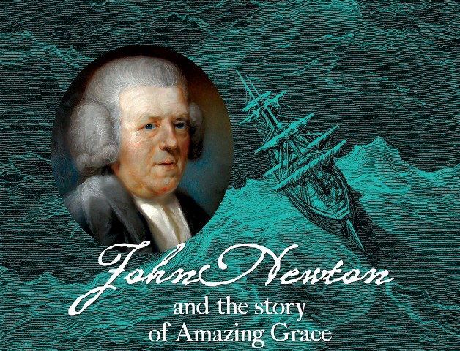
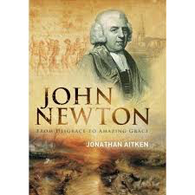
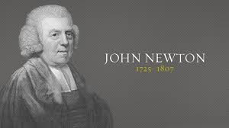
Conclusion: John Newton had rejected his mother's teachings and had led other sailors into unbelief. Certainly he was beyond hope and beyond saving, even if the Scriptures were true. Yet, Newton’s thoughts began to turn to Christ. He found a New Testament and began to read. Luke 11:13 seemed to assure him that God might still hear him: “If ye then, being evil, know how to give good gifts unto your children: how much more shall your heavenly Father give the Holy Spirit to them that ask him.” That day at the helm, March 21, 1748, was a day Newton remembered ever after, for “On that day the Lord sent from on high and delivered me out of deep waters.” Only God's amazing grace could and would take a rude, profane, slave-trading sailor and transform him into a child of God. Newton never ceased to stand in awe of God's work in his life. He wrote “Amazing Grace.”
(8)

Slide 10
“Although my memory’s fading, I remember two things very clearly. I’m a great sinner and Christ is a great Savior.”—John Newton
(11)

