Slide 1
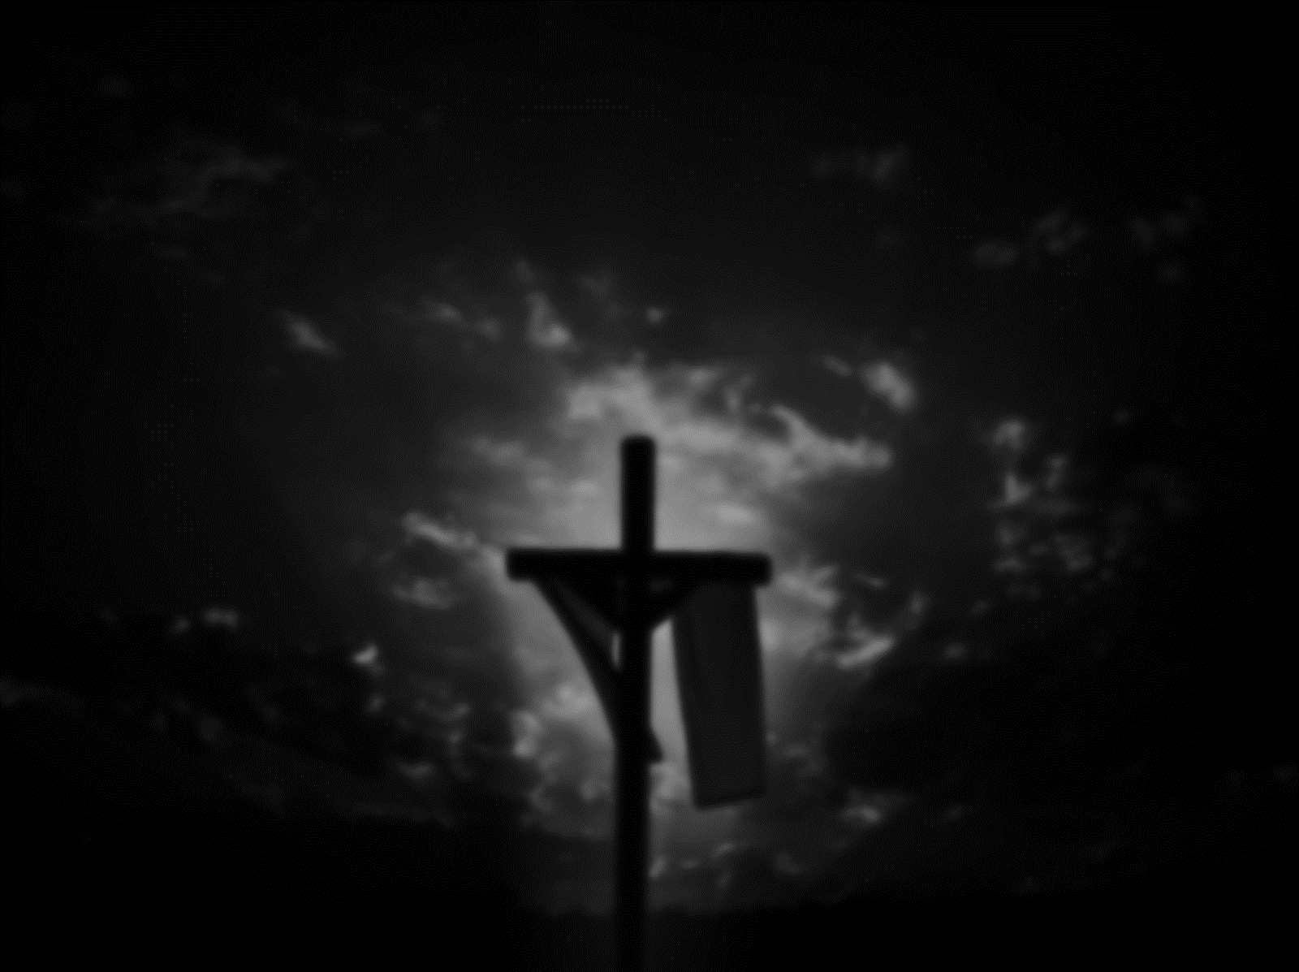

Slide 2
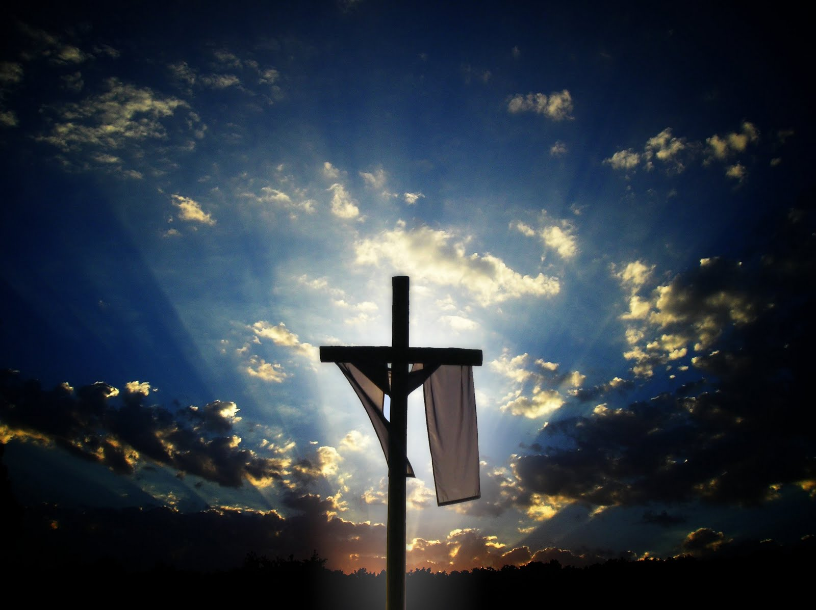
HE is Risen!
祂复活了!

Slide 3
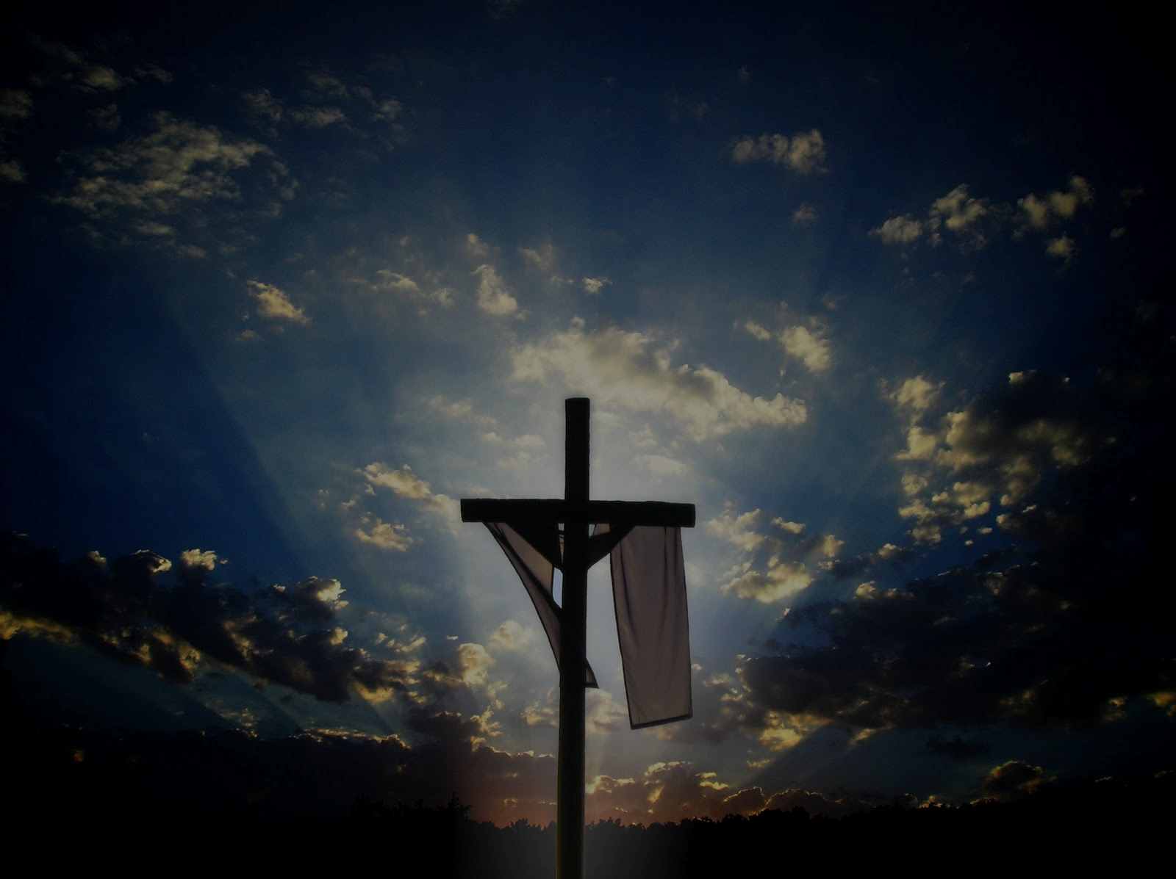
Yes
No Way!
沒这回事!
Any proof? 有证据吗?
Empty Tomb 空的坟墓
Jesus’ appearance 耶稣的显现
There must be explanations
必定有合理的解释…
有

Slide 4
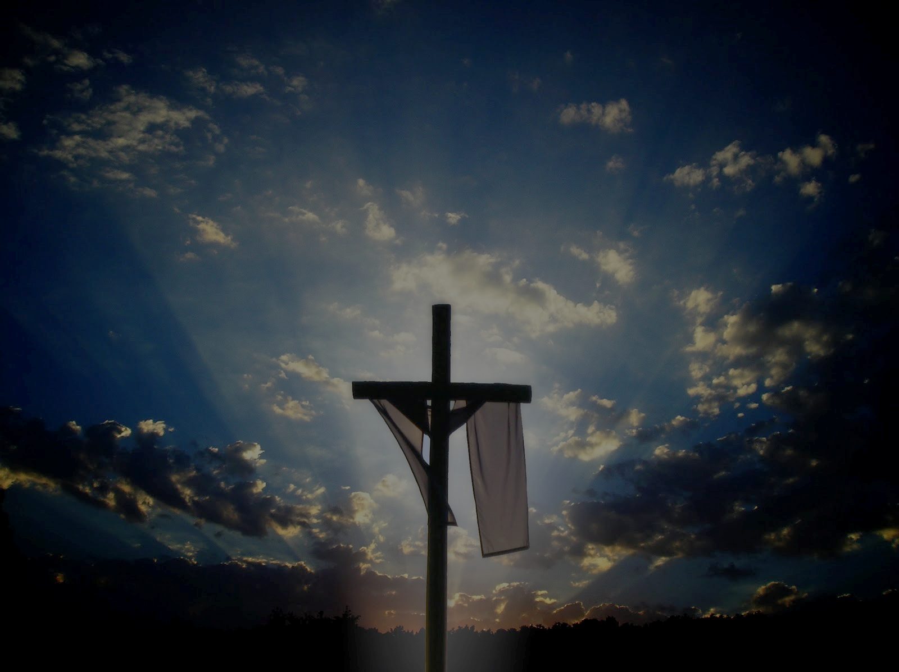
1 Body stolen 尸体被偷
a Romans don’t care
罗马人才不管这事
sealed & guarded 封住加守卫
b Disciples won’t 门徒们不会
die for a known lie? 殉道不殉谎
c The Jews “might” have a motive
只有犹太人“可能”有嫌疑
Yet the body has never emerged
尸体始终未曾出现

Slide 5
Body stolen 尸体被偷
Wrong tomb 找错坟墓
Jesus swooned 耶稣只是昏迷
Spiritual resurrection 灵的復活
Hallucination 幻象
A substitute die in Jesus’ place
十架上的根本就不是耶稣
7 ……
(> 500?)

Slide 6
The truth is…
He is risen indeed!
And He appeared to many.
真相是
祂真的复活了!
并向多人显现.

Slide 7
Is it really THAT important?
复活与否, 有那么重要吗?
林前 1 Cor. 15:14-19
¹⁴ And if Christ has not been raised, our preaching is useless and so is your faith…
¹⁹ If only for this life we have hope in Christ, we are of all people most to be pitied.
¹⁴若基督没有復活,我们所传的便是枉然,你们所信的也是枉然;… ¹⁹我们若靠基督,只在今生有指望,就算比眾人更可怜.

Slide 8
So? 与我何干?!
Am I risen with Him?!
我与祂同复活了吗?!
If so, has my life changed?
我有改变生命的经历吗?

Slide 9
罗马书 Roman 6:4-9
⁴所以,我们藉著洗礼归入死,和他一同埋葬,原是叫我们一举一动有新生的样式,像基督藉著父的荣耀从死里復活一样.
⁴We were therefore buried with him through baptism into death in order that, just as Christ was raised from the dead through the glory of the Father, we too may live a new life.

Slide 10
⁵我们若在他死的形状上与他联合, 也要在他復活的形状上与他联合; ⁶因為知道我们的旧人和他同钉十字架,使罪身灭绝,我们不再作罪的奴僕;
⁵ If we have been united with him like this in his death, we will certainly also be united with him in his resurrection. ⁶ For we know that our old self was crucified with him so that the body of sin might be done away with, that we should no longer be slaves to sin—

Slide 11
⁷因為已死的人是脱离了罪. ⁸我们若是与基督同死,就信必与他同活. ⁹因為知道基督既从死里復活,就不再死,死也不再作他的主了.
⁷ because anyone who has died has been freed from sin. ⁸ Now if we died with Christ, we believe that we will also live with him.
⁹ For we know that since Christ was raised from the dead, he cannot die again; death no longer has mastery over him.

Slide 12
Can we be more practical!?
Sure!
能更实际些吗?
当然!

Slide 13
埋葬Buried Risen復活
(my right to God) (privilege from God)
Self 自己
Right 权利
Ownership 拥有
Get 得到
I am right 我有理
my plan 我的计画
my will 我的意思
my pain 我的伤痛
祂的生命 His Life
服事/事工 Ministry
管家 Stewardship
给予 Give
祂有怜悯 He’s mercy
祂的呼召 His calling
他的意思 His will
祂的恩典 His grace

Slide 14
埋葬Buried Risen復活
(my right to God) (privilege from God)
my idea 我的想法
my likes 我的喜好
my face 我的面子
my gift 我的恩赐
my fun 我的娱乐
my kids 我的孩子
my marriage 婚姻
my life 我的生命
他的智慧 His wisdom
祂的喜悦 His delight
祂的荣耀 His glory
祂的器皿 His tool
祂的喜乐 His joy
祂的儿女 His children
祂的盟约 His covenant
祂的国度 His Kingdom

Slide 15
Have you lived out this
resurrected life?
Try bury your old self!
Are you born again at all?
你活出了这
復活的生命吗?
试试看先埋葬你的老我!
你重生了吗?
No?
没有?

Slide 16
That if you confess with your mouth, “Jesus is Lord,” and believe in your heart that God raised him from the dead, you will be saved. For it is with your heart that you believe and are justified, and it is with your mouth that you confess and are saved.
你若口里认耶穌為主,心里信神叫他从死里復活,就必得救. 因為人心里相信,就可以称义;口里承认,就可以得救. (罗马书 Romans 10:9-10)

Slide 17
Christ The Lord Is Risen Today
基督耶稣今复活
Christ the Lord is risen today, Alleluia!
Earth and heaven in chorus say, Alleluia!
Raise your joys and triumphs high, Alleluia!
Sing, ye heavens, and earth reply, Alleluia!
基督我主今复活 哈利路亚
天使世人同述说 哈利路亚
快乐凯歌高声唱 哈利路亚
诸天大地同颂扬 哈利路亚
4

Slide 18
Christ The Lord Is Risen Today
基督耶稣今复活
Love's redeeming work is done, Alleluia!
Fought the fight, the battle won, Alleluia!
Death in vain forbids him rise, Alleluia!
Christ has opened paradise, Alleluia!
爱的救赎已完成 哈利路亚
属灵战争全得胜 哈利路亚
胜过死亡成救恩 哈利路亚
基督打开乐园门 哈利路亚
3

Slide 19
Christ The Lord Is Risen Today
基督耶稣今复活
Lives again our glorious King, Alleluia!
Where, O death, is now thy sting? Alleluia!
Once he died our souls to save, Alleluia!
Where's thy victory, boasting grave? Alleluia!
荣耀君王已胜利 哈利路亚
死亡毒狗在哪里 哈利路亚
一人受死众得生 哈利路亚
死亡不能再夸胜 哈利路亚
2

Slide 20
Christ The Lord Is Risen Today
基督耶稣今复活
Soar we now where Christ has led, Alleluia!
Following our exalted Head, Alleluia!
Rise like Him, like Him we live, Alleluia!
Ours the cross, the grave, the skies, Alleluia!
在基督里得自由 哈利路亚
跟随耶稣荣耀主 哈利路亚
活出复活新生命 哈利路亚
同死同活同升天 哈利路亚
1

Slide 21
Rise • like • Him,
Like • Him • we • live,
A—lleluia!
Ours • the • cross, the • grave,
the • skies, A—lleluia!
活出复活新生命 哈利路亚
同死同活同升天 哈利路亚

