Slide 1
Text:Lk.12:13-21.Topic:Roots&Fruits:Greed&Generosity.
“Watch out!Be on your guard against all kinds of greed;life does not consist in an abundance of possessions”(Lk.12:15). Introduction:
Opening Questions:
Where did that come from?
What are bad roots of the heart?
How is your heart?
Key Idea: How to deal with the root of greed.
(1) Definition of greed.
(2) Description of greed.
(3) Cause of greed.
(4) Example of greed.
(5) Cure for greed.
(6) Key Application is the habit of generosity.
Conclusion:
文字：路12:13-21.Topic：根与果：贪婪和慷慨。
“你们要谨慎自守、免去一切的贪心．因为人的生命、不在乎家道丰富”（路12:15）。
引言：
开题问题：
那个是从哪里来的？
什么是心的坏根？
你的心怎么样？
关键理念：如何处理贪婪的根源。
（1）贪婪的定义。
（2）贪婪的描述。
（3）贪婪的原因。
（4）贪婪的例子。
（5）贪婪的补救措施。
（6）关键应用是慷慨的习惯。
结论：

Slide 2
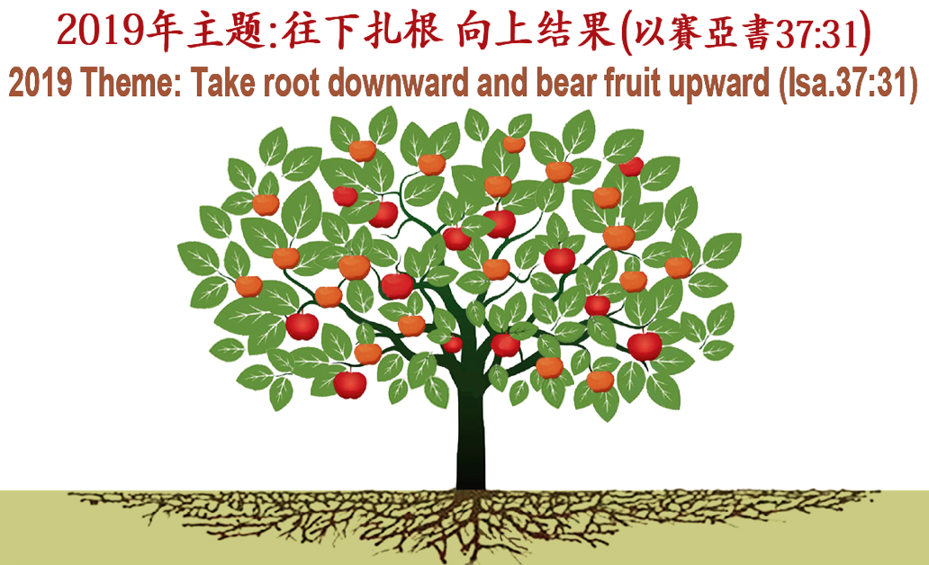
何礼义牧师
Pastor Gary Hart
经文:路12:13-21
Text:Lk.12:13-21
主题:“根与果:贪婪和慷慨”Topic:“Roots&Fruits:Greed&Generosity”
“你们要谨慎自守、免去一切的贪心． 因为人的生命、不在乎家道丰富”（路12:15）。
“Watch out! Be on your guard against all kinds of greed; life does not consist in an abundance of possessions”(Lk.12:15).
主日:二零一九年三月十日 Sunday: Mar.10, 2019

Slide 3
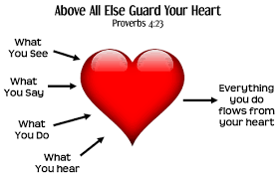
Introduction:引言:
Opening Questions:开场问题:
Where did that come from?It came from
within,from the heart.“Above all else,guard
your heart,for everything you do flows from it”(Pr.4:23).
那个是从哪里来的？它来自内心。你要保守你心，胜过保守一切，因为一生的果效是由心发出(箴4:23)。
What are bad roots of the heart? 什么是心的坏根？
Guilt says, “I owe you.”
Anger says, “You owe me.”
Greed says, “I owe me.”
罪恶感说：“我欠你的。”
生气说：“你欠我的。”
贪婪说：“我欠我的。”
“For the love of money is a root of all kinds of evil. Some people, eager for money, have wandered from the faith and pierced themselves with many griefs”(1Ti.6:10).
“贪财是万恶之根．有人贪恋钱财、就被引诱离了真道、用许多愁苦把自己刺透了”(提前6:10)。
(2)
Notes:
Greedy people believe they deserve every good thing that comes their way. It’s hard to get a greedy person to part with money or stuff. Why? Because it’s theirs.
Greedy people usually have a story to tell. For example…
I was raised in a home with little or no financial security (during the Great Depression/Great famine) or I once lost everything.

Slide 4
Key Question:How is your heart? 关键问题:你的心怎么样？
“Watch out! Be on your guard against all kinds of greed; life does not consist in an abundance of possessions”(Lk.12:15).
“你们要谨慎自守、免去一切的贪心．因为人
的生命、不在乎家道丰富”（路12:15）。
Key Idea:How to deal with the root of greed.
关键理念：如何处理贪婪的根源。
There are 4 roots of the heart: guilt, anger, greed, jealousy.
We deal with the root of guilt with confession and the root of anger with forgiveness.Pull out bad roots and reap good fruits.
“You shall not covet your neighbor’s house…your neighbor’s wife,or his male or female servant,his ox or donkey, or anything that belongs to your neighbor”(Ex.20:17).
“不可贪恋人的房屋、…人的妻子、仆婢、牛驴、并他一切所有的”(出20:17)。
(3)
Notes:
Our ancestors coveted in the garden of Eden(Gen.3:6). The commandment makes it clear that it is wrong to desire the wrong things. But it is right to desire take pleasure in your own house, wife, and possessions. But Rom.7 argues that there is a fault within which is the real origin of covetousness. It is a fault that transforms pleasure in good things into a passionate longing for what we do not have. To say “don’t covet” makes us aware of desire; it does not quench it. It takes a work of God’s Sprit to redirect our desires and to give us contentment in those things that God intends us to have. Covetous describes a person desirous of having more. It means “greedy.”

Slide 5
(1)Definition of greed. “Someone in the crowd said to him, Teacher,tell my brother to divide the inheritance with me. Jesus replied, Man, who appointed me a judge or an arbiter between you? Watch out! Be on your guard against all kinds of greed; life does not consist in an abundance of possessions” (Lk.12:13-15).
(1)贪婪的定义。“众人中有一个人对耶稣说、夫子、请你吩咐我的兄长和我分开家业。耶稣说、你这个人、谁立我作你们断事的官、给你们分家业呢。你们要谨慎自守、免去一切的贪心。因为人的生命、不在乎家道丰富”(路12:13-14)。
Greed was in the hearts of the two brothers. Greed is the unquenchable thirst for getting more and more of something we think we need in order to be truly satisfied. Greed may be a thirst for money or the things that money can buy, or even a thirst for position and power. Jesus made it clear that true life does not depend on an abundance of possessions.
(4)
Notes:
Rabbis were expected to help settle legal matters,but Jesus refused to get involved. Why? Because He knows that no answer He gave would solve the real problem, which was greed in the hearts of the two brothers (“you” is plural).As long as both men were greedy,no settlement would be satisfactory.Their greatest need was to have their hearts changed.Like too many people today,they wanted Jesus to serve them but not to save them. For the greedy person, stuff equals life. My stuff is my life.
He did not deny that we have certain basic needs (Mt.6:32;1Ti.6:17).He only affirmed that we will not make life richer by acquiring more of these things. All believers should “guard against all kinds of greed”(12:15).Greed is a common component in the lists of vices that a Christian should avoid(Mk.7:21;Ro.1:29;Eph.5:3;Col.3:5).

Slide 6
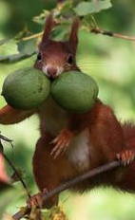
(2)Description of greed.Greed is easy to hide from ourselves.
Greedy people talk a lot and worry a lot about money.Greedy people are not cheerful givers.Greedy people are reluctant to share. Greedy people talk as if they have just enough to get by.Greedy people are reluctant to express gratitude.Greedy people aren’t content with what they have.Greedy people attempt to control people with their money. Greed isn’t a financial issue; it’s a heart issue.
(2)贪婪的描述。贪婪很容易隐藏，让我们自己看不见。贪婪的人总是谈论钱，并且为钱忧虑。贪婪的人不是快乐的人。贪婪的人不愿意分享。贪婪的人说话好像他们只是勉強足够。贪婪的人不愿意表达感激之情。贪婪的人不满足于他们所拥有的东西。贪婪的人们试图用他们的钱来控制人们。贪婪不是财务问题; 这是一个心的问题。
(5)
Notes:
Greed hides behind several virtues.Greedy people are savers,and saving is a good thing.Greedy people are often planners,and planning is a good thing.Greedy people want to make sure their financial future is secure, and that’s a good thing as well.
There are greedy poor people and greedy rich people.
Greedy people fight over insignificant amounts of money.贪婪的人们争夺无足轻重的金钱。

Slide 7
(3)Cause of greed. Greed is supported by an endless cast of “what ifs.” What if it gets lost? What if there’s not enough? What if I don’t get my fair share? What if the economy collapses? A fear that God either can’t or won’t take care of them. Greedy people can never have enough to satisfy their need to feel secure. There is always another “What if” that drives them to acquire more.Their appetites cannot be satisfied. There’s never enough. So the acquisition and hoarding continues.
(3)贪婪的原因。贪婪得到了无穷无尽的“假设”的支持。如果它丢失了怎么办？ 如果还不够怎么办？ 如果我没有得到我的公平份额怎么办？ 如果经济崩溃怎么办？ 担心上帝不能或不会照顾他们。 贪婪的人永远无法满足他们感到安全的需要。 总有另一个“假设”会促使他们获得更多。他们的胃口不能满足。 永远都不够。 因此收购和囤积仍在继续。
(6)
Notes:
Fear is the driving force behind greed. Fear fuels greed.
So,greedy people are rarely at peace with others and never at peace with themselves. Their appetite for financial security can never by fully and finally satisfied.

Slide 8
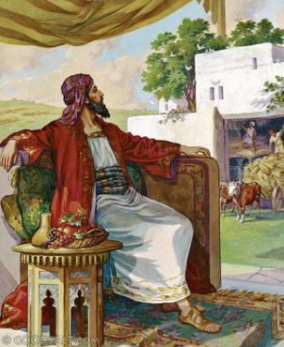
(4)Example of greed. Jesus tells about the parable of a wealthy landowner whose property yielded a much larger crop than he expected or needed. “And he told them this parable:The ground of a certain rich man yielded an abundant harvest”(12:16).
(4)贪婪的例子。 耶稣讲述了一个富裕的土地所有者的比喻，他的财产产生了比他预期或需要的更大的收成。“就用比喻对他们说、有一个财主、田产丰盛”(12:16)。
(7)
Notes:
Jesus told this parable to reveal the dangers that lurk in a greedy heart.
耶稣告诉这个比喻，揭示潜藏在一个贪婪，贪婪的心中的危险。

Slide 9
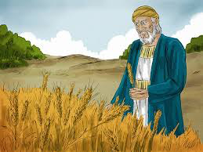
(a)How do you respond to the wealthy farmer’s dilemma? “He thought to himself,What shall I do?I have no place to store my crops”(12:17).
(a) 你如何应对财主的困境？“自己心里思想说,我的出产没有地方收藏,怎么办呢”(12:17)。
What are the dangers of prosperity(Pr.30:7-9)? Wealth can choke the Word of God(Mt.13:22),create snares and temptations(1T6:6-10,17-19), and give you a false sense of security. This farmer saw his wealth as an opportunity to please himself. He had no thoughts of others or of God.
Big…
Bigger…
Biggest…
大…
更大…
最大…
(8)
Notes:
Here was a man who had a problem with too much wealth! If suddenly you inherited a great deal of wealth, would it create a problem for you? Or would you simply praise God and ask Him what He wanted you to do with it?
这是一个财富多到成问题的人！如果突然你继承了大量的财富，它会为你造成问题吗？ 或者你只是赞美上帝并问他他想要你做什么？
The question he should be asking is, “Lord, what do you want me to do with the extra?”

Slide 10
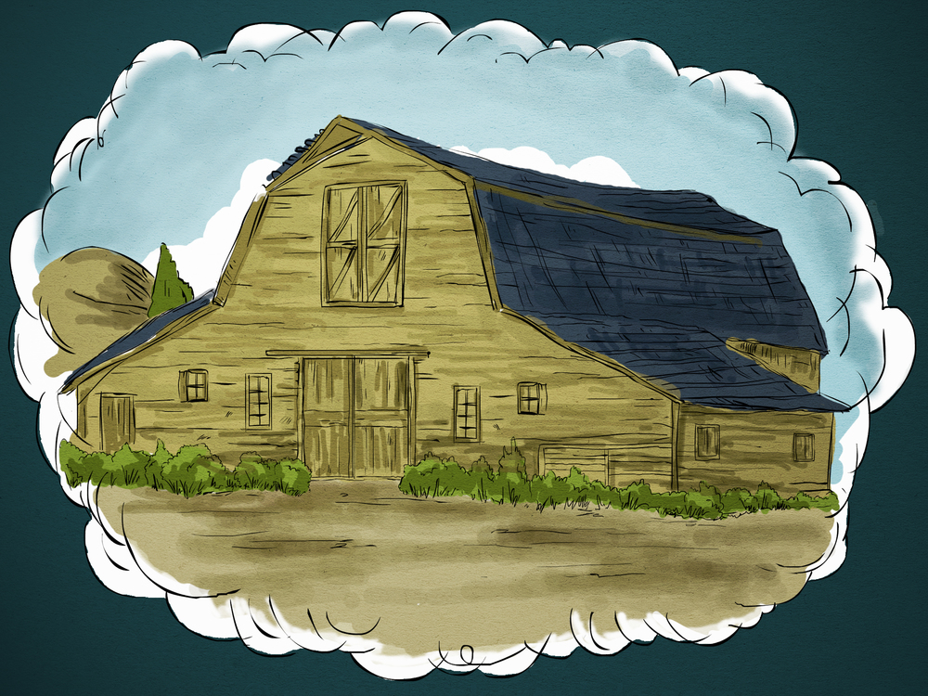
(b) How do you respond to the decisions of the rich man? “Then he said,This is what I’ll do.I will tear down my barns and build bigger ones,and there I will store my surplus grain”
(12:18).
(b)你如何回应富人的决定？“又说、我要这么办．要把我的仓房拆了、另盖更大的．在那里好收藏我一切的粮食和财物”(12:18)。
Big…
Bigger…
Biggest…
大…
更大…
最大…
(9)
Notes:
Are you saying, “He is a wise businessman! Save and have it ready for the future!” But Jesus saw selfish-ness in all that this man did, and He said the man was a fool.
你是说，“他是一个聪明生意人！ 拯救并为未来做好准备！” 但是耶稣看見这个人所做的一切都是自私的。他说这个人是个傻子。
The world’s philosophy is “Take care of Number One!” But Jesus does not endorse that philosophy. There is certainly nothing wrong with following good business principles or even with saving for the future(1ti.5:8). Jesus does not encourage waste(Jn.6:12). But neither does He encourage selfishness motivated by greed. We build bigger barns or rent bigger barns(storage units).
(note the 11 personal pronouns)

Slide 11
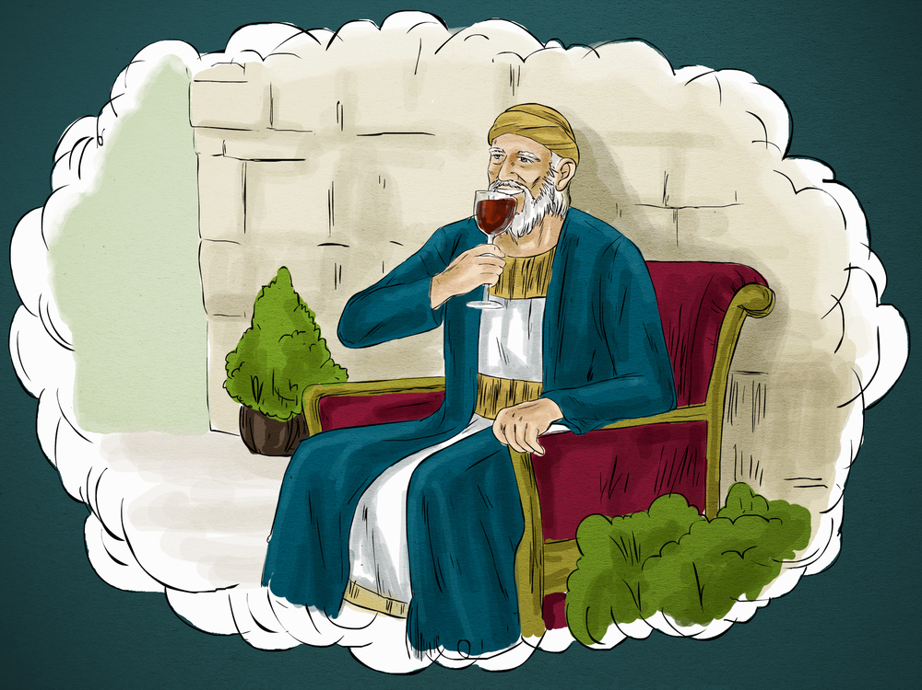
(c)How do you respond to the farmer’s desires? “And I’ll say to myself, You have plenty of grain laid up for many years. Take life easy; eat, drink and be merry”(12:19).
(c)你如何回应农夫的愿望？“然后要对我的灵魂说、灵魂哪、你有许多财物积存、可作多年的费用．只管安安逸逸的吃喝快乐吧”(12:19)。
Big…
Bigger…
Biggest…
大…
更大…
最大…
(10)
Notes:
Jesus made it clear that true life does not come from an abundance of things, nor do true success or security.
耶稣清楚地表明，真正的生活不是来自丰富的事物，也不是真正的成功或安全。
Are you saying, “This is the life!The man has success,satisfaction,and security! What more could he want?” This man had a false view of life. He thought that life came from accumulating things.
你说，“这就是生命！ 这个人有成功，满足和安全！ 他还想要什么？”这个人对生活有一种错误的看法。 他认为生活来自于积累的东西。

Slide 12
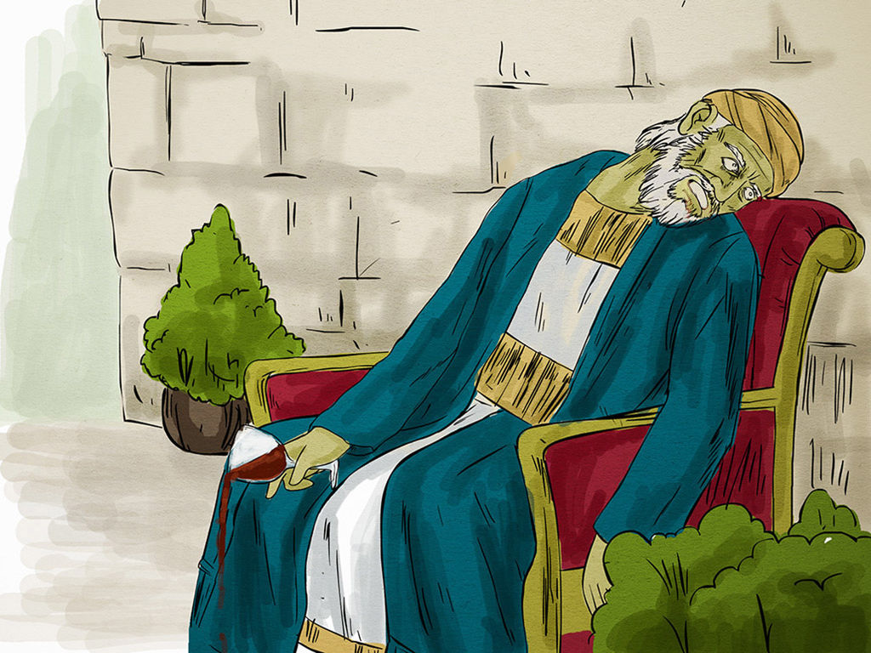
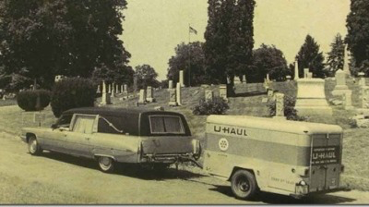
(d)How do you respond to death of this farmer?“But God said to him,You fool!This very night your life will be demanded from you.Then who will get what you have prepared for your-self? This is how it will be with whoever stores up things for themselves but is not rich toward God” (12:20-21).
(d)你如何应对这位农民的死亡？“神却对他说、无知的人哪、今夜必要你的灵魂．你所预备的、要归谁呢。凡为自己积财、在神面前却不富足的、也是这样”(12:20-21)。
Have you ever seen a hearse with a U-Haul? 你有没见过灵车有U-Haul？
(11)
Notes:
The man lived without God and died without God, his wealth was but an incident in his life.God is not impressed with our money.
这个人没有神而没有神而死，他的财富只是他生命中的一件事。神对我们的钱没有留下深刻的印象。
But the greatest tragedy is not what the man left behind but what lay before him: eternity without God!

Slide 13
What does it mean to be “rich toward God”? It means to acknowledge gratefully that everything we have comes from God, and then make an effort to use what He gives us for the good of others and the glory of God.
“在神面前富足的”是什么意思？这意味着要感激地承认我们所拥有的一切都来自神，然后努力利用祂所赐给我们的东西来造福别人和荣耀神。
“因为
你们的财宝
在哪里，
你们的心
也在哪里”
(路12:34)。
(12)
Notes:
Wealth can be enjoyed and used at the same time if our purpose is to honor God(1Ti.6:10). To be rich toward God means spiritual enrichment, not just personal enjoyment. How tragic when people are rich in this world but poor in the next (Mt.6:19-34).
如果我们的目的是要荣耀神(提前6:10)，财富可以同时享受和使用。在神面前富足的人们在今世富足但在来世贫穷是多么悲惨(太6:19-34)。

Slide 14
A person who stores up things for himself but isn’t rich toward God or generous toward those in need. A greedy person is one who saves carefully but gives sparingly. He was rich in this world but poor toward God.
(13)
Notes:
The farmer assumed that his abundance of stuff assured him an abundance of time. He learned that he will run out of time before he runs out of stuff. Either we’ll give it away while we still have time, or it will be taken away when our time runs out.
农夫认为他丰富的东西给了他足够的时间。 他得知他在用完之前会耗尽时间。 要么在我们还有时间的时候放弃它，要么在我们的时间耗尽时将它带走。
一个为自己储存东西但却没有向神致富或对那些有需要的人慷慨的人。贪婪的人为自己积聚，但在神面前却不富足，或吝待有需要的人。贪婪的人努力积聚, 但吝于给予。 他在世上富有, 但向神贫穷。

Slide 15
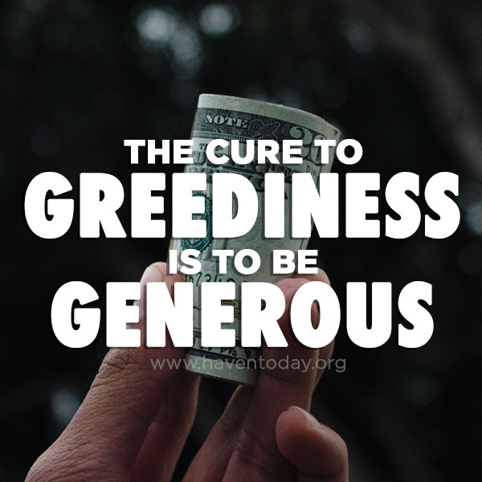
(5)Cure for greed.“No one can serve two masters. Either you will hate the one and love the other, or you will be devoted to the one and despise the other.You cannot serve both God and money”(Mt.6:24).The cure is a choice to serve God,which is followed by a truth. “It is more blessed to give than to receive”(Ac.20:35).
(5)贪婪的补救措施。“一个人不能事奉两个主．不是恶这个爱那个、就是重这个轻那个．你们不能又事奉神、又事奉玛门”(太6:24)。治愈是事
奉神的选择，然后有一个真理。
“施比受更为有福”(徒20:35)。
(6)Key application is the habit of generosity.
(6)关键应用是慷慨的习惯。
(14)
Notes:
When we focus on what we don’t have,it makes our hearts greedy. The greedy farmer believed that he deserved it; he didn’t recognize God’s provision. Why has God provided you with more than you need?
当我们专注于我们没有的东西时，它会让我们的心贪婪。 贪婪的农民认为他应得的; 他不承认神的供应。神为什么为你提供超过你需要的东西？
Think of all that you have. It’s probably more than your parents had at your age. It’s probably more than most people in the world have. Why do you have so much?
When we don’t have enough, we wonder why. Why not wonder when we have more than enough?Remember what your mother told you when you had two cookies and your sibling/friend had none? She would say, Share! Jesus said, “Give to the one who asks you, and do not turn away from the one who wants to borrow from you”(Mt.5:42).Guilt is conquered with confession. Anger is conquered with forgiveness. Greed is conquered with generosity. Generous giving will break the grip of greed on your life. So give and give generously.

Slide 16
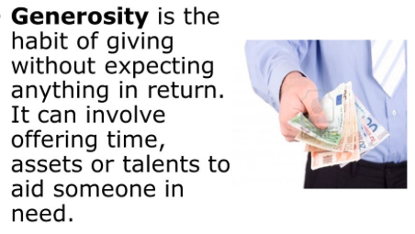
Conclusion: Giving is the way God chooses to change our hearts. As your heart changes, your attitude and feelings will follow. God loves a cheerful giver. Give until you get cheerful.
结论：给予是神选择改变我们心灵的方式。 随着你的心改变，你的态度和感受将随之而来。神喜欢给得乐意的人。给予，直到你有喜悦。
慷慨是给予的习惯而不期待任何回报。 它可能涉及提供时间，资产或人才来帮助有需要的人。
(15)
Notes:
You can feel compassion toward people in need and be as greedy as the rich fool. Greed is evidence not by how you feel but by what you do. Generous feelings and good intentions don’t compensate for a greedy heart. Become a % giver. % giving involves giving away a percentage of everything you receive,right off the top,as soon as you get it. Be a spontaneous giver as well.
你可以对有需要的人感到同情，仍然像无知财主一样贪婪。 贪婪不是你的感受，而是你所做的事情。 慷慨的感情和善意并不能弥补贪婪的心。

Slide 17
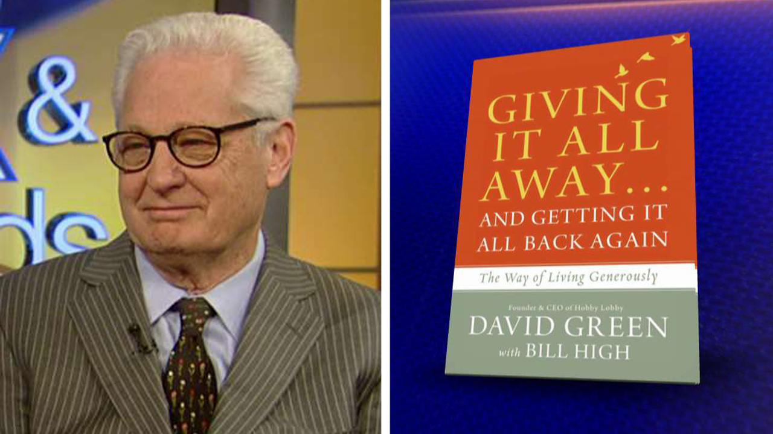
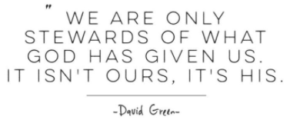
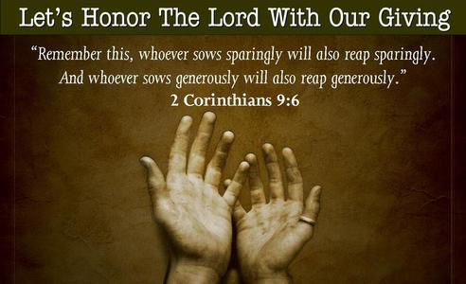
“We are put on this earth to give,
to devote ourselves to a radical brand of generosity that changes lives
and leaves a legacy.” –David Green
让我们用我们的奉献来尊敬主。
“少种的少收、多种的多收．这话是真的”(林后9:6)。
(16)
Notes:
Become a % giver. % giving involves giving away a percentage of everything you receive,right off the top,as soon as you get it. Be a spontaneous giver as well.We’re not owners; we’re managers. The truth is,God owns everything(1Chr.29:11). Ask God,what do you want me to do,after all it’s His money.

