Slide 1
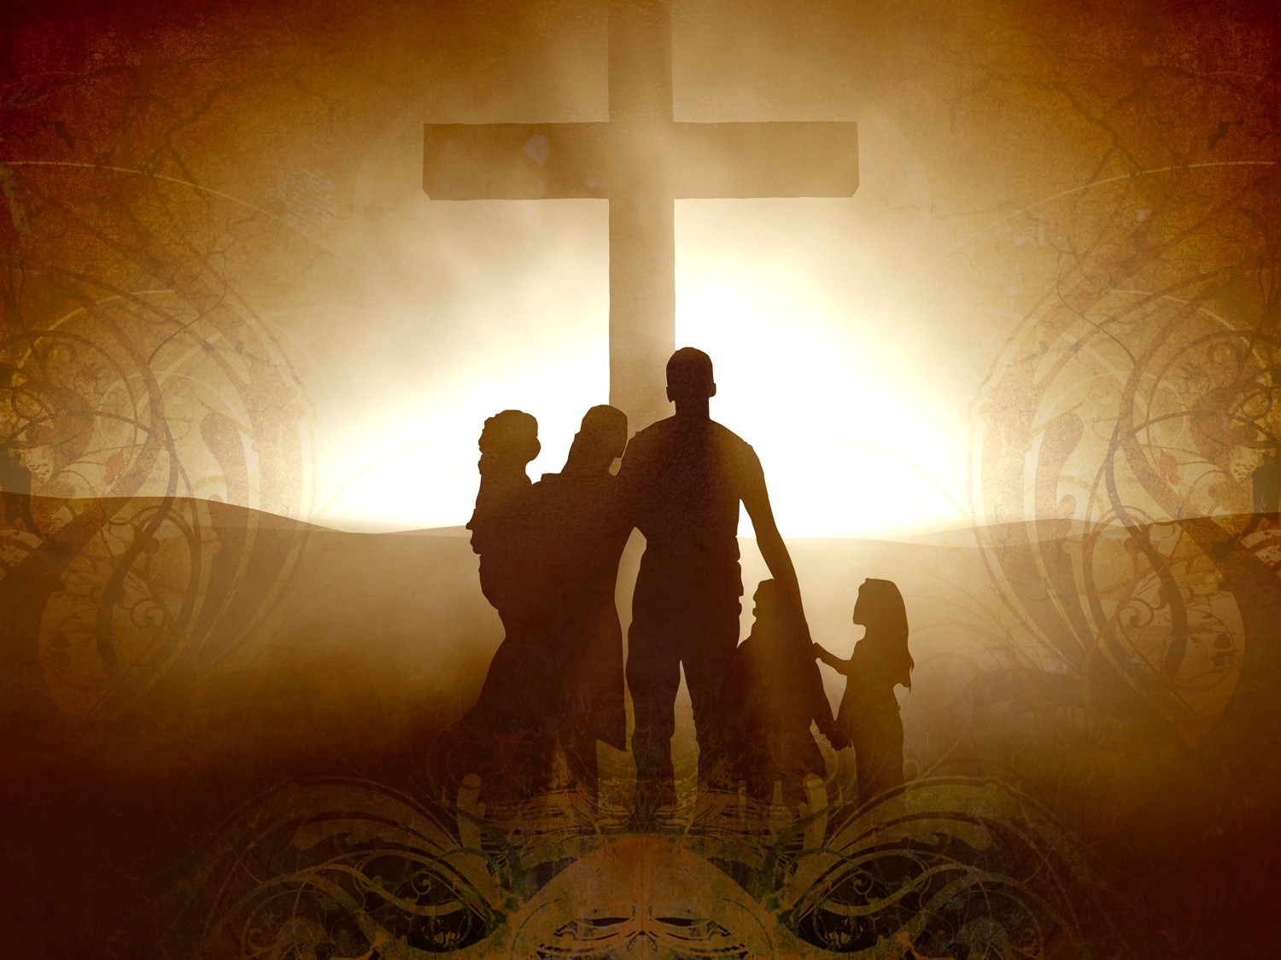
The Demise of Absalom:
A Lesson for Godly Family
4/10/2016
2 Samuel 18:1 – 18:16

Slide 2
The Impact of Parents’ Faith on Children
Robert Bruce and Debra Fulghum Bruce (1996) SBC:
When both parents attend Sunday school, 72% of the children attend Sunday school when grown.
When only the father attends Sunday school, 55% of the children attend when grown.
When only the mother attends Sunday school, 15% of the children attend when grown.
When neither parent attends Sunday school, only 6% of the children attend when grown.

Slide 3
Whose faith in the family has the most impact?
Bob Horner; Ron Ralston; David Sunde (December 1996)Focus on the Family
If a child is the first person in a household to become a Christian, there is a 3.5% probability everyone else in the household will follow.
If the mother is the first to become a Christian, there is a 17% probability everyone else in the household will follow.
However, when the father is first, there is a 93% probability everyone else in the household will follow.

Slide 4
Live Right Not Born Right

Slide 5
Born in a Godly Family
Absalom:
  Son of David, of a royal family (2 Samuel 3:1-3)
  Did he Inherit faith from David?
Religion: Culture? Tradition?
We should appreciate our godly parent(s)
Parent’s faith does not guarantee his child’s salvation
  Personal relationship with God

Slide 6
Driven by Own Desire
Absalom was:
  Young and handsome (2 Samuel 14:25-26)
  Smart and insidious… live by his wits
  Powerful and manipulative
What he did were:
  Murdered Amnon
  Took over the throne
  Tried to kill David
2 Samuel 17:14 …For the LORD had ordained to defeat the good counsel of Ahithophel, so that the LORD might bring harm upon Absalom.

Slide 7
Got Stuck
Absalom defeated:
His army was overturned, disarrayed, and crushed
Puzzled and at his wits end “18:8 …the forest devoured more people that day than the sword.”
Caught in the tree? “18:9 Absalom was riding on his mule, and the mule went under the thick branches of a great oak, and his head caught fast in the oak, and he was suspended between heaven and earth, while the mule that was under him went on.”
  Great oak -> Great “curse”
  Suspended between heaven and earth -> completely helpless
  Mule -> kingdom
Live right not born right

Slide 8
Discipline and Training in Godliness

Slide 9
Like Father Like Son… Maybe?
Do you look like your father? How is your relationship with him like?
Absalom followed his father’s footsteps
  David killed Uriah, Bathsheba’s husband
But Absalom did not inherit David’s good character traits:
  David did not pursue the kingdom from Saul
  Absalom was not close to God at all
Wouldn’t that make you wonder?

Slide 10
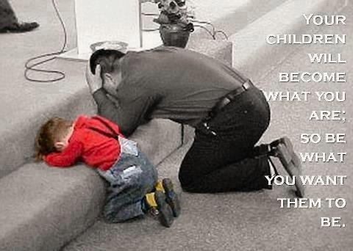
Discipline in Godliness
David did not discipline his children in godliness, though he himself was close to God
David spoiled his children
Parents are the best candidates to raise up godly next generation
Deuteronomy 6:6-7 And these words that I command you today shall be on your heart. ⁷ You shall teach them diligently to your children, and shall talk of them when you sit in your house, and when you walk by the way, and when you lie down, and when you rise.
Deuteronomy 6:12 then take care lest you forget the LORD

Slide 11
A Heartbroken Father
2 Samuel 18:33 And the king was deeply moved and went up to the chamber over the gate and wept. And as he went, he said, "O my son Absalom, my son, my son Absalom! Would I had died instead of you, O Absalom, my son, my son!“
Filled with guilt and regret:
  No parents want to be estranged from their children
  No parents want to see their children’s death
Everything is too late: could have disciplined and trained him

Slide 12
Walk The Walk Not Talk The Talk

Slide 13
Be a Spiritual Parent/Grandparent
We need spiritual role models
  You don’t have to be married and have kids
1 Timothy 4:12 Let no one despise you for your youth, but set the believers an example in speech, in conduct, in love, in faith, in purity.
Show by example in:
  Worship, prayer, fellowship, purity, relationship, working ethic, love to others, personality…

Slide 14
Legacy to Leave Behind
Jonathan Edwards:
1 U.S. Vice-President
3 U.S. Senators
3 governors
3 mayors
13 college presidents
30 judges
65 professors
80 public office holders
100 lawyers
100 missionaries
Max Jukes (Atheist):
7 murderers
60 thieves
50 women of debauchery
130 other convicts
310 paupers, who, combined spent 2,300 years in poorhouses
400 physically wrecked by indulgent living
The “Jukes” descendants cost the state more than $1,250,000

Slide 15
What do we learn today?
Live right not born right (not a culture)
  Build personal relationship with God
Discipline and training in godliness
  Bring your child before the Lord (Commitment, baptism)
Walk the walk not talk the talk
  Show by example to others (every believer)

