Slide 1
Pastor Gary Hart September 13, 2015
Text: “Our Father, who art in heaven, hallowed be thy name. Thy Kingdom come, thy will be done, on earth as it is in heaven. Give us this day our daily bread. And forgive us our trespasses, as we forgive those who trespass against us. And lead us not into temptation, but deliver us from evil. For thine is the kingdom, the power and the glory, for ever and ever. Amen.” Mt.6:9-13
Title:“7 main questions & answers about prayer.”
Announcement: Next Sunday Sept. 20 at 9+11 a.m. our Commissioning Service at Graceway.
(1)

Slide 2
Prayer is a powerful weapon.
http://warroomthemovie.com
(2)

Slide 3
I. What is this prayer? (Mt. 6, Lk. 11, Jn.17)
1. Teaching disciples’ prayer.
2. The Lord’s model prayer.
II. What is this prayer’s setting? (Mt. 5-7)
1. In Matthew, God’s expectations for prayer.
2. In Luke, man’s need for prayer (Lk. 11:1).
“But Jesus often withdrew to lonely places and prayed” (Lk.5:16).
“One day Jesus was praying in a certain place. When he finished, one of his disciples said to him, ‘Lord, teach us to pray, just as John taught his disciples’”(Lk.11:1).
(3)

Slide 4
III. What is the place for prayer?
1. A place for public prayers (Mt. 21:13).
2. A place for private prayers (Mt. 6:6).
“My house will be called a house of prayer”(Mt.21:13).
“And when you pray, do not be like the hypocrites, for love to pray standing in the synagogues and on the street corners to be seen by others. Truly I tell you, they have received their reward in full.” (Mt.6:5)
But when you pray, go into your room, close the door and pray to your Father, who is unseen. Then your Father, who sees what is done in secret, will reward you.” (Mt.6:6)
(4)

Slide 5
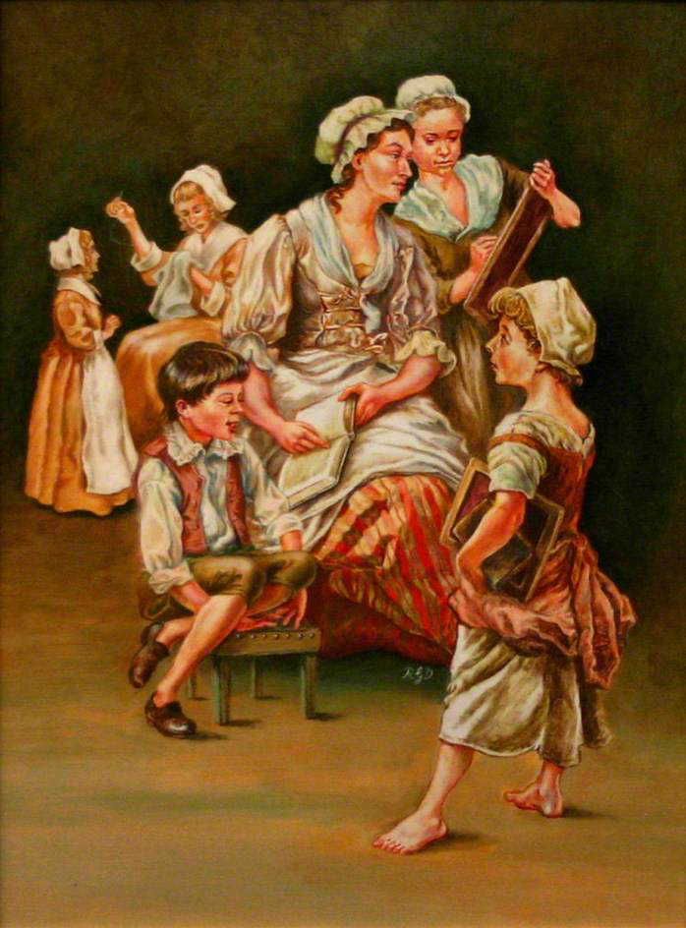
Susanna Wesley
(5)

Slide 6
IV. What is prayer? (Mt. 6:7-8)
1. Prayer is not babbling words.
2. Prayer is talking from my heart to God’s heart.
“And when you pray, do not keep on bab-bling like pagans, for they think they will be heard because of their many words.” (Mt.6:7)
“Do not be like them, for your Father knows what you need before you ask him.” (Mt.6:8)
(6)

Slide 7
V. How to begin prayers? (Lk.18:9-14)
1. The key to prayer is the heart attitude(Mt.5:8).
2. The front door is through Jesus (Jn.14:6).
The Parable of the Pharisee and the Tax Collector: “To some who were confident of their own righteousness and looked down on everyone else. Jesus told this parable. ‘Two men went up to the temple to pray, one a Pharisee and the other a tax collector. The Pharisee stood by himself and prayed: ‘God, I thank you that I am not like other people—robbers, evildoers, adulterers—or even like this tax collector. I fast twice a week and give a tenth of all I get.’ But the tax collector stood at a distance. He would not even look up to heaven, but beat his breast and said, “God, have mercy on me, a sinner.’ I tell you that this man, rather than the other, went home justified before God. For all those who exalt themselves will be humbled, and those who humble themselves will be exalted.” (Lk.18:9-14)
“Blessed are the pure in heart,for they will see God.”(Mt5:8)
“I am the way and the truth and the life. No one comes to the Father except through me” (Jn.14:6).
(7)

Slide 8
VI. To whom should you pray? (Mt. 6:9)
1. To the LORD God (Gen. 4:26).
2. To Almighty God (Gen. 17:1; 35:11).
3. To Heavenly Father (Jn. 17:1, 11, 24, 25).
4. To Abba Father(Mk.14:36;Ro.8:15;Ga.4:6).
“At that time people began to call on the name of the LORD.”(Ge4:26)
“The LORD appeared to him (Abram) and said, “I am God Almighty (El Shaddai)…’” (Gen.17:1; 35:11)
“Our Father in Heaven” (Mt.6:9). How to become God’s child. “Yet to all who did receive him, to those who believed in his name, he gave the right to become children of God”(Jn.1:12).
“Father” (Jn.17:1), “Holy Father” (v.11), “Father” (v.24), “Righteous Father” (v.25).
“Abba Father”(Mk.14:36).“And by him we cry,‘Abba, Father.’” (Ro.8:15). “Because you are his sons, God sent the Spirit of his Son into our hearts, the Spirit who calls out, ‘Abba, Father.’” (Ga.4:6).
(8)

Slide 9
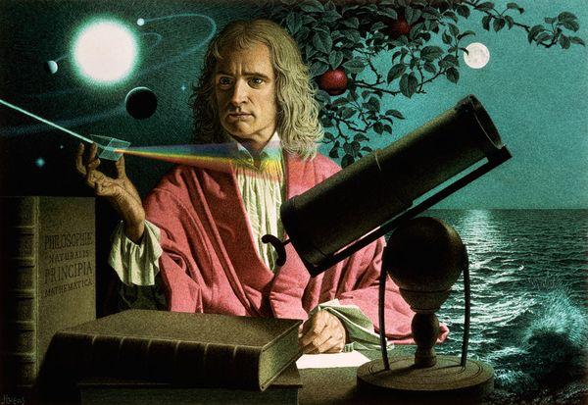
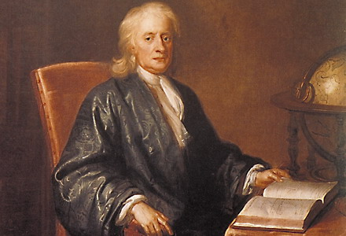
VII. What happens when you pray?
1. Prayer draws us closer to God (Ja. 4:8).
2. Prayer changes us (2 Chron.7:14).
3. Prayer is not a religion but a relationship with my Heavenly Father.
“Come near to God and he will come near to you.” (Ja.4:8)
“If my people, who are called by my name, will humble themselves and pray and seek my face and turn from their wicked ways, then I will hear from heaven, and I will forgive their sin and will heal their land.” (2 Chron.7:14)
Isaac
Newton
(9)

Slide 10
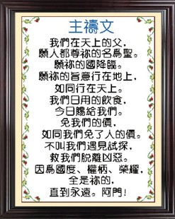
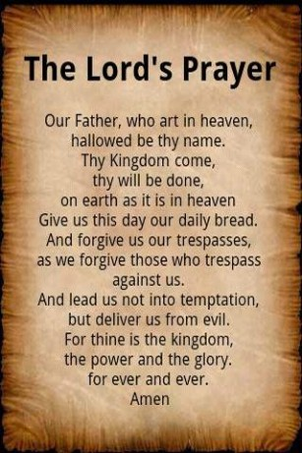
(10)

