Slide 1
(1)
Pastor Gary Hart October 11, 2015
Text: In the year that King Uzziah died, I saw the Lord, high and exalted, seated on a throne; and the train of his robe filled the temple. Above him were seraphim, each with six wings: With two wings they covered their faces, with two they covered their feet, and with two they were flying. And they were calling to one another: “Holy, holy, holy is the Lord Almighty; the whole earth is full of his glory.” (Isaiah 6:1-3) Each of the four living creatures had six wings and was covered with eyes all around, even under its wings. Day and night they never stop saying: “‘Holy, holy, holy is the Lord God Almighty,’ who was, and is, and is to come.” (Revelations 4:8)
Title:“Lift up your eyes and see.”Lord’s Prayer-2

Slide 2
2nd message in a series on the Lord’s Prayer.
a. Teaching disciples’ prayer & model prayer.
b. GOD is First, not me first (relationship).
1). Yahweh (Jehovah) God.
2). Almighty God.
3). Heavenly Father.
4). Abba Father.
c. God is Holy. (Isaiah 6:1-3; Revelations 4:8)
“Our Father, who are in heaven, hallowed be thy name.” (Matthew 6:9)
d. How awesome!
e. What is your focus?
(2)

Slide 3

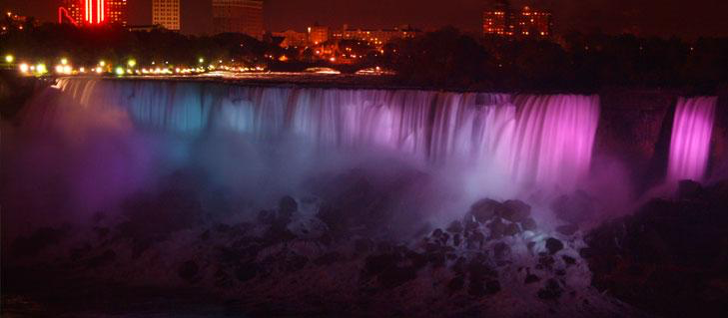
(3)

Slide 4
1. No way or Yahweh?
a. Paul’s weakness.
b. God’s power.
But God said to Paul, “My grace is sufficient for you, for my power is made perfect in weakness. Therefore I will boast all the more gladly about my weaknesses, so that Christ’s power may rest on me. This is why, for Christ’s sake, I delight in weaknesses, in insults, in hardships, in persecutions, in difficulties. For when I am weak, then I am strong” (1 Corinthians 12:9-10).
(4)

Slide 5

Imagine getting through your busy day without hands or legs. Picture your life without the ability to walk, care for your basic needs, or even embrace those you love. Meet Nick Vujicic (VOO-yee-cheech). Without any medical explanation or warning, Nick was born in 1982 in Australia, without arms and legs.
The early days were difficult. Throughout his childhood, Nick not only dealt with the typical challenges of school and adolescence, but he also struggled with depression and loneliness. He’s an author, musician, actor,and his hobbies include fishing, painting and swimming. (www.lifewithoutlimbs.org)

Slide 6
2. Bad or Good?
a. Joseph’s bad situation.
b. God’s goodness.
Joseph acknowledged, “You intended to harm me, but God intended it for good to accomplish what is now being done, the saving of many lives.” (Genesis 50:20)
(5)

Slide 7
3. Sinful or Merciful?
a. Son’s sinfulness.
b. Father’s love and mercy.
“But while he was still a long way off, his father saw him and was filled with compassion for him; he ran to his son, threw his arms around him and kissed him.
“The son said to him, ‘Father, I have sinned against heaven and against you. I am no longer worthy to be called your son.’ “But the father said to his servants, ‘Quick! Bring the best robe and put it on him. Put a ring on his finger and sandals on his feet. Bring the fattened calf and kill it. Let’s have a feast and celebrate. For this son of mine was dead and is alive again; he was lost and is found.’
(6)

Slide 8
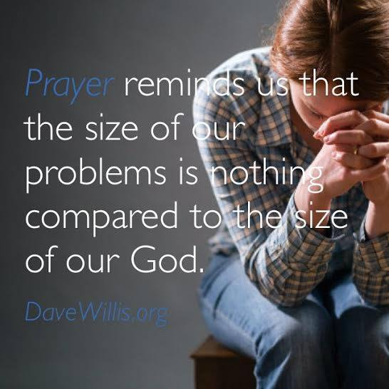
Prayer changes our
focus:
our
big problems or
our
Big
GOD.
(7)

Slide 9
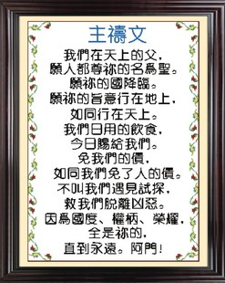
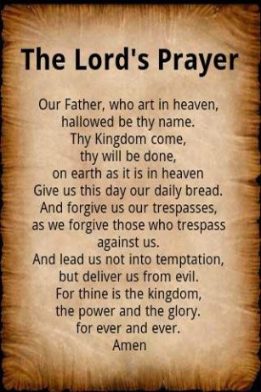
(8)

