Slide 1
(1)
Pastor Gary Hart November 8, 2015
Text: “Whoever wants to be my disciple must deny themselves and take up their cross daily and follow me. For whoever wants to save their life will lose it, but whoever loses their life for me will save it. What good is it for someone to gain the whole world, and yet lose or forfeit their very self? Whoever is ashamed of me and my words, the Son of Man will be ashamed of them when he comes in his glory and in the glory of the Father and of the holy angels.” (Lk.9:23-26)
Title: “Thy will be done.” (Lord’s Prayer-4)
Here are 4 requests about God(on earth & heaven) and
4 requests about us.

Slide 2
4th message in a series on the Lord’s Prayer.
(2)
Here is teaching disciples’ prayer. What is prayer?
a. Prayer is calling on God’s name over other names (Our Father, who art in heaven).
b. Prayer is seeing God’s greatness over our problems (Hallowed be thy name).
c. Prayer is seeking God’s mission over our mission (Thy kingdom come).
d. Prayer is looking for God’s plan over our plans (Thy will be done).
God’s name, greatness, mission and plan.
Other names, problems, missions and plans.
Prayer is lifting up your eyes to see God.

Slide 3
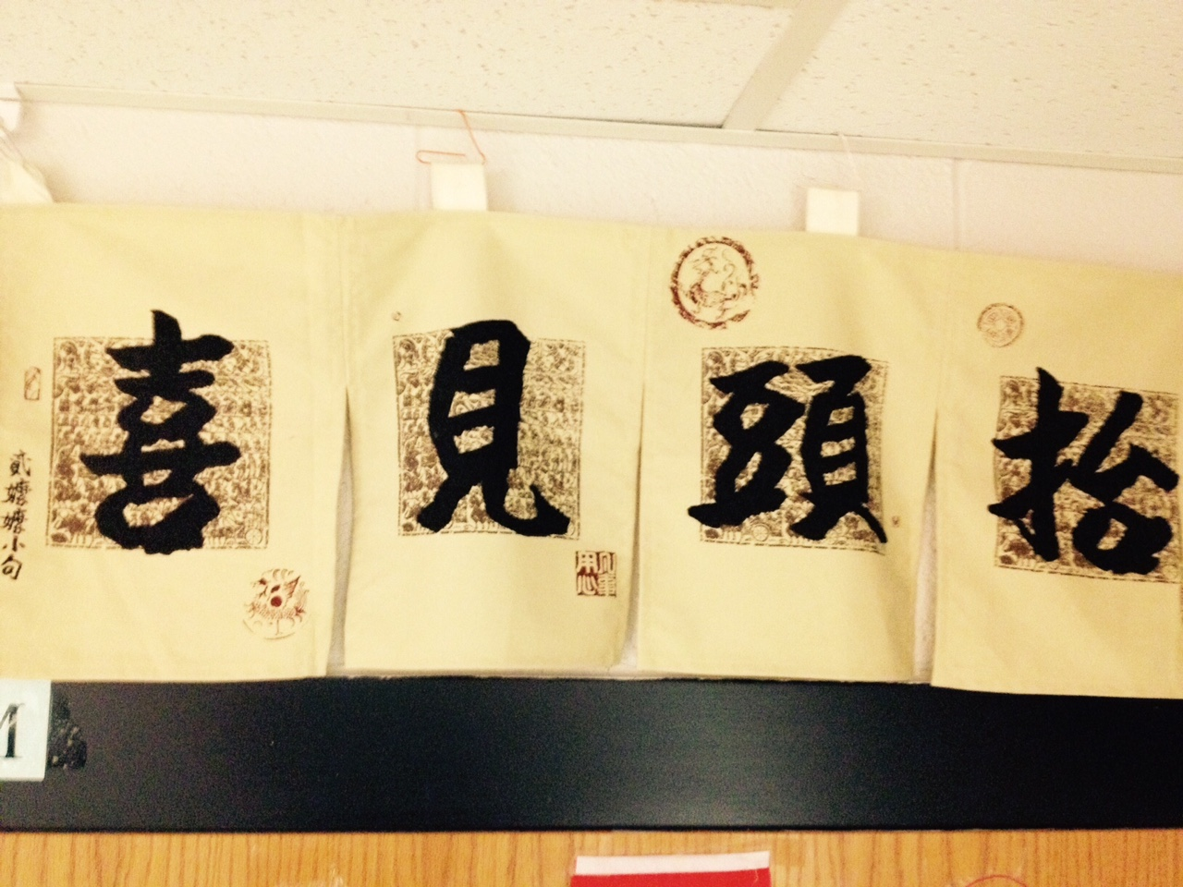
抬头见喜
Look up see joy.

Slide 4
1. What is God’s will? It is not… It is…
a. God reveals His will in His word. They do not live the rest of their earthly lives for evil human desires, but rather for the will of God.(1 Pet.4:2) For I have…proclaim to you the whole will of God. (Ac.20:27).
b. God wants us to do what is good. For it is God’s will that by doing good you should silence the ignorant talk of foolish people. (1 Pet.2:15)
c. God wants us to be saved, to grow and live pure lives. It is God’s will that you should be sanctified: that you should avoid sexual immorality (1 Thes.4:3).
d. God wants us to give thanks in all circumstances. Give thanks in all circumstances; for this is God’s will for you in Christ Jesus. (1 Thes.5:18).
(3)

Slide 5
e. God wants us to follow Jesus and to be His disciples. Paul said, Follow my example, as I follow the example of Christ (1 Co.11:1).
(1) Jesus came to do God’s will. “My food,”said Jesus, “is to do the will of him who sent me and to finish his work.(Jn.4:34) For I have come down from heaven not to do my will but to do the will of him who sent me(6:38).
(2) Jesus was obedient to God’s will. And being found in appearance as a man,he humbled himself by becom-ing obedient to death-even death on a cross!(Phil.2:8).
(3) Jesus submitted to God’s will for him. “My Father, if it is possible, may this cup be taken from me.Yet not as I will,but as you will…may your will be done.”(Mt.26:39,42)
(4)

Slide 6
2. How do we relate to God’s will? It is/not…
Whoever does not take up their cross and follow me is not worthy of me. (Mt.10:38) Whoever wants to be my disciple must deny themselves and take up their cross and follow me. (Mt.16:24, Mk. 8:34, Lk.9:23)
a. We must know His will. We continually ask God to fill you with the knowledge of his will through all the wisdom and understanding that the Spirit gives(Co.1:9).
b. We must understand His will. Be very careful, then, how you live—not as unwise but as wise, making the most of every opportunity, because the days are evil.
Therefore do not be foolish, but understand what the Lord’s will is. (Eph.5:15-17).
(5)

Slide 7
c. We must choose to do his will. Anyone who chooses to do the will of God will find out whether my teach-ing comes from God or whether I speak on my own. (Jn.7:17).
d. We must do His will. I desire to do your will, my God; your law is within my heart.” (Ps.40:8) Teach me to do your will, for you are my God; may your good Spirit lead me on level ground. (143:10)
e. We must approve his will by obedience. Offer your
bodies as a living sacrifice, holy and pleasing to God Do not conform to the pattern of this world, but be transformed by the renewing of your mind. Then you will be able to test and approve what God’s will is—his good, pleasing and perfect will. (Ro.12:1-2).
(6)

Slide 8
3. What does God’s will include?
a. His will may include suffering (Job 1:6-22). So then, those who suffer according to God’s will should commit themselves to their faithful Creator and continue to do good. (1 Pet. 4:19).
b. God works for his people’s good. You intended to harm me, but God intended it for good to accomplish what is now being done,the saving of many lives (Gen.50:20)
(7)

Slide 9
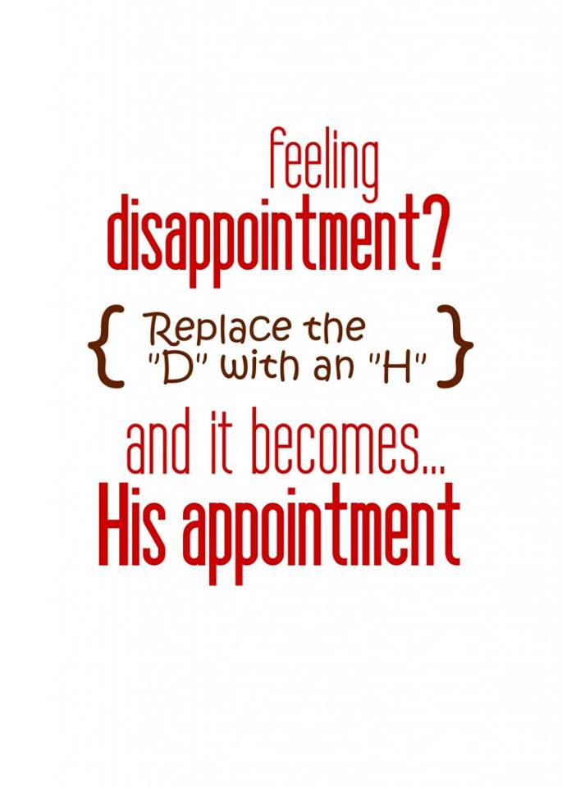
(9)

Slide 10
4. How to pray for God’s will?
a. Pray that God’s will be done.Thy will be done(Mt.6:10).
b. Pray that things happen by God’s will. Paul promis-ed, “I will come back if it is God’s will.” (Ac.18:21) Now listen, you who say, “Today or tomorrow we will go to this or that city, spend a year there, carry on business and make money.” Why, you do not even know what will happen tomorrow. What is your life?You are a mist that appears for a little while and then vanishes. Instead, you ought to say, “If it is the Lord’s will, we will live and do this or that.” (Ja.4:13-15).
c. Submit to God’s plan for us. Paul must go to Rome. We gave up and said, “The Lord’s will be done.” (Ac.21:14).
(8)

Slide 12
Conclusion:
As a disciple, I must deny myself and take up my cross daily and follow Jesus. Let us look for and pray for God’s will. What is God’s will for your life? My mission is…(to be a disciple and to make disciples of Jesus). My vision is…(to look for God’s will to be done in my life). What is God’s will for this church? Our mission is…Our vision is… Let us pray together, “Our Father…”
(9)

Slide 13
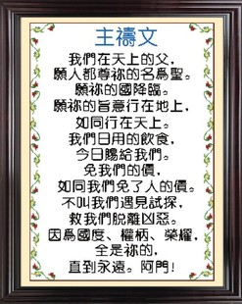
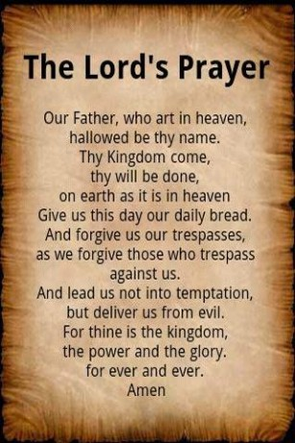
(9)

